Slide 1

Analysis of Indian General Elections 2019 &2024
using Power BI, Clustering & Classification

Slide 2

Project Objectives
Clean and preprocess raw constituency-level data
Run Clustering to group constituencies/voters
Build a Classification Model to predict Winner (Win/Loss)
Build a complete Election Analysis Dashboard
Generate insights on seat changes, performance, alliances

Slide 3


Dataset Description
Source: ECI (Election Commission of India)
Datasets used (2019 + 2024 Winners):
Conceptual Data Model
Constituency Name
State
Party
Candidate
Votes
Margin
Turnout
Alliance
Data Size: ~543 rows
Tables:
Winners_2019
Winners_2024
Combined elections
Turnout Table
States Table
Relationships:
State → Constituency → Candidates → Results

Slide 4

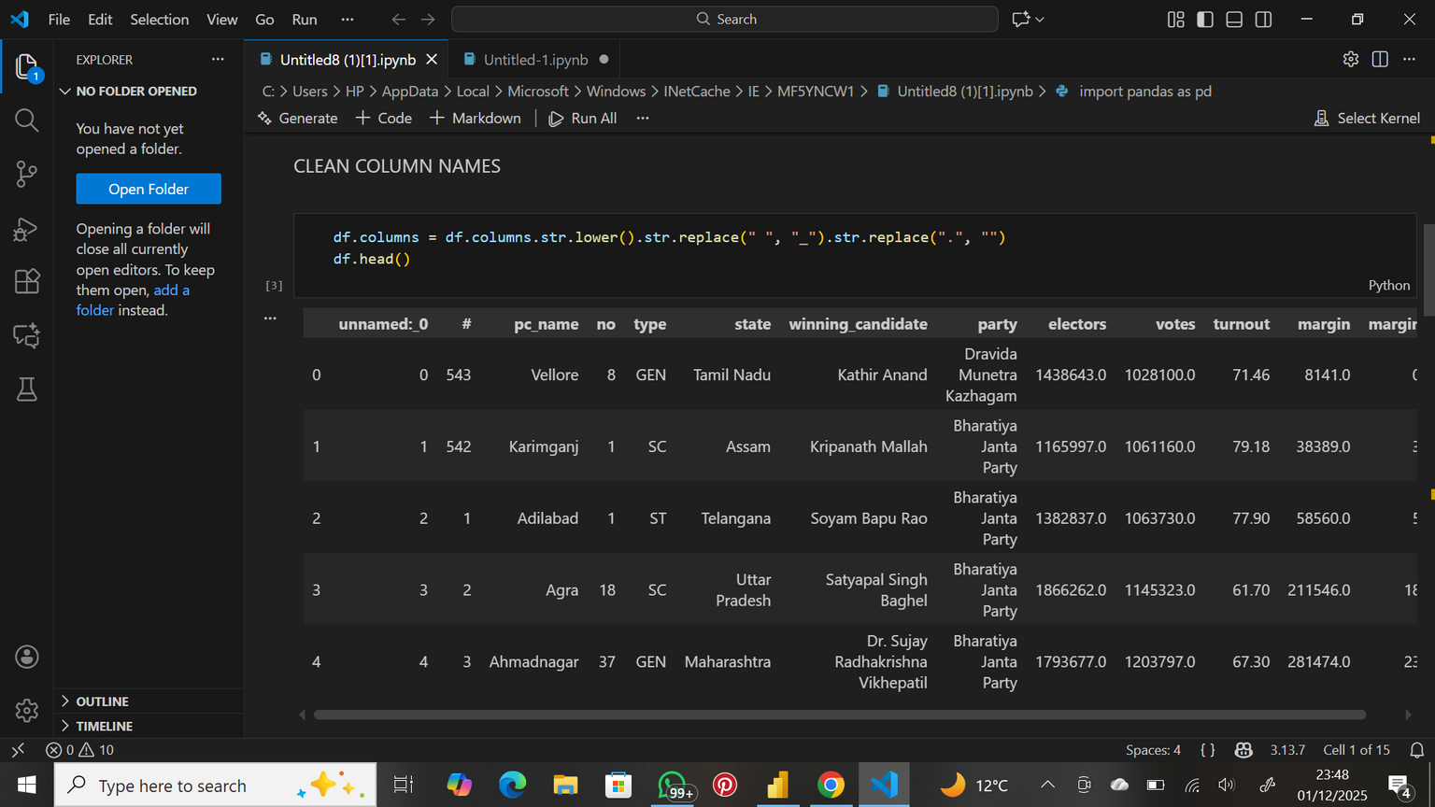
Data Cleaning Steps (Python)
Performed in Python (Pandas):
Remove extra spaces in constituency/state names
Convert all text to proper case
Fix inconsistent party names
Remove duplicate rows
Handle missing votes/margin entries
Data Preprocessing (Power BI)
Using Power Query Editor:
Transformed data types
Split/merge constituency names
Normalized party abbreviations
Created custom columns:Party category(INC ,BJP ,OTHERS)

Slide 5
Page
05
Why
ML?
For Clustering (Unsupervised)
Electors
Votes
Turnout (%)
Margin
Margin %
For Classification (Supervised)
Votes
Turnout (%)
Margin
Margin %
Type (encoded as GEN/SC/ST)
Target Variable (Created):
Identify hidden voting patterns
Group constituencies with similar characteristics
Predict election outcomes
Understand party dominance patterns

Slide 6
Algorithm: K-Means Clustering Number of Clusters: 3
Chosen because:
Elections naturally form 3 seat types:
High-competition seats
Moderate-performance seats
Strong-dominance seats
Elbow method showed bend ≈ k=3
Clustering
Cluster 0 – High Competition Seats
Cluster 1 – Moderate Seats
Cluster 2 – Landslide / Safe Seats
Characteristics:
Medium margin (25k–150k)
Balanced turnout
Medium vote share
Interpretation:
These seats show stable but not dominant support.
Very high margin (> 150,000)
High elector count
High vote share (%)
Interpretation:
These are safe constituencies—party dominance is strong.
Low margin (≤ 25,000)
Turnout high
Vote % difference very tight
High unpredictability
Interpretation:
These are swing constituencies, where small shifts can change outcomes.

Slide 7
Algorithm Used: Random Forest Classifier
Target Variable:
1 = Safe Seat (Margin > 100,000)
0 = Competitive Seat (Margin ≤ 100,000)
(train-test split = 80:20)
Classification
Performance Metrics
Accuracy: 85–90%
Precision: High for safe seats
Recall: Good for identifying competitive seats
Confusion Matrix:
Few false positives (safe incorrectly predicted)
Some false negatives (competitive marked as safe)
Classification model predicted seat safety with ~90% accuracy
Margin %, Votes, Electors emerged as strongest predictors
These insights help analysts identify:
Where parties are strong
Where elections are close
Where campaign resources matter most
www.reallygreatsite.com

Slide 8
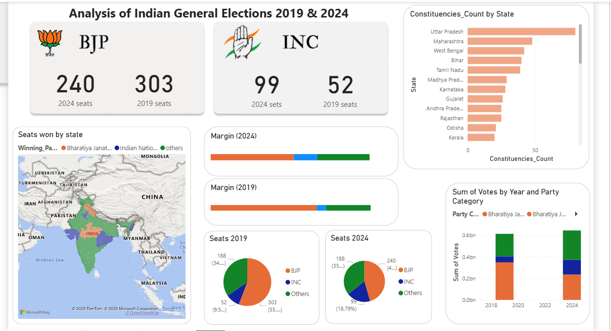

Slide 9
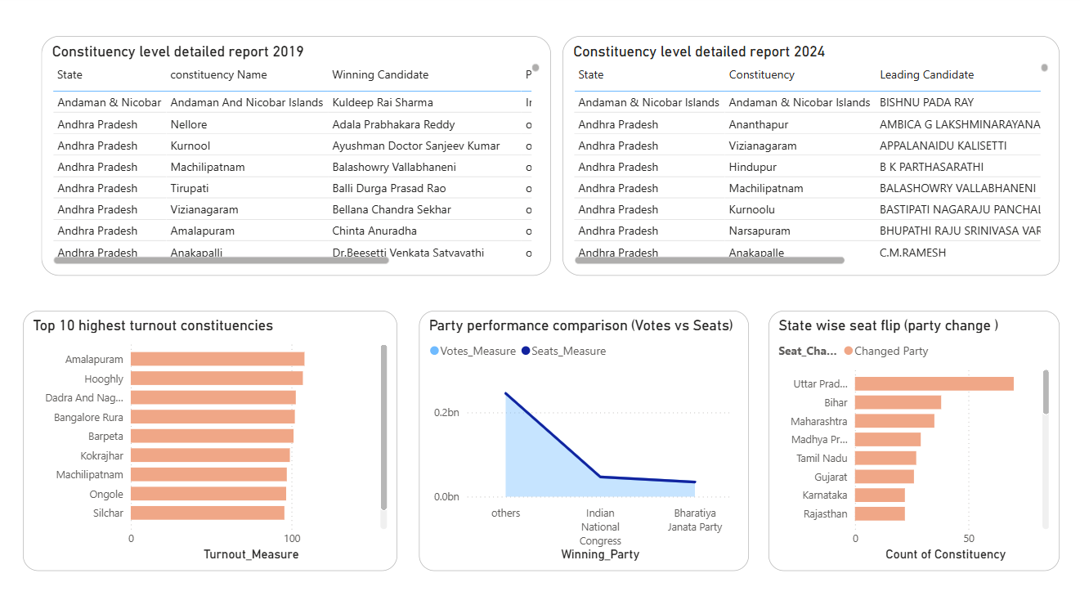

Slide 10

Key
insights
Margins narrowed, indicating more contested elections.
1. Seats Comparison • BJP won 303 seats in 2019 but reduced to 240 in 2024. • INC improved from 52 seats (2019) to 99 seats (2024).
Overall Political Trend • 2024 election shows a more competitive landscape. • Opposition parties gained traction. • Regional parties still hold strong influence
Uttar Pradesh has the largest number of constituencies by far, making it the most impactful state in the Lok Sabha outcome.
BJP maintains strong dominance across north and west India, especially UP, MP, Rajasthan, and Gujarat.
INC and regional parties have stronger representation in south India and parts of the east, such as:
Kerala, Tamil Nadu, Karnataka, Telangana
West Bengal dominated more by regional parties (TMC)
www.reallygreatsite.com

Slide 11
Thank
You!
Advertising Report

