Slide 1

SMART INDIA HACKATHON 2026
TITLE PAGE
Problem Statement ID - 26160
Problem Statement Title - AI-Powered IPsec VPN Protocol Analyzer and Security Assessment Framework
Theme -- Cybersecurity (NTRO - Blockchain & Cybersecurity)
PS Category - Software
Team ID-
Team Name - ENTROPY

Slide 2
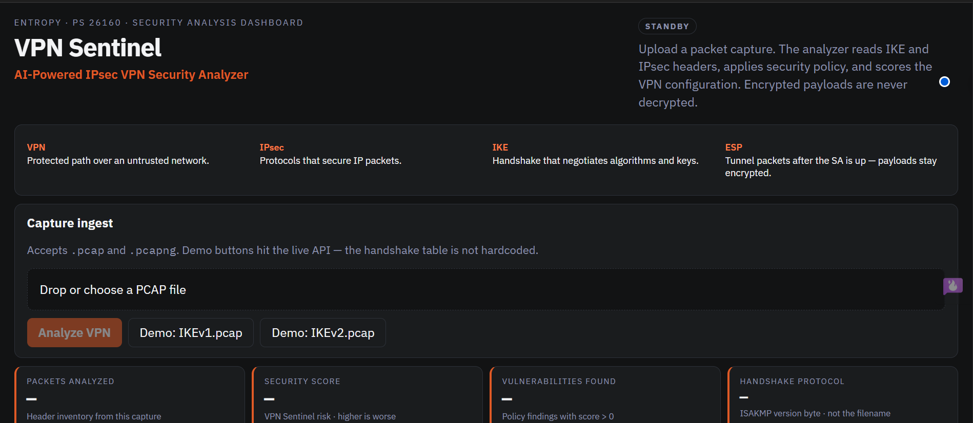
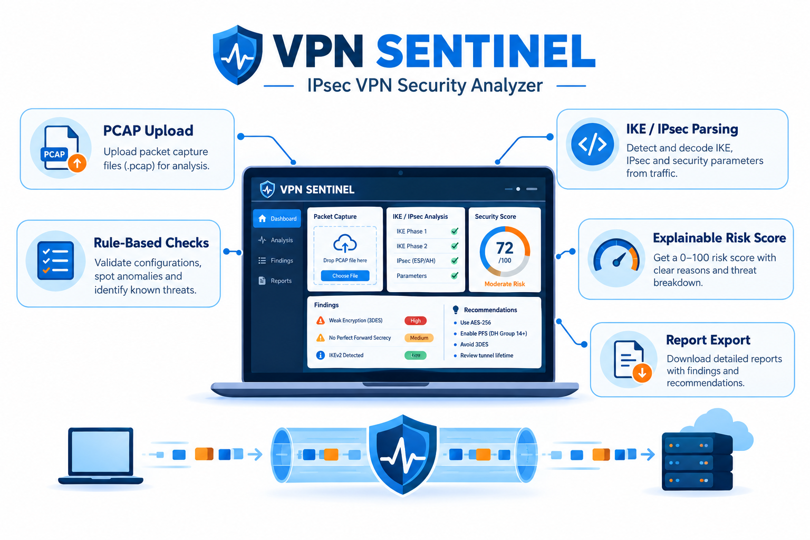
IDEA TITLE · VPN SENTINEL
PROBLEM
OUR IDEA
IPsec VPN security depends on cryptographic choices, key exchange, and configuration that most tools do not automatically assess. Weak ciphers, deprecated IKEv1, and small DH groups go undetected without expert manual analysis in Wireshark.
VPN Sentinel ingests operator-owned PCAPs, reconstructs IKE/ESP headers, and emits protocol facts plus a policy-backed risk score. Encrypted ESP payloads are never decrypted.
PROPOSED SOLUTION
INNOVATION/UNIQUNESS
• Dual RFC parsers: IKEv1 RFC 2409 TV attributes vs IKEv2 RFC 7296 §3.3 Transform Type/ID (ISAKMP version nibble >> 4).
• NIST SP 800-77r1 cryptographic policy checks: cipher-suite verification, weak DH groups (1/2/5), hashing/integrity, IKEv1 deprecation (RFC 9395).
• Zero-decryption behavioral profiling: IsolationForest on ESP flow metadata (size mean/variance, inter-arrival deltas, duration, byte volume). No payload inspection.
• Aggregated security posture index: additive 0–100 risk score with finding IDs and an exportable HTML/JSON audit report.
• IKEv1 RFC 2409 attributes (0x80 0x01) vs IKEv2 RFC 7296 §3.3 Transform Type/ID — shared hunters fail silently on IKEv2.
• Metadata-only signal on encrypted ESP; no decrypt.
• Parse + policy score in one offline PCAP pipeline.
INNOVATION / UNIQUENESS

Slide 3
TECHNICAL APPROACH
SOFTWARE (NO HARDWARE APPLIANCE)
IMPLEMENTATION FLOW
• FastAPI — asynchronous PCAP ingest and analysis API
• Network processing: Scapy reconstruction of ISAKMP/IKE, ESP, AH, UDP/500, UDP/4500
• parse_ikev1_sa — RFC 2409 short-form attributes (0x80 0x01 encryption TV)
• parse_ikev2_sa — RFC 7296 §3.3 Transform Type/ID (no shared 0x80 0x01 hunt)
• YAML policy — NIST-aligned crypto/config findings
• ML core: IsolationForest on scaled ESP flow vectors (size/timing); no payload decryption; does not set the VPN risk score
• Data interface: native PCAP/PCAPNG batch offline dumps
• React (Vite) dashboard
PACKET INGESTION
FastAPI + Scapy (offline PCAP)
IKEv1 PARSER
Version-nibble branch · RFC 2409
IKEv2 PARSER
Version-nibble branch · RFC 7296
Processing splits on the IKE handshake: ISAKMP version nibble (byte 17 >> 4) selects the parser. Filename is ignored.
NIST SP 800-77r1
Cryptographic Policy Check
IsolationForest
Temporal & Structural Anomaly Processor
POSTURE INDEX + FINDINGS → DASHBOARD / AUDIT EXPORT
GitHub: https://github.com/riddhii22/vpn-Sentinel-minor
Repository status: parser core and NIST-aligned verification engine active (prototype testing). IsolationForest scores ESP metadata; it does not classify inner traffic.

Slide 4
FEASIBILITY AND VIABILITY
FEASIBILITY
COMMERCIAL FEASIBILITY
• Offline PCAP analysis removes live-capture operational and legal exposure.
• Deterministic validation: parsers cross-checked against Wireshark-decoded IKEv1/IKEv2 captures (cipher, key length, DH, PSK/hash attributes).
• Policy language tracks NIST SP 800-77r1 IPsec cryptographic guidance — not ad-hoc thresholds.
• Enterprises still run IPsec; automated first-pass audits reduce wait for a packet expert.
• MVP runs locally (Python + React) , no appliance purchase for a demo.
• Targets a known, existing spend category (enterprise VPN/security audit tooling) rather than a new market sizing not yet estimated.
CHALLENGES AND RISKS
STRATEGY
• IKEv1 and IKEv2 require separate SA encodings. A shared 0x80 0x01 hunt fails silently on IKEv2.
• Encrypted-state traversal: Child SA / Quick Mode fields (PFS, tunnel vs transport, replay) that are ciphertext stay Unverified Configuration — the engine never invents values.
• Payload encryption boundary: no inner-traffic class (YouTube/WhatsApp). Analysis stays on cryptographic strength and observable transmission metadata.
• Non-invasive telemetry: IsolationForest profiles ESP structural flow signatures (size/timing). No DPI of ciphertext.
• Lab testbed and labelled web/video/voice classes remain the expansion path under PS 26160.
• Explainable intelligence: each alert maps to a rule ID plus packet evidence; ML is a separate telemetry score and does not overwrite cipher findings.

Slide 5
IMPACT AND BENEFITS
DIRECT IMPACT ON TARGET USERS
STRATEGIC IMPACT
• Security teams: first-pass IPsec configuration audit without exclusive reliance on manual Wireshark trees.
• Network / VPN admins: IKEv1, DES/3DES, and weak DH isolated with a recommendation.
• Operational optimization: automates crypto-suite discovery and handshake compliance parsing.
• Automated initial triage: surfaces high-risk handshake misconfigurations before any later lab-scale deployment.
• Supports correctly configured IPsec (IKEv2, modern ciphers, adequate DH) on enterprise and government paths.
• Distinguishes “VPN is on” from “the handshake is cryptographically sound.”
• Aligns with NTRO PS 26160 assessment and reporting: structural IKE/ESP parsing, policy auditing, and exportable compliance output. Testbed and inner-traffic classification remain the scale-out path.
ECONOMIC / SOCIAL BENEFITS
• Social: fewer unnoticed weak VPN handshakes on networks the operator is allowed to inspect.
• Economic: Reduces reliance on billed expert hours for manual packet-level VPN audits — exact savings not yet quantified.
• Environmental: software-only lab path (PCAP + optional containers) vs extra dedicated hardware for the prototype.

Slide 6
RESEARCH AND REFERENCES
GAP & PROBLEM IDENTIFICATION
LITERATURE SURVEY
Misconfigured IPsec (IKEv1, weak DH, legacy ciphers) is hard to see without packet expertise. PS 26160 asks for automated identification + assessment; generic “AI VPN” tools often skip RFC-correct SA layout.
NIST SP 800-77r1 - IPsec configuration guidance (crypto policy language).
Cremers, ESORICS 2011 - formal IKEv1 vs IKEv2 security comparison.
Draper-Gil et al., ICISSP 2016 - time-related features for encrypted/VPN traffic (basis for metadata-only ESP analysis).
TECHNOLOGY BENCHMARKING
ECONOMIC LANDSCAPE
ike-scan / iker - enumerate IKE transforms from live probes.
VPN Sentinel - same field goal, offline from PCAP, with separate v1/v2 parsers.
Wireshark - ground-truth decode, not replaced.
Demand is for cheaper first-pass audits, not a new VPN vendor.
Total addressable market not sized for this prototype stage; positioned as a cost-reduction tool within existing security-audit spend.
Open stack (Python, Scapy, FastAPI) keeps prototype cost at student/lab scale.
FIELD TESTS / VALIDATION
POLICY / ECOSYSTEM
Wireshark-verified parse on samples/IKEv2.pcap packet 1: ENCR_AES_CBC (12) key 256, PRF SHA2-512, INTEG SHA2-512-256, DH group 20.
IKEv1 sample: AES-CBC, key 256, DH 20, PSK attributes.
RFC 9395 - IKEv1 deprecation (finding, not a slogan).
Operator-owned captures only; no decrypt; no scanning third-party networks.
SIH software prototype: local demo + docs + labelled samples.

