Slide 1
Interactive Sales Dashboard (2017–2020)
Business Insights using Power BI Presented by: Riddhima Das Internship Task 4 – Dashboard Design

Slide 2
Objective
To analyze sales performance over 4 years.
To identify trends in sales, cost, and profit.
To enable interactive filtering based on ship mode, region, and time.
To assist stakeholders in making data-driven decisions.

Slide 3
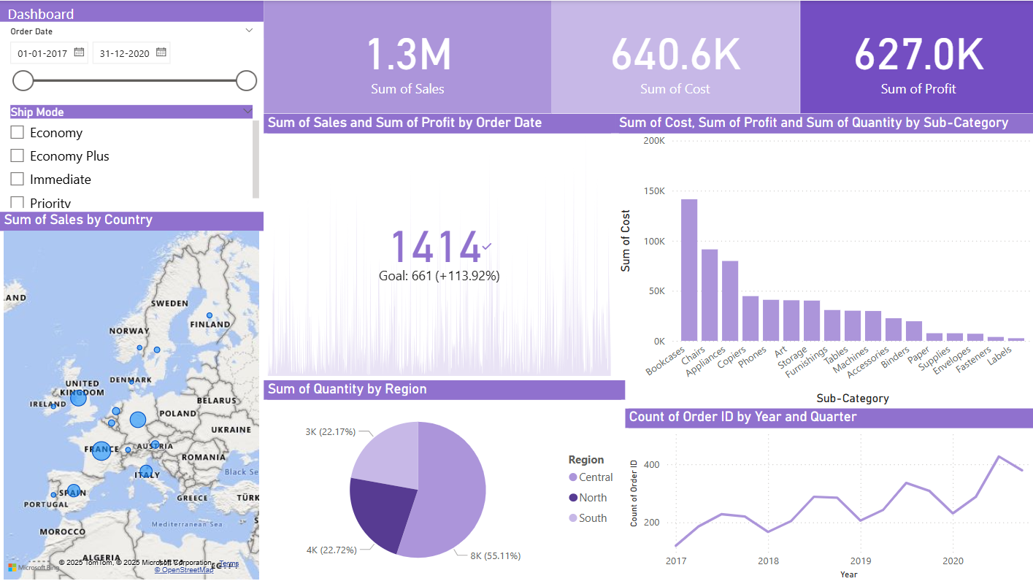

Slide 4
Section | Description | Why it is useful
Top Cards | Sum of Sales (1.3M), Sum of Cost (640.6K), Sum of Profit (627.0K) | Quickly shows important KPIs
Date Slicer | Select start and end dates (2017-2020) | Analyze performance for specific periods
Ship Mode Filter | Filter sales by shipment type (Economy, Immediate, etc.) | Understand how delivery type affects sales
Map (Sum of Sales by Country) | World map showing sales by country using bubble size | See geographic sales distribution
Line Graph (Sum of Sales and Sum of Profit by Order Date) | Time-series trend of sales and profit | Identify seasonal trends or growth patterns

Slide 5
Section | Description | Why it is useful
KPI Visual (Goal 661, Achieved 1414) | Sales/Orders vs Goal with % achievement (113.92% increase) | Monitor performance against targets
Bar Chart (Sum of Cost, Profit, Quantity by Sub-Category) | Cost breakdown for each product category (e.g., Bookcases, Chairs) | Identify costly or profitable products
Pie Chart (Sum of Quantity by Region) | Split of quantity sold across regions (Central, North, South) | See regional distribution
Line Chart (Count of Order ID by Year and Quarter) | Growth in number of orders over time (by year & quarter) | Check business growth year-over-year

