Slide 1
Vibration Study of 2.2 Road (Gymkhana to Nehru Museum), IIT Kharagpur
Using MPU6050, ADXL345 and GPS on a Toto
C2G15 Group: P Prajit, Riddhi Maiti, Nare Mahith Sai
November 2025

Slide 2
Problem Statement
Road roughness and defects cause vehicle vibrations that affect comfort and durability.
The 2.2 Road between Gymkhana and Nehru Museum is frequently used by totos.
Goal: To quantify vibration levels, identify hotspots, and provide actionable maintenance recommendations.

Slide 3
Objectives
To acquire synchronized 3-axis acceleration and GPS data along 2.2 Road.
To process and filter data to remove bias and align time.
To compute RMS and VDV vibration metrics.
To generate vibration heatmap showing hotspots.
To compare MPU6050 and ADXL345 for consistency.

Slide 4
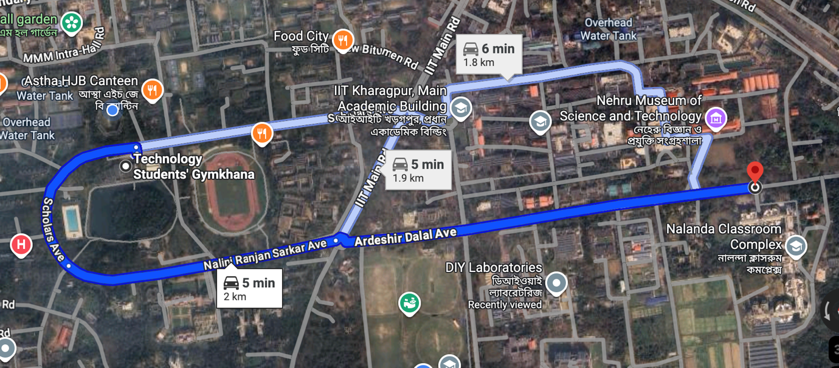
Study Area

Slide 5
Equipment & Specifications
MPU6050: 3-axis accelerometer + gyroscope (±2–16g)
ADXL345: 3-axis accelerometer (±2–16g)
GPS NEO-6M: 1–10 Hz NMEA data logging
Arduino Uno: Data acquisition & timestamping
Laptop: Python, Pandas, Matplotlib, Folium for analysis

Slide 6
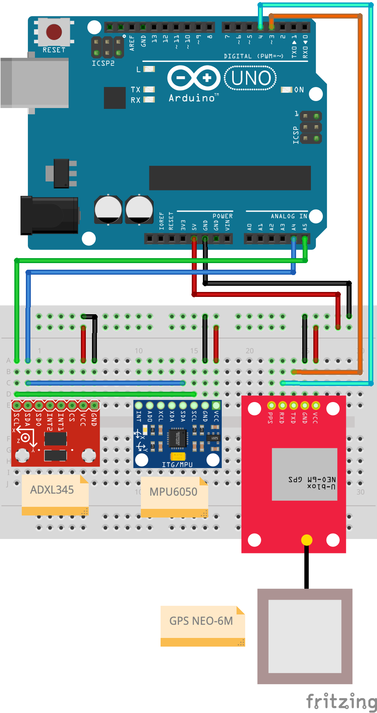
Connection Diagram

Slide 7
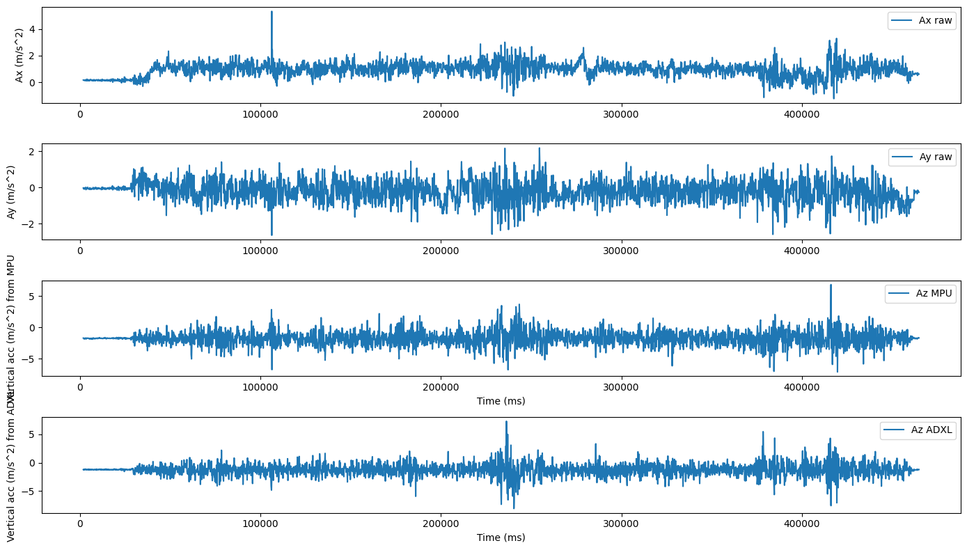
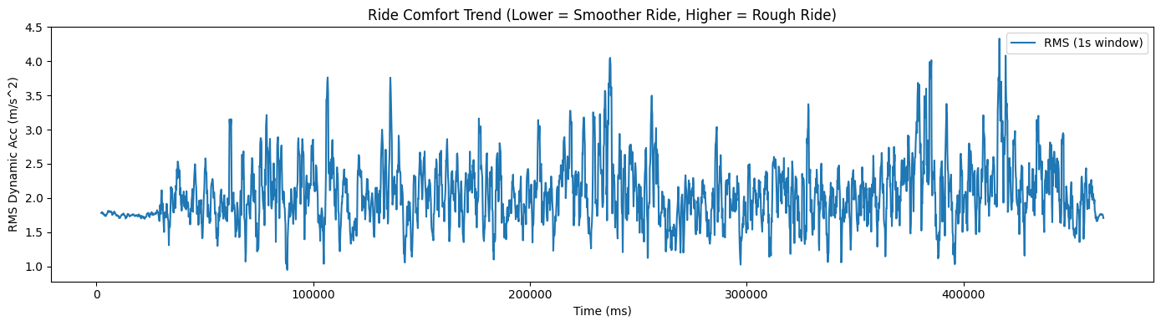
Results
Time-series plots show vibration peaks at bumps.

Slide 8
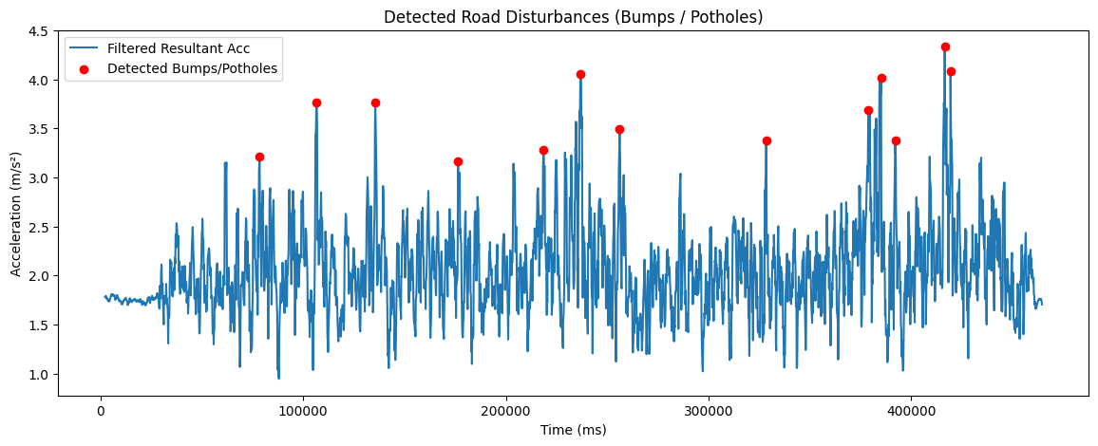
Results
Red circles indicate road irregularities.

Slide 9
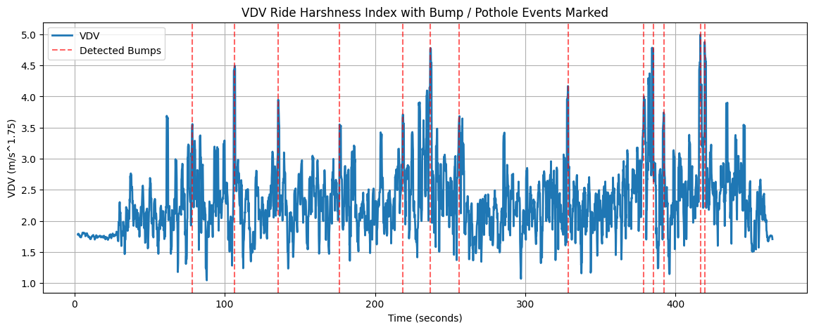
Results

Slide 10
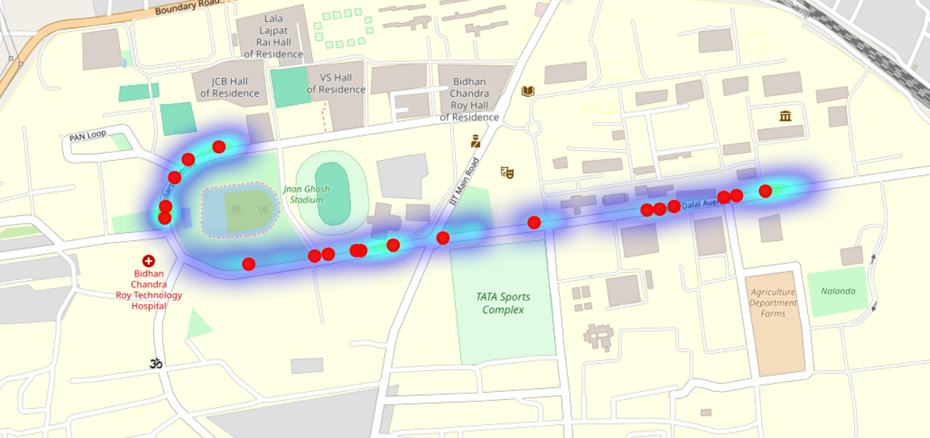
Results

Slide 11
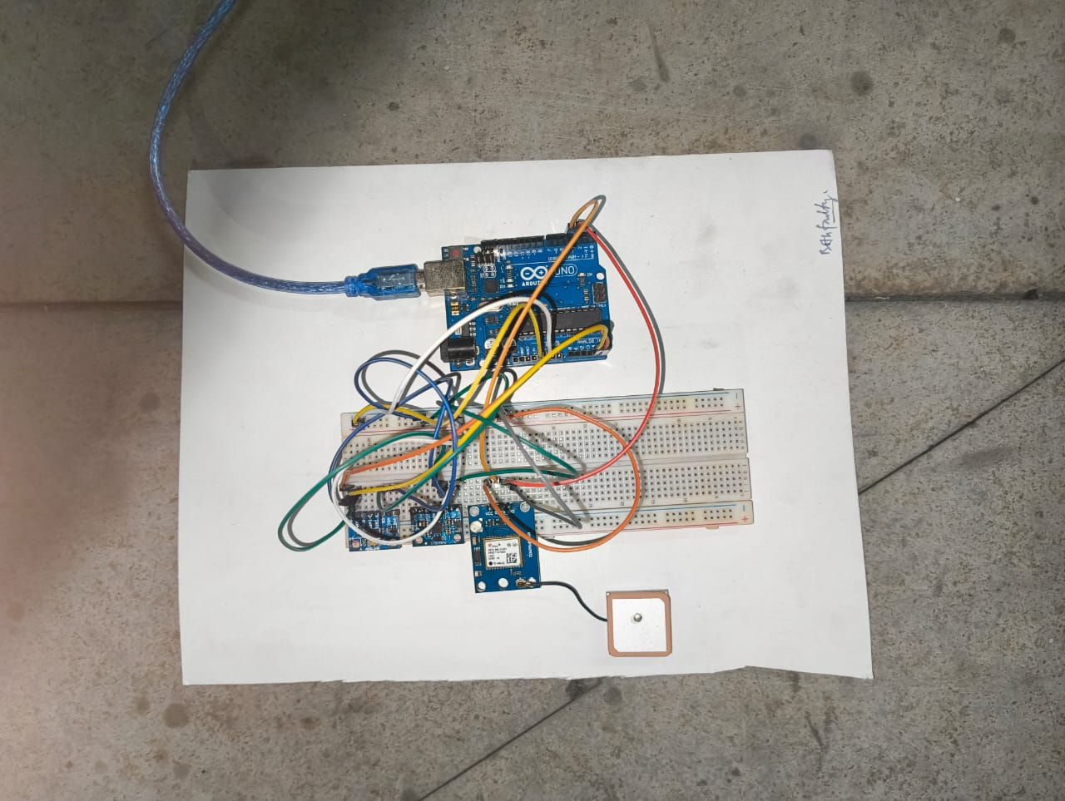
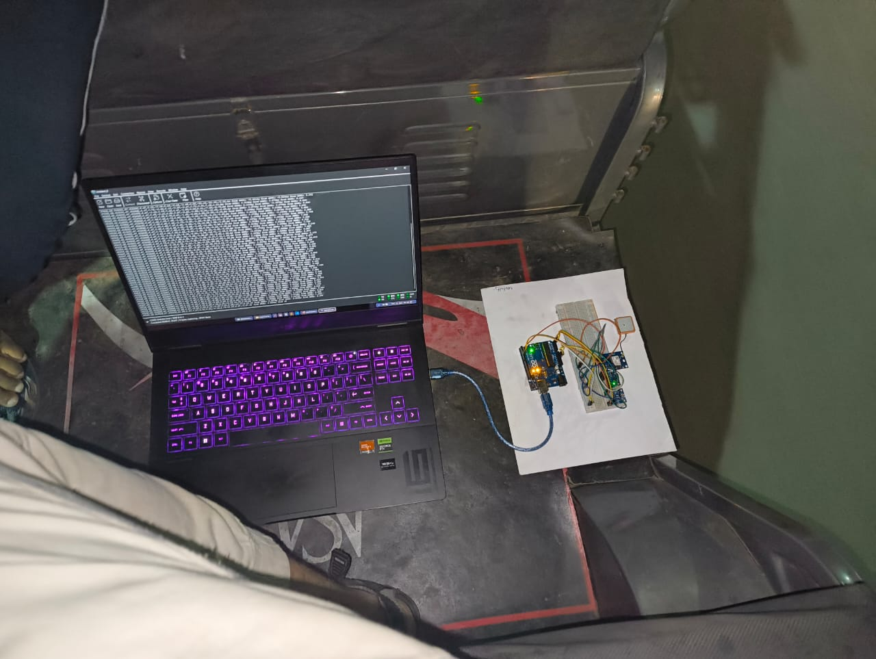
Results
Data collection conducted using Toto-mounted setup.
Good correspondence observed between sensors.

Slide 12
Discussion
Toto suspension amplifies small vibrations.
Sensor redundancy improved confidence.
GPS 1 Hz resolution limits spatial accuracy (~3–5 m).
Repeatability across runs confirms consistent detection.

Slide 13
Conclusions
MEMS sensors effectively detect and localize road irregularities.
IMU+GPS fusion enables useful road roughness mapping.
Suitable for low-cost maintenance prioritization.
Future: Higher-rate GPS and fleet-based studies.

Slide 14
Recommendations
To prioritize repair at identified vibration hotspots.
To use standardized mounting and sampling frequency.
To employ higher update rate GPS for better accuracy.
To repeat experiments across speeds for detailed mapping.

Slide 15
References
Behaviour of Metro Coach on Newly Built Track in Kolkata – Prof. V. Racherla, Dr. S.K. Singh, Dr. H. Danawe.
MPU-6050 Product Specification (InvenSense) datasheet.
ADXL345 Datasheet (Analog Devices).
ISO 2631-1:1997 — Mechanical vibration and shock — Evaluation of human exposure to whole-body vibration.

Slide 16
Thank You!

