Slide 1


Data Science & Analytics Internship
Wheeltrix | Internship Report
STUDENT NAME
ROLL NUMBER
Riddhima Sharma
2410031360
PROGRAMME
ORGANIZATION
B.Tech CSE
Wheeltrix
ROLE
PERIOD
Data Analyst Intern
27 June – 27 July, 2026
School of Computer Science and Engineering | IILM University, Greater Noida

Slide 2


Candidate Profile
FULL NAME
Riddhima Sharma
Academic Background
ROLL NUMBER
Currently pursuing B.Tech in Computer Science and Engineering with a focus on data science and Artificial Intelligence/machine-learning applications.
2410031360
3rd Year
ACADEMIC INSTITUTION
Section: 3CSE22
IILM University, Greater Noida
Batch: 2024 – 2028
DEPARTMENT
School of Computer Science & Engineering
02

Slide 3

About the Internship
ORGANIZATION
INTERNSHIP ROLE
Wheeltrix
Data Analyst Intern
Wheeltrix is a growing Ed-Tech startup that develops intelligent digital solutions using AI, automation, and cloud technologies. The company focuses on delivering innovative, scalable, and secure software solutions tailored to client needs..
Working on a sentiment-analysis project that converts movie-review text into useful audience insights.
FORMAT & DURATION
LEARNING CONTEXT
Internship Project
Academic & Professional
1 month (27 June 2026 – 27 July 2026)
Connecting B.Tech CSE concepts with a complete data-science workflow: data preparation, modeling, evaluation, and documentation.
03

Slide 4


From raw review to prediction
01
02
03
04
05
Collect
→
Clean
→
Represent
→
Learn
→
Evaluate
Read labeled movie reviews from the IMDb benchmark.
Remove markup and noise, normalize text, preserve emphasis.
Convert language into TF-IDF word and bigram features.
Fit a Logistic Regression classifier on the training split.
Measure accuracy, precision, recall, F1-score, and errors.
The same fitted vectorizer transforms both training and unseen test reviews.
04

Slide 5

Preparing language for learning
Decode & normalize
Convert HTML entities, lowercase text, and collapse repeated whitespace.
Cleaning is not about deleting meaning. It is about removing distraction.
Remove markup
Replace review break tags and remove non-alphanumeric noise while retaining ! and ?.
Tokenize
Use word-level tokens and include unigrams plus bigrams to capture short phrases.
The preprocessing choices are deliberately simple and reproducible.
Protect the split
Fit the vocabulary on training data only, then transform the held-out test data.
05

Slide 6

Why TF-IDF + Logistic Regression
REPRESENTATION
CLASSIFIER
TF-IDF gives important words more influence
Logistic Regression is a strong baseline
Term Frequency–Inverse Document Frequency creates a sparse numerical representation. Common words receive less weight; words that distinguish documents receive more.
It is fast, interpretable, and well suited to high-dimensional sparse text features. The model learns which patterns push a review toward positive or negative sentiment.
Features
100,000
A simple model is valuable when the experiment must be measurable, repeatable, and explainable.
Range
unigrams + bigrams
Scaling
sublinear TF
06

Slide 7

Measured baseline performance
90.54%
0.9055
Confusion matrix
test accuracy
positive-class F1-score
Actual \ Predicted
Negative
Positive
Negative
11,301
1,199
0.9043
0.9067
Positive
1,166
11,334
positive precision
positive recall
Correct classifications appear on the diagonal.
Measured on 25,000 held-out IMDb test reviews using TF-IDF word unigrams/bigrams and Logistic Regression.
07

Slide 8
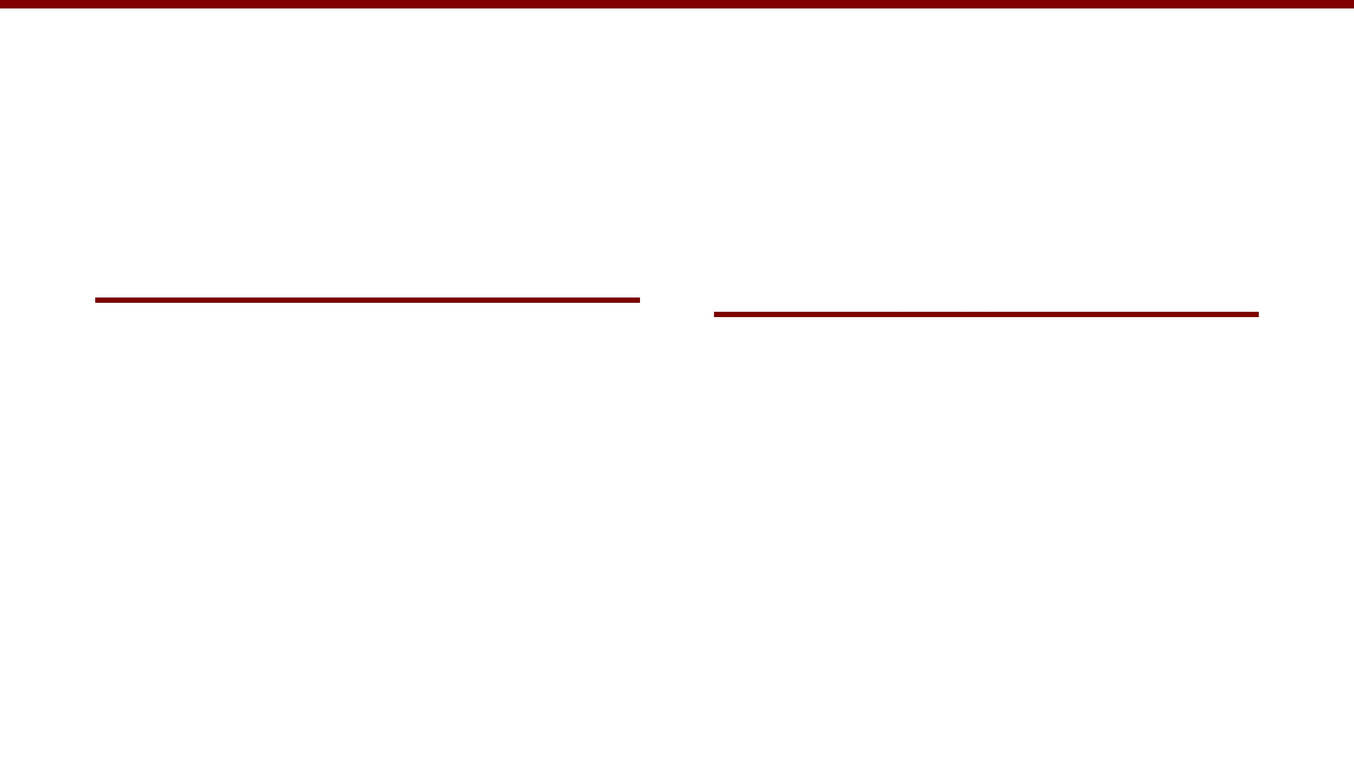
What the results tell us
What worked
What still needs care
The baseline reached above 90% accuracy on a balanced benchmark. Precision and recall were closely matched, which suggests that the classifier did not strongly favor one labeled class.
The score is specific to IMDb-style English reviews. Sarcasm, mixed opinions, changing language, genre differences, and distribution shift can reduce performance in real use.
strong benchmark baseline
balanced errors
simple to reproduce
not universal
not emotion detection
needs external validation
08

Slide 9

Next steps and deployment path
01
02
03
04
Compare models
Improve language coverage
Try transformers
Package the model
Benchmark Linear SVM, Naive Bayes, and calibrated alternatives against the same split.
Evaluate BERT-style models when compute, latency, and explainability trade-offs are acceptable.
Expose a prediction API or dashboard with confidence, monitoring, and clear limitations.
Test character n-grams, negation handling, sarcasm cases, and newer review sources.
Recommended principle: keep the benchmark pipeline as a transparent reference even after more advanced models are added.
09

Slide 10


Thank you
A transparent baseline for understanding audience sentiment
Riddhima Sharma · Roll No. 2410031360
B.Tech CSE · 3rd Year · Section 3CSE22 · Batch 2024-2028
Data Analyst Intern · Wheeltrix · 27 June 2026 – 27 July 2026
School of Computer Science and Engineering · IILM University, Greater Noida
Project topic: Sentiment Analysis on Movie Reviews

