Slide 1
G.H.Raisoni College of engineering and management
TAE2
Computer Department
Subject:-Computer Networking
Guided by:-Prof. Sarita Patil
Topic:-Bluetooth
Roll no:-
TCOA43
TCOA44
TCOA45
Name:-
Pratik Nandalwar
Nikita Aswale
Riddhi Nilawar

Slide 2
Index
Introduction
History
Bluetooth vs other wireless techniques
Bluetooth Protocols
Advantages
Disadvantages
Applications
Features
Conclusion

Slide 3
Introduction
Bluetooth is a short-range and low power wireless technology originally developed for exchanging data over short distances from fixed and mobile devices, creating personal area network(PANs)
Short-range radio frequency technology that operates at 2.4 GHz on an unlicensed Industrial Scientific Medical (ISM) band.
Effective range of Bluetooth devices is 10 meters.
It was originally conceived as a wireless alternative to data cables.

Slide 4
history
The word “Bluetooth” is taken from the 10th century Danish King Harald Bluetooth, he had been influential in uniting Scandinavian tribes into a single Kingdom.
Bluetooth was named so because
1)Bluetooth technology was developed in Scandinavia
2)Bluetooth technology is able to unite differing industries such as the cell phone, computing, and automotive markets.

Slide 5
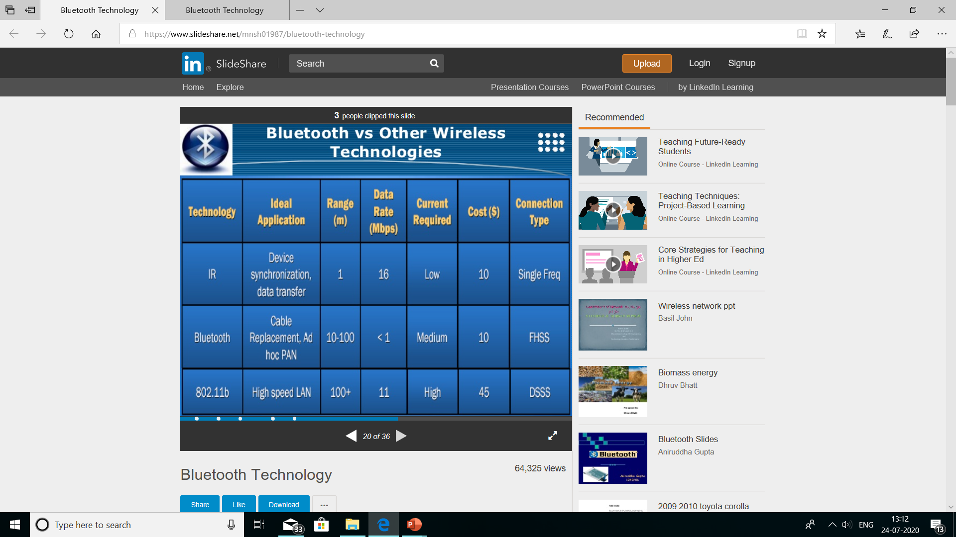
Bluetooth vs other wireless techniques

Slide 6
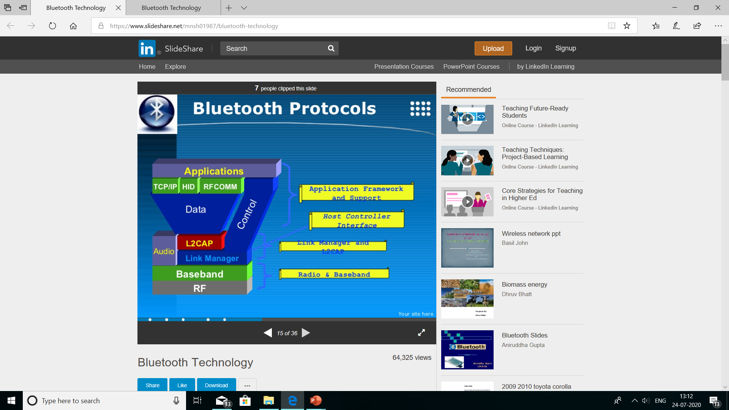
BLUETOOTH PROTOCOLS

Slide 7
BLUETOOTH PROTOCOLS
Radio Protocol
Baseband protocol
Link controller
Responsible for modulation and demodulation of data into RF signals.
The radio layer describes the physical characteristics a bluetooth device’s receiver-transmitter component must have.
Responsible for channel coding and decoding.
Digitize the signals received by the radio for passing up the stack.
Responsibilities for establishing and maintain the links between Bluetooth units.

Slide 8
BLUETOOTH PROTOCOLS
Link manager Protocol(LMP)
Host controller interface(HCI)
Logical link control and adaptation protocol(L2CAP)
Handles the setup, authentication, link configuration and security procedures.
Establishes all connections with the help of baseband protocol.
The host controller interface defines uniform methods for accessing and controlling the lower layers of the protocol stack(baseband and link manager).
Responsibilities for establishing connection across existing ACL links or requesting an ACL link if one dose not already exist.

Slide 9
BLUETOOTH PROTOCOLS
Service Discovery Protocol
Telephony Control Protocol Specification(TCS)
Logical link control and adaptation protocol(L2CAP)
Defines procedure
Discovering services of other devices
Determining the characteristics of those services.
Control signaling for establishing speech and data calls between Bluetooth devices, providing them with telephony services.
Is a specification for object data exchange over IR(Infrared Links)
Examples for using OBEX include exchanging business cards and synchronizing calendar applications.

Slide 10
ADVANTAGES
Eliminates wires
Facilitates Data and Voice Communication
Offers formation
Standardized protocol
Free of charge
Easy to use
Low power consume battery less
Stationary and mobile environments

Slide 11
DISADVANTAGES
Relatively short range
Less security
Interferences with other devices
Mediocre Data rates
Bluetooth internet connection gets slow sometimes.

Slide 12
FEATURES
Bluetooth has a good feature ahead it meets a basic need of connectivity.
Currently a protocol is being researched that would support large and hoc network.
New versions of Bluetooth technology will meet the high-speed and large range.
Many companies are designing the impressive Bluetooth devices which are in demand.
Latest versions of Bluetooth are improving both its security and capabilities.

Slide 13
APPLICATIONS
Wireless communication between mobile phones and a wire less handset. These was the most earlier application to become most popular.
Wireless communication between PC input and output devices, the most common being the mouse, keyboard, and printer.
In 2004, released cars like Toyota prius & lexus have hands free call system.
Sending small advertisements from Bluetooth –enabled advertising hordings to other, discoverable , bluetooth devices.
In games consoles like sony’s playstation 3 and psp go ,use Bluetooth for their respective wireless controls.

Slide 14
CONCLUSION
A new global standard for data and voice
Eliminate cables
Low Power, Low range, Low Cost network devices.
Bluetooth seems to have a bright future after reviewing its benefits and wide use.
Further improvements are planned to be made in
Data Rates
Power Reduction
Range

Slide 15
Thank you

