Slide 1
Visual Question Answering
Project Member : Devangi Bhuva, Riddhi Nisar
Final B.Tech, Dept of Computer Engineering, VJTI College, Mumbai
Project Guide : Prof. P. M. Chawan
Associate Professor, Dept of Computer Engineering and IT, VJTI College, Mumbai

Slide 2
INTRODUCTION
In this project we aim to achieve Visual Question Answering(VQA) using CNN and LSTM.
Model that combine the local image features and the question from corresponding specific parts or regions of an image to produce answers for the questions posed by making use of a pre-processed image dataset.
Since language has a complex compositional structure, the issue of taking care of vision and language becomes a tough task.

Slide 3
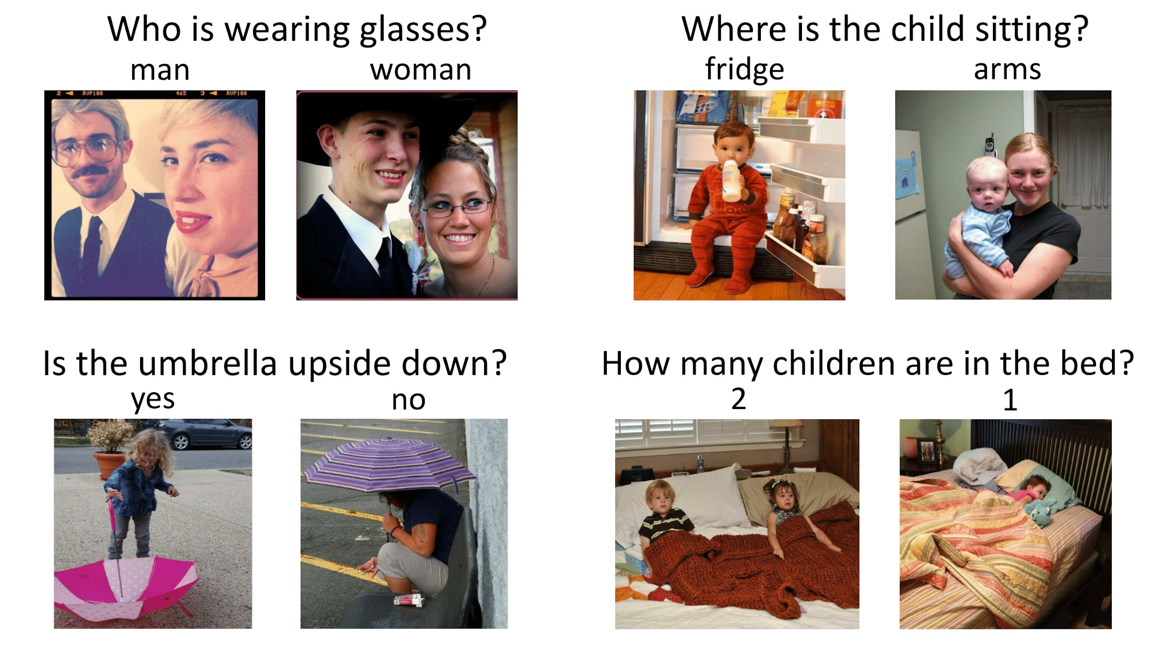
VQA Examples

Slide 4
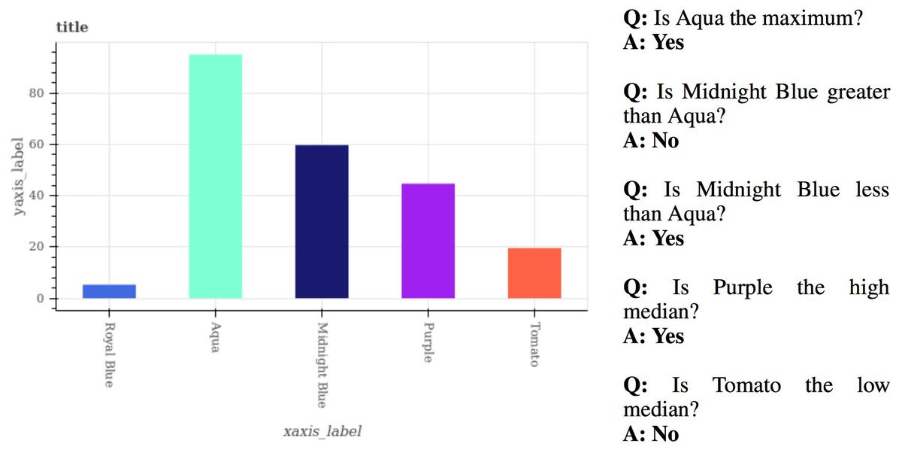
Statistical Database

Slide 5
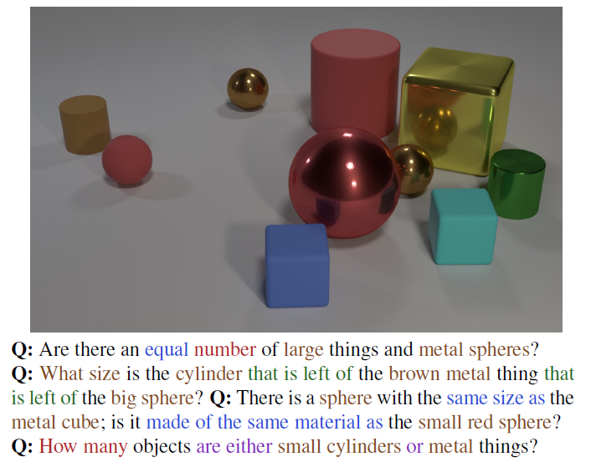
CLEVR dataset

Slide 6
Problem Statement
“To find the correct answer to a question posed based on an image using the technique of combination of language and vision via Keras, long short term memory,convolutional neural network and multilayer perceptron.”

Slide 7
OBJECTIVES
Understand the basics of the Visual Question Answering as they relate to image captioning; including natural language processing.
To learn and group labeled data points together and discover underlying patterns.
To derive efficient techniques for supervised learning on data. Understand CNN, RNN and Element wise summation.

Slide 8
SIGNIFICANCE
Some special type of spectacles can be made which will make use of computer vision (image captioning) along with neural networks to provide a virtual interface to answer questions based on image.
Study and improve Deep learning techniques techniques in data mining algorithm.
Can be used as a step further in business models and scientific research analysis.

Slide 9
Literature Survey: CNN
In neural networks, convolutional neural network (ConvNets or CNNs) are one of the major categories to do the recognition and classification of various types of images. Computers see an input image as an array of pixels and the size of the array depends on the image resolution. It decides the pixels depending on the image resolution, for example we will see h x w x d (h = Height, w = Width, d = Dimension). Similarly, an image of 10 x 10 x 3 array of matrix of RGB (3 refers to RGB values) and an image of 8 x 8 x 1 array of matrix of gray scale image.
Deep learning is used in CNN patterns to prepare and test, where each information picture is gone by a progression of convolution layers which includes of channels (Kernels), completely associated layers, and all the more completely associated layers , and later a Softmax capacity is completed to group the item. Essentially, the picture is encoded into a vector, which has encoded in it all the basic highlights of the model to be needed for handling further in the figure for answer expectation.

Slide 10
Literature Survey: LSTM
In Kafle and Kanan (2016), for example, the authors model the probability of image features given the question features and the type of the answer. They do so because they observe that given a question, the type of answer can be frequently predicted. For example, “How many players are in the image?” is a “how many” question, that needs a number as an answer. To model the probabilities they combine a Bayesian model with a discriminative model. Regarding the features, they use ResNet for the images and skip-thought vectors for text.
Long Short Term Memory networks are usually known as “LSTMs” and these are special kinds of recurrent neural networks which are intelligent enough to learn long-term dependencies. Long short-term memories have been designed for the sole purpose of avoiding long-term dependencies. They use gates and filters to remember old information. Their basic behaviour is to recollect pieces of information for long periods of time rather than for short periods, as is the case of vanilla recurrent neural networks.

Slide 11
Literature Survey: MLP
A multilayer perceptron (MLP) is portrayed fundamentally as a neural system which is profound, which has shrouded layers present in it. As intended by the name, it has various perceptions. A multilayer perceptron contains info layer, managed to transfer the essential information highlights and a yield layer, which give out the conclusive outcome of the counterfeit neural system. In the middle of these two layers, we have at least one number of shrouded layers which are the policy units of the multilayer perceptron that figure the initiation capacities and go about as the cerebrums of the system.
In the Multilayer perceptron, there can more than one linear layer (combinations of neurons). If we take the simple example the three-layer network, first layer will be the input layer and last will be output layer and middle layer will be called hidden layer. We feed our input data into the input layer and take the output from the output layer. We can increase the number of the hidden layer as much as we want, to make the model more complex according to our task. The layers of an MLP consists of several fully connected layers because each unit in a layer is connected to all the units in the previous layer. In a fully connected layer, the parameters of each unit are independent of the rest of the units in the layer, that means each unit possess a unique set of weights.

Slide 12
Literature Survey
In the evolving line of convolutional neural networks (CNNs) proposed for image feature extraction, LeNet, AlexNet, GoogLeNet, VGG-Net and ResNet are representative and widely adopted networks. LeNet is a simple network structure with two convolutional layers and used to solved simple tasks such as handwritten digit recognition. AlexNet, a deeper network with 5 convolutional layers, was the first deep network to boost the classification accuracy. It used ReLu (Rectified Linear Unit) as the activation function which can be trained much faster than sigmoid or tanh. Dropout was also adopted to avoid overfitting.

Slide 13
Proposed Methodology
The Steps are as follow:
The first step will be the word transformation. For the question, we will convert each word to its word vector, and then sum up all the vectors. We have to make sure that the length of this feature vector matches the length of a single word vector, and these word vectors are also called embeddings.
In the next step, these word vectors will be sent sequentially to the long short-term memory network, respective to the tokens in the question. The representation of the input question is actually the vector coming from the output gate of the long short-term memory.

Slide 14
Proposed Methodology
Coming to the image, it is sent through a Deep Convolutional Neural Network (from the well-known VGG Architecture), and the image features are extracted from the activation of the second last layer (that is, the layer before the softmax function).
To combine the features from the image and the word vector, we use a multilayer perceptron consisting of fully connected layers. The final layer consists of the Softmax activation function, and thus we get a probability distribution over all the possible outputs. The output with the highest probability is our answer to the question posed based on the image.

Slide 15
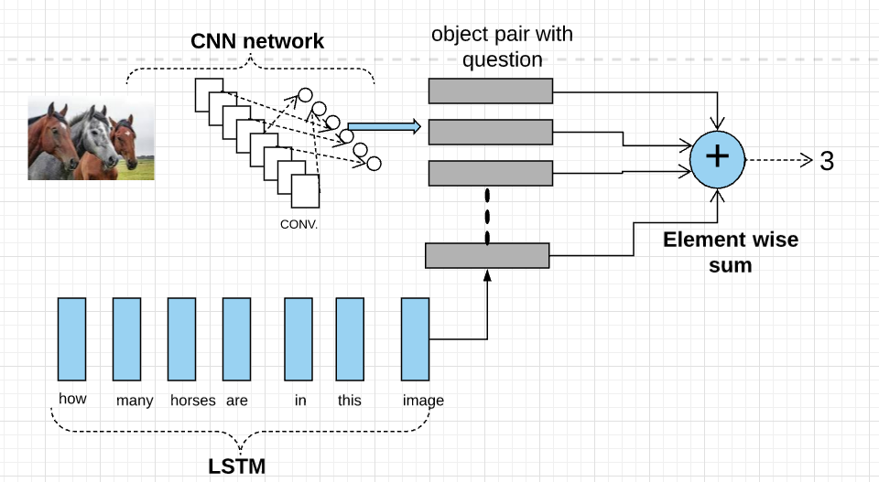
System Architecture

Slide 16
Conclusion
Visual Question Answering is a research topic that covers parts of both computer vision and natural language processing and it requires a system to do much more than simple task-speciﬁc algorithms, such as object recognition and object detection.
To build an algorithm that will be able to answer random questions about images would be a huge achievement in the artiﬁcial intelligence domain, and would have a large potential to benefit visually impaired users.

Slide 17
“AI doesn't have to be evil to destroy humanity – if AI has a goal and humanity just happens in the way, it will destroy humanity as a matter of course without even thinking about it, no hard feelings."
– Elon Musk, Technology Entrepreneur, and Investor.

Slide 18
Reference
Yin and Yang: Balancing and Answering Binary Visual Questions (CVPR 2016)
https://visualqa.org/
Image Captioning and Visual Question Answering Based on Attributes and External Knowledge Qi Wu, Chunhua Shen, Peng Wang, Anthony Dick, Anton van den Henge
Learning to Reason: End-to-End Module Networks for Visual Question Answering ICCV 2017 Ronghang Hu Jacob Andreas Marcus Rohrbach Trevor Darrell Kate Saenko
https://tryolabs.com/blog/2018/03/01/introduction-to-visual-question-answering/

Slide 19
Thank You!

