Slide 1
Visual Question Answering
Project Member : Devangi Bhuva, Riddhi Nisar
Final B.Tech, Dept of Computer Engineering, VJTI College, Mumbai
Project Guide : Prof. P. M. Chawan
Associate Professor, Dept of Computer Engineering and IT, VJTI College, Mumbai

Slide 2
INTRODUCTION
In this project we aim to implement Visual Question Answering(VQA) using Keras in Python.
Model that combine the image features and the question word vector from corresponding parts of an image to produce answers for the questions posed by making use of a pre-processed image dataset.
Since language has a complex compositional structure, the issue of taking care of vision and language becomes a tough task.

Slide 3
Problem Statement
“To find the correct answer, in an implementation, to a question posed based on an image using the technique of combination of language and vision using VGG-16 pre- trained weights, spaCy word embedding and a multi-layer perceptron combining the two with the Keras framework ”

Slide 4
OBJECTIVES
Understand the concepts of the Visual Question Answering as they relate to image captioning, word vector formation, including natural language processing.
To learn and group labeled data points together and discover underlying patterns.
To understand core functionality of libraries provided by Python and the VGG-16 model as well as spaCy word embeddings.

Slide 5
SIGNIFICANCE
Some special type of spectacles can be made which will make use of computer vision (image captioning) along with neural networks to provide a virtual interface to answer questions based on image.
Study and improve Deep learning techniques techniques in data mining algorithm.
Can be used as a step further in business models and scientific research analysis.

Slide 6
Literature Survey: VGG-16
In neural networks, convolutional neural network (ConvNets or CNNs) are one of the major categories to do the recognition and classification of various types of images. Convolutional neural networks are now capable of outperforming humans on some computer vision tasks, such as classifying images. Imagenet was a research project to develop a large database of images with annotations, e.g. images and their descriptions. For the classification task, images must be classified into one of 1,000 different categories.
Researchers from the Oxford Visual Geometry Group, or VGG for short, released two different CNN models, specifically a 16-layer model and a 19-layer model. In our implementation, we use the pre-trained weights of the VGG-16 model for creating the image vector.

Slide 7
Literature Survey: spaCy
Word embeddings using spaCy:
In our implementation, we use a pre-existing model for the word embeddings. With word embeddings, we were able to capture the context of the word and then find semantic and syntactic similarities. we have used the spaCy word embedding model. While spaCy was only recently developed, the algorithm already has a reputation for being the fastest word embedding in the world.

Slide 8
Literature Survey: MLP
A multilayer perceptron (MLP) is portrayed fundamentally as a neural system which is profound, which has shrouded layers present in it. As intended by the name, it has various perceptions. A multilayer perceptron contains info layer, managed to transfer the essential information highlights and a yield layer, which give out the conclusive outcome of the counterfeit neural system.

Slide 9
Proposed Methodology
The Steps are as follow:
The first step will be the word transformation. For the question, we will convert each word to its word vector, and for that we will use the spaCy word embeddings model.
Coming to the image, it is sent through a Deep Convolutional Neural Network (from the well-known VGG Architecture), and the image features are extracted from the activation of the second last layer (that is, the layer before the softmax function).

Slide 10
Proposed Methodology
To combine the features from the image and the word vector, we use a multilayer perceptron consisting of fully connected layers. The layers are mentioned further in the article. We get a probability distribution over all the possible outputs. The output with the highest probability is our answer to the question posed based on the image.

Slide 11
ALGORITHM
Take pre-processed VGG-16 dataset weights, which categorize objects into 1000 categories. It has 16 layers and we pop the last 2 layers for use in our image object classification.
The image is converted to a corresponding (1, 4096) dimension vector by the VGG-16 Model
We use the spaCy dataset for word-embeddings of our question tokens and convert it to a question tensor.
We have {{22}} trainY labels, so we convert it to categorical variables using to_categorical function.
Our final model has the following layers:

Slide 12
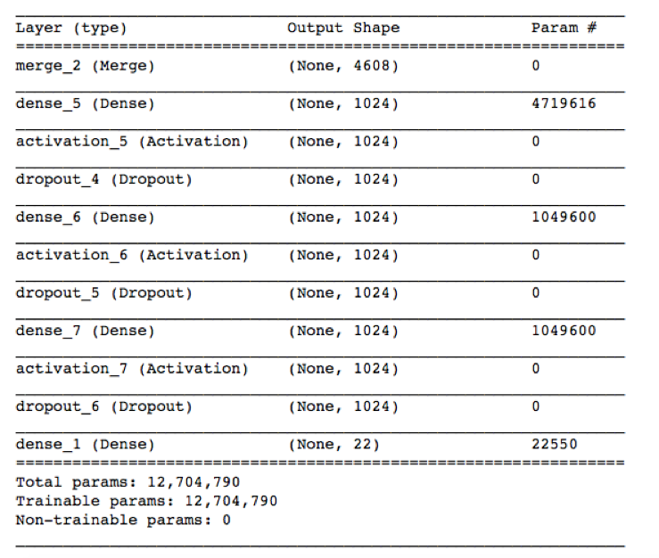
Layers:

Slide 13
ALGORITHM
We train the data by creating image features and question features by passing it through model.fit() function.
Later, we save the model architecture in a JSON file and the model weights in a H5 file.
In our working application, we load the architecture and weights using these saved files, and input image and corresponding question to get result.
The result is probabilistic values of the categories and we output the category with the maximum probability.

Slide 14
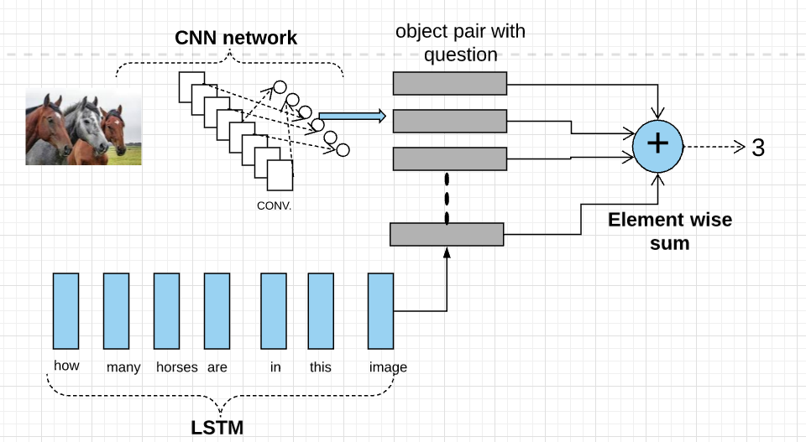
System Architecture

Slide 15
Implementation
DATASET
Libraries: Flask, os, werkzeug_utils.
Dataset: Natural images
List of the steps required to get dataset
Download and collect set of natural images from various repositories
Make sure images have same extension(.jpg or .png)
Create training.csv for all types of natural images you want to select (Eg: Cars,Fruits,Flowers,etc)
Attributes such as IMG_ID, Question and answer mentioned in excel or .CSV file.

Slide 16
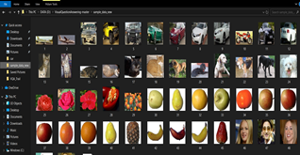
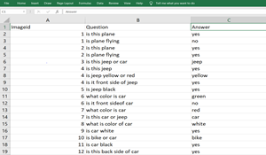
Screenshots

Slide 17
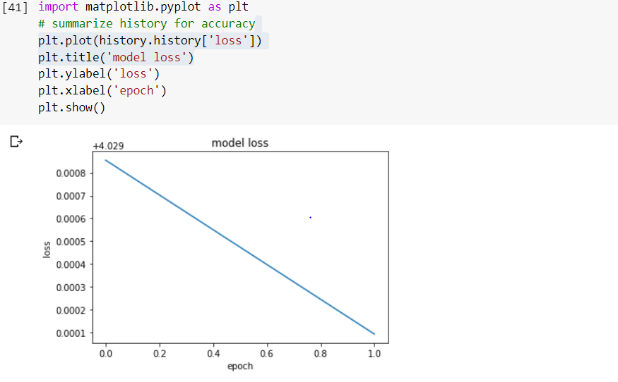
Error rate

Slide 18
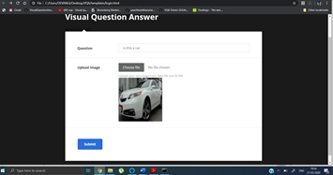

Implementation

Slide 19
Conclusion
We have implemented methodologies for visual question answering using the pre-processed VGG16 weights for image feature extraction and the Spacy word embeddings for question vector creation. We have implemented the techniques using Python Keras framework using Tensorflow as the backend.
For the application part of the project, we have used the light-weight Flask web-framework.The validation set of the dataset exhibits a peak accuracy of 94 percent. This is better than the traditional models not using the convolutional and recurrent neural network deep learning techniques. However, there is a good amount of future scope to improve the accuracy on real-time data, using larger datasets and a wide range of questions along with attention modelling.

Slide 20
“AI doesn't have to be evil to destroy humanity – if AI has a goal and humanity just happens in the way, it will destroy humanity as a matter of course without even thinking about it, no hard feelings."
– Elon Musk, Technology Entrepreneur, and Investor.

Slide 21
Reference
Yin and Yang: Balancing and Answering Binary Visual Questions (CVPR 2016)
https://visualqa.org/
Image Captioning and Visual Question Answering Based on Attributes and External Knowledge Qi Wu, Chunhua Shen, Peng Wang, Anthony Dick, Anton van den Henge
Learning to Reason: End-to-End Module Networks for Visual Question Answering ICCV 2017 Ronghang Hu Jacob Andreas Marcus Rohrbach Trevor Darrell Kate Saenko
https://tryolabs.com/blog/2018/03/01/introduction-to-visual-question-answering/

Slide 22
Thank You!

