Slide 1
TIMETABLE MANAGEMENT SYSTEM

Slide 2
Group members
Rajveer Singh
Saurabh suryavanshi
Riddish sarode
Under the guidance of
Prof. Pranjali gurnule

Slide 3
TABLE OF CONTENT
ABSTRACT
INTRODUCTION
OBJECTIVES
HARDWARE AND SOFTWARE REQUIREMENTS
USERS
SCOPE
FUNCTIONALITIES
FEATURES
UML DIAGRAM
RESULTS
CONCLUSION

Slide 4
ABSTRACT
Timetabling concerns all activities with regard to producing a schedule that must be subjective to different constraints. Timetable can be defined as the optimization of given activities, actions or events to a set ofobjects in space-time matrix to satisfy a set of desirable constraints. A college timetable is a temporal arrangement of a set of lectures and classrooms in which all given constraints are satisfied. Creating such timetables manually is complex and time-consuming process. By automating this process with computer assisted timetable generator can save a lot of precious time of administrators who are involved in creating and managing course timetables. Since every college has its own timetabling problem, the commercially available software packages may not suit the need of every college.
Hence we have developed practical approach for building lecture course timetabling system, which can be customized to fit to any colleges timetabling problem. This project introduces a practical timetabling algorithm capable of taking care of both strong and weak constraints effectively, used in an automated timetabling system. So that each teacher and student can view their timetable once they are finalized for given semester but they can’t edit them.

Slide 5
INTRODUCTION
Timetabling concerns all activities with regard to producing a schedule that must be subjective to different constraints. Timetable can be defined as the optimization of given activities, actions or events to a set of objects in space-time matrix to satisfy a set of desirable constraints. A key factor in running an educational centre or basically an academic environment is the need for a well-planned, well-throughout and clash-free timetable. Back in the days when technology was not in wide use, (lecture) timetables were manually created by the academic institution. Every school year, tertiary institutions are faced with the tedious task of drawing up academic timetables that satisfies the various courses and the respective examination being offered by the different departments.Timetable development process starts when each Head of Department provide the following information to be used for timetable scheduling. The information provides the modules with dates, time and venues suitable in a particular semester:
Examinable courses in a particular semester.
Dates for lectures to be held (Lectures can be scheduled between Monday and Friday).
Specified time for lectures ( i.e. Between 8am and 4pm)
The venue of the scheduled lectures.

Slide 6
OBJECTIVES
The final system should able to generate time tables in completely automated way which will save a lot of time and effort of an institute administration. .
To make a timetable system generic so that I can work equally well for different School, Colleges and Universities.
User defined constraints handling.
Ease of use for user of system so that he/she can make automatic timetable.
Focus on optimization of resources i.e. teachers, labs and rooms etc.
Provide a facility for everyone to view timetable.
Generate multiple useful views from time table.

Slide 7
HARDWARE AND SOFTWARE REQUIRED
Processor: Pentium(R) Dual-core CPU or Higher
• Hard Disk: Minimum 40 GB
• Ram: 512MB or Higher
Platforms: JAVA GUI swing, MySQL
FRONT-END:HTML,CSS,JavaScript, JQuery
BACK-END: PHP
DATABASE: MySQL and PHPMyAdmin
IDE’s: Netbeans, Eclipse, MySQL- Command Line Interface

Slide 8
USERS
User: The User is one who intends to view the Time Table i.e. it can be Student, Teachers, Course/Subject Co-ordinator and even the Head of Department. Multiple users can connect through the software for viewing the time table.
Admin: She/he is the one that uses the Software to generate Time-Table according to the needs and specific requirements of the Class for which the time table needs to be formed.

Slide 9
SCOPE
Timetable Generation System generates timetable for each class and teacher, in keeping with the availability calendar of teachers, availability and capacity of physical resources (such as classrooms, laboratories and computer room) and rules applicable at different classes, semesters, teachers and subjects level. Best of all, this Timetable Generation System tremendously improves resource utilization and optimization.

Slide 10
FUNCTIONALITIES
Creating Recess and Prayer slots
Generate Multiple Time Tables
Information Storing in Data-Base
Vanquishes human errors
Reduces human efforts
Academic Calendar
Systematic planning
Personal Scheduler
Lectures Scheduling
Course Scheduling
Exam Scheduling

Slide 11
FEATURES
Processing Capabilities: The system will have algorithms to process all the data present in the database and keeping in view the various constraints like that a teacher should not have two consecutive lectures/labs, students have minimum one hour gaps, proper rooms are allocated for the lectures and tutorials, labs are used optimally so that they are used for the maximum possible time
Search Panel: The system will have an easy to use to search panel to search according his need on the time tables stored in the database. The system would give the response to the user quires in the proper format and errors messages will be shown properly to tell user about his mistakes and to guide him/her for proper use of the system.
Interface for input: The system will be having an easy to use and interactive interface to enter all the inputs like the workload for the teachers, how many no. of students of which branches are studying the subject in a semester, the data for the rooms and data for the labs.
Database Capabilities: The system will have well-designed database to store all the information which will be entered in as the input. Separate database maintaining basic information’s, subjects, teachers, batches and their associations and other details Database for holding generated timetable and for storing required timetables.

Slide 12
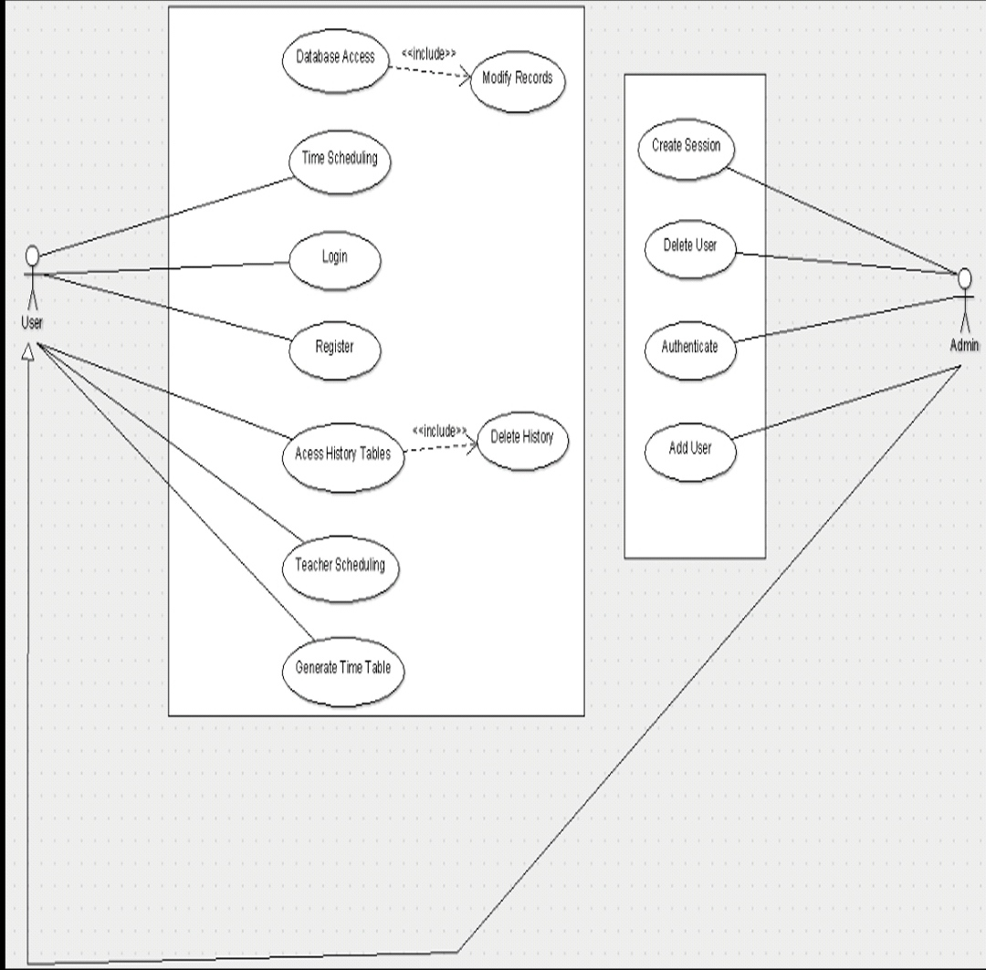
UML DIAGRAM

Slide 13
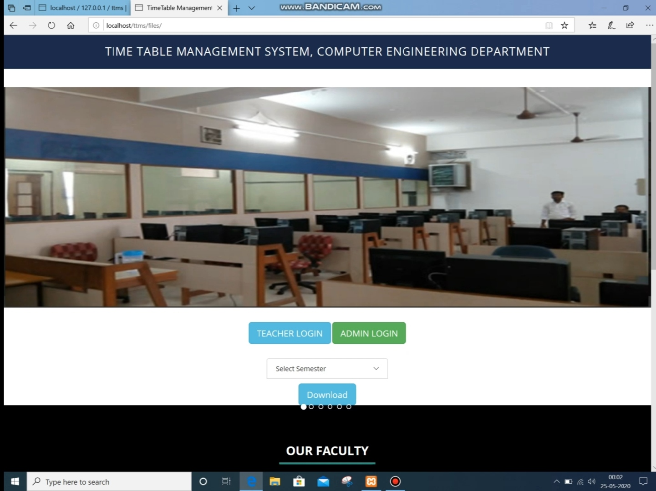
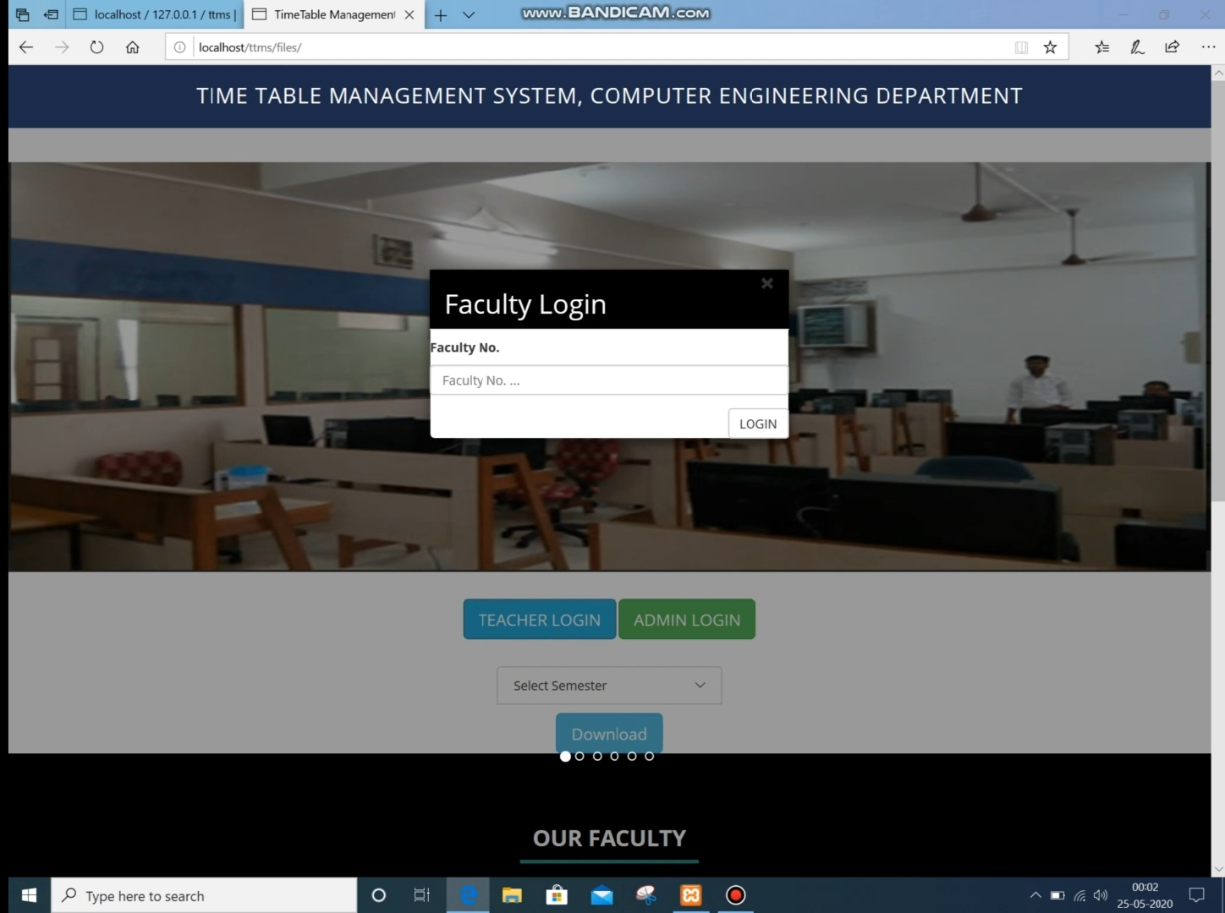
RESULTS

Slide 14
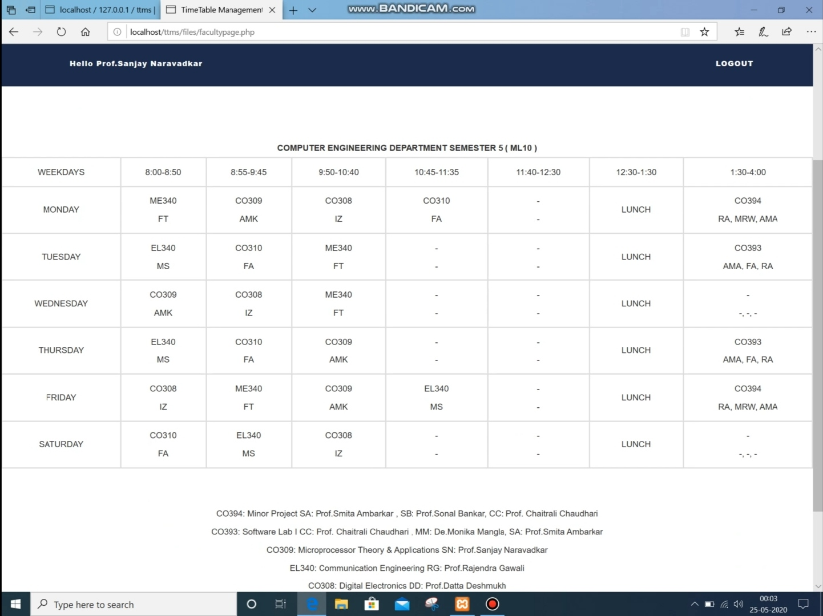
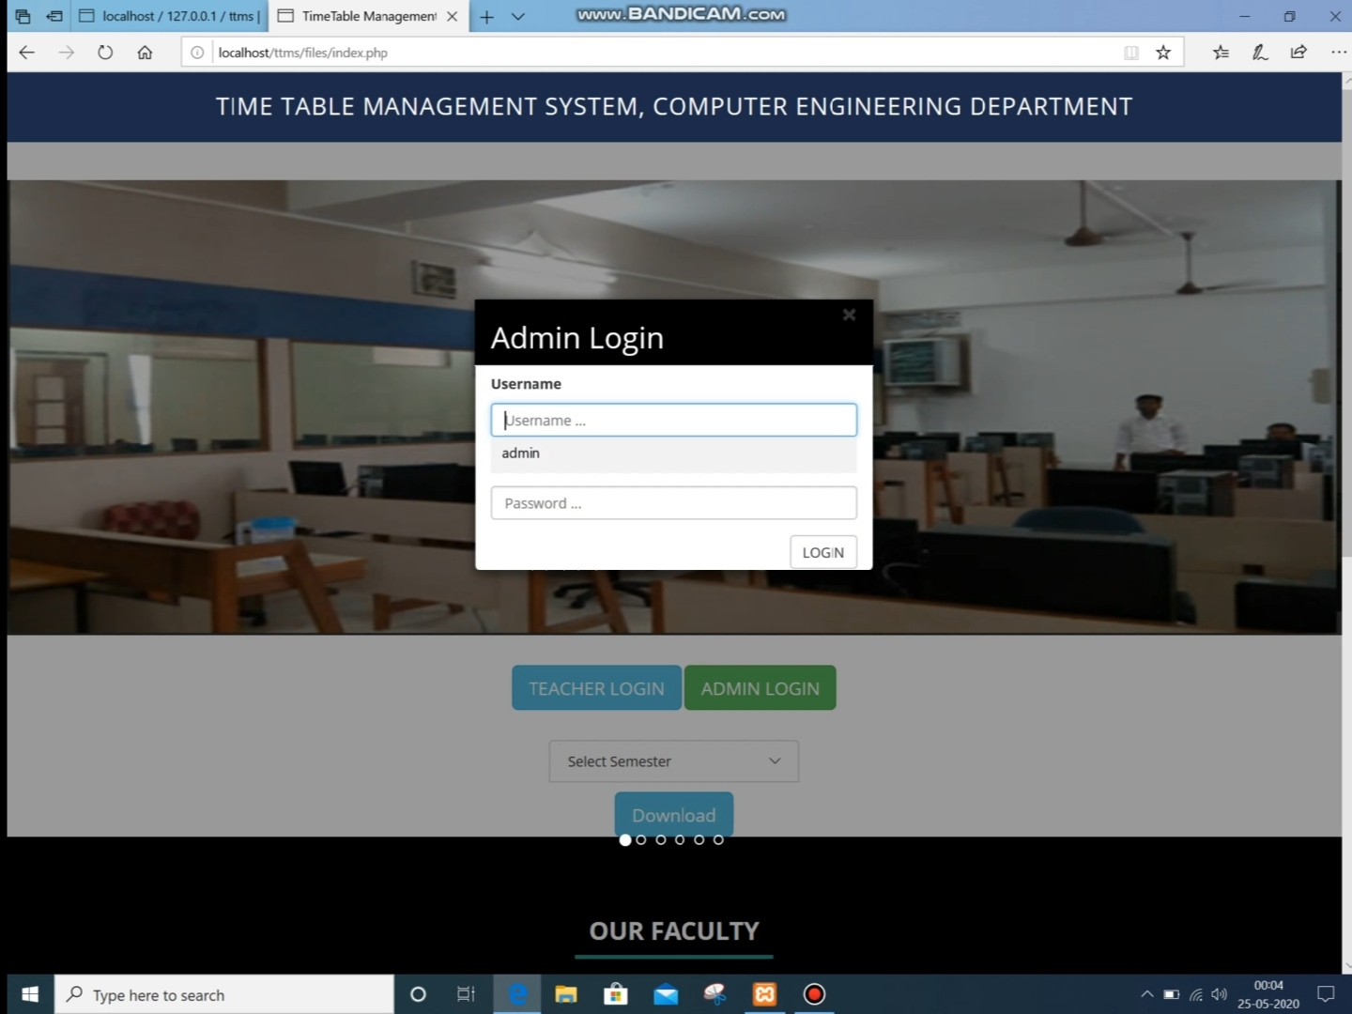

Slide 15
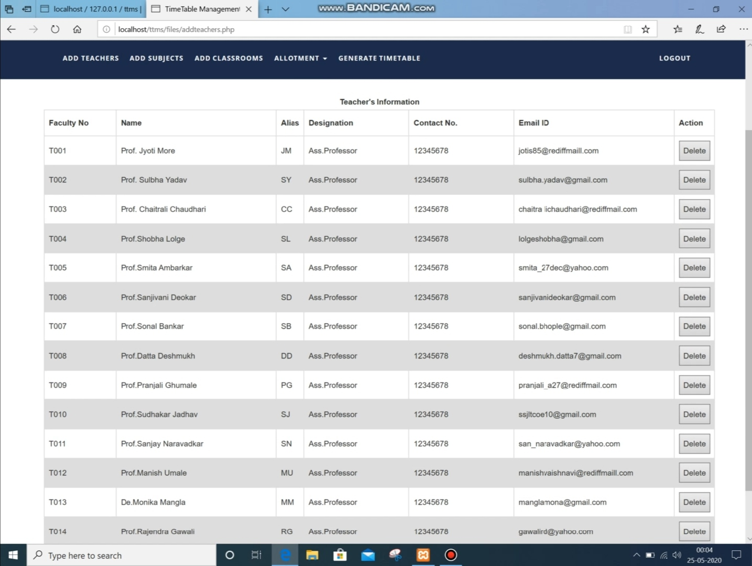
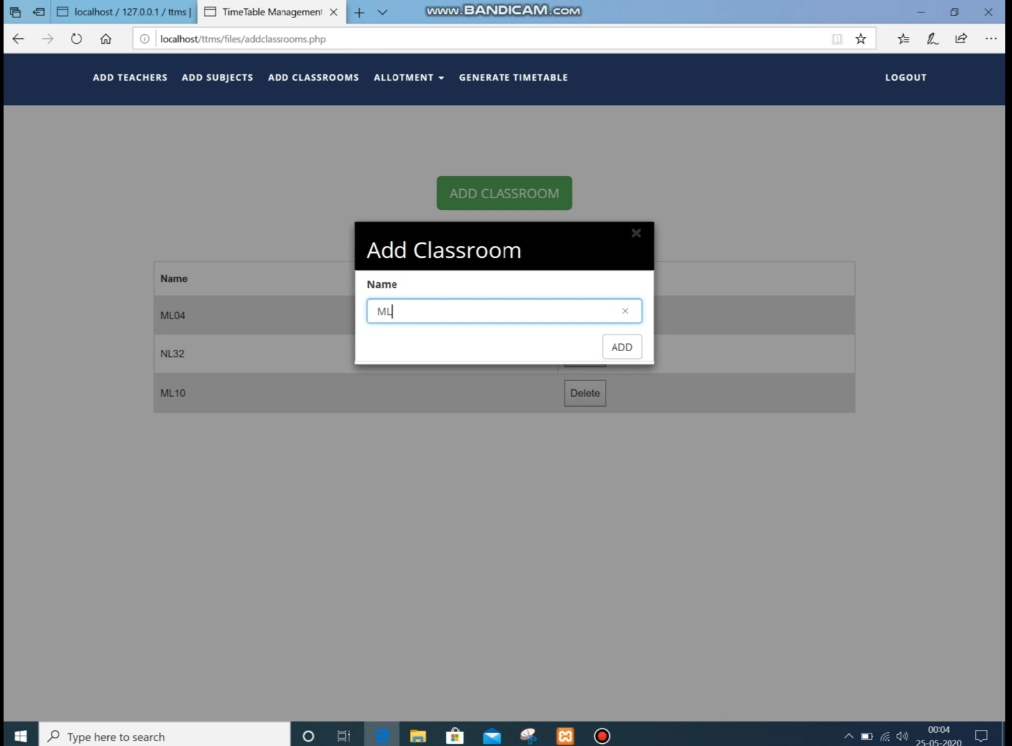

Slide 16
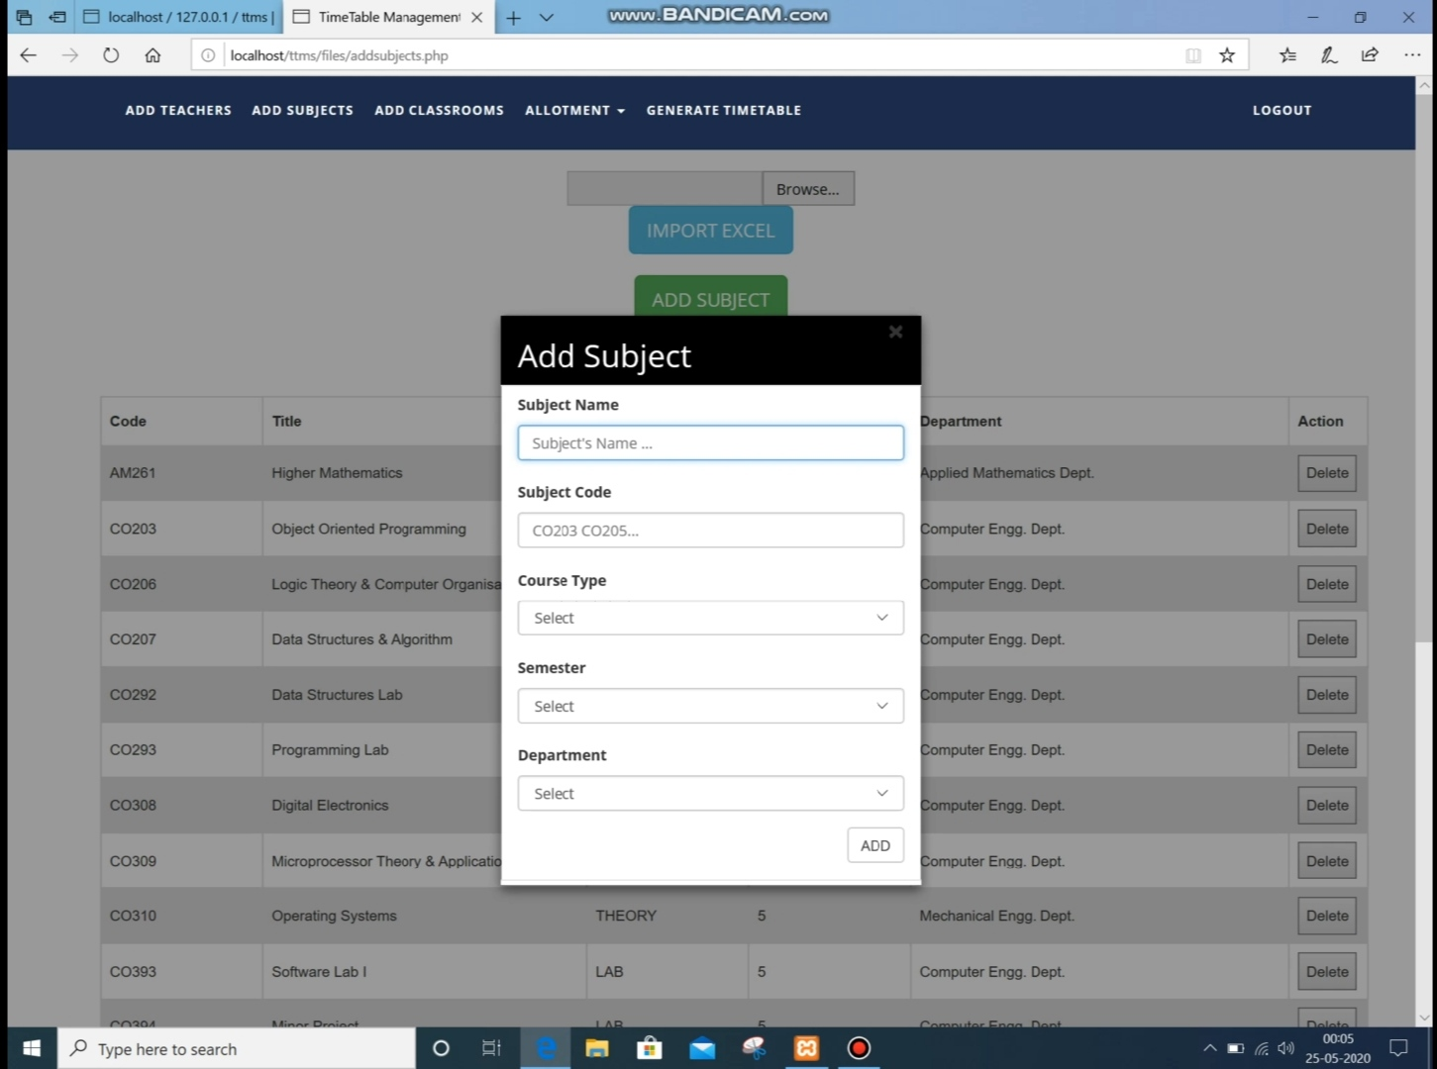
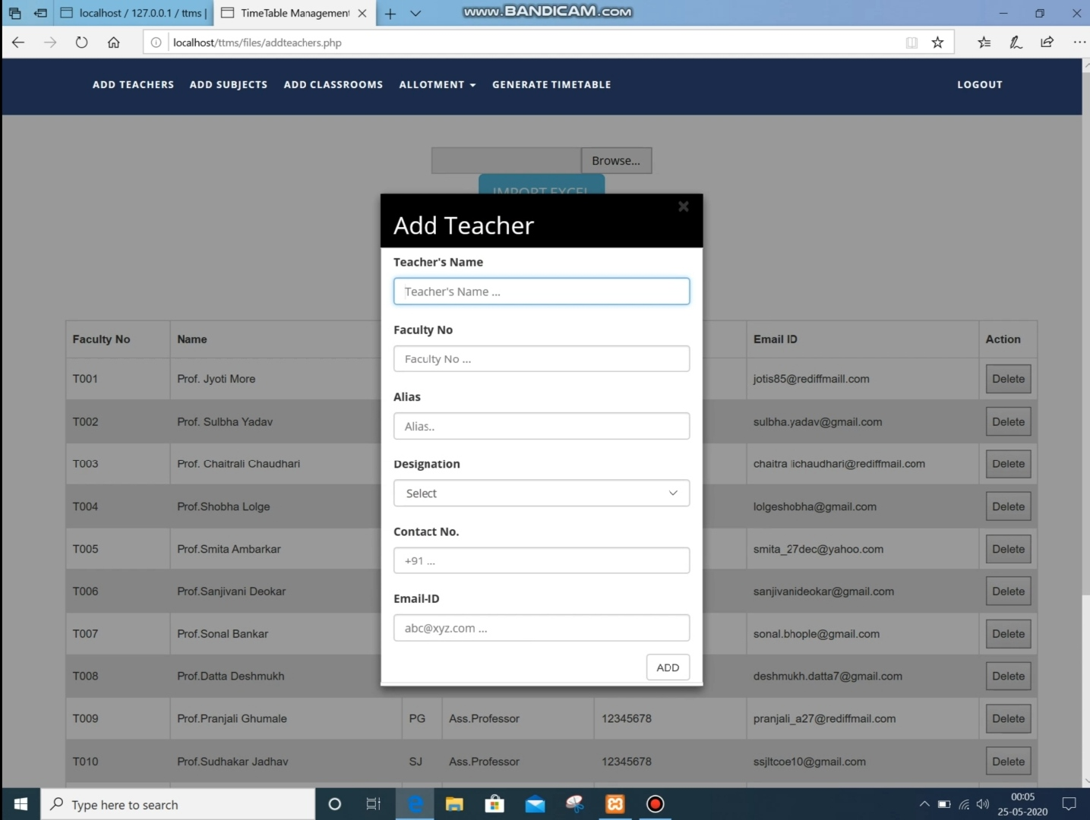

Slide 17
CONCLUSION
University is currently having a Manual Time-Table Generation System Which is very time consuming and even faces clashing. To overcome this problem and provide the university a good automated timetable generation system this project has been taken. The software made i.e. “TIME-TABLE GENERATOR SYSTEM” will be an easy to use and error free system. It will avoid the Clashes and will made time table for all the Classes. It is expected that the project will be completed in this semester, but if due to some problems it is not completed in this semester it will be continued in the next semester till it is completed. Regarding the cost there will be no expenditure in buying the new software to install the system as the university is already having MSSQL and Windows operating system which will be required to use the project. The required hardware is already available with the university.

Slide 18
Thank you!

