Slide 1
Image Processing
And
Computer Vision
Algorithms and Applications

Slide 2
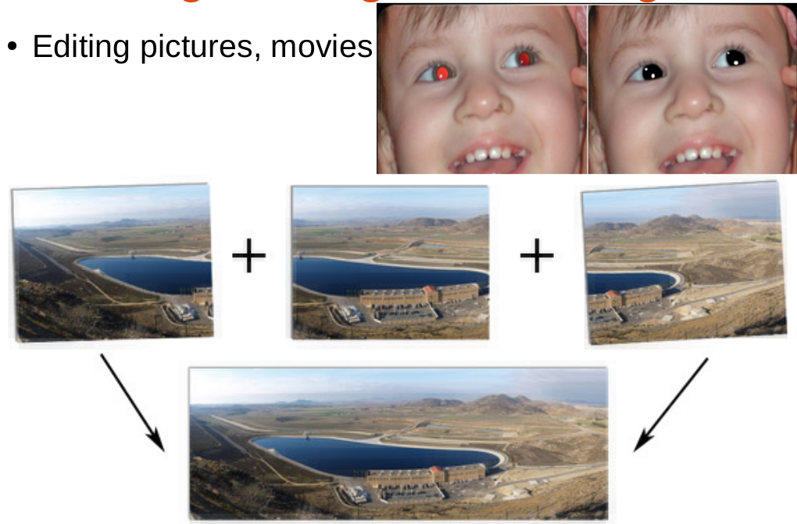
Motivation

Slide 3
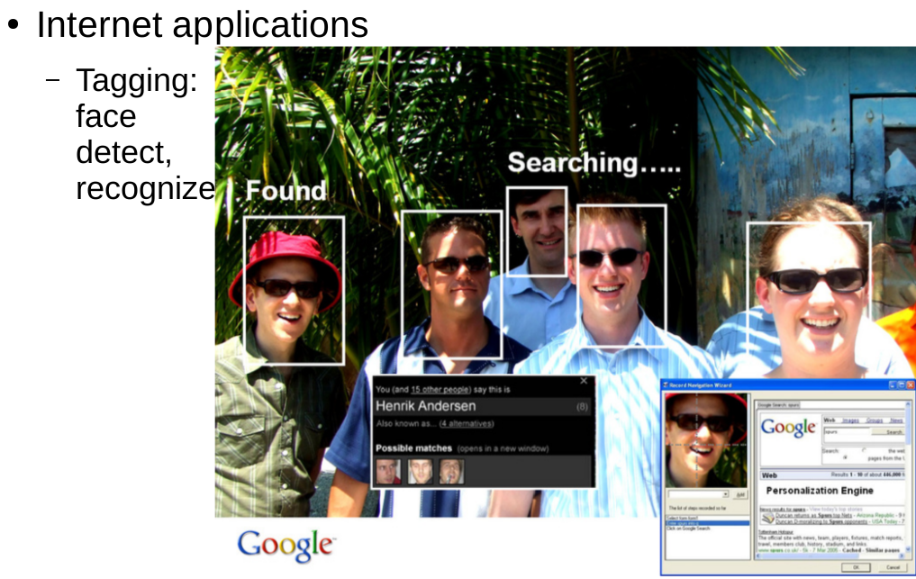
Motivation

Slide 4
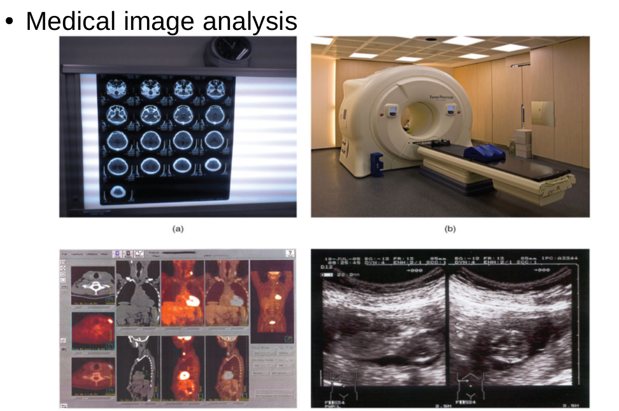
Motivation

Slide 5
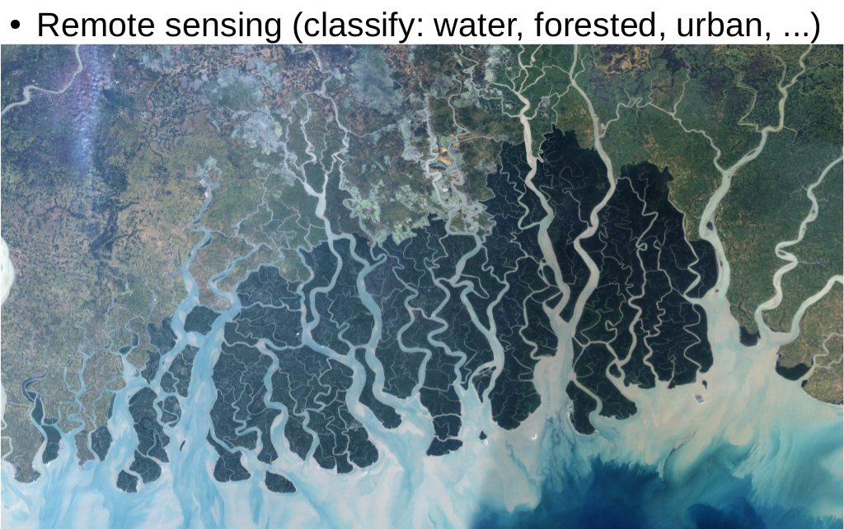
Motivation

Slide 6
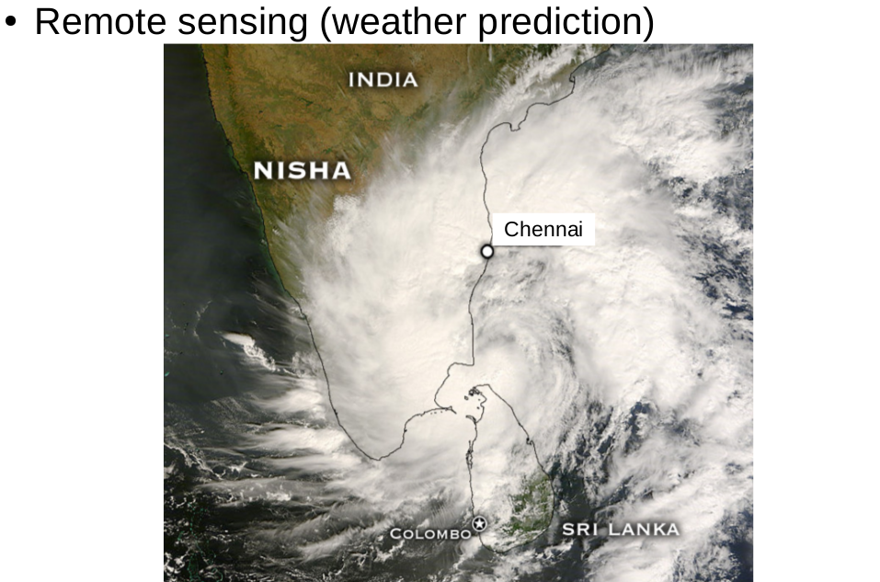
Motivation

Slide 7
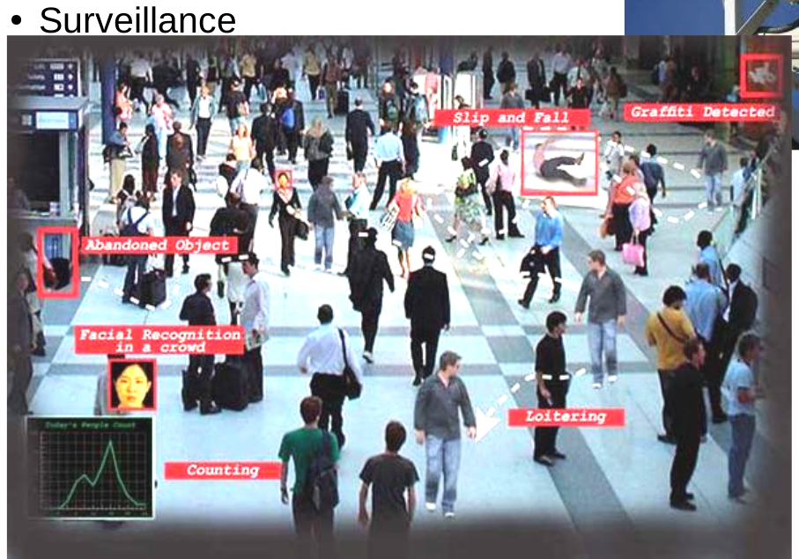
Motivation

Slide 8
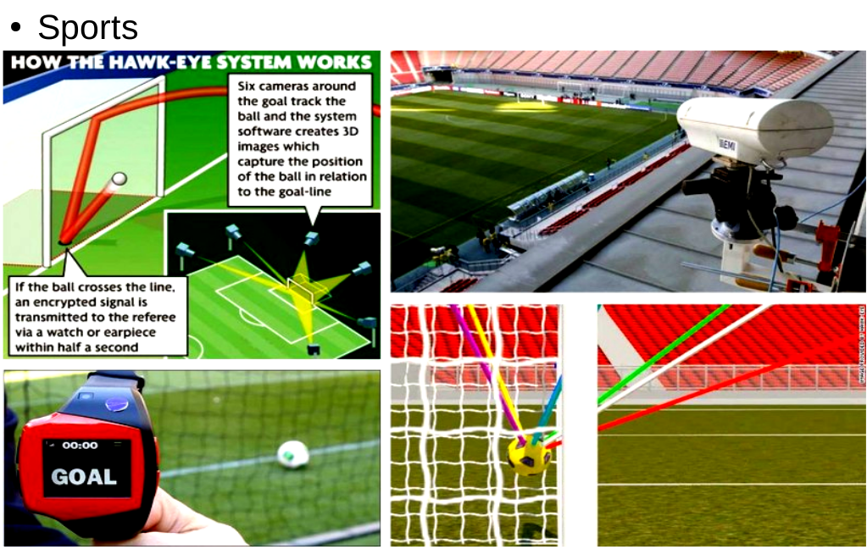
Motivation

Slide 9
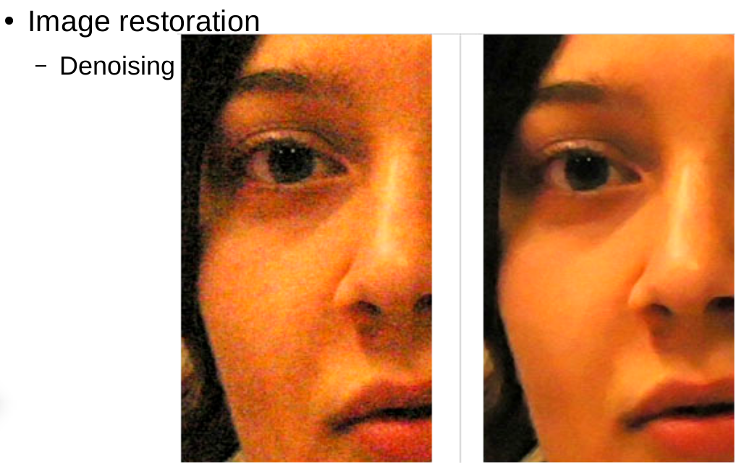
Motivation

Slide 10
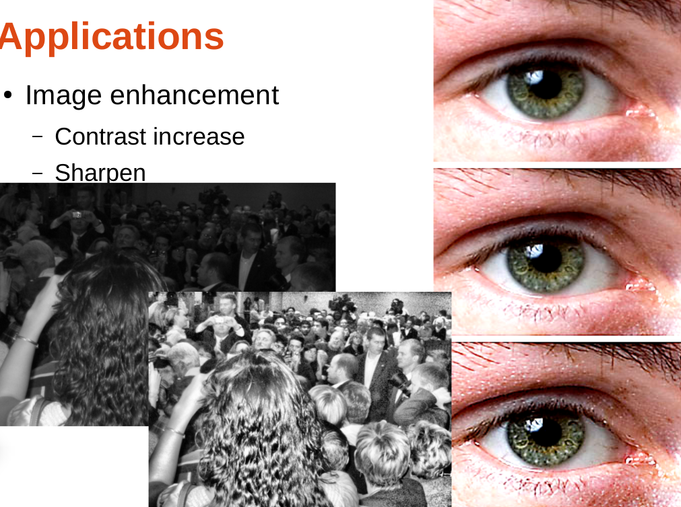
Motivation

Slide 11
Let's Get Started
We will talk about digital images here.
We will be using OpenCV as our toolkit. So along with the concepts I will start refering the OpenCV functions and terminologies as well.
We will have a demo at the end of the session.

Slide 12
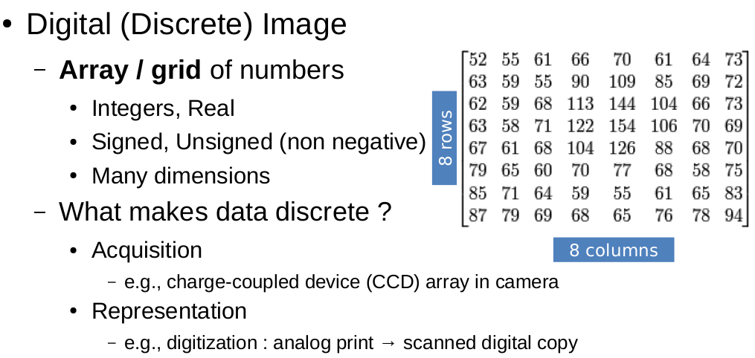
Digital Images
Mat is a data structure to represent such discrete 2D arrays

Slide 13
Contrast and Brightness
Two commonly used point processes are multiplication and addition with a constant
G(x,y) = AF(x,y) + B
The parameters A>0 and B control the contrast and brightness parameters.
Here F(x,y) is the input image and G(x,y) is the output image.

Slide 14
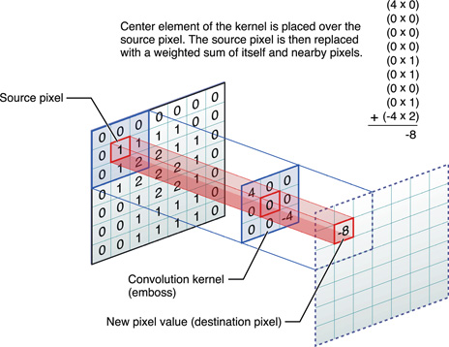
Kernal Operations: Convolution

Slide 15
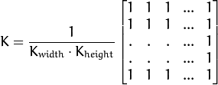
Operation1: Blurring
Blurring or smoothing is one of the most common operations on image using kernal convolution.
Average blur,Gaussian Blur, Median Blur are few commonly used blur kernals.

Slide 16
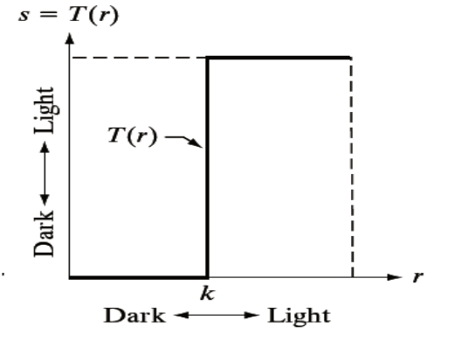
Operation2: Thresholding
Binary and Inverted Binary are two common thresholding avaliable in OpenCV, there is a function named threshold. Thresholding can be understood by this graph.

Slide 17
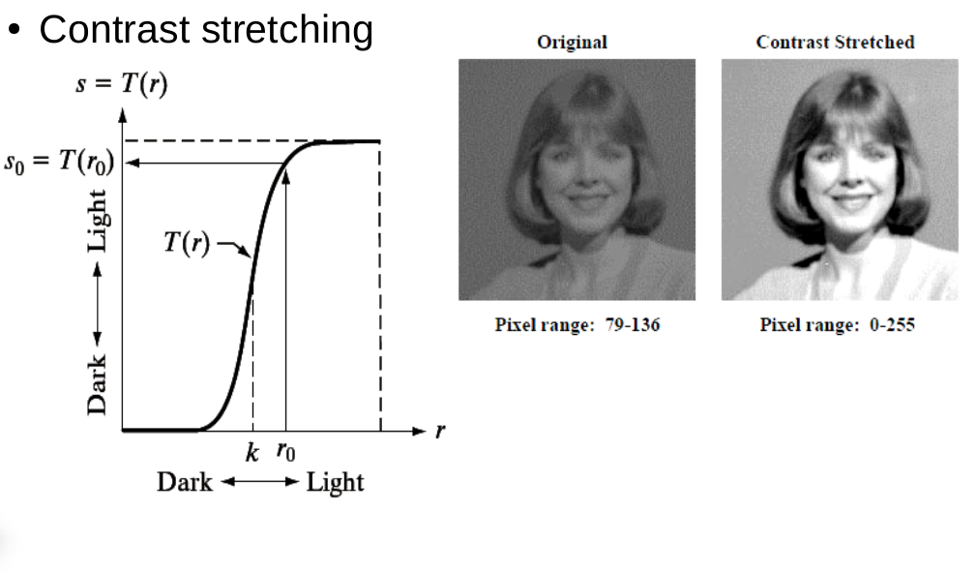
Operation3: Contrast Stretching

Slide 18
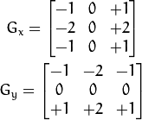
Operation4: Edge Detection
There are many edge detection algorithms, most popular are Sobel, Laplace and Canny, these three have their functions predefined in OpenCV. The basic concept is the same.
When we take the derivative of the image we can find spikes at edges as over there we get a sharp change in intensity.

Slide 19
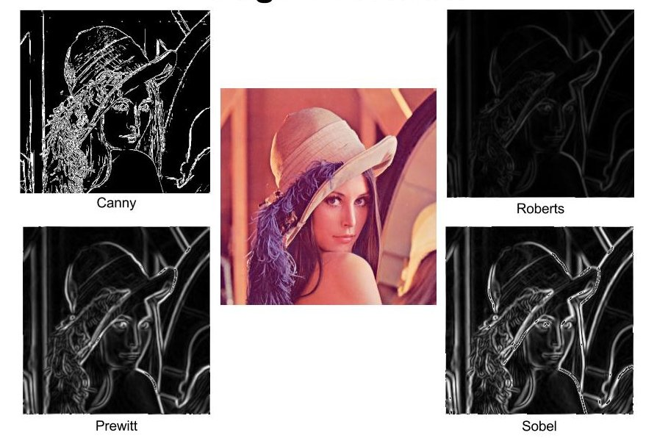
Edge Detection

Slide 20
Any Questions??

Slide 21
Histogram Processing: 1
For image enhancement, histogram based methods are really good.
We will look at a really common and simple method called histogram equilization. In OpenCV we have a function as
equalizeHist( src, dst );
What Histogram Equalization does is to stretch out this range. It takes the values from poplulated areas and give it to unpopulated ones in the spatial(intensity) domain.
For working:
http://en.wikipedia.org/wiki/Histogram_equalization

Slide 22
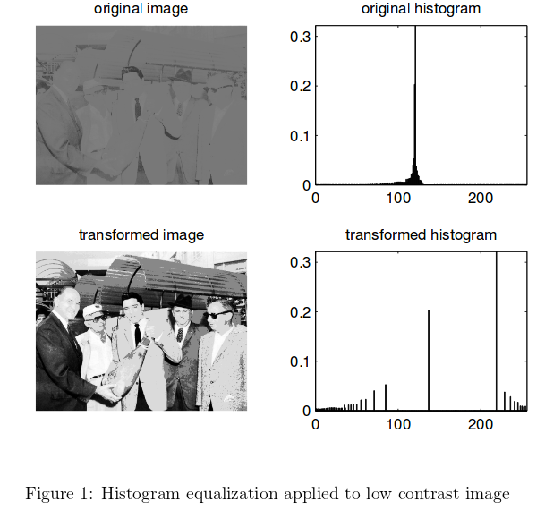
Histogram Processing: 2

Slide 23
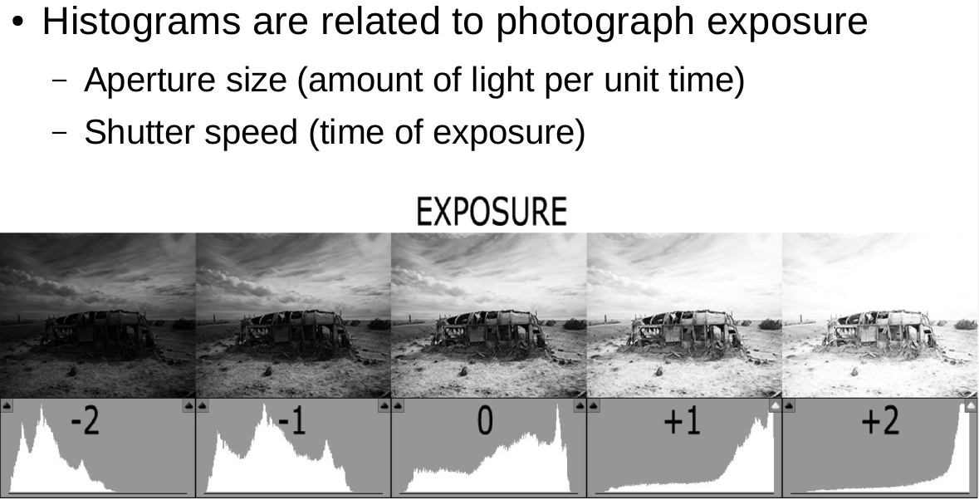
Histogram Processing: 3
Adaptive Histogram Equilization (AHE) and Contrast Limited Adaptive Histogram Equilization(CLAHE) are better versions of this algorithm. If interested you can have a look here.
http://en.wikipedia.org/wiki/Adaptive_histogram_equalization

Slide 24
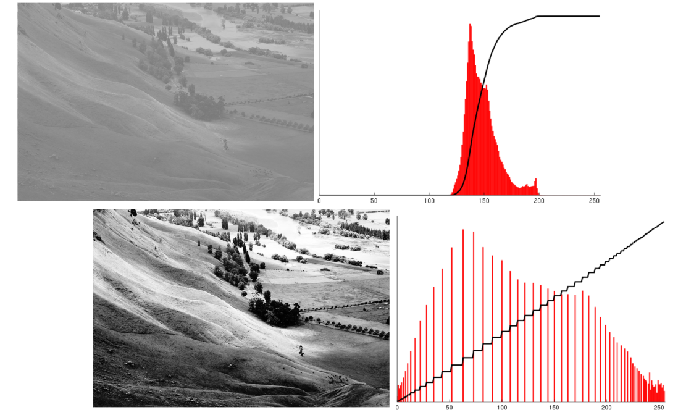
Histogram Processing: 4

Slide 25
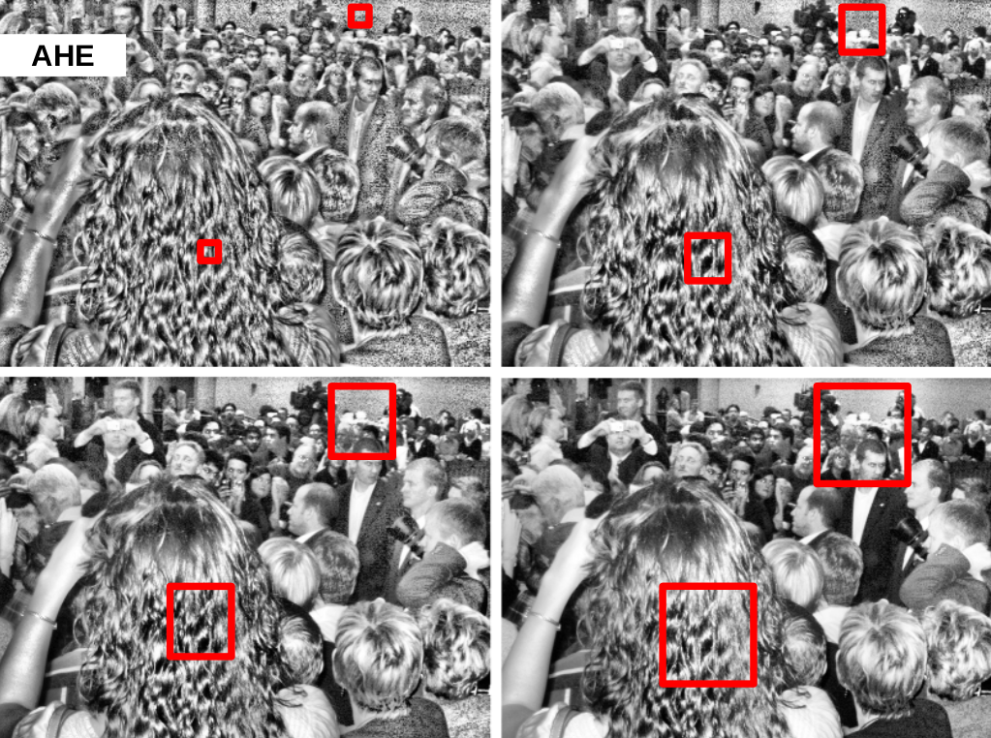
Histogram Processing: 5

Slide 26
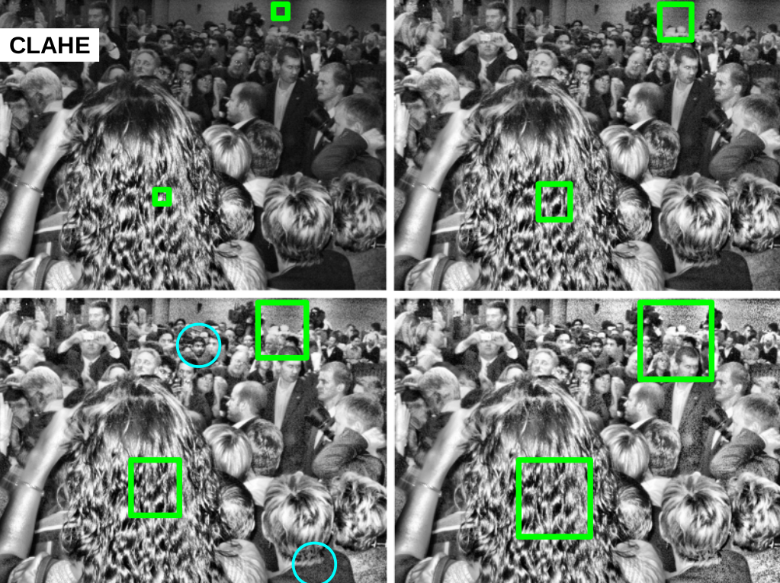
Histogram Processing: 6

Slide 27
Any Questions??

Slide 28
Fuzzy!!
I like to cover fuzzy based image enhancement, so if everyone is willing to do this we will do it.
If we are doing it we can do it after the demo of before it.

Slide 29
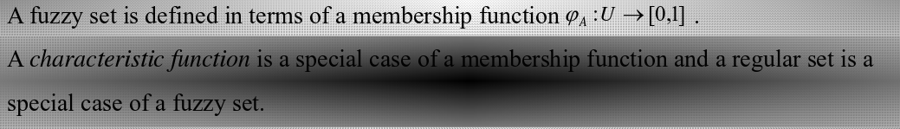
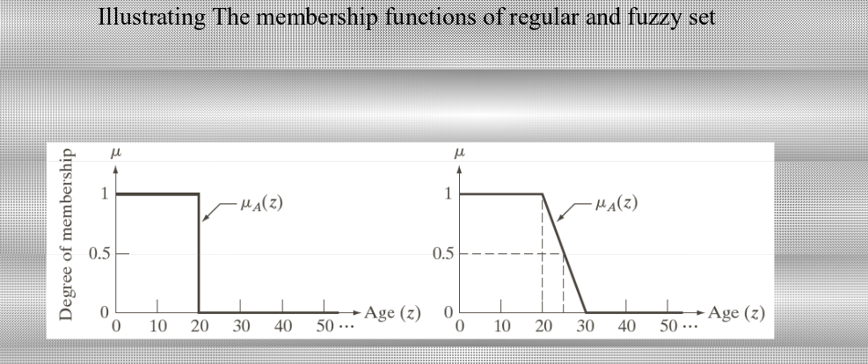
Fuzzy Logic
We will perform contrast enhancement using this method.
It's a set theory method for expressing data more reliastically.

Slide 30
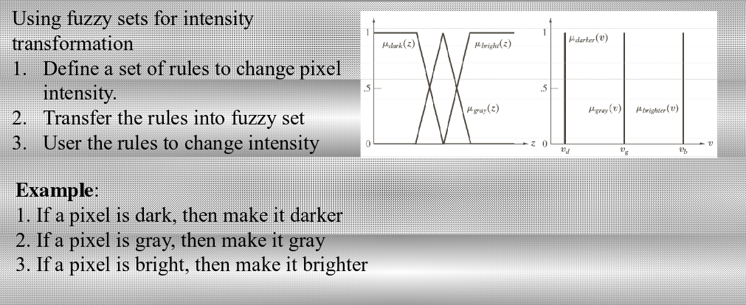
Fuzzy: Contrast Enhancement 1

Slide 31
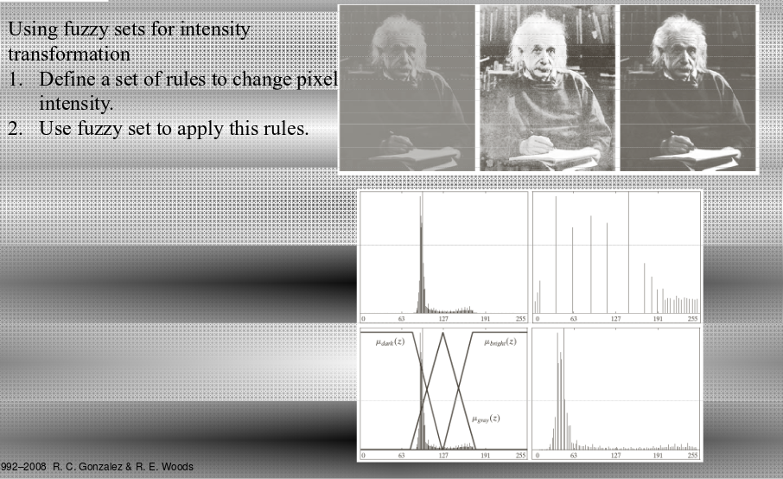
Fuzzy: Contrast Enhancement 2

Slide 32

Things For Demo : 1
Basic definition is given by the function
Area (for binary images) or sum of grey level (for greytone images): M₀₀
Centroid: { x, y } = {M₁₀/M₀₀, M₀₁/M₀₀ }
Useful in tracking applications, how to use moment functions will be explained in demo.

Slide 33
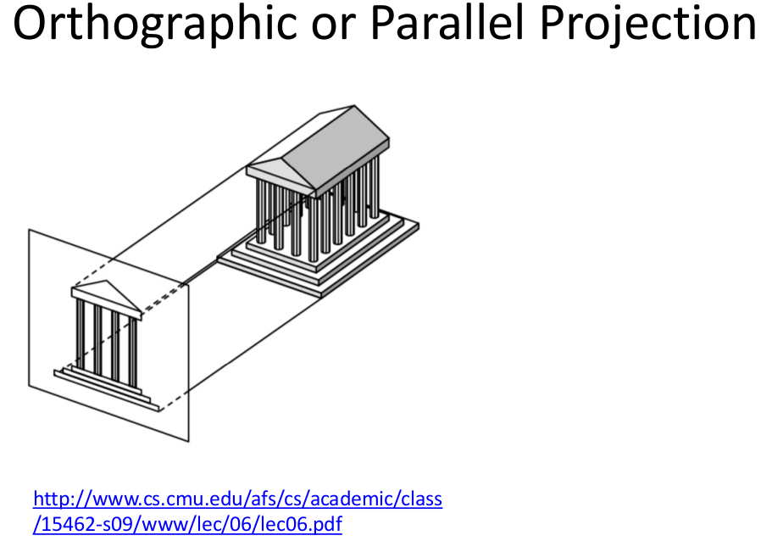
Things For Demo : 2

Slide 34
Pendulum
The folder given to you will have a video of a makeshift pendulum that I recorded yesterday in orthographic projection. We will find the length of this pendulum and hence the time period.
Given:
> 4 screenshots of the video instances.
> The breadth of the image is 480 in pixels and 11 inches in world (see the scale in the side of the video).

Slide 35
Pendulum
Flow of the code:
> We read the 4 screenshots.
> We process each of them sequentially with techniques we have learned in a logical fashion.
> We get the center of the hanging ball in each image say a1,a2,a3,a4.
> use SOT to find r for each 4C3 combinations and average to get r_avg in pixels.
> then use 11inches/480 pixels = length/r_avg.
>Voila!

Slide 36
Thank You

