Slide 1
Notes:
Langweiliger Typ trinkt

Slide 2


Meet Drink 4 Fit
Marius Heil, Benjmin Zaiser, Julia Sandrock, Marita Klein
Notes:
MEET unsere Innovation

Slide 3
Notes:
Handy 1: Wenig Trinker, wird ans Trinken erinnert
Handy 2: Challenge-Typ, Party
Bosch-Cloud: http://drink-4-fit.apps.bosch-iot-cloud.com/index.html

Slide 4
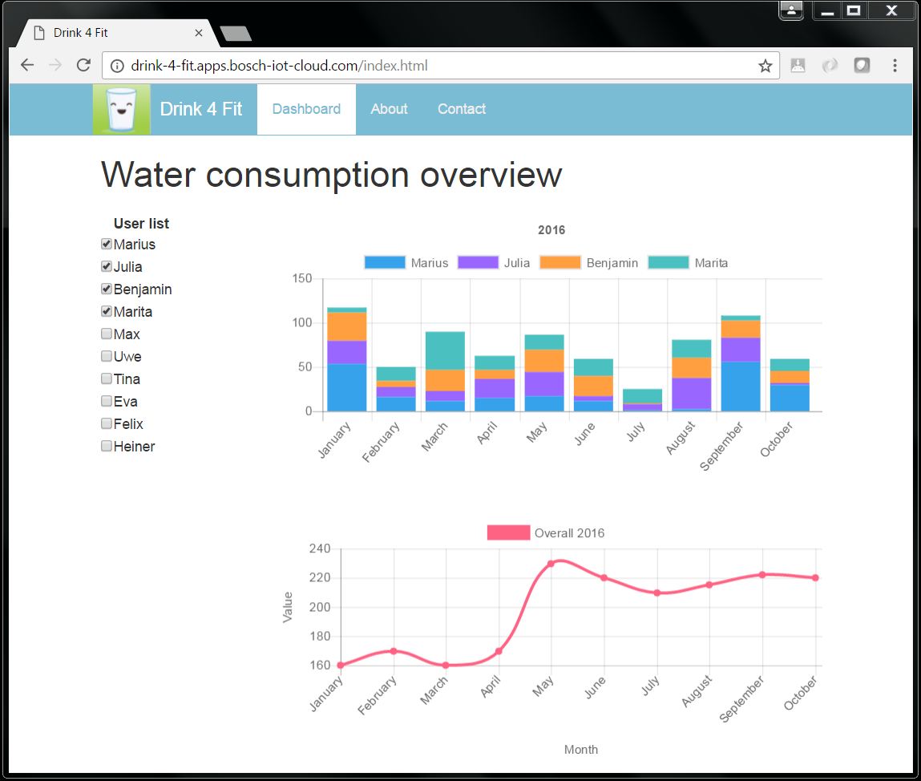

Slide 5
Drink 4 Fit
Marius Heil, Benjmin Zaiser, Julia Sandrock, Marita Klein

Slide 6


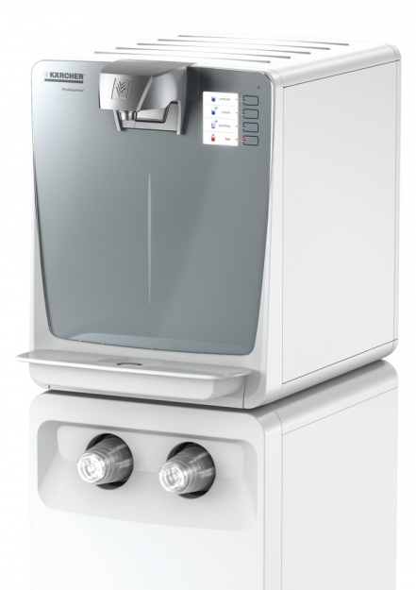
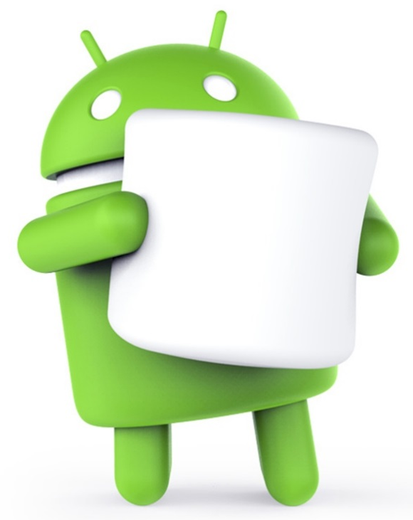

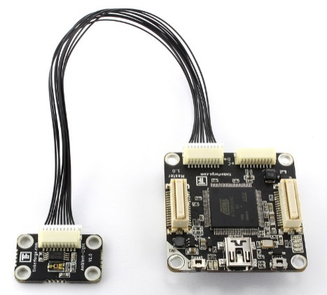

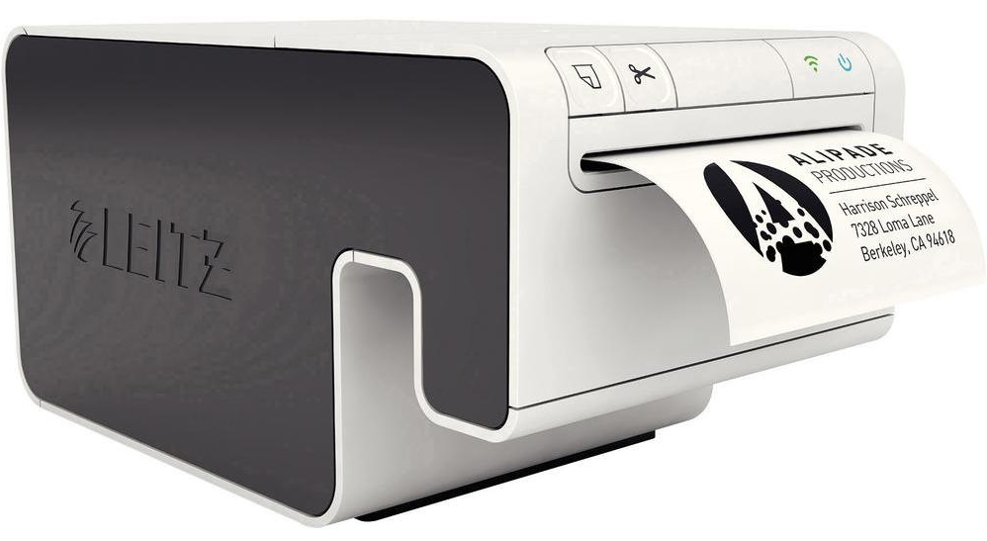



Slide 7

REST
Bluetooth
SSH
Socket

Slide 8

REST
Bluetooth
SSH
Socket

Slide 9

REST
Bluetooth
SSH
Socket

Slide 10


REST
Bluetooth
SSH
Socket

Slide 11


REST
Bluetooth
SSH
Socket

Slide 12
REST
Bluetooth
SSH
Socket

Slide 13
REST
Bluetooth
SSH
Socket

Slide 14
Drink 4 Fit
Marius Heil, Benjmin Zaiser, Julia Sandrock, Marita Klein

Slide 15
