Slide 1
Notes:
Langweiliger Typ trinkt

Slide 2


Meet Drink 4 Fit
Marius Heil, Benjmin Zaiser, Julia Sandrock, Marita Klein
Notes:
MEET unsere Innovation

Slide 3
Notes:
Handy 1: Wenig Trinker, wird ans Trinken erinnert
Handy 2: Challenge-Typ, Party
Bosch-Cloud: http://drink-4-fit.apps.bosch-iot-cloud.com/index.html

Slide 4
Drink 4 Fit
Marius Heil, Benjmin Zaiser, Julia Sandrock, Marita Klein

Slide 5


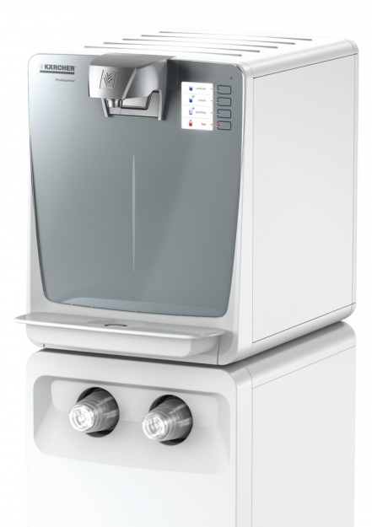
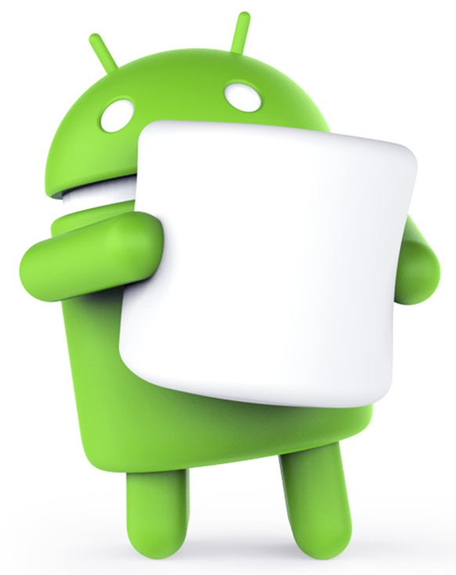

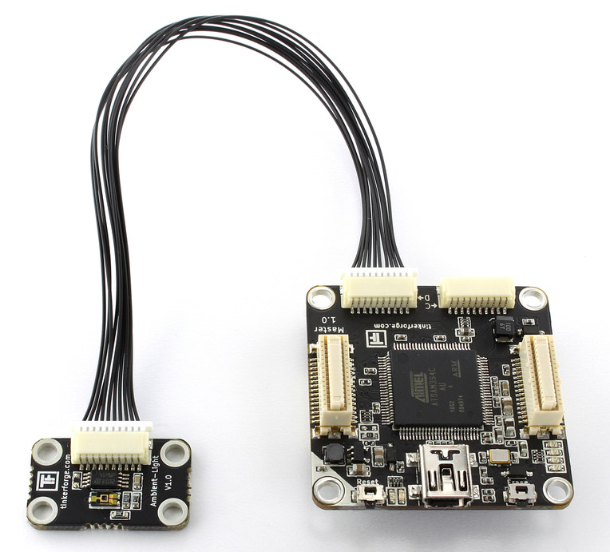

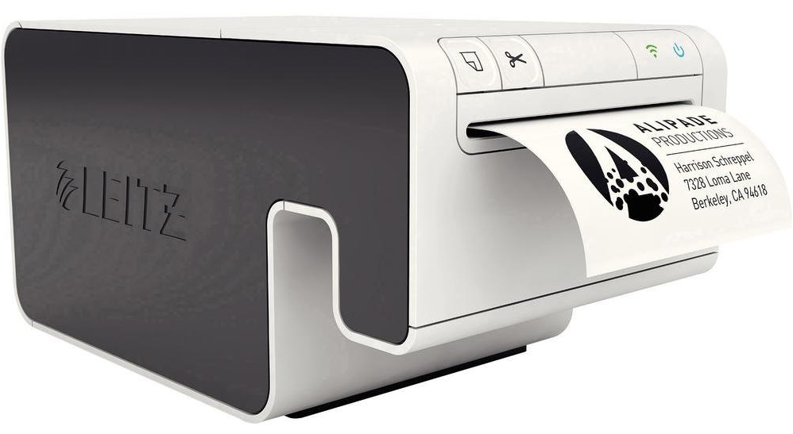



Slide 6
REST
Bluetooth
SSH
Socket

Slide 7
REST
Bluetooth
SSH
Socket

Slide 8
REST
Bluetooth
SSH
Socket

Slide 9
REST
Bluetooth
SSH
Socket

Slide 10
REST
Bluetooth
SSH
Socket

Slide 11
REST
Bluetooth
SSH
Socket

Slide 12
REST
Bluetooth
SSH
Socket

Slide 13
Drink 4 Fit
Marius Heil, Benjmin Zaiser, Julia Sandrock, Marita Klein

