Slide 1

IMPROVEMENT OF PERFORMANCE OF DISTRIBUTED SYSTEMS
Under guidance of
Mrs.Manjula Pawar
TEAM NO - DA6
Shraddha Hegde 01fe19bcs081
Prem Gumathanavar 01fe19bcs083
Ridham Sawhney 01fe19bcs088
Kavya Maremmagol 01fe19bcs165

Slide 2
PROBLEM STATEMENT
Design and develop a AI based algorithm for Improving performance of distributed systems for selection of miners.
OBJECTIVES
To design an algorithm which is efficient than PoW and PoS.
To find best miner using decision tree technique.
To simulate blockchain to create dataset.
To decrease transaction time

Slide 3
Why not DNN?
Repeated training of the model is required which in turn adds more resources .
Training large data again again make it inefficient.
Iterative training is there in dnn , in addition of every node there is requirement to train the model again.
Why not POW
WHY NOT EXISTING ALGORITHMS
Proof-of-work centers on the computational capabilities needed to solve mathematical problems in authenticating blockchain transactions.
Powerful computers inherently consume a lot of energy
The machines require effective heat management or cooling system to remain operational and prevent overheating, as well as associated damages to hardware components due to internal heat build-up.

Slide 4
WHY NOT EXISTING ALGORITHMS
Why not PoS
Here the concern is about helping the rich get richer.
Because it requires to stake cryptocurrencies to participate, and because the higher the stake means the better chances of becoming the chosen validator and earning from doing so, the more cryptocurrencies an individual can afford to buy, the more cryptocurrencies he or she can stake and earn.

Slide 5
For the first 1000 miners
We are designing a basic algorithm which will set a priority variable which will change dynamically and fully responsible to choose a miner.
Beyond 1000 miners
Dataset along with priority parameter is given as input to decision tree.
Now Miner who has the maximum priority variable is selected.
Age variable of selected miner will be changed to 0.
ALGORITHM DESIGN

Slide 6
Basic Info: -- A = Efficiency of the miner
-- B = Inefficiency with impact of faulty block created -- Age = blocks created in interval of miner not selected
-- Fault = Number of faulty blocks/ total number of blocks mined -- Average time = Total time taken to mine all blocks/ total number of blocks A = Number of blocks .
Average transaction time
B = 2^{Fault} Priority = Age + A . Bx10⁵
ALGORITHM DESIGN

Slide 7
ALGORITHM DESIGN
Decision tree is the most powerful and popular tool for classification and prediction.
A Decision tree is a flowchart like tree structure, where each internal node denotes a test on an attribute, each branch represents an outcome of the test, and each leaf node (terminal node) holds a class label.
The strengths of decision tree methods are:
Decision trees are able to generate understandable rules.
Decision trees perform classification without requiring much computation.
Decision trees are able to handle both continuous and categorical variables.
Decision trees provide a clear indication of which fields are most important for prediction or classification.

Slide 8
ALGORITHM DESIGN
Miner
Decision Tree
Age
<10
>10
No
No of blocks >10
No of blocks <10
Efficiency
No of blocks > 5
No of blocks < 5
>25%
<25%
Efficiency
Yes
Yes
increase average time with 2 sec penalty
>10%
<10%
Yes
No
No

Slide 9
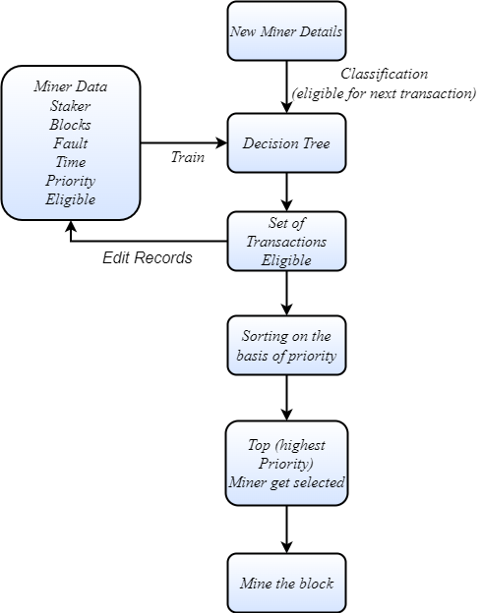
SYSTEM MODEL

Slide 10
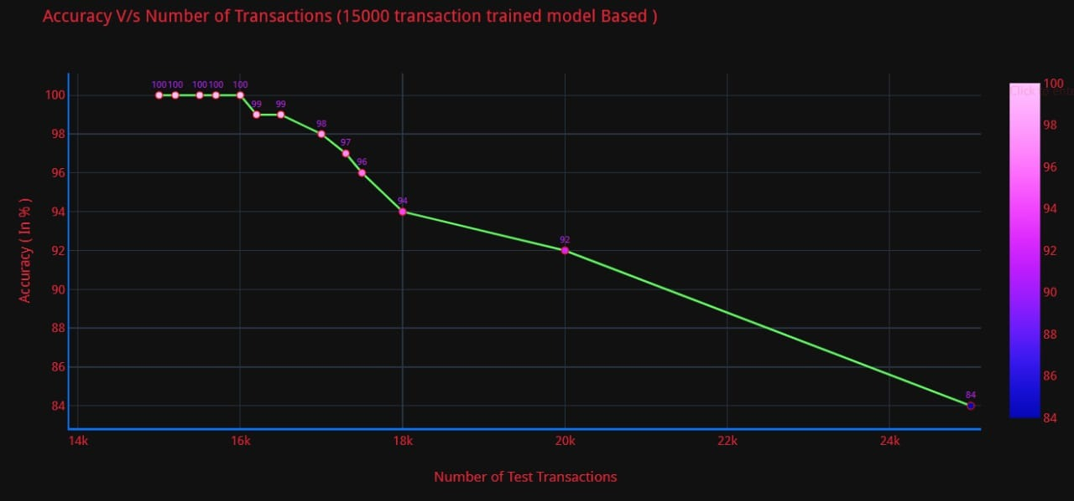
^{Accuracy v/s Number of blocks}
IMPLEMENTATION RESULTS
Here we can observe that , as the dataset increases accuracy decreases

Slide 11
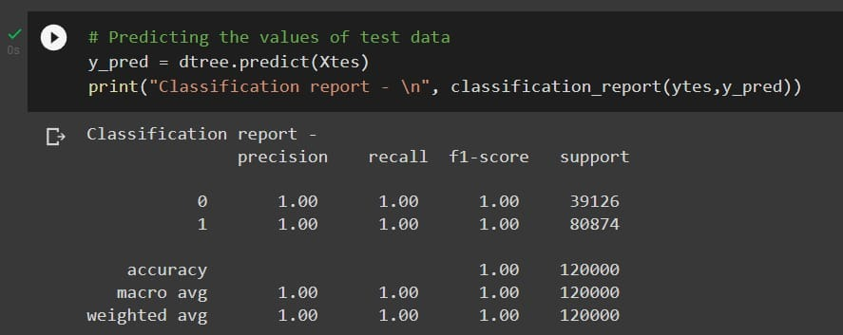
IMPLEMENTATION RESULTS
Input:15000
Output:16000

Slide 12
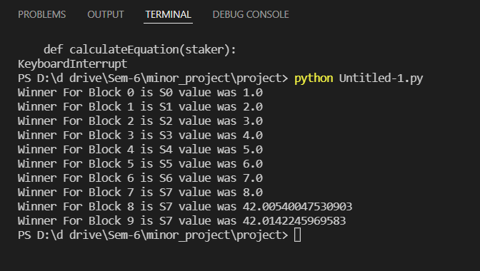
Selection of minor using our algorithm
IMPLEMENTATION RESULTS

Slide 13
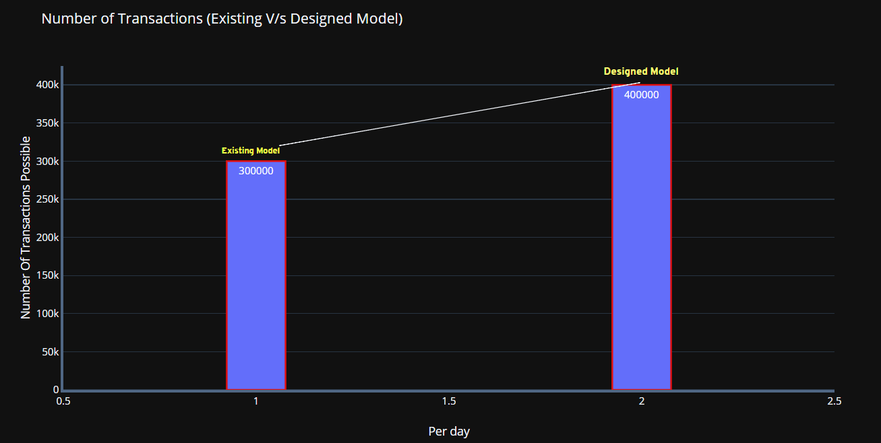
IMPLEMENTATION RESULTS

Slide 14
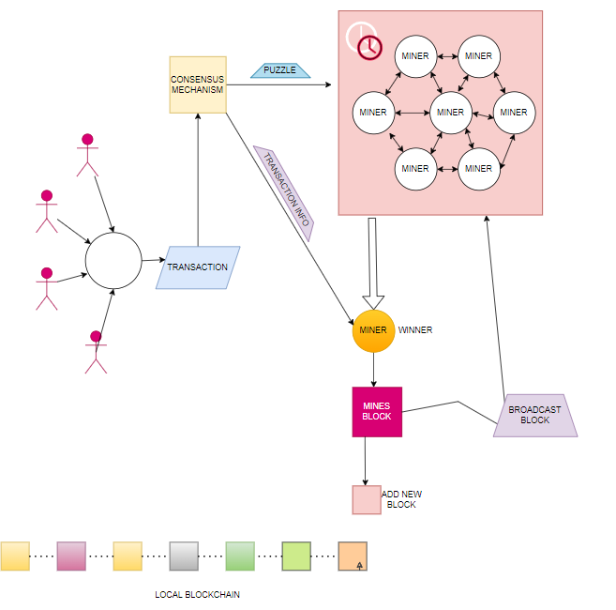
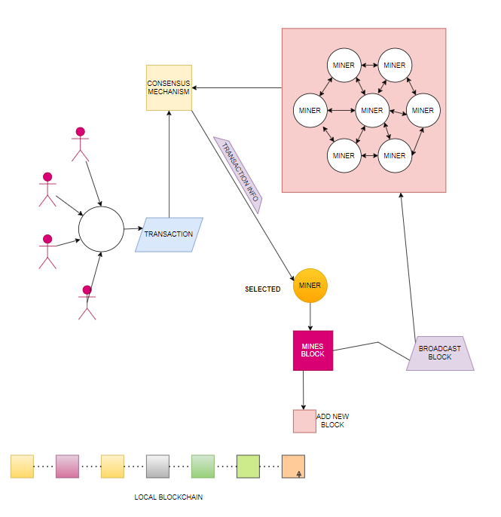
IMPLEMENTATION RESULTS
Existing model
Proposed model

Slide 15
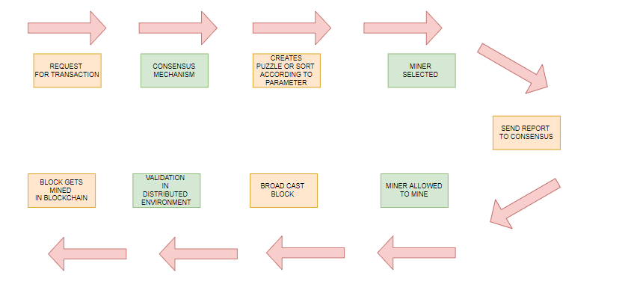
IMPLEMENTATION RESULTS
Existing model
Proposed model

Slide 16
THANK YOU

