Slide 1
UPIShield
A Database System for UPI Payments and Fraud Monitoring
24CS202T Database Management Systems | MySQL 8.0 | Python front end
Team: Member 1 | Member 2 | Member 3
Notes:
Introduce the team and the project: a relational database for UPI payments with a rule-based fraud-monitoring layer, implemented in MySQL with a Tkinter front end.

Slide 2
The problem: payments are instant, so fraud is too
UPI moves money between bank accounts in seconds, 24x7. Once a fraudulent payment succeeds, the money is usually gone. Banks therefore need a database that records every payment reliably and checks it against fraud rules the moment it is written.
1
Consistency
A debit without its matching credit must never be stored, even under heavy concurrency.
2
Detection
Project goal
Suspicious patterns (bursts, night-time transfers, new devices) must be flagged automatically.
Model the UPI ecosystem in a fully normalized MySQL database and enforce payment rules, fraud checks, auditing and access control inside the database itself.
3
Access
Support staff, analysts and auditors each need different, limited views of sensitive data.
Notes:
Explain why UPI is a good DBMS case study: high volume, money must be consistent (ACID), and fraud has to be caught at write time - which maps directly onto transactions, constraints and triggers.

Slide 3
Objectives and use cases
Objectives
Customers
Merchants
Design an ER model with specialization, a weak entity and a recursive relationship
Map it to a relational schema normalized up to 3NF (checked for BCNF)
Process payments as ACID transactions with row-level locking
Detect fraud with triggers and keep a complete audit trail
Protect data with roles, security levels, views and encryption
Register, open accounts, link UPI IDs, pay and raise disputes
Collect P2M payments and receive daily settlements
Fraud analysts
Auditors and public
Review alerts, confirm fraud or mark false positives
Audit trail for auditors, anonymous statistics for the public
Notes:
Objectives map one-to-one to guideline points 2-5. The four user groups become the four security levels later in the deck.

Slide 4
Scope and technology stack
Component | Tool
Database | MySQL 8.0.31+ (InnoDB)
SQL client | MySQL Workbench
ER diagram | Graphviz / draw.io
Data loading | LOAD DATA INFILE
Scheduling | MySQL Event Scheduler
Front end | Python 3, Tkinter
Connector | mysql-connector-python
In scope
Out of scope
Customers, banks, branches, accounts, UPI IDs
P2P and P2M payments
Merchants and daily settlement
Fraud rules, alerts, disputes
Roles, encryption, audit log
Reports and statistics
Real bank / NPCI connectivity
Machine-learning detection
Mobile app
Distributed or NoSQL storage
Notes:
Everything core runs in MySQL, which keeps the project within the syllabus. The front end is the optional bonus.

Slide 5
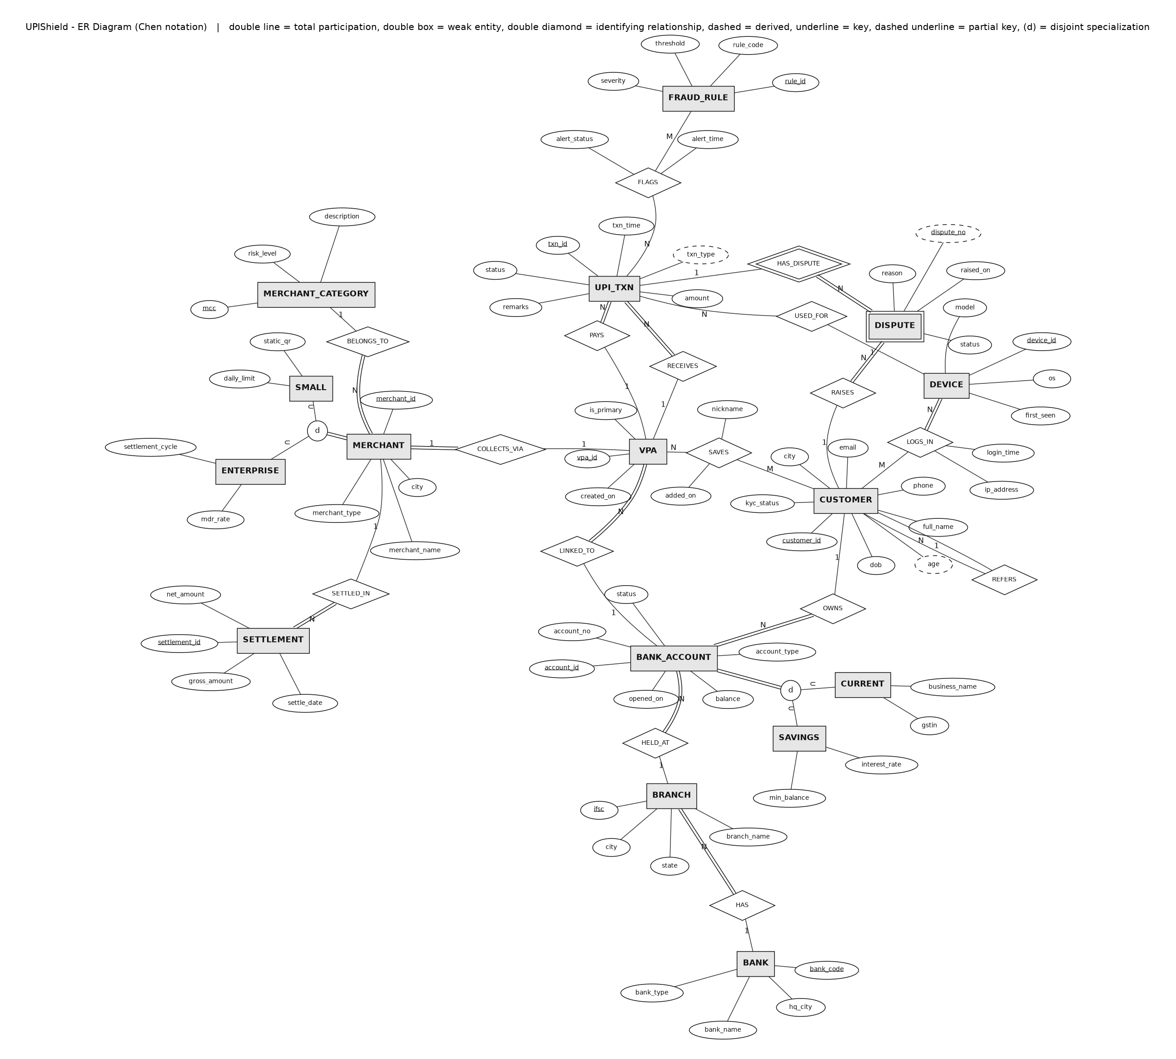
ER diagram (Chen notation)
1
16 entity sets, 16 relationships
Including M:N relationships with attributes: LOGS_IN, SAVES and FLAGS.
2
Disjoint, total specialization
BANK_ACCOUNT into SAVINGS / CURRENT; MERCHANT into SMALL / ENTERPRISE.
3
Weak entity
DISPUTE is identified by its transaction plus dispute_no (identifying relationship HAS_DISPUTE).
4
Recursive relationship
CUSTOMER REFERS CUSTOMER (referral programme).
5
Participation and derived attributes
Double lines show total participation; age and txn_type are derived.
Notes:
Walk through the notation: rectangles are entities, diamonds relationships, ellipses attributes, underlined attributes are keys. Point out the specialization circles marked d, the double box for DISPUTE and the double lines for total participation. Full-size image: docs/erd.png.

Slide 6
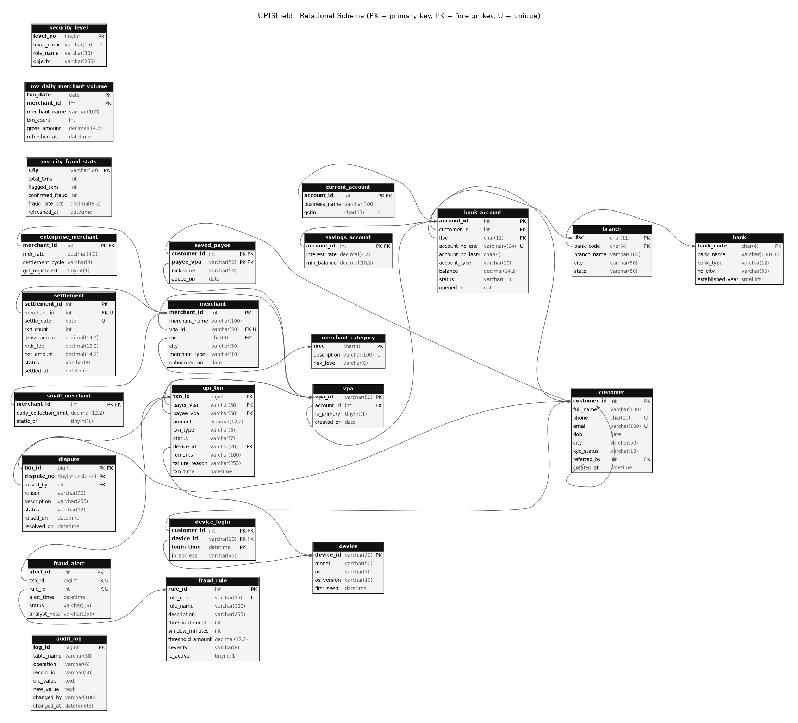
Relational schema and integrity constraints
20
23
tables
foreign keys
41
7
CHECK constraints
views
Specializations mapped as one table per subclass sharing the superclass key
Each M:N relationship became its own table (device_login, saved_payee, fraud_alert)
Every foreign key has an explicit ON UPDATE / ON DELETE action, chosen for the cascade demos
Domains enforced with CHECK and REGEXP: phone, IFSC, GSTIN and UPI ID formats
Notes:
Schema generated from information_schema, so it matches the database exactly. Full data dictionary: docs/data_dictionary.md.

Slide 7
Normalization: from one report sheet to 3NF / BCNF
UNF
1NF
2NF
3NF
Flat UPI alert report
Atomic values
Remove partial dependencies
Remove transitive dependencies
One sheet mixing transaction, customer, bank, merchant and device data. alert_rules is multi-valued.
One row per (transaction, rule). Key becomes (txn_id, rule_code).
txn_id determines the transaction data; rule_code determines rule data. Split into 3 relations.
Chains such as txn_id to payer_vpa to account_id to customer_id split into 11 relations.
Verified
13 functional dependencies listed, closures computed with Armstrong's axioms, minimal cover derived. Every split is lossless (common attribute is a key) and dependency-preserving. All final relations are also in BCNF, because phone and vpa_id are candidate keys.
Notes:
Details, sample rows, the FD list and each decomposition step are in docs/normalization.md. Viva point: txn_type is a stored derived value kept consistent by a trigger.

Slide 8
SQL implementation covers every guideline item
Category | What is demonstrated | File
DDL | CREATE with all constraints, ALTER, RENAME, TRUNCATE, DROP | q01
DML | INSERT; UPDATE and DELETE, each with and without cascade | q02
DCL | GRANT / REVOKE on roles, users, columns, WITH GRANT OPTION | q03
TCL | COMMIT, SAVEPOINT, ROLLBACK, autocommit, implicit commit | q04
DQL | WHERE, aggregates, IN / LIKE / DISTINCT, ORDER BY / LIMIT / OFFSET, GROUP BY / HAVING | q05
Joins and sets | Inner, left, right, full (emulated), cross, natural, self; UNION, INTERSECT, EXCEPT, ANY, ALL | q05
Subqueries | Scalar, IN, correlated, EXISTS / NOT EXISTS, derived table, CTE | q06
Views | Updatable view WITH CHECK OPTION, aggregate views, materialized views | q07
Programs | 6 functions, 8 procedures, 12 triggers | q08
Notes:
Every query file runs end to end; statements marked EXPECTED ERROR fail on purpose to prove a constraint works.

Slide 9
ACID payments: inside sp_transfer
1
Validate the UPI IDs and the amount
Without locking: lost update
Two sessions both read 10,000 and both write. Final balance is 8,000 instead of 7,000. The precedence graph has a cycle, so the schedule is not conflict-serializable.
2
START TRANSACTION and lock both accounts (FOR UPDATE, ascending id)
3
Check status and minimum balance
4
INSERT the payment; triggers run the daily limit and fraud rules
With SELECT ... FOR UPDATE
5
Debit payer, credit payee, COMMIT
The second session waits for the exclusive lock, then reads 9,000. Final balance 7,000. The schedule is equivalent to the serial order T1, T2.
6
On any error: ROLLBACK and log a FAILED attempt
Notes:
Demonstrate live with queries/concurrency/session_A.sql and session_B.sql in two Workbench tabs. Locking in a fixed order prevents deadlocks between opposite transfers.

Slide 10
Rule-based fraud monitoring with triggers
Velocity
5+ payments from one UPI ID within 10 minutes
High value, new payee
Rs. 50,000+ to someone never paid before (critical)
Night high value
Rs. 20,000+ between midnight and 5 AM
New device
Rs. 10,000+ from a device first seen under 24 hours ago
High-risk merchant
Rs. 25,000+ to crypto, gaming or jewellery merchants
49 alerts confirmed as fraud, 9 marked false positive, 10 still under review
Notes:
trg_txn_bi enforces the Rs. 1,00,000 daily limit and derives P2P/P2M; trg_txn_ai evaluates the five active rules after each successful payment. Rules live in a table, so thresholds can change without changing code. A sixth rule is stored but inactive.

Slide 11
Security: four clearance levels
Discretionary access control
4 SECRET
Roles granted to users; each role inherits the level below it.
Auditor: Audit trail, decryption key
Mandatory access control (simulated)
3 CONFIDENTIAL
security_level table plus per-level views; no reading up.
Fraud analyst: Transactions, alerts, disputes
Encryption
Account numbers stored with AES_ENCRYPT; SHA2 for one-way hashes.
2 INTERNAL
Support desk: Masked customer and account view
Audit trail
Triggers log every balance, status, KYC and alert change.
1 PUBLIC
Statistical database
Dashboard: Aggregate city statistics only
Public view hides groups smaller than 5 customers.
Notes:
Show the denial live: log in as support_riya and try SELECT * FROM upi_txn - access is denied, but v_support_customer works.

Slide 12
Views and materialized views
View
Materialized view (emulated)
Stored query, re-computed on every read
Stored result, refreshed on demand or schedule
Always current
No extra storage
Used for the role-based external level
v_active_savings_accounts is updatable WITH CHECK OPTION
Fast to read, can be stale
MySQL has no native support: summary table + refresh procedure
EVENT refreshes it every hour
Staleness shown live in q07
Notes:
7 views in total. The two materialized views are mv_daily_merchant_volume and mv_city_fraud_stats, refreshed by sp_refresh_all_mv.

Slide 13
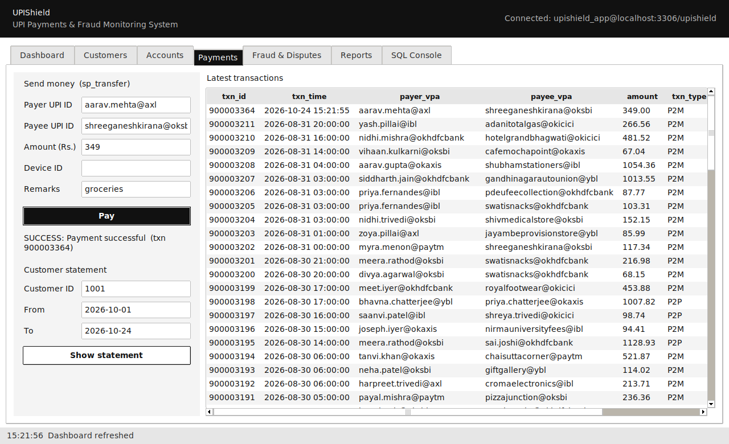
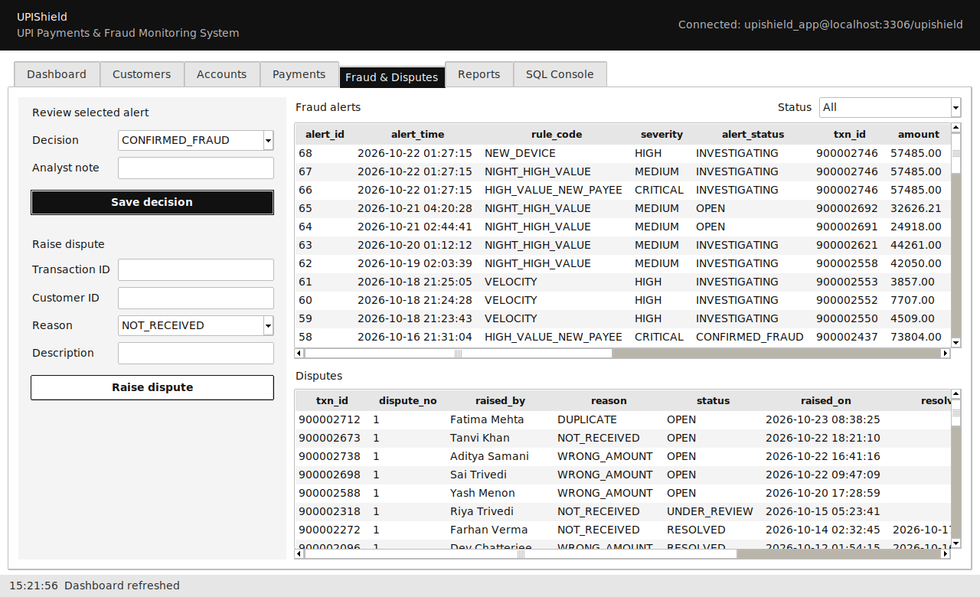
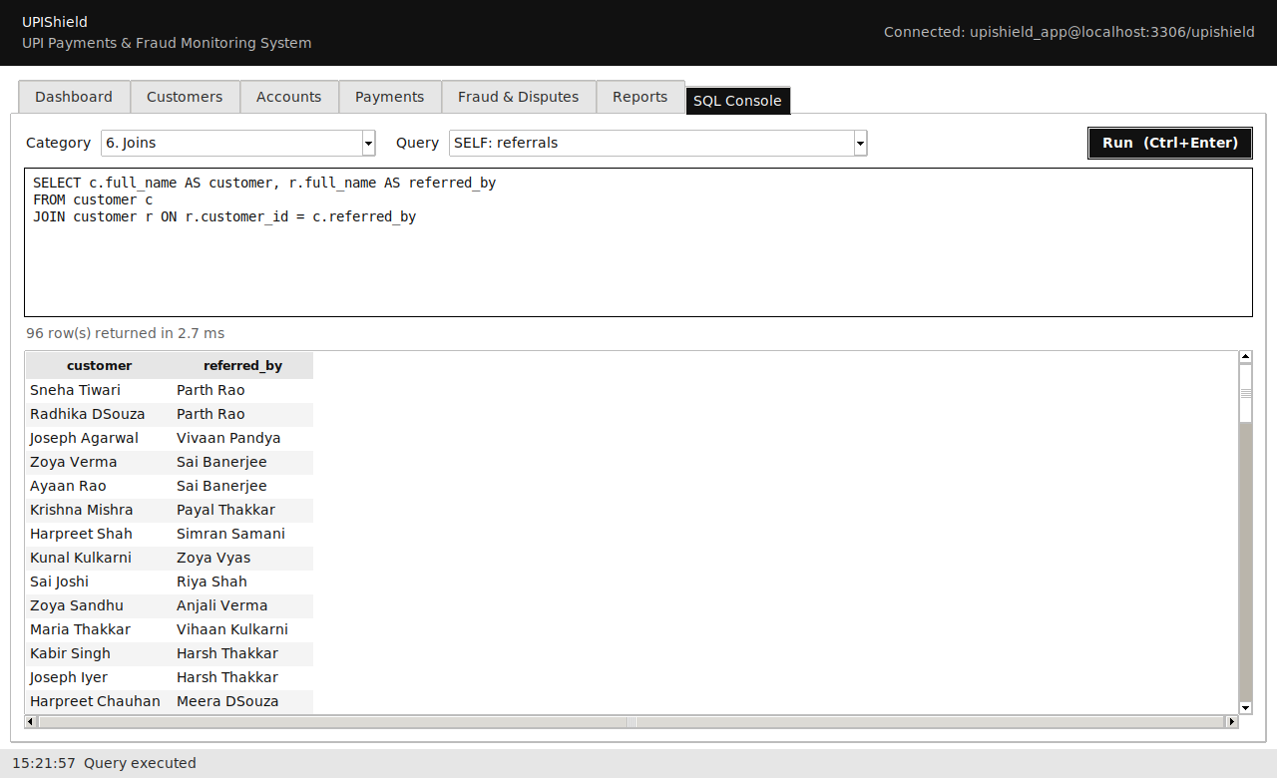
Front end: forms on top of the procedures
Python, Tkinter and mysql-connector. Seven tabs: dashboard, customers, accounts, payments, fraud and disputes, reports, SQL console. Every action calls a stored procedure or view, so all rules stay inside the database.
Notes:
Live demo order: pay a merchant, then pay Rs. 60,000 to a new payee and switch to the Fraud tab to show the critical alert. Finish with the SQL console running a join from the catalog.

Slide 14
Results
8,900+
3,200+
68
rows of data
UPI transactions
fraud alerts raised by triggers
12
8
6
triggers
stored procedures
functions
Notes:
All scripts rebuild the database from scratch in a few seconds with one command (rebuild.bat or sql/00_rebuild.sql).

Slide 15
Conclusion
UPIShield keeps payments consistent, catches suspicious activity at write time and limits who can see what - all inside MySQL.
Future scope: ML-based risk scores, real-time notifications, a mobile client, and partitioning upi_txn by month.
Notes:
Close by inviting questions. Common viva topics: why triggers instead of CHECK, how the materialized view is emulated, why the schedule without locks is not serializable.

