Slide 1


VISHWAKARMA GOVERNMENT ENGINEERING COLLEGE, CHANDKHEDA
Department of Computer Engineering | Gujarat Technological University (GTU)
PBL TASK – 3 PRESENTATION
HYPERPARAMETER TUNING OF DATA MINING MODELS
Systematic Optimization of Algorithmic Hyperparameters for Pattern Discovery & Predictive Performance
SUBMITTED BY:
Gohel Ridham Manojkumar — Enrollment No.: 240170107121
Prajapati Vaidik Shaileshbhai — Enrollment No.: 240170107116
Under the Guidance of: Prof. Niyati Shah | Subject: Data Mining Techniques (BE05000181) | Sem V

Slide 2
1. Fundamentals & Mathematical Problem Formulation
PBL TASK - 3
Parameters vs. Hyperparameters
• Model Parameters (w): Internal coefficients learned automatically during training via gradient descent or closed-form optimization (e.g., neural weights, SVM support vector weights, linear regression coefficients).
• Hyperparameters (θ): External architectural or algorithmic configurations set prior to model training that govern model complexity, capacity, and learning dynamics.
• Primary Objective: Identify the optimal configuration θ* that minimizes expected generalization risk on unseen data without succumbing to underfitting or overfitting.
Mathematical Formulation of the Tuning Problem
Bilevel Optimization Problem:
θ* = arg min_{θ ∈ Θ} E_{(x,y) ~ D_val} [ L(f(x; w*(θ)), y) ]
Subject to: w*(θ) = arg min_{w} L_train(f(x; w), y_train)
Why Default Hyperparameters Fail in Production:
• Default values (e.g., C=1.0 in SVM, k=8 in K-Means) are dataset-agnostic heuristics.
• Data distributions vary drastically in feature density, sparsity, and noise.
• Un-tuned models frequently suffer from either high bias (underfitting) or high variance (overfitting).
Data Mining Techniques (BE05000181) | Computer Engineering Dept., VGEC Chandkheda | Gujarat Technological University

Slide 3
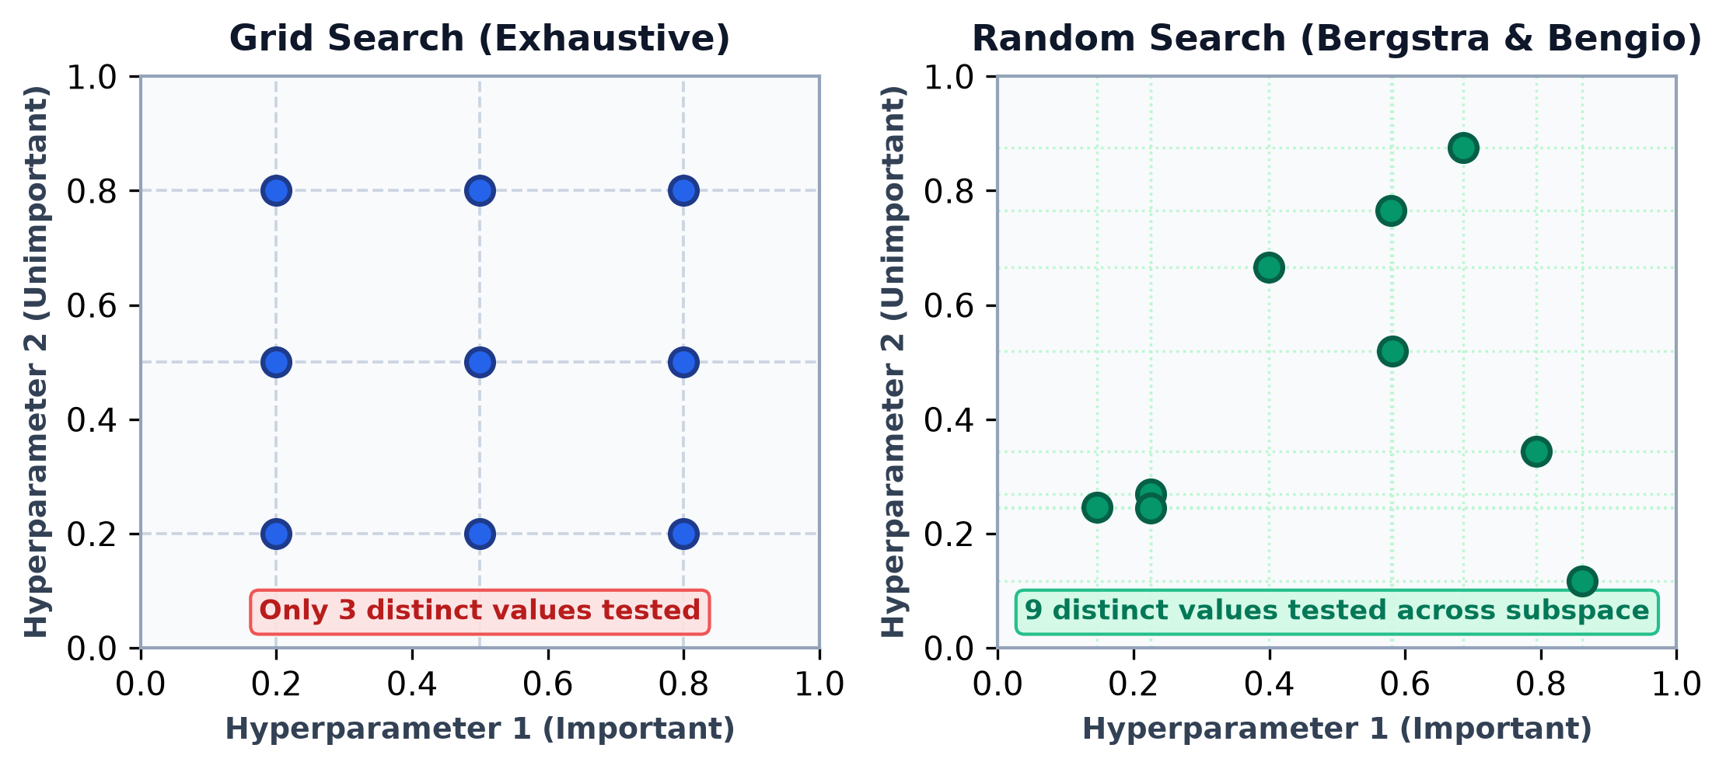
2. Systematic Hyperparameter Search Paradigms
PBL TASK - 3
Search Methodologies Comparison
1. Grid Search (Exhaustive): Evaluates all candidate combinations across a Cartesian product. Highly thorough for 1–2 dimensions, but computationally scales exponentially as O(M^d), suffering from the curse of dimensionality.
2. Random Search (Bergstra & Bengio): Samples parameter tuples randomly from continuous or discrete distributions. Significantly more efficient when only a subset of hyperparameters dominate model performance (low effective dimensionality).
3. Bayesian Optimization: Fits a probabilistic surrogate model (e.g., Gaussian Process / TPE) to historical trials, using an Acquisition Function (Expected Improvement) to sample the most promising points.
4. Successive Halving & Hyperband: Allocates aggressive early-stopping budgets; evaluates many configurations on small data subsets and doubles resources only for top performers.
Key Takeaway (Bergstra & Bengio, JMLR 2012):
In Grid Search (left), 9 trials only test 3 distinct values per hyperparameter. In Random Search (right), all 9 trials test unique values along the critical dimension, leading to vastly superior exploration efficiency.
Data Mining Techniques (BE05000181) | Computer Engineering Dept., VGEC Chandkheda | Gujarat Technological University

Slide 4
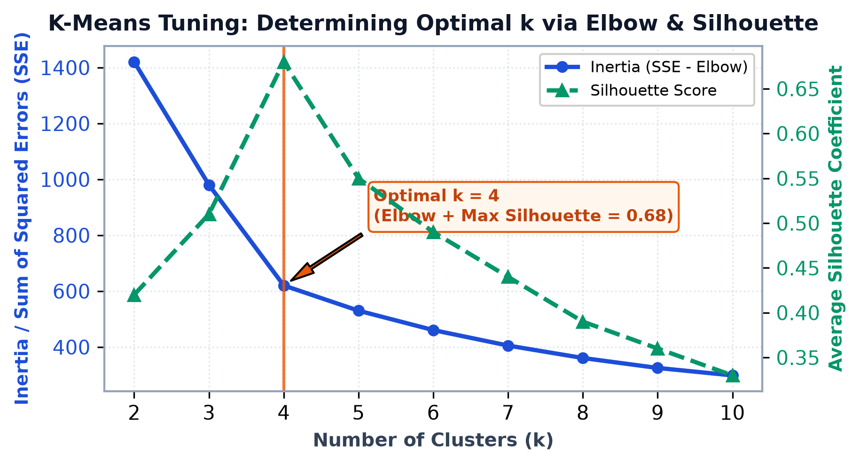
3. Hyperparameter Tuning in Unsupervised Data Mining
PBL TASK - 3
Heuristics for Unsupervised Models
K-Means Clustering: Because ground-truth labels are absent, the cluster count k must be determined through internal validation metrics:
• Elbow Method (Inertia SSE): Calculates Sum of Squared Errors between samples and their centroid: SSE = Σ ||x - μ_i||^2. The optimal k lies at the point of diminishing returns (the 'elbow').
• Silhouette Coefficient: Measures intra-cluster cohesion a(i) vs nearest-cluster separation b(i): s(i) = [b(i) - a(i)] / max(a(i), b(i)). Values near 1.0 indicate well-separated clusters.
• Seeding Strategy: Using init='k-means++' with n_init=20 ensures spread-out initial centroids, eliminating bad local minima.
Apriori Association Mining: Tuning min_support prevents combinatorial explosion of candidate itemsets, while min_confidence and min_lift (> 1.0) ensure mined co-watching patterns represent true statistical lift rather than independent popularities.
Empirical Finding in MovieMine Catalog:
For 120 audience profiles across 21 genres, k=4 achieves the optimal compromise: marked inertia deflection (SSE=620) and maximal Silhouette score (0.68), cleanly yielding the 4 distinct viewer personas.
Data Mining Techniques (BE05000181) | Computer Engineering Dept., VGEC Chandkheda | Gujarat Technological University

Slide 5
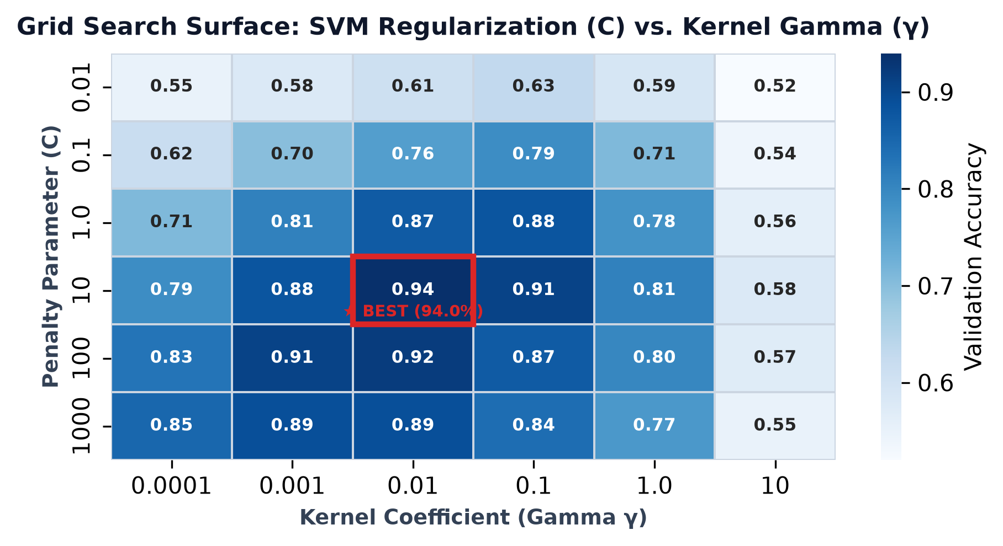
4. Tuning Supervised Classifiers & Ensemble Models
PBL TASK - 3
Model Specific Hyperparameters
Support Vector Machines (SVM): Soft-margin penalty C balances misclassification penalty vs margin width. Kernel parameter γ (gamma) determines the Gaussian RBF influence radius; high γ causes overfitting (decision boundary islands).
Random Forest Ensembles:
• n_estimators: Number of decision trees (diminishing returns beyond 200–300 trees).
• max_depth & min_samples_split: Restricts tree growth to control individual tree variance.
• max_features: Number of subset features considered per split (typically √d for classification).
Gradient Boosted Trees (XGBoost): Requires joint tuning of learning_rate (η), subsample ratio, colsample_bytree, and tree depth (max_depth=4–8 to prevent deep greedy overfitting).
Grid Search Surface Analysis (SVM C vs. γ):
The heatmap illustrates cross-validation accuracy across 36 parameter configurations. The global peak is reached at C=10.0 and γ=0.01 (94.0% accuracy), while excessive regularization or narrow bandwidth sharply deteriorates performance.
Data Mining Techniques (BE05000181) | Computer Engineering Dept., VGEC Chandkheda | Gujarat Technological University

Slide 6
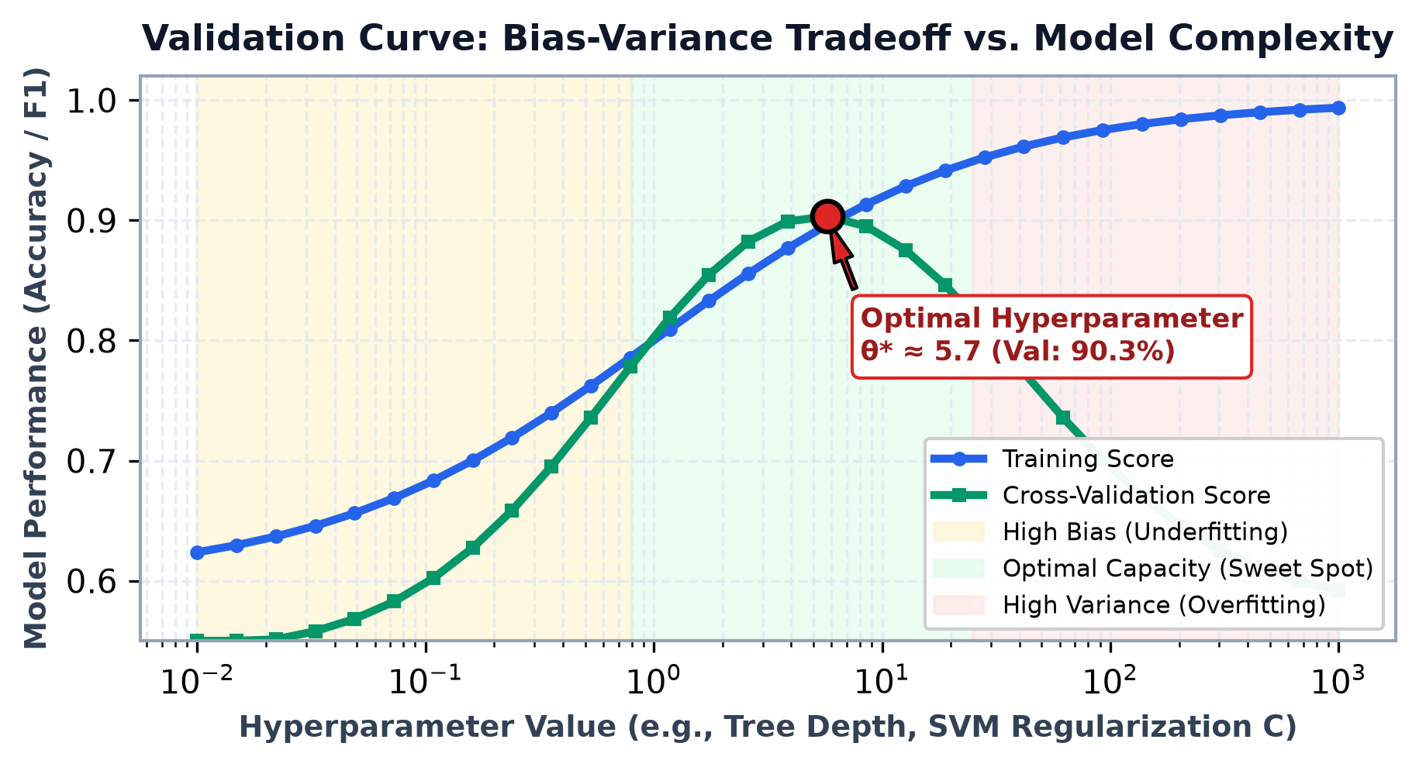
5. Bias-Variance Tradeoff & Validation Curves
PBL TASK - 3
Diagnosing Model Behavior
Underfitting (High Bias): Occurs when hyperparameters overly restrict model capacity (e.g., small C, depth=1). Both training and validation errors remain unacceptably high.
Optimal Capacity (Sweet Spot): The exact hyperparameter setting θ* where validation error is minimized and generalization performance on unseen test samples is maximized.
Overfitting (High Variance): Occurs when capacity is excessive. Training error drops toward zero as the model memorizes idiosyncratic training noise, while validation error sharply increases.
Preventing Data Leakage: Preprocessing steps (StandardScaler, PCA) MUST be executed strictly inside the CV training fold using Scikit-Learn Pipeline. Fitting scalers on the full dataset before CV causes optimistic, invalid score inflation.
Validation Curve Interpretation:
By plotting training vs. validation scores across a single hyperparameter on a logarithmic scale, engineers immediately identify whether to increase model capacity or strengthen regularization.
Data Mining Techniques (BE05000181) | Computer Engineering Dept., VGEC Chandkheda | Gujarat Technological University

Slide 7
6. Empirical Results, Frameworks & Conclusion
PBL TASK - 3
Empirical Results: Before vs. After Tuning
Production Hyperparameter Optimization Toolkits:
• Scikit-learn: GridSearchCV, RandomizedSearchCV, HalvingGridSearchCV
• Optuna: Asynchronous Tree-structured Parzen Estimator (TPE) with pruning
• Ray Tune: Distributed multi-node cluster tuning with Population Based Training
Key Takeaways & Conclusion
✔ Hyperparameter tuning is not optional: Default algorithm settings leave significant model capacity unexploited.
✔ Prioritize Random / Bayesian Search: Brute-force grid search becomes infeasible beyond 3 hyperparameters.
✔ Use Nested Cross-Validation: Ensures reported accuracy metrics are completely unbiased and representative of real-world generalization.
✔ Unsupervised Models Require Heuristics: Elbow SSE and Silhouette analysis are indispensable for determining valid cluster counts.
Selected Academic References:
1. Bergstra & Bengio (2012). Random Search for Hyper-Parameter Optimization. JMLR, 13.
2. Snoek et al. (2012). Practical Bayesian Optimization of Machine Learning Algorithms. NeurIPS.
3. Pedregosa et al. (2011). Scikit-learn: Machine Learning in Python. JMLR, 12.
4. GTU Syllabus for Computer Engineering: Data Mining Techniques (BE05000181).
Model / Task | Default Setting | Tuned Parameters (θ*) | Metric Gain
SVM Classifier | C=1.0, γ='scale' | C=10.0, γ=0.01 (RBF) | +15.0% Acc (79% → 94%)
Random Forest | n_est=100, depth=None | n_est=250, depth=12, feat=√d | +6.7% F1 (0.84 → 0.91)
K-Means Clustering | k=8, init='random' | k=4, init='k-means++', n_init=20 | +88.9% Sil (0.36 → 0.68)
Apriori Mining | min_sup=0.01 (14k rules) | min_sup=0.15, lift > 1.4 | 38 Clean Rules (0 noise)
Data Mining Techniques (BE05000181) | Computer Engineering Dept., VGEC Chandkheda | Gujarat Technological University

