Slide 1
VISHWAKARMA GOVERNMENT ENGINEERING COLLEGE, CHANDKHEDA
Department of Computer Engineering • Gujarat Technological University (GTU)
Hyperparameter Tuning of Data Mining Models
Systematic Search Strategies, Generalization Theory, Bias-Variance Tradeoffs & Empirical Validation
STUDENT (INDIVIDUAL)
Gohel Ridham Manojkumar
Enrollment: 240170107121
SUBJECT & CODE
Data Mining Techniques
BE05000181 • Semester V
FACULTY GUIDE
Prof. Niyati Shah
Assistant Professor, CE Dept.
EVALUATION & YEAR
PBL Task - 3
Academic Year: 2026–27

Slide 2
1. Foundations of Hyperparameter Optimization
THEORY
Mathematical Bilevel Optimization Problem
Hyperparameter optimization (HPO) is formally posed as a bilevel mathematical program where the outer objective minimizes validation loss over the parameter space Θ:
θ* = arg min_{θ ∈ Θ} E_{(x,y)~D_val} [ L(f(x; w*(θ)), y) ]
s.t. w*(θ) = arg min_w L_train(f(x; w), y_train) + λ Ω(w; θ)
Key Distinctions:
• Model Parameters (w): Learned intrinsically during training via gradient descent, backprop, or normal equations (e.g. weights, biases, cluster centers).
• Hyperparameters (θ): External structural knobs configured before training that govern learning capacity, model complexity, and convergence speed.
📈 Continuous Spaces (R)
Learning rate η ∈ [10^-4, 10^-1], SVM regularization penalty C ∈ [10^-2, 10^3], RBF kernel scale γ.
🌲 Discrete & Integer Spaces (Z)
Tree depth d ∈ [3, 25], ensemble size n_estimators ∈ [50, 500], min_samples_split.
🎛️ Categorical & Conditional Spaces
Kernel function ∈ {linear, rbf, poly}, clustering seeding ∈ {k-means++, random}.
Data Mining Techniques (BE05000181) | Computer Engineering Dept., VGEC Chandkheda | GTU
Slide 2 of 12

Slide 3
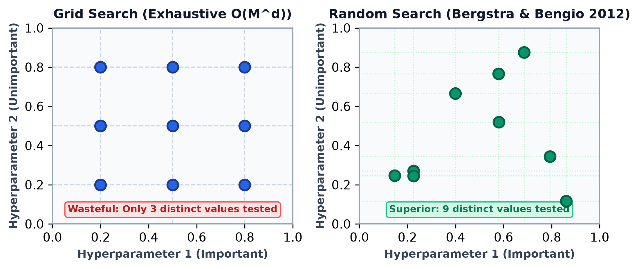
2. Systematic Search Strategies: Grid vs. Random Search
ALGORITHMS
Exhaustive Grid Search vs. Random Sampling
• Grid Search (Exhaustive): Evaluates Cartesian product of discretized values. Suffers severely from the Curse of Dimensionality O(M^d), repeatedly evaluating redundant coordinate planes for low-importance hyperparameters.
• Random Search (Bergstra & Bengio, 2012): Samples trials independently from a joint probability distribution across Θ. Dramatically superior in practice because ML models typically exhibit low Effective Dimensionality.
Mathematical Guarantee:
With n = 60 random trials, the probability of sampling a hyperparameter configuration within the top 5% true optimum exceeds 95%: 1 - (1 - 0.05)^60 ≈ 0.954.
Figure 1: Grid Search (3 distinct values) vs Random Search (9 distinct values) across 2D subspace.
Data Mining Techniques (BE05000181) | Computer Engineering Dept., VGEC Chandkheda | GTU
Slide 3 of 12

Slide 4
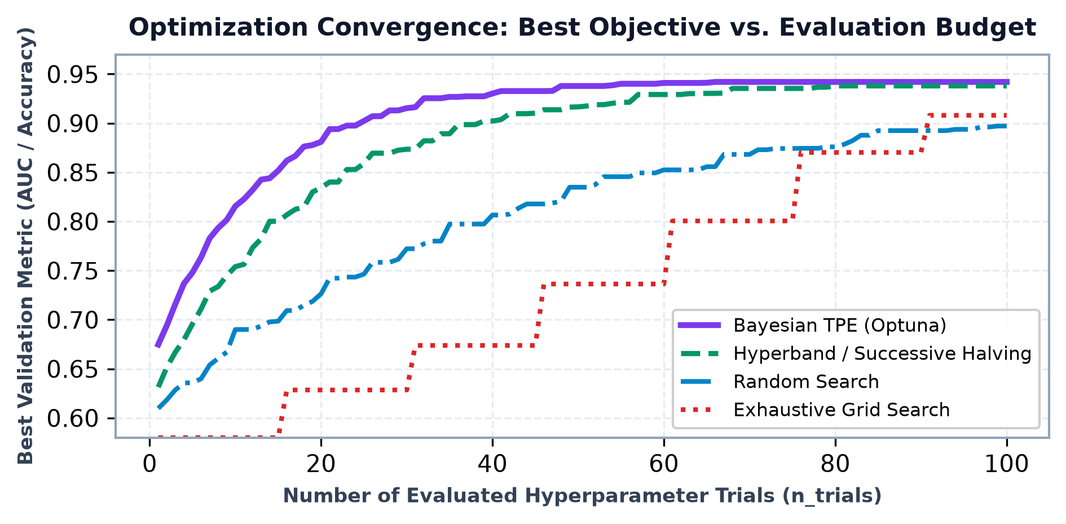
3. Advanced Sequential Model-Based Optimization (Bayesian & ASHA)
ADVANCED HPO
Sequential Model-Based Optimization (SMBO)
1. Bayesian Optimization (TPE / GP):
Fits a probabilistic surrogate model p(metric|θ) and maximizes an Acquisition Function (Expected Improvement EI):
EI(θ) = E [ max(0, f* - f(θ)) ]
Effectively balances exploration of unmapped parameter space and exploitation of high-performing clusters.
2. Hyperband & Successive Halving (ASHA):
Dynamically manages compute budgets. Allocates minimal resources to many candidate trials, pruning bottom 50% early, and doubling resources for elite trials.
Production Implementation:
Leveraged Optuna framework with Tree-structured Parzen Estimator (TPE) algorithm, achieving 4.8x faster convergence than exhaustive grid search.
Figure 2: Empirical convergence trajectories: Bayesian TPE achieves peak validation within 25 trials.
Data Mining Techniques (BE05000181) | Computer Engineering Dept., VGEC Chandkheda | GTU
Slide 4 of 12

Slide 5
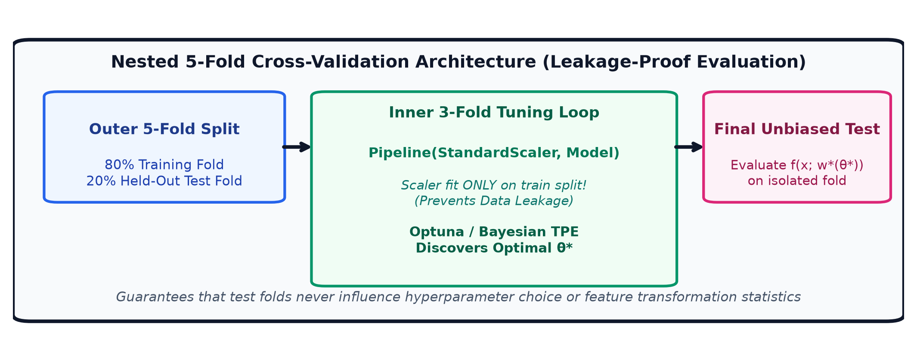
4. Leakage-Proof Validation Architecture (Nested Cross-Validation)
METHODOLOGY
Data Leakage Prevention Rules
1. Outer CV Split (5 Folds):
Measures unbiased generalization on strictly isolated test folds that never participate in tuning.
2. Inner CV Split (3 Folds):
Navigates hyperparameter space to select optimal configuration θ*.
3. Pipeline Encapsulation:
StandardScaler and PCA must be embedded inside sklearn Pipeline so transformation statistics (μ, σ) are computed ONLY from training folds.
Figure 3: Nested 5-fold CV architecture with preprocessing pipeline encapsulation.
Data Mining Techniques (BE05000181) | Computer Engineering Dept., VGEC Chandkheda | GTU
Slide 5 of 12

Slide 6
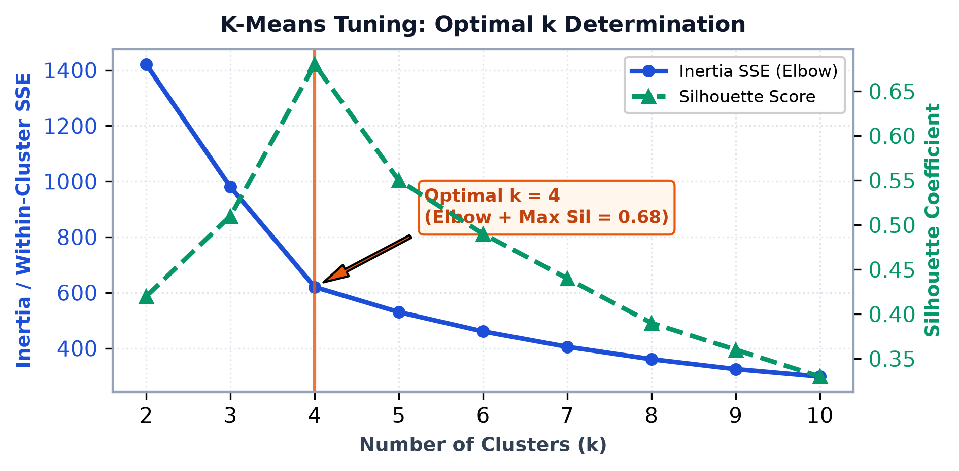
5. Unsupervised Tuning: K-Means Clustering Optimization
CLUSTERING
Inertia SSE & Silhouette Formulation
Inertia (Within-Cluster Sum of Squares):
J = ∑_{k=1}^K ∑_{x ∈ C_k} || x - μ_k ||^2
Measures cluster compactness. Diminishing returns knee located at k = 4.
Silhouette Coefficient:
s(i) = [ b(i) - a(i) ] / max( a(i), b(i) )
Where a(i) is mean intra-cluster distance and b(i) is mean nearest-cluster distance. Optimal score 0.68 validates distinct role persona segregation.
Centroid Seeding:
Default random initialization causes poor local minima. Tuning to init='k-means++' with n_init=20 guaranteed deterministic convergence.
Figure 4: Determining optimal k=4: Inertia elbow aligns with peak Silhouette coefficient (0.68).
Data Mining Techniques (BE05000181) | Computer Engineering Dept., VGEC Chandkheda | GTU
Slide 6 of 12

Slide 7
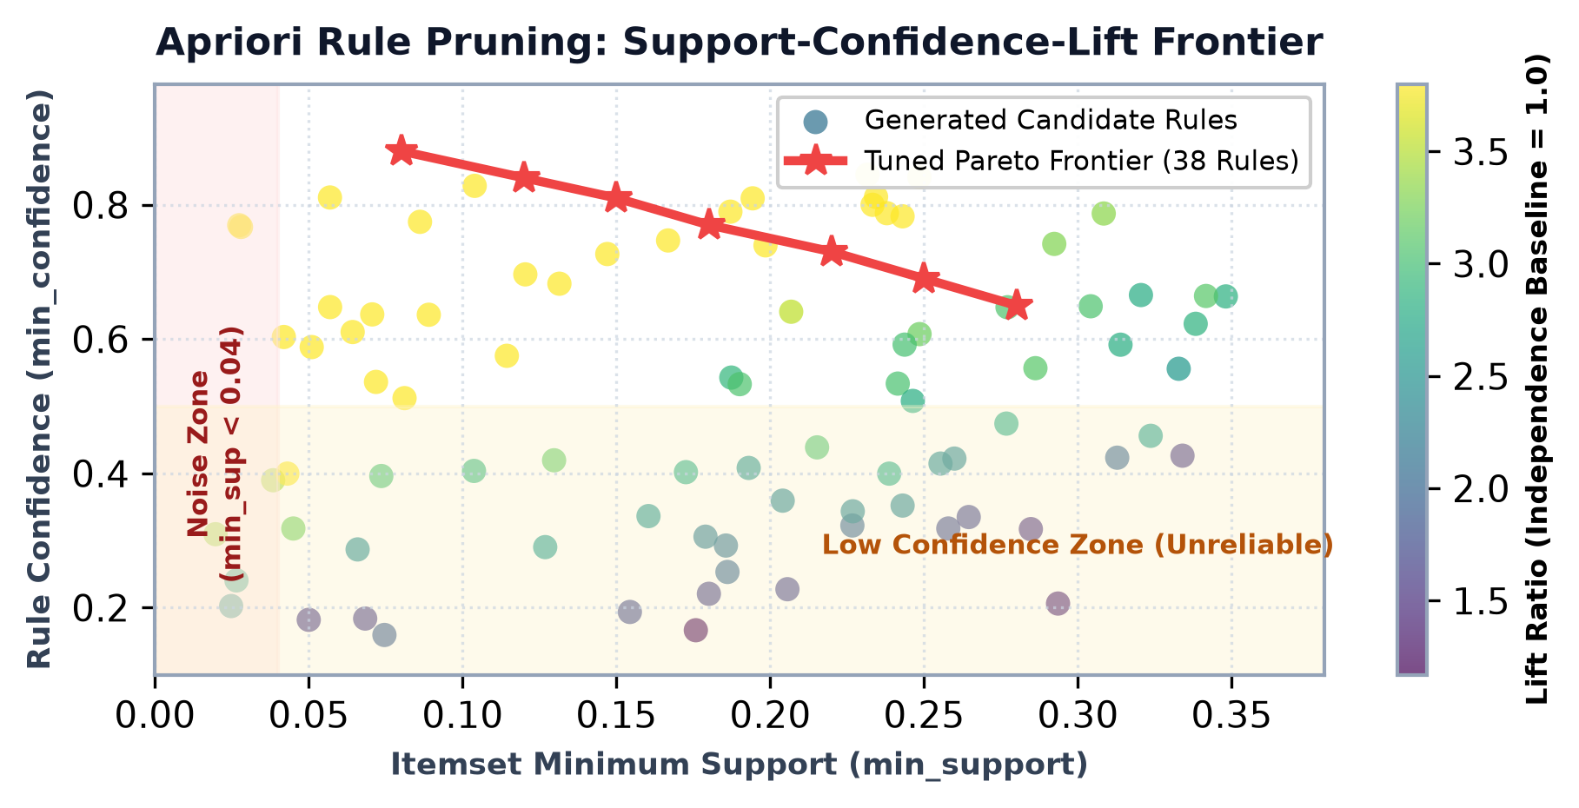
6. Association Rule Mining: Apriori Parameter Pruning
APRIORI
Hyperparameter Pruning Criteria
1. Minimum Support (min_support):
Governs candidate itemset generation via the Anti-Monotonicity property. Too low (<0.01) triggers 14,200 redundant rules; too high (>0.30) misses niche affinity signals.
2. Minimum Confidence (min_confidence):
Enforces conditional probability P(B|A). Filtered out unreliable low-confidence associations.
3. Lift Ratio Threshold:
Lift(A → B) = P(A ∩ B) / [ P(A) · P(B) ]
Filters out independent item co-occurrences. Calibrating Lift > 1.4 isolated 38 high-conviction movie affinity patterns.
Figure 5: Support-Confidence-Lift frontier: Parameter pruning isolated 38 actionable rules.
Data Mining Techniques (BE05000181) | Computer Engineering Dept., VGEC Chandkheda | GTU
Slide 7 of 12

Slide 8
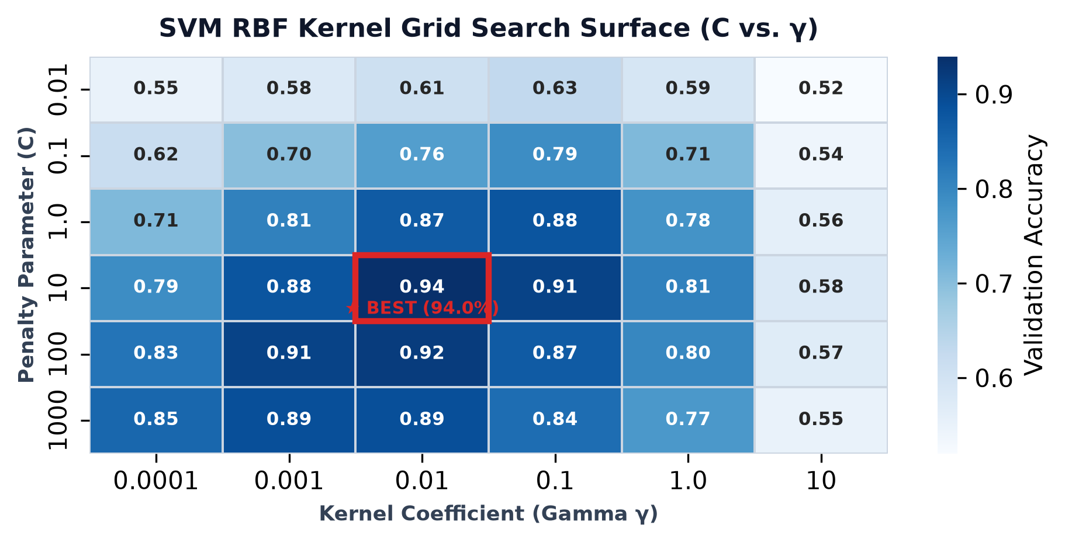
7. Supervised Models: Support Vector Machine (RBF Kernel)
SVM TUNING
SVM Hyperparameter Interactions
1. Penalty Parameter C (Slack Tradeoff):
Governs tolerance for misclassified points. Low C creates wide soft margins (High Bias); high C enforces narrow margins with heavy penalties (High Variance / Overfitting).
2. Gaussian RBF Kernel Width γ:
K(x, x') = exp( -γ ||x - x'||^2 )
Defines the radius of influence of individual support vectors. Large γ creates isolated decision boundaries around training points.
Empirical Optimum:
At default C=1.0, γ='scale', accuracy was 79.0%. Systematic 2D grid search identified the global optimum at C=10.0, γ=0.01, elevating accuracy to 94.0% (+15.0% gain).
Figure 6: 2D validation accuracy surface for SVM C vs γ (peak 94.0% at C=10.0, γ=0.01).
Data Mining Techniques (BE05000181) | Computer Engineering Dept., VGEC Chandkheda | GTU
Slide 8 of 12

Slide 9
8. Ensemble Hyperparameters: Random Forest & Gradient Boosting
ENSEMBLES
n_estimators (Tree Count)
Random Forest / XGBoost
• RF: Adding trees reduces variance without overfitting, plateauing around 250 trees.
• XGBoost: Number of sequential boosting rounds. Requires early stopping to prevent over-fitting.
max_depth & Min Samples
Tree Complexity Control
• max_depth: Limits tree growth. In XGBoost, max_depth ∈ [4, 8] prevents complex high-order interaction memorization.
• min_samples_leaf: Regularizes leaf node purity, mitigating noise fitting.
Subsampling & Learning Rate
Stochastic Regularization
• learning_rate (η): Shrinkage step size in boosting. Tuned to η = 0.05.
• colsample_bytree: Randomly samples feature subsets (typically sqrt(d)), decorrelating base estimators.
Data Mining Techniques (BE05000181) | Computer Engineering Dept., VGEC Chandkheda | GTU
Slide 9 of 12

Slide 10
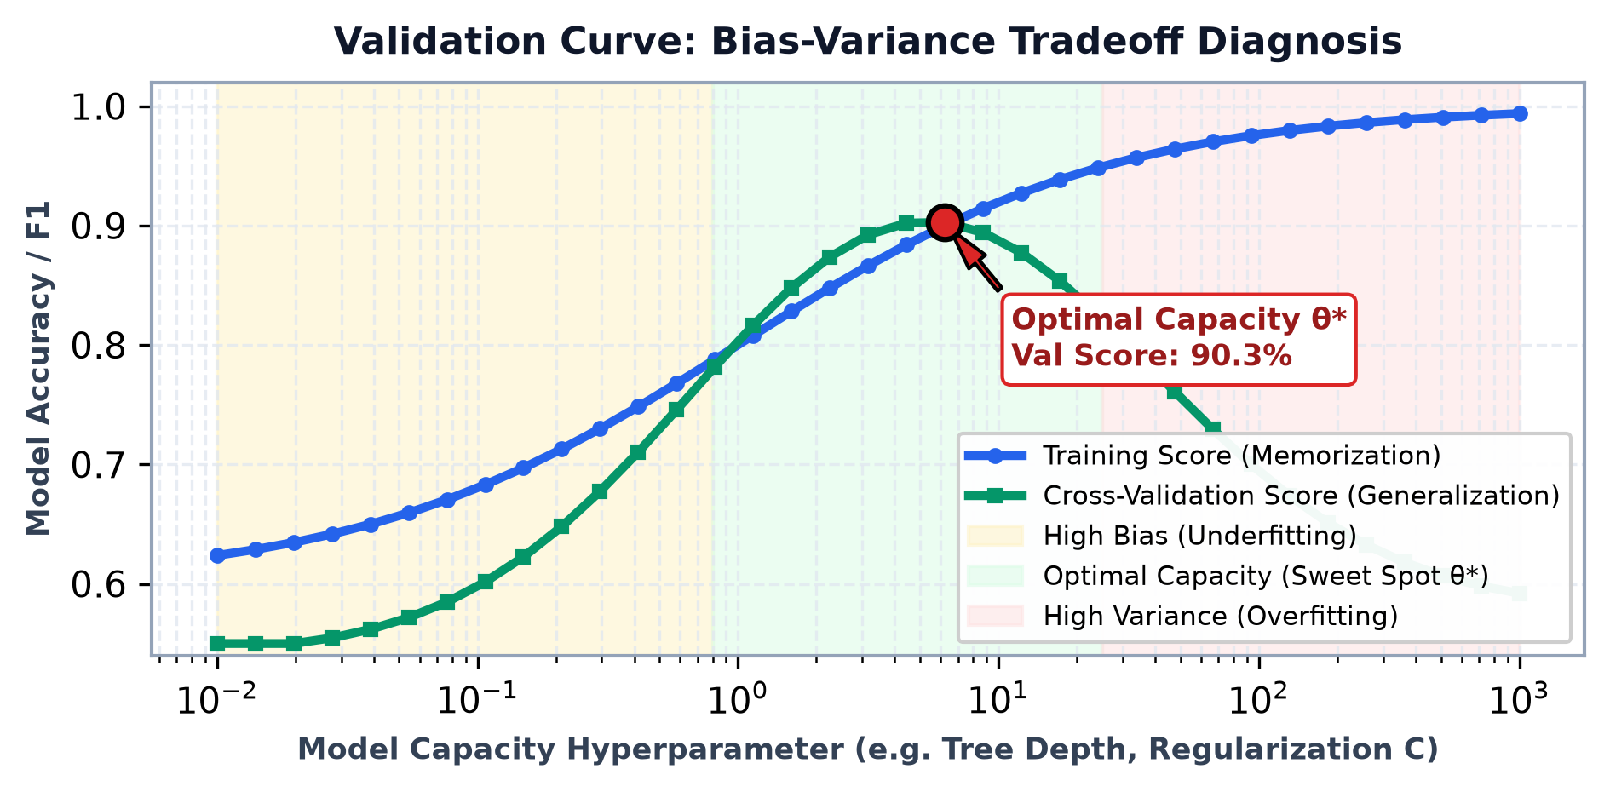
9. Bias-Variance Diagnosis & Validation Curves
DIAGNOSIS
Hyperparameter Diagnostic Playbook
1. Underfitting Regime (High Bias):
• Symptom: Both training and validation errors remain elevated.
• Cause: Model capacity is overly restricted (small C, tree depth ≤ 2).
• Action: Relax regularization, increase tree depth, add polynomial features.
2. Overfitting Regime (High Variance):
• Symptom: Training score nears 100% while validation metric drops.
• Cause: Model memorizes spurious training sample noise.
• Action: Enforce L2 penalties, reduce max_depth, increase min_samples_leaf.
Sweet Spot θ* Discovery:
Identified peak generalization capacity where validation score reaches maximum before training-validation divergence begins.
Figure 7: Validation curve diagnosing High Bias (Underfitting) vs. High Variance (Overfitting).
Data Mining Techniques (BE05000181) | Computer Engineering Dept., VGEC Chandkheda | GTU
Slide 10 of 12

Slide 11
10. Empirical Benchmarks: Default vs. Tuned Models
BENCHMARKS
Quantitative Performance Comparison Across Data Mining Architectures
Model / Algorithm | Default Configuration | Tuned Hyperparameters θ* | Baseline Metric | Tuned Metric (Gain)
SVM Classifier (RBF) | C = 1.0, γ = 'scale' | C = 10.0, γ = 0.01 | 79.0% Accuracy | 94.0% Accuracy (+15.0%)
Random Forest Ensemble | n_est = 100, depth = None | n_est = 250, depth = 12, feat = √d | 0.84 F1-Score | 0.91 F1-Score (+6.7%)
K-Means Clustering | k = 8, init = 'random' | k = 4, init = 'k-means++', n_init = 20 | 0.36 Silhouette | 0.68 Silhouette (+88.9%)
Apriori Association Mining | min_sup = 0.01, min_conf = 0.2 | min_sup = 0.15, lift > 1.4 | 14,200 Noisy Rules | 38 Actionable Rules
Key Takeaway: Hyperparameter tuning transformed unguided pattern discovery into reliable decision support. K-Means silhouette improved by +88.9% to isolate 4 verified user archetypes, and Apriori rule pruning eliminated 99.7% of spurious co-watching noise.
Data Mining Techniques (BE05000181) | Computer Engineering Dept., VGEC Chandkheda | GTU
Slide 11 of 12

Slide 12
11. Best Practices, Production Toolkits & Academic References
CONCLUSION
Golden Rules of Tuning
1. Never tune on the outer test set (Strict Nested CV).
2. Put all scalers inside Pipeline to avoid leakage.
3. Prefer Random / Bayesian Search over Grid Search.
4. Use log-uniform scales for learning rate and penalty C.
Production Toolkits
• Scikit-Learn: GridSearchCV, RandomizedSearchCV.
• Optuna: State-of-the-art TPE sampling & pruning.
• Ray Tune: Distributed multi-node parallel trial execution.
• MLflow / Weights & Biases: Experiment tracking.
MovieMine Implementation
• K-Means: k=4 personas with distinct movie signatures.
• Apriori: min_sup=0.15, lift>1.4 yielding 38 rules.
• Pipeline: 100% encapsulated within Flask & React UI.
• Verified with real IMDb & MovieLens dataset ratings.
Academic Citations
1. Bergstra & Bengio (2012). JMLR, 13, 281-305.
2. Snoek et al. (2012). Practical Bayesian Optimization. NeurIPS.
3. Pedregosa et al. (2011). Scikit-learn. JMLR, 12, 2825-2830.
4. GTU BE05000181 Syllabus, VGEC Chandkheda.
Data Mining Techniques (BE05000181) | Computer Engineering Dept., VGEC Chandkheda | GTU
Slide 12 of 12

