Slide 1
IoT Prototype: Smart Sensing via LoRa.
Presented by(Group-6):
Ridham Pansara (45148)
Mishal Meethian Naina (44943)
Ndayambaje Celestin (44714)
Nasir Sani Ahmed (44749)
Abdullah Ashtar (468943)
Guided by:
Prof, Mürsel Yildiz

Slide 2
Introduction
What is the Project?
“We developed a smart sensing prototype using an STM32 microcontroller to collect and send environmental data over a wireless LoRa link.”
Project Goal:
“To create a compact, low-power IoT node that can measure air quality (temperature, humidity, pressure, gas) and send the data wirelessly using LoRa, controlled via a simple command-line interface over UART.”
Key Components Used:
🧠 NUCLEO-G071RB
🌡️ BME680 Sensor
📡 SX126x LoRa HAT
🔌 UART to USB Interface
💻 PuTTY / Terminal

Slide 3
Key Features / Capabilities
Real-time Environmental Sensing: Instantly reads temperature, humidity, pressure, and gas from the environment.
Wireless Data Transmission: Sends sensor data wirelessly over long distances using the LoRa radio link.
User-friendly CLI: Simple command-line interface (PuTTY/Terminal) allows users to request data or control the node easily.
Compact and Low-Power Design: Efficient for remote or battery-powered use cases.
Modular and Extensible: Easy to add new sensors or commands in future versions.

Slide 4
Team Organization: Roles & Responsibilities & Tools
Mishal (System Setup Coordinator) • Planned board layout and pin assignments • Checked all I2C/SPI/UART connections
Nasir (Protocol & Wiring Specialist) • Designed I2C, SPI, UART protocols • Connected components and managed wiring
Ridham (Software & Implementation Lead) • Wrote and tested STM32 code • Integrated sensors (I2C) and LoRa (SPI) • Built the UART command interface
Celestine (Documentation & Testing) • Managed reports, notes, and traceability
• Tracked project progress and solved problems • Tested features and explored new tools
Main Tools Used
STM32CubeIDE
PuTTY (UART terminal)
Excel (docs)
PowerPoint (presentation)
WhatsApp/Email (team-communication)

Slide 5
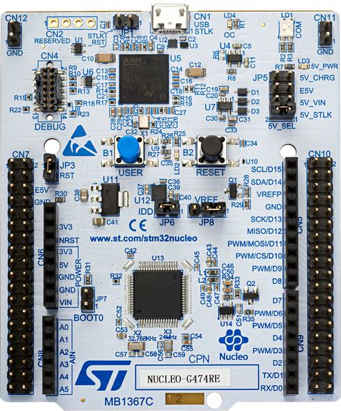
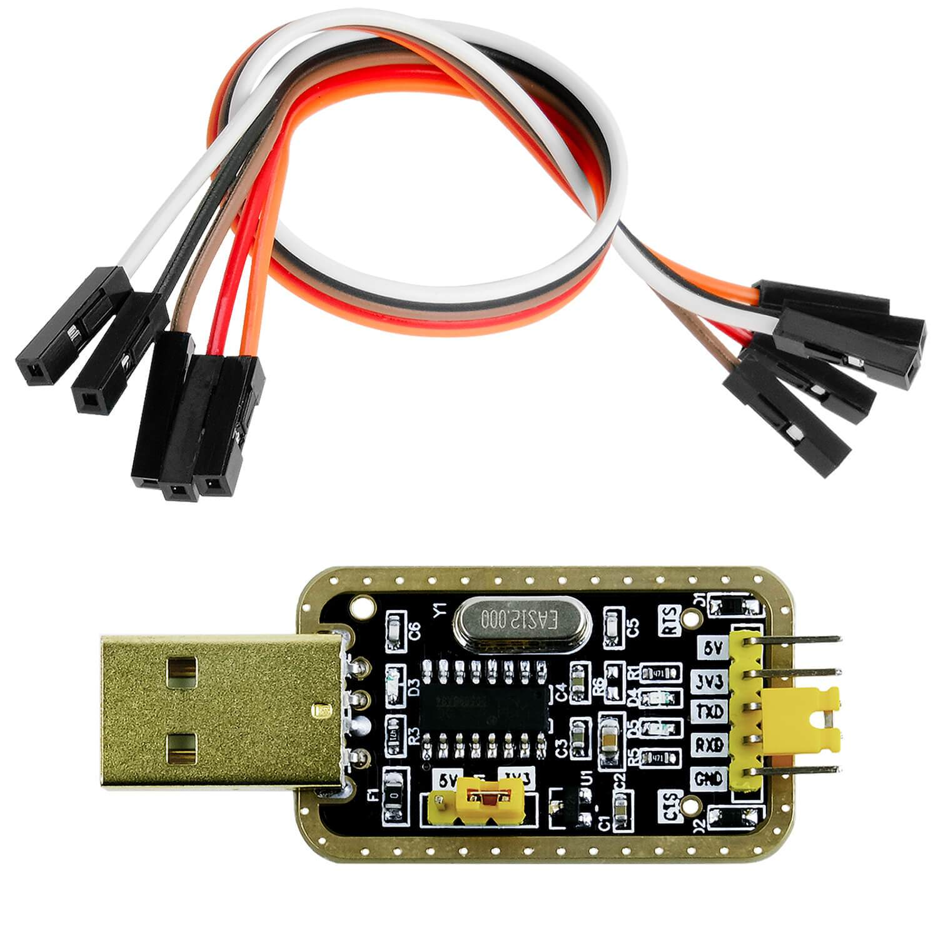
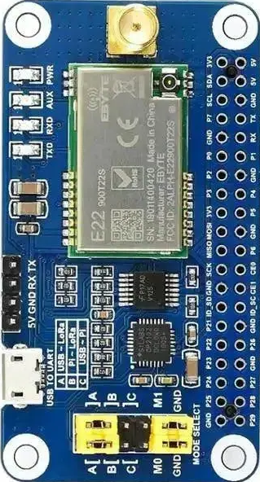
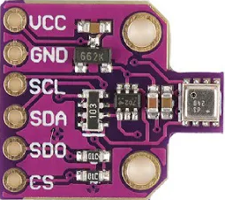
Components Description
01
🧠 NUCLEO-G071RB
02
Main microcontroller board used for all processing
🔌 UART to USB Interface
Lets the PC send commands and receive sensor data
04
03
🌡️ BME680 Sensor
📡 SX126x LoRa HAT
Measures temperature, humidity, pressure, and gas resistance
Sends sensor data wirelessly over LoRa using SPI

Slide 6
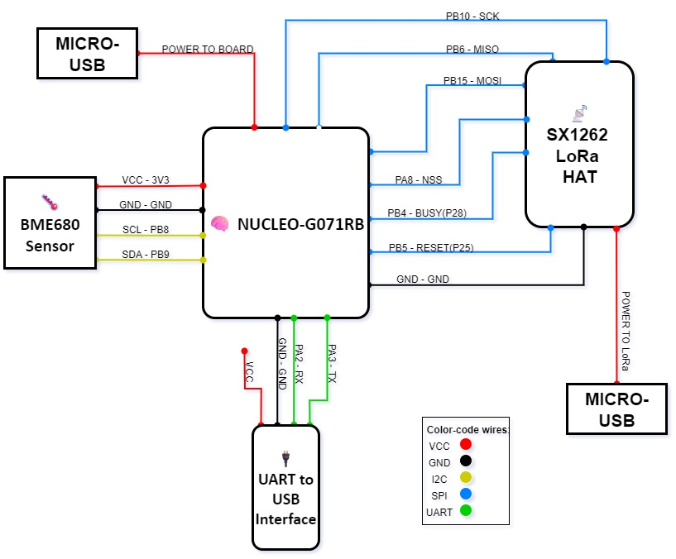
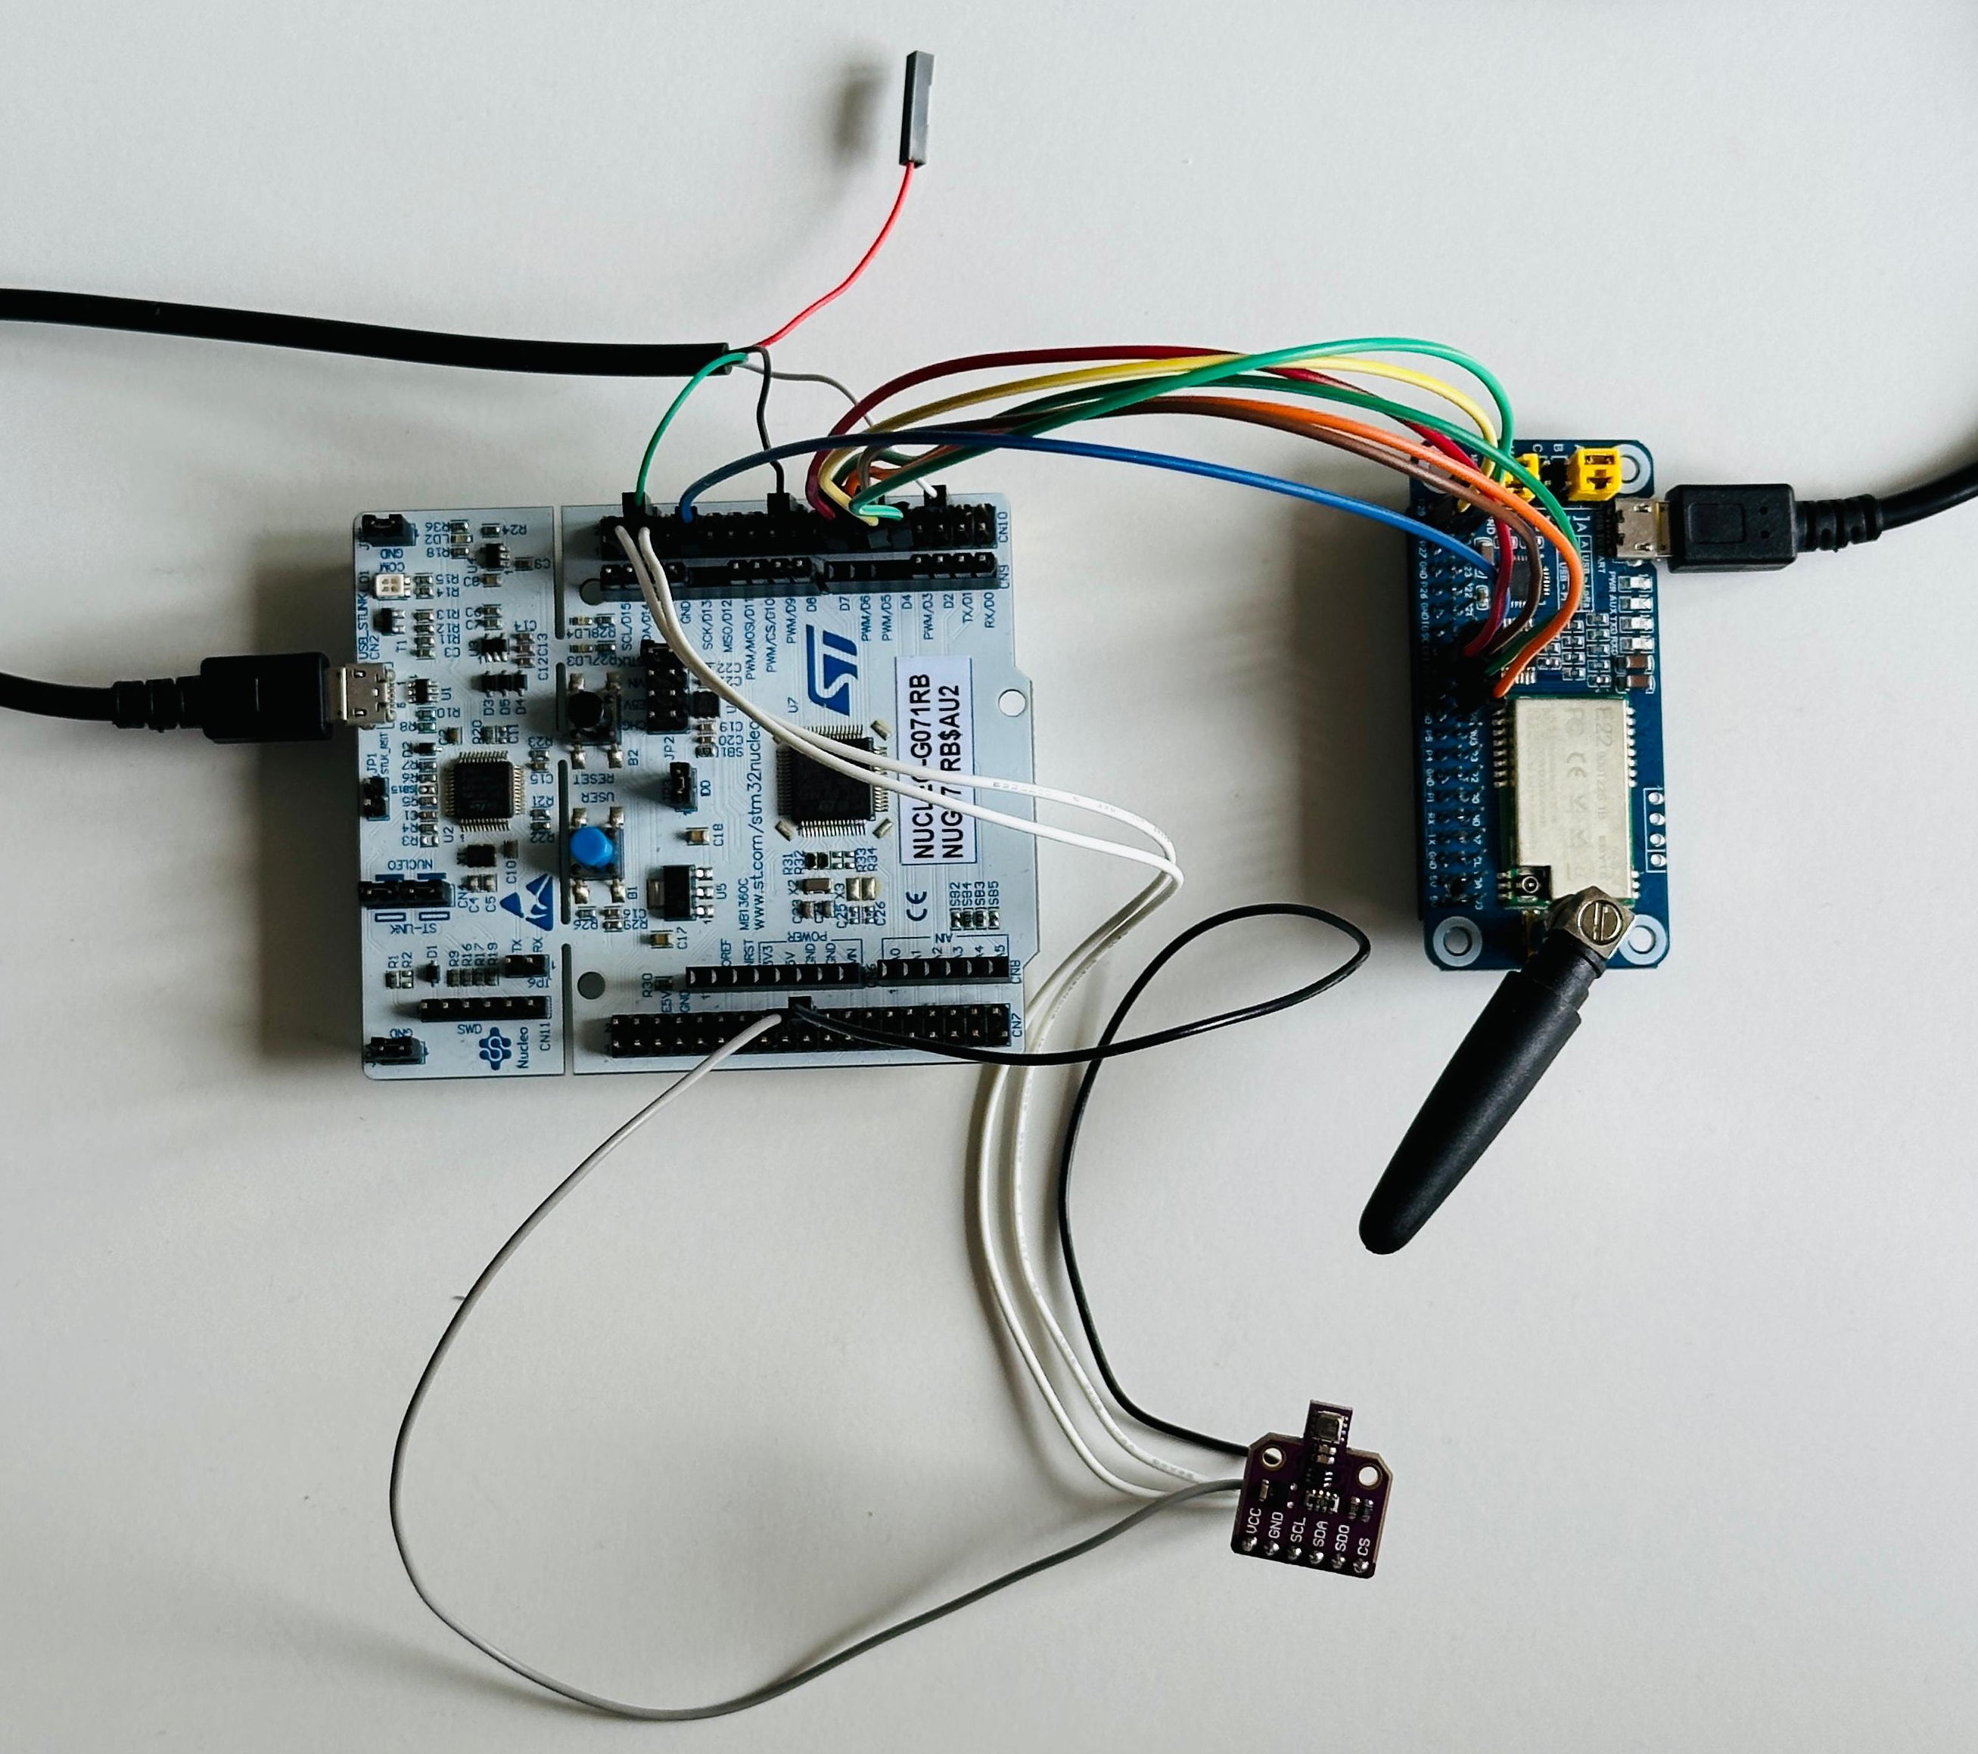
Hardware: Pin Configuration

Slide 7
I2C Protocol – Design Approach
Two-wire Bus: SDA (Data), SCL (Clock)
Master-Slave Communication: One master controls one or more slaves
Device Addressing: Each device has a unique address (7/10 bits)
Data Flow: Master initiates all transfers; slaves respond
Shared Bus: All devices connected to the same two wires
Speed: Standard mode (100kHz), Fast mode (400kHz), up to 1MHz (Fast+)
Pros: Fewer wires, simple wiring for many devices
Cons: Slower than SPI, bus can get crowded with many devices
Use Cases: Sensors (BME680), EEPROM, RTCs, low-speed peripherals

Slide 8
SPI Protocol – Design Approach
Four-wire Interface: MOSI, MISO, SCK, SS/CS
Master-Slave Communication: One master, multiple slaves (selected by CS)
No Addressing: Each slave selected by individual Chip Select line
Full Duplex: Data sent and received at the same time
Speed: Much faster than I2C (up to tens of MHz)
Pros: High speed, reliable, simple protocol
Cons: More wires needed (extra CS per device), less scalable for many devices
Use Cases: Radio modules (SX1262 LoRa), SD cards, displays, high-speed ADC/DAC

Slide 9
UART Protocol – Design Approach
Two-wire Serial Communication: TX (Transmit), RX (Receive)
Point-to-Point: Only connects two devices (no bus, no multiple slaves)
Asynchronous: No clock line, relies on agreed baud rate
Simple Data Framing: Start bit, data bits, optional parity, stop bit
Full Duplex: Can send and receive at the same time
Configuration Needed: Baud rate, data bits, parity, stop bits must match
Typical Speeds: Common from 9600 to 115200 baud (can be faster)
Pros: Very simple wiring, widely used for debugging, supported everywhere
Cons: Only two devices, not suitable for complex/many devices
Use Cases: Microcontroller-PC connection (via USB), GPS/Bluetooth/WiFi modules, debug console

Slide 10
Comparison – I2C & SPI Protocol
Feature | I2C | SPI | UART
Data Lines | 2 (SDA, SCL) | 4+ (MOSI, MISO, SCK, CS) | 2 (TX, RX)
Addressing | Yes (device address) | No (chip select pin) | No
Speed | Up to 1 MHz (standard) | Up to 50+ MHz | 9600 to 1+ M baud (depends)
Topology | Multi-master, multi-slave | One master, many slaves | Point-to-point (one-to-one)
Best For | Sensors, EEPROM, RTC | Radios, displays, SD cards | Debug console, PC connection, GPS/Bluetooth modules

Slide 11
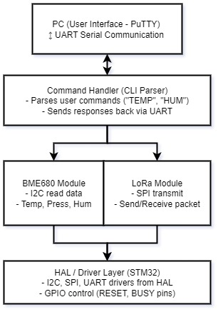
Software Architecture
UART Communication: Acts as interface between user (PuTTY) and board.
Command Handler: Receives and interprets commands from UART.
Sensor Driver: Interfaces with BME680 over I2C to collect data.
LoRa Driver: Sends or receives messages over SPI using SX1262.
HAL Layer: Uses STM32Cube HAL for low-level I2C, SPI, and UART communication.

Slide 12
Software Implementation
Step 1: I2C & UART – Sensor Data to PC
Configured I2C communication for BME680 sensor using Bosch drivers.
Configured UART (serial) communication to PC.
Printed live sensor data (temperature, humidity, etc.) directly to PuTTY.
Step 2: Command-Line Interface (CLI)
Implemented a CLI system for interactive control via PuTTY.
Created handle_command() function to process user commands.
User can type commands like TEMP, HUM, PRESS, ALL to get sensor values on demand.

Slide 13
Software Implementation
Step 3: SPI & LoRa Integration
Implemented SPI protocol for communication with the SX1262 LoRa module.
Developed required LoRa driver functions (send, reset, init, status, etc.).
Enabled sending sensor data or custom messages wirelessly using commands like LORA SEND.
Step 4: CLI Math Operations
Added basic mathematical command support in CLI.
User can now type commands like SUM 5 10, SUB 9 3, MUL 2 7, or DIV 10 2.
Board parses the numbers and prints the calculation result.

Slide 14
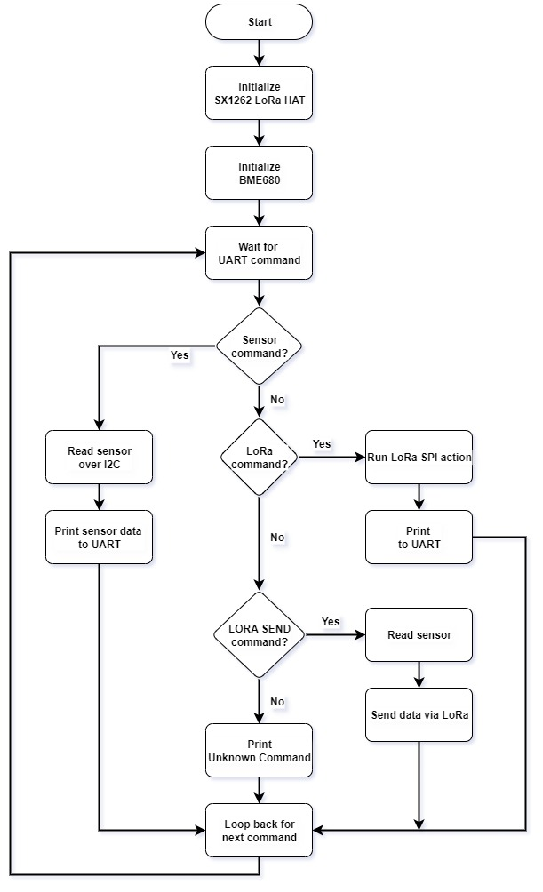
Software – Flow Diagram

Slide 15
Problems & Fixes
Issue | Cause | Solution
UART-USB not working | Unsupported UART driver in Windows | Installed legacy driver
No CLI response | No command handler implemented | Added handle_command() function
Unhandled UART flags | Not clearing RXNE/overrun interrupt flags | Clear flags after data read (HAL macros)
UART DMA/IRQ conflict | DMA & IRQ enabled at the same time | Use either DMA or IRQ for UART, not both
LoRa not sending | Missing BUSY, RESET, GND connections | Connected all required LoRa pins

Slide 16
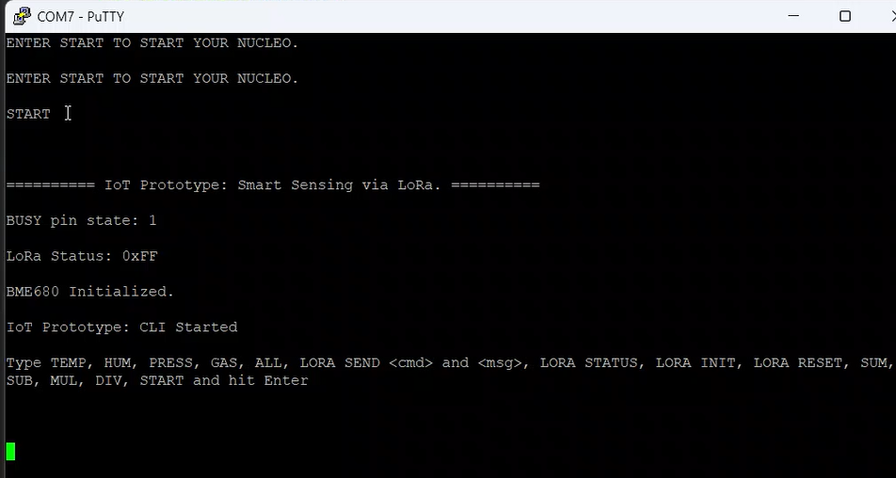
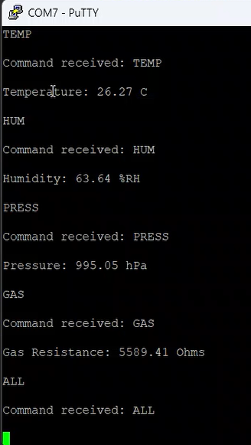
PuTTY Demo

Slide 17
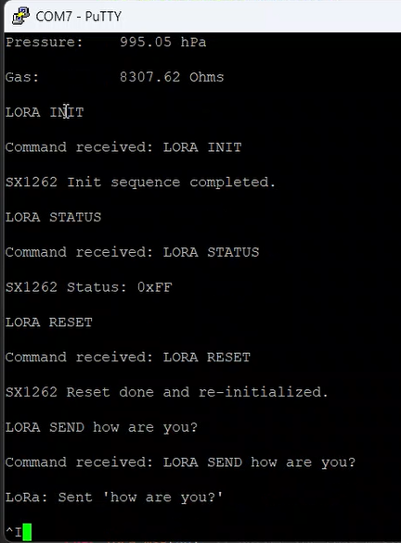
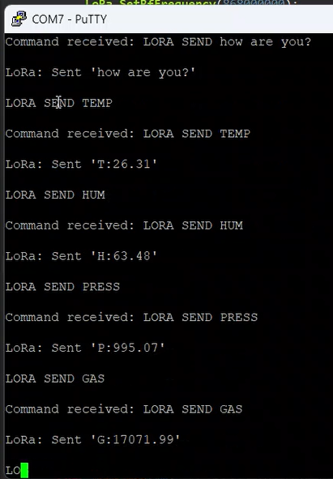
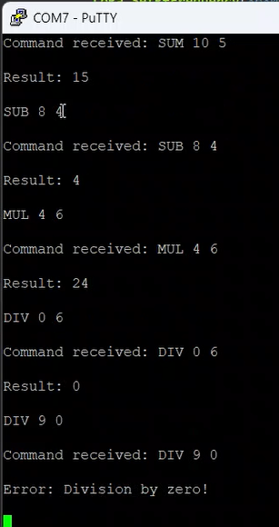
PuTTY Demo

Slide 18
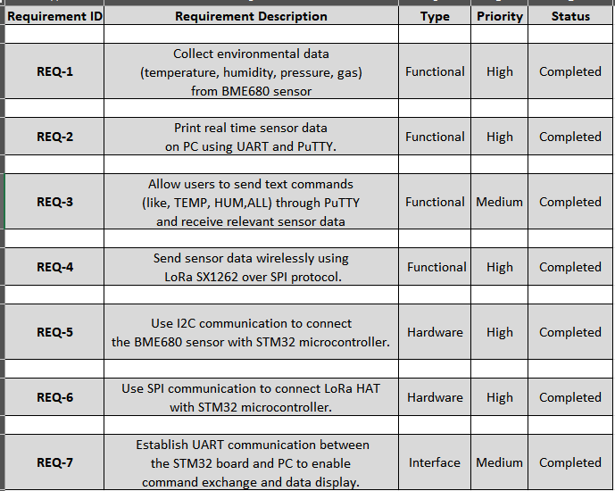
Requirements

Slide 19
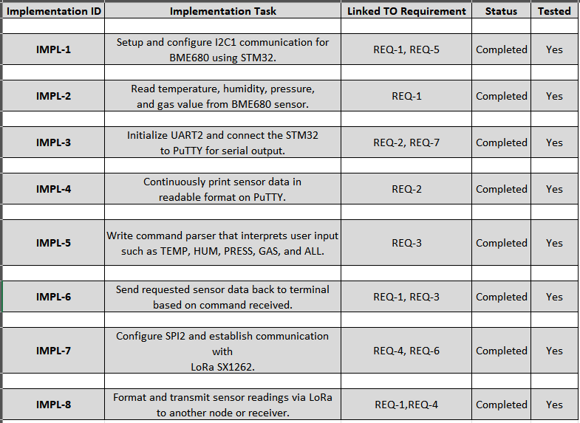
Implementation

Slide 20
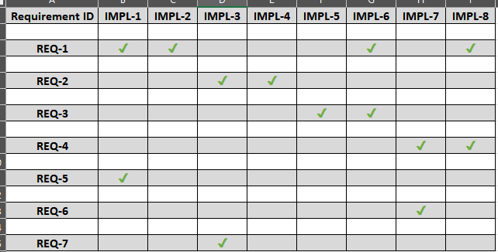
Traceability

Slide 21
Future Work – Towards a Smart Agriculture Node
Battery & Low Power: Add battery and optimize for long field operation
Weatherproofing: Enclose all hardware in a waterproof outdoor case
LoRa Network: Connect to LoRaWAN gateway for long-range, multi-node support
Cloud Dashboard: Send data to a cloud server or dashboard for remote monitoring
Extra Sensors: Integrate soil moisture, temperature, or rain sensors
Reliable Data: Improve sensor calibration and add data validation
User Setup: Make configuration easy (via CLI or wireless update)
Security & Updates: Plan for secure, reliable, and updatable firmware

Slide 22
Future Work – Smart Home Air Quality Node
Indoor Air Quality Monitoring: Use the existing prototype to monitor air quality inside homes, offices, or schools.
Real-Time Alerts: Send notifications if temperature, humidity, or gas levels exceed safe thresholds.
Home Automation Integration: Connect the node to smart home systems (e.g., trigger fans, purifiers, or alarms).
Multi-Room Setup: Deploy several nodes in different rooms, all sending data wirelessly to a central hub.
Mobile App Dashboard: Display live data and historical trends in a user-friendly mobile or web app.
Easy Installation: Compact size and wireless operation allow flexible placement anywhere in the home.
Battery Operation: Optimize for long battery life, making the device maintenance-free for months.

Slide 23
Experience
Technical Lessons Learned
Embedded Communication
Sensor Integration
Debugging Hardware & Software
Command Line Interface
LoRa Wireless Communication
Code Organization
Problem-Solving
Teamwork Experience
Collaboration
Shared Learning
Communication
Adaptability
Time Management

Slide 24
Conclusion
Successfully built an IoT prototype using STM32, BME680, and SX126x LoRa HAT.
Collected and transmitted environmental data (temperature, humidity, pressure, gas) wirelessly via LoRa.
Developed a command-line interface (CLI) using UART for easy user interaction.
Implemented and tested key embedded protocols: I2C (for sensor), SPI (for LoRa), UART (for PC interface).
Solved hardware and software integration challenges as a team.
Gained hands-on experience in embedded programming, protocol debugging, and teamwork.
Created a functional and reliable foundation for future IoT or sensing applications.

Slide 25
THANK YOU

