Slide 1
Salesdata1
File created on: 01-07-2022 15:33:02

Slide 2
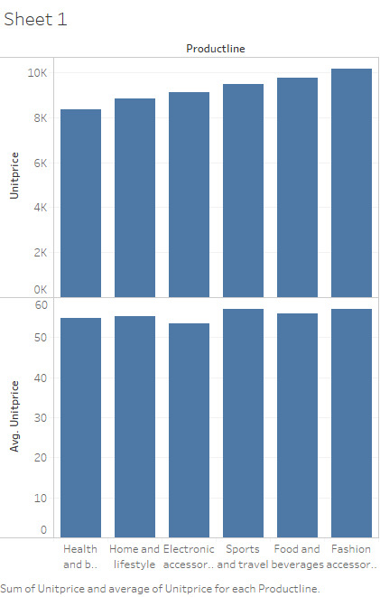

Slide 3
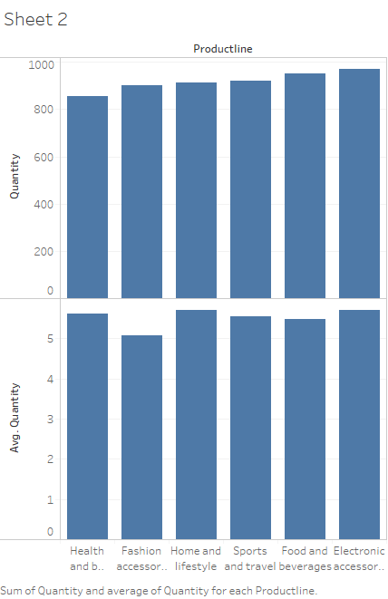

Slide 4


Slide 5


Slide 6


Slide 7


Slide 8


Slide 9


Slide 10
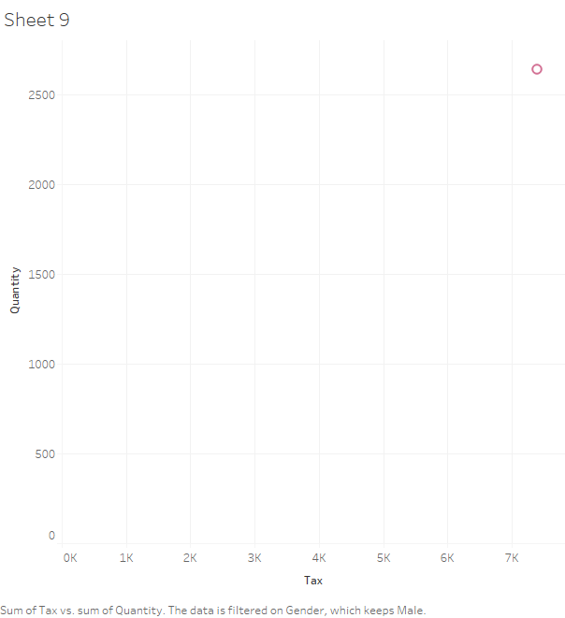

Slide 11


Slide 12


