Slide 1
DS SPRINT 2026 / ROUND 4
CUSTOMER
CHURN INSIGHT
Understand disengagement. Strengthen retention.
Business insights & targeted retention actions
ConnectSphere Telecom Pvt. Ltd. • Synthetic practice data
CUSTOMER CHURN INSIGHT • SYNTHETIC PRACTICE DATA
01

Slide 2
DS SPRINT 2026 • ROUND 4
The business problem
ConnectSphere wants to understand which customer patterns are associated with churn—and where retention effort should focus.
• Customer data spans profile, tenure, plan, usage, billing, service and support.
• The task is to identify disengagement signals, not merely report totals.
• Management needs targeted actions supported by evidence from the analysis.
CUSTOMER CHURN INSIGHT • SYNTHETIC PRACTICE DATA
02

Slide 3
DS SPRINT 2026 • ROUND 4
What the practice dataset tells us
CUSTOMER RECORDS
CHURNED
RETAINED
AVG. MONTHLY CHARGE
500
215
285
₹738
Synthetic records
43.0% labelled churned
57.0% labelled retained
Practice-data average
These metrics describe the generated practice sample only—not verified company KPIs.
CUSTOMER CHURN INSIGHT • SYNTHETIC PRACTICE DATA
03

Slide 4
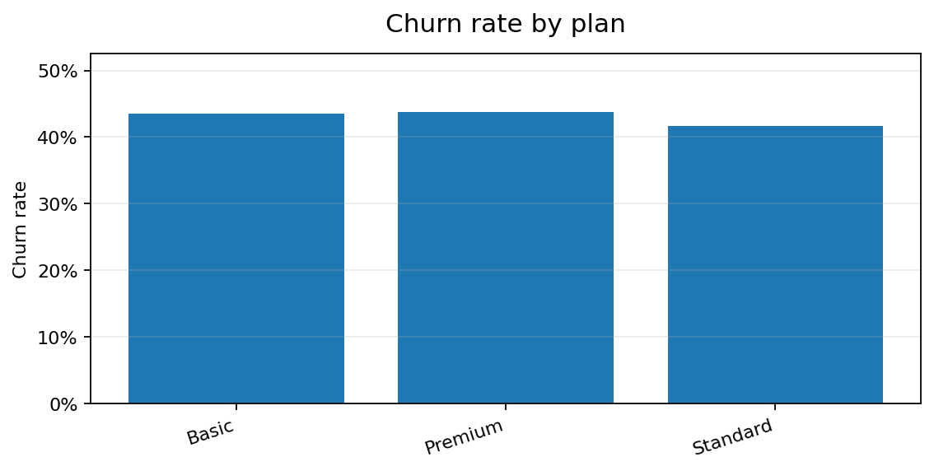
DS SPRINT 2026 • ROUND 4
Churn is not uniform across plans
Highest observed group:
Premium • 43.8%
Business meaning
Plan differences can prioritize investigation, but plan alone does not explain why a customer leaves.
CUSTOMER CHURN INSIGHT • SYNTHETIC PRACTICE DATA
04

Slide 5
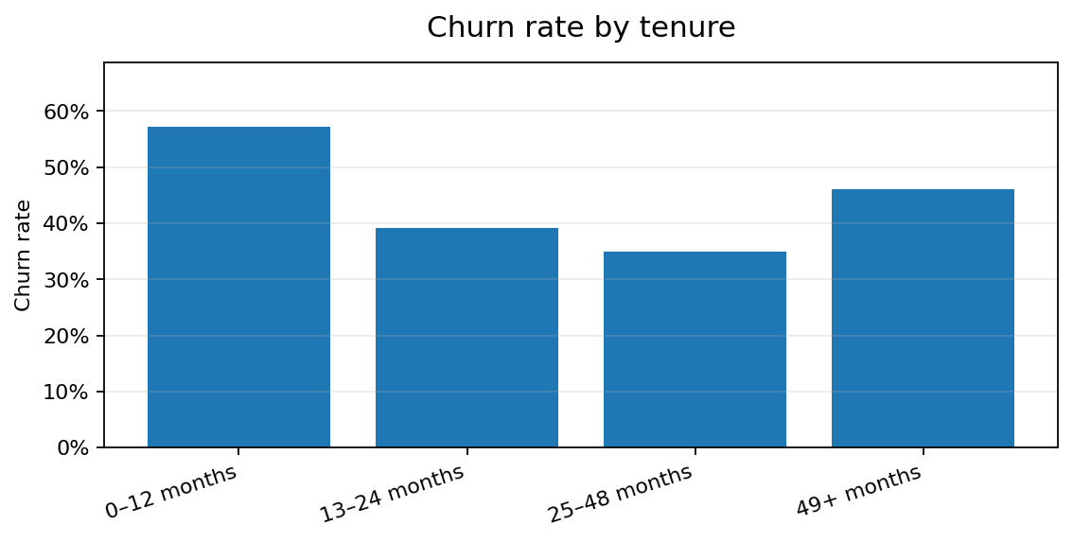
DS SPRINT 2026 • ROUND 4
Early tenure deserves attention
Highest observed group:
0–12 months • 57.3%
Business meaning
Test onboarding check-ins and early-life support to reduce possible customer friction.
CUSTOMER CHURN INSIGHT • SYNTHETIC PRACTICE DATA
05

Slide 6
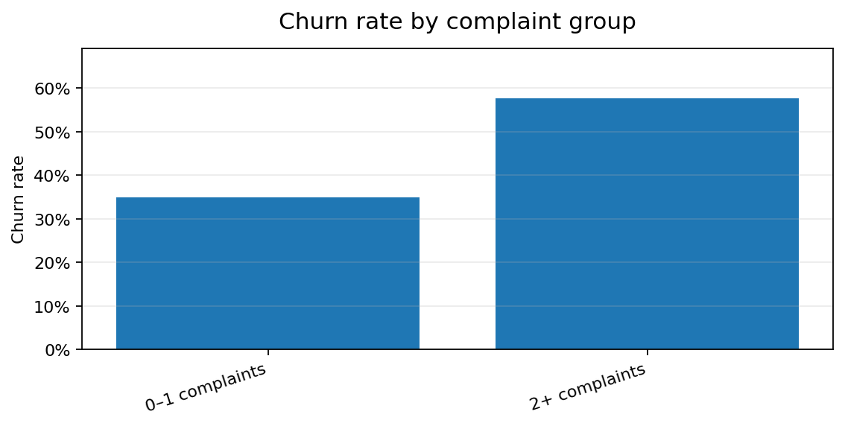
DS SPRINT 2026 • ROUND 4
Support experience is a retention signal
Highest observed group:
2+ complaints • 57.6%
Business meaning
Prioritize timely ticket resolution, follow-up after complaints, and root-cause review.
CUSTOMER CHURN INSIGHT • SYNTHETIC PRACTICE DATA
06

Slide 7
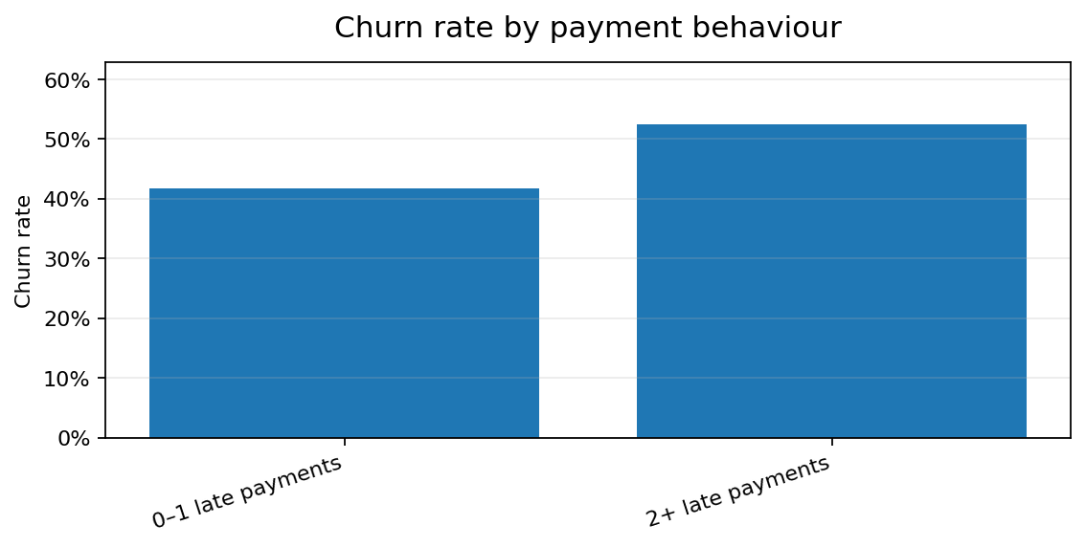
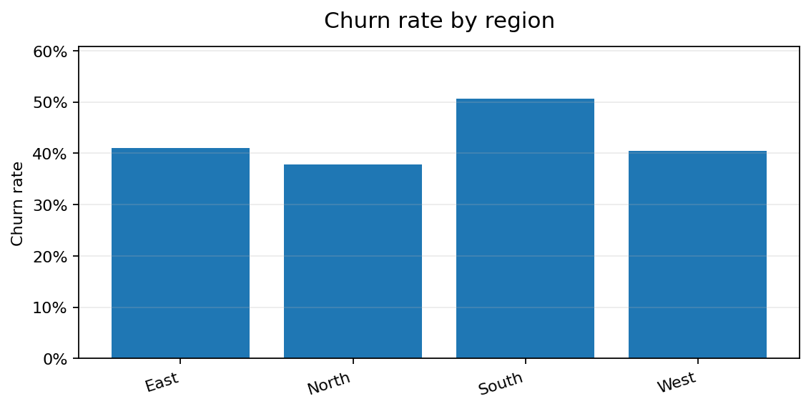
DS SPRINT 2026 • ROUND 4
Payment behaviour and regional differences
Highest payment-group churn: 2+ late payments (52.4%)
Highest regional churn: South (50.7%)
Prioritization clues only; validate sample sizes and operational context.
CUSTOMER CHURN INSIGHT • SYNTHETIC PRACTICE DATA
07

Slide 8
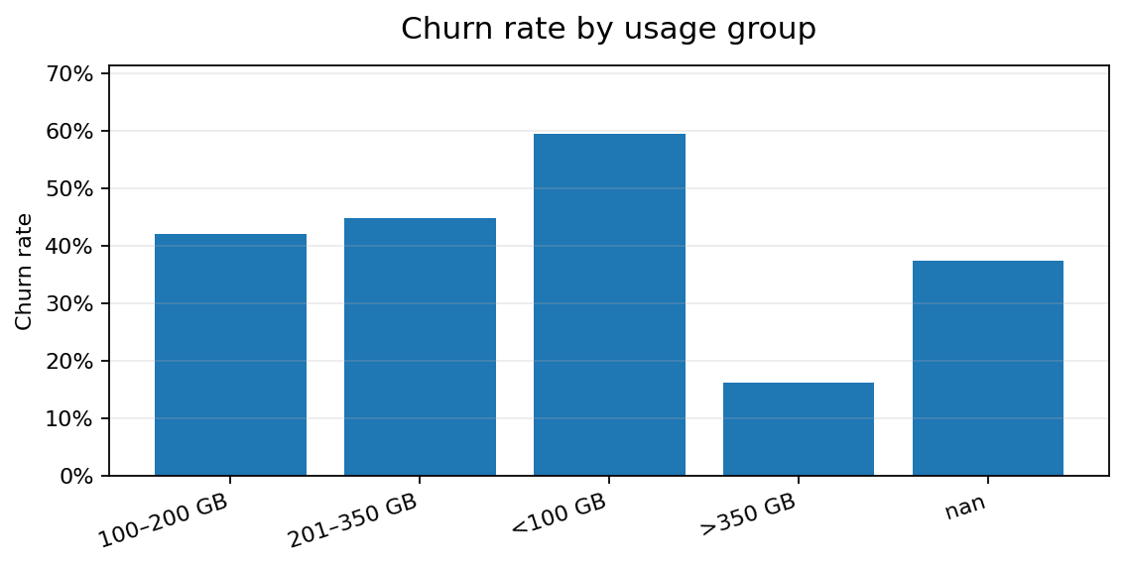
DS SPRINT 2026 • ROUND 4
Usage can help flag disengagement
Highest observed usage group:
<100 GB • 59.6%
Low usage may signal reduced engagement. Test a helpful check-in or plan-fit review before offering discounts.
CUSTOMER CHURN INSIGHT • SYNTHETIC PRACTICE DATA
08

Slide 9
DS SPRINT 2026 • ROUND 4
Recommended retention playbook
01 ONBOARD
02 RESOLVE
03 ENGAGE
First 90 days
Complaint recovery
Usage & plan fit
Welcome journey, usage education and proactive check-in.
Prioritize repeat complaints; follow up after resolution.
Contact low-usage customers with relevant options.
04 SUPPORT
05 MEASURE
Payment assistance
Controlled tests
Gentle reminders and clear payment support.
Compare outcomes against baseline or holdout group.
CUSTOMER CHURN INSIGHT • SYNTHETIC PRACTICE DATA
09

Slide 10
DS SPRINT 2026 • ROUND 4
30–60–90 day action plan
• Days 1–30 — Validate data quality, confirm risk segments and agree on baseline churn metrics.
• Days 31–60 — Pilot onboarding, complaint-recovery and payment-support interventions.
• Days 61–90 — Compare outcomes with baseline/control and scale only interventions that improve retention.
Success measures: churn rate • retention rate • complaint resolution time • repeat complaints • campaign response
CUSTOMER CHURN INSIGHT • SYNTHETIC PRACTICE DATA
10

Slide 11
DS SPRINT 2026 • ROUND 4
How we will know it worked
• Primary KPI: churn rate for each targeted segment.
• Guardrails: customer satisfaction, complaint recurrence and cost per retained customer.
• Evaluation: compare pilot results with a baseline or comparable control group.
• Scale only when improvement is measurable and sustainable.
No retention uplift is claimed before the interventions are tested.
CUSTOMER CHURN INSIGHT • SYNTHETIC PRACTICE DATA
11

Slide 12
DS SPRINT 2026 • ROUND 4
Conclusion: act on signals, validate impact
The analysis gives management a practical way to prioritize retention work.
• Identify segments with higher observed churn.
• Investigate tenure, complaints, payment behaviour and usage together.
• Launch focused retention pilots and measure their effect.
• Validate every pattern against real company data before operational decisions.
Understand customers. Detect disengagement. Strengthen retention.
CUSTOMER CHURN INSIGHT • SYNTHETIC PRACTICE DATA
12

