Slide 1

Project Expo 2026
Team Cognitrail
SatQuery
Satellite Intelligence, Queried Clearly
An interactive web application that brings satellite imagery
exploration, natural-language querying, and evidence-transparent
analysis into one workspace.
Krishiv | Srujan | Bhavna | Ridhi
SatQuery | Project Expo | Team Cognitrail
Satellite Intelligence, Queried Clearly
1 / 10

Slide 2
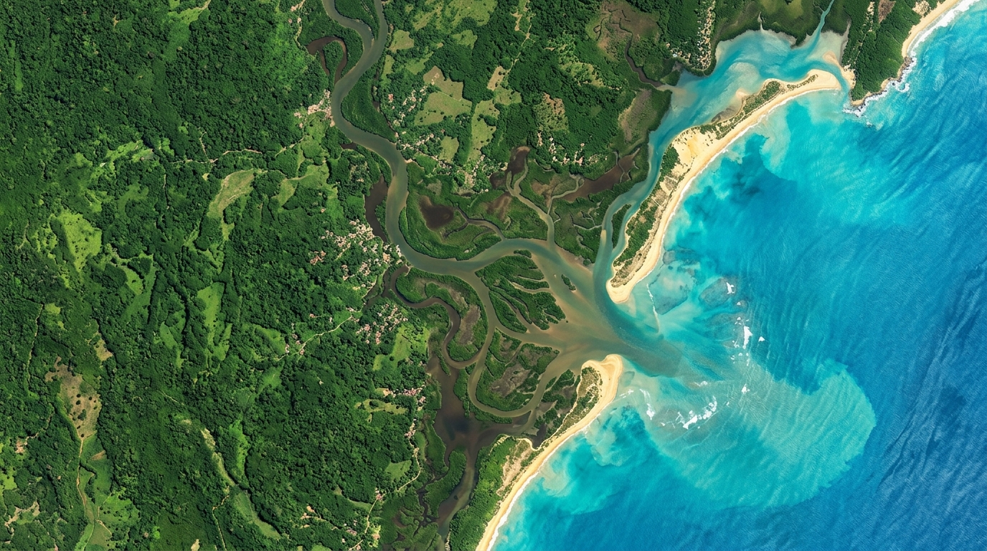
THE PROBLEM
Satellite data is powerful -- but using it takes expertise and many tools.
Finding Usable Imagery
Comparing Over Time
Trusting AI Output
Satellites may not have captured an image on the exact date requested.
No image for the exact date
Clouds & shadows block the view
Different dates = different extents
Small previews get blurry when enlarged
Comparing images across dates requires aligning projections, resolutions, and display settings.
Manual co-registration needed
Resolution mismatches between dates
No unified comparison workspace
Causes of change are hard to identify
AI explanations can sound convincing without enough supporting evidence behind them.
Explanations lack traceability
Source imagery not visible
Users cannot verify claims
Black-box answers erode trust
SatQuery bridges this gap: from geographic question to inspectable satellite evidence.
SatQuery | Project Expo | Team Cognitrail
Satellite Intelligence, Queried Clearly
2 / 10

Slide 3
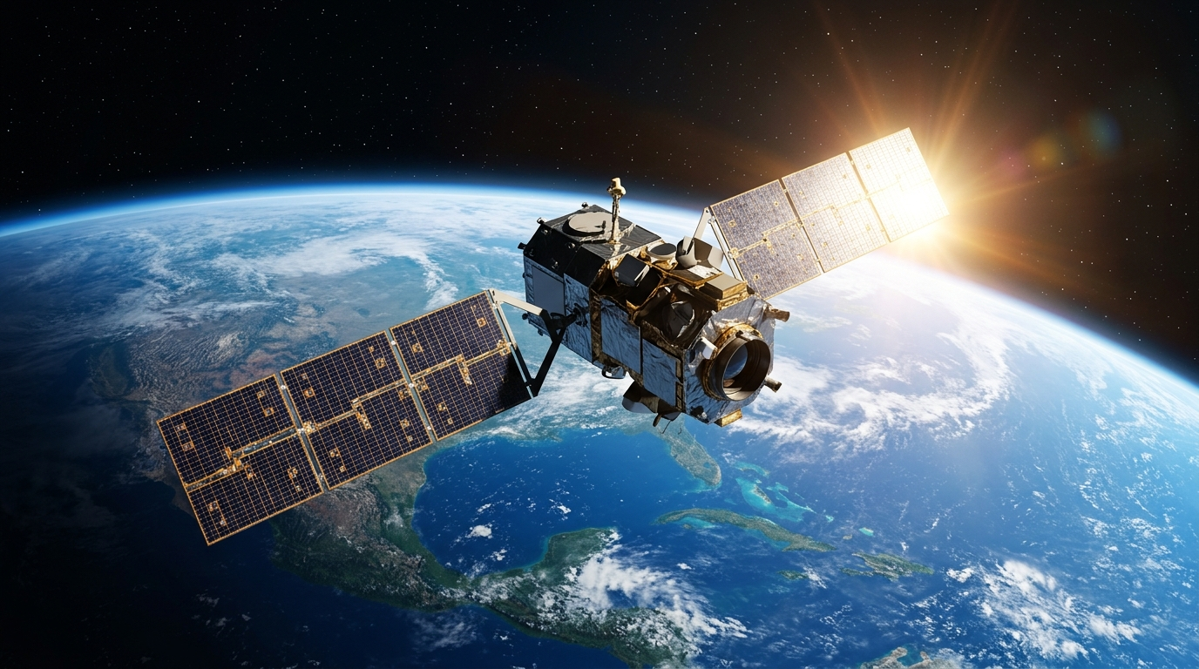
WHAT IS SATQUERY?
A web application that helps users explore satellite imagery, ask questions about a location, and compare observations from different dates -- combining maps, a 3D Earth viewer, image tools, and AI explanations in one workspace.
Search & Select
Retrieve & Prepare
Analyze & Explain
Inspect & Export
Search for any place on Earth
Enter coordinates or click the map
Choose area size to inspect
Pick dates or date ranges
Tolerance search for nearby dates
Find observations via STAC catalog
Sentinel-2 optical imagery
Sentinel-1 radar assets
Cloud/shadow pixel exclusion
Aligned images for comparison
Ask questions in plain English
Gemini & GeoChat AI adapters
Water-change screening
Spectral classification data
Explanations linked to evidence
Native-pixel image viewer
Zoom, pan, brightness controls
Synchronized side-by-side compare
Markdown & JSON reports
GeoJSON change polygons
SatQuery | Project Expo | Team Cognitrail
Satellite Intelligence, Queried Clearly
3 / 10

Slide 4
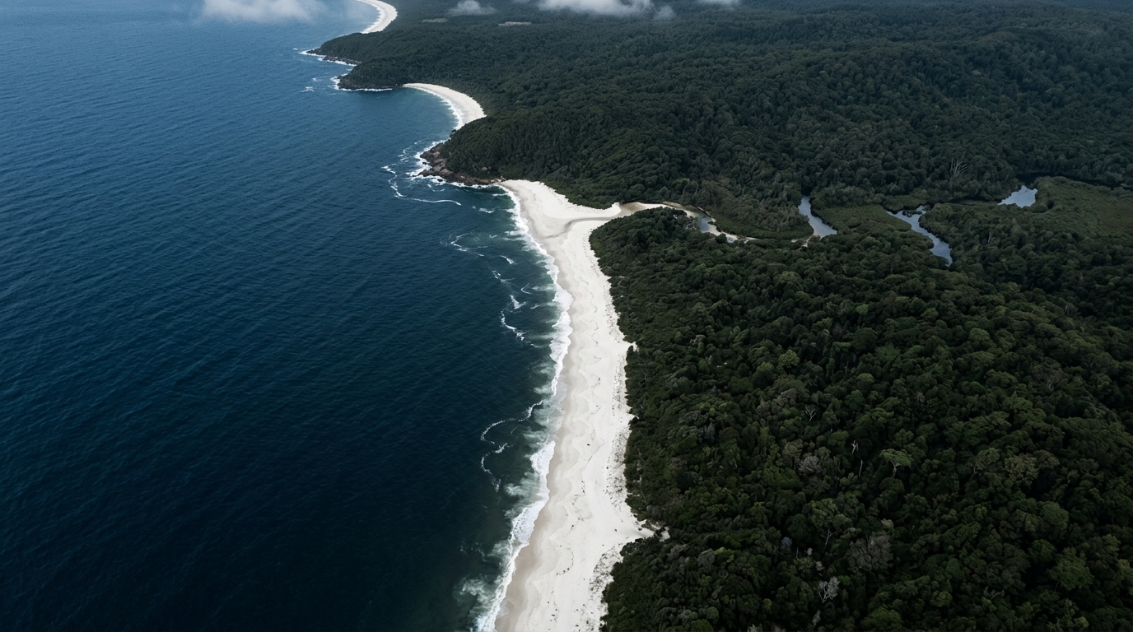
KEY FEATURES
Interactive Globe
Natural Language
Change Detection
Gesture Control
CesiumJS 3D Earth viewer with
rotation, zoom & evidence overlays
Ask questions like "What changed?"
and get traceable AI explanations
Bi-temporal comparison with
water-change screening & GeoJSON
MediaPipe hand-tracking to
rotate and zoom the globe
Evidence Trail
Smart Image Viewer
Multi-Sensor
Export & Reports
Every answer links to source
pixels, scene IDs & content hashes
Native-pixel zoom, pan, fullscreen,
brightness & contrast controls
Sentinel-2 optical + Sentinel-1
radar via Planetary Computer STAC
Markdown, JSON records, GeoJSON
polygons & image downloads
All features designed to make satellite analysis approachable while keeping source imagery and metadata available for inspection.
SatQuery | Project Expo | Team Cognitrail
Satellite Intelligence, Queried Clearly
4 / 10

Slide 5

SYSTEM ARCHITECTURE
USER INTERFACE
NL Query Chat
3D Globe Viewer
Leaflet Map
Image Viewer
FRONTEND (Vercel)
React | Vite | TypeScript | TailwindCSS
Leaflet | CesiumJS | MediaPipe Hand Tracking
BACKEND (Render)
FastAPI | Job Queue
Image Pipeline + AI
Rasterio + GDAL + NumPy
AI & ANALYSIS
Gemini LLM
GeoChat VLM
Water Change
Scene Classification
DATA SOURCES
Sentinel-2 Optical
Sentinel-1 SAR
Planetary Computer STAC
Esri World Imagery
SQLite Jobs
SatQuery | Project Expo | Team Cognitrail
Satellite Intelligence, Queried Clearly
5 / 10

Slide 6
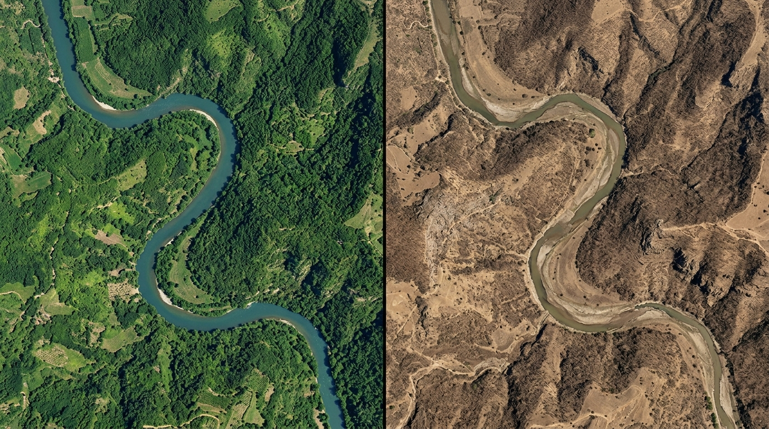
HOW IT WORKS
From geographic question to inspectable satellite evidence
1
2
3
4
5
6
Pick a Place
Choose Dates
Ask a Question
Retrieve
Analyze
Inspect
Search, enter coords,
or click the map.
Choose area size.
Select one date or
two for comparison.
Date tolerance search.
"Describe water features"
"What changed?"
"Any limitations?"
STAC catalog search.
Cloud filtering.
Align & crop tiles.
AI interpretation.
Water-change screening.
Spectral classification.
View evidence, maps,
explanations & warnings.
Export reports.
EXAMPLE QUERY
"Does the available imagery suggest a change in water coverage between these two dates?"
SatQuery | Project Expo | Team Cognitrail
Satellite Intelligence, Queried Clearly
6 / 10

Slide 7

TECHNOLOGY STACK
FRONTEND
BACKEND
AI / ANALYSIS
DATA & DEPLOY
React
Python
Gemini
Planetary Computer
Application UI
Core language
NL interpretation
STAC satellite catalog
Vite
FastAPI
GeoChat
Sentinel-2
Build & dev server
API & job queue
Vision-language model
10m optical imagery
Leaflet
Rasterio
Scene Classification
Sentinel-1
2D interactive maps
Raster image I/O
Cloud/water/land pixels
SAR radar data
CesiumJS
GDAL
Water Screening
SQLite
3D Earth globe
Geospatial transforms
Change estimation
Job state persistence
MediaPipe
NumPy
Content Hashing
Vercel
Hand gesture tracking
Array computation
Evidence fingerprints
Frontend hosting
TailwindCSS
PyProj
Job Pipeline
Render
Utility-first styling
Geographic calculations
Async processing
Backend hosting
SatQuery | Project Expo | Team Cognitrail
Satellite Intelligence, Queried Clearly
7 / 10

Slide 8

3D GLOBE & GESTURE CONTROLS
CesiumJS 3D Earth
Performance Optimizations
Rotate, zoom, and fly to any location
Display dated imagery layers with adjustable opacity
Show area-of-interest and change polygons
Distinguishes navigation from analysis imagery
Gesture Modes (MediaPipe):
Auto -- One-hand rotate + two-hand zoom
Rotate -- Open hand movement controls rotation
Zoom -- Pinch or spread palms to zoom
Lower hands or close fists to pause
Press Escape to disable camera
All processing happens locally in browser
Low-resolution camera input for speed
Capped inference rate
Slower tracking while paused
Adaptive delays on slower devices
Reuse of image-processing canvas
Motion smoothing & small-movement thresholds
Rejection of large tracking jumps
Movement references reset on gesture change
Mouse and touch input always available
as alternatives for all users.
SatQuery | Project Expo | Team Cognitrail
Satellite Intelligence, Queried Clearly
8 / 10

Slide 9
EVIDENCE & TRANSPARENCY
Every result is traceable to its source observations
What Gets Recorded
Export Formats
Satellite / sensor name & scene identifier
Requested date vs. actual acquisition date
Geographic bounds & image dimensions
Usable-pixel coverage percentage
Processing details & pipeline steps
Content hash (digital fingerprint of image bytes)
Markdown Reports
Readable analysis summaries
JSON Evidence
Structured metadata & results
GeoJSON
Change polygons for mapping tools
Image Downloads
Processed observation copies
Browser Storage
Recent analyses saved locally
Honest Limitations
Imagery may be unavailable for the exact date requested
Image enlargement cannot overcome source-resolution limits
Water-change estimates require independent validation
AI explanations depend on external services & require review
Focuses on exploration -- not operational-grade measurement
SatQuery | Project Expo | Team Cognitrail
Satellite Intelligence, Queried Clearly
9 / 10

Slide 10

Thank You!
Satellite Intelligence, Queried Clearly
Team
Cognitrail
Krishiv | Srujan | Bhavna | Ridhi
SatQuery | Project Expo | Team Cognitrail
Satellite Intelligence, Queried Clearly
10 / 10

