Slide 1

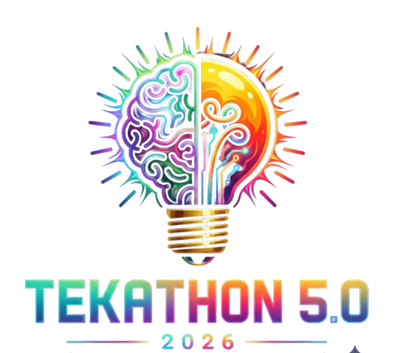
TEKATHON-5.0- 2026
Problem Statement ID – SIH26164
Problem Statement Title- Enterprise Cryptographic Discovery & Analysis Tool (ECDAT)
Theme- Blockchain & Cybersecurity
PS Category- Software
Team Name - Cognitrail

Slide 2
IDEA TITLE
Enterprise Cryptographic Posture Management
Proposed Solution
1. Tri-Modal Discovery: Fuses AST, network (TLS) & binary scans.
2. Unified Dashboard: Single-pane enterprise crypto inventory.
3. Automated Compliance: Real-time CycloneDX v1.6 CBOM.
Addressing the Problem
1. Zero Alert Fatigue: Prunes false positives via reachability slicing
2. Finds Hidden Keys: Network
probes catch what static scans miss.
3. Actionable Fixes: Precise, automated refactoring guidance.
Innovation & Uniqueness
1. Mosca's Risk Engine: Prioritizes threats via "Harvest Now, Decrypt Later."
2. Blast-Radius Mapping: Neo4j maps failures before key rotation.
@TEKATHON-4.0- Template

Slide 3
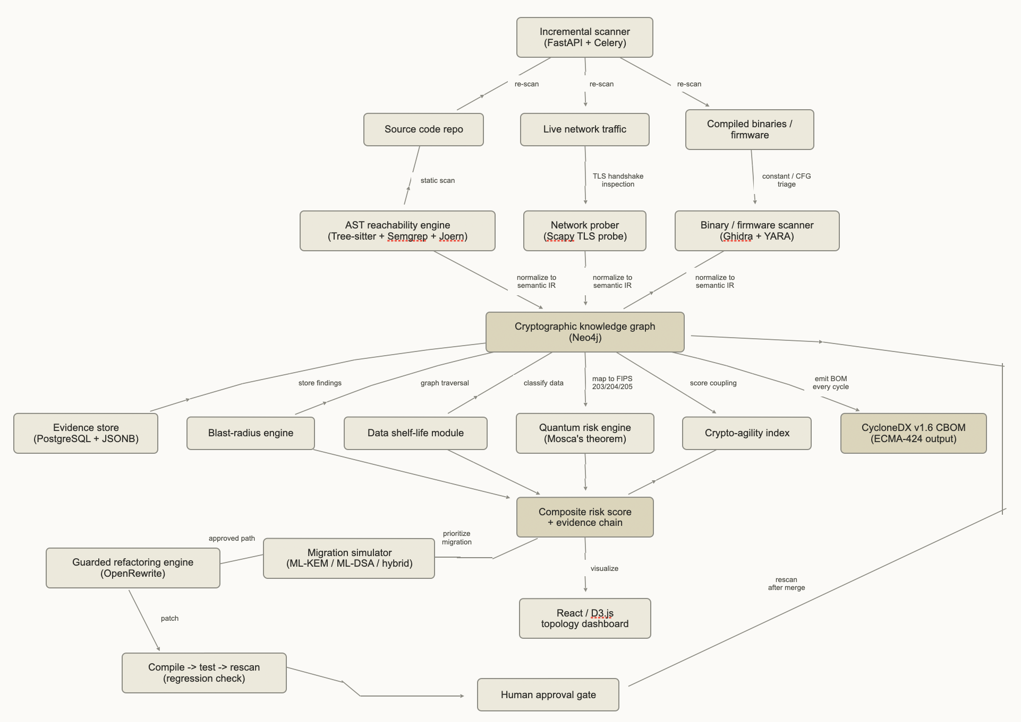
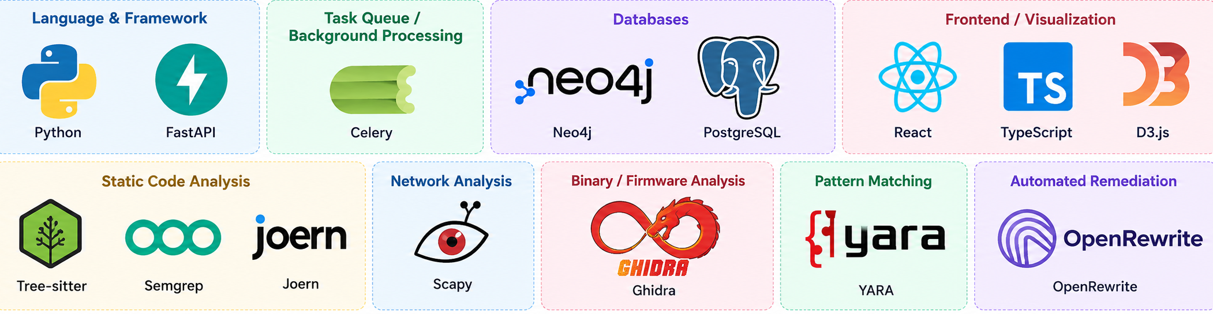
TECHNICAL APPROACH
ARCHITECTURE
Multi-Modal Discovery: Source Code + Live Network + Binary/Firmware
Unified Crypto Knowledge Graph: Correlates cryptographic assets
Context-Aware Risk Engine: Quantum Risk + HNDL + Data Shelf-Life + Blast Radius
PQC Migration Simulator: ML-KEM / ML-DSA / Hybrid + MTU, latency & compatibility analysis
Guarded Remediation: Patch → Compile → Test → Rescan → Human Approval
Continuous Posture: Incremental scanning + live CBOM generation
COMPONENTS
Discovery Engine: Tree-sitter, Semgrep, Joern, YARA
Knowledge Graph: Neo4j + PostgreSQL/JSONB
Backend: Python + FastAPI + Celery
Risk & Migration: Graph-based analysis + Mosca’s Theorem + PQC simulation
Remediation: OpenRewrite for AST-safe automated changes
Dashboard: React + TypeScript + D3.js
@TEKATHON-4.0- Template
@TEKATHON-3.0- Template
Notes:
Generated notes (Beta). Check for accuracy.
Let's dive into the technical approach of ECDAT
We've organized our solution into several key layers
Starting with the Discovery Layer, this is where we gather all our raw data
We analyze source code using advanced tools like Tree-sitter and Semgrep
For network discovery, we employ Scapy for non-intrusive TLS probing
Binary and firmware analysis is handled with Ghidra and YARA
This comprehensive approach lets us detect cryptographic algorithms, keys, and their usage

Slide 4
FEASIBILITY AND VIABILITY
Analysis of the feasibility of the idea
Sovereign Architecture: 100% Air-Gapped capability. Zero external cloud API dependencies, ensuring strict compliance for defense networks.
2. Compilation Independent: AST parsers read raw code directly, bypassing complex enterprise build environments (e.g., Maven, NPM).
3. Non-Intrusive Network Probing: Analyzes TLS client-hello handshakes without interrupting live production traffic.
Potential challenges and risks
Alert Fatigue: Legacy code dead-paths generating thousands of false positives
Scan Bottlenecks: Enterprise-scale monorepos stalling CI/CD pipelines.
Breaking Code: Automated crypto fixes crashing applications silently.
Strategies for overcoming these challenges
Reachability Slicing:
Call-graphs prove if crypto is actually reachable in production
Incremental Scanning:
Uses delta-caching and content hashing.
Guarded Refactoring:
Patch → Compile → Test → Human Approval loop.
@TEKATHON-4.0- Template
@TEKATHON-3.0- Template
@TEKATHON-3.0- Template

Slide 5
IMPACT AND BENEFITS
IMPACT
1. Government & Defense (NTRO, CERT-In):
Provides deterministic sovereign posture management defending against nation-state data harvesting operations.
2. Critical Infrastructure (BFSI):
Secures power grids and banking by mapping downstream blast-radii before deprecating legacy keys.
FOR INSTANCE : USER STORY
Scenario
A defence organization uses ECDAT in its secure, air-gapped network to find and track cryptography across its applications and systems.
Impact
Better Security: Quickly identifies outdated or risky cryptographic algorithms.
Clear Visibility: Shows where cryptography is being used and which systems depend on it.
Benefits
Quantum Ready: Helps prioritize systems that need safer, post-quantum algorithms.
Safer Updates: Supports controlled fixes without disrupting critical applications.
Easy Audits: Generates clear cryptographic inventory and compliance reports.
BENEFITS
1. Security: Deterministic defense against "Harvest Now, Decrypt Later."
2. Economic: Cuts multi-month audits to minutes of automation.
3. Operational: Instant, audit-ready CycloneDX compliance evidence.
@TEKATHON-4.0- Template
@TEKATHON-3.0- Template
@TEKATHON-3.0- Template

Slide 6
RESEARCH AND REFERENCES
https://csrc.nist.gov/pubs/cswp/39/upd1/considerations-for-achieving-crypto-agility/final
https://pages.nist.gov/nccoe-migration-post-quantum-cryptography/
https://csrc.nist.gov/pubs/fips/203/final
https://csrc.nist.gov/pubs/fips/204/final
https://csrc.nist.gov/pubs/fips/205/final
https://eprint.iacr.org/2015/1075
https://cyclonedx.org/news/cyclonedx-v1.6-now-an-ecma-international-standard/
https://ecma-international.org/wp-content/uploads/ECMA-424_1st_edition_june_2024.pdf
https://www.etsi.org/deliver/etsi_tr/104000_104099/104016/01.01.01_60/tr_104016v010101p.pdf
https://english.aivd.nl/documents/2024/12/3/the-pqc-migration-handbook
https://www.nsa.gov/Cybersecurity/Post-Quantum-Cybersecurity-Resources/
https://github.com/NationalSecurityAgency/ghidra
@TEKATHON-4.0- Template
@TEKATHON-3.0- Template
@TEKATHON-3.0- Template

