Slide 1

RESUME PROJECT CHALLENGE
Presenter: Rhytham Bajaj
Challenge #6
Provide Insights to the Marketing Team in Food & Beverage Industry
Domain: F & B Function: Marketing
Company Name : CodeX
Tools Used :
MySQL
Power BI

Slide 2
About CodeX
CodeX is a German beverage company that is aiming to make its mark in the Indian market.
BACKGROUND
1. A few months ago, they launched their energy drink in 10 cities of India.
2. With the launch of the energy drinks They conducted a survey in those 10 cities and received results from 10k respondents.
3. The Marketing team is now aiming for increasing brand awareness, market share, and product development.
OBJECTIVE
The Objective is to create a dashboard for the marketing team to convert these survey results to meaningful insights
which can be used to drive actions and help in better and deeper understanding of the market.

Slide 3
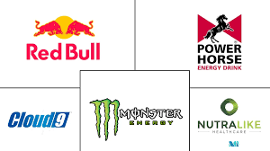
India Energy Drinks Market Analysis
The India energy drink market is projected to register a CAGR of 9.98% over the next five years.
Energy drinks are gaining massive popularity among millennials due to aggressive marketing campaigns targeting young consumers. Moreover, advertisements promote energy drinks as drinks that ignite the mind, refresh the body, and enhance performance and stamina.
Over the medium term, the increased demand for energy boosters from the young population in parties and clubs is accelerating the demand for energy drinks in India. Increased urbanization, rising disposable income, and growing health consciousness among the Indian youth have increased the demand for non-carbonated drinks called energy drinks. At the same time, long and erratic working hours led to consumption of energy drinks.
Major soft drink companies like PepsiCo and Coca-Cola entered the market for energy drinks to compete with industry leaders in India.
India Energy Drinks Market Leaders
Goldwin Healthcare
Power Horse Energy Drinks GMBH
Monster Beverage Corporation
Nutra like Health Care
Red Bull GMBH

Slide 4
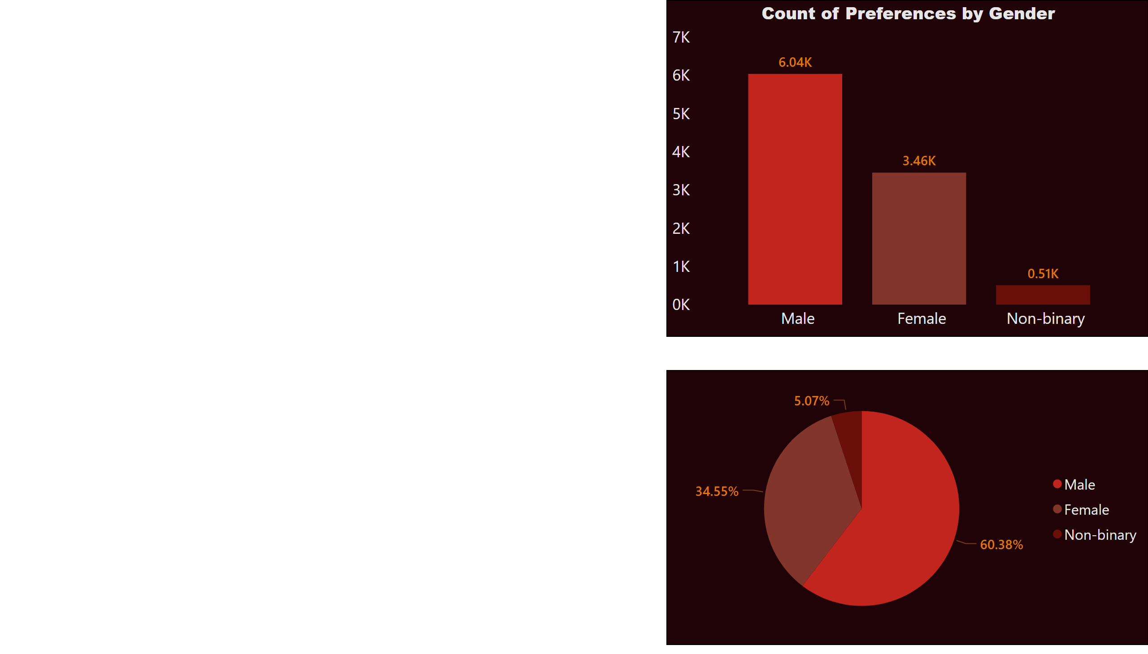
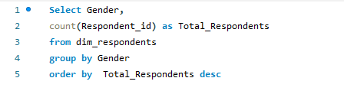
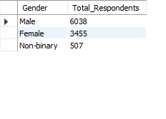
Page 1
Demographic Insights
Who prefers energy drink more? (male/female/non-binary?)
Query
Output
Energy drinks are more popular among males followed by females and non binary population.
Notes:
pieChart
No alt text provided
Count of Preferences by Gender
No alt text provided

Slide 5
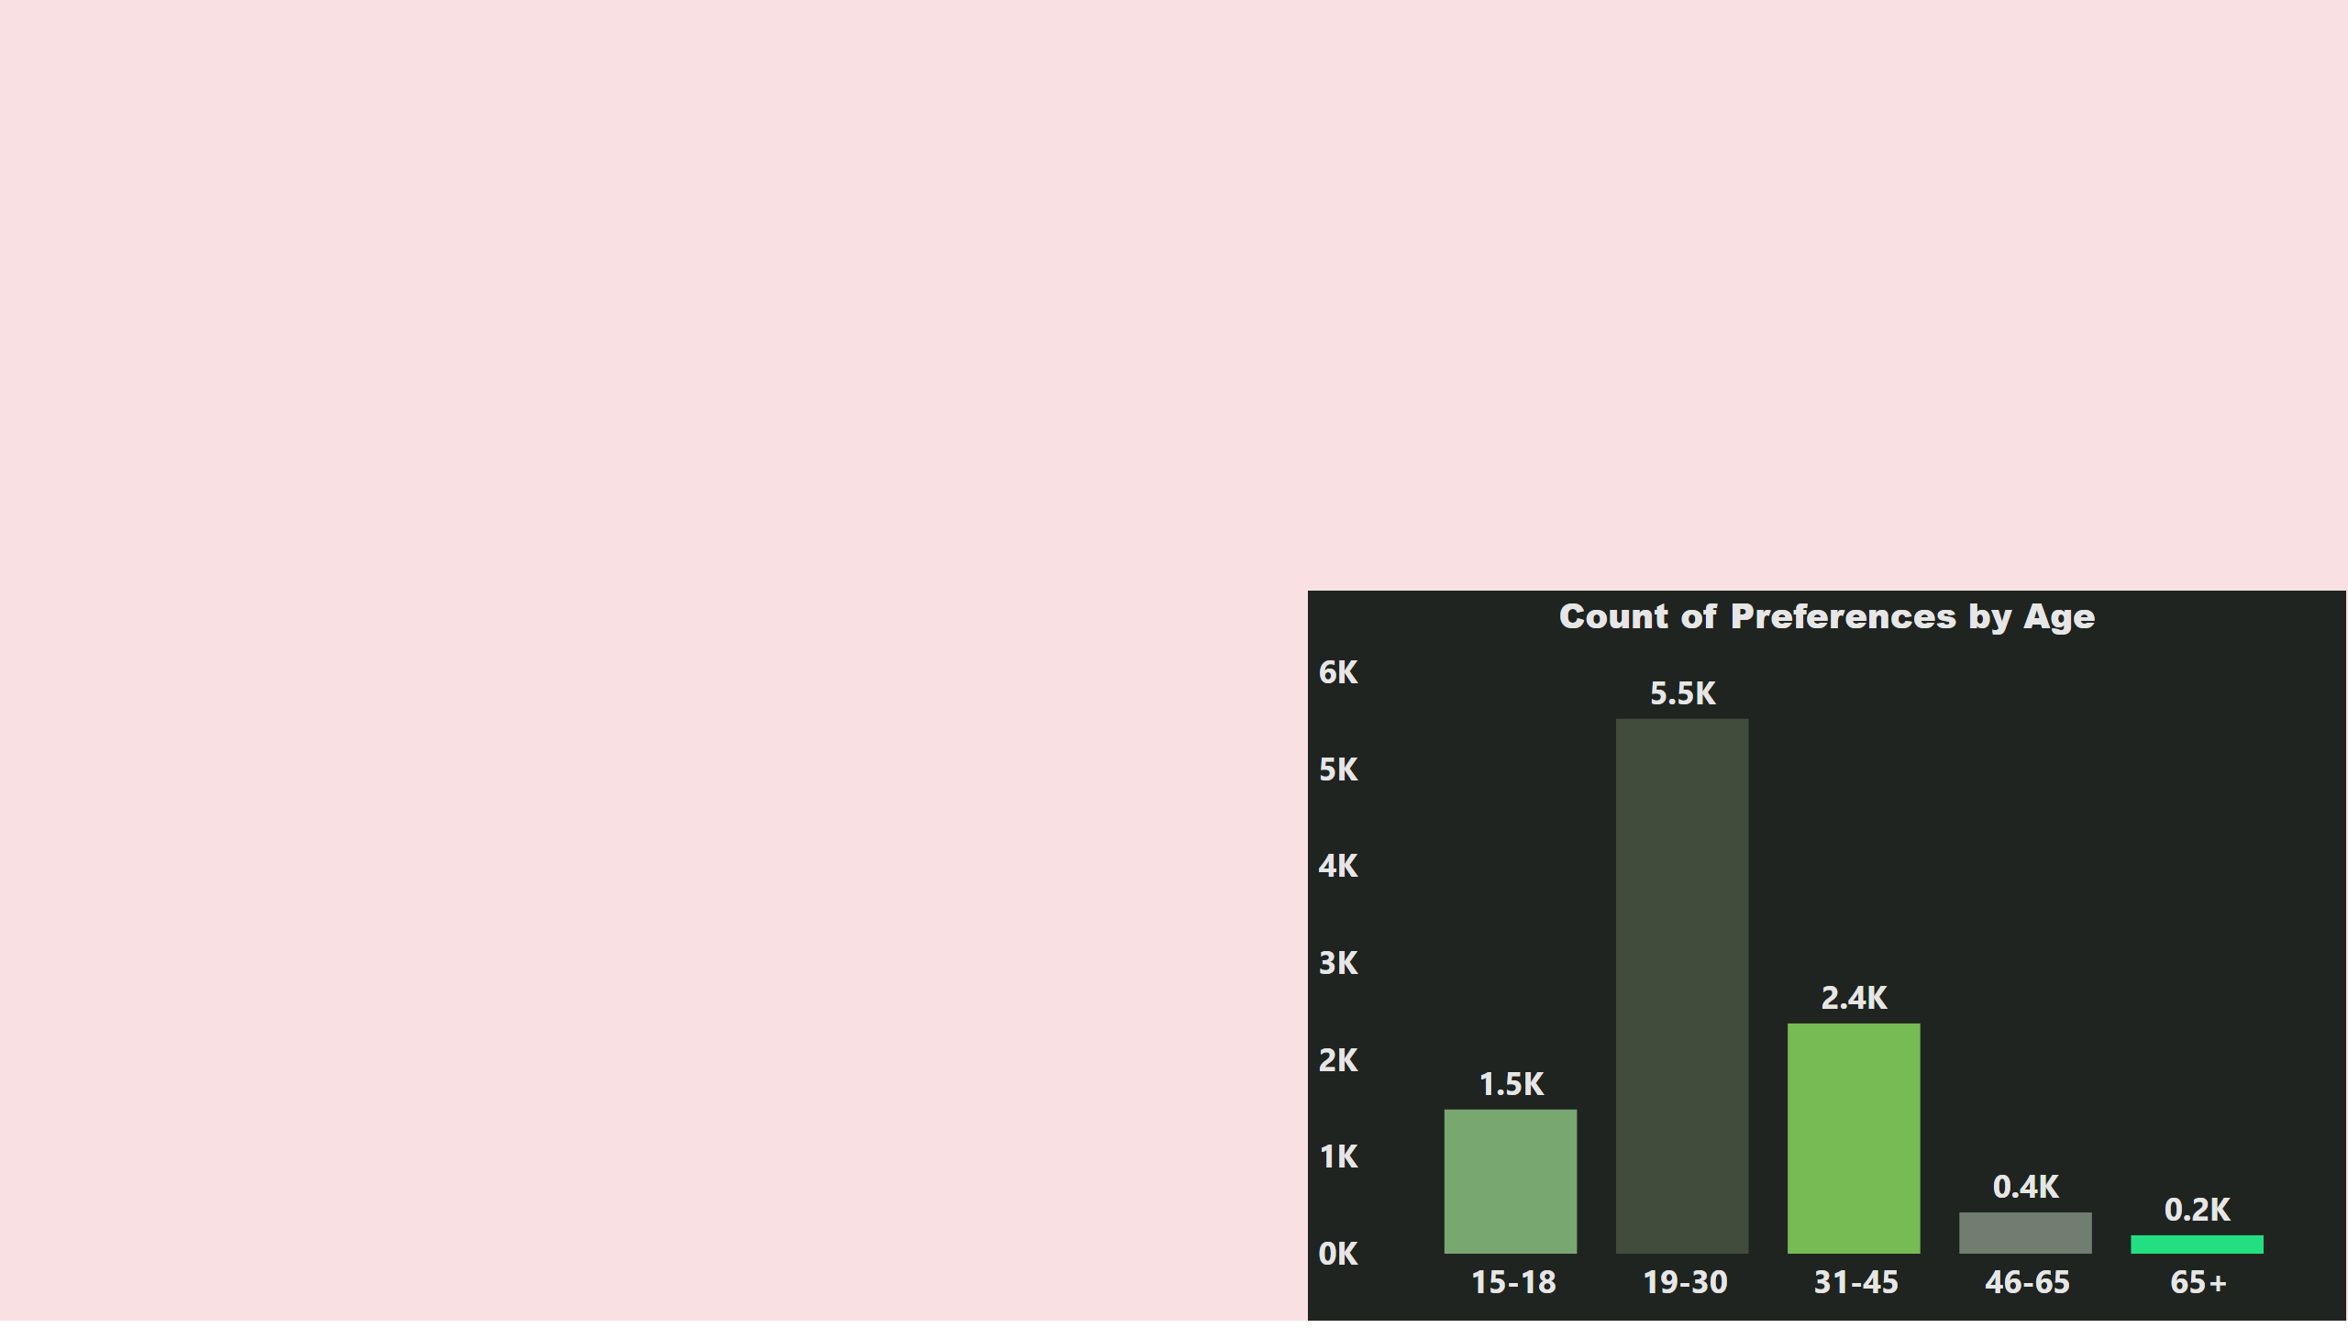
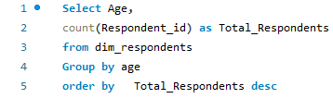
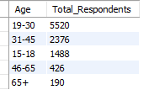
Page 2
Demographic Insights
Which age group prefers energy drinks more?
Query
Output
The age group 19-45 years has the highest consumer base and it is important to target this segment more effectively.
Notes:
Count of Preferences by Age
No alt text provided

Slide 6
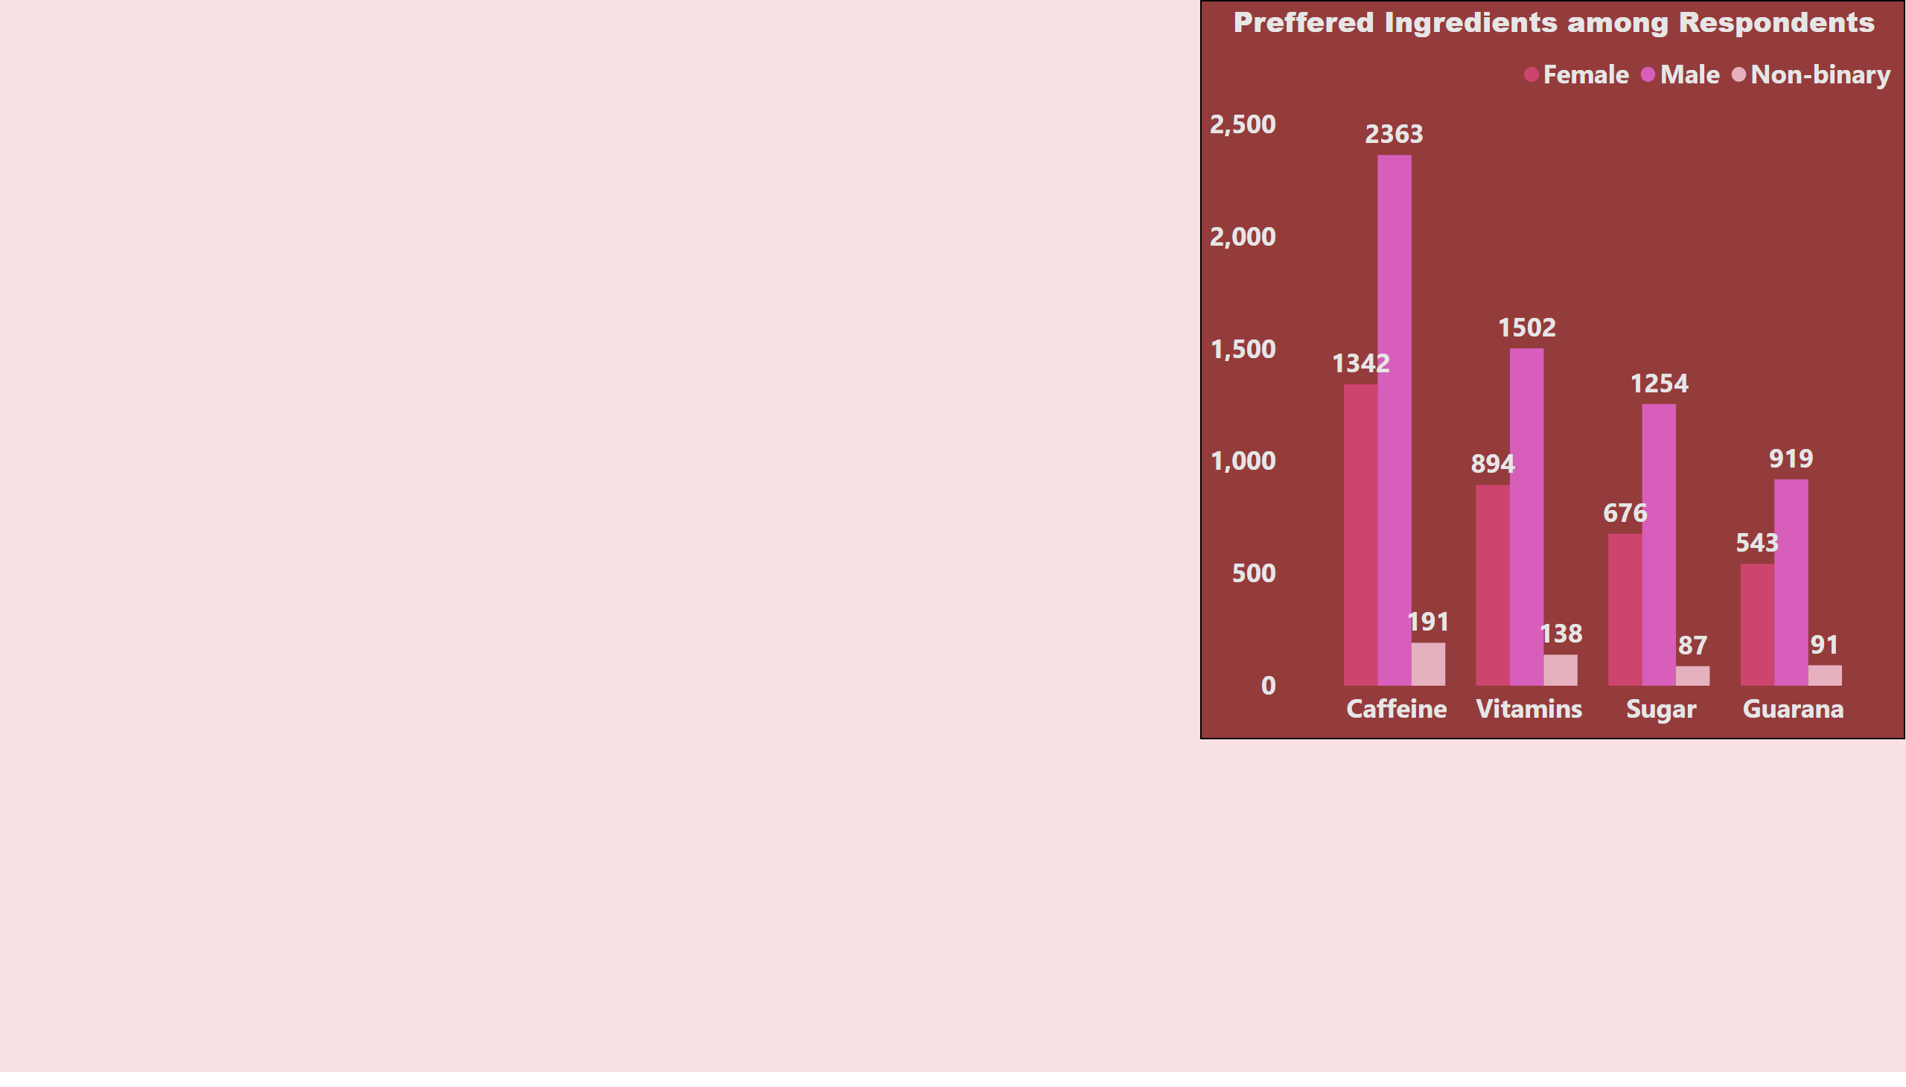
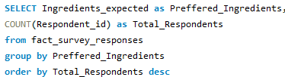

Page 3
Consumer Preferences:
What are the preferred ingredients of energy drinks among respondents?
Query
Output
People like caffeine more in comparison with other ingredients hence , more caffeine based products should be considered.
Notes:
Preffered Ingredients among Respondents
No alt text provided

Slide 7
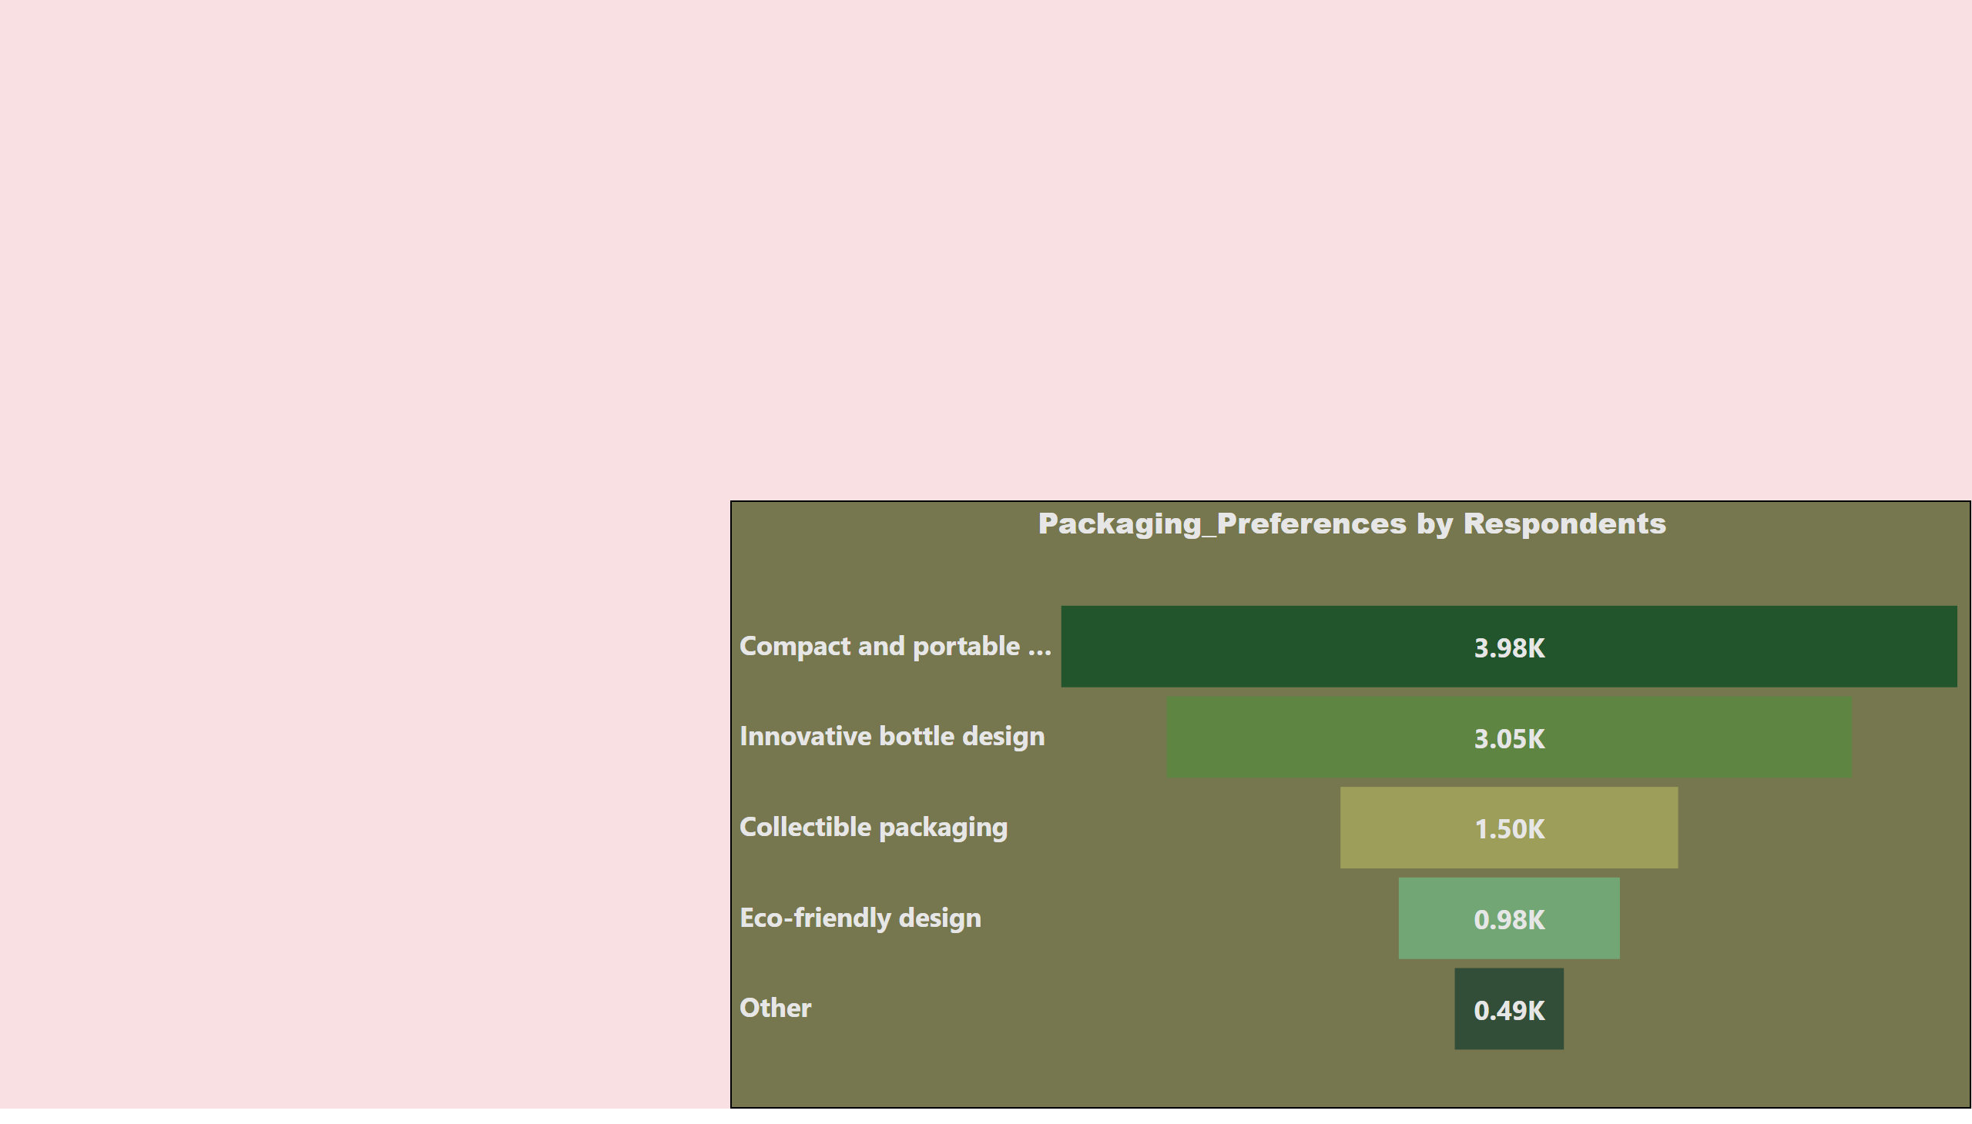
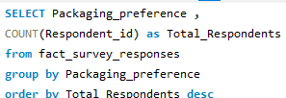
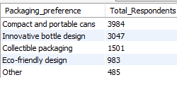
Page 4
Consumer Preferences:
What packaging preferences do respondents have for energy drinks?
Query
Output
Compact and portable cans are mainly preferred by the customers because they are handy and convenient to carry . Moreover, it looks quite attractive.
Notes:
Packaging_Preferences by Respondents
No alt text provided

Slide 8
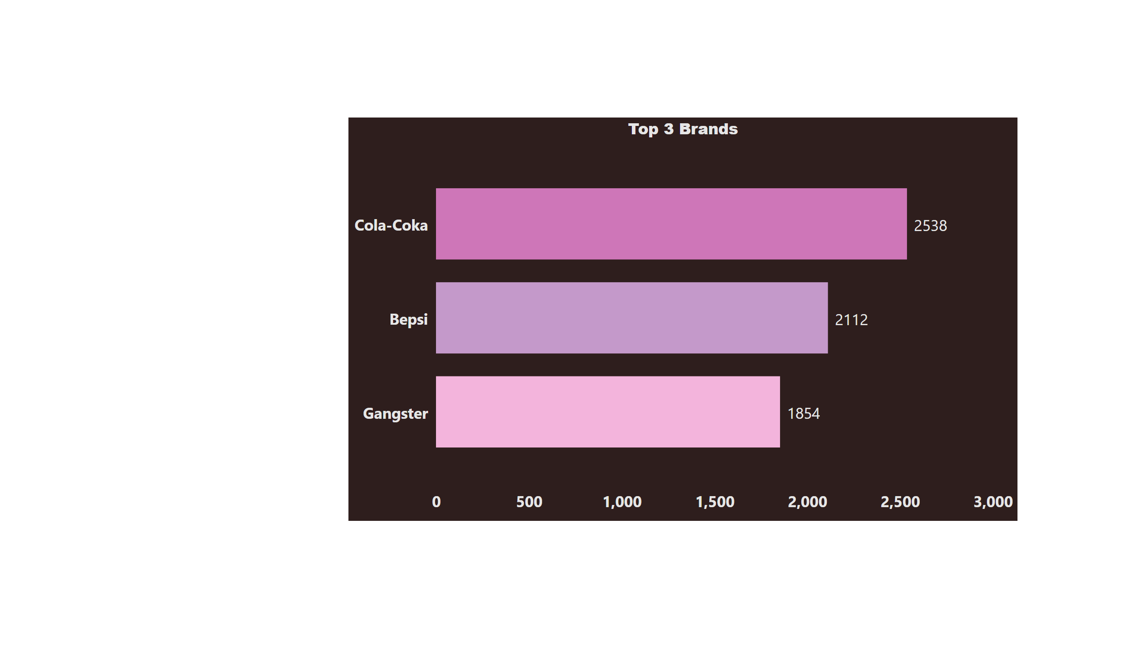
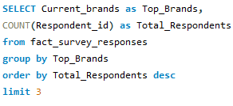

Page 5
Competition Analysis
Who are the current market leaders?
Query
Output
Cola-Coka , Bepsi , Gangster are the current market leaders.
Notes:
Top 3 Brands
No alt text provided

Slide 9
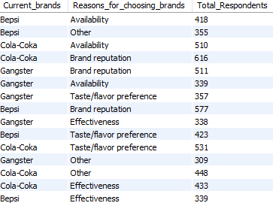
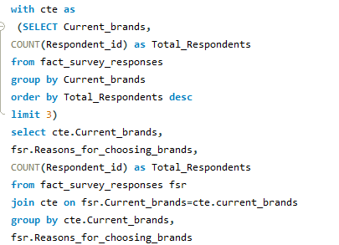
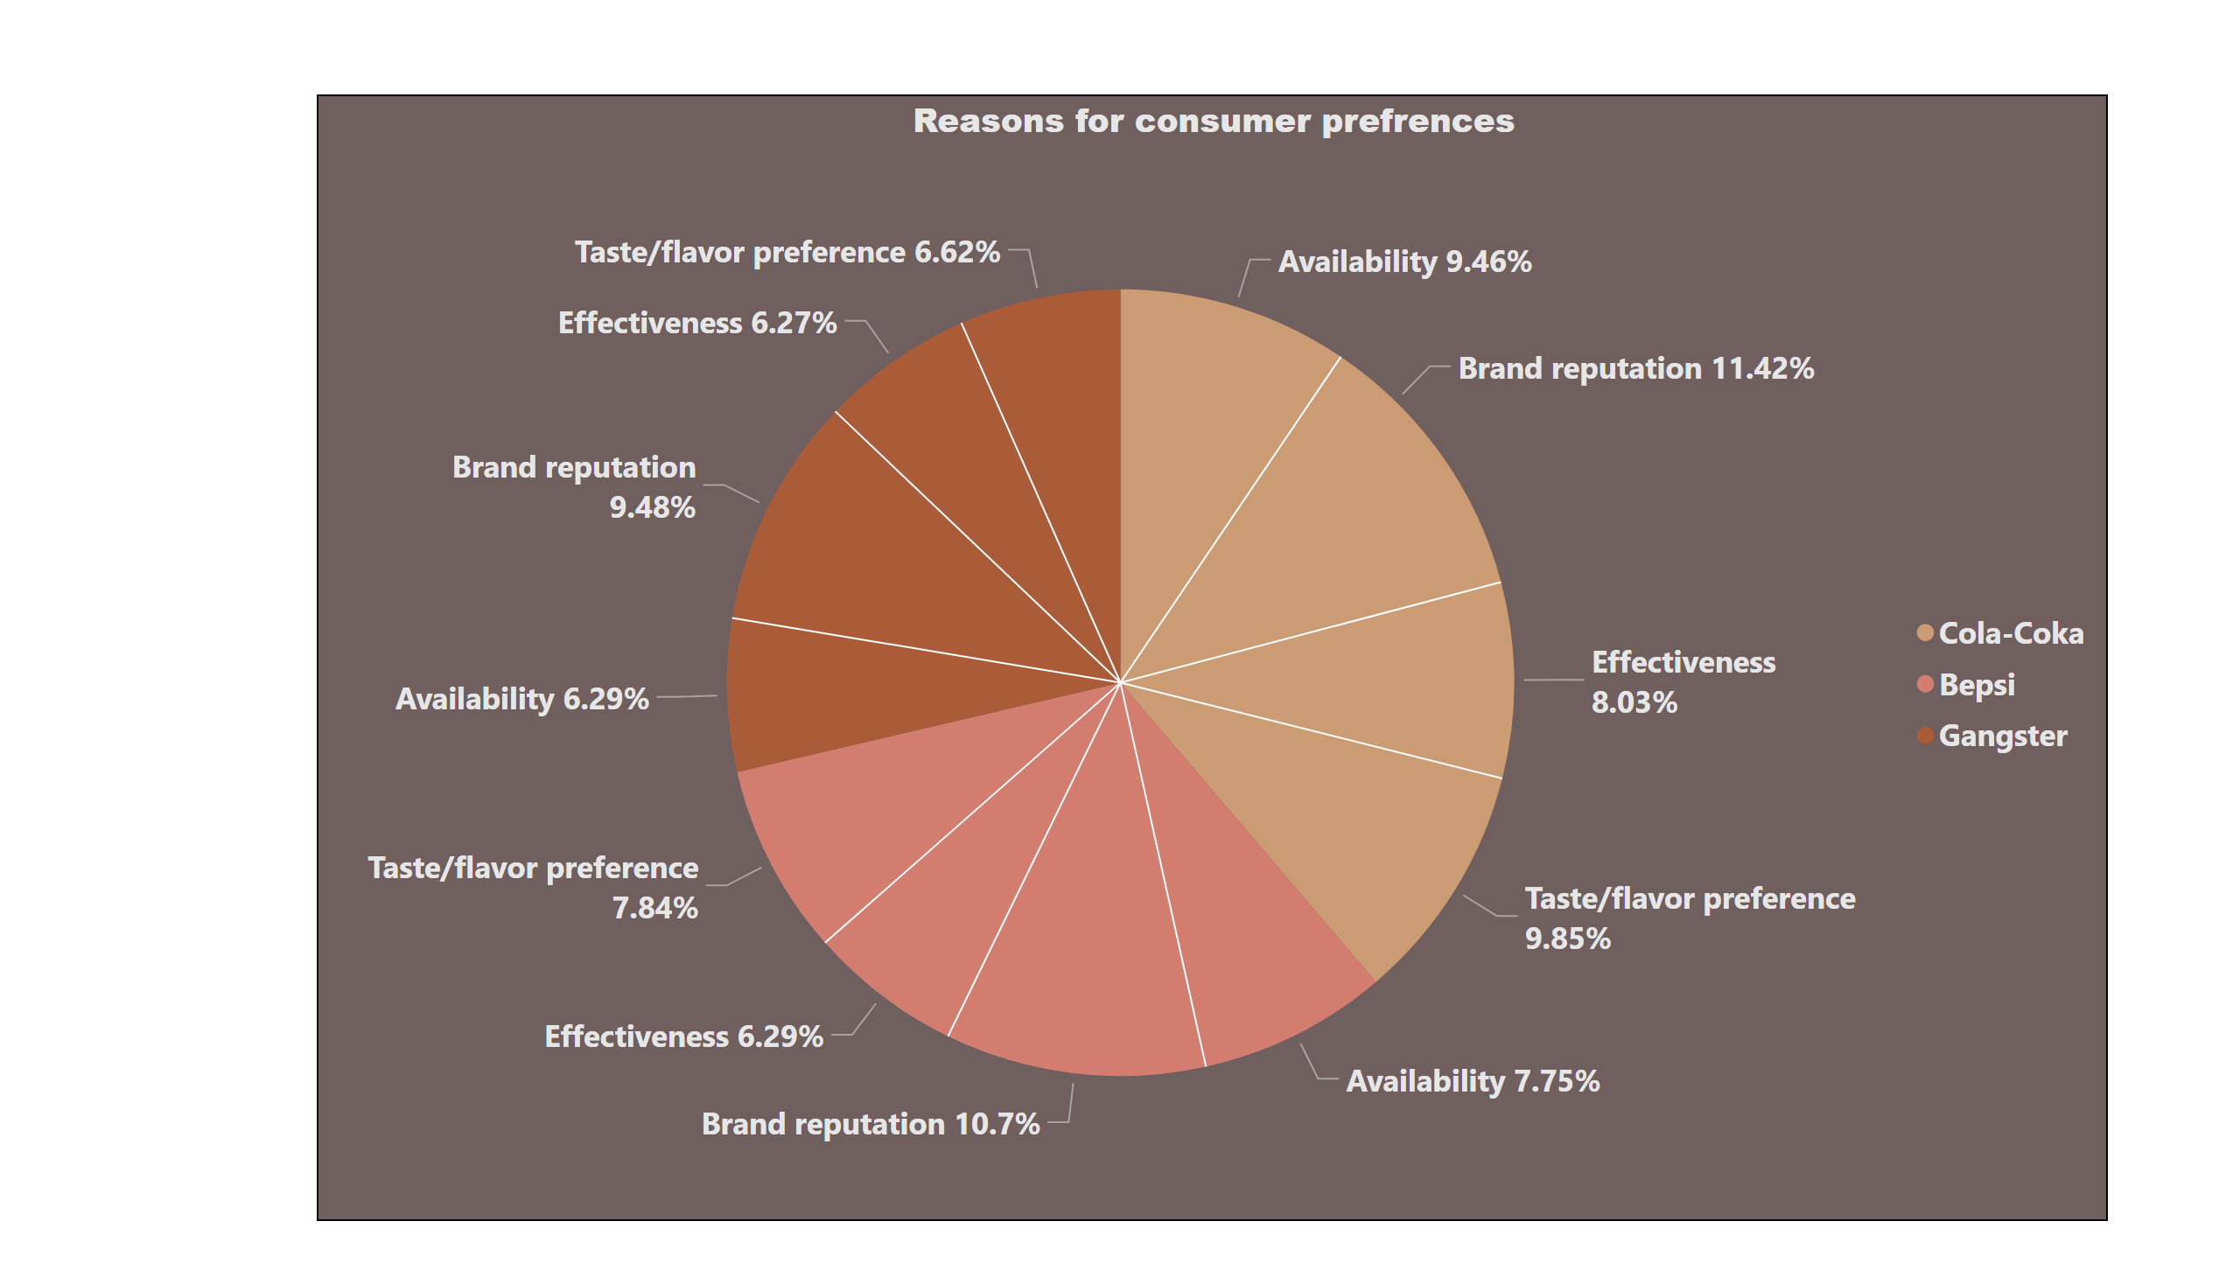

Page 6
Competition Analysis
What are the primary reasons consumers prefer those brands over ours?
The reasons for choosing these brands over CodeX are their easy availability, brand reputation, taste and preferences and effectiveness.
Notes:
Reasons for consumer prefrences
No alt text provided

Slide 10
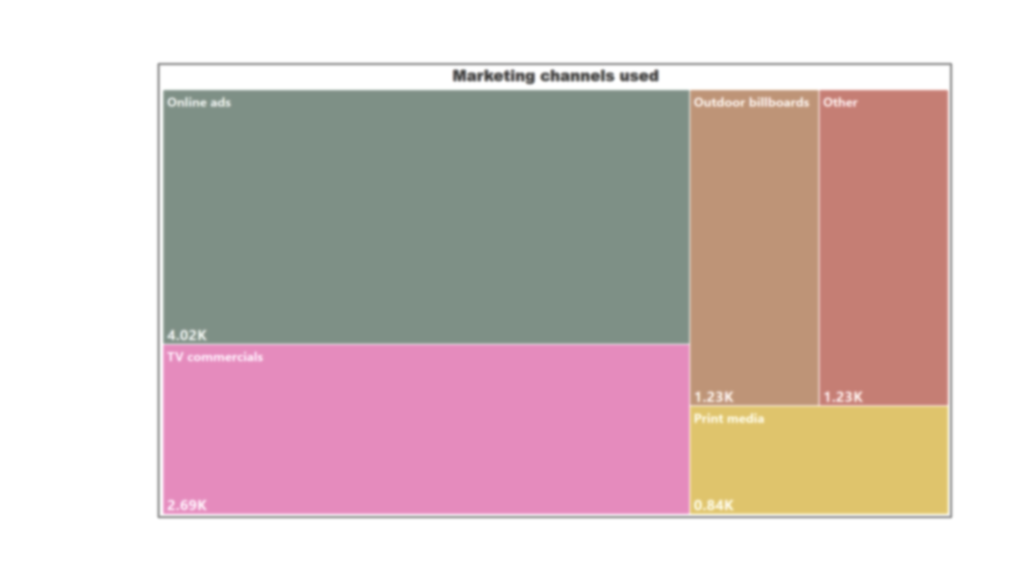
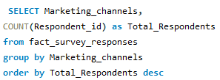
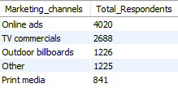
Page 7
Marketing Channels and Brand Awareness
Which marketing channel can be used to reach more customers?
Query
Output
Online ads are most effective way to reach more audience followed by TV commercials. So, CodeX should be spend more on these online ads.
Notes:
Marketing channels used
No alt text provided

Slide 11
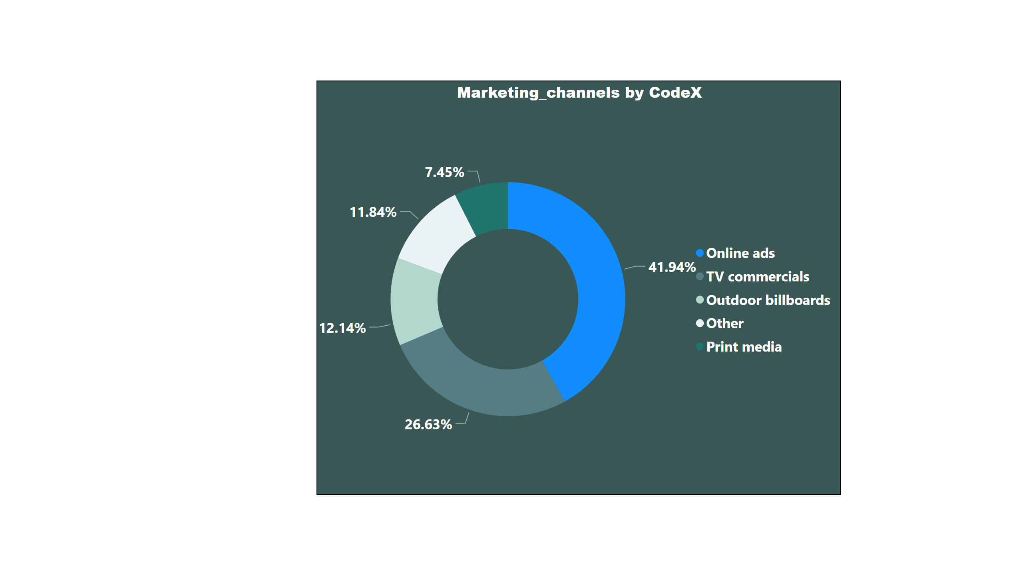
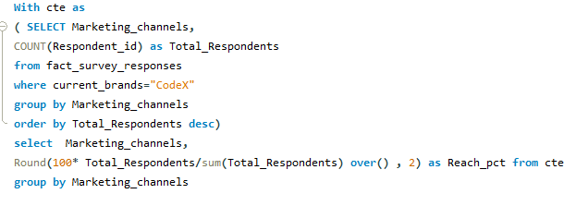
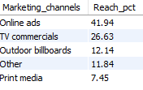
Page 8
Marketing Channels and Brand Awareness
How effective are different marketing strategies and channels in reaching our customers ?
Query
Output
Notes:
Marketing_channels by CodeX
No alt text provided

Slide 12
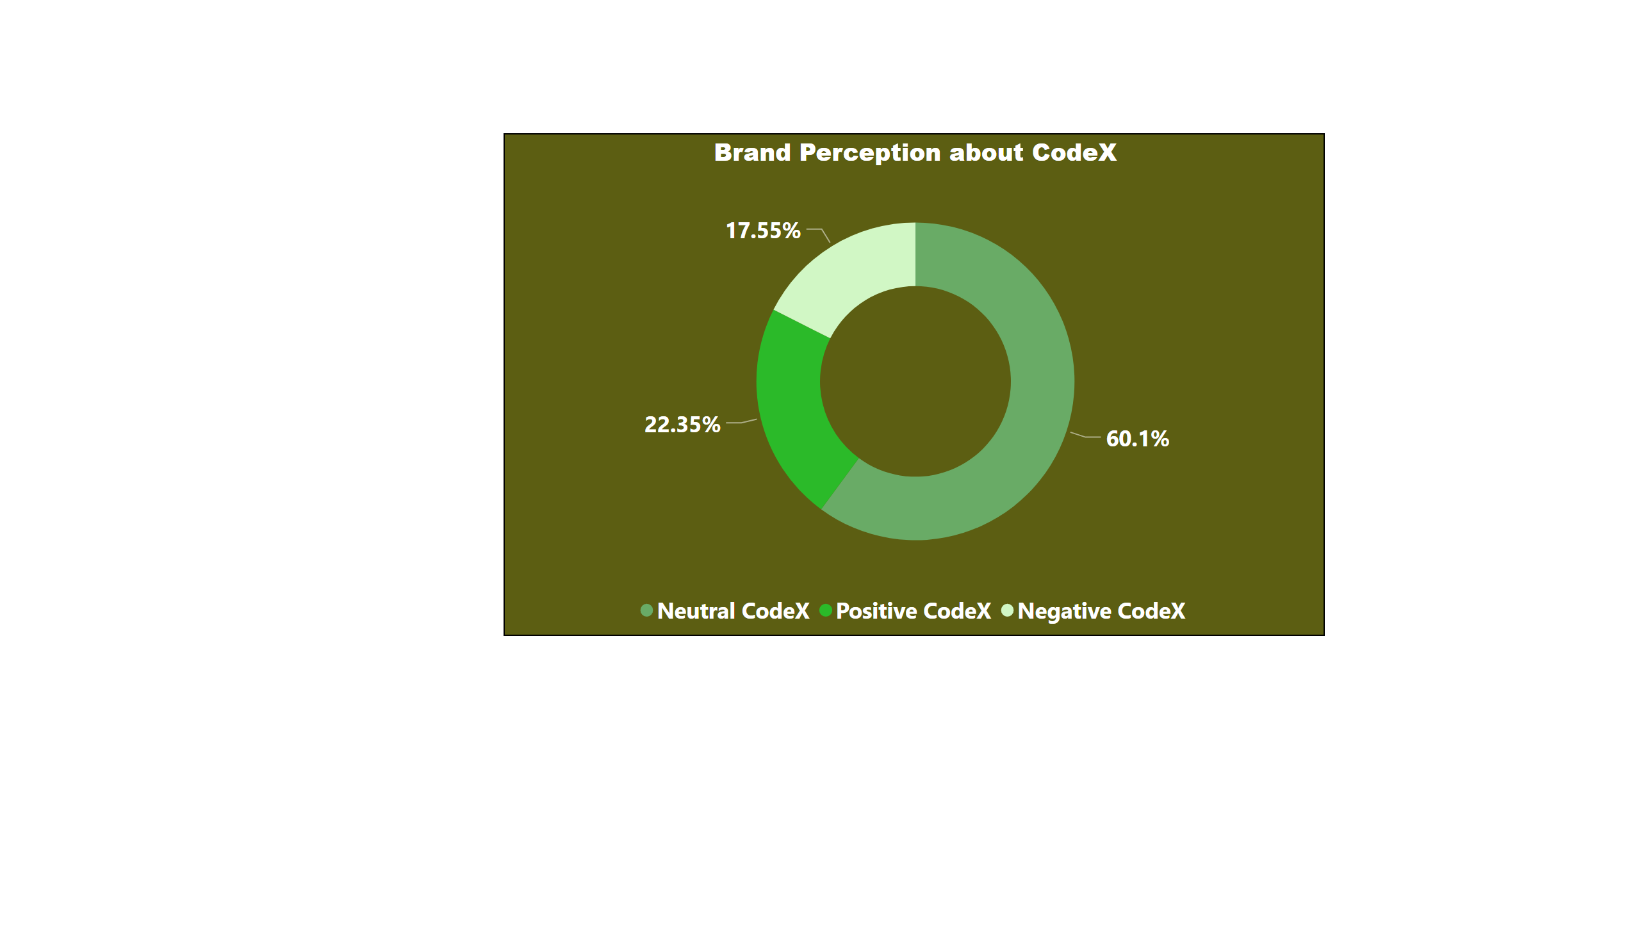
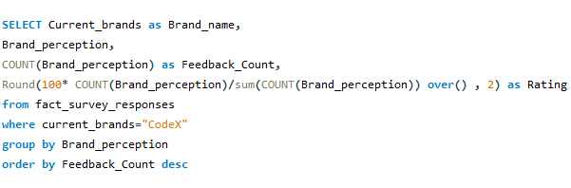

Page 9
Brand Penetration
What do people think about our brand? (overall rating)
Query
Output
Most of the respondents have a neutral view about CodeX . However , CodeX can implement right strategies effectively to strengthen their consumer base.
Notes:
Brand Perception about CodeX
No alt text provided

Slide 13
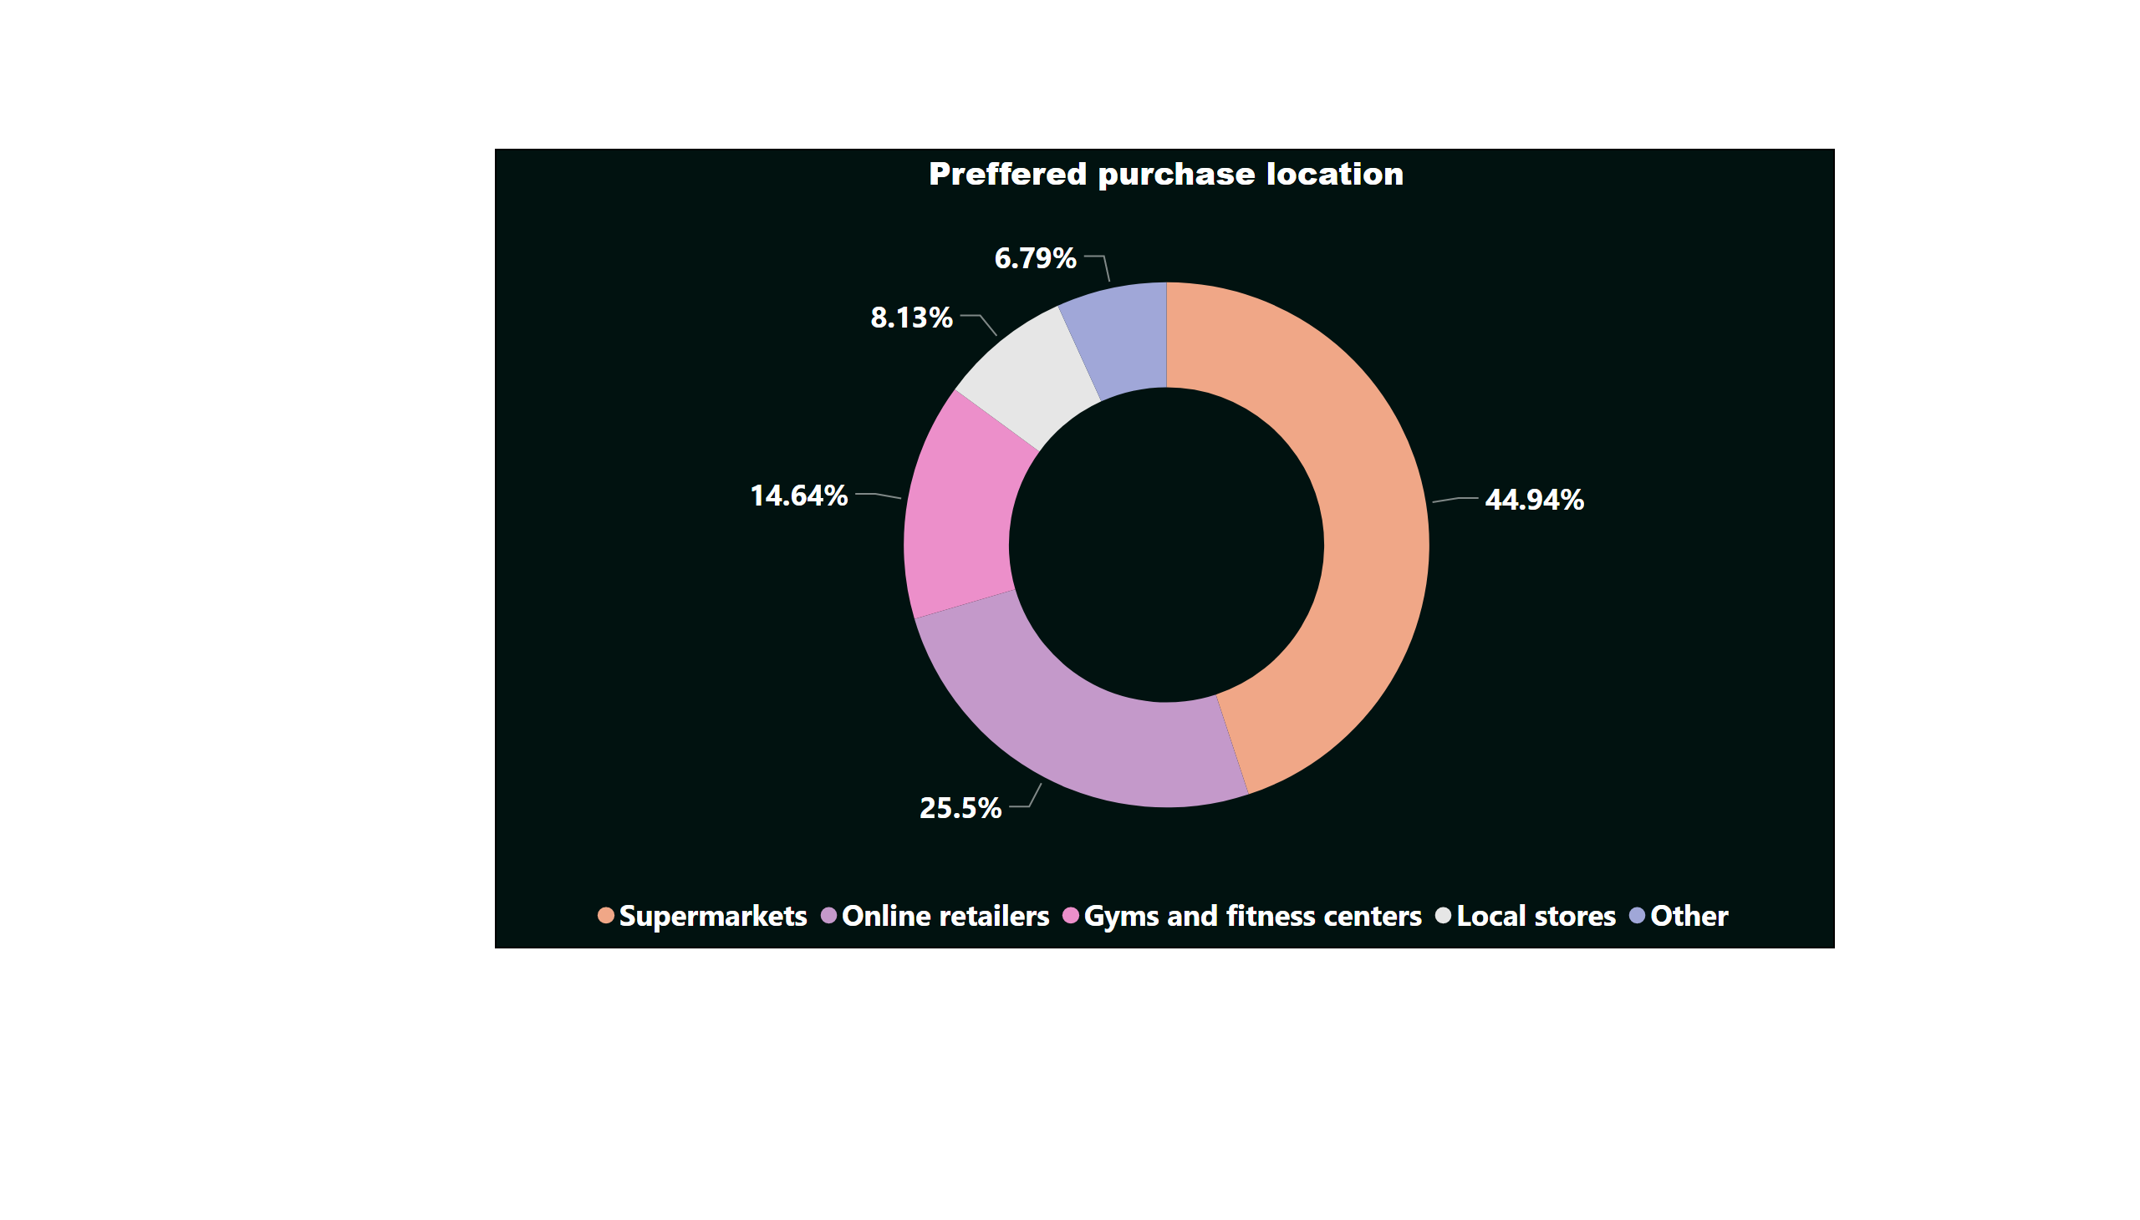
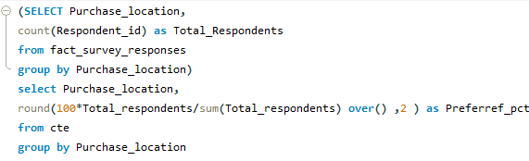
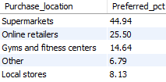
Page 10
Purchase Behavior
Where do respondents prefer to purchase energy drinks ?
Query
Output
In terms of purchase location consumers prefer buying their energy drinks from supermarkets and online retailers..
Notes:
Preffered purchase location
No alt text provided

Slide 14
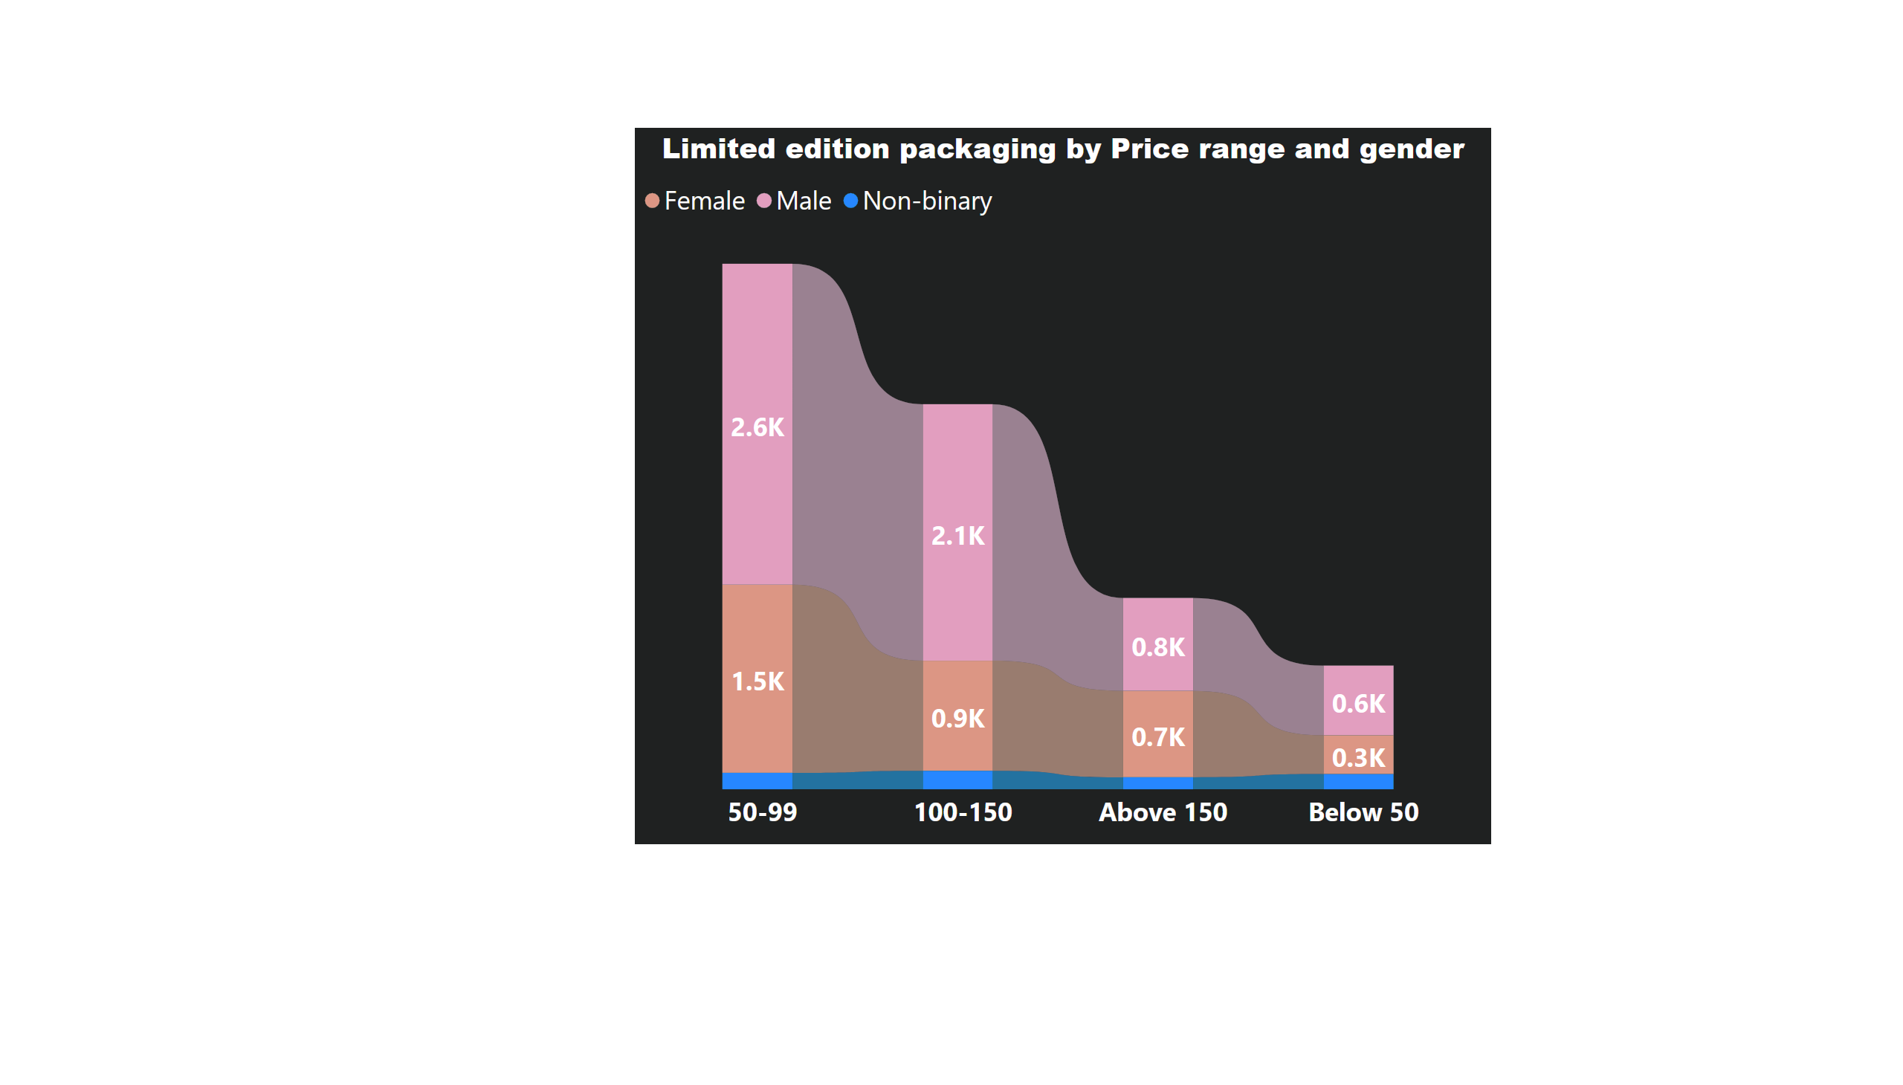
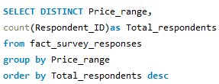

Page 12
Purchase Behavior
What factors influence respondents purchase decisions, such as price range and limited edition packaging?
Query
Output
As the price increases the count of respondents is decreasing hence, it shows the inverse relationship between price and count of respondents and it is also exhibiting the pricing method where customers do not buy beyond a certain price range.
Notes:
Limited edition packaging by Price range and gender
No alt text provided

Slide 15
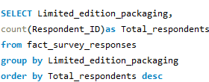
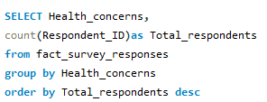
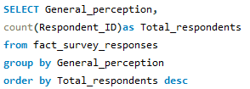



Other Factors Influencing Purchase Decisions
Query
Output

Slide 16
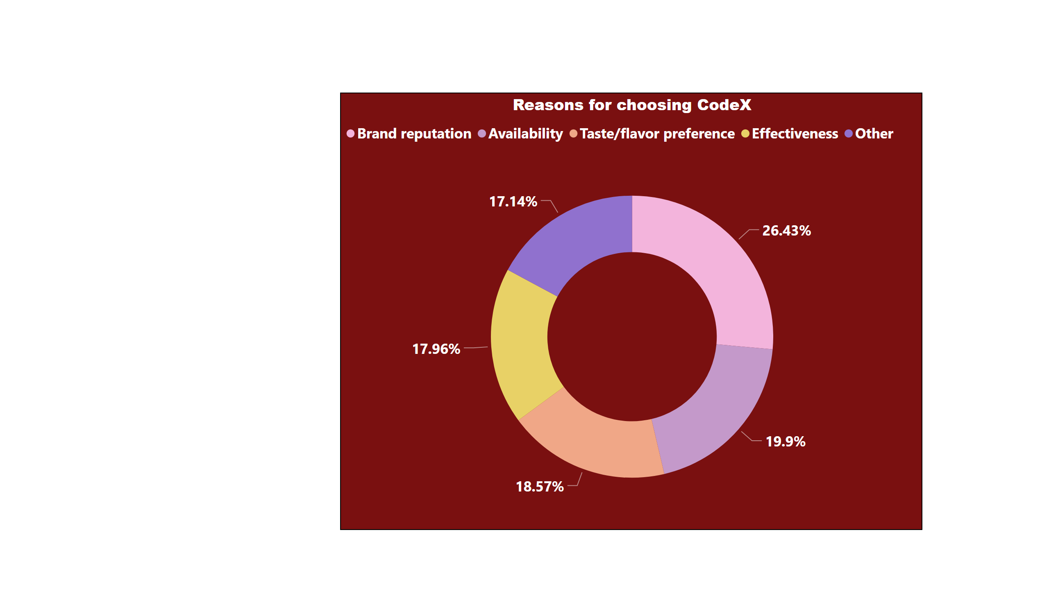
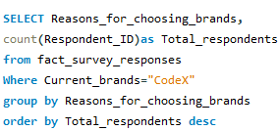

Page 13
Product Development
Which area of business should we focus more on our product development? (Branding/taste/availability)
Query
Output
Brand reputation and Availability are major factors attracting customer base. CodeX should focus more on taste and effectiveness.
Notes:
Reasons for choosing CodeX
No alt text provided

Slide 17
RECOMMENDATIONS
Millennials are becoming increasingly fascinated with energy drinks. Aggressive marketing activities, primarily targeted at young people, are the leading cause of its popularity. Additionally, energy drink marketing claims to energize the body, sharpen the mind, and improve performance and stamina, attracting more customers. The increasing occurrence of social gatherings are driving Indian youngsters towards consuming energy drinks, which are primarily classified as non-alcoholic, caffeinated, and sports drinks. Thus, Codex should focus on the young generation between the age group of 15-30 years.
Compact and portable cans should be used by CodeX as these are convenient and lightweight. Being absolutely airtight cans allow beverages to stay fresh for longer. These are ideal for travelling purposes as they have a low risk of leaking or tearing during transportation. Thus, it can attract the premium customers . Introducing innovative pet bottle designs at a lower price for targeting medium and lower segments could lead to reach broader market area and would cater to diverse packaging styles.
Price and demand have a inverse relationship. Higher the price , demand will decrease. As CodeX is new in market so it should adopt low pricing strategy( A pricing strategy in which a company offers a relatively low price to stimulate demand and gain market share). Introducing 250 ml cans priced between 50-99 units and a small variant of 100 ml pet bottles priced below 50 units would cater to large customer base and to increase brand awareness.

Slide 18
RECOMMENDATIONS
Social media influencers can help spread the word about your brand . Young people respond well to influencers because they’re real people. Your brand is largely faceless, and even if you have a celebrity representing you, it’s obvious that their entire job is built around advertising for you. But When you pick influencers, they are more relatable to the average person . Make sure that you pick influencers that fit your brand .Find an influencer that fits your “vibe” and negotiate with them. It’s helpful if you let them try your product with no strings attached if you want an authentic advertisement from them.
CodeX should distribute drink samples to provide customers with firsthand experience with it. Products can be distributed through various channels, such as in-store promotions , mail-outs or by publishing coupons in print advertisements. Another campaign can involve encouraging customers to participate in recycling program. For instance , If a customer return 10 cans for recycling , they will be eligible to get extra cans with their next purchase. This will promote sustainability and will recognize CodeX as environment conscious brand that would differentiate it with other leading brands. CodeX could also offer discounts on bulk purchase of cans.

Slide 19


