Slide 1
Classical Cryptography Analysis Tool
Caesar Cipher • Vigenère Cipher • Frequency Analysis • Brute Force
Developed by Ridhi Jain

Slide 2
About the Project
This is a simple Python tool for learning classical cryptography.
It can encrypt and decrypt messages using Caesar and Vigenère Cipher.
It also includes Frequency Analysis and Caesar Brute Force.
The tool runs in a web browser using Streamlit.

Slide 3
Objectives
Understand basic encryption and decryption.
Use a shift value with Caesar Cipher.
Use a key with Vigenère Cipher.
Check how often letters appear in a text.
Try all 26 Caesar shifts to show a basic brute-force method.

Slide 4
Tools Used
Python — used for the main program.
Streamlit — used to create the browser interface.
Visual Studio Code — used to write and test the code.
Main files: app.py, caesar.py, vigenere.py and frequency_analysis.py.

Slide 5
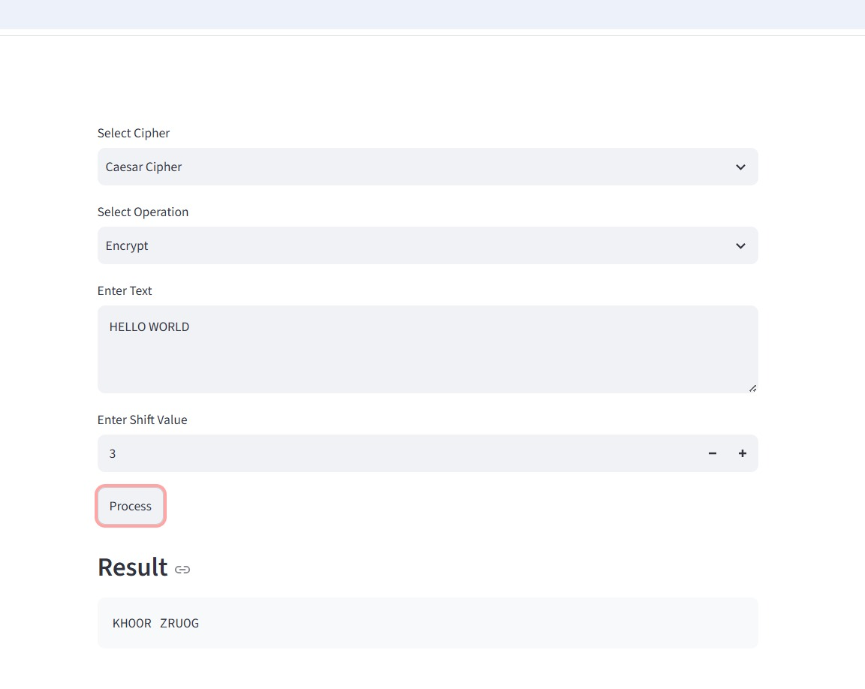
Caesar Encryption — Test
Input: HELLO WORLD
Shift: 3
Operation: Encrypt
Result: KHOOR ZRUOG
HELLO WORLD with shift 3 gives KHOOR ZRUOG.

Slide 6
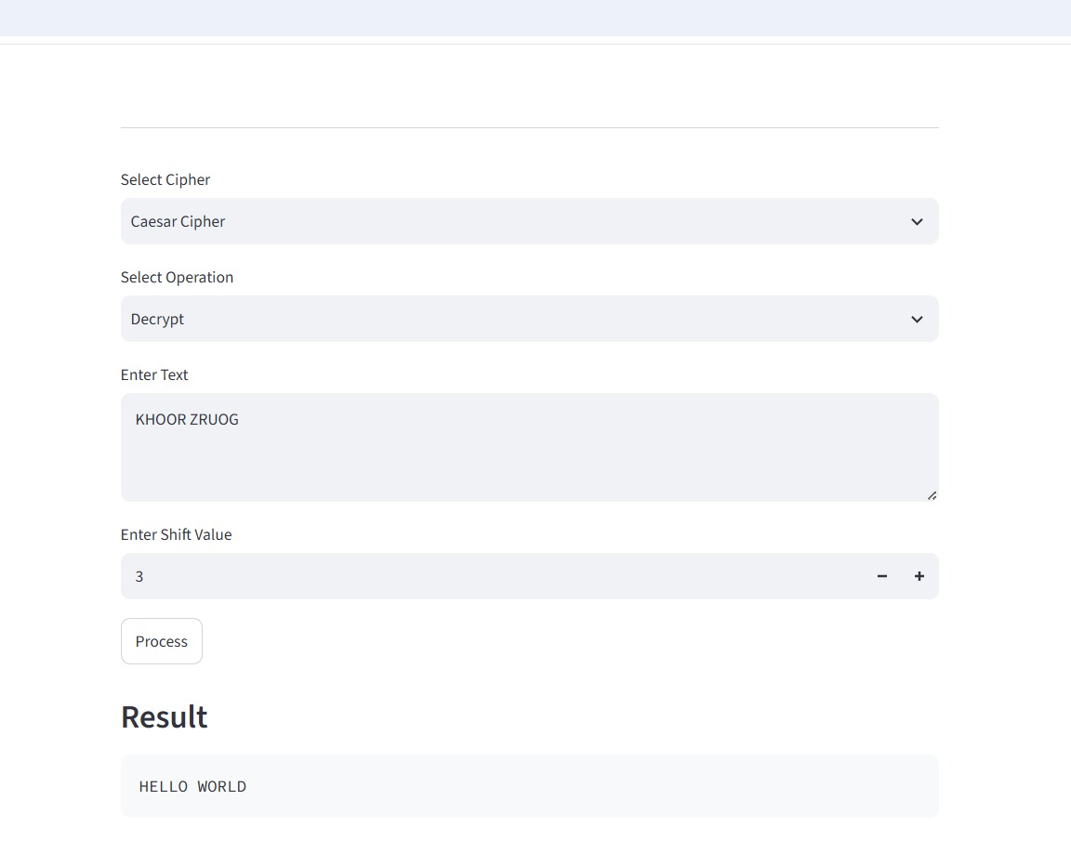
Caesar Decryption — Test
Input: KHOOR ZRUOG
Shift: 3
Operation: Decrypt
Result: HELLO WORLD
KHOOR ZRUOG with shift 3 gives HELLO WORLD.

Slide 7
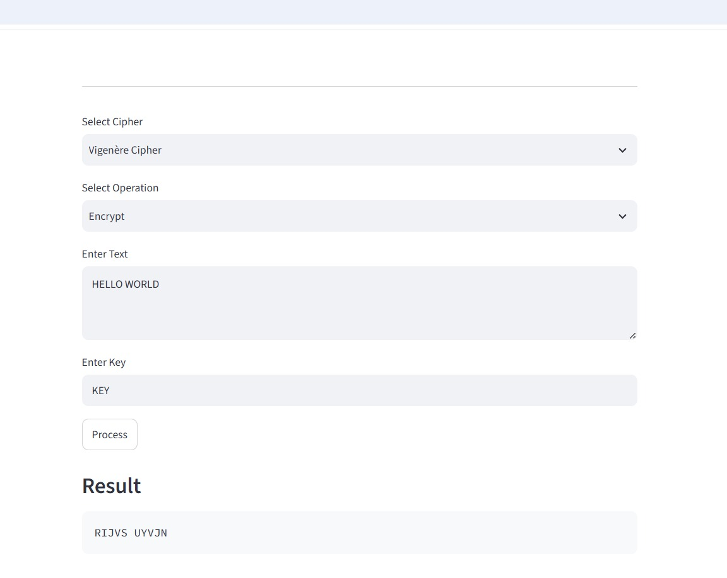
Vigenère Encryption — Test
Input: HELLO WORLD
Key: KEY
Operation: Encrypt
Result: RIJVS UYVJN
HELLO WORLD with key KEY gives RIJVS UYVJN.

Slide 8
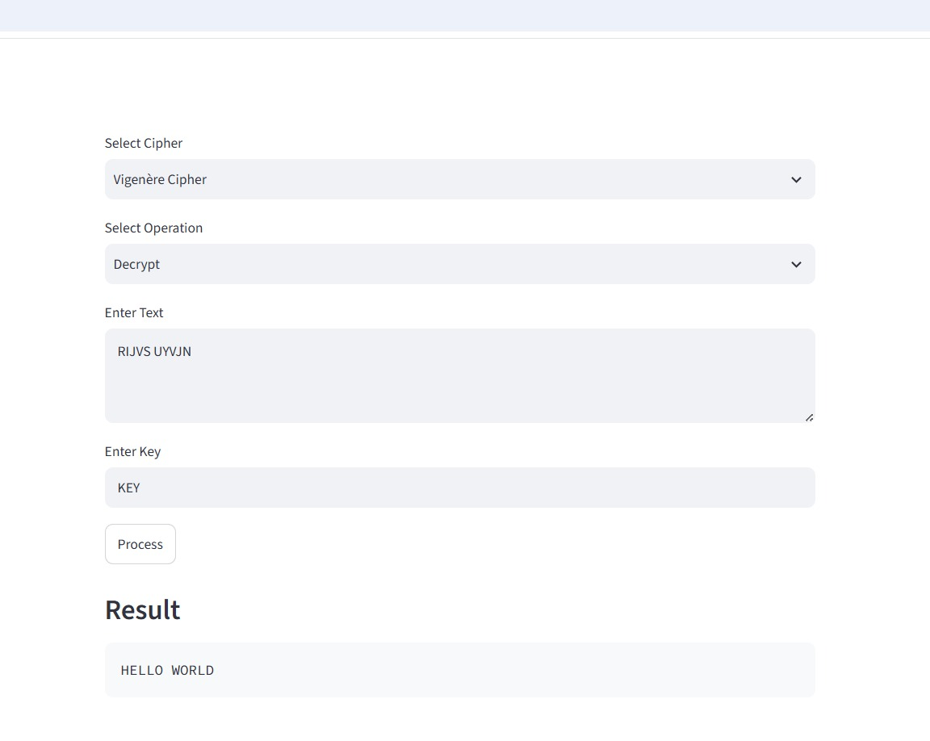
Vigenère Decryption — Test
Input: RIJVS UYVJN
Key: KEY
Operation: Decrypt
Result: HELLO WORLD
RIJVS UYVJN with key KEY gives HELLO WORLD.

Slide 9
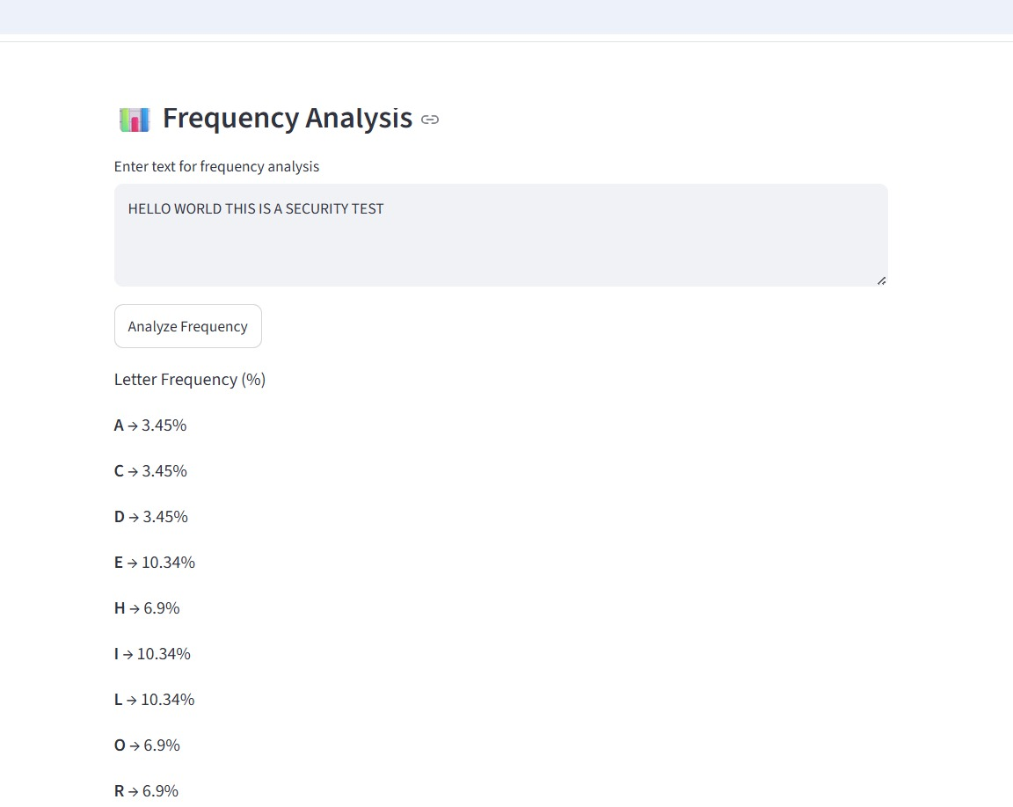
Frequency Analysis — Test
Text is entered for analysis.
Alphabetic characters are counted.
The result shows letter percentages.
This helps study letter patterns.
The tool counts letters and shows their percentage.

Slide 10
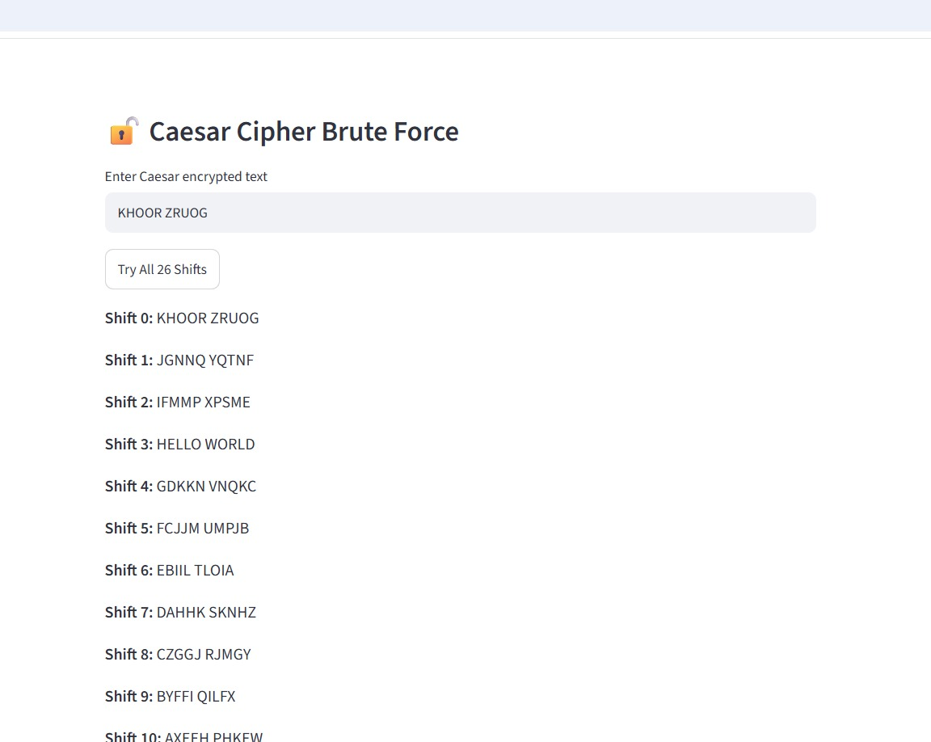
Caesar Brute Force — Test
Input: KHOOR ZRUOG
Shifts 0–25 are tested.
Shift 3 gives HELLO WORLD.
This shows the small key space of Caesar Cipher.
The tool tests all 26 possible Caesar shifts.

Slide 11
How the Tool Works
1. Select a cipher and an operation.
2. Enter the message and a shift or key when needed.
3. The Python function processes the message.
4. Streamlit shows the result in the browser.
5. Analysis options can be used to study the text.

Slide 12
Testing and Result
Caesar encryption and decryption were tested.
Vigenère encryption and decryption were tested.
Frequency Analysis displayed letter percentages.
Brute Force generated all 26 Caesar shift results.
The complete tool worked successfully in the browser.

Slide 13
What I Learned
How simple encryption and decryption work.
How a key can change the way letters are encrypted.
How letter frequency can be used to study text.
Why Caesar Cipher is easy to test using all possible shifts.
Why classical ciphers are mainly useful for learning and are not suitable for modern secure data.

Slide 14
Conclusion
The project combines four simple cryptography features in one tool.
It provides a clear way to test encryption, decryption and basic analysis.
The results were checked using practical examples.
The project helped build a basic understanding of cryptography and its limitations.

Slide 15


