Slide 1
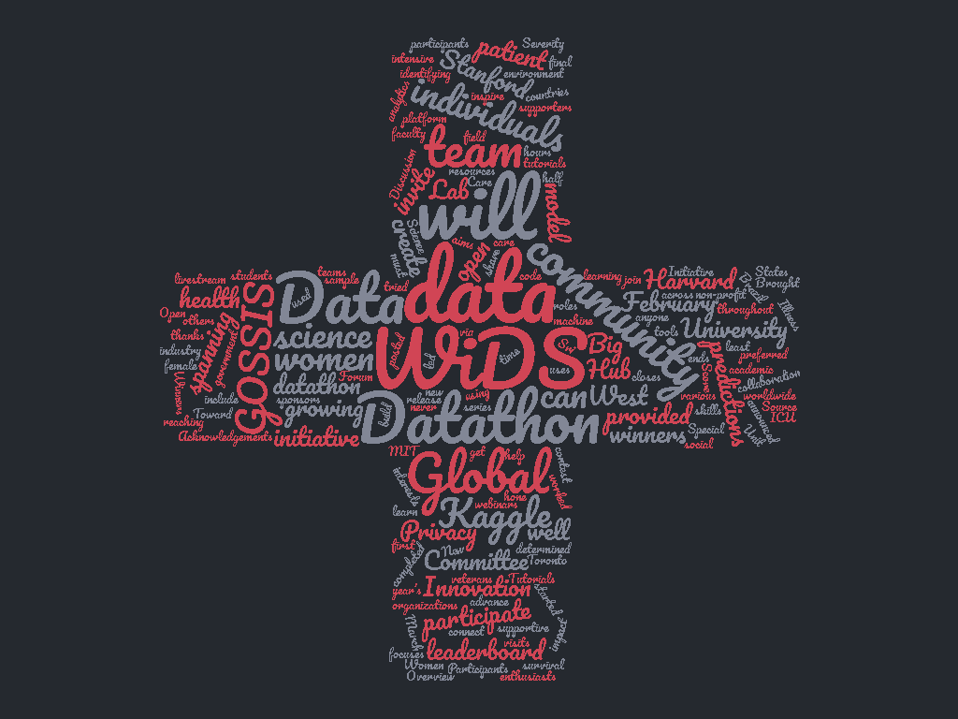

Slide 2







Problem
WiDS Datathon 2020focused on
patient health through data from
MIT’s GOSSIS (Global Open Source Severity of Illness Score) initiative.
The challenge was to create a model that uses data from
the first 24 hours of intensive care to predict
patient survival.

Slide 3

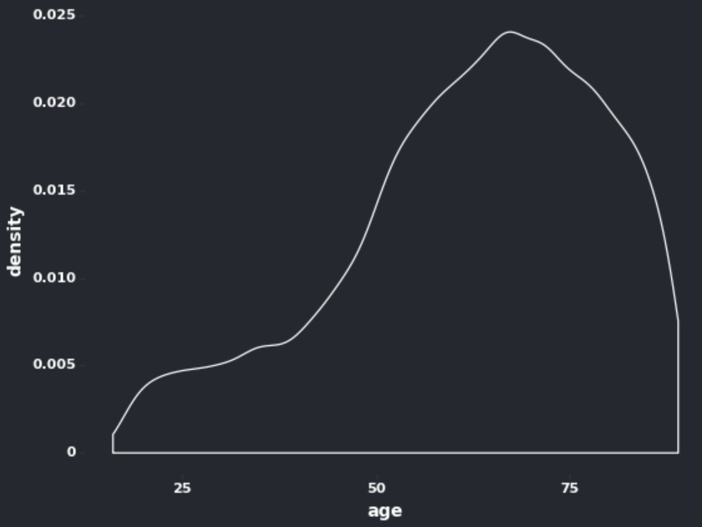
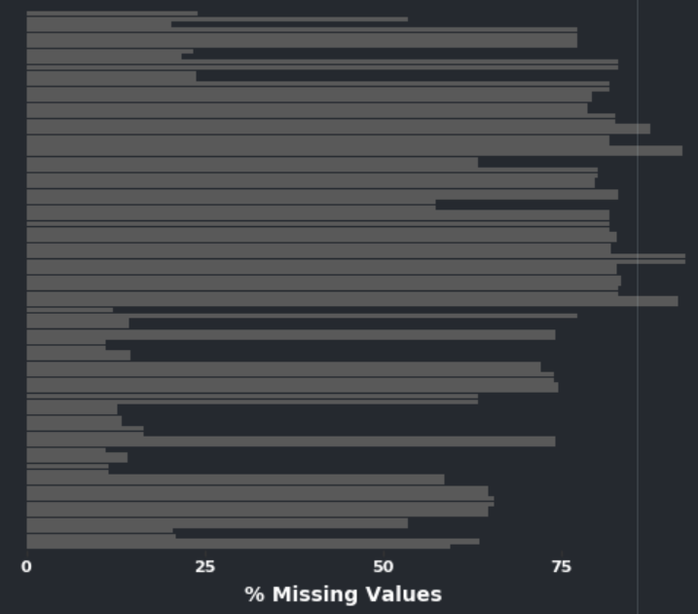
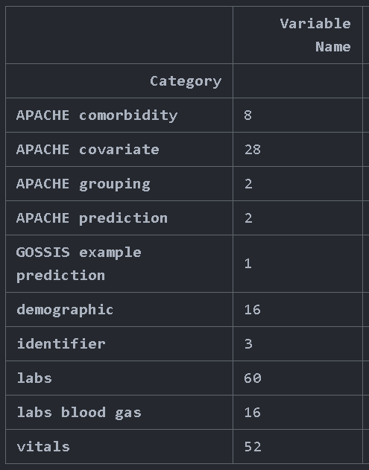
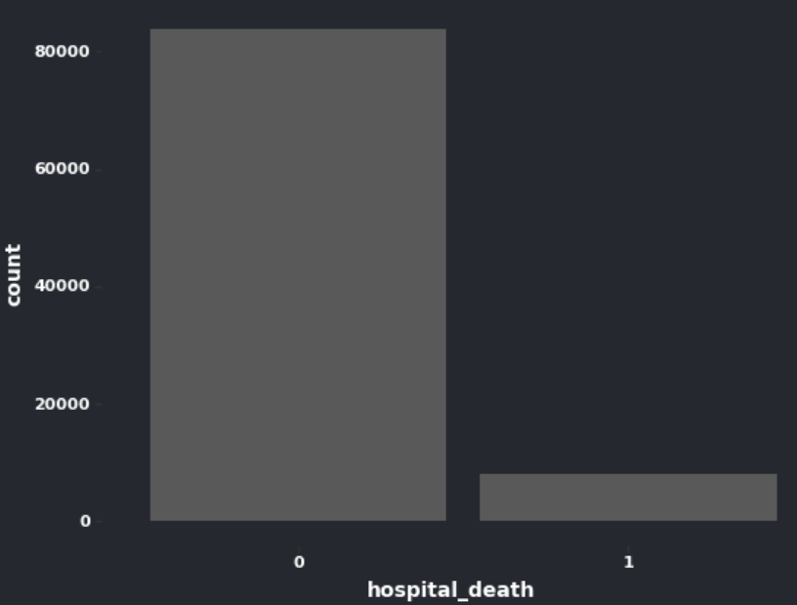
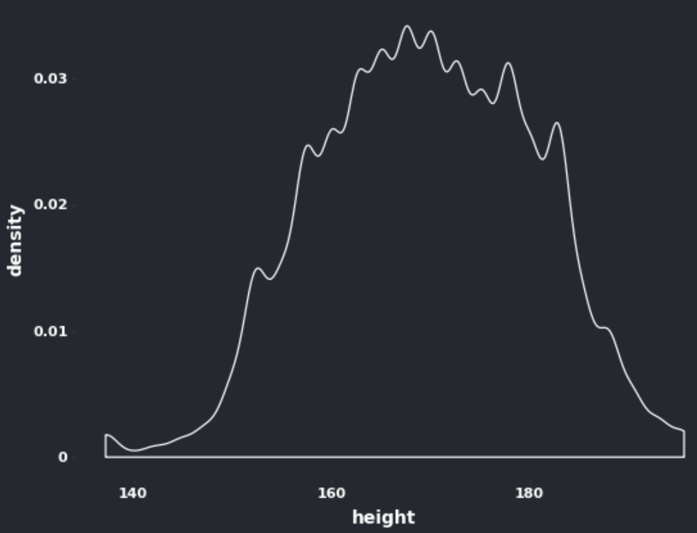
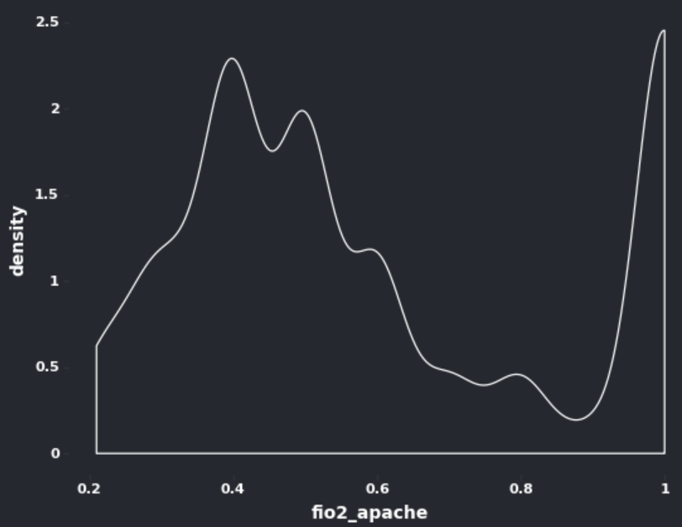
Data
Messiness
Shape
Skews
Missing Values
Column Categories
Target Variable

Slide 4






Models
Research Questions
• What features influence the survival of the patients the most ?
• How does age affect patient survival ? Are older patients at higher risk irrespective of the condition?
• Is there any strong correlation between disease/Condition and the number of fatalities ?
• Is there a correlation between disease/Condition and patient admissions and readmissions?
Ensemble
Stacking
KNN
Generalized Knowledge
Experience/
Case-Based Knowledge

Slide 5
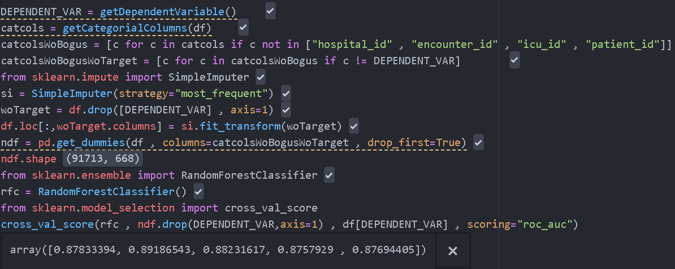
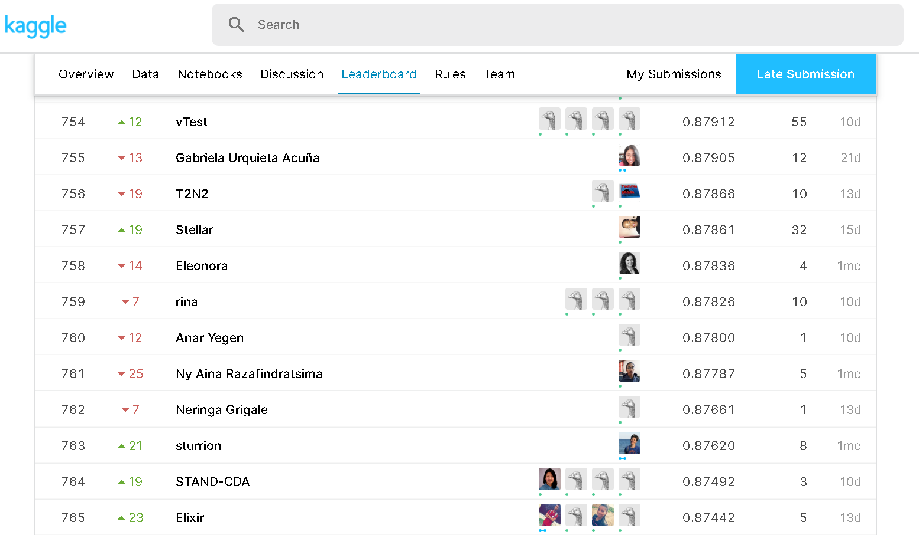
Baseline
Missing values
Categorical Columns
Modelling
Score
0.878
760/940

Slide 6
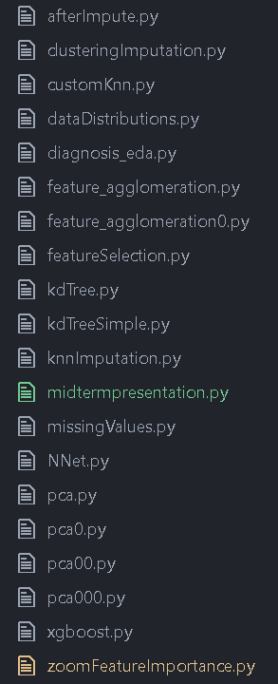

Missing values | Feature Engineering | Modelling
Simple Imputation | PCA | Random Forest
Knn Imputation | Agglomerative Clustering | NNet
KDTree | Random Forest Feature Importance | XGBoost , LGM
Random Forest Imputation | Recursive Feature Elimination | Stacking
Variance Based Drop Column | ANOVA | Logistic Regression

Slide 7



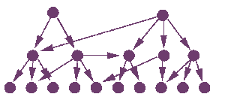
More to Come
Cloud
KNN
HyperParameter Tuning
Belief Networks
Notes:
Further steps to be tested for improving the model accuracy:
Go back to variable imputation/transformation/selection and try different techniques to capture more variation in data.
Since few algorithms have not been tried due to computational time and hardware requirements, it can be tested by moving to cloud environment.
Hyperparameter tuning using GridSearch can be tested on cloud as it is relatively fast.
Use KNN to segment the data and try models on the segmented data to validate if any improvement in performance.

