Slide 1

Introduction

Slide 2


Slide 3
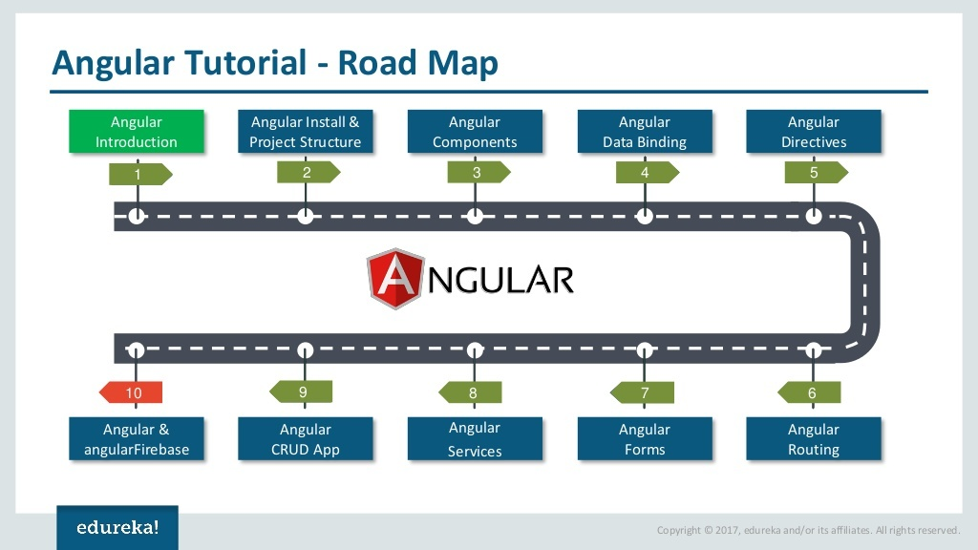

Slide 4


Slide 5
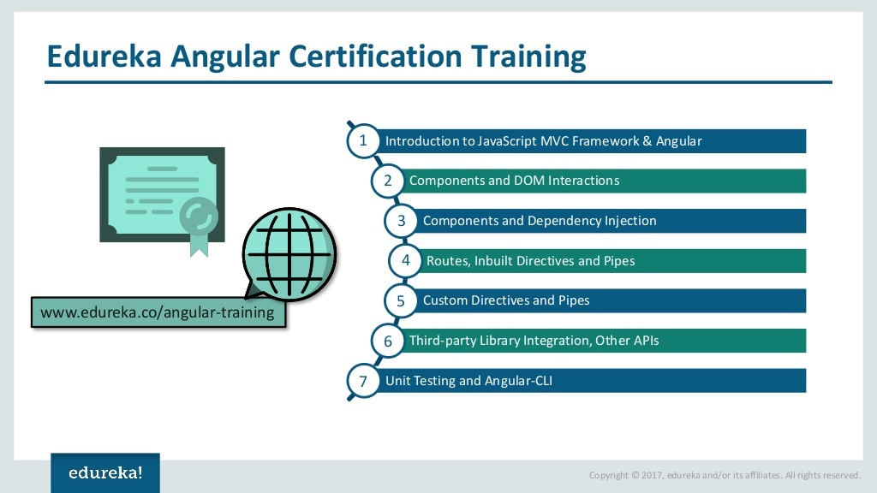

Slide 6


Slide 7
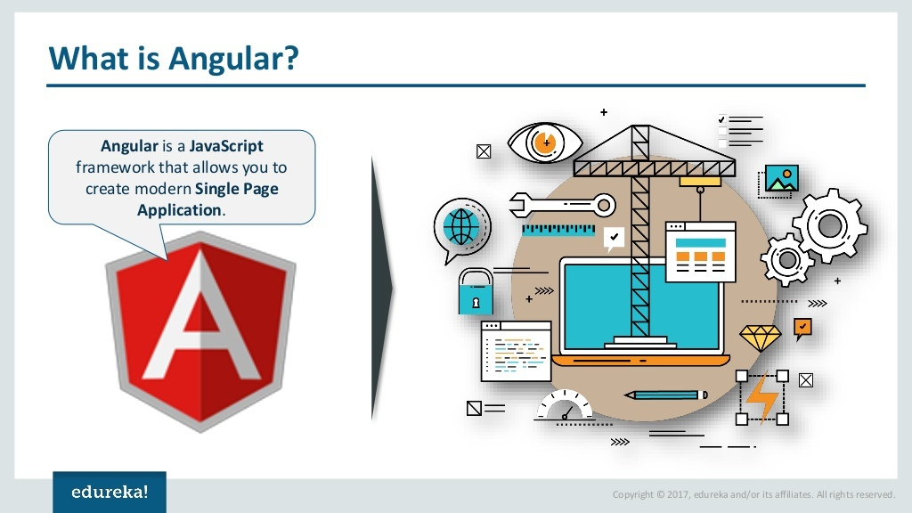

Slide 8
Angular Introduction
Angular is a popular, TypeScript-based open-source web application framework led by Google, designed for building scalable single-page applications.
It is used to build Single Page Applications (SPAs) and dynamic, responsive web applications.
Key features include components, dependency injection, and a built-in CLI.
Unlike traditional websites that reload the entire page, Angular updates only the required part of the page, providing a faster and smoother user experience.

Slide 9
Why Angular?
Angular helps developers build enterprise-level web applications with:
Reusable components
Two-way data binding
Dependency Injection
Routing
Form Validation
REST API integration
State Management
Testing support
High performance

Slide 10


Slide 11
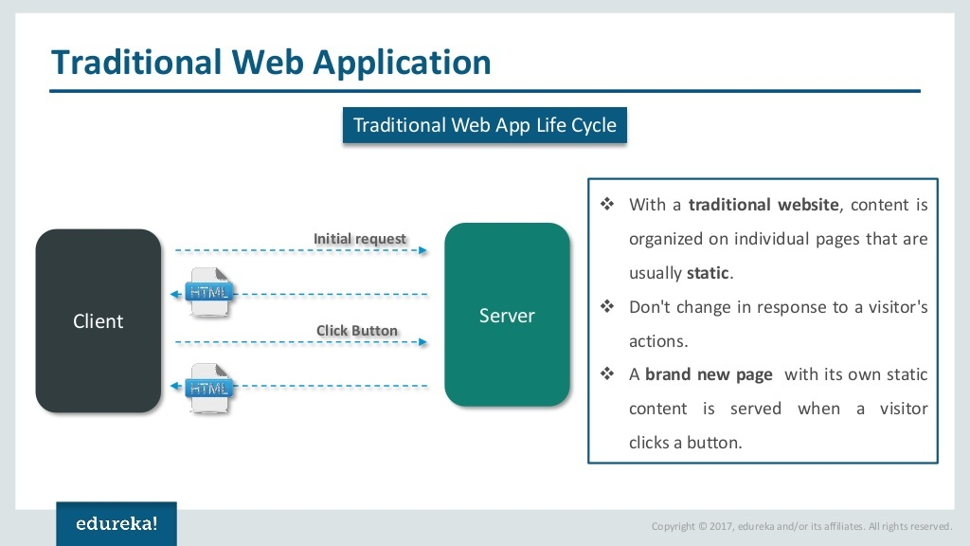

Slide 12
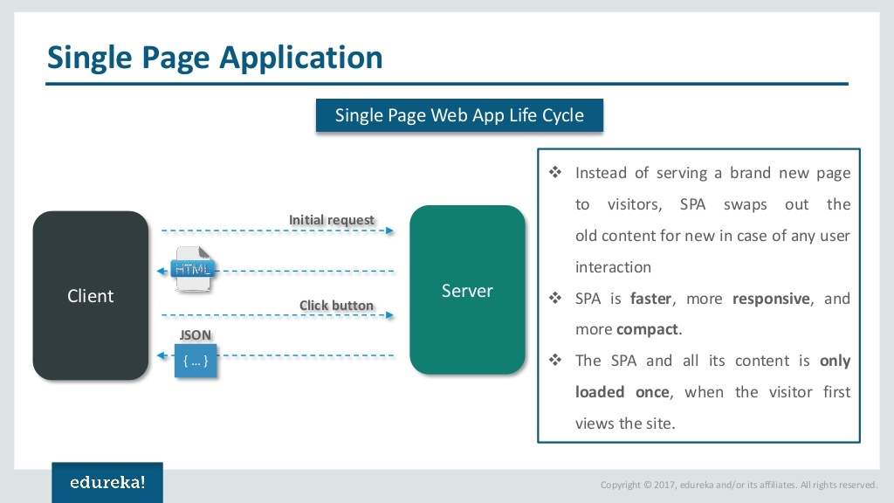

Slide 13
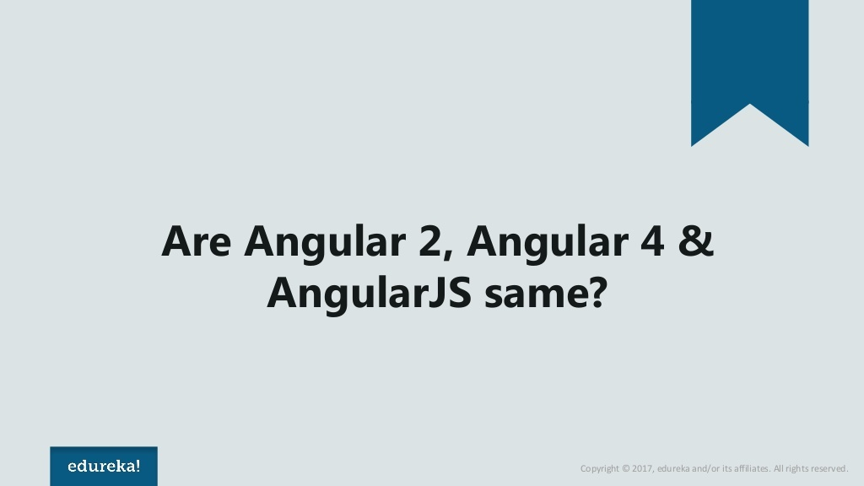

Slide 14
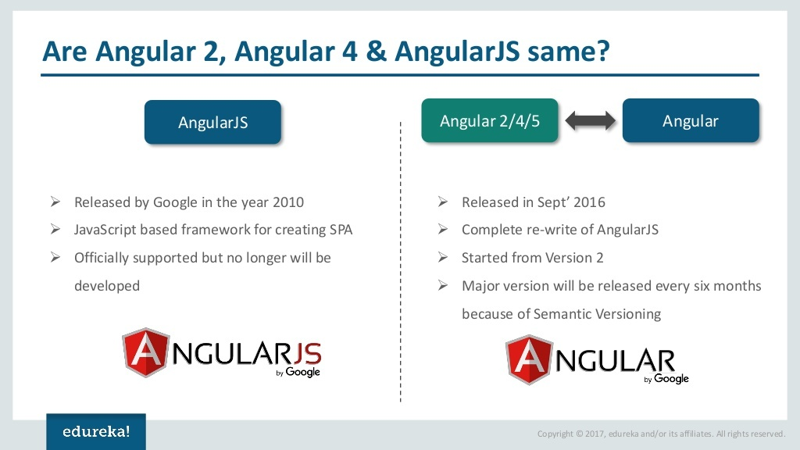

Slide 15


Slide 16
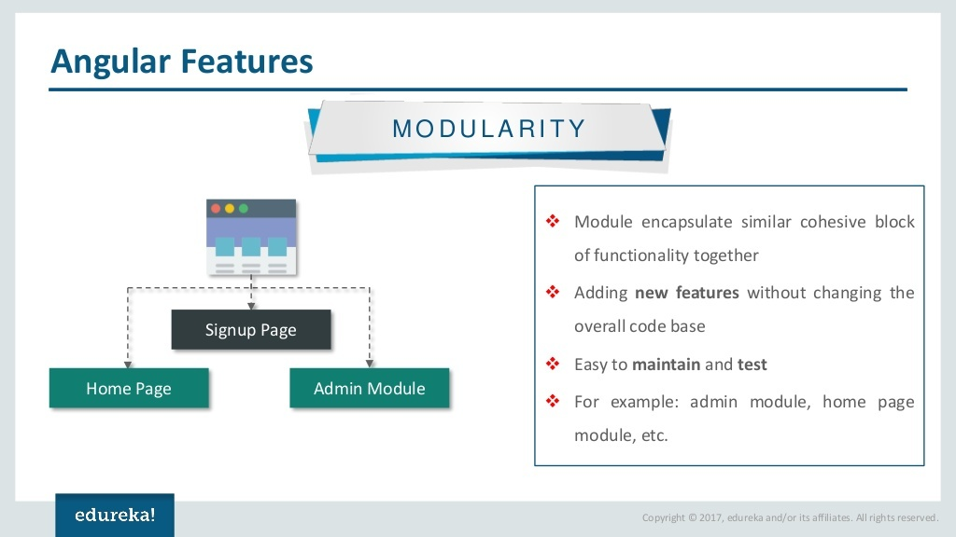

Slide 17
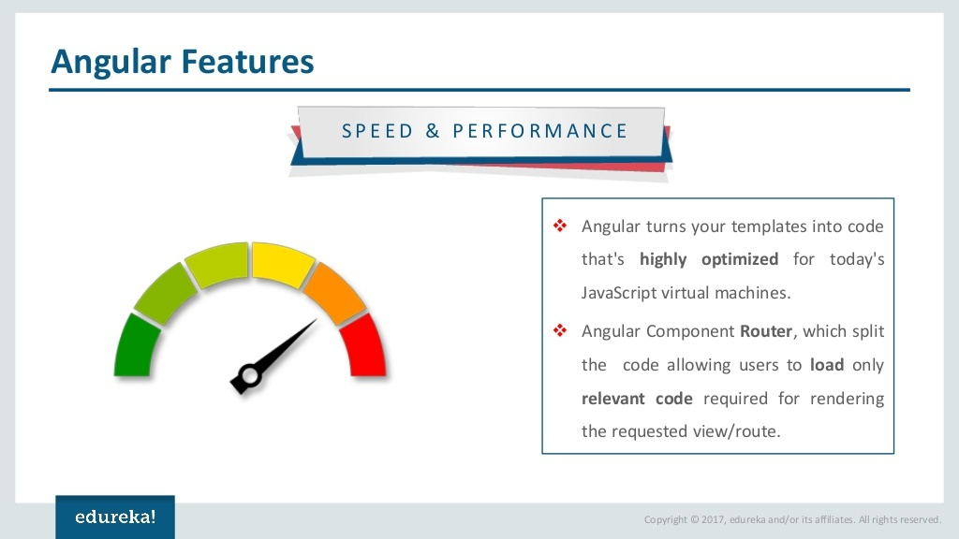

Slide 18
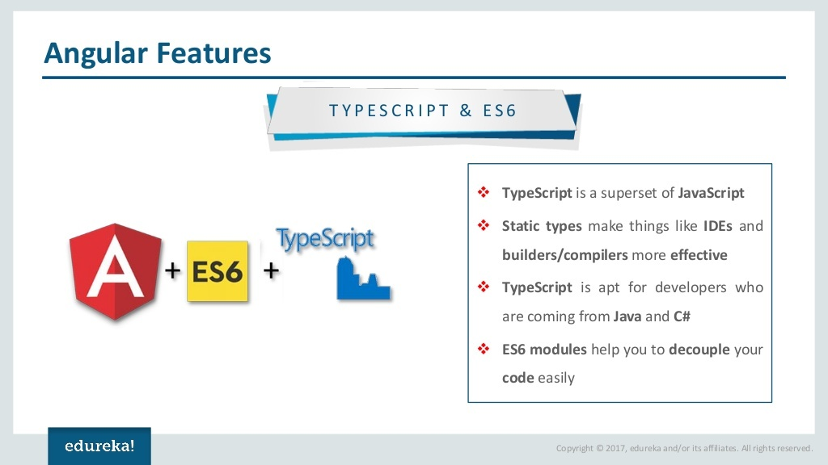

Slide 19
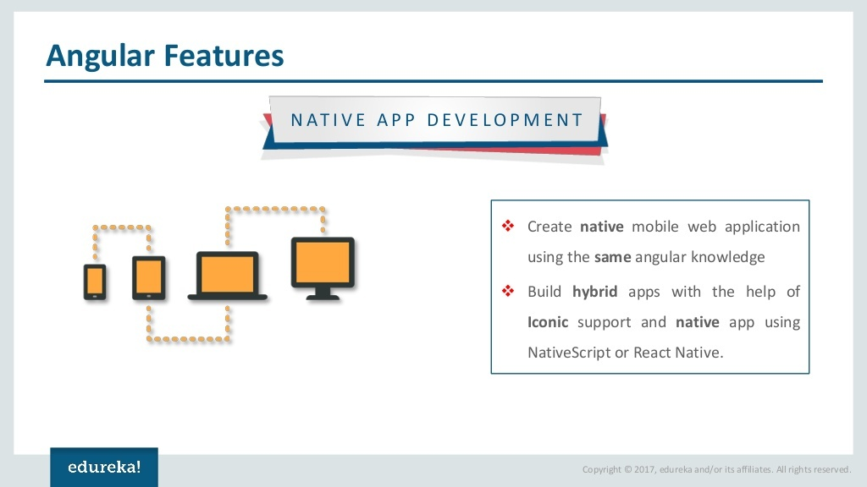

Slide 20


