Slide 1

Angular 7 Routers

Slide 2
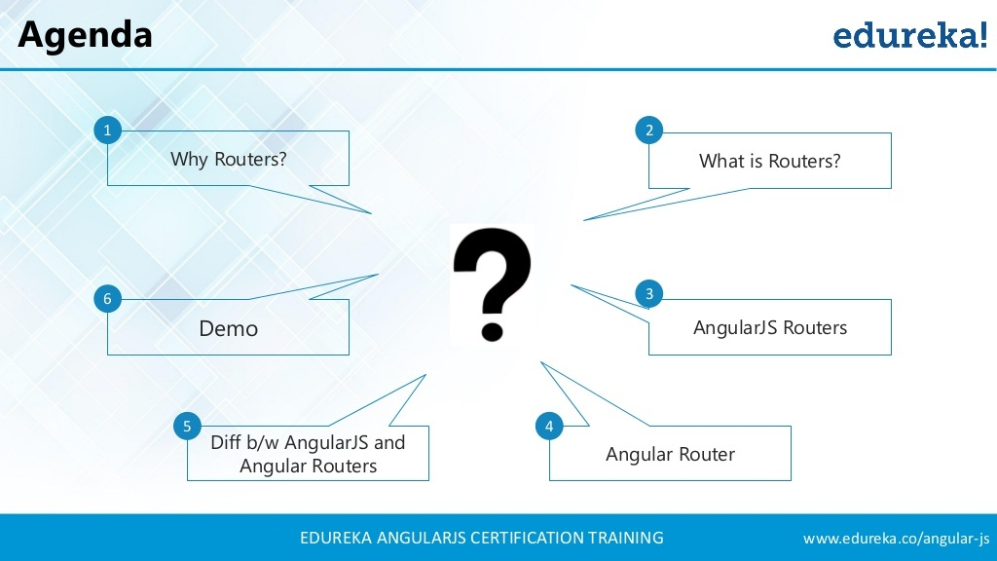

Slide 3


Slide 4
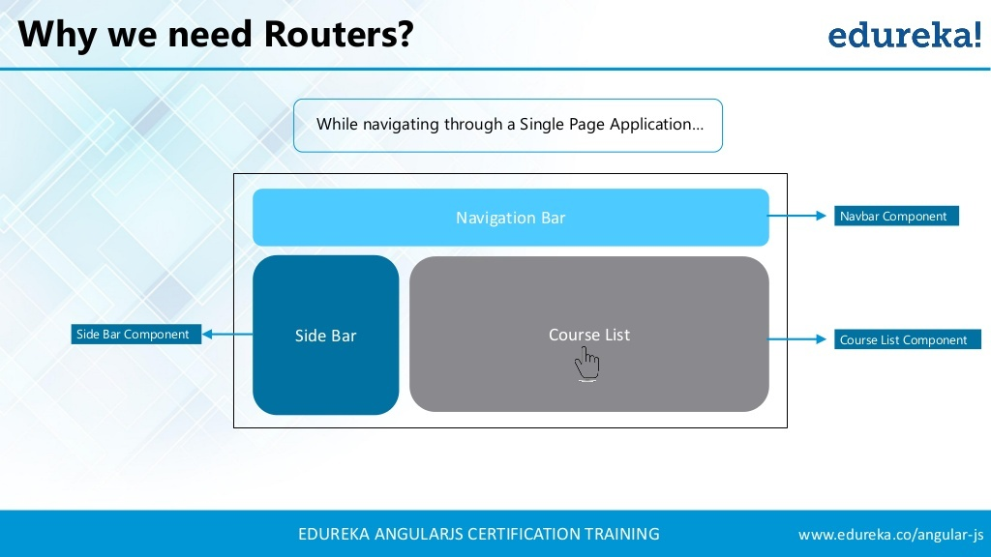

Slide 5
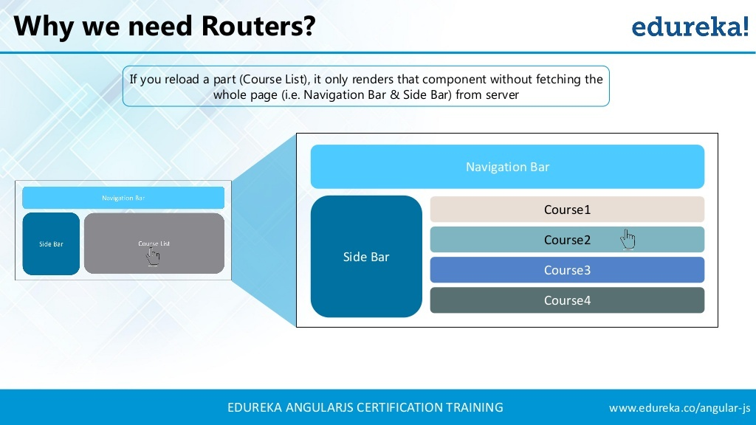

Slide 6
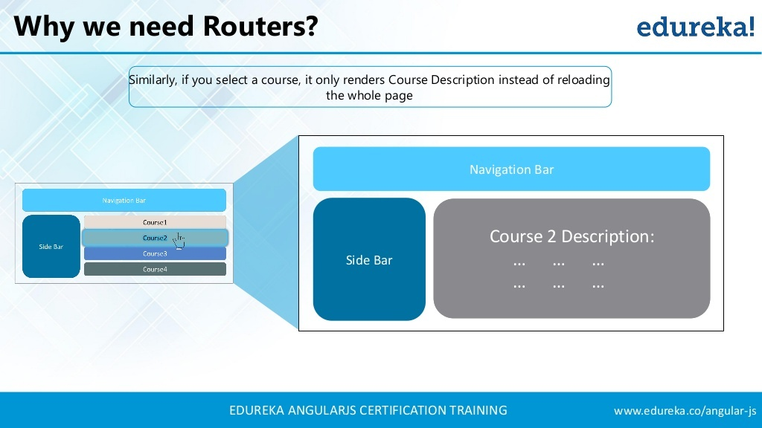

Slide 7


Slide 8
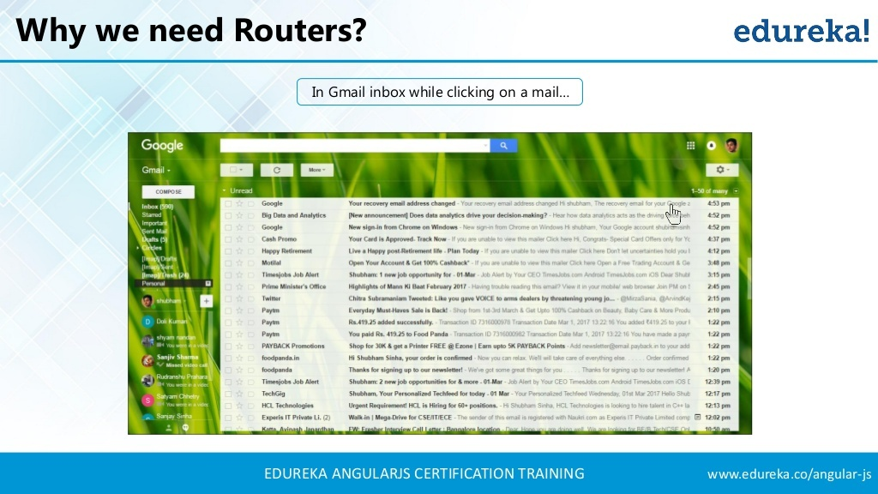

Slide 9
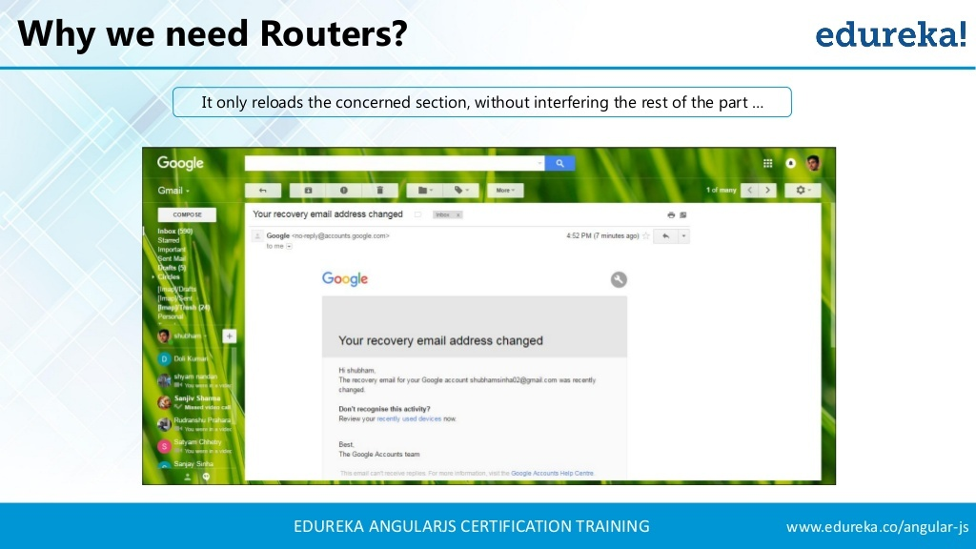

Slide 10


Slide 11
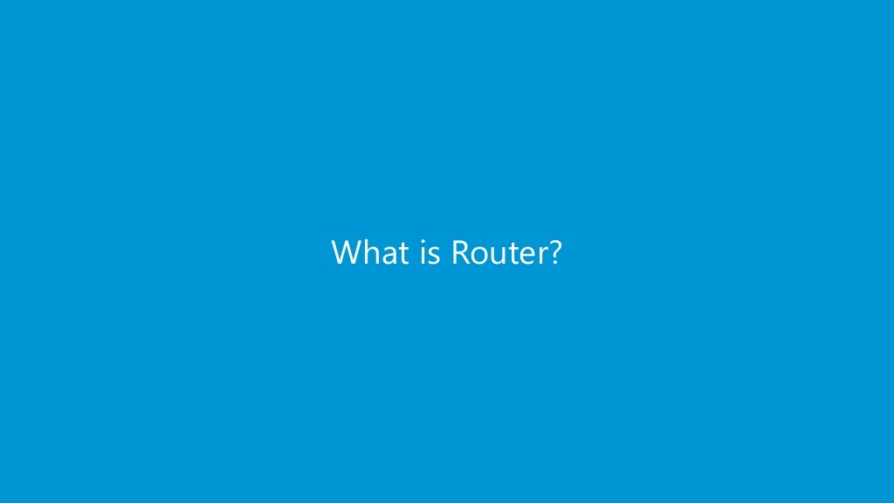

Slide 12
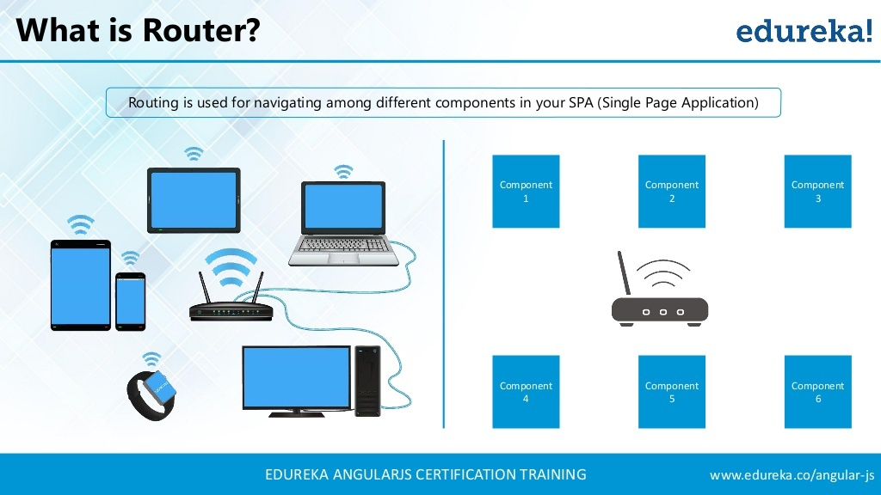

Slide 13
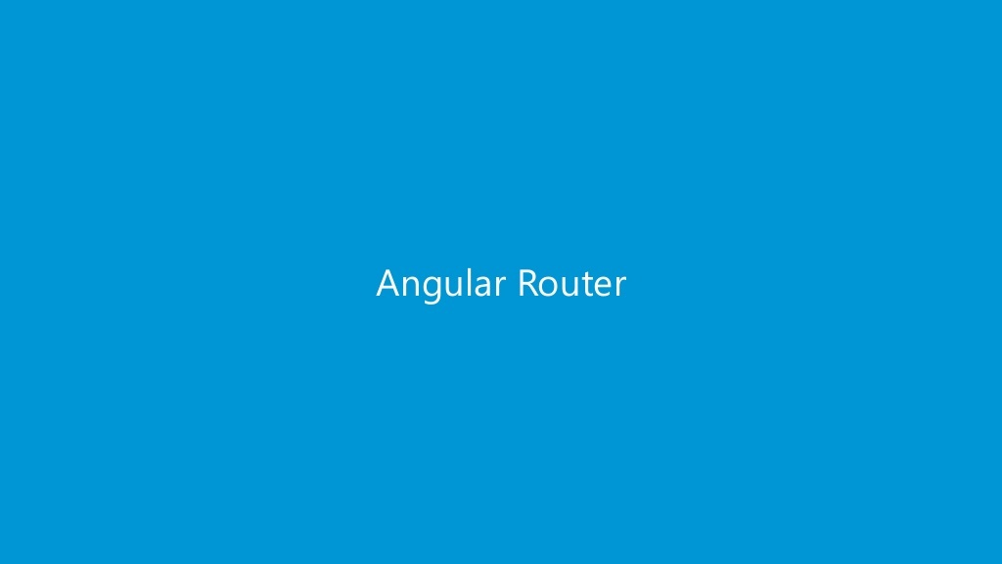

Slide 14
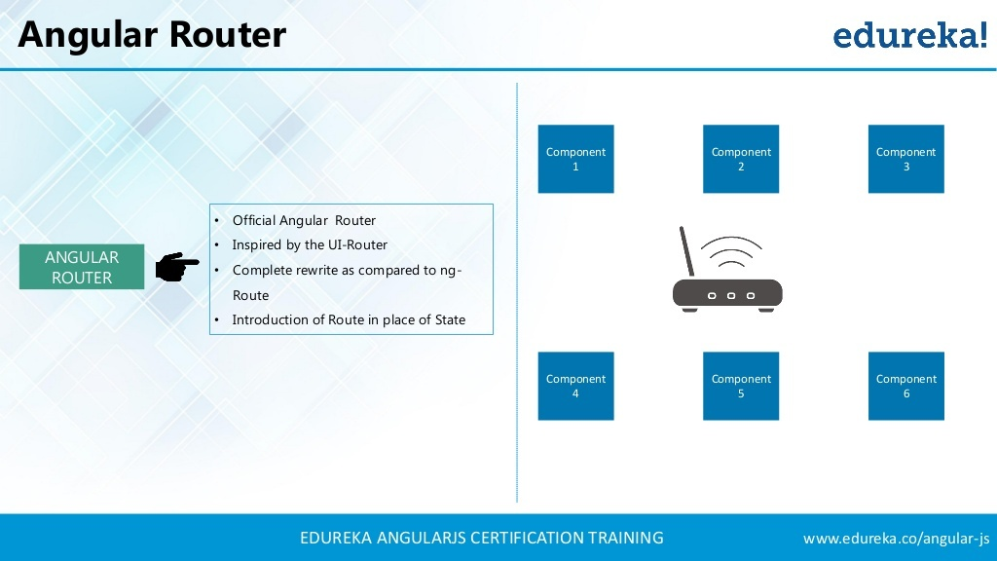

Slide 15
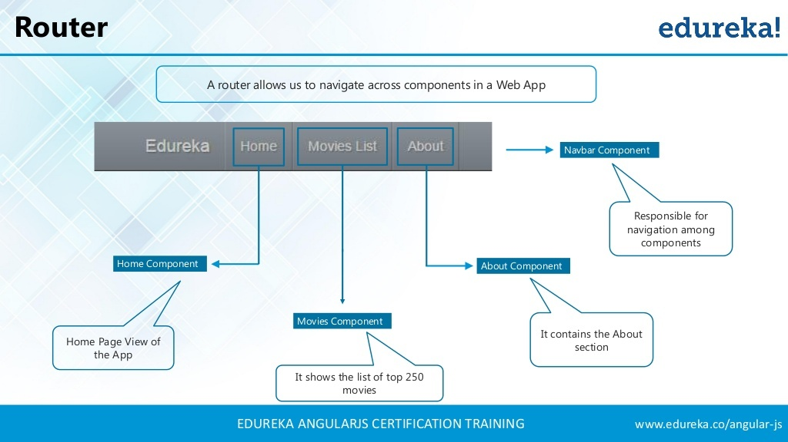

Slide 16
Introducing Angular Router
Angular Router is a powerful JavaScript router built and maintained by the Angular core team that can be installed from the @angular/router package.
It provides a complete routing library with the possibility to have multiple router outlets, different path matching strategies
It also provides easy access to route parameters and route guards to protect components from unauthorized access.
The Angular router is a core part of the Angular platform.
It enables developers to build Single Page Applications with multiple views and allow navigation between these views.

Slide 17


Slide 18
ROUTES & PATHS
Routes are definitions (objects) comprised from at least a path and a component (or a redirectTo path) attributes.
The path refers to the part of the URL that determines a unique view that should be displayed, and component refers to the Angular component that needs to be associated with a path.
Based on a route definition that we provide (via a static method), the Router is able to navigate the user to a specific view.
Each Route maps a URL path to a component.

Slide 19
ROUTES & PATHS
The path can be empty which denotes the default path of an application and it’s usually the start of the application.
The path can take a wildcard string (**).
The router will select this route if the requested URL doesn’t match any paths for the defined routes.
This can be used for displaying a “Not Found” view or redirecting to a specific view if no match is found.
{ path: 'contacts', component: ContactListComponent}
If this route definition is provided to the Router configuration, the router will render when the browser URL for the web application becomes

Slide 20
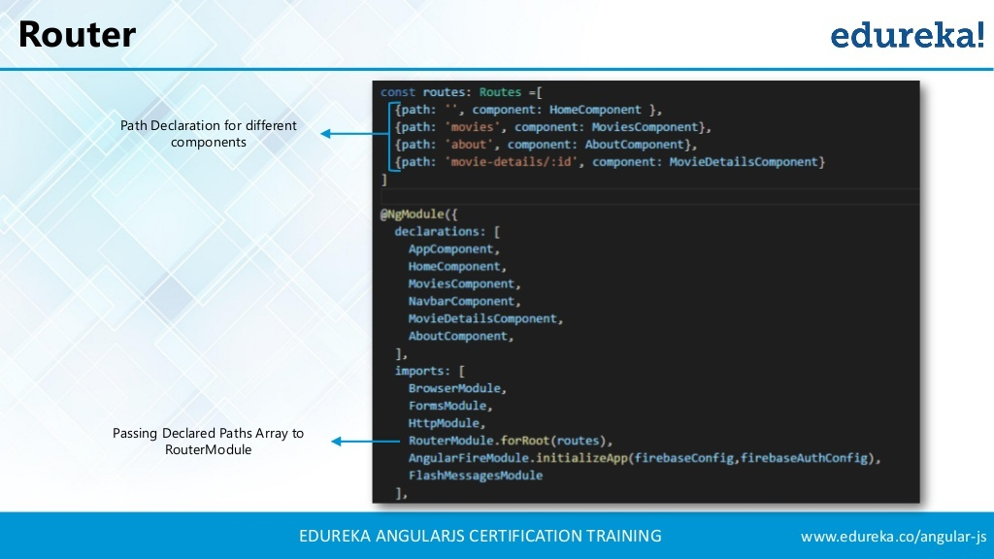

Slide 21
NAVIGATION DIRECTIVE
The Angular Router provides the directive to create navigation links.
<a [routerLink]="'/contacts'">Contacts</a>
This directive takes the path associated with the component to navigate to.

Slide 22
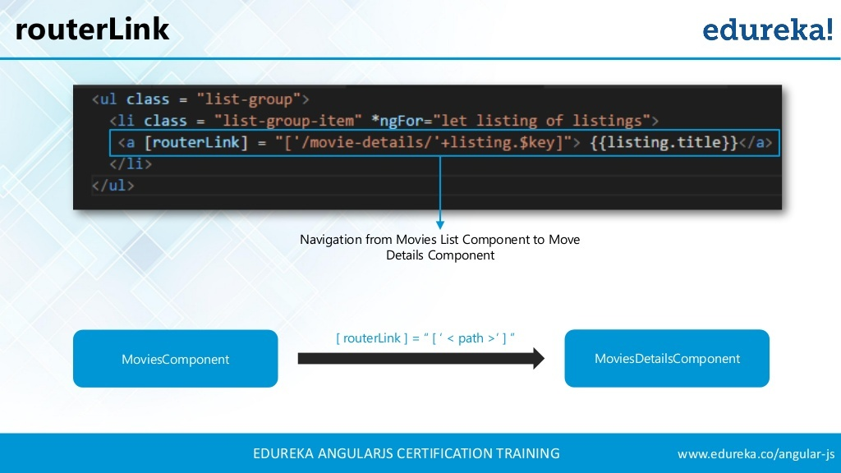

Slide 23
ROUTER-OUTLET
The Router-Outlet is a directive that’s available from the router library.
Router inserts the component that gets matched based on the current browser’s URL.
You can add multiple outlets in your Angular application which enables you to implement advanced routing scenarios.
<router-outlet></router-outlet>
Any component that gets matched by the Router will render it as a sibling of the Router outlet.

Slide 24
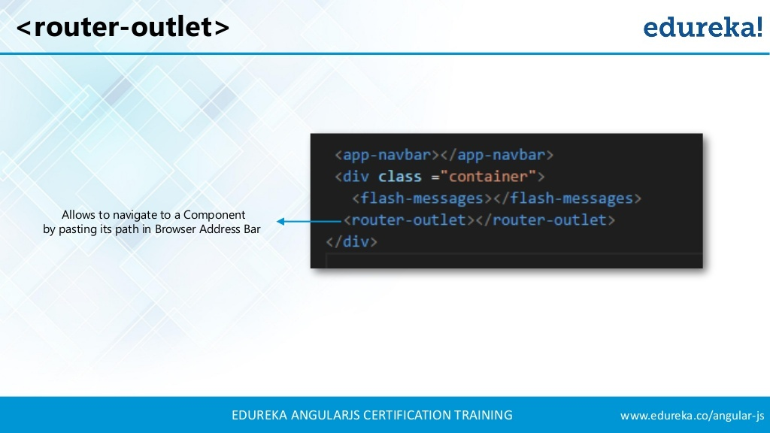

Slide 25
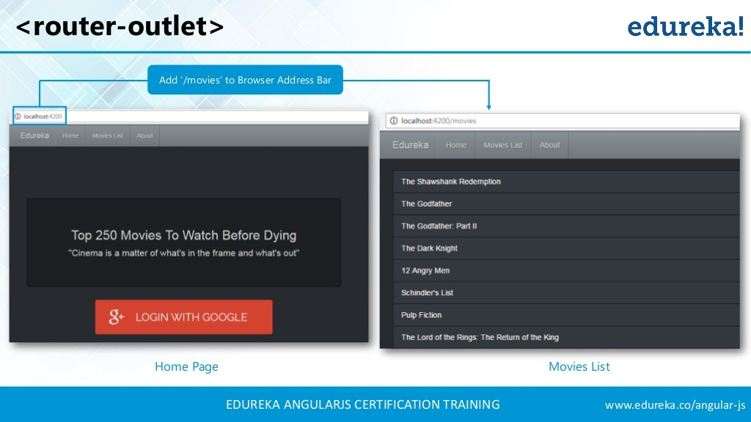

Slide 26
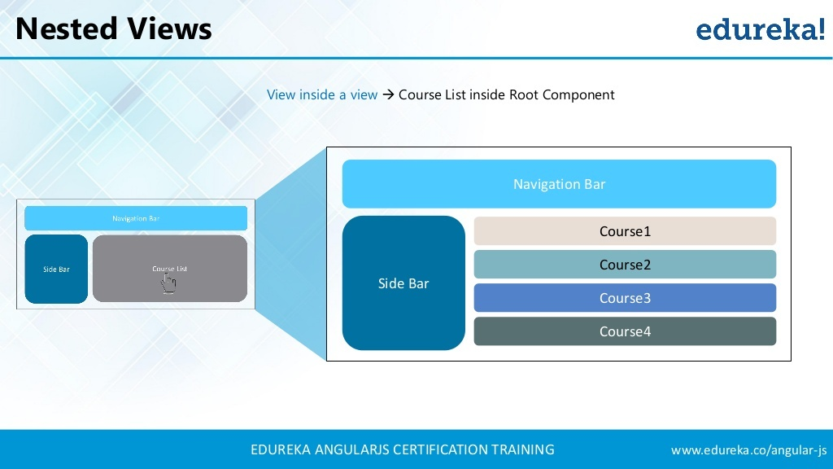

Slide 27
MULTIPLE OUTLETS AND AUXILIARY ROUTES
Angular Router supports multiple outlets in the same application.
A component has one associated primary route and can have auxiliary routes.
To create an auxiliary route, you’ll need a named router outlet where the component associated with the auxiliary route will be displayed.
Auxiliary routes enable developers to navigate multiple routes at the same time.

Slide 28
MULTIPLE OUTLETS AND AUXILIARY ROUTES
<router-outlet></router-outlet>
<router-outlet name="outlet1"></router-outlet>
The outlet with no name is the primary outlet.
All outlets should have a name except for the primary outlet.
You can then specify the outlet where you want to render your component using the outlet attribute:
{ path: "contacts", component: ContactListComponent, outlet: "outlet1" }

Slide 29
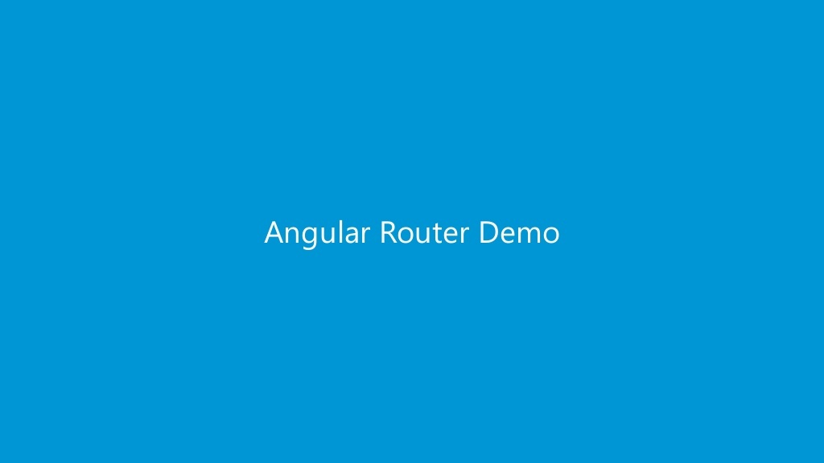

Slide 30
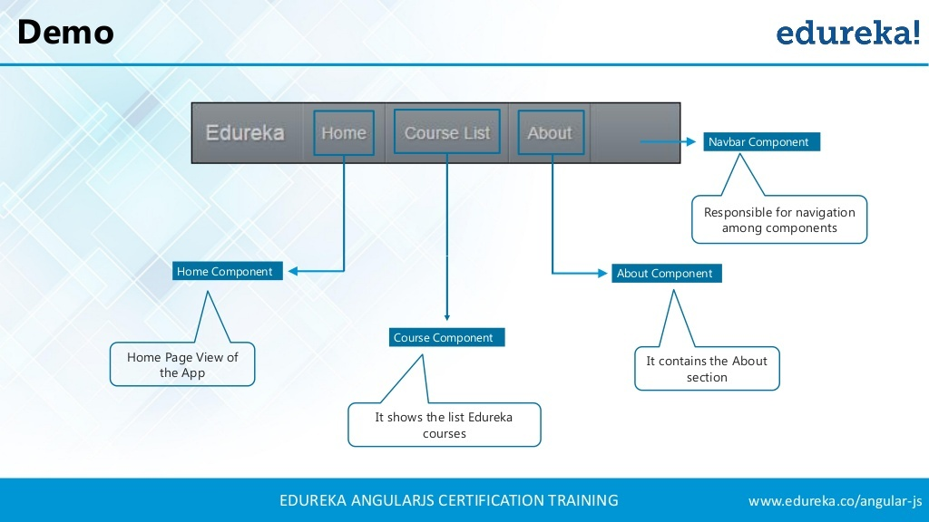

Slide 31
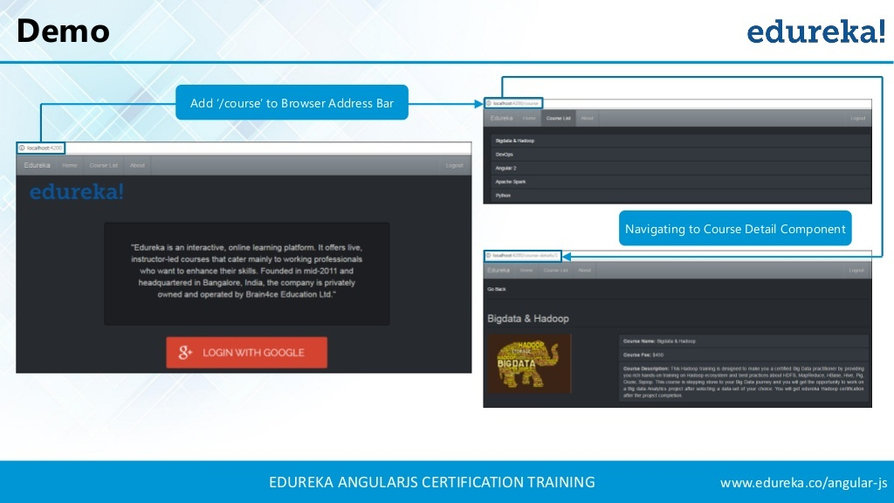

Slide 32
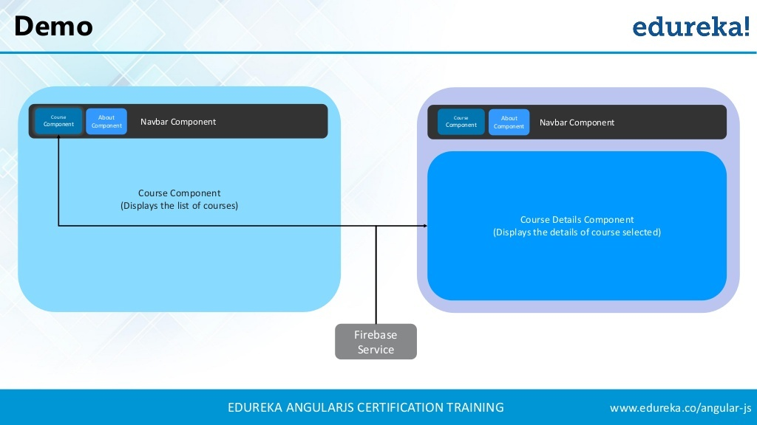

Slide 33


