Slide 1
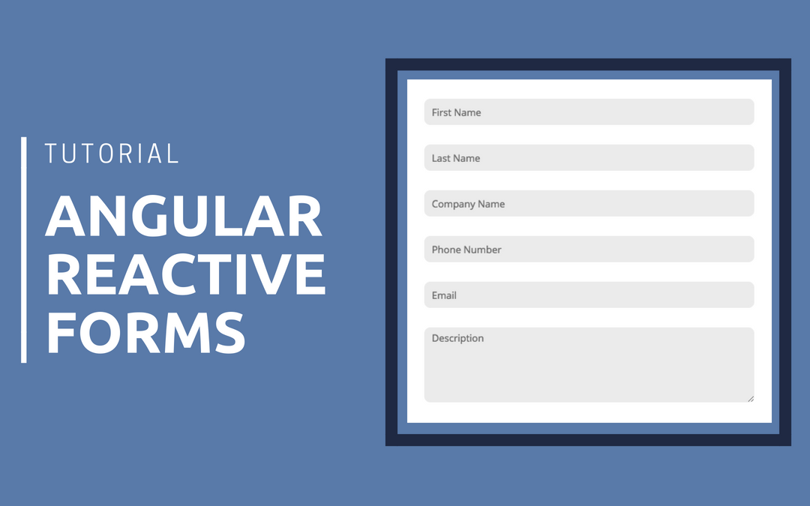


Slide 2
Angular 7 Forms
Angular forms are used to handle user's input.
We can use Angular form in our application to enable users to log in, to update profile, to enter information, and to perform many other data-entry tasks.
In Angular 7, there are 2 approaches to handle user's input through forms:
Reactive forms
Template-driven forms
Both approaches are used to collect user input events from the view, validate the user input, create a form model and data model to update, and provide a way to track changes.

Slide 3
Reactive Forms
Reactive forms are more robust.
Reactive forms are more scalable, reusable, and testable.
They are most preferred to use if forms are a key part of your application, or your application is already built using reactive patterns.
In both cases, reactive forms are best to use.

Slide 4
Template-driven Forms
Template-driven forms are best if you want to add a simple form to your application. For example: email list signup form.
Template-driven forms are easy to use in the application but they are not as scalable as Reactive forms.
Template-driven forms are mainly used if your application's requires a very basic form and logic. It can easily be managed in a template.

Slide 5
Reactive Forms vs. Template-driven Forms
Comparison Index | Reactive Forms | Template-driven Forms
Setup (form model) | Reactive forms are more explicit. They are created in component class. | Template-driven forms are less explicit. They are created by directives.
Data model | Structured | Unstructured
Predictability | Synchronous | Asynchronous
Form validation | Functions | Directives
Mutability | Immutable | Mutable
Scalability | Low-level API access | Abstraction on top of APIs

Slide 6
Similarity between Reactive Forms and Template-driven Forms
There are some building blocks which are shared by both reactive and template-driven forms:
FormControl: It is used to track the value and validation status of an individual form control.
FormGroup: It is used to track the same values and status for a collection of form controls.
FormArray: It is used to track the same values and status for an array of form controls.
ControlValueAccessor: It is used to create a bridge between Angular FormControl instances and native DOM elements.

Slide 7
template-driven forms
Build an Angular form with a component and template.
Create html-input-elements and then use directives like ngModel to bind their value to a component's variable.
Use ngModel to create two-way data bindings for reading and writing input-control values.
Track state changes and the validity of form controls.
Provide visual feedback using special CSS classes that track the state of the controls.
Display validation errors to users and enable/disable form controls.
Share information across HTML elements using template reference variables.

Slide 8
Reactive forms
Reactive forms provide a model-driven approach to handling form inputs whose values change over time.
We can create and update a basic form control, progress to using multiple controls in a group, validate form values.
Create dynamic forms where you can add or remove controls at run time

Slide 9
Overview of reactive forms
Reactive forms use an explicit and immutable approach to managing the state of a form at a given point in time.
Each change to the form state returns a new state, which maintains the integrity of the model between changes.
Reactive forms are built around observable streams, where form inputs and values are provided as streams of input values, which can be accessed synchronously.
Reactive forms also provide a straightforward path to testing because you are assured that your data is consistent and predictable when requested.

Slide 10
Adding a basic form control
Four steps to using form controls.
Register the reactive forms module in your app.
This module declares the reactive-form directives that you need to use reactive forms.
Generate a new FormControl instance and save it in the component.
Register the FormControl in the template.
Display the form by adding the component to the template.

Slide 11
Register the reactive forms module
To use reactive form controls, import ReactiveFormsModule from the @angular/forms package and add it to your NgModule's imports array.
import { ReactiveFormsModule } from '@angular/forms';
@NgModule({ imports: [ // other imports ... ReactiveFormsModule ],
})
export class AppModule { }

Slide 12
Generating and importing a new form control
The FormControl class is the basic building block when using reactive forms.
To register a single form control, import the FormControl class into your component and create a new instance of the form control to save as a class property.
Use the constructor of FormControl to set its initial value, which in this case is an empty string.
By creating these controls in your component class, you get immediate access to listen for, update, and validate the state of the form input.
import { FormControl } from '@angular/forms';
export class NameEditorComponent {
name = new FormControl(''); }

Slide 13
register the control in the template
After creating the control in the component class, you have to add it to the form control element in the template.
Use the formControl binding provided by FormControlDirective to update the template with the form control.
We have registered the form control to the name input element in the template.
Now, the form control and DOM element communicate with each other and the view reflects changes in the model, and the model reflects changes in the view.
<label>
Name:
<input type="text" [formControl]="name">
</label>

Slide 14
Displaying the component
The form control assigned to name is displayed when the component is added to a template.
TypeScript Code: <app-name-editor></app-name-editor>

Slide 15
Managing control values
Reactive forms give you access to the form control state and value at a point in time.
You can manipulate the current state and value through the component class or the component template.
Displaying a form control value
<p> Value: {{ name.value }} </p>

Slide 16
Generating form controls with FormBuilder
FormBuilder service provides convenient methods for generating controls.
Step 1: Importing the FormBuilder class
import { FormBuilder } from '@angular/forms';
Step 2: Injecting the FormBuilder service
The FormBuilder service is an injectable provider that is provided with the reactive forms module.
Inject this dependency by adding it to the component constructor.
constructor(private fb: FormBuilder) { }

Slide 17
Generating form controls with FormBuilder
Generating form controls with FormBuilder
The FormBuilder service has three methods: control(), group(), and array().
These are factory methods for generating instances in your component classes including form controls, form groups, and form arrays.
export class ProfileEditorComponent { profileForm = this.fb.group({
firstName: [''],
lastName: [''],
address: this.fb.group({ street: [''],
city: [''], state: [''], zip: [''] }), });
constructor(private fb: FormBuilder) { } }

Slide 18
Validators in reactive forms
import { FormBuilder, FormGroup, Validators } from '@angular/forms';
ngOnInit() {
this.registerForm = this.formBuilder.group({
fname: ['',[ Validators.required,Validators.pattern('^[a-zA-Z]+$')]],
lname: ['',[ Validators.required,Validators.pattern('^[a-zA-Z]+$')]],
email: ['', [Validators.required, Validators.email]],
password: ['', [Validators.required, Validators.minLength(6)]],
dob: ['', [Validators.required]],
phoneNo: ['', [Validators.required]],
street: ['', [Validators.required]],
city: ['', [Validators.required]],
pincode: ['', [Validators.required]],
});
}

Slide 19
Reactive forms template
<form [formGroup]="registerForm" (ngSubmit)="onSubmit()">
<div class="form-group">
<div class="form-group">
<label>Email</label>
<input type="text" formControlName="email" class="form-control" [ngClass]="{ 'is- invalid': submitted && f.email.errors }" />
<div *ngIf="submitted && f.email.errors" class="invalid-feedback">
<div *ngIf="f.email.errors.required">Email is required</div>
<div *ngIf="f.email.errors.email">Email must be a valid email address</div>
</div>
</div>

Slide 20
The RxJS library
Reactive programming is an asynchronous programming paradigm concerned with data streams and the propagation of change .
RxJS (Reactive Extensions for JavaScript) is a library for reactive programming.
Using observables that makes it easier to compose asynchronous or callback-based code.
RxJS provides an implementation of the Observable type, which is needed until the type becomes part of the language and until browsers support it

Slide 21
utility functions
RxJS library provides utility functions for creating and working with observables.
These utility functions can be used for:
Converting existing code for async operations into observables
Iterating through the values in a stream
Mapping values to different types
Filtering streams
Composing multiple streams

Slide 22
Observables in Angular
Angular makes use of observables as an interface to handle a variety of common asynchronous operations.
You can define custom events that send observable output data from a child to a parent component.
The HTTP module uses observables to handle AJAX requests and responses.
The Router and Forms modules use observables to listen for and respond to user-input events.

Slide 23
HTTP
Angular’s HttpClient returns observables from HTTP method calls. For instance, http.get(‘/api’) returns an observable.
This provides several advantages over promise-based HTTP APIs:
Observables do not mutate the server response (as can occur through chained .then() calls on promises).
Instead, you can use a series of operators to transform values as needed.
HTTP requests are cancellable through the unsubscribe() method.
Requests can be configured to get progress event updates.
Failed requests can be retried easily.

Slide 24
Router
Router.events provides events as observables.
You can use the filter() operator from RxJS to look for events of interest.
And subscribe to them in order to make decisions based on the sequence of events in the navigation process.
The ActivatedRoute is an injected router service that makes use of observables to get information about a route path and parameters.
import { ActivatedRoute } from '@angular/router';
export class Routable2Component implements OnInit {
constructor(private activatedRoute: ActivatedRoute) {}
ngOnInit() {
this.activatedRoute.url .subscribe(url => console.log('The URL changed to: ' + url)); } }

