Slide 1

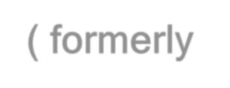

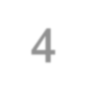

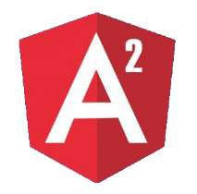
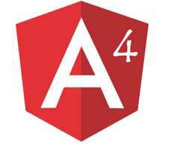
Angular
( formerly Angular 4 )
One framework.
Mobile & desktop.

Slide 2
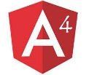

Agenda
Introduction of Angular.
Features of Angular.
Development environment setup.
Project setup
Structure of Angular project.
How to install packages.
What is TypeScript .
How Angular application start.
Components.
How to create component.
Styling component.
Component selector.
Databinding

Slide 3

Angular
Angular is an open source JavaScript framework that is used to build single page based web applications.
Developed by Google
Release Date - March 2016
One framework. Mobile & Desktop.

Slide 4





Features of Angular
Cross Platform
Productivity
Speed and Performance
 |  | Development

Slide 5
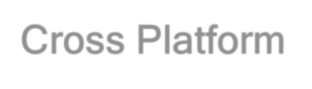
Cross Platform
Angular use modern web platform capabilities to deliver app-like experiences.
High performance and zero-step installation.
Build native mobile apps with Ionic Framework, NativeScript, and React Native.
Create desktop - installed apps across Mac, Windows, and Linux.

Slide 6

Speed and Performance
Angular turns our templates into code that's highly optimized for today's JavaScript
machines.
Serve the first view of your application on node.js, .NET, PHP, and other servers for rendering in just HTML and CSS. .
Angular apps load quickly with the new Component Router.

Slide 7

Productivity
Quickly create UI views with simple and powerful template syntax.
Command line tools:
Start building fast
Add components and tests
Then instantly deploy.
Get intelligent code completion, instant errors in popular editors and IDEs.

Slide 8

Full Development Story
Karma for unit tests.
Protractor makes our scenario tests run faster and in a stable manner.
Create high-performance, complex choreographies and animation timelines with very little code through Angular's intuitive API.

Slide 9
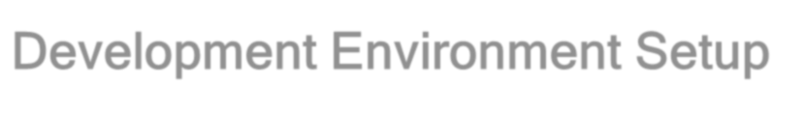

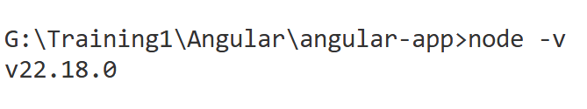
Development Environment Setup
Node.js
https://nodejs.org/en/download/
Node.js is an open-source, cross-platform JavaScript run-time environment for executing JavaScript code server-side.
Download latest version i.e. node v22.18.0
Check node.js version
Syntax : - node -v
This command is used for checking current installed version of node.

Slide 10
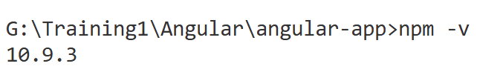
Check npm version
Syntax : - npm -v
This command is used for checking current installed version of Node Package Manager (npm).
Text Editor
Visual Studio Code, WebStrome , Sublime or any other text editor IDE

Slide 11
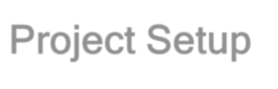
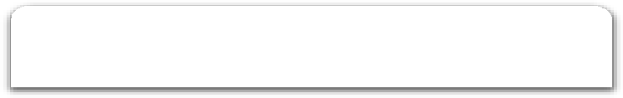

Project Setup
Angular CLI is command line interface for Angular
Open node js command prompt in admin mode.
Syntax : - npm install –g <packagename>
F:/Angular4> npm install –g @angular/cli
Node.js command prompt
> npm install –g @angular/cli@latest > npm install –g @angular/cli@19.2.15
Current working directory
Package Name
Globally
> ng version

Slide 12
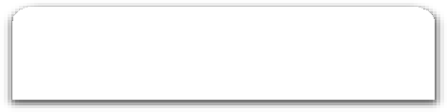

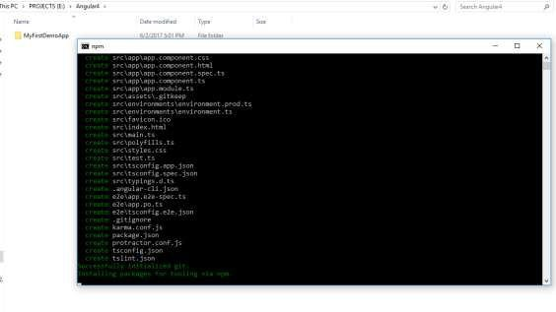
Creating project using Angular CLI
Syntax : - ng new <project_name>
F:/Angular4> ng new MyFirstDemoApp
Node.js command prompt
Current working directory
Project Name

Slide 13

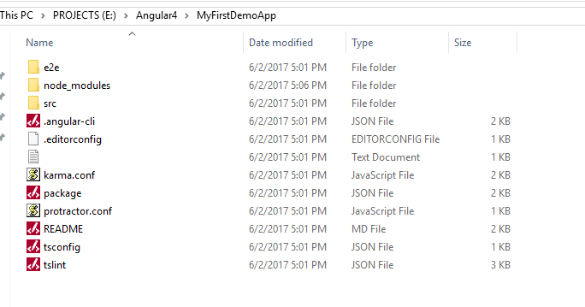
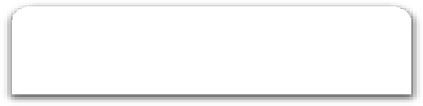

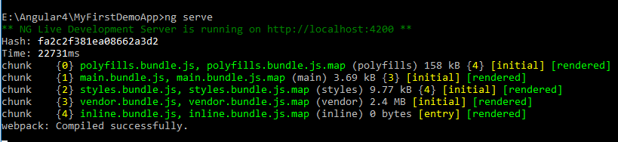
Enter into newly created project folder i.e. MyFirstDemoApp
Step 4
Run application
ng serve command is used for to run application.
Syntax : - ng serve
F:/Angular4/MyFirstDemoApp> ng serve

Slide 14
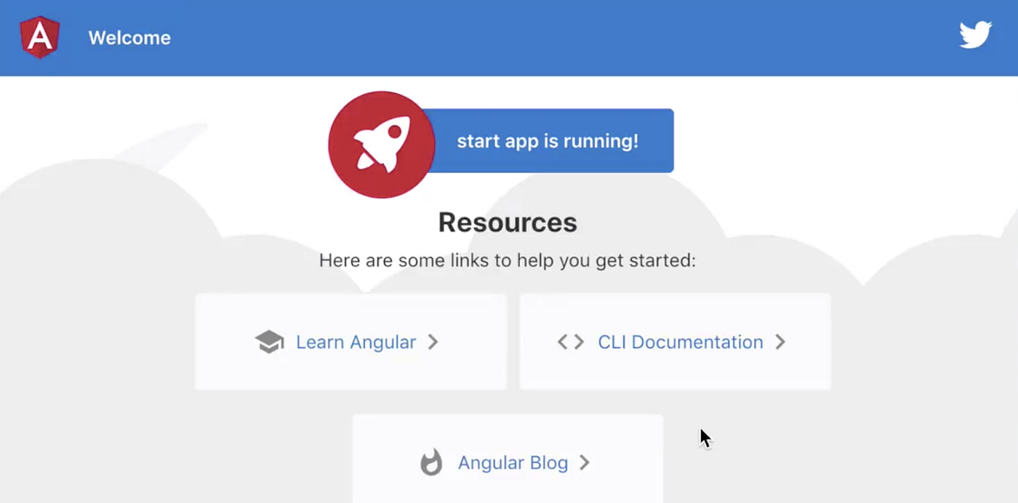
Open web browser - localhost:4200

Slide 15
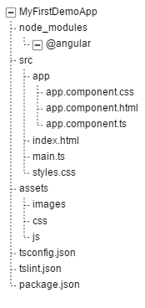
Structure of project
NPM is the node package manager, which installs packages locally into a project, specifically, into the node_modules folder.
Root project folder, all components reside is app folder.
Entry point of application
All images, stylesheets, JavaScript or third party libraries reside in assets
Configuration Files

Slide 16

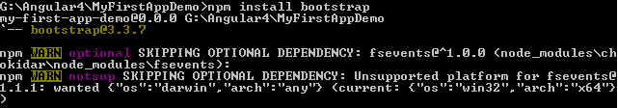
Installing Packages
npm install command is used for installing packages.
Syntax
npm install <package_name>
Example
F:/Angular4/MyFirstDemoApp> npm install bootsrap

Slide 17

How App Start
main.ts
Main.ts file is entry point of our application.
Main.ts file bootstrap app.config.ts file
App.config.ts
This file bootstrap our first component i.e app.component.ts
app.component.ts
This file render app.component.html file.
app.component.html
Final HTML template

Slide 18
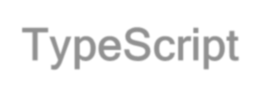
TypeScript
TypeScript is a free and open source programming language.
TypeScript is a syntactic superset of JavaScript which adds static typing.
TypeScript being a Syntactic Superset means it shares the same base syntax as JavaScript, but adds something to it.
It is developed and maintained by Microsoft.
It is syntactical superset of JavaScript and adds optional static typings and class based object oriented programming to the language.

Slide 19
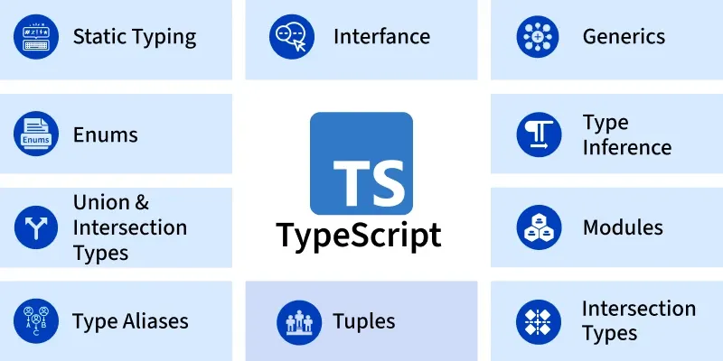
TypeScript Features
TypeScript is a superset of JavaScript that adds extra features like static typing, interfaces, enums, and more.
TypeScript is JavaScript with additional syntax for defining types, making it a powerful tool for building scalable and maintainable applications.
Static typing allows you to define variable types and helps catch errors before running the code at compile time.

Slide 20
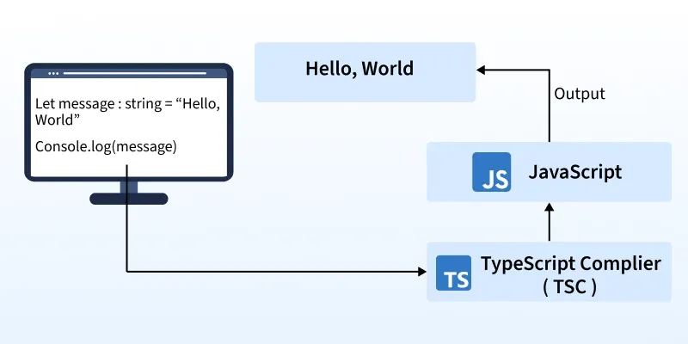
TypeScript Features
TypeScript is compiled into JavaScript, ensuring it works in all JavaScript environments.

Slide 21
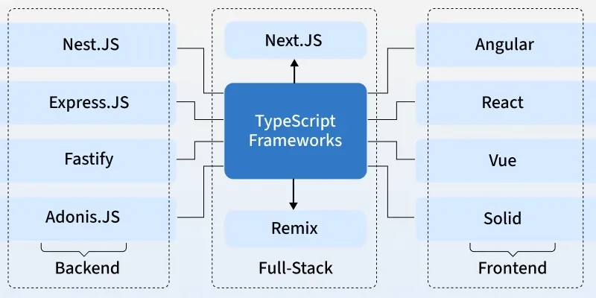
TypeScript Features
It’s widely used for web development on both the client and server sides.

Slide 22
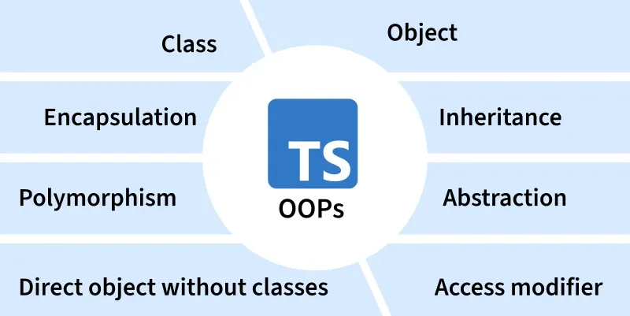
TypeScript Features

Slide 23
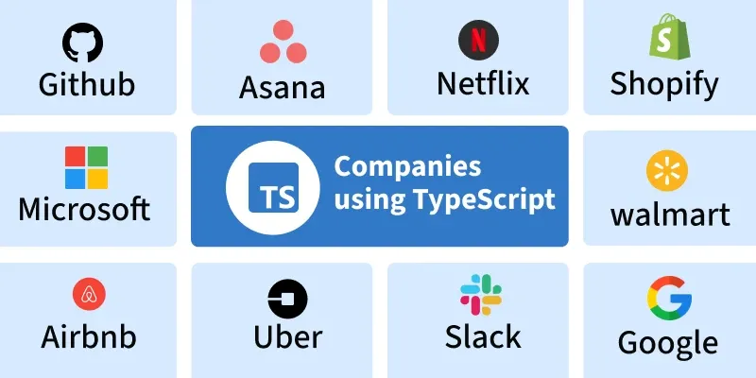
TypeScript Features
Developed by Microsoft, TypeScript is trusted by companies like Google, Slack, Airbnb, and Asana.

Slide 24
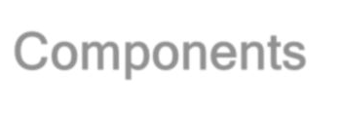




Components
Components are a logical piece of code for Angular application.
A Component consists of the following −
Appcomponent
App.component.html
App.component.ts
App.component.css
Template is used to render the view for the application.
This contains the HTML that
needs to be rendered in the application.
This is like a class defined in any language such as C#.
This has the code which is used to support the view.
It is defined in TypeScript.
This has the styles defined for the Angular html file.

Slide 25
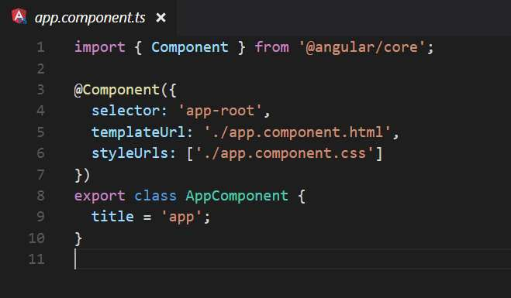
We are using the import keyword to import the ‘Component’ decorator from the angular/core module.
Decorator
Defines the name of the HTML tag.
It holds our HTML template.
The styles option is used to style a specific component
Defining a class called AppComponent.
The export keyword is used so that the component can be used in other modules in the application.
title is the name of the property.
The property is given a value of
‘app’.

Slide 26

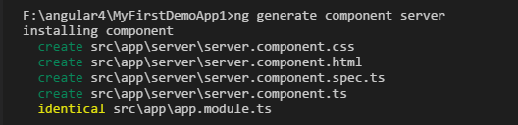
Creating Component
ng generate command is used for create component.
Example F:/Angular4/MyFirstDemoApp> ng g c server
Syntax
ng generate component <component_name>
or
ng g c <component_name>

Slide 27

Component Selector
By Element
Define by square brackets [ ] in selector name.
Example
@Component({
selector: '[app-root]',
templateUrl: './app.component.html', styleUrls: ['./app.component.css']
})
Syntax
@Component({
selector: '[selector-name]', templateUrl: ‘html - template',
styleUrls: [‘stylesheet']
})
<div selector_name> </div>
<div app-root> </div>

Slide 28
Define by dot ( . ) in selector name.
By Class
Example
@Component({ selector: ‘.app-root',
templateUrl: './app.component.html', styleUrls: ['./app.component.css']
})
Syntax
@Component({
selector: ‘.selector-name',
templateUrl: ‘html - template', styleUrls: [‘stylesheet']
})
<div class =“selector-name”>
<div class=“app-root”> </div>

Slide 29

Data binding
Data binding is communication between business logic and views.
Data binding = Communication
Typescript
Code
(Business Logic)
Output Data
Template (HTML)
String Interpolation => {{ data }}
Property Binding => [property] = “ data “

Slide 30
String Interpolation
Interpolation markup is used to provide data-binding to text and attribute values.
Example
export class AppComponent
{
title = ‘This is my demo app';
}
Syntax
export class <class_name>
{
variableName = ‘any string';
}
<div {{variableName }} >
<div {{ title }} > </div>

Slide 31
Property Binding
Property binding allow us to bind values to properties of an element to modify their behavior or appearance. This can include properties such as class, disabled, href or textContent.
Typescript export class ClientComponent { isActive = false;
constructor() {
setTimeout(() =>
{ this.isActive = true; }, 2000); } ngOnInit() { }
HTML
<button [disabled]="!isActive" class="btn">ADD</button>

Slide 32



