Slide 1


Slide 2
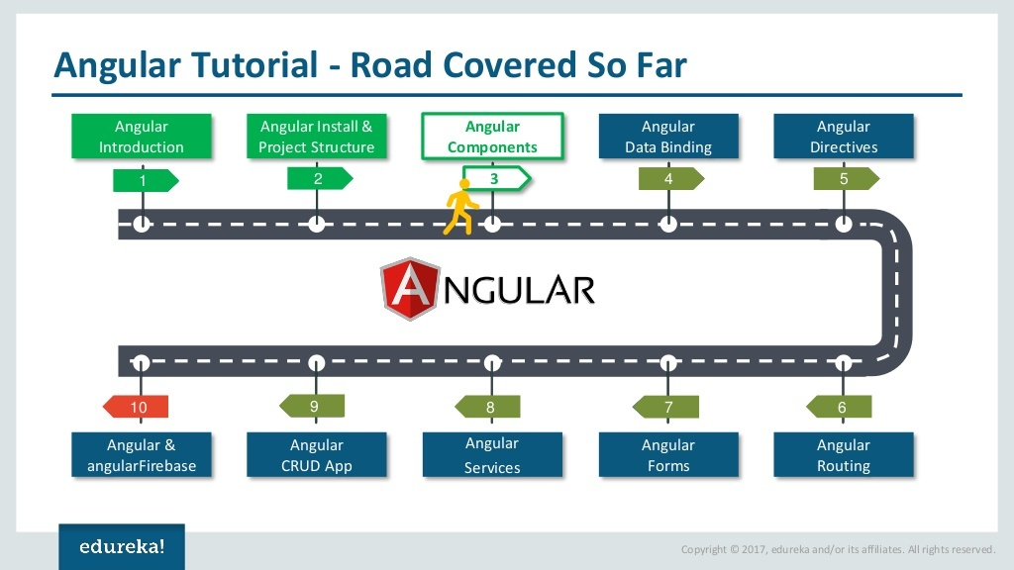

Slide 3


Slide 4
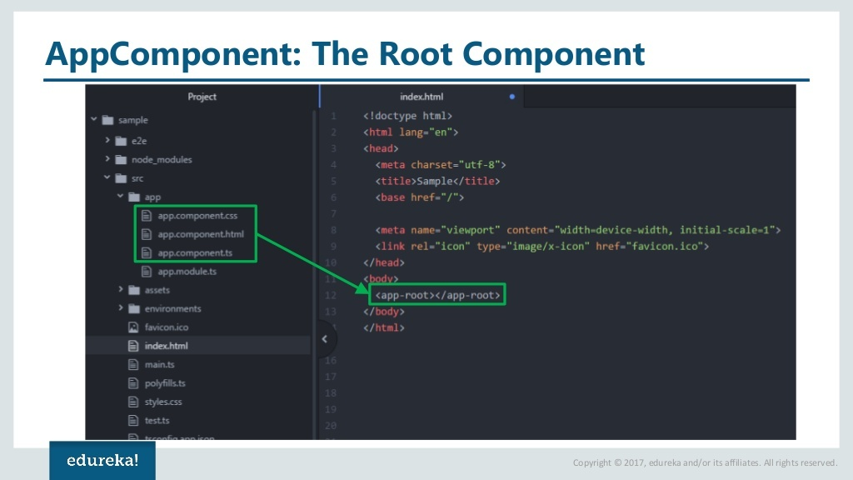

Slide 5
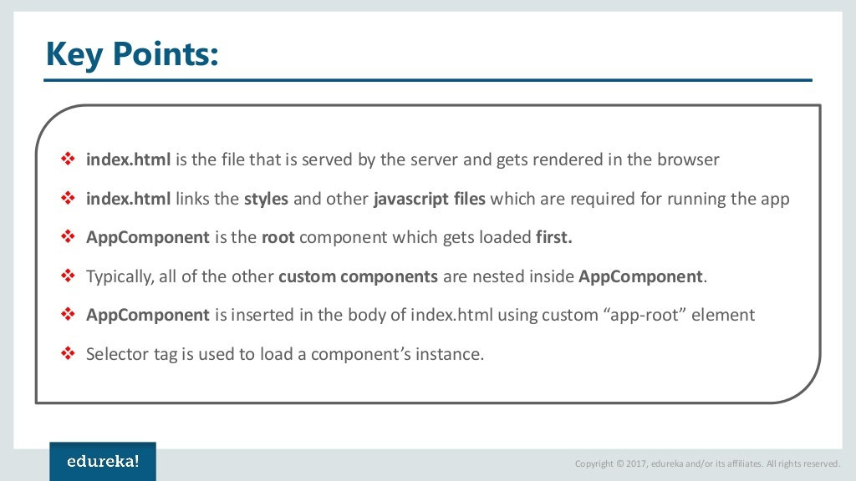

Slide 6
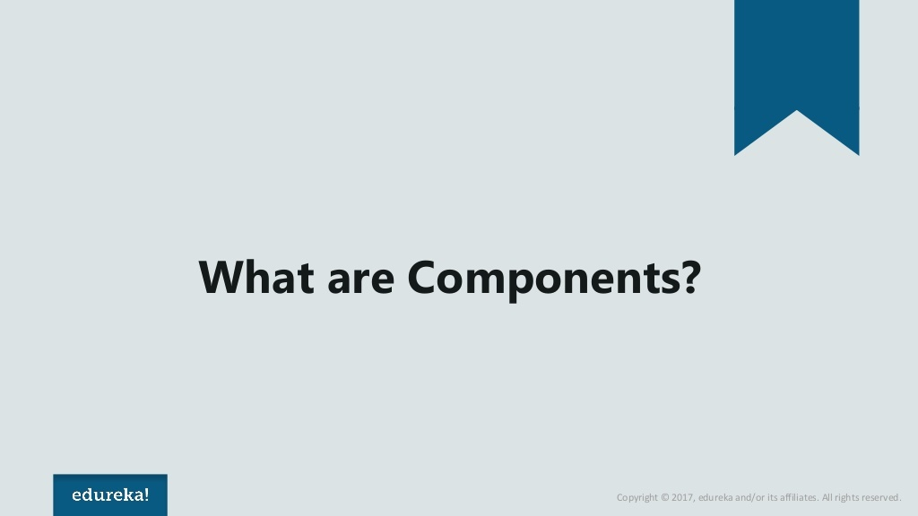

Slide 7
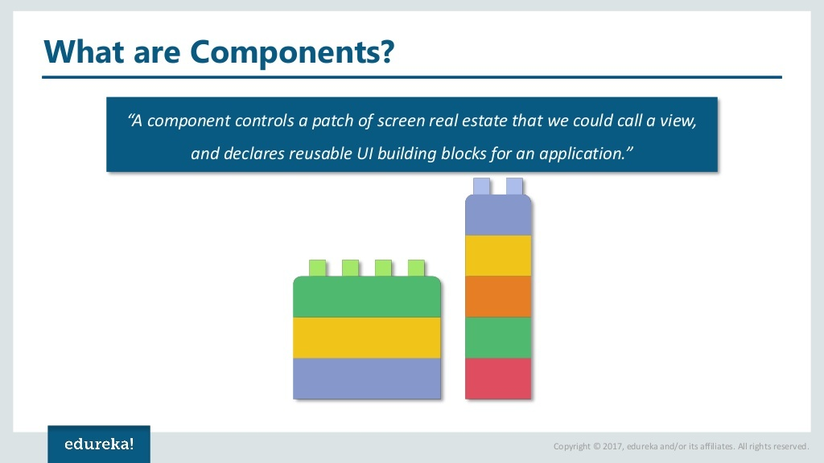

Slide 8
What is an Angular Component
The Component is the main building block of an Angular Application.
The Component contains the data & user interaction logic that defines how the View looks and behaves.
A view in Angular refers to a template (HTML).
The Angular Components are plain JavaScript/Type Script classes and defined using @Component Decorator.
This Decorator provides the component with the View to display & Metadata about the Component

Slide 9
What is an Angular Component
The Component is responsible to provide the data to the view.
The Angular does this by using data binding to get the data from the Component to the View.
This is done using the special HTML markup knows as the Angular Template Syntax.
The Component can also get notified when the View Changes.
The Angular applications will have lots of components.
Each component handles a small part of UI.
These components work together to produce the complete user interface of the application

Slide 10
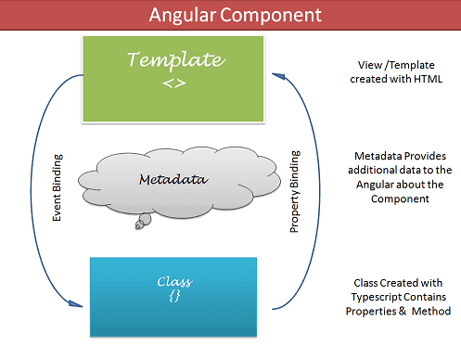
What is an Angular Component
The Components consists of three main building blocks
Template
Class
MetaData

Slide 11


Slide 12
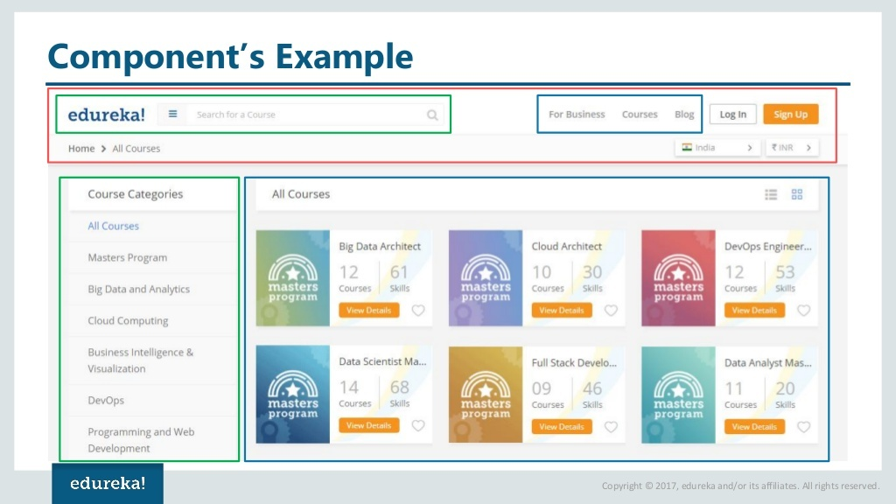

Slide 13
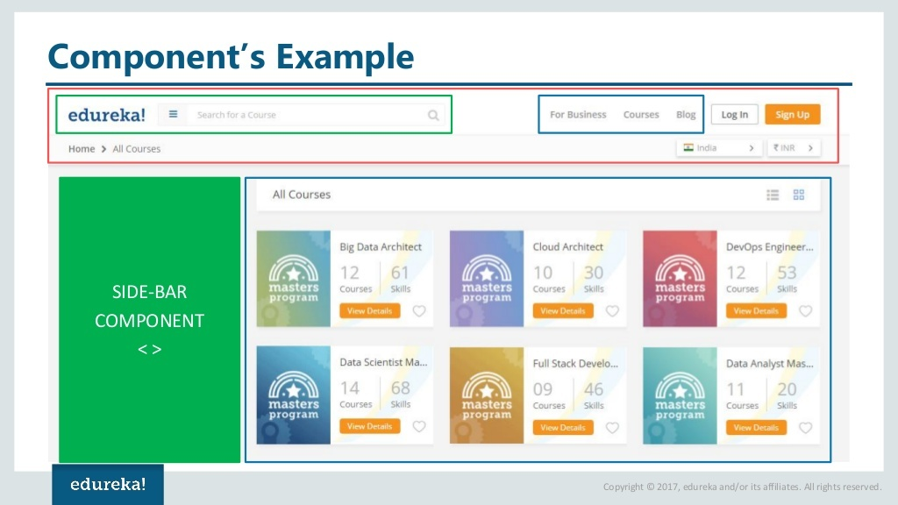

Slide 14
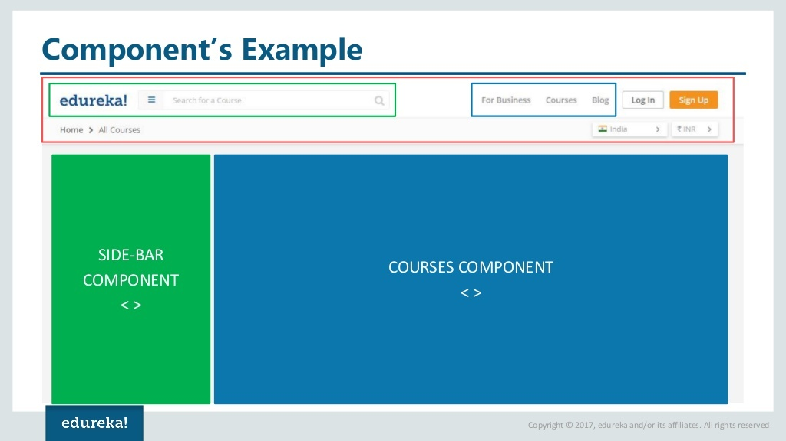

Slide 15
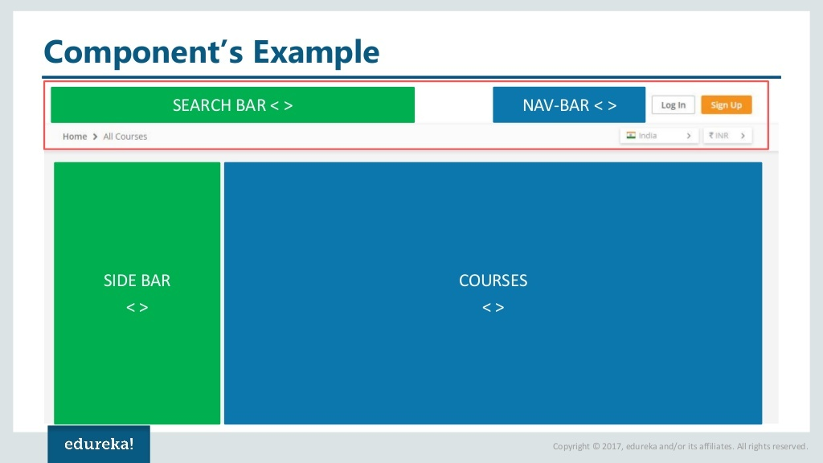

Slide 16
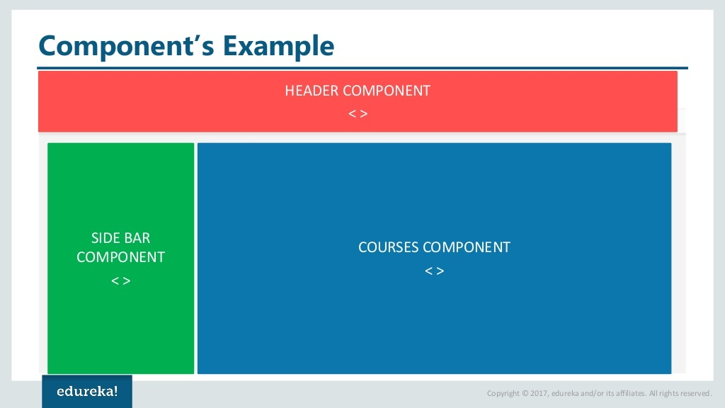

Slide 17
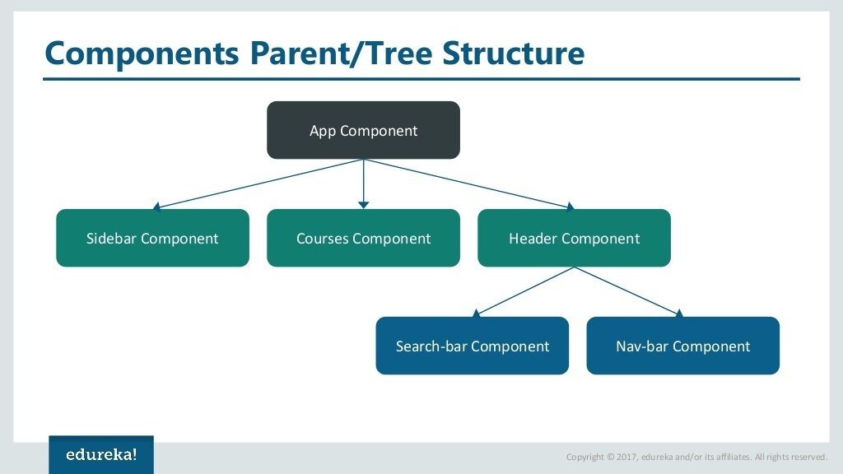

Slide 19
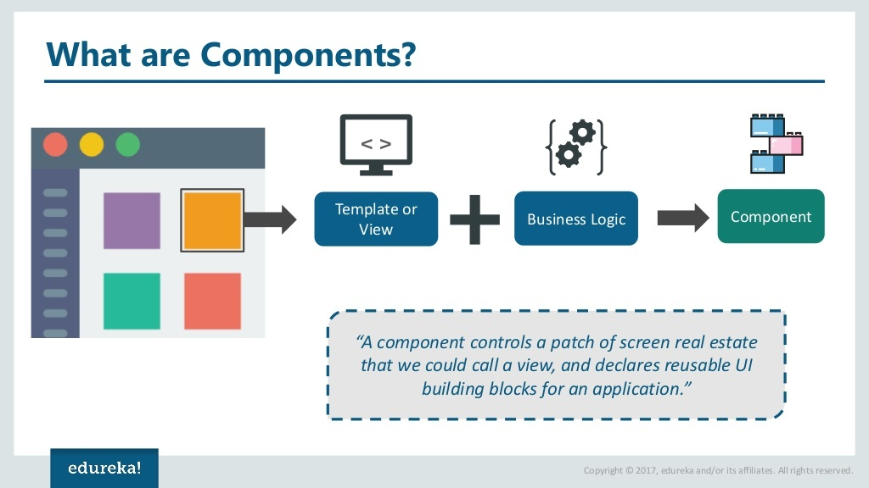

Slide 20


Slide 21
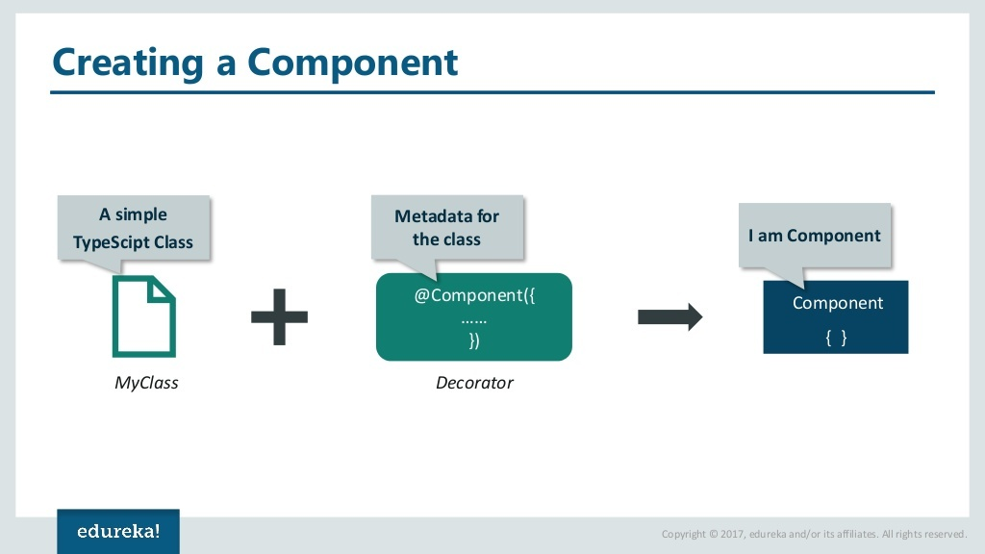

Slide 22
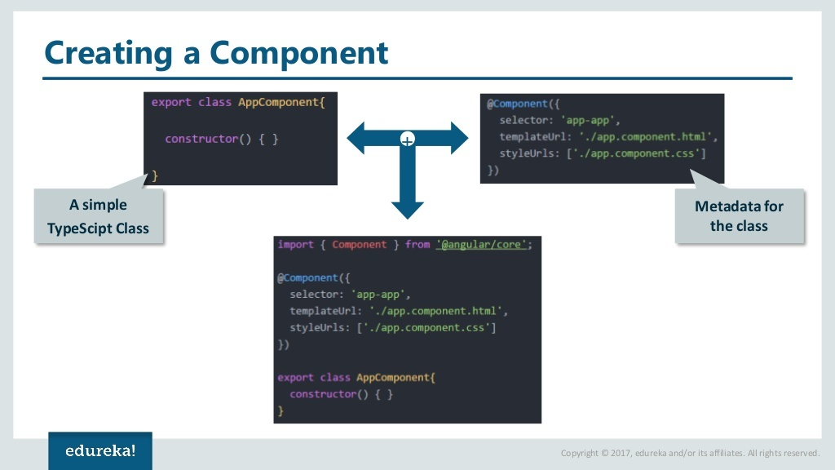

Slide 23


Slide 24


Slide 25
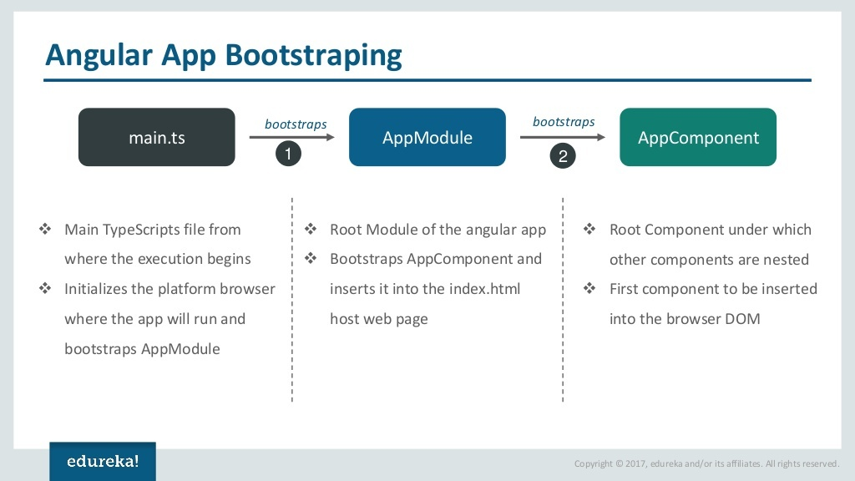
App.config.ts

Slide 26


Slide 27
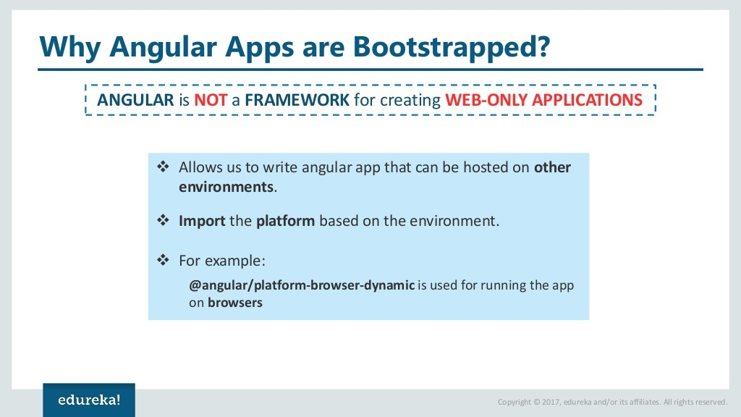

Slide 28
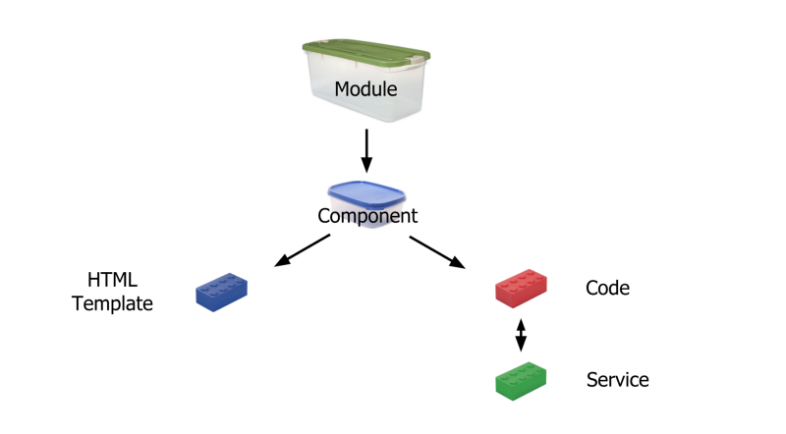
The Big Picture
Angular modules are containers of code parts that implement related domain requirements.
They let developers create apps with modular architectures and reusable code just like components.
Angular uses NgModules to create modules and submodules

Slide 29
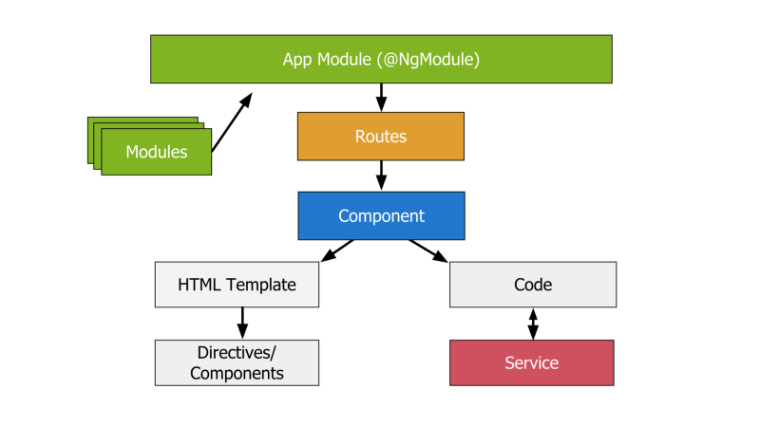
Components & Modules — Overview
Components are made up of code and HTML template and it can have a selector, so we can call it in our HTML.
<appcomponent></appcomponent>

Slide 30
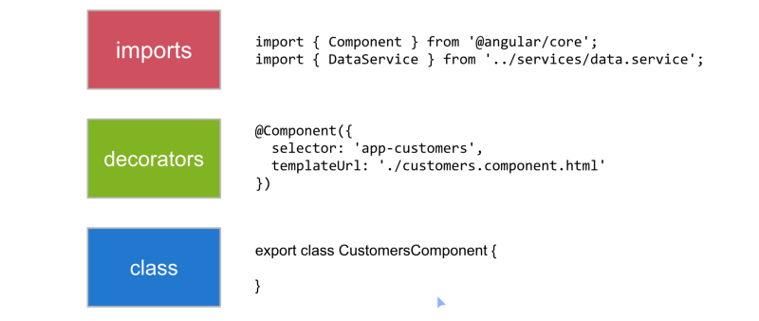
Component Structure

Slide 31


