Slide 1


Slide 2
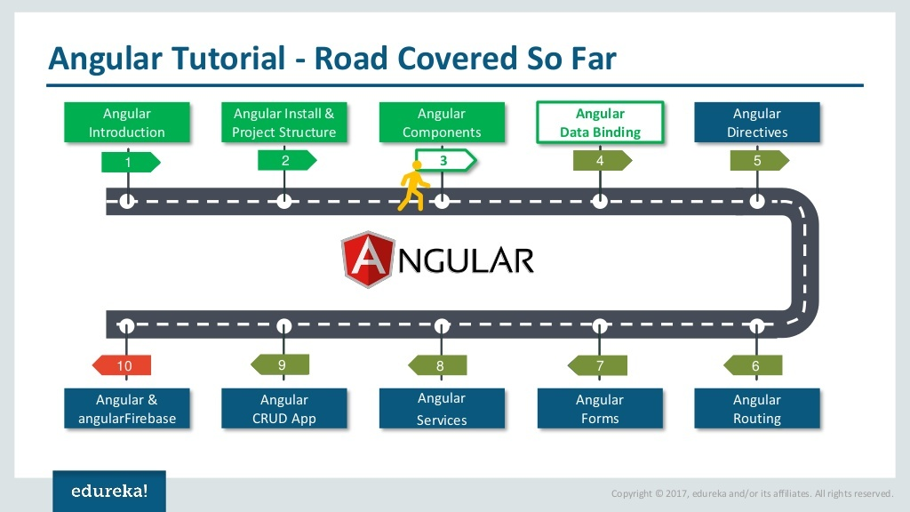

Slide 3
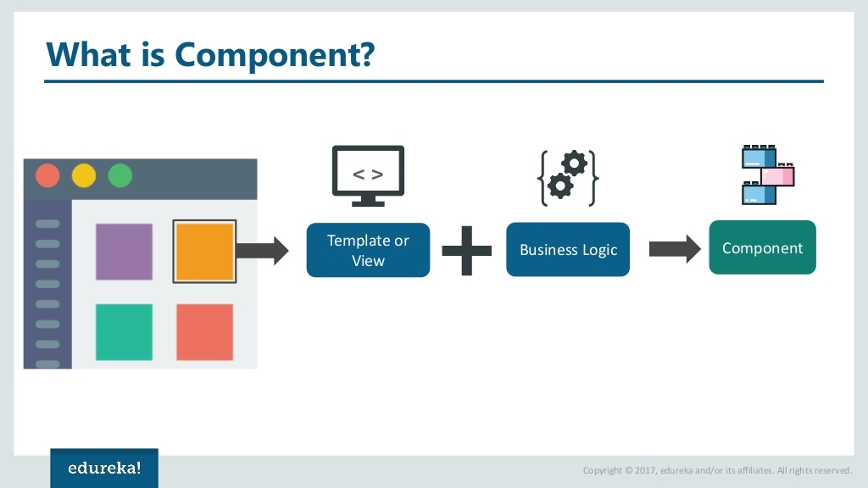

Slide 4


Slide 5
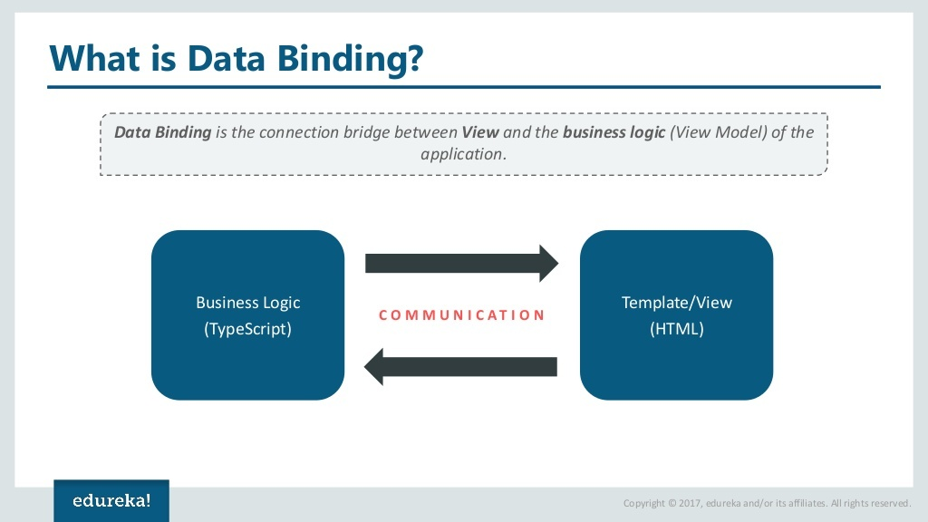

Slide 6


Slide 7
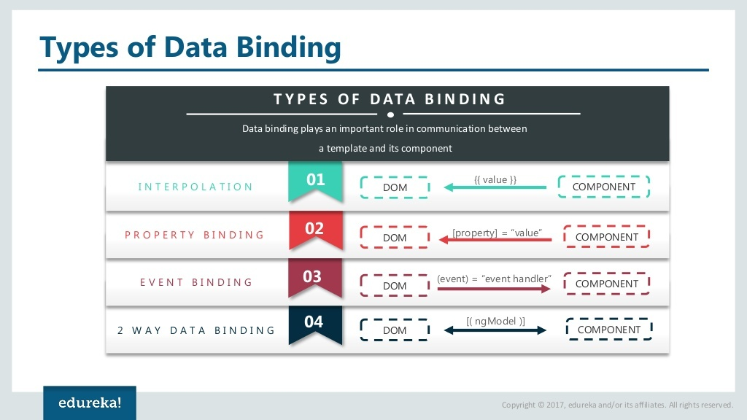

Slide 8
Types of Data Binding
Angular supports two main categories of data binding:
One-Way Data Binding (unidirectional) and
Two-Way Data Binding (bidirectional).
These mechanisms synchronize data between the component's TypeScript logic and the HTML view template, using specific syntax for different types of data flow.

Slide 9
One-Way Data Binding
In one-way binding, data flows in a single direction, either from the component to the view or from the view to the component.

Slide 10
One-Way Data Binding
In one-way binding, data flows in a single direction,
Either from the component to the view or
From the view to the component.

Slide 11
One-Way Data Binding-From Component to View
Interpolation ({{ ... }}): The simplest form, used to display dynamic text values from the component into the HTML view. The expression inside the double curly braces is converted to a string and inserted into the text flow.
Example: <p>Hello, {{ name }}!</p>
Property Binding ([property]="..."): Used to bind a component property to a DOM element's property, allowing for non-string values like booleans, objects, or arrays.
Example: <img [src]="imageUrl">
Attribute Binding ([attr.attribute]="..."): Used when a property binding is not available, typically for standard HTML attributes like colspan or ARIA attributes.
Example: <td [attr.colspan]="span"></td>

Slide 12
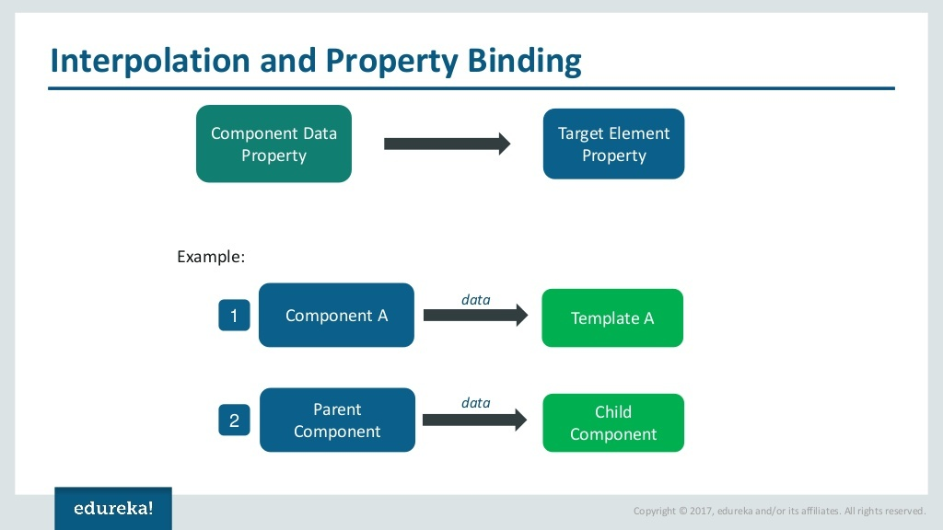

Slide 13
One-Way Data Binding-From Component to View
Class Binding ([class.className]="..."): Conditionally adds or removes a CSS class to an element based on a boolean value in the component.
Example: <div [class.is-active]="isActive"></div>
Style Binding ([style.styleProperty]="..."): Conditionally sets an inline style for an HTML element.
Example: <h1 [style.color]="color"></h1>

Slide 14
One-Way Data Binding- From View to Component
This binding allows the application to respond to user actions in the view, such as clicks or keystrokes, and execute methods in the component.
Event Binding ((event)="..."): Binds a DOM event (e.g., click, input, submit) to a method in the component's class.
The $event object can be passed to the handler to access data about the event.
Example: <button (click)="onClick()">Click me</button>

Slide 15


Slide 16
Two-Way Data Binding
Two-way data binding provides a seamless, automatic synchronization between the component's property and the view's input element.
Changes in the component update the view, and changes in the view update the component simultaneously.
[(ngModel)]="...": This is the primary way to achieve two-way binding with form controls in Angular. It is a special directive that combines property binding ([]) and event binding (()) syntax, often referred to as the "banana-in-a-box" syntax.
Prerequisite: You must import the FormsModule in your application module to use ngModel.
Example: <input [(ngModel)]="name">
This combination is equivalent to using separate property and event bindings like: <input [value]="name" (input)="name = $any($event.target).value">

Slide 17
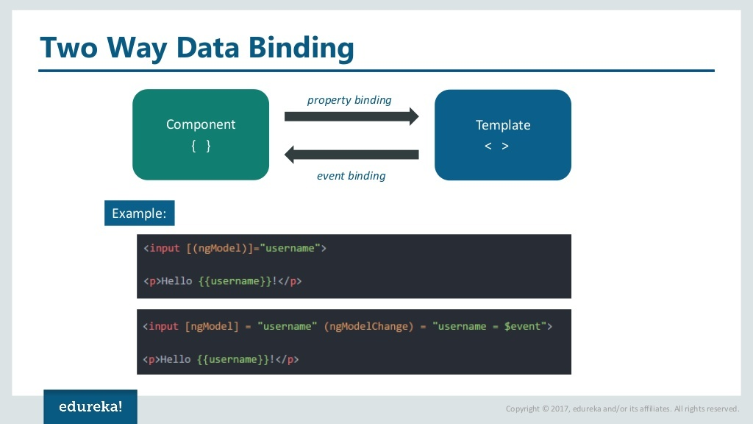

Slide 18


