Slide 1
Normalization
DataModelling

Slide 2
Normalization
The biggest problem needed to be solved in database is data redundancy.
Why data redundancy is the problem? Because it causes:
  Insert Anomaly
  Update Anomaly
  Delete Anomaly
Teacher | Subject | Teacher Degree | Tel
Sok San | Database | Master's | 012666777
Van Sokhen | Database | Bachelor's | 017678678
Sok San | E-Commerce | Master's | 012666777

Slide 3
Normalization (Cont.)
Normalization is the process of removing redundant data from your tables to improve storage efficiency, data integrity, and scalability.
Normalization generally involves splitting existing tables into multiple ones, which must be re-joined or linked each time a query is issued.
Why normalization?
  The relation derived from the user view or data store will most likely be unnormalized.
  The problem usually happens when an existing system uses unstructured file, e.g. in MS Excel.

Slide 4
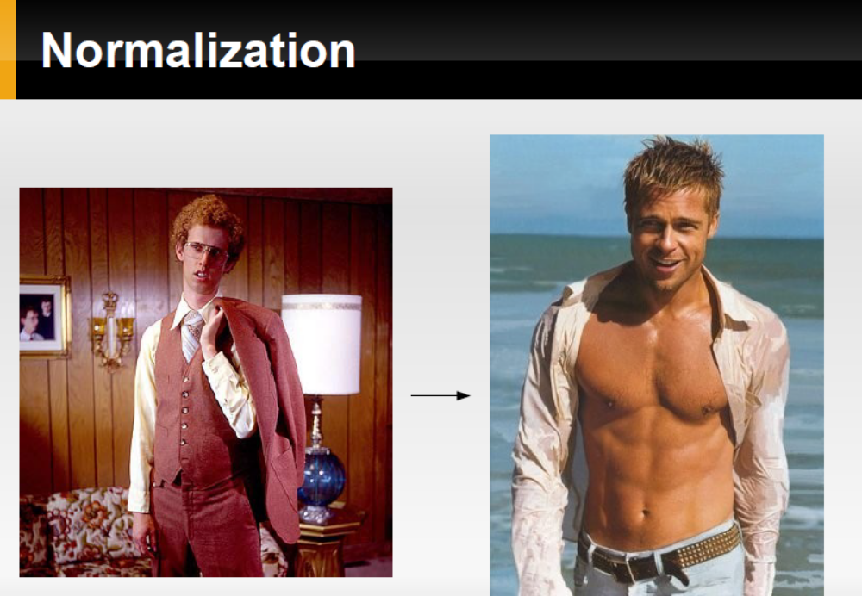

Slide 5
Steps of Normalization
First Normal Form (1NF)
Second Normal Form (2NF)
Third Normal Form (3NF)
Boyce-Codd Normal Form (BCNF)
Fourth Normal Form (4NF)
Fifth Normal Form (5NF)
In practice, 1NF, 2NF, and 3NF are enough for database.

Slide 6
First Normal Form (1NF)
The official qualifications for 1NF are:
  Each attribute name must be unique.
  Each attribute value must be single.(ATOMIC)
  Each row must be unique.
  There is no repeating groups.
Additional:
  Choose a primary key.
Reminder:
A primary key is unique, not null, unchanged. A primary key can be either an attribute or combined attributes.

Slide 7
First Normal Form (1NF) (Cont.)
Example of a table not in 1NF :
It violates the 1NF because:
Attribute values are not single.
Repeating groups exists.
Group | Topic | Student | Score
Group A | Intro MongoDB | Sok San | 18 marks
 |  | Sao Ry | 17 marks
Group B | Intro MySQL | Chan Tina | 19 marks
 |  | Tith Sophea | 16 marks

Slide 8
First Normal Form (1NF) (Cont.)
After eliminating:
Now it is in 1NF.
However, it might still violate 2NF and so on.
Group | Topic | Family Name | Given Name | Score
A | Intro MongoDB | Sok | San | 18
A | Intro MongoDB | Sao | Ry | 17
B | Intro MySQL | Chan | Tina | 19
B | Intro MySQL | Tith | Sophea | 16

Slide 9
Functional Dependencies
We say an attribute, B, has a functional dependency on another attribute, A, if for any two records, which have
the same value for A, then the values for B in these two records must be the same. We illustrate this as:
  A → B (read as: A determines B or B depends on A)
employee name | project | email address
Sok San | POS Mart Sys | soksan@yahoo.com
Sao Ry | Univ Mgt Sys | sao@yahoo.com
Sok San | Web Redesign | soksan@yahoo.com
Chan Sokna | POS Mart Sys | chan@gmail.com
Sao Ry | DB Design | sao@yahoo.com
    employee name → email address

Slide 10
Functional Dependencies (cont.)
EmpNum
EmpEmail
EmpFname
EmpLname
123
jdoe@abc.com
John
Doe
456
psmith@abc.com
Peter
Smith
555
alee1@abc.com
Alan
Lee
633
pdoe@abc.com
Peter
Doe
787
alee2@abc.com
Alan
Lee
If EmpNum is the PK then the FDs:
EmpNum → EmpEmail, EmpFname, EmpLname
must exist.

Slide 11
Functional Dependencies (cont.)
EmpNum → EmpEmail, EmpFname, EmpLname
3 different ways you might see FDs depicted
EmpEmail
EmpNum
EmpFname
EmpLname
EmpNum EmpEmail EmpFname EmpLname

Slide 12
Determinant
Functional Dependency
EmpNum → EmpEmail
Attribute on the left hand side is known as the determinant
  EmpNum is a determinant of EmpEmail

Slide 13
Second Normal Form (2NF)
The official qualifications for 2NF are:
A table is already in 1NF.
All nonkey attributes are fully dependent on the primary key.
All partial dependencies are removed to place in another table.
Functional Dependency: All non-primary key fields should be functionally dependent on primary key field.
A table should have fields , which are functionally dependent on primary key field.
12

Slide 14


Example of a table not in 2NF:
CourseID | SemesterID | Num Student | Course Name
IT101 | 201301 | 25 | Database
IT101 | 201302 | 25 | Database
IT102 | 201301 | 30 | Web Prog
IT102 | 201302 | 35 | Web Prog
IT103 | 201401 | 20 | Networking
Primary Key
The Course Name depends on only CourseID, a part of the primary key
not the whole primary {CourseID, SemesterID}.It’s called partial dependency.
Solution:
Remove CourseID and Course Name together to create a new table.

Slide 15
CourseID | Course Name
IT101 | Database
IT101 | Database
IT102 | Web Prog
IT102 | Web Prog
IT103 | Networking
CourseID | SemesterID | Num Student
IT101 | 201301 | 25
IT101 | 201302 | 25
IT102 | 201301 | 30
IT102 | 201302 | 35
IT103 | 201401 | 20
Done? Oh no, it is still not in 1NF yet.
Remove the repeating
groups too.
Finally, connect the relationship.
Semester
CourseID | Course Name
IT101 | Database
IT102 | Web Prog
IT103 | Networking

Slide 16
Third Normal Form (3NF)
The official qualifications for 3NF are:
A table is already in 2NF.
Nonprimary key attributes do not depend on other nonprimary key attributes
(i.e. no transitive dependencies)
  All transitive dependencies are removed to place in another table.

Slide 17


Example of a Table not in 3NF:
StudyID | Course Name | Teacher Name | Teacher Tel
1 | Database | Sok Piseth | 012 123 456
2 | Database | Sao Kanha | 0977 322 111
3 | Web Prog | Chan Veasna | 012 412 333
4 | Web Prog | Chan Veasna | 012 412 333
5 | Networking | Pou Sambath | 077 545 221
Primary Key
The Teacher Tel is a nonkey attribute, and
the Teacher Name is also a nonkey atttribute.
But Teacher Tel depends on Teacher Name.
It is called transitive dependency.
Solution:
Remove Teacher Name and Teacher Tel together
to create a new table.

Slide 18
Done?
Oh no, it is still not in 1NF yet.
Remove Repeating row.
Teacher Name | Teacher Tel
Sok Piseth | 012 123 456
Sao Kanha | 0977 322 111
Chan Veasna | 012 412 333
Chan Veasna | 012 412 333
Pou Sambath | 077 545 221
StudyID | Course Name | T.ID
1 | Database | T1
2 | Database | T2
3 | Web Prog | T3
4 | Web Prog | T3
5 | Networking | T4
Teacher Name | Teacher Tel
Sok Piseth | 012 123 456
Sao Kanha | 0977 322 111
Chan Veasna | 012 412 333
Pou Sambath | 077 545 221
Note about primary key:
In theory, you can choose
Teacher Name to be a primary key.
But in practice, you should add
Teacher ID as the primary key.
ID | Teacher Name | Teacher Tel
T1 | Sok Piseth | 012 123 456
T2 | Sao Kanha | 0977 322 111
T3 | Chan Veasna | 012 412 333
T4 | Pou Sambath | 077 545 221

Slide 19
Boyce Codd Normal Form (BCNF) – 3.5NF
The official qualifications for BCNF are:
A table is already in 3NF.
All determinants must be superkeys.
All determinants that are not superkeys are removed to place in another table.

Slide 20
Boyce Codd Normal Form (BCNF) (Cont.)
Example of a table not in BCNF:
Key: {Student, Course}
Functional Dependency:
  {Student, Course}→ Teacher
  Teacher → Course
Problem: Teacher is not a superkey but determines Course.
Student | Course | Teacher
Sok | DB | John
Sao | DB | William
Chan | E-Commerce | Todd
Sok | E-Commerce | Todd
Chan | DB | William

Slide 21
Solution: Decouple a table contains Teacher and Course from from original table (Student, Course). Finally, connect the new and old table to third table contains Course.
Student | Course
Sok | DB
Sao | DB
Chan | E-Commerce
Sok | E-Commerce
Chan | DB
Course
DB
E-Commerce
Course | Teacher
DB | John
DB | William
E-Commerce | Todd

Slide 22
Forth Normal Form (4NF)
The official qualifications for 4NF are:
A table is already in BCNF.
A table contains no multi-valued dependencies.
Multi-valued dependency: MVDs occur when two or more independent multi valued facts about the same attribute occur within the same table.
A →→ B (B multi-valued depends on A)

Slide 23
Forth Normal Form (4NF) (Cont.)
Example of a table not in 4NF:
Key: {Student, Major, Hobby}
MVD: Student →→ Major, Hobby
Student | Major | Hobby
Sok | IT | Football
Sok | IT | Volleyball
Sao | IT | Football
Sao | Med | Football
Chan | IT | NULL
Puth | NULL | Football
Tith | NULL | NULL

Slide 24
Solution: Decouple to each table contains MVD. Finally, connect each to a third table contains Student.
Student | Major
Sok | IT
Sao | IT
Sao | Med
Chan | IT
Puth | NULL
Tith | NULL
Student
Sok
Sao
Chan
Puth
Tith
Student | Hobby
Sok | Football
Sok | Volleyball
Sao | Football
Chan | NULL
Puth | Football
Tith | NULL

Slide 25
Fifth Normal Form (5NF)
The official qualifications for 5NF are:
A table is already in 4NF.
The attributes of multi-valued dependencies are related.

Slide 26
Fifth Normal Form (5NF) (Cont.)
Example of a table not in 5NF:
Key: {Seller, Company, Product}
MVD: Seller →→ Company, Product
Product is related to Company.
Seller | Company | Product
Sok | MIAF Trading | Zenya
Sao | Coca-Cola Corp | Coke
Sao | Coca-Cola Corp | Fanta
Sao | Coca-Cola Corp | Sprite
Chan | Angkor Brewery | Angkor Beer
Chan | Cambodia Brewery | Cambodia Beer

Slide 27
Seller | Company
Sok | MIAF Trading
Sao | Coca-Cola Corp
Chan | Angkor Brewery
Chan | Cambodia Brewery
Company
MIAF Trading
Coca-Cola Corp
Angkor Brewery
Cambodia Brewery
Seller
Sok
Sao
Chan
1
M
1
1
1
M
M
1
Company | Product
MIAF Trading | Zenya
Coca-Cola Corp | Coke
Coca-Cola Corp | Fanta
Coca-Cola Corp | Sprite
Angkor Brewery | Angkor Beer
Cambodia Brewery | Cambodia Beer
Seller | Product
Sok | Zenya
Sao | Coke
Sao | Fanta
Sao | Sprite
Chan | Angkor Beer
Chan | Cambodia Beer
M
Product
Zenya
Coke
Fanta
Sprite
Angkor Beer
Cambodia Beer
M
1

Slide 28
De- Normalisation
Denormalization is a database optimization technique in which we add redundant data to one or more tables.
This can help us avoid costly joins in a relational database.
Note that denormalization does not mean not doing normalization.
It is an optimization technique that is applied after doing normalization.

Slide 29
De-Normalization
Pros of Denormalization:-
Retrieving data is faster since we do fewer joins
Queries to retrieve can be simpler(and therefore less likely to have bugs),
since we need to look at fewer tables.
Cons of Denormalization:-
Updates and inserts are more expensive.
Denormalization can make update and insert code harder to write.
Data may be inconsistent . Which is the “correct” value for a piece of data?
Data redundancy necessities more storage.

