Slide 1
Structure Query Language

Slide 2
Introduction to SQL
SQL is a standard language for accessing and manipulating databases.
SQL stands for Structured Query Language
SQL lets you access and manipulate databases
SQL is an ANSI (American National Standards Institute) standard

Slide 3
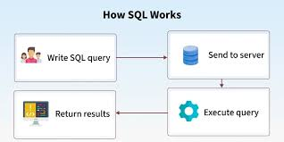

Slide 4
What Can SQL do?
SQL can execute queries against a database
SQL can retrieve data from a database
SQL can insert records in a database
SQL can update records in a database
SQL can delete records from a database
SQL can create new databases
SQL can create new tables in a database
SQL can create stored procedures in a database
SQL can create views in a database
SQL can set permissions on tables, procedures, and views

Slide 5
Using SQL in Your Web Site
To build a web site that shows data from a database, you will need:
An RDBMS database program (i.e. MS Access, SQL Server, MySQL, Oracle)
To use a server-side scripting language, like PHP, ASP.Net, Spring Boot.
To use SQL to get the data you want
To use HTML / CSS /Angular/React JS

Slide 6
Introduction to DBMS
DBMS is a Database Management System.
It is a program that uses one or more computer users create and access database.
It allows data definition, storage and management of data in the centralized pool that can be shared by many users.

Slide 7
Advantages of Database Management System
Controlling Data Redundancy:
A properly set-up database minimizes data redundancy. It will avoid data repetition in the databases.
Controls Data Concurrency
Databases allow multiple users to access the same database simultaneously.
Ensures Data Validity
Database allow you to setup rules that ensure that data remains consistent when data is modified or addded

Slide 8
Database Management System Benefits..
Ensures Data Sharing
Since it allows multiple users to access the data, sharing data becomes easier in database.
Ensures Data Security
Data is secured as different privileges and roles can be assigned to each other.

Slide 9
3-Tier Architecture
Web Browser (Client)
Web Server
Database Server
Java
Web App

Slide 10
RDBMS
RDBMS stands for Relational Database Management System.
RDBMS is the basis for SQL, and for all modern database systems such as MS SQL Server, IBM DB2, Oracle, MySQL, and Microsoft Access.
The data in RDBMS is stored in database objects called tables.
A table is a collection of related data entries and it consists of columns and rows.

Slide 11

MySQL
MySQL is a database system used on the web
MySQL is a database system that runs on a server
MySQL is ideal for both small and large applications
MySQL is very fast, reliable, and easy to use
MySQL supports standard SQL
MySQL compiles on a number of platforms
MySQL is free to download and use
MySQL is developed, distributed, and supported by Oracle Corporation
MySQL is named after co-founder Monty Widenius's daughter: My

Slide 12
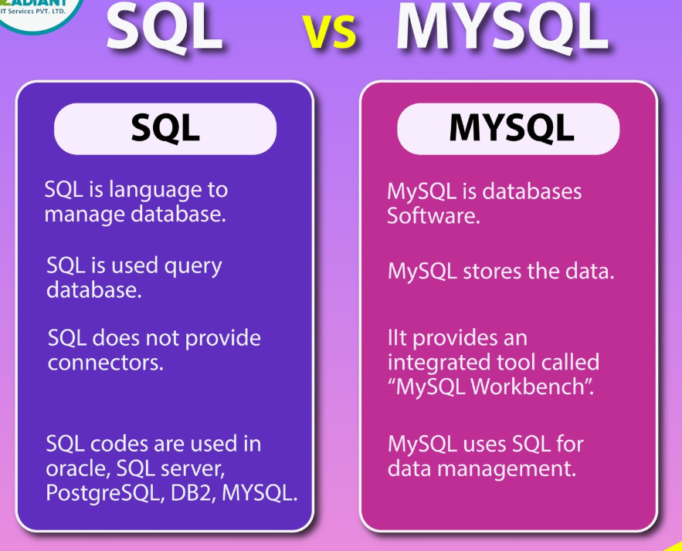

Slide 13
SQL
Depending on the functionality SQL is classified as follows:
Data Definition Lanaguage (DDL)
Data Manipulation Language (DML)
Data Control Language (DCL)

Slide 14
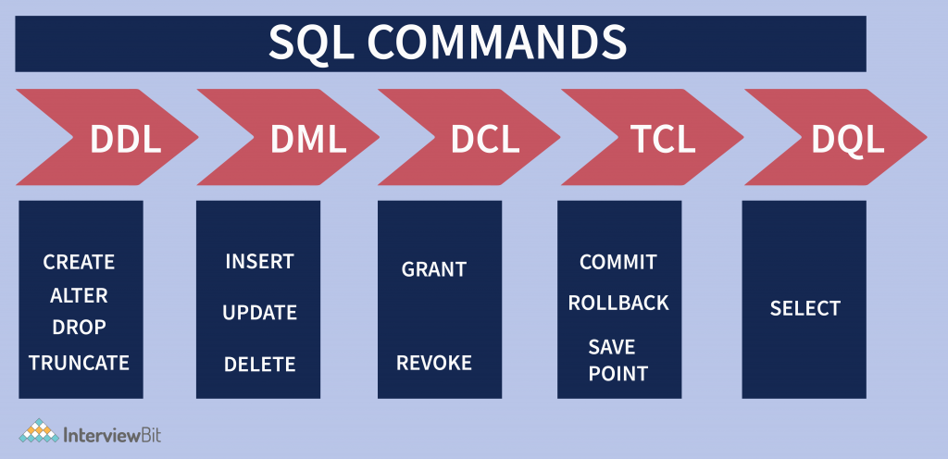

Slide 15
Data Definition Language (DDL
Data Definition Language (DDL) statements are used to define the database structure or schema.
CREATE - to create objects in the database
ALTER - alters the structure of the database
DROP - delete objects from the database
TRUNCATE - remove all records from a table, including all spaces allocated for the records are removed
COMMENT - add comments to the data dictionary
RENAME - rename an object

Slide 16
Data Manipulation Language (DML)
Data Manipulation Language (DML) statements are used for managing data within schema objects.
SELECT - retrieve data from the a database
INSERT - insert data into a table
UPDATE - updates existing data within a table
DELETE - deletes all records from a table, the space for the records remain
MERGE - UPSERT operation (insert or update)
CALL - call a PL/SQL or Java subprogram
EXPLAIN PLAN - explain access path to data
LOCK TABLE - control concurrency

Slide 17
Data Control Language (DCL)
GRANT - gives user's access privileges to database
REVOKE - withdraw access privileges given with the GRANT command

Slide 18
Some of The Most Important SQL Commands
SELECT - extracts data from a database
UPDATE - updates data in a database
DELETE - deletes data from a database
INSERT INTO - inserts new data into a database
CREATE DATABASE - creates a new database
ALTER DATABASE - modifies a database
CREATE TABLE - creates a new table
ALTER TABLE - modifies a table
DROP TABLE - deletes a table
CREATE INDEX - creates an index (search key)
DROP INDEX - deletes an index

Slide 19
SQL SELECT Statement
The SELECT statement is used to select data from a database.
The result is stored in a result table, called the result-set.
Syntax:
SELECT column_name,column_name FROM table_name;
SELECT * FROM table_name;

Slide 20
SELECT
column_1, column_2, ...
FROM
table_1
[INNER | LEFT |RIGHT] JOIN table_2 ON conditions
WHERE
conditions
GROUP BY column_1
HAVING group_conditions
ORDER BY column_1
LIMIT offset, length];

Slide 21
SELECT followed by a list of comma-separated columns or an asterisk (*) to indicate that you want to return all columns.
FROM specifies the table or view where you want to query the data.
JOIN gets related data from other tables based on specific join conditions.
WHERE clause filters row in the result set.
GROUP BY clause groups a set of rows into groups and applies aggregate functions on each group.
HAVING clause filters group based on groups defined by GROUP BY clause.
ORDER BY clause specifies a list of columns for sorting.
LIMIT constrains the number of returned rows.

Slide 22
The SQL SELECT DISTINCT Statement
In a table, a column may contain many duplicate values; and sometimes you only want to list the different (distinct) values.
The DISTINCT keyword can be used to return only distinct (different) values.
Syntax:
SELECT DISTINCT column_name,column_name FROM table_name;

Slide 23
The SQL WHERE Clause
The WHERE clause is used to extract only those records that fulfill a specified criterion.
Syntax
SELECT column_name,column_name FROM table_name WHERE column_name operator value;
Example
SELECT * FROM Customers WHERE Country='Mexico';

Slide 24
Operators in The WHERE Clause
Operator | Description
= | Equal
<> | Not equal. Note: In some versions of SQL this operator may be written as !=
> | Greater than
< | Less than
>= | Greater than or equal
<= | Less than or equal
BETWEEN | Between an inclusive range
LIKE | Search for a pattern
IN | To specify multiple possible values for a column

Slide 25
The SQL AND & OR Operators
The AND operator displays a record if both the first condition AND the second condition are true.
The OR operator displays a record if either the first condition OR the second condition is true.

Slide 26
AND Operator Example
The following SQL statement selects all customers from the country "Germany" AND the city "Berlin", in the "Customers" table:
Example
SELECT * FROM Customers WHERE Country='Germany' AND City='Berlin';

Slide 27
OR Operator Example
The following SQL statement selects all customers from the city "Berlin" OR "München", in the "Customers" table:
Example
SELECT * FROM Customers WHERE City='Berlin' OR City='München';

Slide 28
Combining AND & OR
The following SQL statement selects all customers from the country "Germany" AND the city must be equal to "Berlin" OR "München", in the "Customers" table:
Example
SELECT * FROM Customers WHERE Country='Germany' AND (City='Berlin' OR City='München');

Slide 29
The SQL SELECT TOP Clause
The SELECT TOP clause is used to specify the number of records to return.
The SELECT TOP clause can be very useful on large tables with thousands of records. Returning a large number of records can impact on performance.
Syntax
SELECT column_name(s)FROM table_name LIMIT OFFSET, [COUNT];
Eg: SELECT *FROM Persons LIMIT 5,10;

Slide 30
SQL LIKE Operator
The LIKE operator is used in a WHERE clause to search for a specified pattern in a column.
Syntax:
SELECT column_name(s) FROM table_name WHERE column_name LIKE pattern;
The following SQL statement selects all customers with a City starting with the letter "s“ :
SELECT * FROM Customers WHERE City LIKE 's%';

Slide 31
LIKE Operator….
The "%" sign is used to define wildcards (missing letters) both before and after the pattern. You will learn more about wildcards in the next chapter.
SELECT * FROM Customers WHERE City LIKE '%s';
The following SQL statement selects all customers with a Country containing the pattern "land":
SELECT * FROM Customers WHERE Country LIKE '%land%';

Slide 32
SQL Wildcards
Wildcard | Description
% | A substitute for zero or more characters
_ | A substitute for a single character
[charlist] | Sets and ranges of characters to match
[^charlist] or [!charlist] | Matches only a character NOT specified within the brackets

Slide 33
Using the SQL _ Wildcard
The following SQL statement selects all customers with a City starting with any character, followed by "erlin":
SELECT * FROM Customers WHERE City LIKE '_erlin‘;

Slide 34
Regular Expressions
MySQL supports another type of pattern matching operation based on the regular expressions.
REGEXP operator.
If you are aware of PHP or PERL, then it is very simple for you to understand because this matching is same like those scripting the regular expressions.

Slide 35
REGEXP operator Patterns
Pattern | What the pattern matches
^ | Beginning of string
$ | End of string
. | Any single character
[...] | Any character listed between the square brackets
[^...] | Any character not listed between the square brackets
p1|p2|p3 | Alternation; matches any of the patterns p1, p2, or p3
* | Zero or more instances of preceding element
+ | One or more instances of preceding element
{n} | n instances of preceding element
{m,n} | m through n instances of preceding element

Slide 36
REGEXP Examples
Query to find all the names starting with 'st' −
mysql> SELECT name FROM person_tbl WHERE name REGEXP '^st';
Query to find all the names ending with 'ok' −
mysql> SELECT name FROM person_tbl WHERE name REGEXP 'ok$';
Query to find all the names, which contain 'mar' −
mysql> SELECT name FROM person_tbl WHERE name REGEXP 'mar';
Query to find all the names starting with a vowel and ending with 'ok' −
mysql> SELECT name FROM person_tbl WHERE name REGEXP '^[aeiou]|ok$';

Slide 37
SQL IN Operator
The IN operator allows you to specify multiple values in a WHERE clause.
Syntax
SELECT column_name(s) FROM table_name WHERE column_name IN (value1,value2,...);
Example
SELECT * FROM Customers WHERE City IN ('Paris','London');

Slide 38
SQL BETWEEN Operator
The BETWEEN operator selects values within a range. The values can be numbers, text, or dates.
Syntax
SELECT column_name(s) FROM table_name WHERE column_name BETWEEN value1 AND value2;
Example
SELECT * FROM Products WHERE Price BETWEEN 10 AND 20;
Example
SELECT * FROM Orders WHERE OrderDate BETWEEN #07/04/1996# AND #07/09/1996#;

Slide 39
SQL ORDER BY Keyword
The ORDER BY keyword is used to sort the result-set by one or more columns.
The ORDER BY keyword sorts the records in ascending order by default. To sort the records in a descending order, you can use the DESC keyword.
Syntax:
SELECT column_name,column_name FROM table_name ORDER BY column_name,column_name ASC|DESC;

Slide 40
ORDER BY Examples
SELECT * FROM Customers ORDER BY Country;
SELECT * FROM Customers ORDER BY Country DESC;
Several Columns Example
SELECT * FROM Customers ORDER BY Country,CustomerName;

Slide 41
SQL Functions
SQL has many built-in functions for performing calculations on data.
Aggregate Functions
Aggregate functions return a single value, calculated from values in a column.
Scalar functions
Scalar functions return a single value, based on the input value.

Slide 42
Aggregate Functions
AVG() - Returns the average value
COUNT() - Returns the number of rows
FIRST() - Returns the first value
LAST() - Returns the last value
MAX() - Returns the largest value
MIN() - Returns the smallest value
SUM() - Returns the sum

Slide 43
AVG() Function
The AVG() function returns the average value of a numeric column.
Syntax
SELECT AVG(column_name) FROM table_name
Example
SELECT AVG(Price) AS PriceAverage FROM Products;

Slide 44
SQL COUNT() Function
The COUNT() function returns the number of rows that matches a specified criteria.
SQL COUNT(column_name) Syntax
The COUNT(column_name) function returns the number of values (NULL values will not be counted) of the specified column:
SELECT COUNT(column_name) FROM table_name;
SELECT COUNT(CustomerID) AS OrdersFromCustomerID7 FROM Orders WHERE CustomerID=7;

Slide 45
SQL COUNT(*) Syntax
The COUNT(*) function returns the number of records in a table:
SELECT COUNT(*) FROM table_name;
Example
SELECT COUNT(*) AS NumberOfOrders FROM Orders;

Slide 46
SQL MAX() Function
The MAX() function returns the largest value of the selected column.
Syntax
SELECT MAX(column_name) FROM table_name;
Example
SELECT MAX(Price) AS HighestPrice FROM Products;

Slide 47
SQL MIN() Function
The MIN() function returns the smallest value of the selected column.
Syntax
SELECT MIN(column_name) FROM table_name;
Example
SELECT MIN(Price) AS SmallestOrderPrice FROM Products;

Slide 48
SQL SUM() Function
The SUM() function returns the total sum of a numeric column.
Syntax
SELECT SUM(column_name) FROM table_name;
Example
SELECT SUM(Quantity) AS TotalItemsOrdered FROM OrderDetails;

Slide 49
SQL GROUP BY Statement
Aggregate functions often need an added GROUP BY statement.
The GROUP BY statement is used in conjunction with the aggregate functions to group the result-set by one or more columns.
Syntax
SELECT column_name, aggregate_function(column_name) FROM table_name WHERE column_name operator value GROUP BY column_name;

Slide 50
SQL GROUP BY Example
SELECT * FROM products GROUP BY productCode
SELECT productCode, COUNT(*) FROM products GROUP BY productCode;
SELECT productCode, COUNT(*) AS count FROM products GROUP BY productCode ORDER BY count DESC;
SELECT productCode, MAX(price) AS `Highest Price`, MIN(price) AS `Lowest Price` FROM products GROUP BY productCode;

Slide 51
Scalar functions
UPPER() - Converts a field to upper case
LOWER() - Converts a field to lower case
MID() - Extract characters from a text field
LENGTH() - Returns the length of a text field
ROUND() - Rounds a numeric field to the number of decimals specified
NOW() - Returns the current system date and time
FORMAT() - Formats how a field is to be displayed

Slide 52
SQL UCASE() Function
The UPPER() function converts the value of a field to uppercase.
SELECT UPPER(column_name) FROM table_name;
Example
SELECT UPPER(CustomerName) AS Customer, City FROM Customers;

Slide 53
SQL LCASE() Function
The LOWER() function converts the value of a field to lowercase.
Syntax
SELECT LOWER(column_name) FROM table_name;
Example
SELECT LOWER(CustomerName) AS Customer, City FROM Customers;

Slide 54
SQL MID() Function
The MID() function is used to extract characters from a text field.
Syntax
SELECT MID(column_name,start[,length]) FROM table_name;
Example
SELECT MID(City,1,4) AS ShortCity FROM Customers;

Slide 55
SQL LEN() Function
The LENGTH() function returns the length of the value in a text field.
Syntax
SELECT LENGTH(column_name) FROM table_name;
Example
SELECT CustomerName,LENGTH(Address) as LengthOfAddress FROM Customers;

Slide 56
SQL ROUND() Function
The ROUND() function is used to round a numeric field to the number of decimals specified.
Syntax
SELECT ROUND(column_name,decimals) FROM table_name;
Example
SELECT ProductName, ROUND(Price,0) AS RoundedPrice FROM Products;

Slide 57
SQL NOW() Function
The NOW() function returns the current system date and time.
Syntax
SELECT NOW() FROM table_name;
Example
SELECT ProductName, Price, Now() AS PerDate FROM Products;

Slide 58
SQL FORMAT() Function
The FORMAT() function is used to format how a field is to be displayed.
Syntax
SELECT FORMAT(column_name,format) FROM table_name;
Example
SELECT ProductName,FORMAT(Price,’2) AS WholePrice FROM Products;

Slide 59
SQL Joins
SQL joins are used to combine rows from two or more tables.
An SQL JOIN clause is used to combine rows from two or more tables, based on a common field between them.
An SQL INNER JOIN return all rows from multiple tables where the join condition is met.

Slide 60
Different SQL JOINs
INNER JOIN: Returns all rows when there is at least one match in BOTH tables
LEFT JOIN: Return all rows from the left table, and the matched rows from the right table
RIGHT JOIN: Return all rows from the right table, and the matched rows from the left table
FULL JOIN: Return all rows when there is a match in ONE of the tables
Self Join : Joining a Table to Itself

Slide 61
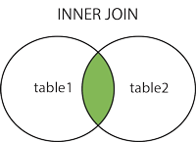
SQL INNER JOIN
The INNER JOIN keyword selects all rows from both tables as long as there is a match between the columns in both tables.
Syntax
SELECT column_name(s) FROM table1 INNER JOIN table2 ON table1.column_name=table2.column_name;

Slide 62
INNER JOIN Example
The following SQL statement will return all customers with orders:
SELECT Customers.CustomerName, Orders.OrderID FROM Customers INNER JOIN Orders ON Customers.CustomerID=Orders.CustomerID ORDER BY Customers.CustomerName;

Slide 63
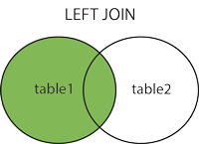
SQL LEFT JOIN Keyword
The LEFT JOIN keyword returns all rows from the left table (table1), with the matching rows in the right table (table2). The result is NULL in the right side when there is no match.
Syntax
SELECT column_name(s) FROM table1 LEFT JOIN table2 ON table1.column_name=table2.column_name;

Slide 64
SQL LEFT JOIN Example
The following SQL statement will return all customers, and any orders they might have:
Example
SELECT Customers.CustomerName, Orders.OrderID FROM Customers LEFT JOIN Orders ON Customers.CustomerID=Orders.CustomerID ORDER BY Customers.CustomerName;

Slide 65
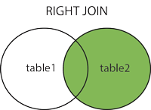
SQL RIGHT JOIN Keyword
The RIGHT JOIN keyword returns all rows from the right table (table2), with the matching rows in the left table (table1). The result is NULL in the left side when there is no match.
Syntax
SELECT column_name(s) FROM table1 RIGHT JOIN table2 ON table1.column_name=table2.column_name;

Slide 66
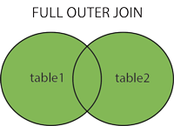
SQL FULL OUTER JOIN Keyword
The FULL OUTER JOIN keyword returns all rows from the left table (table1) and from the right table (table2).
The FULL OUTER JOIN keyword combines the result of both LEFT and RIGHT joins.
MySQL does not support Full Join. It should be implemented using UNION of LEFT Join & Right Join.

Slide 67
Self Join
Joining a Table to itself.
The self join is often used to query hierarchical data or to compare a row with other rows within the same table.
To perform a self join, you must use table aliases to not repeat the same table name twice in a single query.
Note that referencing a table twice or more in a query without using table aliases will cause an error.

Slide 68
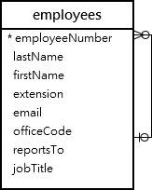
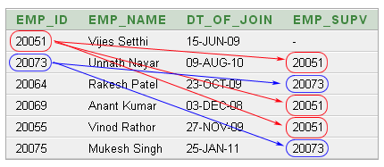
Self Join
The table employees stores not only employees data but also the organization structure data.
The reportsto column is used to determine the manager id of an employee

Slide 69
SQL SELECT INTO Statement
With SQL, you can copy information from one table into another.
The SELECT INTO statement copies data from one table and inserts it into a new table.
Syntax
SELECT * INTO newtable [IN externaldb] FROM table1;
SELECT column_name(s) INTO newtable [IN externaldb] FROM table1;

Slide 70
Sub Queries
A MySQL subquery is a query that is nested inside another query.
Subquery is also called an inner query, while the query that contains the subquery is called an outer query.
Sub query acts a criteria for Outer query.
A subquery is used to return data that will be used in the main query as a condition to further restrict the data to be retrieved.

Slide 71
Sub Queries
Subqueries can be used with the SELECT, INSERT, UPDATE, and DELETE statements along with the operators like =, <, >, >=, <=, IN, BETWEEN, etc.
Subqueries are on the right side of the comparison operator.
A subquery is enclosed in parentheses.
In the Subquery, ORDER BY command cannot be used.
But GROUP BY command can be used to perform the same function as ORDER BY command.
SELECT * FROM t1 WHERE column1 = (SELECT column1 FROM t2);

Slide 72
Examples
The following SQL statement selects the "ProductName" and "Price" records that have an above average price:
SELECT ProductName, Price FROM Products
WHERE Price>(SELECT AVG(Price) FROM Products);
Sub queries are used, when we are not sure of the criteria value.

Slide 73
Manipulating Data

Slide 74
SQL INSERT INTO Statement
The INSERT INTO statement is used to insert new records in a table.
It is possible to write the INSERT INTO statement in two forms.
The first form does not specify the column names where the data will be inserted, only their values:
Syntax:
INSERT INTO table_name VALUES (value1,value2,value3,...);

Slide 75
INSERT INTO Statement…
The second form specifies both the column names and the values to be inserted:
Synatx:
INSERT INTO
table_name (column1,column2,column3,...) VALUES (value1,value2,value3,...);
Eg: INSERT INTO Customers (CustomerName, ContactName, Address, City, PostalCode, Country) VALUES ('Cardinal','Tom B. Erichsen','Skagen 21','Stavanger','4006','Norway');

Slide 76
SQL UPDATE Statement
The UPDATE statement is used to update existing records in a table.
Syntax:
UPDATE table_name SET column1=value1,column2=value2,... WHERE some_column=some_value;
Eg:UPDATE Customers SET ContactName='Alfred Schmidt', City='Hamburg' WHERE CustomerName='Alfreds Futterkiste';

Slide 77
Update Warning!
Be careful when updating records. If we had omitted the WHERE clause, in the example above, like this
UPDATE Customers SET ContactName='Alfred Schmidt', City='Hamburg';

Slide 78
SQL DELETE Statement
The DELETE statement is used to delete records in a table.
Syntax”
DELETE FROM table_name WHERE some_column=some_value;
Example
DELETE FROM Customers WHERE CustomerName='Alfreds Futterkiste' AND ContactName='Maria Anders';

Slide 79
Delete All Data
It is possible to delete all rows in a table without deleting the table.
This means that the table structure, attributes, and indexes will be intact:
DELETE FROM table_name; or DELETE * FROM table_name
Example
DELETE FROM Customers WHERE CustomerName='Alfreds Futterkiste' AND ContactName='Maria Anders';
Note: Be very careful when deleting records. You cannot undo this statement!

Slide 80
DDL
DDL in SQL stands for Data Definition Language.
It is a subset of SQL commands used to define, modify, and manage the structure of a database and its objects.
DDL commands are responsible for creating, altering, and dropping database objects like tables, indexes, views, and schemas.
DDL commands are fundamental for database administrators and developers to establish and maintain the organizational structure of a database.
They define the schema, which is the blueprint of the database, and ensure data integrity through constraints and relationships.

Slide 81
DDL Commands
CREATE: Used to create new database objects.
ALTER: Used to modify the structure of existing database objects.
This can involve adding, dropping, or modifying columns, or adding/removing constraints.
ALTER TABLE Employees ADD COLUMN DepartmentID INT;
DROP: Used to delete existing database objects.
This permanently removes the object and its associated data.

Slide 82
DDL Commands
TRUNCATE: Used to remove all rows from a table, but keep the table structure intact.
It is a faster operation than DELETE for removing all data.
RENAME: Used to change the name of a database object, such as a table or a column.

Slide 83
SQL CREATE DATABASE Statement
The CREATE DATABASE statement is used to create a database.
Syntax
CREATE DATABASE dbname;
The following SQL statement creates a database called "my_db":
CREATE DATABASE my_db;

Slide 84
SQL CREATE TABLE Statement-DDL
The CREATE TABLE statement is used to create a table in a database.
Tables are organized into rows and columns; and each table must have a name.
Syntax
CREATE TABLE table_name ( column_name1 data_type(size), column_name2 data_type(size), column_name3 data_type(size),....);

Slide 85
CREATE TABLE….
The column_name parameters specify the names of the columns of the table.
The data_type parameter specifies what type of data the column can hold (e.g. varchar, integer, decimal, date, etc.).
The size parameter specifies the maximum length of the column of the table.
Example
CREATE TABLE Persons ( PersonID int, LastName varchar(255), FirstName varchar(255), Address varchar(255), City varchar(255) );

Slide 86
SQL Data Types
Data type | Description
CHAR(size) | Holds a fixed length string (can contain letters, numbers, and special characters). The fixed size is specified in parenthesis. Can store up to 255 characters
VARCHAR(size) | Holds a variable length string (can contain letters, numbers, and special characters). The maximum size is specified in parenthesis. Can store up to 255 characters. Note: If you put a greater value than 255 it will be converted to a TEXT type
TEXT | Holds a string with a maximum length of 65,535 characters
BLOB | For BLOBs (Binary Large OBjects). Holds up to 65,535 bytes of data
SET | Similar to ENUM except that SET may contain up to 64 list items and can store more than one choice
SMALLINT(size) | -32768 to 32767 normal. 0 to 65535 UNSIGNED*. The maximum number of digits may be specified in parenthesis
INT(size) | -2147483648 to 2147483647 normal. 0 to 4294967295 UNSIGNED*. The maximum number of digits may be specified in parenthesis
FLOAT(size,d) | A small number with a floating decimal point. The maximum number of digits may be specified in the size parameter. The maximum number of digits to the right of the decimal point is specified in the d parameter

Slide 87
Data Types….
DOUBLE(size,d) | A large number with a floating decimal point. The maximum number of digits may be specified in the size parameter. The maximum number of digits to the right of the decimal point is specified in the d parameter
DECIMAL(size,d) | A DOUBLE stored as a string , allowing for a fixed decimal point. The maximum number of digits may be specified in the size parameter. The maximum number of digits to the right of the decimal point is specified in the d parameter
DATE() | A date. Format: YYYY-MM-DDNote: The supported range is from '1000-01-01' to '9999-12-31'
DATETIME() | *A date and time combination. Format: YYYY-MM-DD HH:MM:SSNote: The supported range is from '1000-01-01 00:00:00' to '9999-12-31 23:59:59'
TIME() | A time. Format: HH:MM:SSNote: The supported range is from '-838:59:59' to '838:59:59'

Slide 88
Data Integrity
Data integrity refers to the overall accuracy, completeness, and consistency of data.
It is maintained by a collection of processes, rules, and standards implemented during the design phase.
When the integrity of data is secure, the information stored in a database will remain complete, accurate, and reliable no matter how long it’s stored or how often it’s accessed.
Data integrity also ensures that your data is safe from any outside forces.
There are the different categories of data integrity exist with each RDBMS

Slide 89
Data Integrity
Entity integrity:
It specifies that there should be no duplicate rows in a table.
Domain integrity:
It enforces valid entries for a given column by restricting the type, the format, or the range of values.
Referential integrity:
It specifies that rows cannot be deleted, which are used by other records.
User-defined integrity:
It enforces some specific business rules that are defined by users. These rules are different from entity, domain or referential integrity.

Slide 90
SQL Constraints
SQL constraints are used to specify rules for the data in a table.
If there is any violation between the constraint and the data action, the action is aborted by the constraint.
Constraints can be specified when the table is created (inside the CREATE TABLE statement) or after the table is created (inside the ALTER TABLE statement).

Slide 91
SQL Constraints….
Syntax
CREATE TABLE table_name ( column_name1 data_type(size) constraint_name, column_name2 data_type(size) constraint_name, column_name3 data_type(size) constraint_name, .... );

Slide 92
SQL Constraints….
NOT NULL - Indicates that a column cannot store NULL value
UNIQUE - Ensures that each row for a column must have a unique value
PRIMARY KEY - A combination of a NOT NULL and UNIQUE. Ensures that a column (or combination of two or more columns) have an unique identity which helps to find a particular record in a table more easily and quickly
FOREIGN KEY - Ensure the referential integrity of the data in one table to match values in another table
CHECK - Ensures that the value in a column meets a specific condition
DEFAULT - Specifies a default value when specified none for this column

Slide 93
SQL NOT NULL Constraint
By default, a table column can hold NULL values.
The NOT NULL constraint enforces a column to NOT accept NULL values.
The NOT NULL constraint enforces a field to always contain a value. This means that you cannot insert a new record, or update a record without adding a value to this field.
Example
CREATE TABLE PersonsNotNull ( P_Id int NOT NULL, LastName varchar(255) NOT NULL, FirstName varchar(255), Address varchar(255), City varchar(255) )

Slide 94
SQL UNIQUE Constraint
The UNIQUE constraint uniquely identifies each record in a database table.
The UNIQUE and PRIMARY KEY constraints both provide a guarantee for uniqueness for a column or set of columns.
A PRIMARY KEY constraint automatically has a UNIQUE constraint defined on it.
Note that you can have many UNIQUE constraints per table, but only one PRIMARY KEY constraint per table.

Slide 95
UNIQUE Constraint on CREATE TABLE
CREATE TABLE PersonsUnique ( P_Id int NOT NULL, LastName varchar(255) NOT NULL, FirstName varchar(255), Address varchar(255), City varchar(255), UNIQUE (P_Id) )
ALTER TABLE Persons ADD CONSTRAINT uc_PersonID UNIQUE (P_Id,LastName)

Slide 96
SQL PRIMARY KEY Constraint
The PRIMARY KEY constraint uniquely identifies each record in a database table.
Primary keys must contain unique values.
A primary key column cannot contain NULL values.
Each table should have a primary key, and each table can have only ONE primary key.

Slide 97
PRIMARY KEY Constraint on CREATE TABLE
CREATE TABLE Persons ( P_Id int NOT NULL, LastName varchar(255) NOT NULL, FirstName varchar(255), Address varchar(255), City varchar(255), PRIMARY KEY (P_Id) )

Slide 98
Candidate Key
A candidate key is a minimal set of attributes (columns) in a table that can uniquely identify each row.
A table can have multiple candidate keys, but only one is chosen to be the primary key.
These keys are essential for maintaining data integrity and preventing duplicate data.

Slide 99
Candidate Key – Key Characterstics
Uniqueness:
Every value in the candidate key column(s) must be unique for each row.
Minimality:
A candidate key is "minimal" because removing any attribute from it would make it unable to uniquely identify a row.
One or more attributes:
A candidate key can be a single column or a combination of multiple columns.
Multiple candidate keys:
A table can have more than one candidate key. From these, one is selected as the primary key, while the others are called alternate keys.

Slide 100
Candidate Key – Example
Consider a Students table with the following columns: StudentID, Email, and Phone.
StudentID can uniquely identify each student, and no two students can have the same StudentID.
Email can also uniquely identify each student.
Phone could also be a candidate key if each student has a unique phone number.
In this case, StudentID, Email, and Phone are all candidate keys.
The database designer would then choose one of them (e.g., StudentID) as the primary key, and the other(s) would be designated as alternate keys.

Slide 101
SQL FOREIGN KEY Constraint
A FOREIGN KEY in one table points to a PRIMARY KEY in another table.
P_Id | LastName | FirstName | Address | City
1 | Hansen | Ola | Timoteivn 10 | Sandnes
2 | Svendson | Tove | Borgvn 23 | Sandnes
3 | Pettersen | Kari | Storgt 20 | Stavanger
Persons
O_Id | OrderNo | P_Id
1 | 77895 | 3
2 | 44678 | 3
3 | 22456 | 2
4 | 24562 | 1
Orders

Slide 102
FOREIGN KEY Constraint…
Note that the "P_Id" column in the "Orders" table points to the "P_Id" column in the "Persons" table.
The "P_Id" column in the "Persons" table is the PRIMARY KEY in the "Persons" table.
The "P_Id" column in the "Orders" table is a FOREIGN KEY in the "Orders" table.
The FOREIGN KEY constraint is used to prevent actions that would destroy links between tables.
The FOREIGN KEY constraint also prevents invalid data from being inserted into the foreign key column, because it has to be one of the values contained in the table it points to.

Slide 103
FOREIGN KEY Constraint Syntax
CREATE TABLE Orders ( O_Id int NOT NULL, OrderNo int NOT NULL, P_Id int, PRIMARY KEY (O_Id), FOREIGN KEY (P_Id) REFERENCES Persons(P_Id) )
ALTER TABLE Orders DROP FOREIGN KEY fk_PerOrders

Slide 104
SQL CHECK Constraint
The CHECK constraint is used to limit the value range that can be placed in a column.
If you define a CHECK constraint on a single column it allows only certain values for this column.
If you define a CHECK constraint on a table it can limit the values in certain columns based on values in other columns in the row.

Slide 105
CHECK Constraint on CREATE TABLE
CREATE TABLE Persons ( P_Id int NOT NULL, LastName varchar(255) NOT NULL, FirstName varchar(255), Address varchar(255), City varchar(255), CHECK (P_Id>0) )
"P_Id" must only include integers greater than 0.

Slide 106
SQL DEFAULT Constraint
The DEFAULT constraint is used to insert a default value into a column.
The default value will be added to all new records, if no other value is specified.
CREATE TABLE Persons ( P_Id int NOT NULL, LastName varchar(255) NOT NULL, FirstName varchar(255), Address varchar(255), City varchar(255) DEFAULT 'Sandnes’)

Slide 107
CASCADE
In SQL, "CASCADE" is an action used in conjunction with foreign key constraints to define how changes in a parent table affect related data in child tables.
It is primarily used to maintain referential integrity automatically.
Types of CASCADE actions are:
ON DELETE CASCADE
ON UPDATE CASCADE

Slide 108
ON UPDATE CASCADE
When the primary key value of a row in the parent table is updated, the corresponding foreign key values in the child table(s) are automatically updated to reflect this change.
CREATE TABLE Products (
ProductID INT PRIMARY KEY,
ProductName VARCHAR(255) );
CREATE TABLE OrderItems (
ItemID INT PRIMARY KEY,
OrderID INT,
ProductID INT,
Quantity INT, FOREIGN KEY (ProductID) REFERENCES Products(ProductID) ON UPDATE CASCADE );

Slide 109
Benefits of using CASCADE
Automated Referential Integrity:
Eliminates the need for manual deletion or updating of related records, reducing the risk of inconsistencies.
Simplified Application Logic:
Reduces the amount of code needed in applications to handle related data changes.

Slide 110
SQL Views
A view is a virtual table based on the result-set of an SQL statement.
A view contains rows and columns, just like a real table.
The fields in a view are fields from one or more real tables in the database.
You can add SQL functions, WHERE, and JOIN statements to a view and present the data as if the data were coming from one single table.

Slide 111
Views
Note that a view does not physically store the data.
When you issue the SELECT statement against the view, MySQL executes the underlying query specified in the view’s definition and returns the result set.
For this reason, sometimes, a view is referred to as a virtual table.
Syntax :
CREATE VIEW view_name AS SELECT column_name(s) FROM table_name WHERE condition

Slide 112
CREATE VIEW Examples
CREATE VIEW [Current Product List] AS SELECT ProductID,ProductName FROM Products WHERE Discontinued=No
SELECT * FROM [Current Product List]

Slide 113
CREATE VIEW Examples
CREATE VIEW [Products Above Average Price] AS SELECT ProductName,UnitPrice FROM Products WHERE UnitPrice>(SELECT AVG(UnitPrice) FROM Products)
SELECT * FROM [Products Above Average Price]
DROP VIEW Syntax
DROP VIEW view_name

Slide 114
SQL CREATE INDEX Statement
The CREATE INDEX statement is used to create indexes in tables.
Indexes allow the database application to find data fast; without reading the whole table.
An index can be created in a table to find data more quickly and efficiently.
The users cannot see the indexes, they are just used to speed up searches/queries.

Slide 115
SQL CREATE INDEX Syntax
Creates an index on a table. Duplicate values are allowed:
CREATE INDEX index_name ON table_name (column_name)
UNIQUE INDEX Syntax
Creates a unique index on a table. Duplicate values are not allowed:
CREATE UNIQUE INDEX index_name ON table_name (column_name)

Slide 116
CREATE INDEX Example
The SQL statement below creates an index named "PIndex" on the "LastName" column in the "Persons" table:
CREATE INDEX PIndex ON Persons (LastName)
If you want to create an index on a combination of columns, you can list the column names within the parentheses, separated by commas: CREATE INDEX PIndex ON Persons (LastName, FirstName)

Slide 117
SQL DROP
Indexes, tables, and databases can easily be deleted/removed with the DROP statement.
ALTER TABLE table_name DROP INDEX index_name
DROP TABLE table_name
DROP DATABASE database_name
If we only want to delete the data inside the table, and not the table itself?Then, use the TRUNCATE TABLE statement:
TRUNCATE TABLE table_name

Slide 118
The ALTER TABLE Statement
The ALTER TABLE statement is used to add, delete, or modify columns in an existing table.
Syntax
ALTER TABLE table_name MODIFY COLUMN column_name datatype
ALTER TABLE Persons MODIFY DateOfBirth date
ALTER TABLE Persons DROP COLUMN DateOfBirth

Slide 119
Create User Accounts Using MySQL
We can specify not only who can connect to the database server but also from which host that the user connects.
A user account in MySQL consists of a username and a host name separated by the @ character.
If the admin user connects to the MySQL database server from localhost, the user account is admin@localhost.
This makes the MySQL database server even more secure.

Slide 120
Create User
MySQL provides the CREATE USER statement that allows you to create a new user account. Syntax :
CREATE USER user_account IDENTIFIED BY password;
Example:
CREATE USER dbadmin@localhost IDENTIFIED BY 'secret';

Slide 121
SHOW GRANTS
To view the privileges of a user account, you use the SHOW GRANTS statement.
SHOW GRANTS FOR dbadmin@localhost;
The *.* in the result shows that the dbadmin user account can only login to the database server and has no other privileges.
To grant permission to the user, you use the GRANT statement.

Slide 122
GRANT PRIVILAGES
After creating a new user account, the user doesn’t have any privileges.
To grant privileges to a user account, you use the GRANT statement.
GRANT ALL ON *.* TO 'super'@'localhost' WITH GRANT OPTION;

Slide 123
Revoking Privileges From Users
In order to revoke privileges from a user account, you use the MySQL REVOKE statement.
MySQL allows you to revoke one or more privileges or all privileges from a user.
Syntax:
REVOKE ALL PRIVILEGES, GRANT OPTION FROM user [, user]…
Syntax:
REVOKE ALL PRIVILEGES, GRANT OPTION FROM rfc;

Slide 124
Backup & Restore MySQL Database
MySQL provides a very useful tool for backing up or dumping MySQL databases locally on the server very fast.
The backup file is stored in the file system in the server.
The tool to backup MySQL databases is mysqldump.
It is located in the root/bin folder of MySQL installation folder.
The mysqldump is a program provided by MySQL that can be used to dump databases for backup or transfer database to another database server.
The dump file contains a set of SQL statements to create database objects.

Slide 125
mysqldump
It creates a *.sql file with DROP table, CREATE table and INSERT into sql-statements of the source database.
To restore the database, execute the *.sql file on destination database.
We can backup a local database and restore it on a remote database at the same time, using a single command.

Slide 126
mysqldump
backup:
# mysqldump -u root -p[root_password] [database_name] > dumpfilename.sql
restore:
# mysql -u root -p[root_password] [database_name] < dumpfilename.sql

Slide 127
MySQL Replication
Replication is used to create multiple copies of our database.
These copies then can either be used as another database to run our queries on. Q
Queries that might otherwise affect performance of master server like running some heavy analytics queries or we can just use them for data redundancy purposes or for both.
We can automate the whole process i.e. data replication occurs automatically from master to slave.
Backups are be done without affecting the write operations of the master

Slide 128
PHP + MySQL
PHP combined with MySQL are cross-platform (you can develop in Windows and serve on a Unix platform)
We can query a database for specific information and have a recordset returned.

Slide 129
A Sample PHP Code
<html>
<head>
<title>Variables - Some Practice</title>
</head>
<body>
<?php print("It Worked!"); ?>
</body>
</html>

Slide 130
PHP Connect to the MySQL Server
Use the PHP mysqli_connect() function to open a new connection to the MySQL server.
Before we can access data in a database, we must open a connection to the MySQL server.
mysqli_connect()
Syntax
mysqli_connect(host,username,password,dbname);
To close the connection before, use the mysqli_close() function:

Slide 131
Insert Data From a Form Into a Database
Create a table named "Persons", with three columns:Serviceno "FirstName", "LastName" and "Age“
HTML form:
<html> <body> <form action="insert.php" method="post"> Firstname: <input type="text" name="firstname"> Lastname: <input type="text" name="lastname"> Age: <input type="text" name="age"> <input type="submit"> </form> </body> </html>

Slide 132
Inert.php
<?php $con=mysqli_connect("example.com","peter","abc123","my_db"); // Check connection if (mysqli_connect_errno()) { echo "Failed to connect to MySQL: " . mysqli_connect_error(); } $sql="INSERT INTO Persons (FirstName, LastName, Age) VALUES ('$_POST[firstname]','$_POST[lastname]','$_POST[age]')"; if (!mysqli_query($con,$sql)) { die('Error: ' . mysqli_error($con)); } echo "1 record added"; mysqli_close($con); ?>

Slide 133
Display the Result in an HTML Table
<?php $con=mysqli_connect("example.com","peter","abc123","my_db"); // Check connection if (mysqli_connect_errno()) { echo "Failed to connect to MySQL: " . mysqli_connect_error(); } $result = mysqli_query($con,"SELECT * FROM Persons"); echo "<table border='1'> <tr> <th>Firstname</th> <th>Lastname</th> </tr>"; while($row = mysqli_fetch_array($result)) { echo "<tr>"; echo "<td>" . $row['FirstName'] . "</td>"; echo "<td>" . $row['LastName'] . "</td>"; echo "</tr>"; } echo "</table>"; mysqli_close($con); ?>

