Slide 1
Master Thesis: Defense Techniques
for Model Extraction Attacks on Deep
Learning Models
Ridhima Garg (sa46jiza)
Supervisors
Prof. Dr. Christian Riess (FAU, Department of Computer Science)
Mr. Yannick Möll (ITK Engineering GmbH, Data-Driven Software and Sensors)

Slide 2




Dawn: DyNAMIC ADVERSRIAL WATERMARKING of neural networks
Defense Technique for Model Extraction Attacks
Invasive: No changes to training process
GOAL: Dynamically watermark fraction of queries (changing prediction responses)
F_{v}
F_{A} surrogate of F_{v}?
Watermark
F_{v}
X_{n}, Bv(x_{n})
.
.
X_{N},Bv(x_{N})
verify
DAWN
F_{v}(x_{i})
x_{i}
F_{v}(x_{i})
B_{v}(x_{i})
x_{i}
x_{i}
X₀, Fv(x₀)
X₁, Fv(x₁)
.
.
X_{n}, Bv(x_{n})
.
.
X_{N},Bv(x_{N})
D_{A}
X₀, Fv(x₀)
X₁, Fv(x₁)
.
.
.
X_{n}, Fv(x_{n})
Train
F_{A}
D_{A}
Train
F_{A}
Adversary training without Defense
Adversary training with DAWN Defense
internal

Slide 3
Dawn: watermark generation
𝑊_{V}(𝑥): should the response to 𝑥 be watermarked?
𝐵_{V}(𝑥): what is the (backdoored watermark) response?
F_{v}
K_{w}
F_{v}
K_{w}
𝑊_{V}(𝑥) = 0
Or
𝑊_{V}(𝑥) = 1
SHA(K_{w}, x_{i})
f(K_{w}, F_{v(xi)})
𝐵_{V}(𝑥)
F_{A}
F_{A}
x_{i}
x_{i}
K_{w} is model specific key
X_{i} is the query sent by adversary to victim model
SHA is the 256 hash key
f is pseudo random perturbation function
06/02/2023
internal

Slide 4
Dawn: CHALLENGES
Adversaries can select the training data or manipulate the training process to resist the embedding of watermarks
Indistinguishability : subtle modification 𝛿 to 𝑥 leads to 𝑊_{V}(𝑥) ≠𝑊_{V}(𝑥 + 𝛿)
Different mapping (watermark or non-watermark) but same prediction (label)
Same mapping (both samples[original and perturb] either watermark or non-watermark) but same prediction (label)
Different prediction irrespective of mapping
Mapping Algorithm for Indistinguishability
𝑊_{V}(𝑥): should the response to 𝑥 be watermarked?
𝛿 is the perturbation level
06/02/2023
internal

Slide 5
Experiments : perfect attacker
Adversaries which has perfect knowledge of the victim model.
Evaluation -:
Success of A’s -: maximize the test accuracy of surrogate model 𝐴𝑐𝑐_{𝑡𝑒𝑠𝑡} (𝐹_{A}) on test set
Success of V’s -: maximize the embedding of watermark set , watermark accuracy of surrogate model 𝐴𝑐𝑐_{𝑤𝑚}(𝐹_{A})
DAWN‘s aim is to maximize 𝐴𝑐𝑐_{𝑤𝑚}(𝐹_{A}) regardless of 𝐴𝑐𝑐_{𝑡𝑒𝑠𝑡} (𝐹_{A})
A‘s aim is to maximize 𝐴𝑐𝑐_{test}(𝐹_{A}) while minimize 𝐴𝑐𝑐_{𝑤𝑚}(𝐹_{A})
Experiments on CIFAR10 and MNIST
06/02/2023
internal

Slide 6
Experiments : perfect attacker
Model | After 500 Epoch (watermark) | After 500 Epoch (test)
cifar10 (3 conv block, weight decay = 3e^-4) | 23.2 | 58.17
cifar10 (3 conv block, dropout = 0.3) | 82 | 84.56
cifar10 (3 conv block, dropout=0.5) | 60.4 | 84.21
MNIST base l5 (3 conv block) | 99.6 | 99.18
MNIST l5 (3 conv block dropout = 0.3) | 13.2 | 11.35
MNIST l2 (2 conv block 3L) | 13.2 | 11.35
Low capacity models (500 training epochs, watermark size = 250)
Conclusion
Acc_{wm} is low for some models (MNIST-base 3L, MNIST %L (DO)) but at the same time test accuracy is low which claims Adversary is unusable.
Regularization prevents embedding of the watermark in some cases MNIST-5L but also reduced the test accuracy
06/02/2023
internal

Slide 7
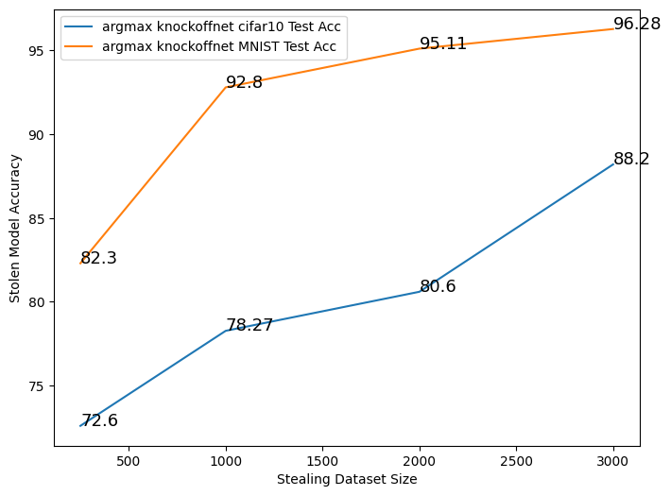
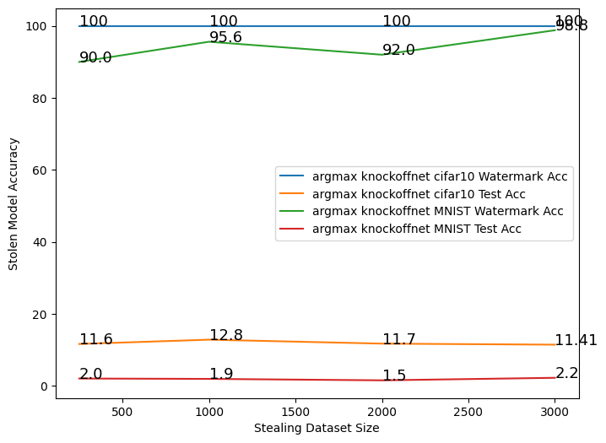
Experiments : DAWN ON REAL MODEL STEALING ATTACK - Knockoffnet
Same model architecture of the adversary and victim model but not parameters(hyperparameters)
CIFAR10 : ResNet 34 model architecture (high capacity model)
MNIST: 3-convolution blocks with dropout -0.5(low capacity model)
Model Stealing Without DAWN (No. of epoch = 50)
Model Stealing After DAWN
(No. of epochs = 50)
06/02/2023
internal

Slide 8
Experiments : WATERMARK REMOVAL
MAPPING : Algorithm for Indistinguishability
Create latent embeddings as an autoencoder
Embedding created - middle layer of the victim model
Binarizing latent representation – results in medians of each feature
Perform Mapping
Dataset | Noise level | Latent Representation Size | Same Label and Same mapping | Same Label and Different Mapping | Different Label
CIFAR10 | 0.2 | 512 | 94.55 | 5.44 | 35.89
CIFAR10 | 0.2 | 10 | 100.0 | 0 | 35.79
CIFAR10 | 0.1 | 512 | 95.67 | 4.32 | 13.47
CIFAR10 | 0.1 | 10 | 100 | 0 | 13.59
CIFAR10 | 0.09 | 512 | 95.85 | 4.149 | 11.80
CIFAR10 | 0.09 | 10 | 100 | 0 | 11.74
CIFAR10 | 0.075 | 512 | 96.06 | 3.93 | 9.33
CIFAR10 | 0.075 | 10 | 100 | 0 | 9.337
Mapping Results for CIFAR10
06/02/2023
internal

Slide 9
Experiments : WATERMARK REMOVAL
pruning
Adversary attempt to prune the model by setting random weights of the model to zero.
Before Pruning on CIFAR10
Test set accuracy- 60.95
Watermark set accuracy- 71.17
Dataset | Pruning level | After Pruning (test) | After Pruning (watermark)
CIFAR10 | 0.01 | 60.94 | 71.33
CIFAR10 | 0.05 | 60.96 | 71.17
CIFAR10 | 0.1 | 60.83 | 70.69
CIFAR10 | 0.25 | 59.83 | 70.20
CIFAR10 | 0.4 | 48.45 | 54.91
CIFAR10 | 0.5 | 44.96 | 16.58
CIFAR10 | 0.75 | 10.0 | 16.26
CIFAR10 | 0.9 | 10.0 | 11.43
Pruning results with different pruning level
06/02/2023
internal

Slide 10
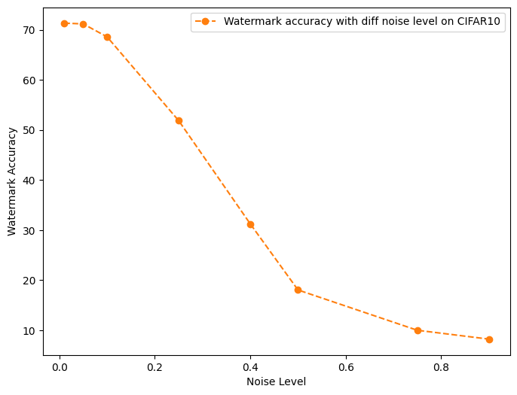
Experiments : WATERMARK REMOVAL
NOISE VERIFICATION
Adversary attempt to inference victim model with noisy samples.
Without Noise on CIFAR10
Watermark set accuracy - 71.17
Noisy watermark data accuracy with different noise level
06/02/2023
internal

Slide 11
Next steps and discussion
Watermarking for Object Detection
DAWN worked fine for Watermark removal techniques
Entangled watermarking – training victim model with new loss – avoid detection of watermark dataset (from adversary)
Organizational
Template for monthly presentation
06/02/2023
internal

Slide 12
Secure AI: Defense Techniques for Model Extraction Attacks on Deep Learning Models
x_{i}
x_{i}
F_{v}(x_{i})
Model deployed on cloud
Access by API Client
Black box or white box
Extracted Training Data
Goal -Secure Victim (Original) model
Train Model
06/02/2023
internal

Slide 13
Secure AI: Defense Techniques for Model Extraction Attacks on Deep Learning Models
x_{i}
F_{v}(x_{i})
Defense –Watermarking Methods
Extracted Training Data
+
Watermarked Data
Verify?
Train Model
If trained model is stolen from original model
Trained model have watermark information in hidden form
06/02/2023
internal

Slide 14
06/02/2023
internal

