Slide 1
Master Thesis: Defense Techniques
for Model Extraction Attacks on Deep
Learning Models
Fourth Round Discussion
Ridhima Garg (sa46jiza)
Supervisors
Prof. Dr. Christian Riess (FAU, Department of Computer Science)
Mr. Yannick Möll (ITK Engineering GmbH, Data-Driven Software and Sensors)

Slide 2
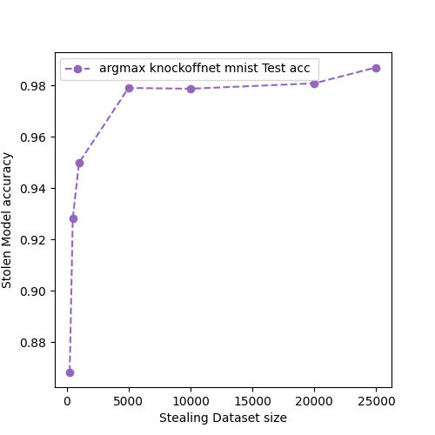
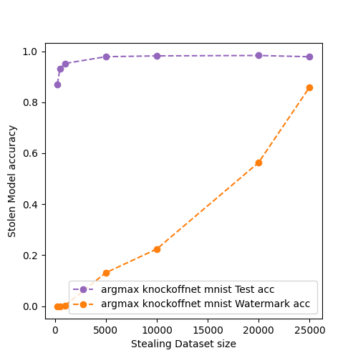
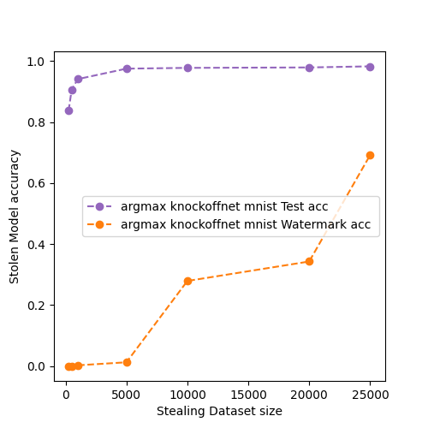
RECAP: Experiments : EWE ON REAL MODEL STEALING ATTACK - Knockoffnet
MNIST: 2-convolution blocks with dropout -0.5 (low capacity model) [same model victim and adversary]
Black box model – 3 convolution blocks with dropout – 0.5 [victim same as above]
Model Stealing Without EWE (No. of epoch = 10)
Model Stealing With EWE
(No. of epochs = 10)
Model Stealing With EWE
(No. of epochs = 10), Blackbox setting
07/28/2023
internal

Slide 3
RECAP: EWE on Trained model APPROACHES
Model (trained on task, without watermark)
Model (trained on task, without watermark)
Model (trained on task, without watermark)
Same model architecture (transfered weights)
Different model architecture (take input from above model)
Different model architecture (take input from above model)
Model training with watermarking
Model training with watermarking on new model only.
Model training with watermarking keeping some layers unfreezed of base model.
Tranfering weights
Finetuning with all layers freezed
Finetuning with some layers freezed
07/28/2023
internal

Slide 4
RECAP: Experiments : EWE ON trained model
Dataset (EWE Model) | Method | Distribution for Watermark | Victim (Validation) | Victim (Watermark) | Extracted (Validation) | Extracted (Watermark) | Original Model | Original Model Accuracy
MNIST (EWE_feature_extract_Keras) | Finetuning | out | 0.989 | 1.00 | 0.989 | 0.61 | Plain_2_conv_Keras | 0.989
MNIST (EWE_Plain_2_conv) | Transfering weights | out | 0.989 | 1.00 | 0.988 | 0.697 | Plain_2_conv | 0.989
FASHION MNIST (EWE_feature_extract_Keras) | Finetuning | out | 0.898 | 1.00 | 0.89 | 0.828 | Plain_2_conv_Keras | 0.911
FASHION MNIST (EWE_2_conv) | Transfering weights | out | 0.897 | 1.00 | 0.891 | 0.857 | Plain_2_conv | 0.905
Training Victim with 50 epochs, extracted model with 20 epochs, original model w
07/28/2023
internal

Slide 5
RECAP: FINAL EXPERIMENT RESULTS OVERVIEW
Datasets – MNIST (FASHION MNIST), CIFAR10
Models – 2/3 layer ConvNet (with and without dropout), DenseNet, ResNet
Dataset (Model architecture) | Defense Method | Model without defense |  | Model with defense (scratch) |  |  |  | Model with defense (finetuning)
 |  | Acc_{test} | Acc_{w} | Victim Model |  | Adversary Model |  | Victim Model |  | Adversary Model
 |  |  |  | Acc_{test} | Acc_{w} | Acc_{test} | Acc_{w} | Acc_{test} | Acc_{w} | Acc_{test} | Acc_{w}
MNIST (2-Conv) | DAWN
CIFAR10 (DenseNet) | EWE

Slide 6
RECAP: NEXT Steps AND Discussion
Results with CIFAR 10 dataset and ReSNet and DenseNet model.
EWE for the watermark removal techniques – Pruning, Neural Cleanse
Real model stealing attacks on watermark embedding with finetuning.
Which method to pick next?
06/02/2023
internal

Slide 7
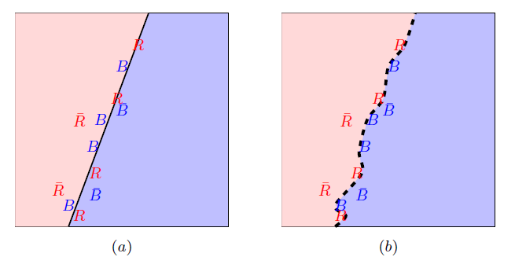
FRONTIER STICHING
Defense Technique for Model Extraction Attacks
Invasive: Changes to training process
GOAL: Use the adversarial samples to clamp original model in a unique and harmless way.
(a.) Calculate the true adversary (without bar) and false adversary (with bar). (b.) fine-tunes classifier to classify true ones.
06/02/2023
internal

Slide 8
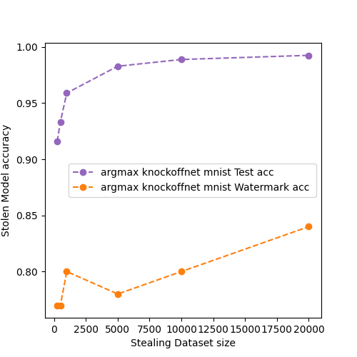
FROntier STICHING
MNIST: 2-layer conv (low capacity model) [same model victim and adversary]
No. Of queries | Watermark acc | Test acc
250 | 0.77 | 0.916
500 | 0.77 | 0.933
1000 | 0.80 | 0.959
10000 | 0.80 | 0.989
20000 | 0.84 | 0.993
Model Stealing With FS
(No. of epochs = 50, eps=0.1, watermark size = 100)
06/02/2023
internal

Slide 9
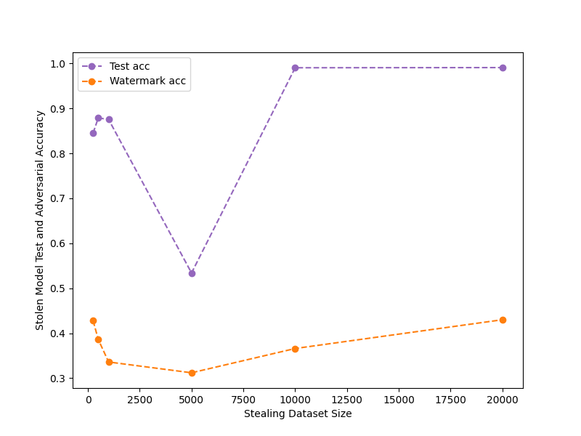
FROntier STICHING
MNIST: 2-layer conv (low capacity model) [same model victim and adversary]
Model Stealing With FS, eps=0.5, watermark size = 500
06/02/2023
internal

Slide 10
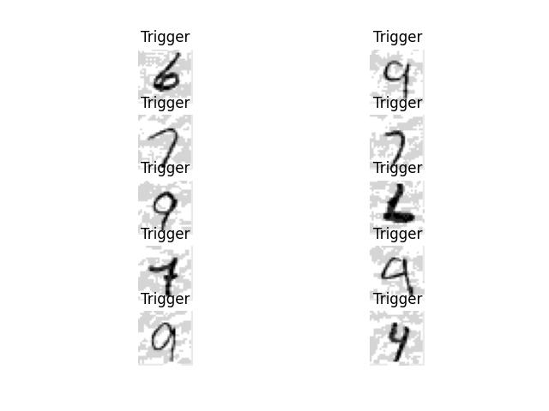
FROntier STICHING
Triggers are generated with noise = 0.1 and 100 watermark size
06/02/2023
internal

Slide 11
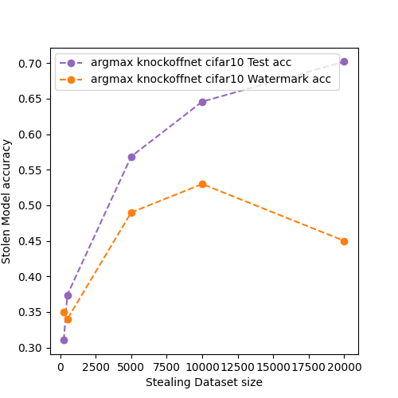
FROntier STICHING
CIFAR10: 3 convblocks with dropouts and batchnorm [same model victim and adversary]
06/02/2023
internal

Slide 12
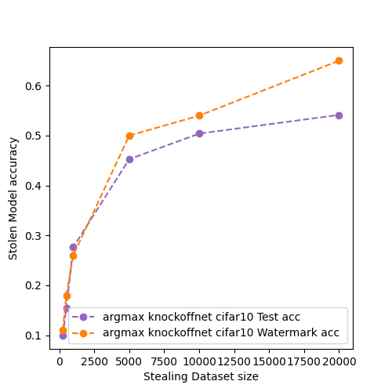
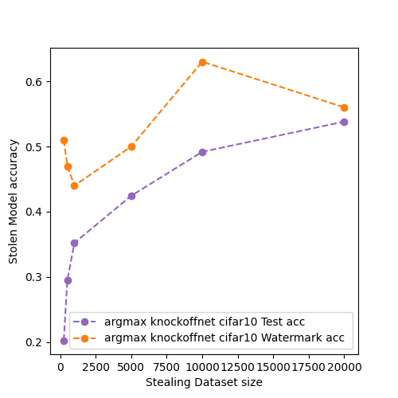
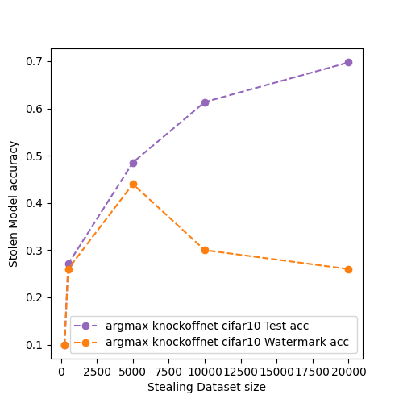
FROntier STICHING
CIFAR10: RESNET34 architecture for the attacker.
eps – 0.1 , l=100
Model Stealing With FS
(No. of epochs = 15, Victim model – 3 conv block.)
Model Stealing With FS
(No. of epochs = 15, Victim model – 3 conv block)
Model Stealing With FS
(No. of epochs = 50, Victim model – RESNET34)
06/02/2023
internal

Slide 13
FIDELITY (DECREASE IN ACCURACY of original model)
Dataset | Model | Final Epoch Without frontier (Victim - test) | Final Epoch After frontier (Victim - test)
MNIST | 2-layer conv (drop=0) | 99.3 | 99.3
MNIST | 2-layer conv (drop=0.2) | 99.3 | 99.3
CIFAR10 | 3 conv blocks (multiple drops) | 84.0 | 81.7
CIFAR10 | ResNet34 | 85.2 | 85.1

Slide 14
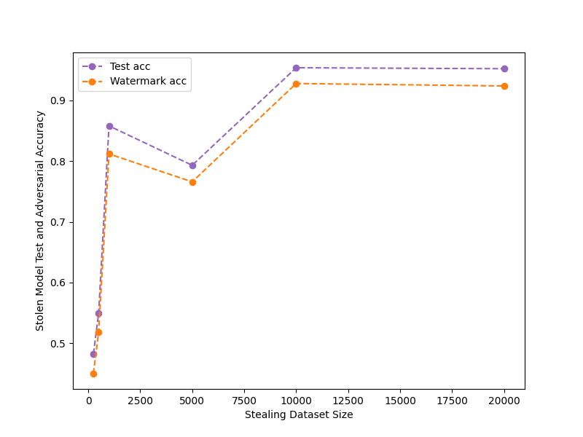
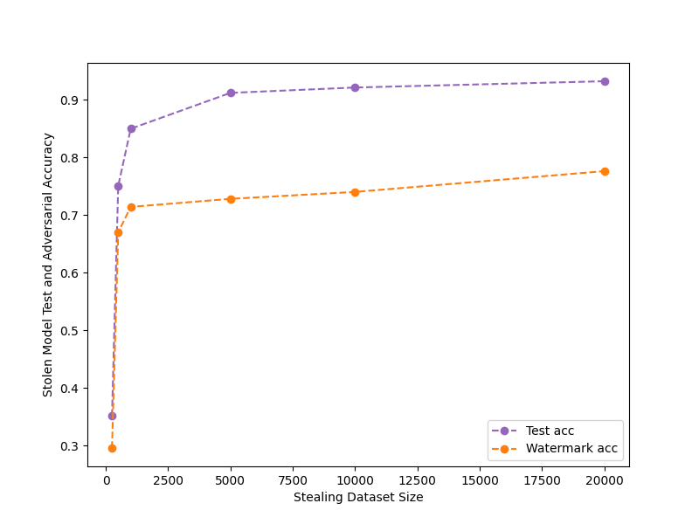
FALSE POSITIVES on MODEL Without FS
MNIST – 10 epochs, watermark size = 500
Model Stealing With FS
(eps =0.1)
Model Stealing With FS
(eps =0.25)

Slide 15
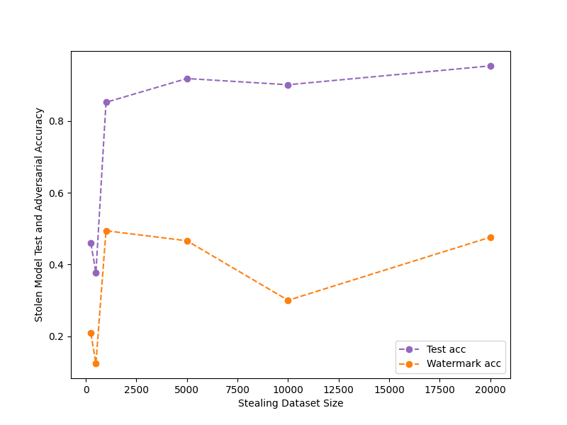
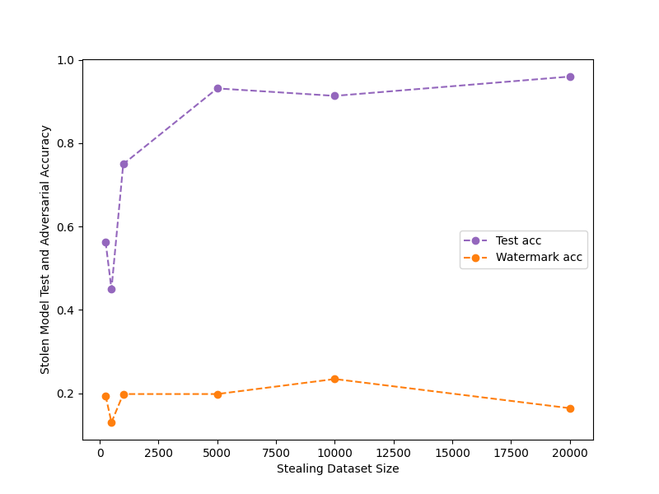
FALSE POSITIVES on MODEL Without FS
MNIST – 10 epochs, watermark size = 500
Model Stealing With FS
(eps =0.5)
Model Stealing With FS
(eps =0.75)

Slide 16
PRoBABLISTIC APPROACH FOR CLAIMING OWNERSHIP
Theta: max no. of errors tolerated for the watermark set from adversary model.
If no. of errors < theta : model is watermarked.
Triggers are generated with noise = 0.1 and 100 watermark size
Dataset | No. Of queries | Frontier Stitching Watermarking Claim | False predictions | False Prediction Tolerance
MNISTL2 (drop=0) | 250 | True | 23 | 42
MNISTL2 (drop=0) | 500 | True | 23 | 42
MNISTL2 (drop=0) | 1000 | True | 20 | 42
MNISTL2 (drop=0) | 10000 | True | 20 | 42
MNISTL2 (drop=0) | 20000 | True | 16 | 42

Slide 17
FROntier STICHING
P-value approach to decision criteria
Z: mismatching labels for the watermark set from adversary and non-watermarked model
Probability that there will be z errors P(Z < theta | f_{a}(w) = f_{v}(w)) < p-value, model is attacked.
For watermark size =100 and p-value = 0.05 : theta: 42
For watermark size =20 and p-value = 0.05 : theta: 6
06/02/2023
internal

Slide 18
PLAN: EVALUATION AND COMPARISON
Evaluation is performed on two datasets and 3methods
Datasets -:
MNIST
CIFAR10
Defense methods -:
DAWN – non invasive
EWE – invasive
Frontier Stiching - invasive
Quantitative Evaluation
Watermark Accuracy
Fidelity (differences (watermarked model and non-watermarked model) can aslo be plotted in terms of graphs)
Robustness against watermark removal techniques
Evaluation of finetuning approaches (still blurry)
Runtime Evaluation – runtime to embed the watermark.
06/02/2023
internal

Slide 19
NEXT Steps AND Discussion
Watermark Removal – Pruning, Neural Cleanse.
Frontier stitching with finetuning cases.
Analysis of false positives for CIFAR-10 dataset.
06/02/2023
internal

Slide 20
06/02/2023
internal

