Slide 1
Master Thesis: Defense Techniques
for Model Extraction Attacks on Deep
Learning Models
Sixth Round Discussion
Ridhima Garg (sa46jiza)
Supervisors
Prof. Dr. Christian Riess (FAU, Department of Computer Science)
Mr. Yannick Möll (ITK Engineering GmbH, Data-Driven Software and Sensors)

Slide 2
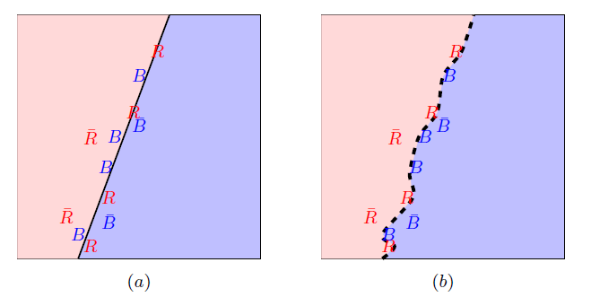
RECAP: FRONTIER STICHING
Defense Technique for Model Extraction Attacks
Invasive: Changes to training process
GOAL: Use the adversarial samples to clamp original model in a unique and harmless way.
(a.) Calculate the true adversary (without bar) and false adversary (with bar). (b.) fine-tunes classifier to classify true ones.
09/22/2023
internal

Slide 3
RECAP: PHASE 1: Full adversaries with retraining

Slide 4
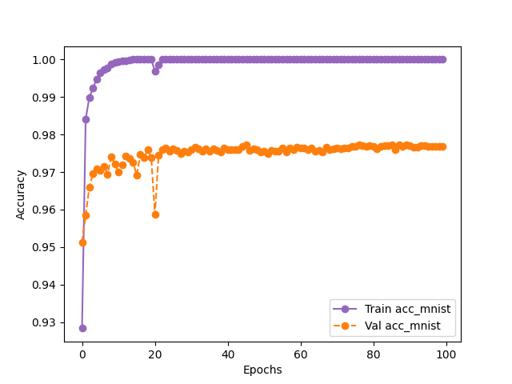
Retraining to watermark model FOR MNIST
Epochs - 100, eps - 0.25, watermark_size - 500
eps=0.25, watermark_size = 500
Dataset | Final Epoch Without Frontier (Victim - test) | Final Epoch After Frontier (using finetuning) (Victim - test) | Final Epoch After Frontier (Victim - watermark)
MNIST | 99.9 | 99.22 ( 0.5%) | 95.99

Slide 5
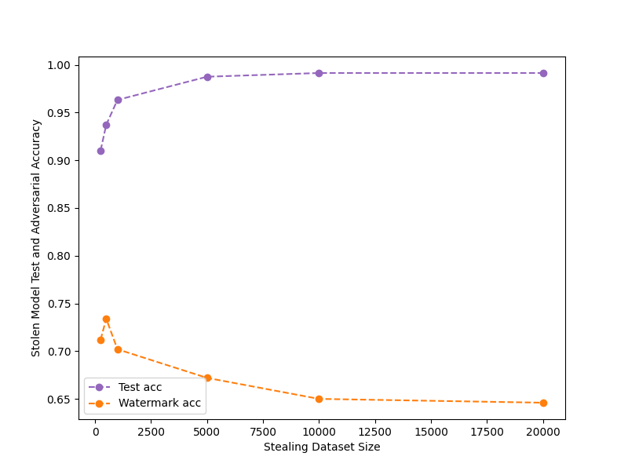
Attacking retrained (watermarked) model
Attack with architecture: MNIST – 2 conv layer, epochs: 50
eps=0.25, watermark_size = 500

Slide 6
RECAP:PHASE 3: True adversaries with Finetuning (extended frontier stitching)

Slide 7
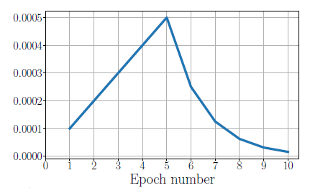
Learning rate for finetuning
Finetuning the pretrained network only on watermark samples.
The network will forget the old weights.
To overcome this: the starting learning rate is chosen small, and then smoothly increased (new distribution is learnt at a faster pace, without forgetting the distribution of original samples), and then the learning rate is reduced fast, without too much time to overfit.
Slow start, Fast decay
Learning Rate Schedule

Slide 8
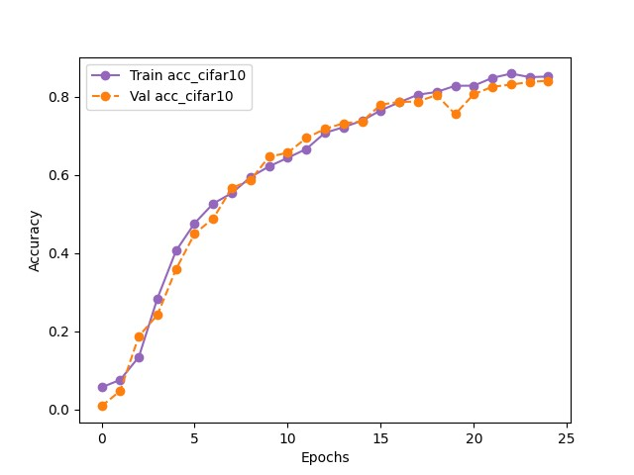
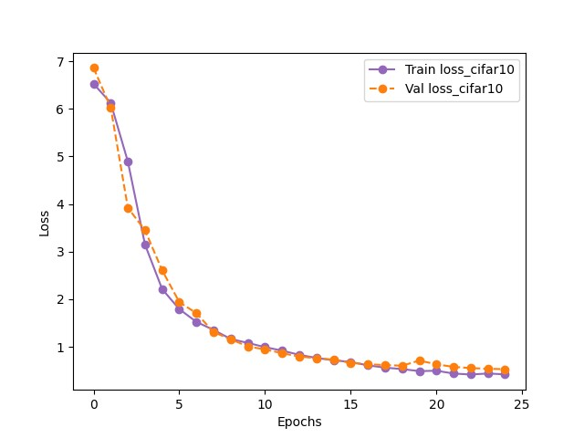
Finetuning to embed watermark
CIFAR10: 3-conv block with batchnorm and dropout
Finetuning with noise level (eps = 0.035),
Learning rate - epoch <= 20 : (0.0001 * epoch) and epoch > 20 : power(2, (epoch -5))
Finetuning with 25 epochs
With learning rate pattern (to increase and decrease)

Slide 9
FIDELITY (DECREASE IN ACCURACY of original model)
Dataset | Final Epoch Without Frontier (Victim - test) | Final Epoch After Frontier (using finetuning) (Victim - test) | Final Epoch After Frontier (Victim – watermark)
CIFAR10 | 82.5 | 74.9 ( 8 %) | 82.9

Slide 10
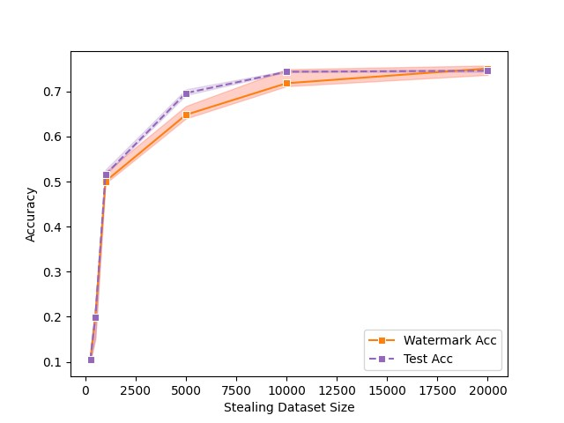
Attacking Finetuned (watermarked) model
Original Model - CIFAR10 3-conv block with batch norm and dropout
Attack with architecture: CIFAR10 3-conv block, epochs: 50, averaged: 5 runs
Representing the 5 runs by taking the 20th quartile and 90th quartile.
Conclusion
Acc_{wm} (watermark acc) is preserved with more than 90% confidence for every run from a lower to a higher number of queries.

Slide 11
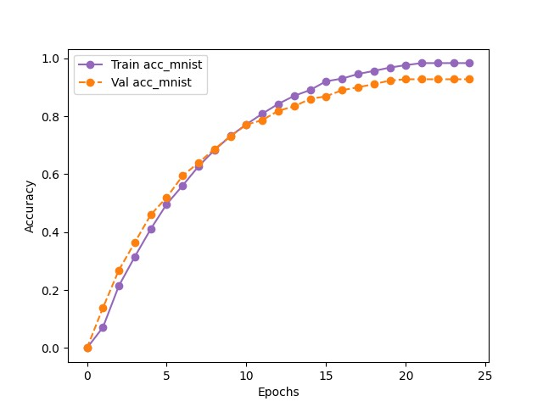
Finetuning to embed watermark on MNIST
MNIST: 2-Conv layer
Finetuning with noise level (eps = 0.25)
Finetuning with 25 epochs,
eps = 0.25

Slide 12
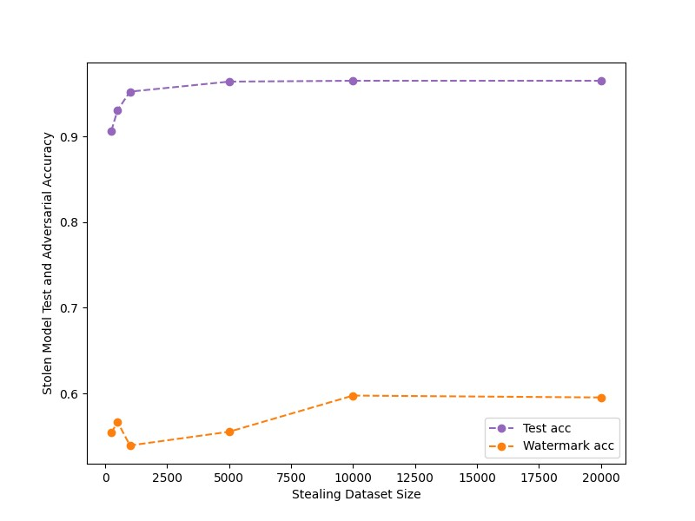
Attacking Finetuned model
eps = 0.25

Slide 13
RECAP: Conclusion
Frontier Stitching
Focus of the work was more on Fidelity metrics instead of watermark preserving.
We fixed the issue by introducing finetuning and using only true adversaries.
Robust towards watermark removal attacks – pruning.
Attack is successful in black box setting.
Finetuning is more successful in claiming ownership but drop in accuracy (fidelity) of original model is littler higher than retraining.
Results are model and dataset dependent.
General Watermarking
All works have focused on when the attacker is attacking with a large number of queries.
Our work analyzed the watermark presence with varying numbers of queries.

Slide 14
RECAP: NEXT Steps AND Discussion
Experiments
Finalizing DAWN
Revisiting Entangled Watermarking – quite a few work is remaining there.
Writing
Outline of the thesis
Template
06/02/2023
internal

Slide 15
DAWN: Dynamic adversarial watermarking

Slide 16
RECAP: Dawn: watermark generation
𝑊_{V}(𝑥): should the response to 𝑥 be watermarked?
𝐵_{V}(𝑥): what is the (backdoored watermark) response?
F_{v}
K_{w}
F_{v}
K_{w}
𝑊_{V}(𝑥) = 0
Or
𝑊_{V}(𝑥) = 1
SHA(K_{w}, x_{i})
f(SHA(K_{w}, x_{i}),F_{v(xi)}))
𝐵_{V}(𝑥)
F_{A}
F_{A}
x_{i}
x_{i}
K_{w} is model specific key
X_{i} is the query sent by an adversary to victim model
SHA is the 256 hash key
f is pseudo-random perturbation function which is implemented using the Fisher-Yates algorithm
06/02/2023
internal

Slide 17
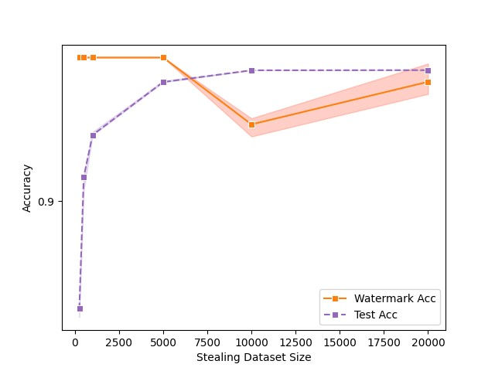
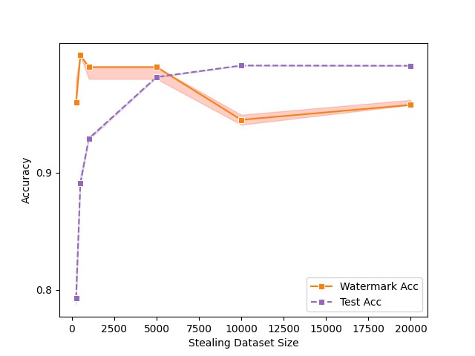
Experiments : DAWN ON REAL MODEL STEALING ATTACK - MNIST
Original Model - MNIST 2-conv layer
Attack with architecture: MNIST 2-conv layer (white-box) and MNIST 3-conv layer (black-box) , epochs: 50, averaged: 5 runs
Representing the 5 runs by taking the 20th quartile and 90th quartile.
Model Stealing after DAWN – White box
Model Stealing After DAWN – Black box
06/02/2023
internal

Slide 18
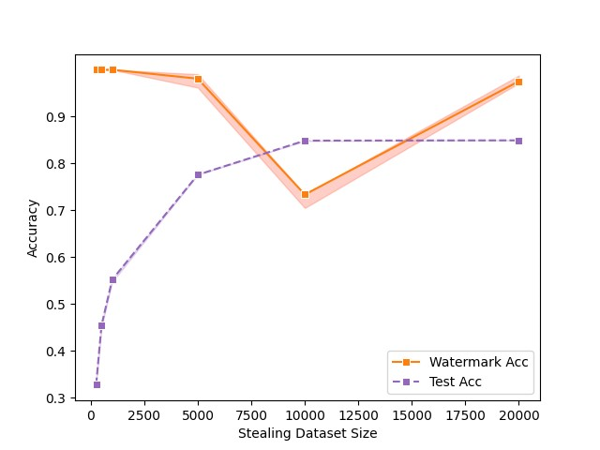
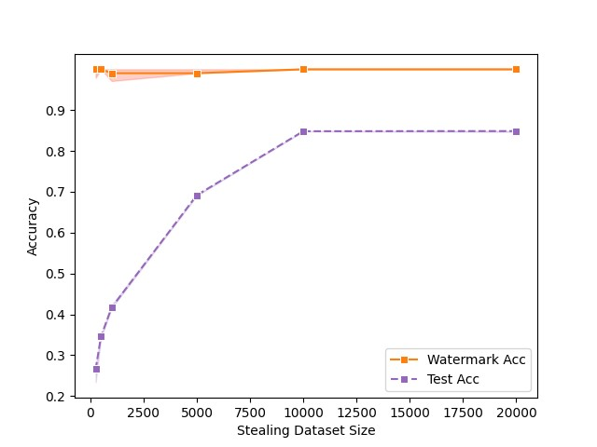
Experiments : DAWN ON REAL MODEL STEALING ATTACK – CIFAR10 (shallow N/w)
Original Model - CIFAR10 3-conv block with batch norm and dropout
Attack with architecture: CIFAR10 3-conv block (white-box) and ReSNet (black-box), epochs: 50, averaged: 5 runs
Representing the 5 runs by taking the 20th quartile and 90th quartile.
Model Stealing after DAWN – White box
Model Stealing After DAWN – Black box
06/02/2023
internal

Slide 19
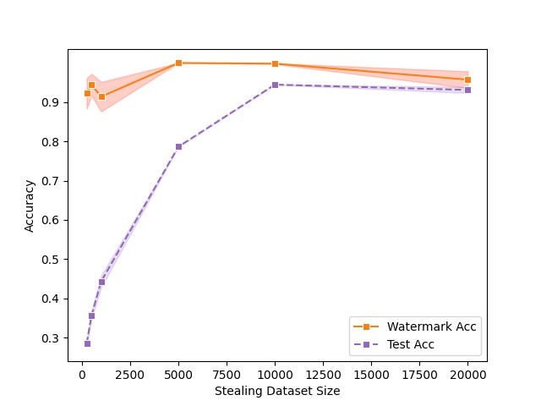
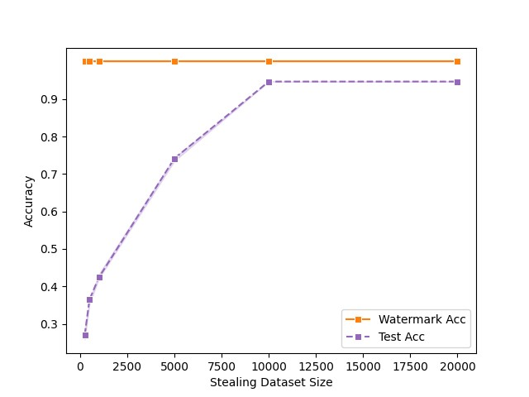
Experiments : DAWN ON REAL MODEL STEALING ATTACK - CIFAR10 (deep N/w)
Original Model - CIFAR10 ReSNet
Attack with architecture: CIFAR10 ReSNet (white-box) and 3-conv block (black-box), epochs: 50, averaged: 5 runs
Representing the 5 runs by taking the 20th quartile and 90th quartile.
Model Stealing after DAWN – White box
Model Stealing After DAWN – Black box
06/02/2023
internal

Slide 20
Experiments : WATERMARK REMOVAL
pruning
Adversary attempt to prune the model by setting random weights of the model to zero.
Before Pruning on MNIST
Test set accuracy-98.7
Watermark set accuracy- 87.71
Dataset | Pruning level | After Pruning (test) | After Pruning (watermark)
MNIST | 0.01 | 98.7 | 87.71
MNIST | 0.05 | 98.66 | 86.86
MNIST | 0.1 | 98.65 | 87.71
MNIST | 0.25 | 98.79 | 87.71
MNIST | 0.4 | 98.62 | 86.01
MNIST | 0.5 | 98.63 | 84.74
MNIST | 0.75 | 98.64 | 87.28
MNIST | 0.9 | 98.85 | 86.86
Pruning results with different pruning level
06/02/2023
internal

Slide 21
Experiments : WATERMARK REMOVAL
FINE-pruning
Adversary attempt to prune the model by setting random weights of the model to zero and then finetuning the model with collected data.
Before Pruning on MNIST
Test set accuracy-98.7
Watermark set accuracy-87.71
Dataset | Pruning level | After Pruning (test) | After Pruning (watermark)
MNIST | 0.01 | 99.12 | 7.2
MNIST | 0.05 | 100.0 | 5.5
MNIST | 0.1 | 99.98 | 4.23
MNIST | 0.25 | 99.99 | 10.11
MNIST | 0.4 | 1.0 | 11.86
MNIST | 0.5 | 99.99 | 13.13
MNIST | 0.75 | 99.8 | 0.8
MNIST | 0.9 | 98.03 | 0.4
Pruning results with different pruning level
06/02/2023
internal

Slide 22
Experiments : WATERMARK REMOVAL
pruning
Adversary attempt to prune the model by setting random weights of the model to zero.
Before Pruning on CIFAR10
Test set accuracy-84.92
Watermark set accuracy- 78.27
Dataset | Pruning level | After Pruning (test) | After Pruning (watermark)
CIFAR10 | 0.01 | 84.92 | 78.27
CIFAR10 | 0.05 | 84.92 | ´78.68
CIFAR10 | 0.1 | 84.91 | 79.09
CIFAR10 | 0.25 | 84.85 | 77.04
CIFAR10 | 0.4 | 83.99 | 60.65
CIFAR10 | 0.5 | 72.13 | 34.01
CIFAR10 | 0.75 | 19.29 | 13.52
CIFAR10 | 0.9 | 10.34 | 9.42
Pruning results with different pruning level
06/02/2023
internal

Slide 23
Experiments : WATERMARK REMOVAL
FINE pruning
Adversary attempt to prune the model by setting random weights of the model to zero and then finetuning the model with collected data.
Before Pruning on CIFAR10
Test set accuracy-84.92
Watermark set accuracy- 78.27
Dataset | Pruning level | After Pruning (test) | After Pruning (watermark)
CIFAR10 | 0.01 | 92.74 | 17.62
CIFAR10 | 0.05 | 92.25 | 18.44
CIFAR10 | 0.1 | 92.39 | 18.44
CIFAR10 | 0.25 | 91.02 | 19.67
CIFAR10 | 0.4 | 90.28 | 20.49
CIFAR10 | 0.5 | 89.11 | 20.08
CIFAR10 | 0.75 | 86.02 | 12.22
CIFAR10 | 0.9 | 64.87 | 4.50
Pruning results with different pruning level
06/02/2023
internal

Slide 24
Experiments : WATERMARK REMOVAL
MAPPING : Algorithm for Indistinguishability for mnist
Create latent embeddings as an autoencoder
Embedding created - middle layer of the victim model
Binarizing latent representation – results in medians of each feature
Perform Mapping
Noise level | Latent Representation Size | Same Label and Same mapping | Different Label and Same Mapping | Same Label | Different Label | Different Mapping
0.2 | 1024 | 90.073 | 0.481 | 95.363 | 4.637 | 9.446
0.2 | 10 | 94.583 | 2.787 | 95.801 | 4.198 | 2.630
0.1 | 1024 | 90.34 | 0.399 | 95.482 | 4.518 | 9.261
0.1 | 10 | 95.379 | 3.409 | 95.926 | 4.074 | 1.212
0.09 | 1024 | 90.457 | 0.451 | 95.503 | 4.497 | 9.092
0.09 | 10 | 95.437 | 3.409 | 95.939 | 4.061 | 1.154
0.075 | 1024 | 90.463 | 0.452 | 95.502 | 4.498 | 9.085
0.075 | 10 | 95.577 | 3.531 | 95.957 | 4.043 | 0.892
06/02/2023
internal

Slide 25
Experiments : WATERMARK REMOVAL
MAPPING : Algorithm for Indistinguishability FOR CIFAR10
Noise level | Latent Representation Size | Same Label and Same mapping | Different Label and Same Mapping | Same Label | Different Label | Different Mapping
0.2 | 128 | 53.50 | 36.66 | 56.88 | 43.11 | 9.82
0.2 | 10 | 57.28 | 39.15 | 58.37 | 41.62 | 3.56
0.1 | 128 | 77.17 | 13.27 | 81.54 | 18.45 | ´9.55
0.1 | 10 | 81.69 | 14.57 | 83.751 | 16.24 | 3.73
0.09 | 128 | 79.16 | 11.25 | 83.78 | 16.21 | 9.57
0.09 | 10 | 83.85 | 12.44 | 85.99 | 14.01 | 3.7
0.075 | 128 | 82.2 | 8.372 | 86.84 | 13.15 | 9.42
0.075 | 10 | 87.23 | 9.39 | 89.25 | 10.744 | 3.3
06/02/2023
internal

Slide 26








Above row: eps-0.2 and below row eps- 0.075
Original and Perturbed: Not watermarked, Same labels
Original: Not watermarked, Perturbed: Watermarked, Different labels
Original: Watermarked, Perturbed: Not Watermarked, same labels
Original: Watermarked, Perturbed: Watermarked, same labels
Original and Perturbed: Not watermarked, Same labels
Original: Not watermarked, Perturbed: Watermarked, same labels
Original: watermarked, Perturbed: Not Watermarked, different labels
Original: Watermarked, Perturbed: Watermarked, diff labels

Slide 27
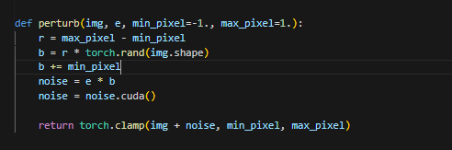

Slide 28
Entangled Watermarking

Slide 29

EWE : Entangled watermarking
Defense Technique for Model Extraction Attacks
Invasive: Changes to training process
GOAL: Leverage the soft nearest neighbor loss to entangle representations extracted from training data and watermark data
Overcomes the limitation of watermarked models roughly split their parameter set into two subsets, the first encodes the task distribution while the second overfits to the watermarks
Assumptions about adversary
Has knowledge of the training data used to train the victim model
Knows the architecture of the victim model
Has knowledge that watermarking is deployed but not what kind of watermarking as defense
06/02/2023
internal

Slide 30

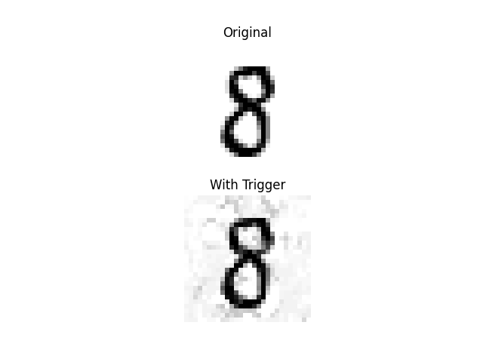


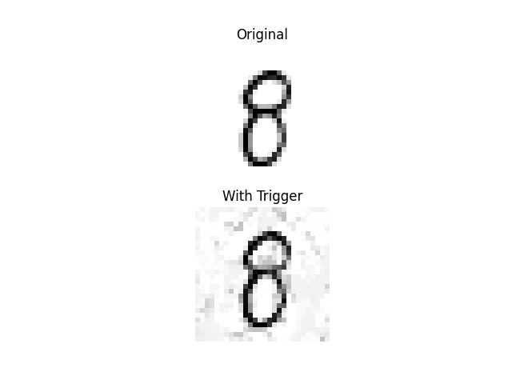

EWE : Entangled watermarking Algorithm
Create watermark set
Compute the trigger positions for the watermark samples
Train the model to have the special behavior that it classifies watermarked sample (x_{w}) as semantically different target class (c_{t})
Create watermark set
(in and out distribution, one target class, one source class)
Compute the trigger position
Modify the Loss function
(Compute SNNL and sum across all layers)
Training model (watermark + train set) (soft nearest neighbor + cross entropy)
Argmax(conv(grad_{Xw}(SNNL([X_{w};X_{cT} ];Y;T))))
Cross_enrtopy - SNNL
Watermark set
With label = t-shirt
06/02/2023
internal

Slide 31
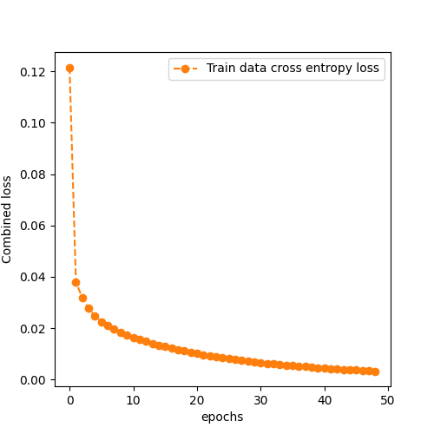
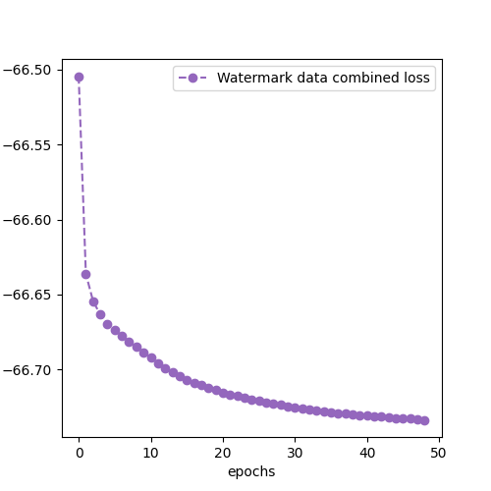
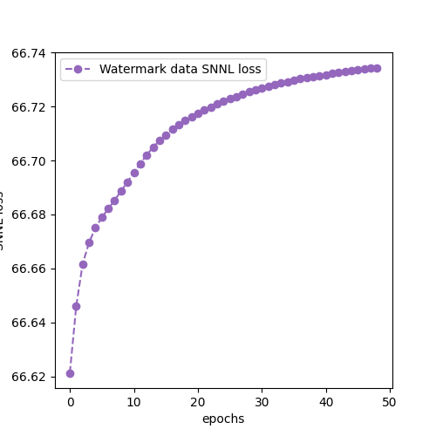
Experiments : EWE Watermark embedding Retraining
MNIST: 3-convolution layers (low capacity model)
Out distribution: Fashion Mnist
Target class: 7, source class 1
06/02/2023
internal

Slide 32
Experiments : Fidelity Retraining
MNIST: 3-convolution layers (low capacity model)
Out distribution: Fashion Mnist
Target class: 7, source class 1
Dataset | Final Epoch Without EWE (Victim - test) | Final Epoch After EWE (using finetuning) (Victim - test) | Final Epoch After EWE (Victim – watermark)
CIFAR10 | 99.26 | 98.99 ( 0.27 %) | 82.9
06/02/2023
internal

Slide 33
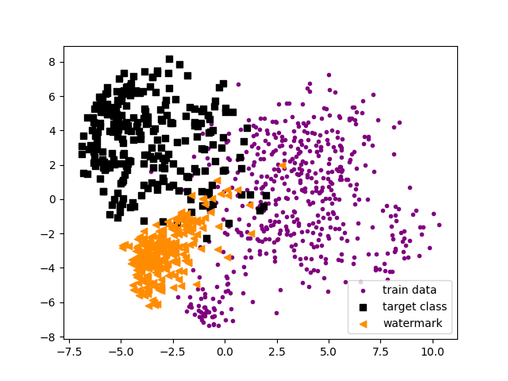
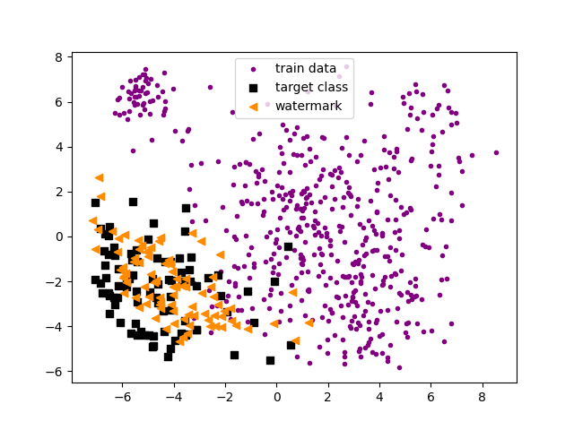
Experiments : Visual entanglement
MNIST: 3-convolution layers (low capacity model)
Out distribution: Fashion Mnist
Target class: 7, source class 1
06/02/2023
internal

Slide 34
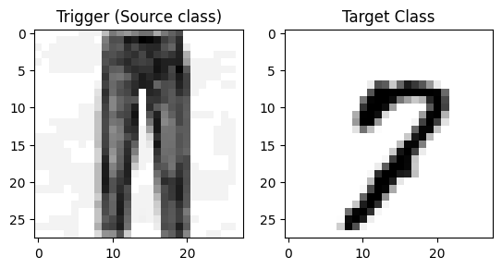
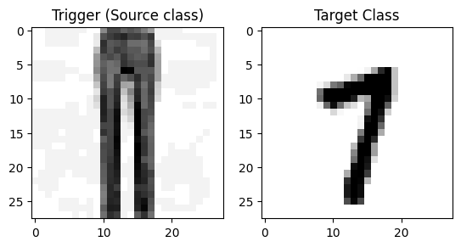
Experiments : Watermark samples
MNIST: 3-convolution layers (low capacity model)
Out distribution: Fashion Mnist
Target class: 7, source class 1
Triggers are created using FGSM
Label will be assigned = 7
06/02/2023
internal

Slide 35
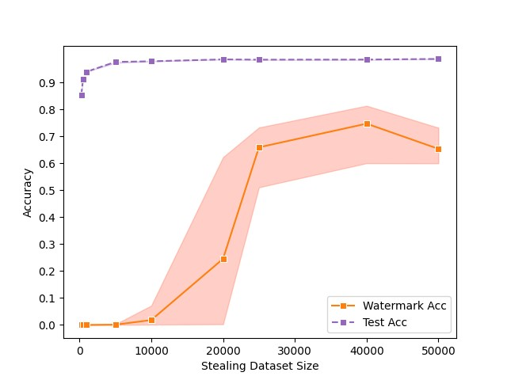
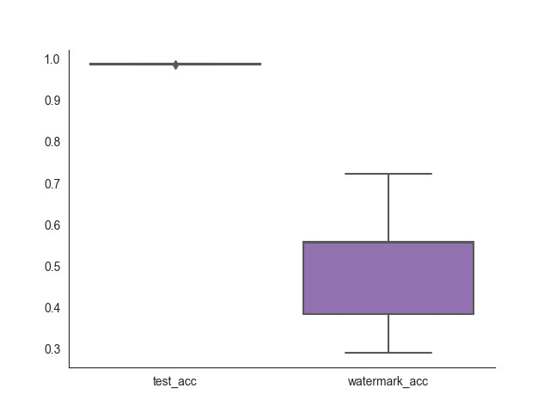
Experiments : ATTACK AND VERIFICATION
Representing the 5 runs
Averaged 5 runs (right plot) taking the 20th quartile and 90th quartile.
Attack and Verification with full dataset
Attack and Verification with query budget
06/02/2023
internal

Slide 36
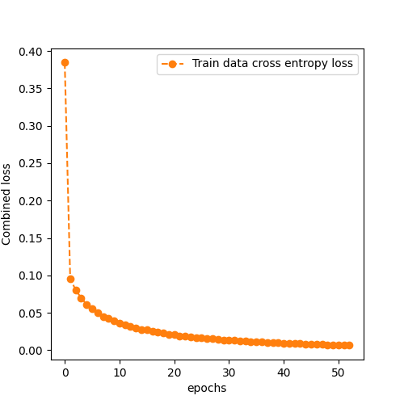
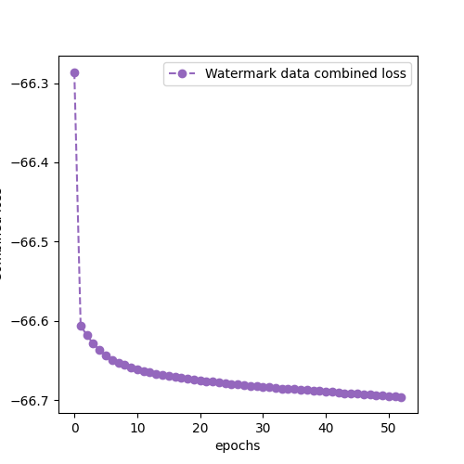
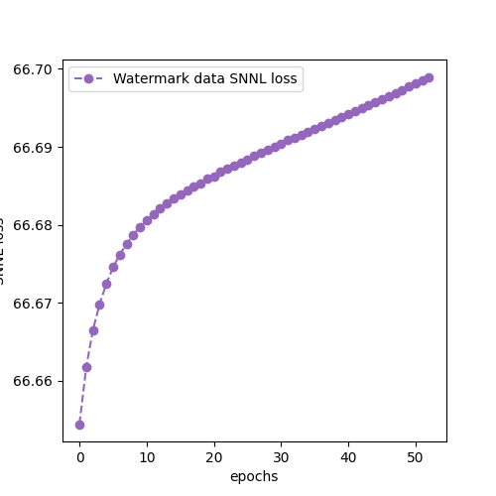
Experiments : EWE Watermark embedding retraining
MNIST: 3-convolution layers (low capacity model)
In distribution: MNIST
Target class: 3, source class 4
06/02/2023
internal

Slide 37
Experiments : fidelity retraining
MNIST: 3-convolution layers (low capacity model)
In distribution: MNIST
Target class: 3, source class 4
Dataset | Final Epoch Without EWE (Victim - test) | Final Epoch After EWE (using finetuning) (Victim - test) | Final Epoch After EWE (Victim – watermark)
CIFAR10 | 99.26 | 97.81 ( 1.45 %) | 82.9
06/02/2023
internal

Slide 38
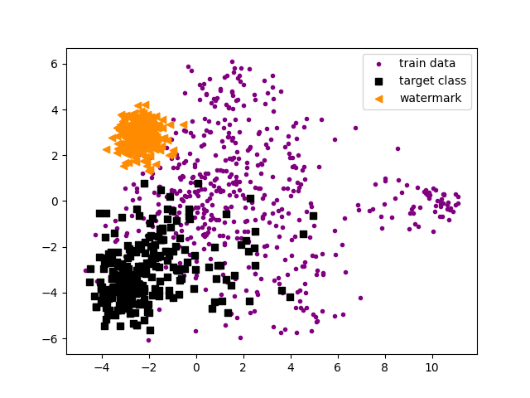
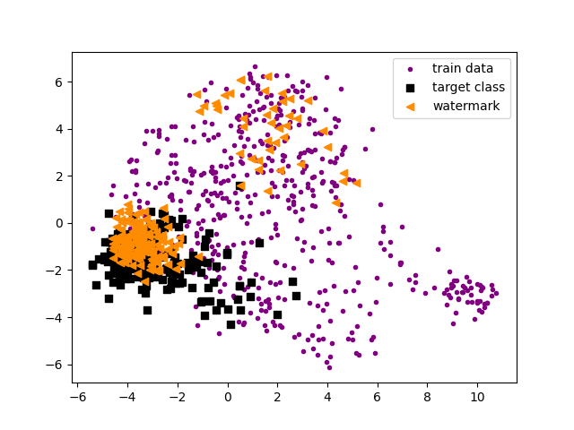
Experiments : VISUAL ENTNAGLEMENT
MNIST: 3-convolution layers (low capacity model)
In distribution: MNIST
Target class: 3, source class 4
06/02/2023
internal

Slide 39
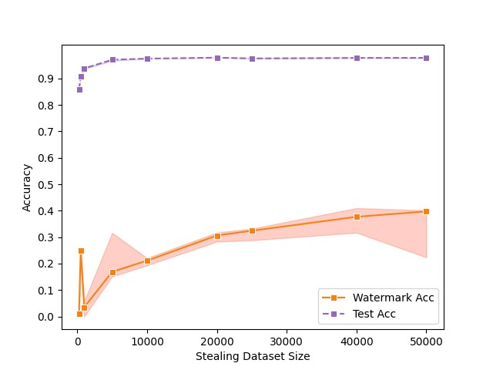
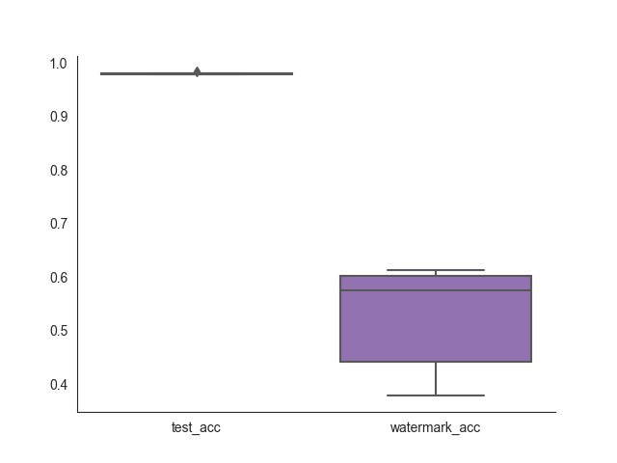
Experiments : ATTACK AND VERIFICATION
Representing the 5 runs
Averaged 5 runs (right plot) taking the 20th quartile and 90th quartile.
06/02/2023
internal

Slide 40
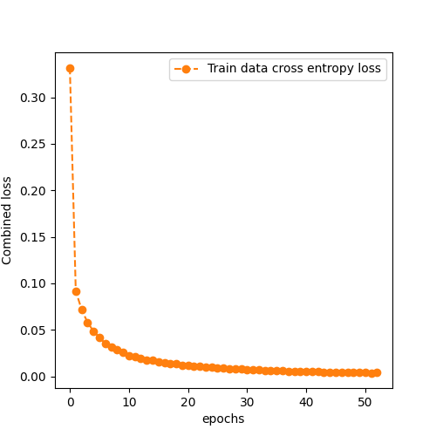
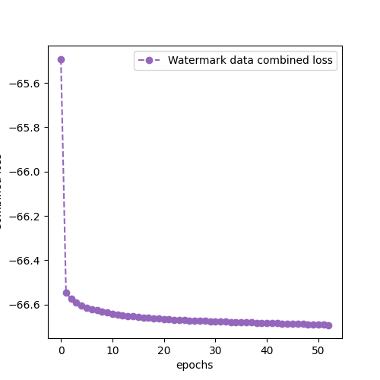
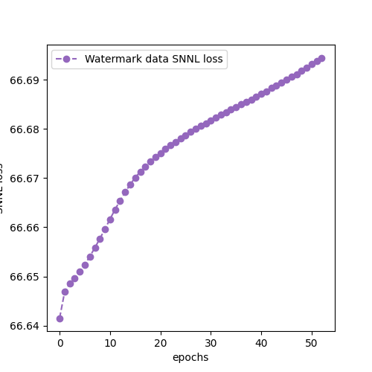
Experiments : EWE Watermark embedding finetuning
MNIST: 3-convolution layers (low capacity model)
In distribution: MNIST
Target class: 3, source class 4
06/02/2023
internal

Slide 41
Experiments : fidelity finetuning
MNIST: 3-convolution layers (low capacity model)
In distribution: MNIST
Target class: 3, source class 4
Dataset | Final Epoch Without EWE (Victim - test) | Final Epoch After EWE (using finetuning) (Victim - test) | Final Epoch After EWE (Victim – watermark)
CIFAR10 | 99.26 | 97.88 ( 1.38 %) | 82.9
06/02/2023
internal

Slide 42
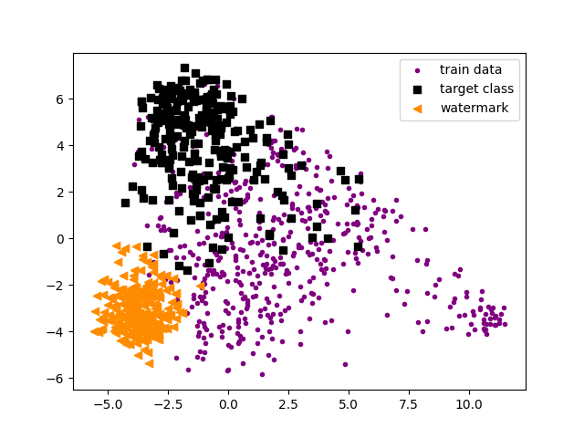
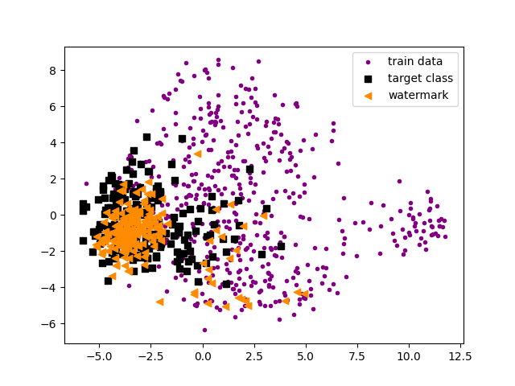
Experiments : VISUAL ENTNAGLEMENT
MNIST: 3-convolution layers (low capacity model)
In distribution: MNIST
Target class: 3, source class 4
06/02/2023
internal

Slide 43
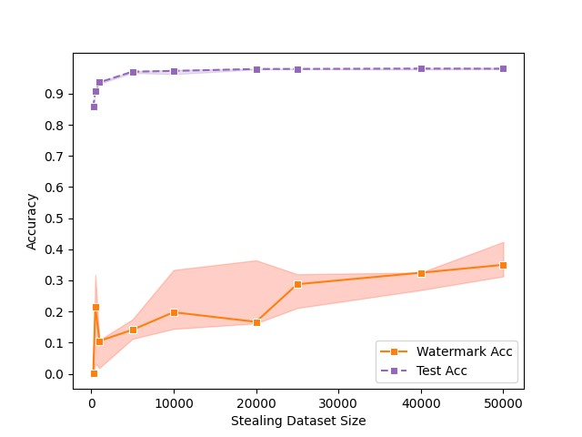
Experiments : ATTACK AND VERIFICATION
Representing the 5 runs
Averaged 5 runs (right plot) taking the 20th quartile and 90th quartile.
06/02/2023
internal

Slide 44
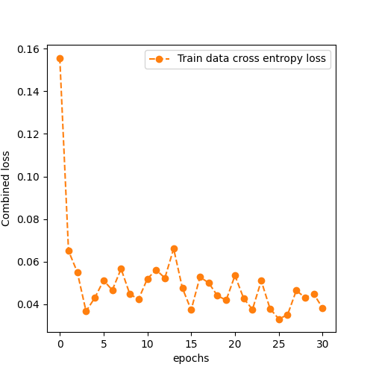
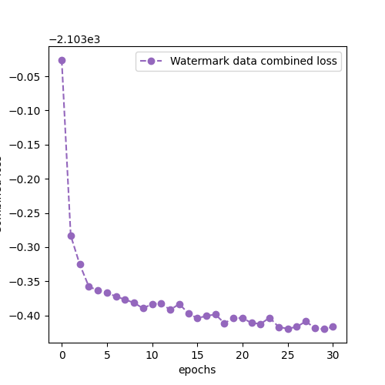
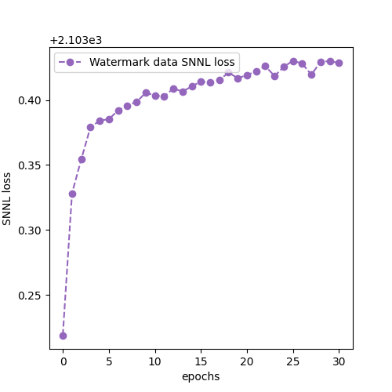
Experiments : EWE Watermark embedding REtraining
CIFAR10: 3-convolution blocks
Out distribution: SVHN
Target class: 9, source class 5
06/02/2023
internal

Slide 45
Experiments : fidelity REtraining
CIFAR10: 3-convolution blocks
Out distribution: SVHN
Target class: 9, source class 5
Dataset | Final Epoch Without EWE (Victim - test) | Final Epoch After EWE (using finetuning) (Victim - test) | Final Epoch After EWE (Victim – watermark)
CIFAR10 | 82.5 | 80.0 ( 2 %) | 82.9
06/02/2023
internal

Slide 46
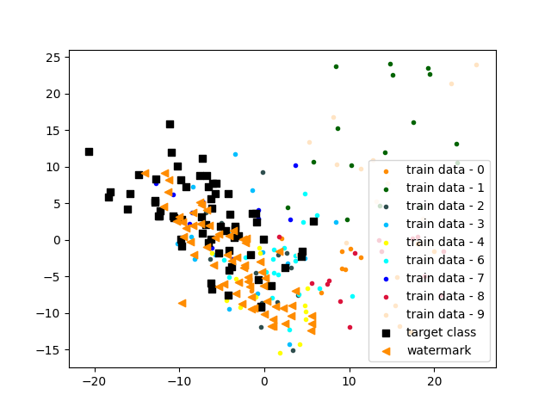
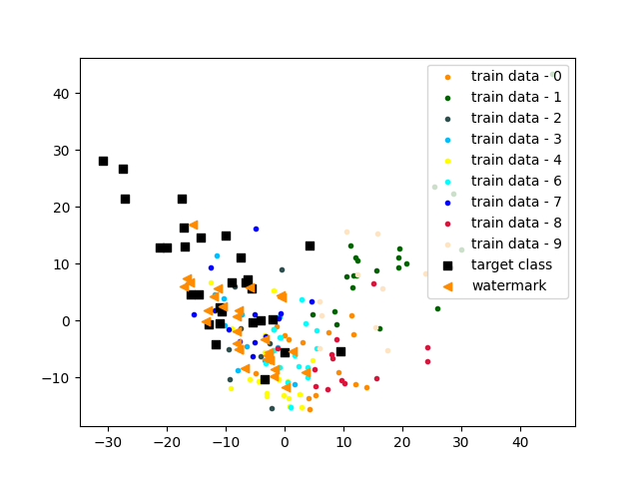
Experiments : VISUAL ENTNAGLEMENT
CIFAR10: 3-convolution blocks
Out distribution: SVHN
Target class: 9, source class 5
06/02/2023
internal

Slide 47
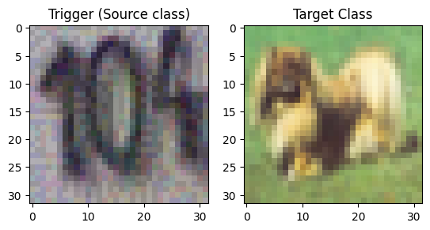
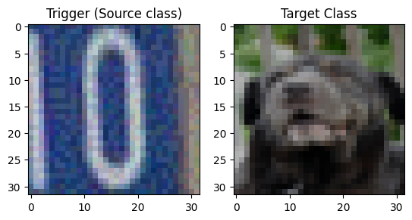
Experiments : WATERMARK SAMPLES
CIFAR10: 3-convolution blocks
Out distribution: SVHN
Target class: 5, source class 9
06/02/2023
internal

Slide 48
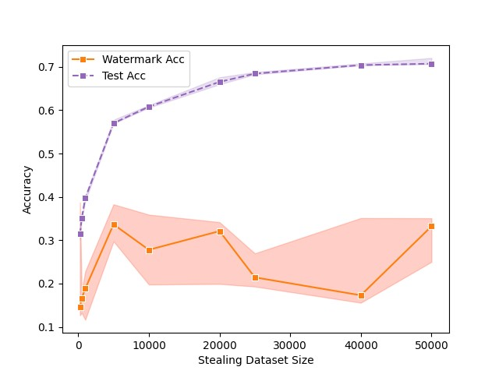
Experiments : ATTACK AND VERIFICATION

Slide 49
COnclusion
 | Frontier Stitching |  |  | Extended Frontier Stitching |  |  | DAWN |  |  | EWE
Data | MN | CF10-L | CF10-H | MN | CF10-L | CF10-H | MN | CF10-L | CF10-H | MN | CF10-L | CF10-H
Ownership Verification | With FP | With FP | With FP |  |  |  |  |  |  | Higher no. Of queries | ~ Low confidence | -
Fidelity |  |  |  |  | Little more drop | Little more drop | Not directly applicable
Pruning | -- |  |  |  |  | Pending |  |  | Pending
FinePruning |  |  |  | Pending |  | Pending |  |  | Pending
metric

Slide 50
Conclusion and next steps
Watermarking as Defense
Outcomes
Active (Inference) Method is successful with high confidence irrespective of test accuracy.
Trigger-based training-based approaches are a little difficult to capture the watermark information.
Entangled Watermarking addresses the problem of disentanglement.
Successful with a higher no. of queries.
Original Frontier Stitching Paper is not tested against Model Extraction directly.
Extended Frontier Stitching overcomes the challenge of False Positives.
Next Steps
Defense Date
Writing Feedback – Few chapters for now

Slide 51
09/22/2023
internal

