Slide 1
Master Thesis: Defense Techniques
for Model Extraction Attacks on Deep
Learning Models
Third Round Discussion
Ridhima Garg (sa46jiza)
Supervisors
Prof. Dr. Christian Riess (FAU, Department of Computer Science)
Mr. Yannick Möll (ITK Engineering GmbH, Data-Driven Software and Sensors)

Slide 2
RECAP: Experiments : ROBUSTNESS AGAINST EXTRACTION in white box setting
Dataset | Method | Distribution for watermark | Victim (Validation) | Victim (Watermark) | Extracted (Validation) | Extracted (Watermark)
MNIST (2-conv) | Baseline | out | 0.98 | 1.00 | 0.98 | 0.01
 | EWE | out | 0.98 | 1.00 | 0.98 | 0.75
FASHION MNIST (2-conv) | Baseline | out | 0.84 | 1.0 | 0.84 | 0.92
 | EWE | out | 0.90 | 0.99 | 0.89 | 0.78
FASHION MNIST (RESNET) | Baseline | out | 0.45 | 1.00 | 0.46 | 0.98
 | EWE | out | 0.88 | 0.95 | 0.87 | 0.27
CNN models (50 training epochs) Baseline model (trains with cross entropy only)
Conclusion
Acc_{wm} is always high for EWE models except for the RESNET (high capacity model), residual connections pose a greater problem for entanglement because there are often no shared features.
Baseline is performing better than EWE in some cases.
06/02/2023
internal

Slide 3
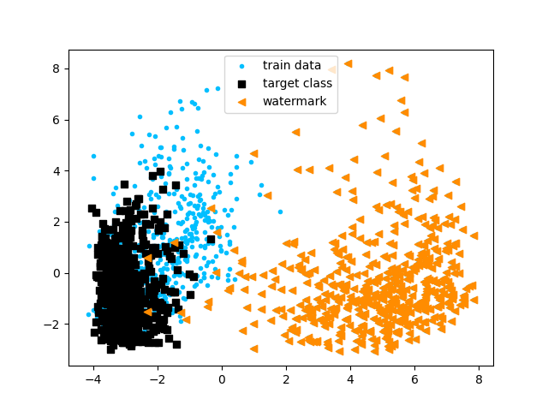
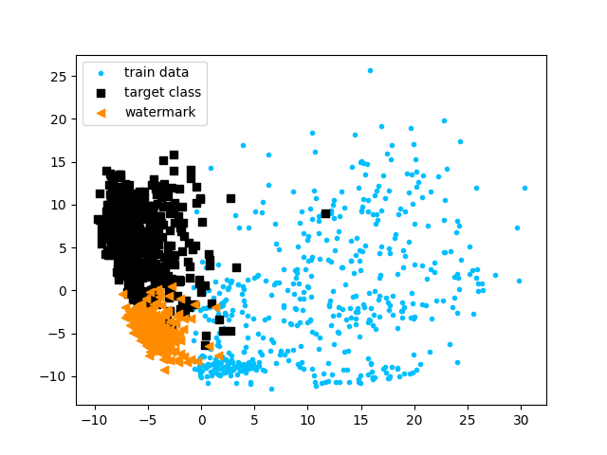
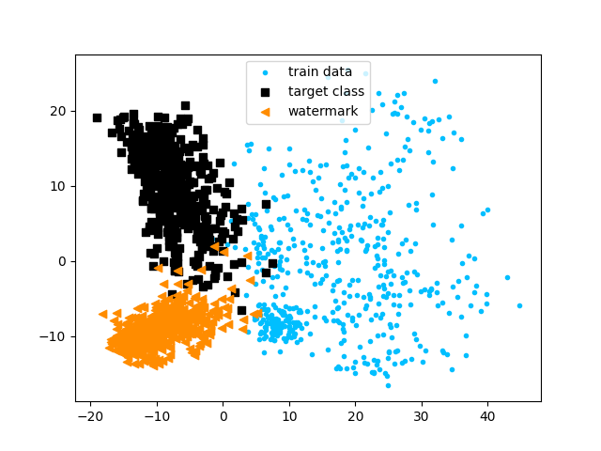
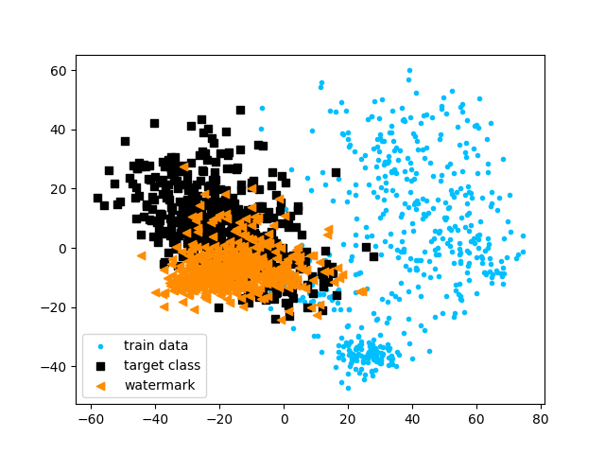
RECAP: Experiments : Visualization of entanglement
Before training
During training
After training
Baseline MNIST Out distribution (FASHION MNIST), watermark class 1, target class 7
EWE MNIST Out distribution (FASHION MNIST)
PCA is used to project representations of model’s penultimate layer onto its two principal components
06/02/2023
internal

Slide 4
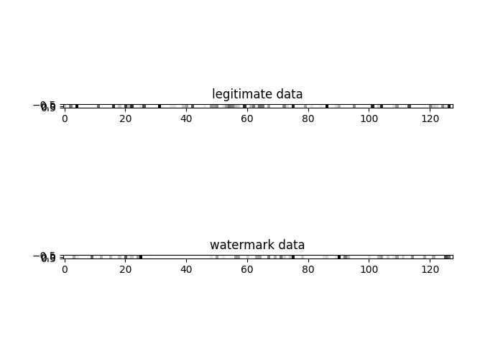
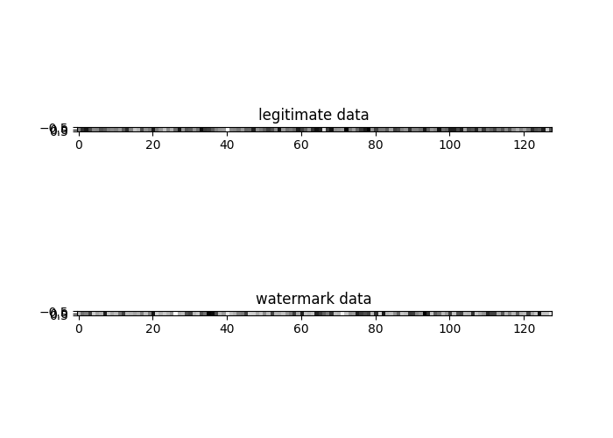
RECAP: Experiments : activation patterns
EWE encourages activation pattern for legitimate task and watermark task to be similar.
Watermark robust to model extraction attacks.
Baseline approach has distinct activation pattern - original task and watermark task.
Fewer neurons are activated for watermark task in baseline as this task is easier than original classification task
Left image: Activation of neurons of last FC layer using Baseline, Right image: using EWE over MNIST for both legitimate and watermark data (out distribution)
Conclusion
More neurons are activated (black – higher intensity) during EWE method
EWE has more similar activation of neurons for both legitimate and watermark data
06/02/2023
internal

Slide 5
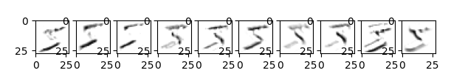
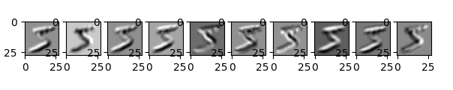
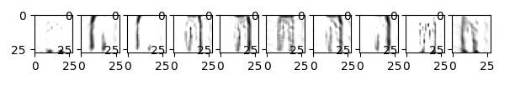
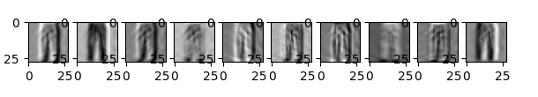
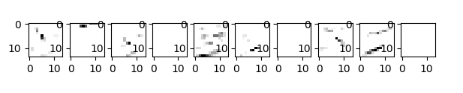
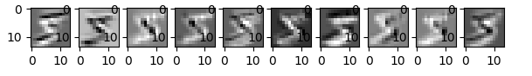
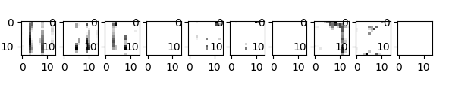
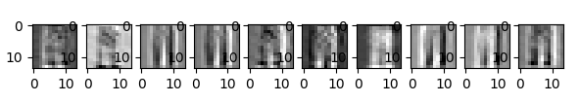
RECAP: Experiments : SCALABILITY to deeper architectures
First convolution layer: legitimate data
First convolution layer: legitimate data
First convolution layer: watermark data
First convolution layer: watermark data
Second convolution layer: legitimate data
Second convolution layer: legitimate data
Second convolution layer: watermark data
Second convolution layer: watermark data
BASELINE: Activation of watermarked and legitimate data is
more significant
EWE: High frequency of activations for neurons.
Entangling legitimate and watermark data, representations become similar as we go deeper in the architecture.
06/02/2023
internal

Slide 6


RECAP: NEXT Steps AND Discussion
How EWE work for black-box (real model stealing) attacks (MNIST, FASHION MNIST)
EWE for the watermark removal techniques
Handling research question -:
Making the comparison of the watermarking removal techniques with DAWN
Comparison of EWE for model trained from scratch with EWE on trained model with
finetuning (MNIST, FASHION MNIST)
Why Baseline is working better than EWE sometimes – debugging
Organizational
Session in Prof’s Christian research group.
06/02/2023
internal

Slide 7
Experiments : perfect attacker
Dataset | Method | Victim (Validation) | Victim (Watermark) | Extracted (Validation) | Extracted (Watermark)
MNIST (2-conv) | EWE | 0.98 | 1.00 | 0.98 | 0.67
FASHION MNIST (2-conv) | EWE | 0.90 | 0.99 | 0.89 | 0.78
FASHION MNIST (RESNET) | EWE | 0.88 | 0.95 | 0.87 | 0.27
MNIST (MNIST_L5_DR05) | EWE | 0.97 | 1.0 | 0.97 | 0.60
FASHION MNIST (MNIST_L5_DR05) | EWE | 0.885 | 1.0 | 0.895 | 0.51
Low capacity models (50 training epochs)
07/28/2023
internal
07/28/2023

Slide 8
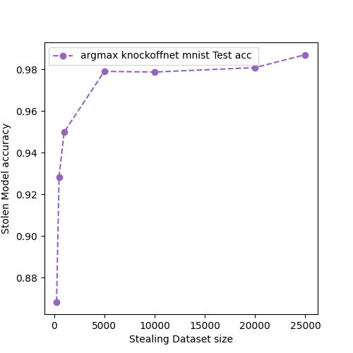
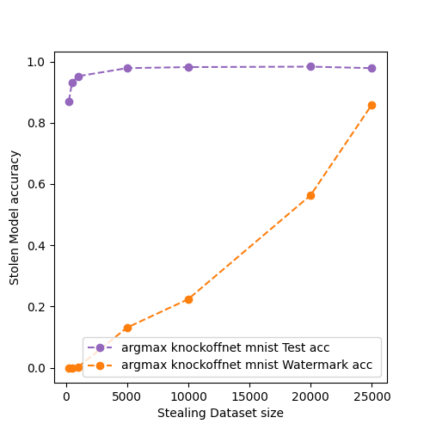
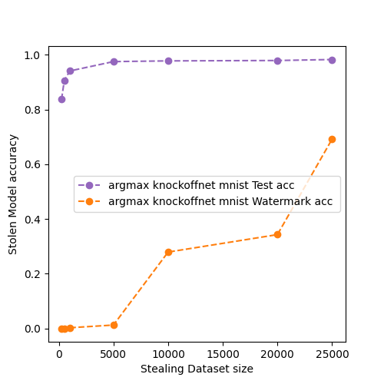
Experiments : EWE ON REAL MODEL STEALING ATTACK - Knockoffnet
MNIST: 2-convolution blocks with dropout -0.5 (low capacity model) [same model victim and adversary]
Black box model – 3 convolution blocks with dropout – 0.5 [victim same as above]
Model Stealing Without EWE (No. of epoch = 10)
Model Stealing With EWE
(No. of epochs = 10)
Model Stealing With EWE
(No. of epochs = 10), Blackbox setting
07/28/2023
internal

Slide 9
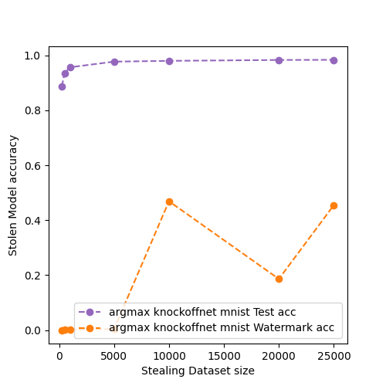
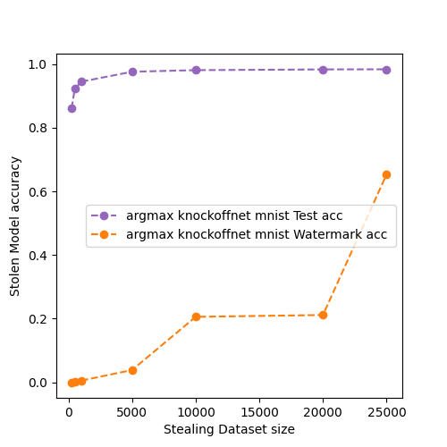
Experiments : EWE ON REAL MODEL STEALING ATTACK - Knockoffnet
MNIST: 2-convolution blocks with dropout -0.5(low capacity model) [same model victim and adversary]
Black box model – 3 convolution blocks with dropout – 0.5 [victim same as above]
Model Stealing With EWE
(No. of epochs = 50)
Model Stealing With EWE
(No. of epochs = 50), Blackbox setting
07/28/2023
internal

Slide 10
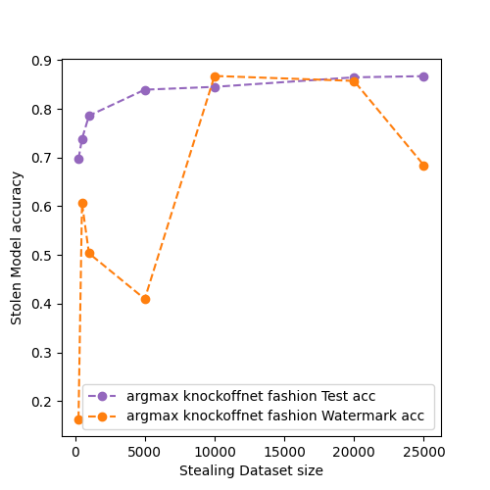
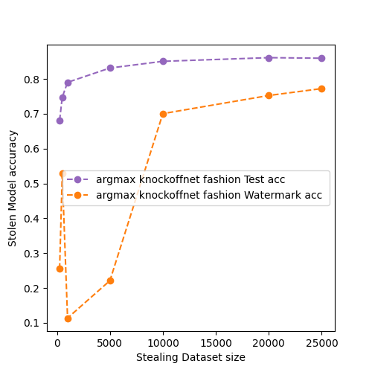
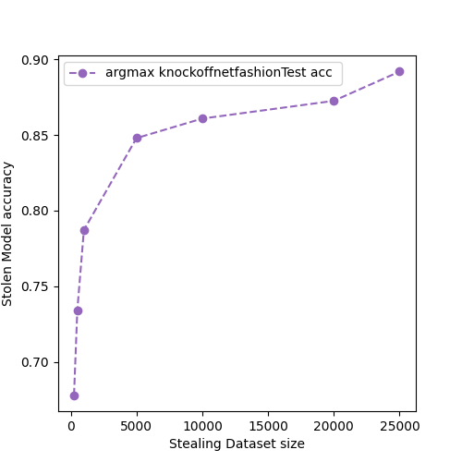
Experiments : EWE ON REAL MODEL STEALING ATTACK - Knockoffnet
FASHION MNIST: 2-convolution blocks with dropout -0.5(low capacity model) [same model victim and adversary]
Black box model – 3 convolution blocks with dropout – 0.5 [victim same as above]
Model Stealing Without EWE (No. of epoch = 10)
Model Stealing With EWE
(No. of epochs = 10), Blackbox setting
Model Stealing Without EWE (No. of epoch = 10)
Model Stealing With EWE
(No. of epochs = 10)
07/28/2023
internal

Slide 11
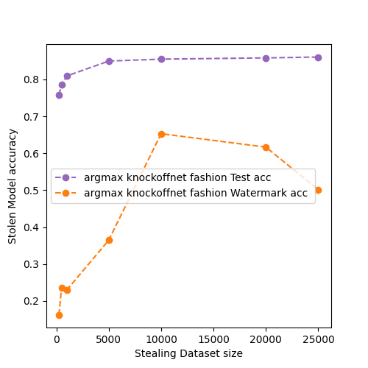
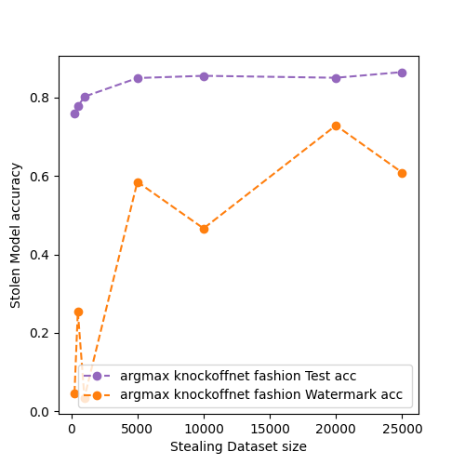
Experiments : EWE ON REAL MODEL STEALING ATTACK - Knockoffnet
FASHION MNIST: 2-convolution blocks with dropout -0.5(low capacity model) [same model victim and adversary]
Black box model – 3 convolution blocks with dropout – 0.5 [victim same as above]
Model Stealing With EWE
(No. of epochs = 50)
Model Stealing With EWE
(No. of epochs = 50), Blackbox setting
07/28/2023
internal

Slide 12
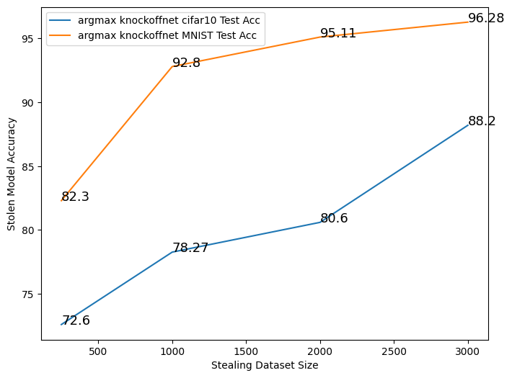
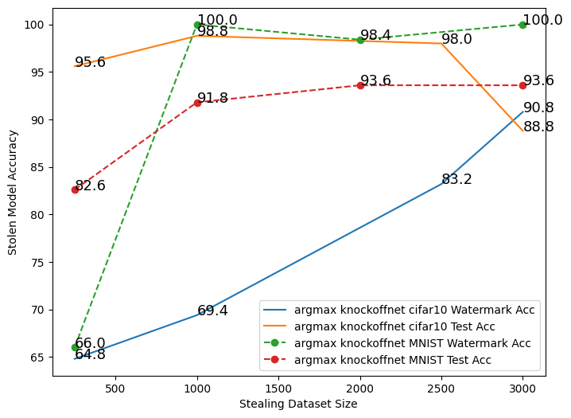
Experiments : DAWN for comparision
Same model architecture of the adversary and victim model but not parameters(hyperparameters)
Model Stealing Without DAWN (No. of epoch = 50)
Model Stealing After DAWN
(No. of epochs = 50)
CIFAR10 : ResNet 34 model architecture
MNIST: 3-convolution blocks with dropout -0.5

Slide 13
EWE on Trained model APPROACHES
Model (trained on task, without watermark)
Model (trained on task, without watermark)
Model (trained on task, without watermark)
Same model architecture (transfered weights)
Different model architecture (take input from above model)
Different model architecture (take input from above model)
Model training with watermarking
Model training with watermarking on new model only.
Model training with watermarking keeping some layers unfreezed of base model.
Tranfering weights
Finetuning with all layers freezed
Finetuning with some layers freezed
07/28/2023
internal

Slide 14
Experiments : EWE ON trained model
Dataset (EWE Model) | Method | Distribution for Watermark | Victim (Validation) | Victim (Watermark) | Extracted (Validation) | Extracted (Watermark) | Original Model | Original Model Accuracy
MNIST (EWE_feature_extract_Keras) | Finetuning | out | 0.989 | 1.00 | 0.989 | 0.61 | Plain_2_conv_Keras | 0.989
MNIST (EWE_Plain_2_conv) | Transfering weights | out | 0.989 | 1.00 | 0.988 | 0.697 | Plain_2_conv | 0.989
FASHION MNIST (EWE_feature_extract_Keras) | Finetuning | out | 0.898 | 1.00 | 0.89 | 0.828 | Plain_2_conv_Keras | 0.911
FASHION MNIST (EWE_2_conv) | Transfering weights | out | 0.897 | 1.00 | 0.891 | 0.857 | Plain_2_conv | 0.905
Training Victim with 50 epochs, extracted model with 20 epochs, original model w
07/28/2023
internal

Slide 15
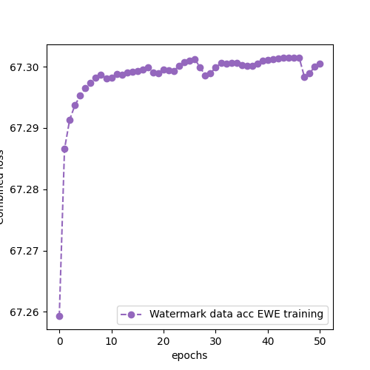
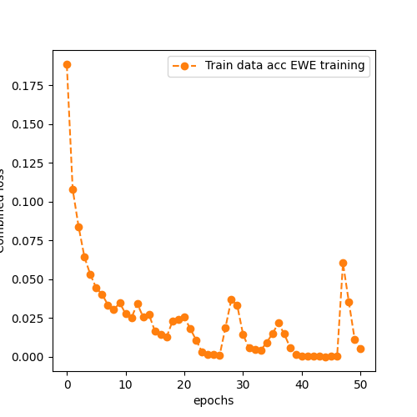
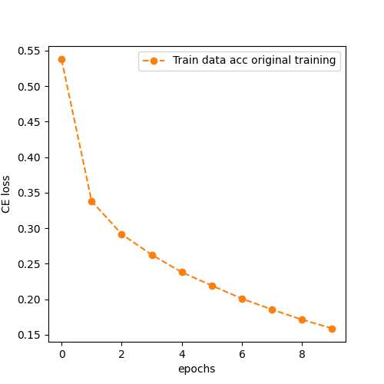
Experiments :EWE on trained model
Experiments :EWE on trained model
FASHION MNIST (EWE_feature_extract_Keras)
07/28/2023
internal

Slide 16
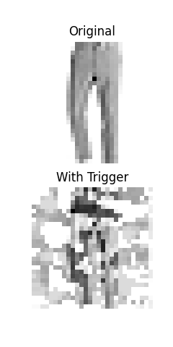
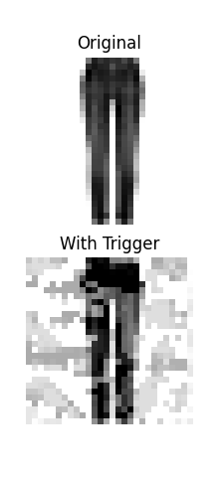
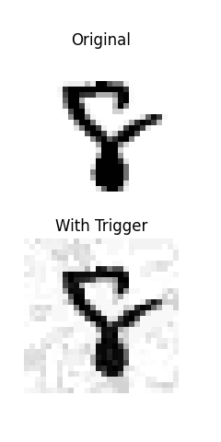
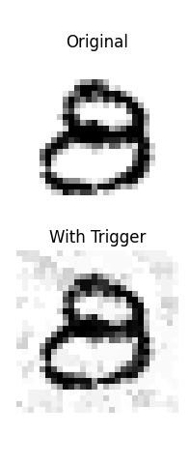
Experiments : Trigger on trained model
MNIST (EWE_feature_extract_Keras)
FASHION MNIST (EWE_feature_extract_Keras)
07/28/2023
internal

Slide 17
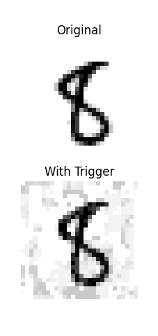
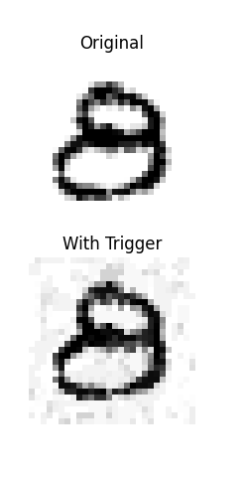
Experiments : Trigger on trained model
FASHION MNIST (EWE_2_conv)
07/28/2023
internal

Slide 18
Experiments : HYPERPARAMETERS in ewe
Hyperparameters | MNIST | FASHION MNIST
temperatures | [1,1,1] | [1,1,1]
factors | [32, 32, 32] | [32, 32, 32]
Source_class | 1 | 8
Target class | 7 | 1
lr | 0.001 | 0.001
W_lr | 0.01 | 0.01
06/02/2023
internal

Slide 19
FINAL EXPERIMENT RESULTS OVERVIEW
Datasets – MNIST (FASHION MNIST), CIFAR10
Models – 2/3 layer ConvNet (with and without dropout), DenseNet, ResNet
Dataset (Model architecture) | Defense Method | Model without defense |  | Model with defense (scratch) |  |  |  | Model with defense (finetuning)
 |  | Acc_{test} | Acc_{w} | Victim Model |  | Adversary Model |  | Victim Model | Adversary Model
 |  |  |  | Acc_{test} | Acc_{w} | Acc_{test} | Acc_{w} | Acc_{test} | Acc_{w}
MNIST (2-Conv) | DAWN
CIFAR10 (DenseNet) | EWE

Slide 20
NEXT Steps AND Discussion
Results with CIFAR 10 dataset and ReSNet and DenseNet model.
EWE for the watermark removal techniques – Pruning, Finepruning, Neural Cleanse
Real model stealing attacks on watermark embedding with finetuning.
Finetuning on CIFAR 10 dataset.
Which method to pick next?
06/02/2023
internal

Slide 21
06/02/2023
internal

