Slide 1
Master Thesis: Defense Techniques
for Model Extraction Attacks on Deep
Learning Models
Second Round Discussion
Ridhima Garg (sa46jiza)
Supervisors
Prof. Dr. Christian Riess (FAU, Department of Computer Science)
Mr. Yannick Möll (ITK Engineering GmbH, Data-Driven Software and Sensors)

Slide 2
RECAP: Dawn
No changes to training process
GOAL: Dynamically watermark fraction of queries (changing prediction responses)
F_{v}
K_{w}
F_{v}
K_{w}
𝑊_{V}(𝑥) = 0
Or
𝑊_{V}(𝑥) = 1
SHA(K_{w}, x_{i})
f(K_{w}, F_{v(xi)})
𝐵_{V}(𝑥)
F_{A}
F_{A}
x_{i}
x_{i}
K_{w} is model specific key
X_{i} is the query sent by adversary to victim model
SHA is the 256 hash key
f is pseudo random perturbation function
internal

Slide 3
Dawn: CHALLENGES
Adversaries can select the training data or manipulate the training process to resist the embedding of watermarks
Indistinguishability : subtle modification 𝛿 to 𝑥 leads to 𝑊_{V}(𝑥) ≠𝑊_{V}(𝑥 + 𝛿)
Different mapping (watermark or non-watermark) but same prediction (label)
Same mapping (both samples[original and perturb] either watermark or non-watermark) but same prediction (label)
Different prediction irrespective of mapping
Mapping Algorithm for Indistinguishability
𝑊_{V}(𝑥): should the response to 𝑥 be watermarked?
𝛿 is the perturbation level
06/02/2023
internal

Slide 4
Experiments : perfect attacker
Model | After 500 Epoch (watermark) | After 500 Epoch (test)
cifar10 (3 conv block, weight decay = 3e^-4) | 23.2 | 58.17
cifar10 (3 conv block, dropout = 0.3) | 82 | 84.56
cifar10 (3 conv block, dropout=0.5) | 60.4 | 84.21
MNIST base l5 (3 conv block) | 99.6 | 99.18
MNIST l5 (3 conv block dropout = 0.3) | 13.2 | 11.35
MNIST l2 (2 conv block 3L) | 13.2 | 11.35
Low capacity models (500 training epochs, watermark size = 250)
Conclusion
Acc_{wm} is low for some models (MNIST-base 3L, MNIST %L (DO)) but at the same time test accuracy is low which claims Adversary is unusable.
Regularization prevents embedding of the watermark in some cases MNIST-5L but also reduced the test accuracy
06/02/2023
internal

Slide 5
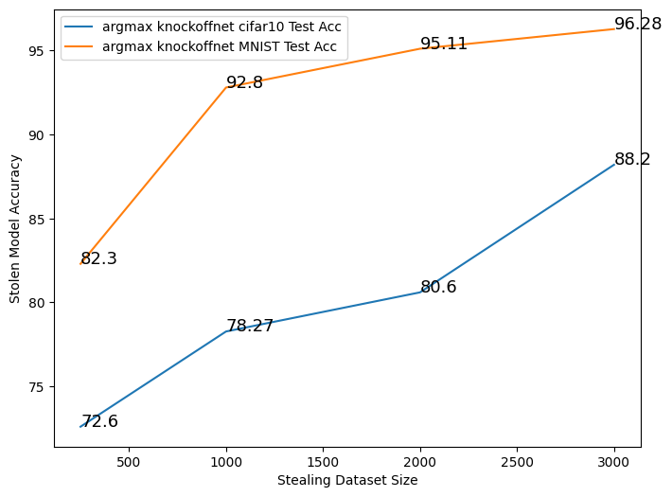
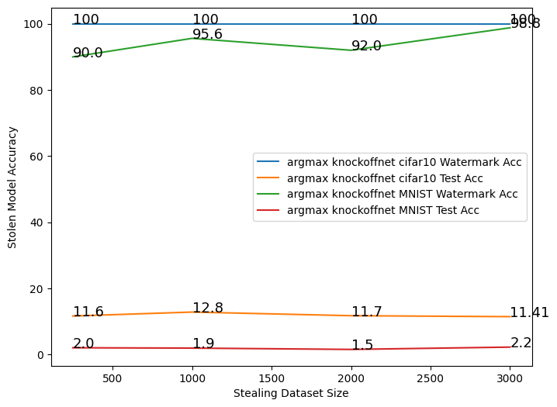
Experiments : DAWN ON REAL MODEL STEALING ATTACK - Knockoffnet
Same model architecture of the adversary and victim model but not parameters(hyperparameters)
CIFAR10 : ResNet 34 model architecture (high capacity model)
MNIST: 3-convolution blocks with dropout -0.5(low capacity model)
Model Stealing Without DAWN (No. of epoch = 50)
Model Stealing After DAWN
(No. of epochs = 50)
06/02/2023
internal

Slide 6
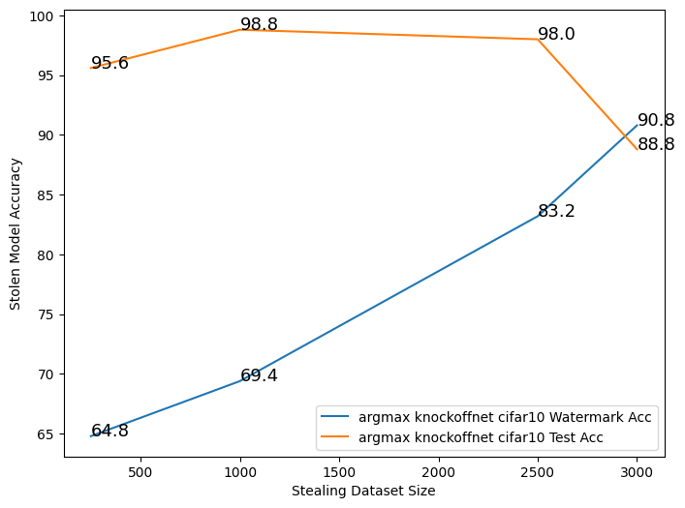
Experiments : DAWN ON REAL MODEL STEALING ATTACK - Knockoffnet
Same model architecture of the adversary and victim model but not parameters(hyperparameters)
CIFAR10 : ResNet 34 model architecture (high capacity model)
MNIST: 3-convolution blocks with dropout -0.5(low capacity model)
Model Stealing Without DAWN (No. of epoch = 50)
Model Stealing After DAWN
(No. of epochs = 50)
06/02/2023
internal

Slide 7
Experiments : WATERMARK REMOVAL
MAPPING : Algorithm for Indistinguishability
Create latent embeddings as an autoencoder
Embedding created - middle layer of the victim model
Binarizing latent representation – results in medians of each feature
Perform Mapping
Dataset | Noise level | Latent Representation Size | Same Label and Same mapping | Same Label and Different Mapping | Different Label
CIFAR10 | 0.2 | 512 | 94.55 | 5.44 | 35.89
CIFAR10 | 0.2 | 10 | 100.0 | 0 | 35.79
CIFAR10 | 0.1 | 512 | 95.67 | 4.32 | 13.47
CIFAR10 | 0.1 | 10 | 100 | 0 | 13.59
CIFAR10 | 0.09 | 512 | 95.85 | 4.149 | 11.80
CIFAR10 | 0.09 | 10 | 100 | 0 | 11.74
CIFAR10 | 0.075 | 512 | 96.06 | 3.93 | 9.33
CIFAR10 | 0.075 | 10 | 100 | 0 | 9.337
Mapping Results for CIFAR10
06/02/2023
internal

Slide 8
Experiments : WATERMARK REMOVAL
pruning
Adversary attempt to prune the model by setting random weights of the model to zero.
Before Pruning on CIFAR10
Test set accuracy- 60.95
Watermark set accuracy- 71.17
Dataset | Pruning level | After Pruning (test) | After Pruning (watermark)
CIFAR10 | 0.01 | 60.94 | 71.33
CIFAR10 | 0.05 | 60.96 | 71.17
CIFAR10 | 0.1 | 60.83 | 70.69
CIFAR10 | 0.25 | 59.83 | 70.20
CIFAR10 | 0.4 | 48.45 | 54.91
CIFAR10 | 0.5 | 44.96 | 16.58
CIFAR10 | 0.75 | 10.0 | 16.26
CIFAR10 | 0.9 | 10.0 | 11.43
Pruning results with different pruning level
06/02/2023
internal

Slide 9
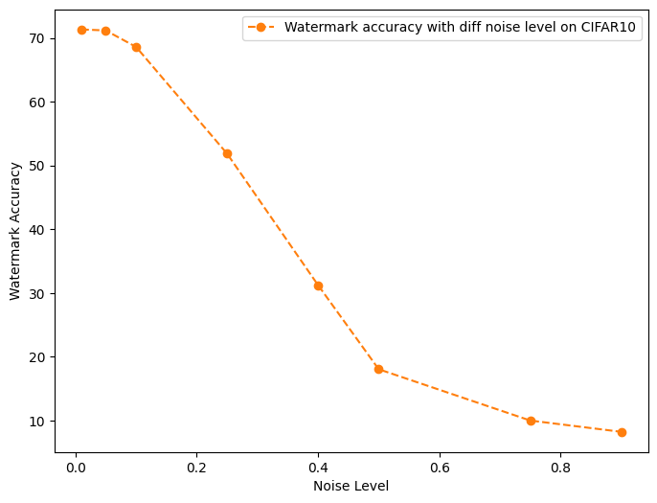
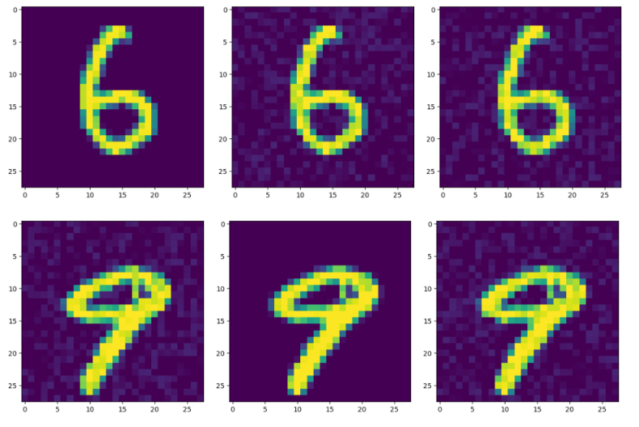
Experiments : WATERMARK REMOVAL
NOISE VERIFICATION
Adversary attempt to inference victim model with noisy samples.
Without Noise on CIFAR10
Watermark set accuracy - 71.17
Noisy watermark data accuracy with different noise level
06/02/2023
internal

Slide 10
RECAP: ConClusion
DAWN worked fine for Watermark removal techniques
Real Model stealing attacks is also working fine now
06/02/2023
internal

Slide 11

EWE : Entangled watermarking
Defense Technique for Model Extraction Attacks
Invasive: Changes to training process
GOAL: Leverage the soft nearest neighbor loss to entangle representations extracted from training data and watermark data
Overcomes the limitation of watermarked models roughly split their parameter set into two subsets, the first encodes the task distribution while the second overfits to the watermarks
Assumptions about adversary
Has knowledge of the training data used to train the victim model
Knows the architecture of the victim model
Has knowledge that watermarking is deployed but not what kind of watermarking as defense
06/02/2023
internal

Slide 12
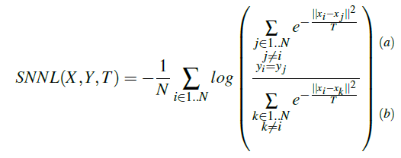
EWE : Soft nearest neighbor loss (SNNL)
Measures the entanglement between representations learned by the model for both task and watermarked data.
Compares intra - to inter-class distances.
Entanglement: Points from different groups are closer than average distance between two points
Temperature (T) gives more or less emphasis on smaller distances (small temperatures) or larger distances (high temperature)
X, Y are pairs of (input data images, labels)
T: temperature parameter.
06/02/2023
internal

Slide 13

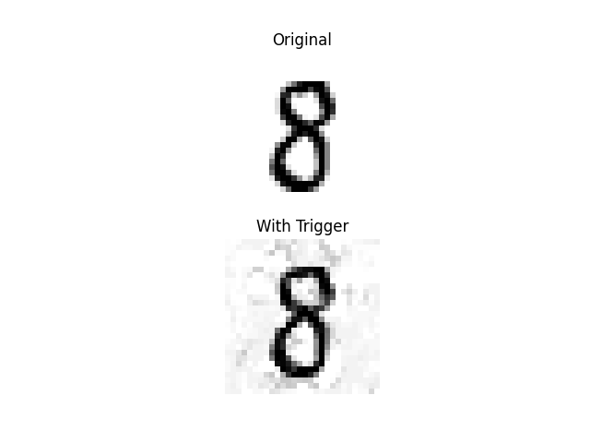


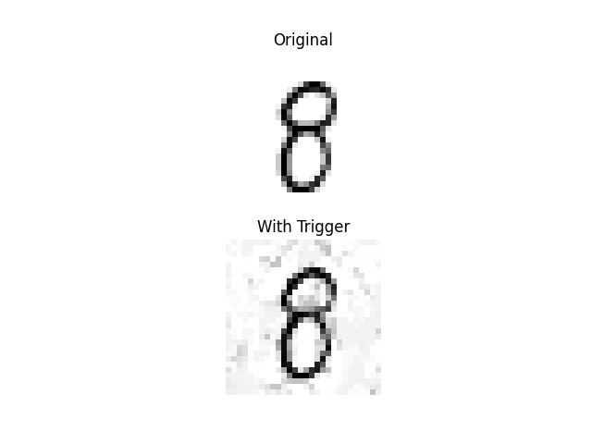

EWE : Entangled watermarking Algorithm
Create watermark set
Compute the trigger positions for the watermark samples
Train the model to have the special behavior that it classifies watermarked sample (x_{w}) as semantically different target class (c_{t})
Create watermark set
(in and out distribution, one target class, one source class)
Compute the trigger position
Modify the Loss function
(Compute SNNL and sum across all layers)
Training model (watermark + train set) (soft nearest neighbor + cross entropy)
Argmax(conv(grad_{Xw}(SNNL([X_{w};X_{cT} ];Y;T))))
Cross_enrtopy - SNNL
Watermark set
With label = t-shirt
06/02/2023
internal

Slide 14
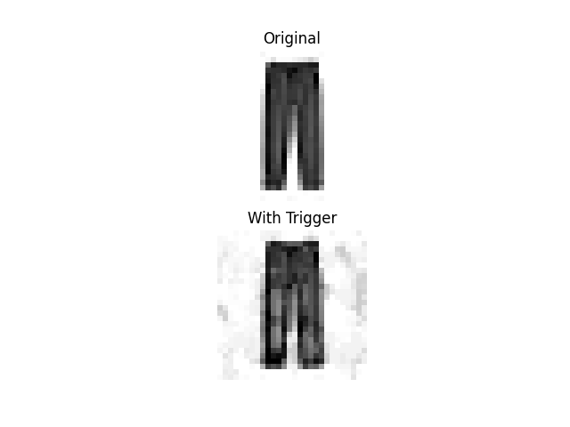
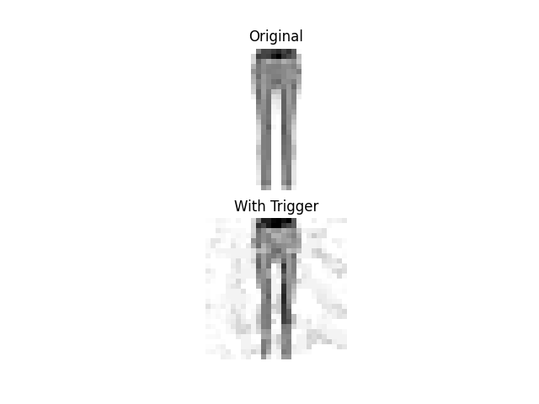
EWE : Trigger Generation
06/02/2023
internal

Slide 15
Experiments : ROBUSTNESS AGAINST EXTRACTION in white box setting
Dataset | Method | Distribution for watermark | Victim (Validation) | Victim (Watermark) | Extracted (Validation) | Extracted (Watermark)
MNIST (2-conv) | Baseline | out | 0.98 | 1.00 | 0.98 | 0.01
 | EWE | out | 0.98 | 1.00 | 0.98 | 0.75
FASHION MNIST (2-conv) | Baseline | out | 0.84 | 1.0 | 0.84 | 0.92
 | EWE | out | 0.90 | 0.99 | 0.89 | 0.78
FASHION MNIST (RESNET) | Baseline | out | 0.45 | 1.00 | 0.46 | 0.98
 | EWE | out | 0.88 | 0.95 | 0.87 | 0.27
CNN models (50 training epochs) Baseline model (trains with cross entropy only)
Conclusion
Acc_{wm} is always high for EWE models except for the RESNET (high capacity model), residual connections pose a greater problem for entanglement because there are often no shared features.
Baseline is performing better than EWE in some cases.
06/02/2023
internal

Slide 16
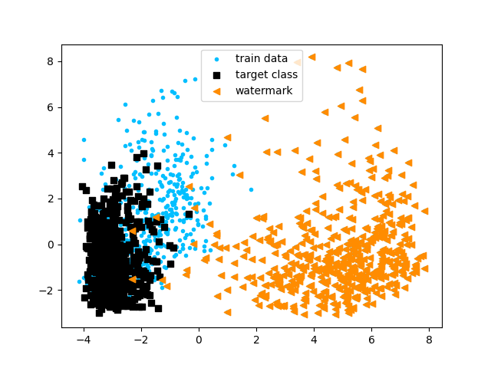
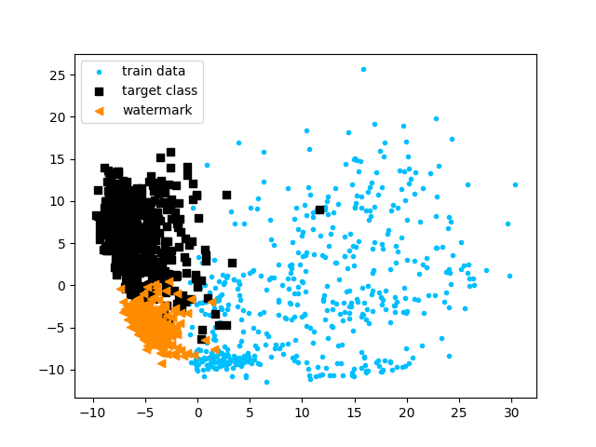
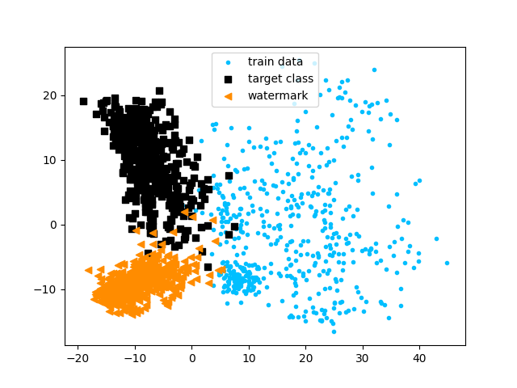
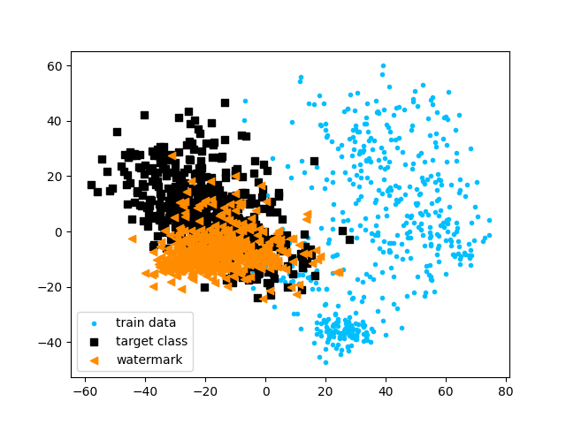
Experiments : Visualization of entanglement
Before training
During training
After training
Baseline MNIST Out distribution (FASHION MNIST), watermark class 1, target class 7
EWE MNIST Out distribution (FASHION MNIST)
PCA is used to project representations of model’s penultimate layer onto its two principal components
06/02/2023
internal

Slide 17
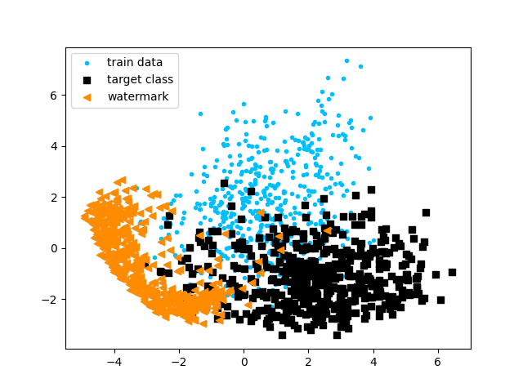
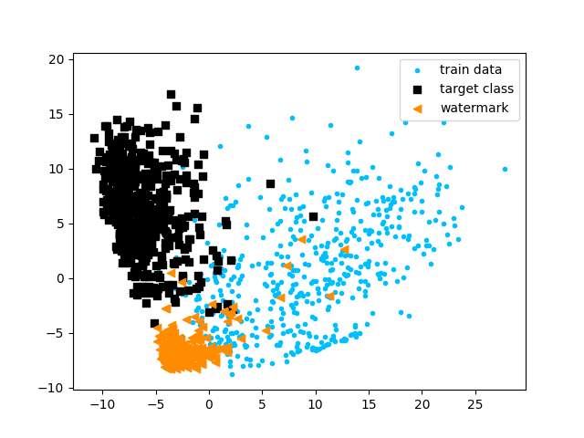
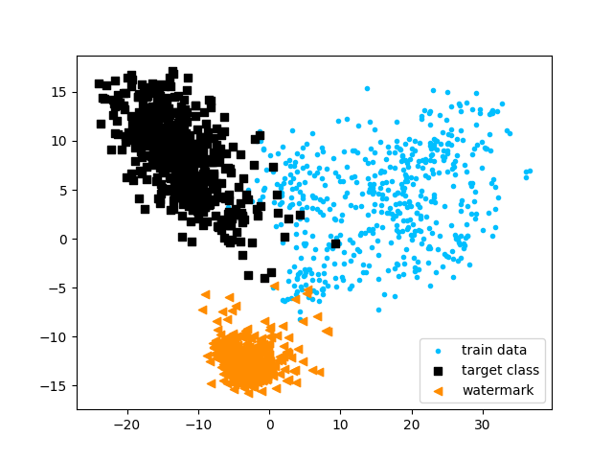
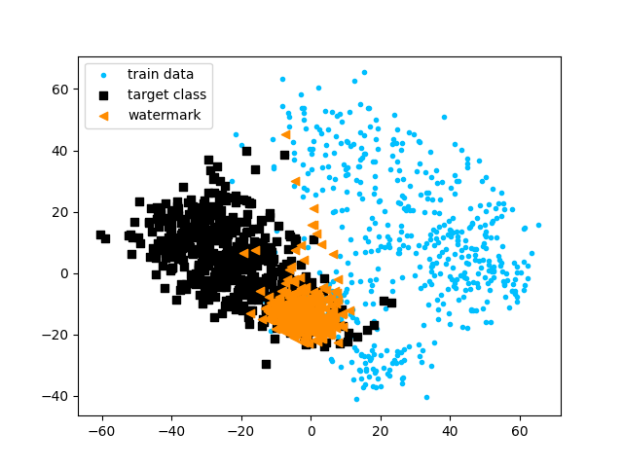
Experiments : Visualization of entanglement
Before training
During training
After training
Baseline MNIST In distribution, watermark class 1, target class 7
EWE MNIST In distribution, watermark class 1, target class 7
06/02/2023
internal

Slide 18
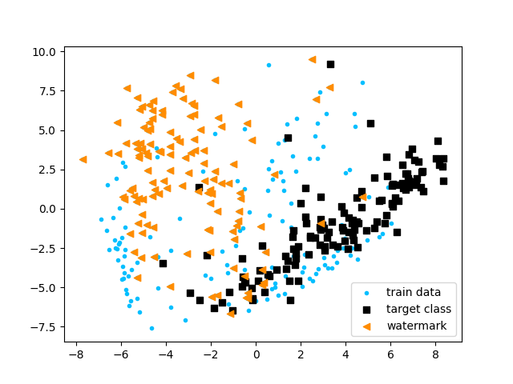
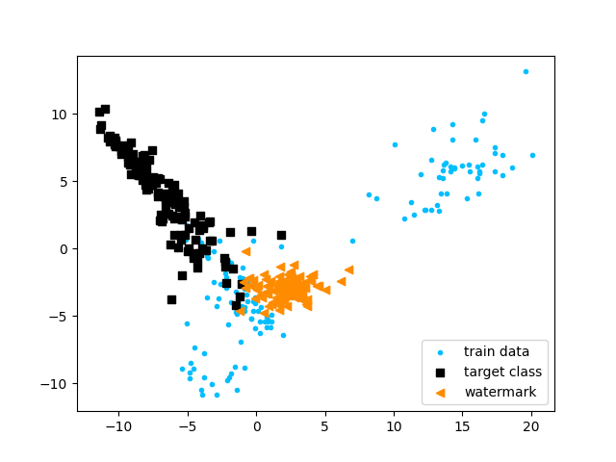
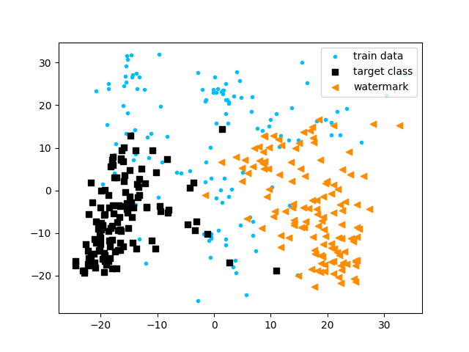
Experiments : Visualization of entanglement
Before training
During training
After training
Baseline FASHION MNIST In distribution, watermark class 8, target class 0
EWE FASHION MNIST In distribution, watermark class 8, target class 0
06/02/2023
internal

Slide 19
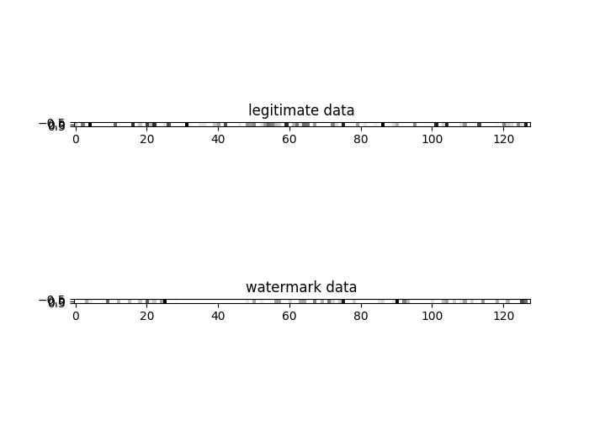
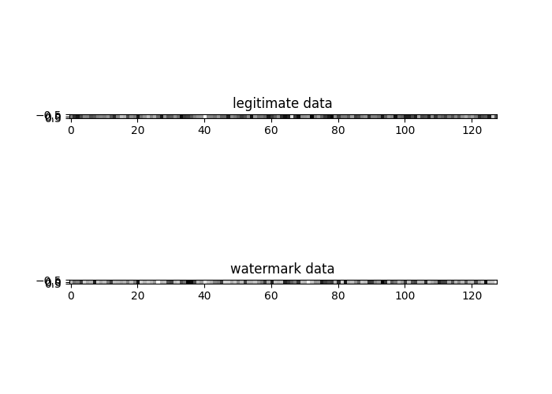
Experiments : activation patterns
EWE encourages activation pattern for legitimate task and watermark task to be similar.
Watermark robust to model extraction attacks.
Baseline approach has distinct activation pattern - original task and watermark task.
Fewer neurons are activated for watermark task in baseline as this task is easier than original classification task
Left image: Activation of neurons of last FC layer using Baseline, Right image: using EWE over MNIST for both legitimate and watermark data (out distribution)
Conclusion
More neurons are activated (black – higher intensity) during EWE method
EWE has more similar activation of neurons for both legitimate and watermark data
06/02/2023
internal

Slide 20
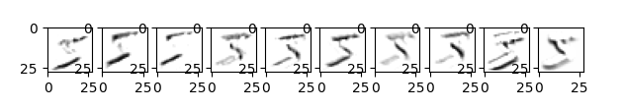
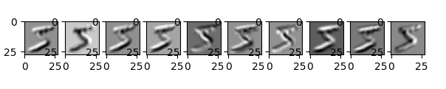
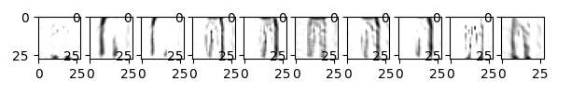
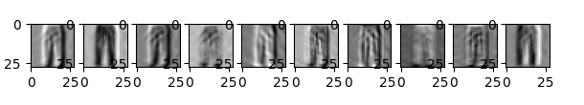
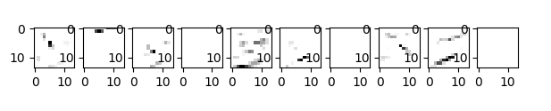
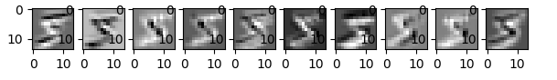
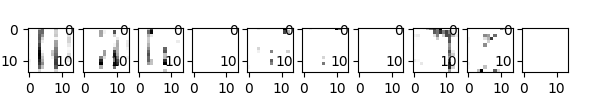
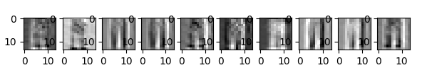
Experiments : SCALABILITY to deeper architectures
First convolution layer: legitimate data
First convolution layer: legitimate data
First convolution layer: watermark data
First convolution layer: watermark data
Second convolution layer: legitimate data
Second convolution layer: legitimate data
Second convolution layer: watermark data
Second convolution layer: watermark data
BASELINE: Activation of watermarked and legitimate data is
more significant
EWE: High frequency of activations for neurons.
Entangling legitimate and watermark data, representations become similar as we go deeper in the architecture.
06/02/2023
internal

Slide 21
NEXT Steps AND Discussion
How EWE work for black-box (real model stealing) attacks
EWE for the watermark removal techniques
Handling research question -:
Making the comparison of the watermarking removal techniques with DAWN
Comparison of EWE for model trained from scratch (already done) with EWE on trained model with finetuning
Why Baseline is working better than EWE sometimes – debugging
Organizational
Session in Prof’s Christian research group.
06/02/2023
internal

Slide 22
06/02/2023
internal

