Slide 1




SMART INDIA HACKATHON 2026
TITLE PAGE
Problem Statement ID – SIH26214
Problem Statement Title-Student Innovation
Theme-Agriculture, FoodTech & Rural Development
PS Category- Hardware
Team ID-
Team Name - RANG

Slide 2
PROJECT RANG
RANG
PROBLEM
SOLUTION
Artisan Marginalization
Rural women have skills but lack access to high-end, modern global markets.skills but lack access to high-end, modern global markets.
Economic Empowerment (The "Who")
Transforming homemakers into entrepreneurs by upskilling them in design and financial literacy, turning "latent talent" into a steady income stream.
Outsourced sustainable banana-fibre fabrics
Low-risk, fast market entry
Paint-to-order, low waste
Fair & direct payments to women
Story tag with every product
Initial Stage
The Market Gap
Conscious consumers are stuck between overpriced luxury and low-quality mass production, with no affordable ethical alternative.
Affordable Sustainability (The "Why")
Bridging the market gap by offering eco-friendly, hand-painted products at competitive prices, making ethical fashion accessible to everyone.
Circular banana-based system
Banana pulp will be used to make biodegradable packaging
It is Plastic-free, low-cost packaging
We will outsource the fabric making process and then extract pulp from the fibres to make the tags and packaging.
Later Stage
Environment
Traditional cotton is water-intensive and the industry needs a sustainable alternative.
Direct Market Linkage (The "How")
Eliminating middlemen through a Direct-to-Consumer (D2C) model, ensuring that 60-70% of the profit margin goes directly back to the women artisans.
DIRECT CONNECT
FAIR INCOME
PAINT TO ORDER
@SIH Idea submission- Template
2
Notes:
2

Slide 3
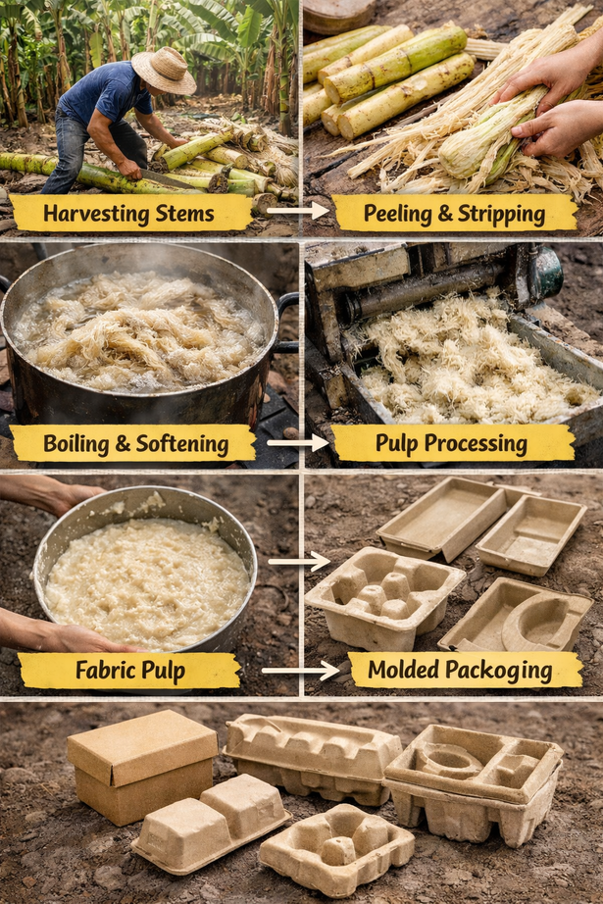
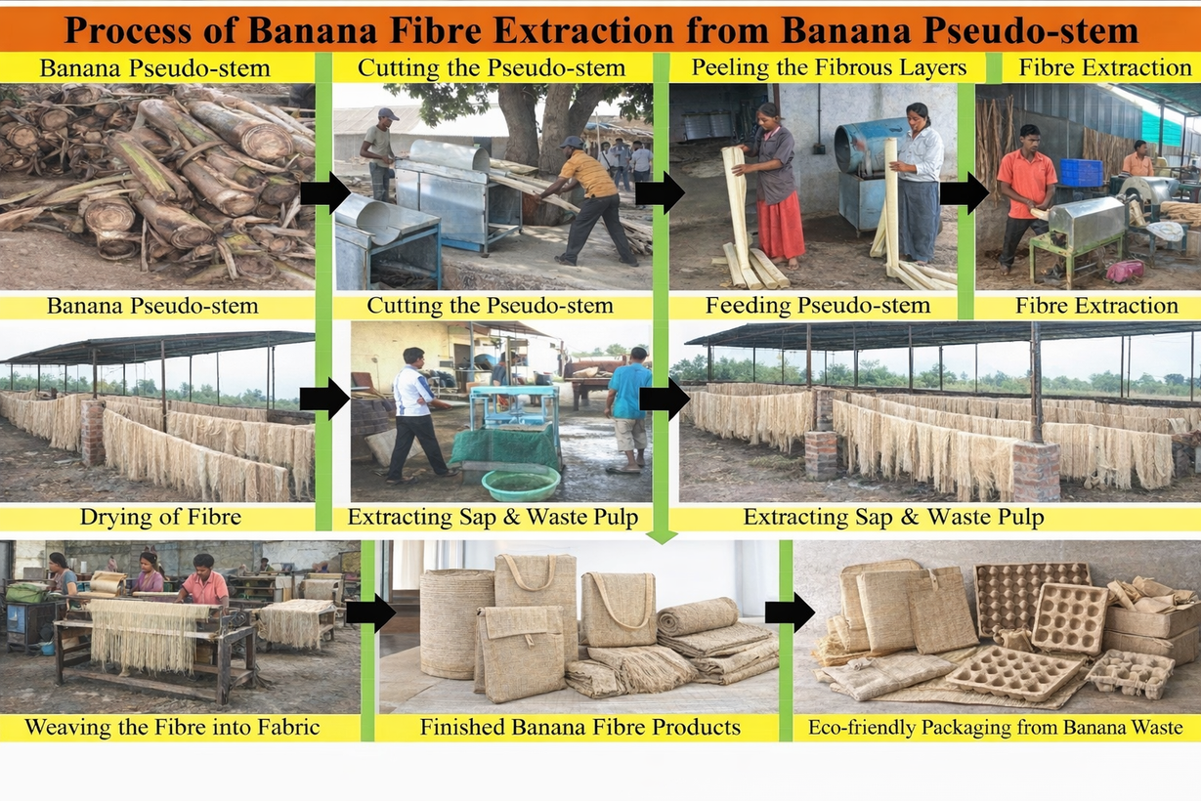
RANG
TECHNICAL APPROACH
Banana stems are processed to provide fibres for making fabric. To crush the pseudostem we will use sugarcane crushers which are cheaper and readily available.
The leftover bananas are pulped and processed, rather than discarding them.
Pulp is processed into packaging material like trays and boxes.
It becomes biodegradable and plastic packaging afterwards.
One banana stem → fabric + zero-waste packaging
CENTRAL CORE (10-15%)
OTHER INDUSTRIES SUCH AS CANDY,PICKLE
BANANA FIBRE(1.5-2%)
USED FOR MAKING BANANA FABRIC FOR TOTE BAGS,BEDSHEETS ETC.
BANANA PSEUDO STEM
WASTE MATERIAL (85-90%)FABRIC PULP
USED FOR MAKING THE PACKAGING
Process of making fabric and packaging from banana pseudo stem
Making packaging from pulp
The banana pseudo-stem is cut and processed to take out the fibers.
After extraction, the fibres are washed, dried, and then spun into yarn.
Yarn is given a weave to make banana fibre fabric.
The residual waste pulp is then utilized in making biodegradable packaging.
@SIH Idea submission- Template
3
Notes:
3

Slide 4

FEASIBILITY AND VIABILITY
RANG
RISK VS SOLUTION
Feasibilty
Technical: Banana pulp produces packaging 3x stronger than wood pulp with superior tear resistance.
Operational: 100% circular model; leftover pulp from textile extraction directly feeds into packaging molds.
Economic: Banana pulp is significantly more cost-effective to produce than traditional plastic or paper packaging.
Risk
Solution
High setup cost for Pulp Lab machinery. | Outsource pulp processing in the initial stage; reinvest early profits to build in-house capacity.
B2B doubts about packaging strength. | Lead marketing with certified data showing it is "3x stronger than wood pulp".
Inconsistent raw stem collection. | Partner with established NGO networks (like Goonj) for steady, rural supply chains.
Production waste management. | Zero-waste lifecycle: all stem remnants and fabric offcuts are repurposed into packaging.
1
1
Scalability
Challenges
2
Integrated Craft Hubs: Setting up dual wings: one for textiles, one dedicated to pulp-molded packaging.
In-House Pulp Lab: Phasing out third-party sourcing to produce 100% of packaging in-house.
Bio-Plastics: Developing banana-peel starch into compostable, transparent protective sleeves.
•Initial Setup Cost: High capital required to eventually build an in-house pulp molding lab.
Durability Doubts: Convincing B2B buyers that bio-packaging matches plastic's strength.
Transport Logistics: Efficiently transporting heavy, wet pseudo-stems from farms to processing units.
2
3
Viability
Vast Raw Material: India generates ~30M tons of pseudo-stem waste annually, providing near-free raw material.
Proven Model: Similar banana-fibre businesses (e.g., Musa Pacta) process 12-13 tons/month profitably.
B2B Expansion: Huge potential to sell our low-cost banana pulp packaging directly to other businesses (B2B).
3
4
@SIH Idea submission- Template
4
4
Notes:
4

Slide 5

IMPACT AND BENEFITS
RANG
Before
During
After
Skill upgradation & quality training
Access to raw materials & tools
Clear product standards & timelines
Fair pricing structure introduced
Stable monthly income (₹8,500–₹9,000)
18–22 working days per month
Direct payments with transparency
Ability to price work independently
Environmental Sustainability
Social
Sustainability
Economic Sustainability
Informal skill
Middlemen dependent
Low confidence
Less financial knowledge
Work seen as hobby
No savings or financial planning
Women-led, home-based work
Flexible hours mean increased participation.
Skill ownership-not dependency
Fair & transparent payments
Banana fabric is used
Water-based/natural dyes
Paint-to-order so nearly zero waste
Minimum packaging using banana pulp
Revenue-generating business model
Repeat-use products are there so repeat income
Profit reinvestment for scale
No reliance on donations
200% income growth
100% women paid directly
0 middlemen involvement
100% skill certification
@SIH Idea submission- Template
5
Notes:
5

Slide 6
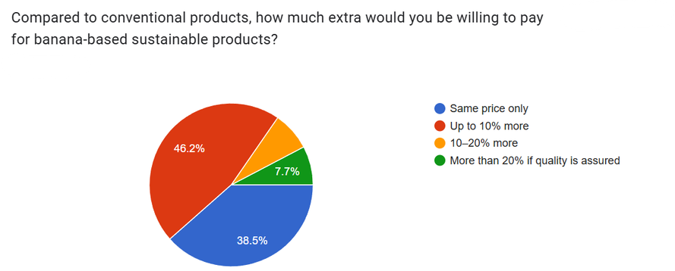
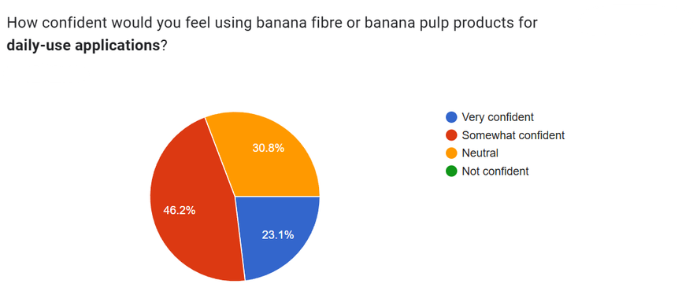
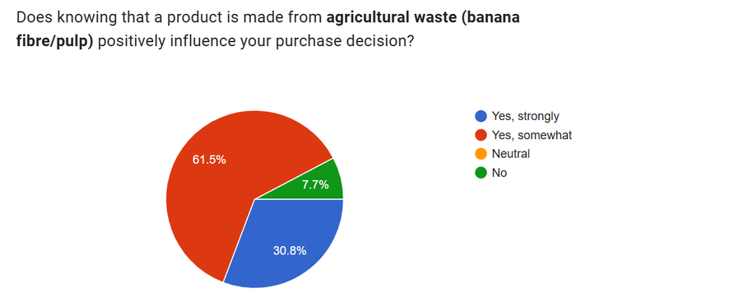
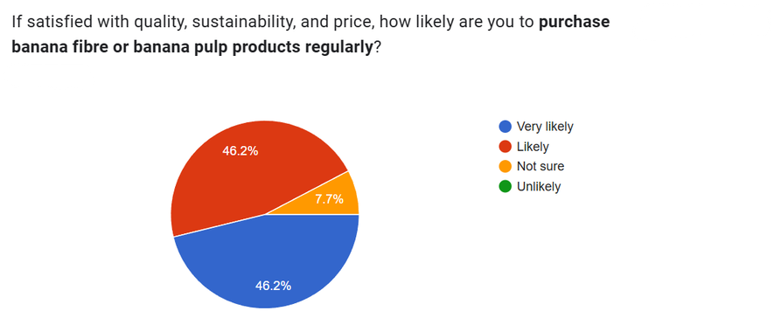
RESEARCH AND REFERENCES
RANG
SURVEY FORM LINK:
https://indjst.org/articles/banana-peel-and-potato-as-a-biodegradable-plastic
https://www.ijirset.com/upload/2020/july/141_PRODUCTION_NC.PDF
https://share.google/fKnPHKXQkVJHH39Fv
https://ajbs.scione.com/cms/fulltext.php?id=1160
https://www.scribd.com/document/420810906/Bioplastic-docx
https://www.vegetosindia.org/article/development-of-food-carrying-bio-plastic-film-from-banana-peels-starch-incorporated-with-sugarcane-bagasse-cellulose
https://www.sciencedirect.com/science/article/pii/S2666893923000877
https://www.sciencedirect.com/science/article/pii/S2949750725000422
https://www.mdpi.com/2813-0391/3/4/37
@SIH Idea submission- Template
6
Notes:
6

