Slide 1
Presented By –
Ridhima Patnala
VNR Vignana Jyothi Institute Of Engineering & Technology
STUDENT DROPOUT RISK & EDUCATION RETENTION ANALYTICS SYSTEM

Slide 2
Business Context
Student data spread across multiple academic and administrative systems
Manual analysis fails to identify at-risk students early
Lack of insights into factors contributing to student dropouts
Early identification of at-risk students enables:
  Timely academic and counseling interventions
  Improved student retention rates
  Data-driven decision-making for administrators & educators.

Slide 3
PROBLEM STATEMENT
Existing analysis methods are mostly manual or spreadsheet based
Institutions lack data-backed insights and early warning indicators.
Student dropouts are influenced by multiple factors like poor academic performance, low attendance and participation, and socio-economic challenges.

Slide 4

Project objectives
To design and build an end-to-end analytics system that identifies students at risk of dropping out
Analyze academic, attendance, and demographic patterns
Generate meaningful risk indicators and KPIs
Automate data processing and analytics workflows

Slide 5




TECHNOLOGY STACK
Data Processing
  Python – Core data processing logic
  Pandas & NumPy – Data cleaning, EDA, and feature engineering
Big Data Analytics
  PySpark – Large-scale transformations and aggregations
  Databricks – Scalable analytics and notebook execution
  Delta / CSV– Storage
Workflow Orchestration
  Apache Airflow – Pipeline orchestration and scheduling
Visualization & Reporting
  Power BI – Dropout risk and retention dashboards

Slide 6
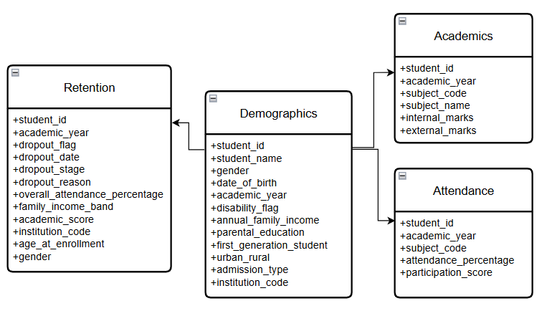
Dataset Overview
Academic Performance Data – Subject-wise marks and grades
Attendance & Participation Data – Subject-level attendance percentages and participation scores
Demographic & Socio-Economic Data –Gender, Age, Regional & Economic Attributes
Retention / Dropout Data – Historical student retention status

Slide 7
Data Preprocessing
Data Cleaning
Identification of missing and null values
Handling incomplete academic and attendance records
Removal of duplicate records
Data Standardization
Standardizing categorical values
Normalizing academic and attendance metrics
Validating student IDs and academic year formats

Slide 8
Feature Engineering
Calculation of average academic scores
Derivation of attendance-based indicators
Creation of risk-related flags and metrics:
  Academic_risk_flag = 1 if avg_academic_score<40 & failed_subject_count >=3
  Attendance_risk_flag = 1 if avg_attendance_percentage < 40 & low_attendance_subjects >=3
  Socio_economic_risk_flag = 1if income_band == 1 & first_gen_student == 1 & region = ‘RURAL’
  Age_risk_flag = 1 if age<17 & age>22

Slide 9
Architecture
Input data: CSV Files
Layered architecture (Bronze > Silver > Gold)
Separation of raw, processed, and analytics-ready data
Scalable design using Databricks and Spark
Centralized orchestration using Apache Airflow
Data-driven dashboards

Slide 10
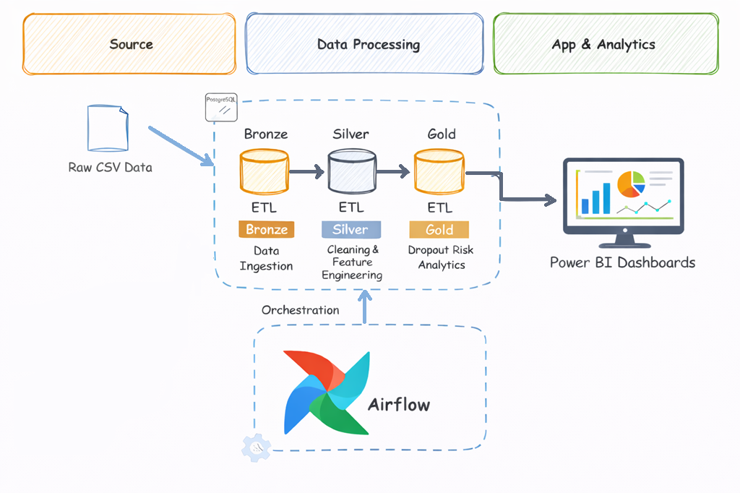
Architecture Diagram

Slide 11
PIPELINE DESIGN
BRONZE LAYER
Purpose: Data preservation and auditability
Ingest raw CSV data as-is
Preserve original schema and structure
Retain duplicates, nulls, and inconsistencies for reprocessing
SILVER LAYER
Purpose: Analytics-ready standardized data
Clean and normalize raw datasets
Handle duplicates and missing values
Standardize data types and categorical fields

Slide 12
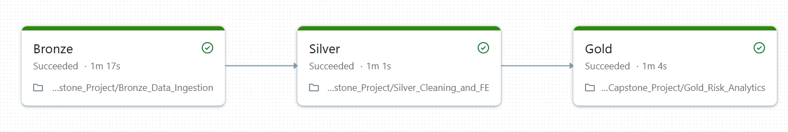
PIPELINE DESIGN
GOLD LAYER
Purpose: Business-level insights and reporting
Aggregate data at student, subject, and institution levels
Derive risk and retention indicators
Prepare optimized datasets for Power BI dashboards

Slide 13
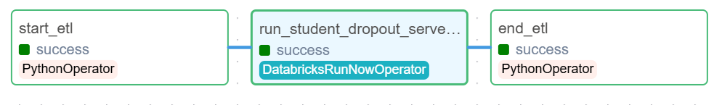
WORKFLOW AUTOMATION
Databricks Jobs used to execute analytics notebooks
Apache Airflow used for orchestration and scheduling
Airflow DAG Design
Single DAG triggering a Databricks Job
Task dependency enforced: Bronze > Silver > Gold
Centralized execution and monitoring

Slide 14
Analytics & Risk Logic
Analytical Outputs
At-risk student lists
Subject-wise and year-wise risk trends
Aggregated risk metrics for reporting
Key Risk Indicators
Low academic performance
High number of failed subjects
Low attendance percentage
Low participation score
Socio-economic attributes
Risk Evaluation Logic
Rule-based risk identification
Combination of academic and attendance factors

Slide 15
Power BI Dashboard Overview
The purpose of building dashboards is to provide a consolidated view of student data and enable data-driven decisions & early intervention support.
Data Source - Gold layer tables
Use Cases Addressed:
  Identify At-Risk Students
  Attendance vs Academic Performance
  Subject-wise Risk Analysis
  Retention & Dropout Trends

Slide 16
Results & Insights
Students with consistently low attendance show higher dropout risk
Poor academic performance strongly correlates with dropout indicators
Certain subjects, institutions and academic years exhibit higher risk patterns
Certain socio-economic indicators like low income bands and first generation students show higher risk rates.

Slide 17
Conclusion
Integrated data ingestion, processing, analytics, and visualization into a single system
Provide actionable insights through Power BI dashboards
Future enhancements include predictive machine learning models for dropout probability, automated alerts and intervention recommendation systems.

Slide 18
THANK YOU
Ridhima Patnala
VNR Vignana Jyothi Institute of Engineering & Technology

