Slide 1

Mutual Fund Analytics Platform
Bluestock Fintech Data Analyst Internship | Project Presentation Ridhi M. Jain

Slide 2
Problem & Objective
Problem
Mutual fund data is available across different datasets.
Organising and comparing this information can be challenging.
Objective
Prepare and analyse mutual fund data.
Build an interactive dashboard to explore trends and performance.

Slide 3
Data Sources
Tools used
Python and Pandas
SQLite and SQL
Power BI
Datasets
Fund master and NAV data
AUM and fund performance
SIP inflows and folio counts
Investor transactions and holdings
Benchmark index data
Some NAV observations are simulated, and investor transaction data is synthetic.

Slide 4
Project Architecture
01 EXTRACT
Read source CSVs and supplied datasets
02 TRANSFORM
Parse dates, check duplicates, validate values, standardise fields
03 LOAD
Store prepared data in SQLite tables
04 ANALYSE
Use SQL queries and Python notebooks
05 VISUALISE
Present findings in Power BI

Slide 5
EDA Highlights - Industry Trends
Findings describe the prepared project dataset—not the entire industry.
Highest AUM
SBI MF
Highest displayed AUM in the 2025 comparison.
Highest SIP Inflow
₹31,002 Cr
December 2025.
Folio Growth
+97%
13.26 Cr to 26.12 Cr folios.

Slide 6
EDA Highlights - Investor & Holdings Insights
Findings describe the prepared project dataset—not the entire industry.
Most Frequent Transaction
19,716
SIP transaction records.
Daily Return Correlations
−0.39 to 0.68
Range for selected funds.
Sector Weight
Banking
Largest summed sector weight in the available holdings records.

Slide 7
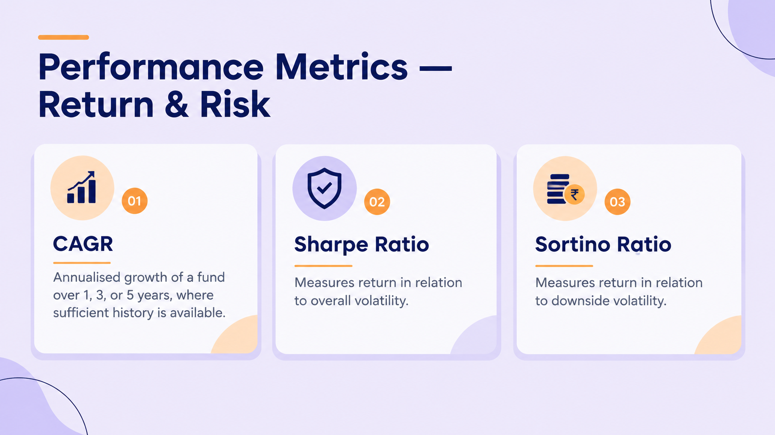

Slide 8
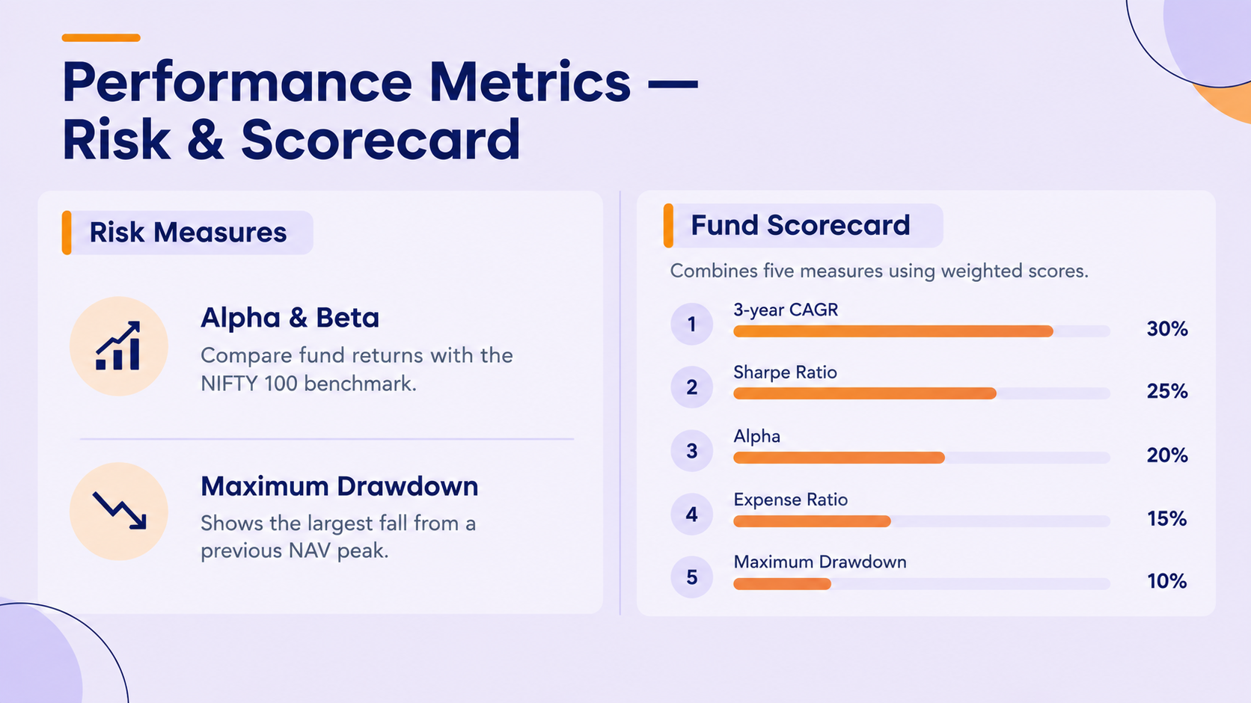

Slide 9
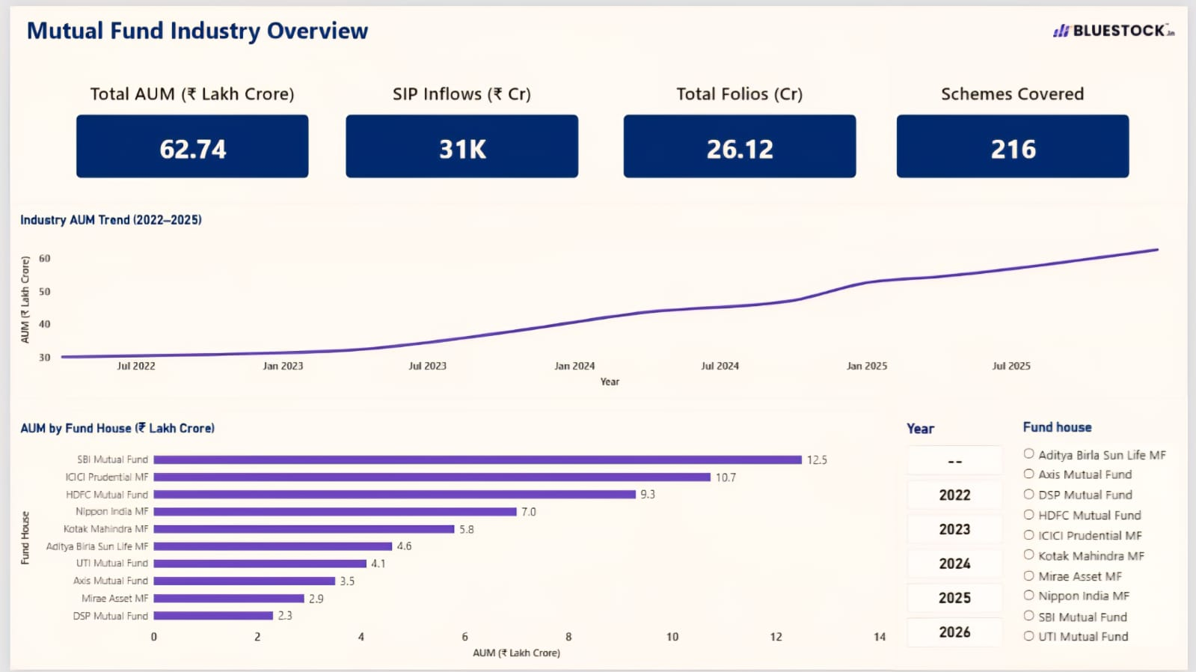
Power BI Dashboard — Industry Overview

Slide 10
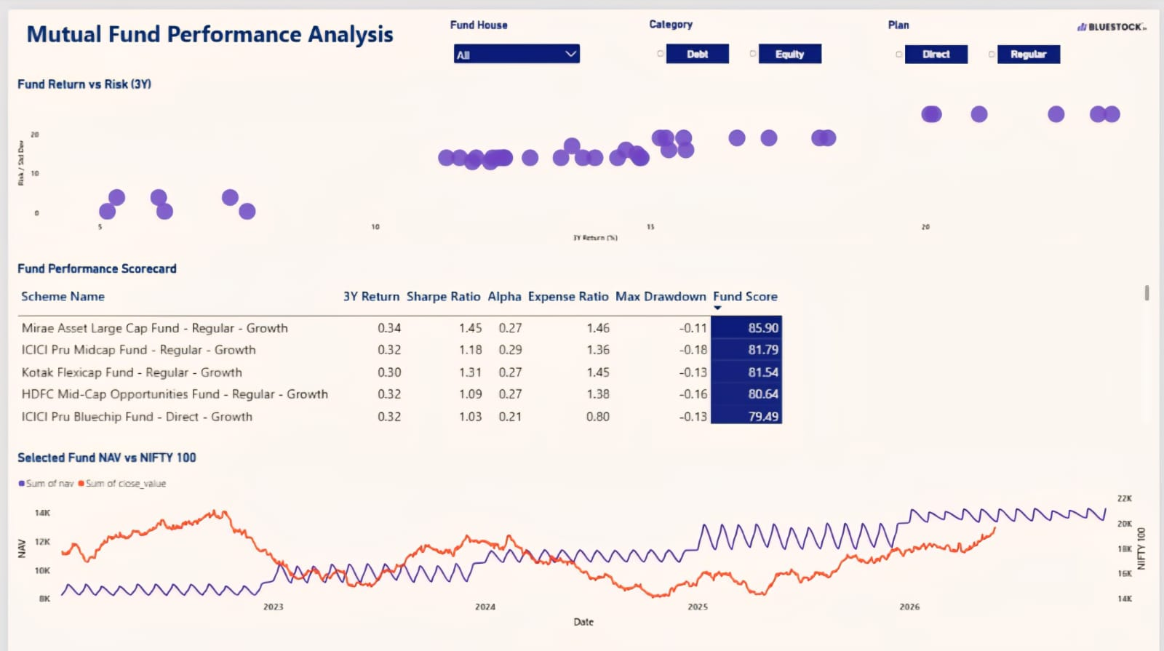
Power BI Dashboard — Fund Performance

Slide 11
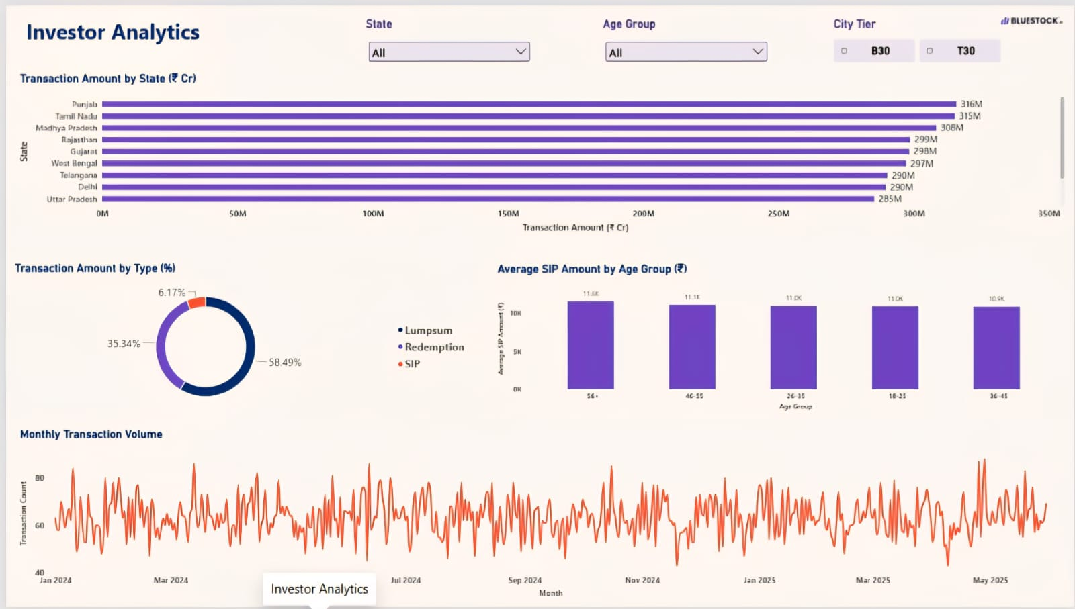
Power BI Dashboard — Investor Analytics

Slide 12
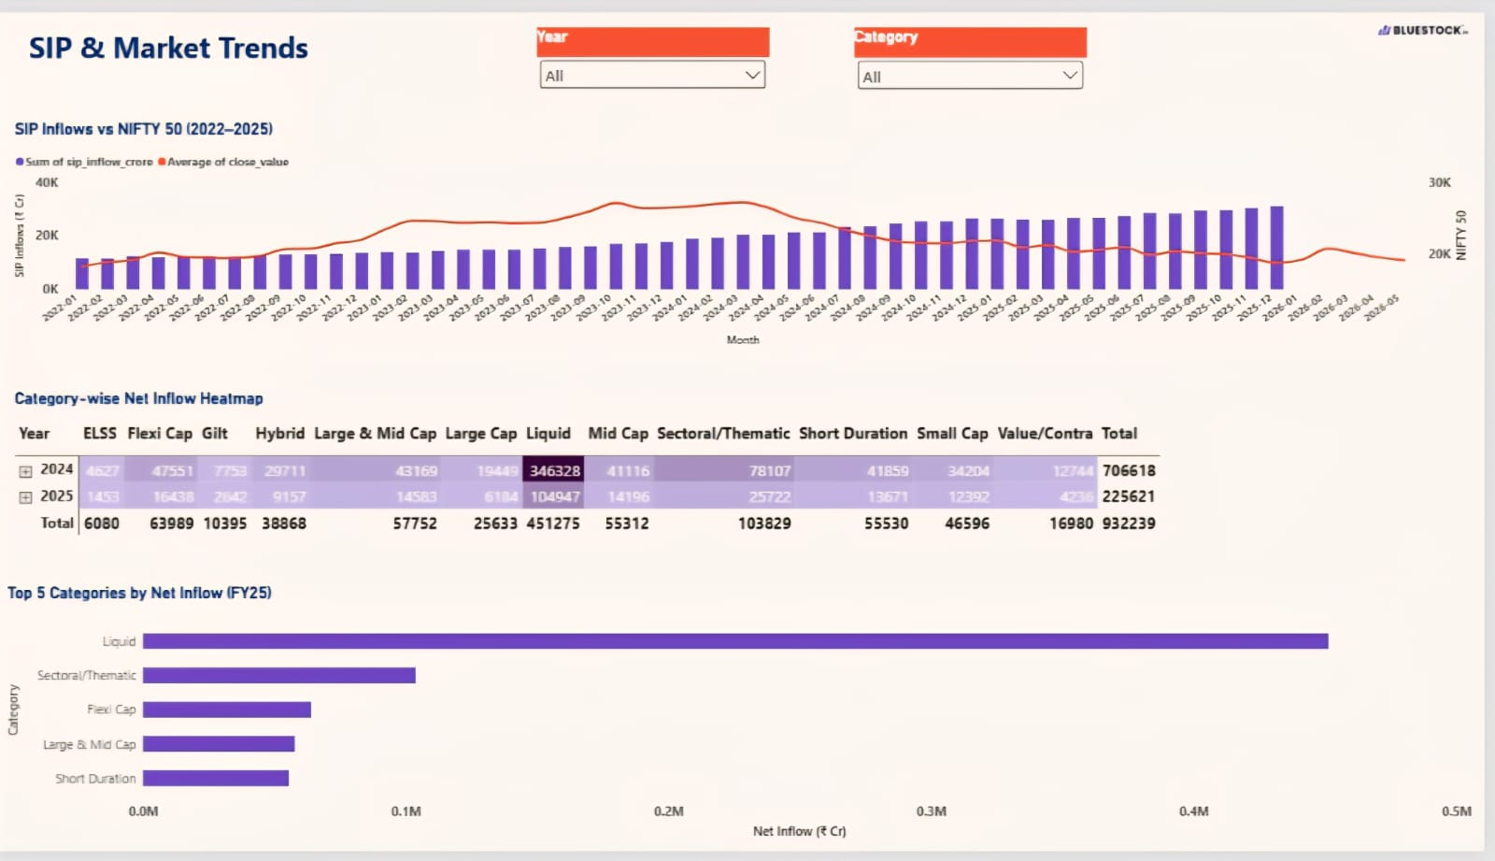
Power BI Dashboard — SIP & Market Trends

Slide 13
Key Findings
1
Data Integration: Multiple mutual fund datasets were brought into one analytics workflow.
2
Data Quality: Cleaning and validation helped prepare the data for analysis.
3
Performance Analysis: The project calculated return and risk measures to compare funds.
4
Interactive Dashboard: Power BI brings industry trends, fund performance, investor analytics, and SIP trends together.
Some data is simulated or synthetic; findings should be interpreted within the project’s dataset and limitations.

Slide 14


