Slide 1
Fraud Detection

Slide 2
Fraud Detection
In the realm of financial security and risk management, this project focuses on the strategic enhancement of detection algorithms through cutting-edge machine learning techniques. By honing our efforts on fraud detection, we aim to lead advancements that will redefine fraud prevention strategies and significantly reduce financial losses. This initiative aspires to safeguard systems against evolving threats, ensuring trust and resilience in digital transactions while contributing to the overall integrity of financial ecosystems.

Slide 3
Content
INTRODUCTION
EXPLORATORY DATA ANALYSIS (EDA)
DATA GATHERING / DATA REFINEMENT
FEATURE EXTRACTION
METHODOLOGY
EXPERIMENTAL RESULTS
CONCLUSION

Slide 4

INTRODUCTION
In today’s increasingly digital world, fraudulent activities pose significant challenges to businesses and individuals, leading to substantial financial losses and eroding trust. This project focuses on leveraging advanced machine learning techniques to develop robust fraud detection systems. By analyzing patterns and anomalies in transactional data, the system aims to identify and prevent fraudulent activities

Slide 5
Problem Statement
Problem Description:
Financial fraud involves any illegal activity that misleads individuals or institutions for financial gain.
Detecting fraud in a large volume of transactions is challenging, especially with evolving fraudulent tactics.
Why it Matters:
Fraudulent transactions can lead to major financial losses for banks, merchants, and customers.
There is a need for automated systems that can accurately identify fraudulent transactions in real-time.

Slide 6
Objective
Goal:
Develop a machine learning model that can predict whether a transaction is fraudulent or legitimate.
Specific Objectives:
Clean and preprocess the provided transaction dataset.
Extract relevant features from the data to improve model performance.
Evaluate different machine learning models and select the best-performing one.
Test the model’s accuracy and effectiveness in detecting fraud.
Deploy the final model for potential use in fraud detection systems.

Slide 7
Dataset Overview
Dataset Features
step
Represents a unit of time in the dataset (e.g., hours since the start of data collection).
type
The type of transaction, such as TRANSFER or CASH_OUT.
amount
The monetary value of the transaction.
nameOrig
Unique identifier for the source account initiating the transaction.
oldbalanceOrg
The initial balance of the source account before the transaction.
newbalanceOrig
The remaining balance in the source account after the transaction.
nameDest
Unique identifier for the destination account receiving the transaction.
oldbalanceDest
The initial balance of the destination account before the transaction.
newbalanceDest
The resulting balance in the destination account after the transaction.
isFraud
Target variable indicating whether the transaction is fraudulent (1) or not (0).
The provided dataset consists of 11,142 records and 10 features, structured to analyze fraudulent transactions

Slide 8
Data Preprocessing
Steps Involved:
Handling Missing Values: There were no missing or null values.
Removing Duplicates: No duplicates as well.
Feature Encoding: Categorical variables (such as Country) were encoded into numeric values.
Feature Scaling: Standardized numeric features like Quantity and UnitPrice to avoid scale-related issues in model performance.
Outlier Detection: Identified and removed outliers in the data to prevent them from skewing model predictions.

Slide 9

Exploratory Data Analysis (EDA)
Exploratory Data Analysis (EDA) helped us understand the data structure, find patterns, identify trends, and gain valuable insights from the dataset.
From EDA we analyze, the distribution of each features, checking the correlation between the features .
Using visuals helped us see the data clearly, understand the clinical data relationship with each other, and pinpoint factors that plays vital role in predictions

Slide 10
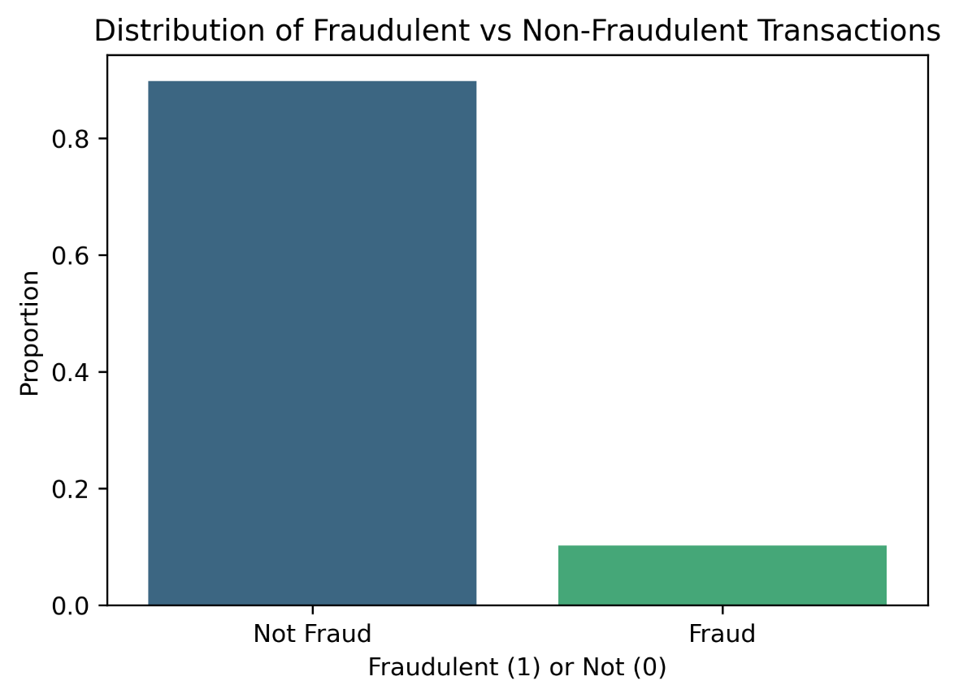
Distribution of Fraudulent vs Non-Fraudulent Transactions
Class Distribution (isFraud):
Fraudulent transactions are significantly outnumbered by non-fraudulent ones, indicating Class imbalance

Slide 11
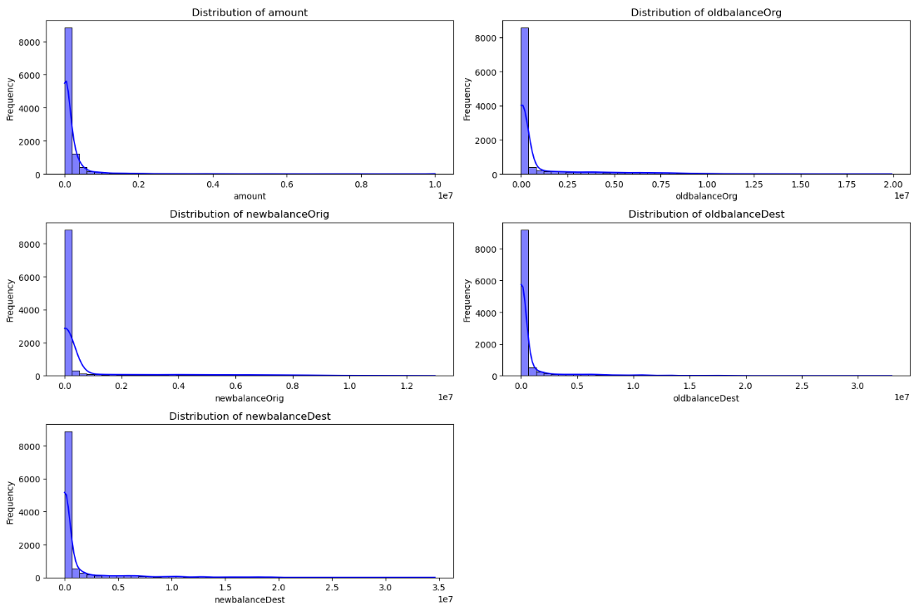
Distributions of Numerical Columns
The amount column is highly skewed, with most transactions involving smaller amounts.
oldbalanceOrg and newbalanceOrg:
Many accounts have zero balance before and after the transaction. -
oldbalanceDest and newbalanceDest:
Similar pattern as the origin accounts, with a majority of accounts having low balances.

Slide 12
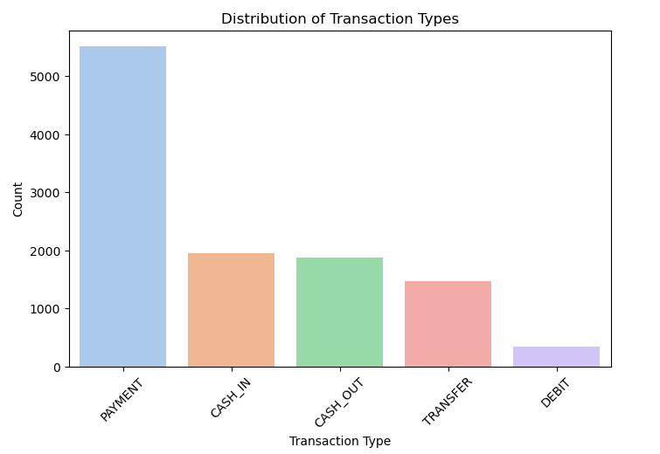
Distribution of Transaction Types

Slide 13
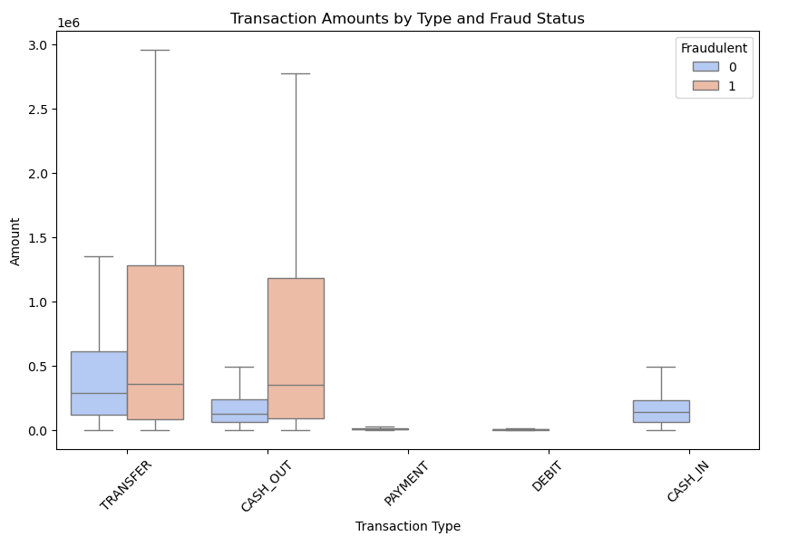
Transaction Amounts by Type and Fraud Status
Fraud is concentrated in TRANSFER and CASH_OUT transactions.
Other transaction types (e.g., PAYMENT, DEBIT) show negligible fraud occurrences.

Slide 14
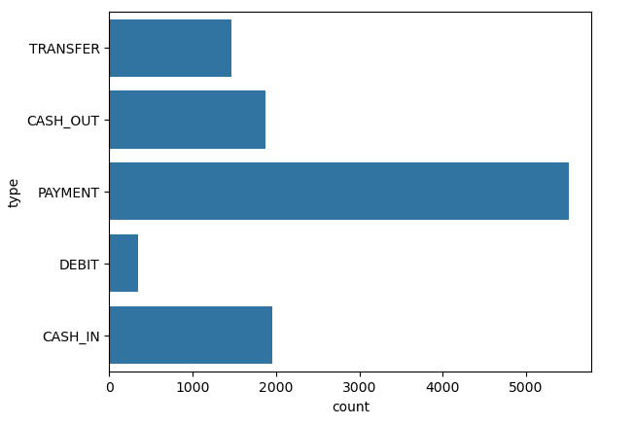
Type of Payment by Count

Slide 15
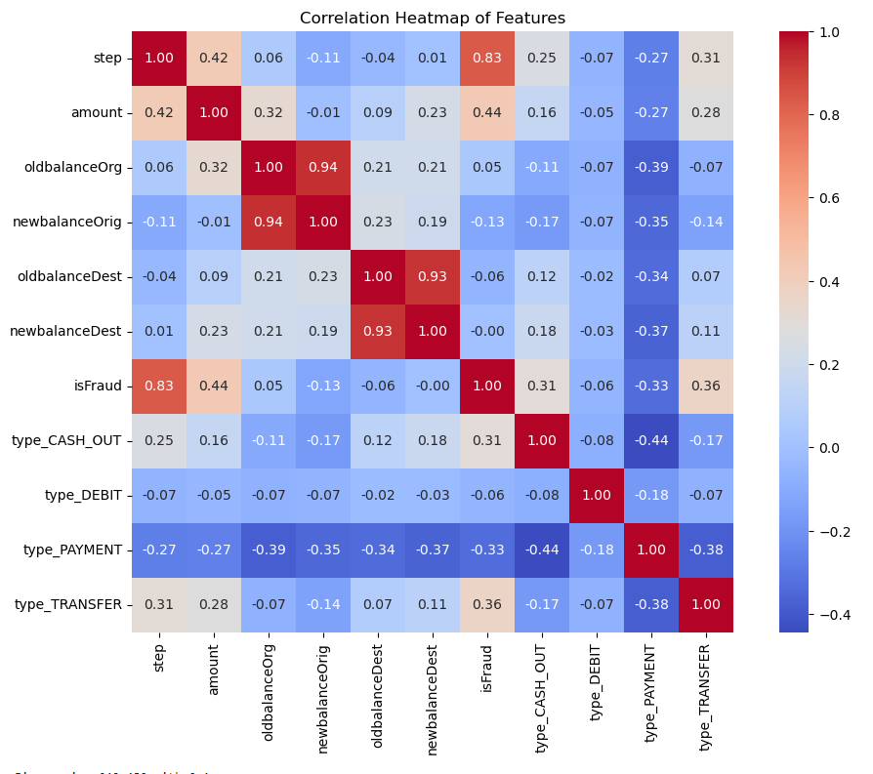
Correlation Heatmap of Features
Strong correlations observed between:
oldbalanceOrg and newbalanceOrig: Customers with higher initial balances often retain a proportionate amount post-transaction.
oldbalanceDest and newbalanceDest: Similar trend for destination accounts.
The isFraud feature has weak correlations with most numerical features, suggesting that detecting fraud may require advanced modeling or feature engineering.

Slide 16
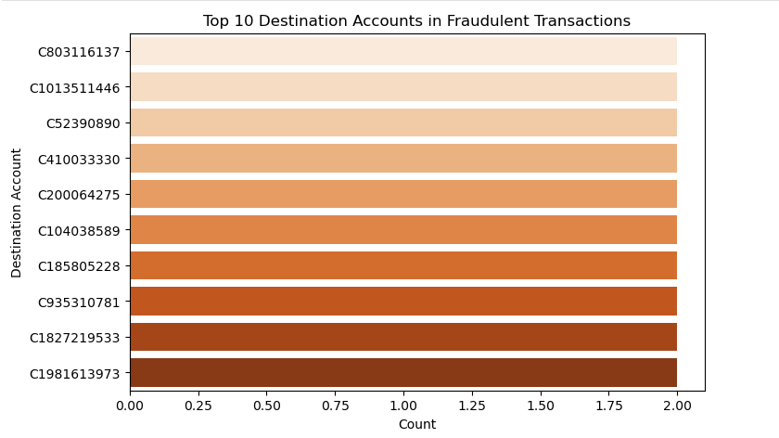
Top 10 Accounts in Fraudulent Transactions

Slide 17
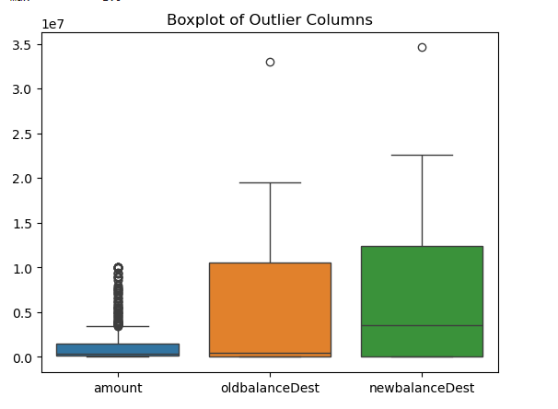
Outlier Detection
Objective:
Identify and analyze outliers in the dataset using the Z-score method, which indicates how far a data point is from the mean of the dataset.
Steps:
Z-Score Calculation:
Calculated Z-scores for numerical columns ('step', 'amount', 'oldbalanceDest', 'newbalanceDest').
Outliers are defined as values with a Z-score above 3 or below -3.
Flagging Outliers:
Created a new column, 'is_outlier', to flag rows with outliers in any selected column.
Separating Outliers:
Extracted outliers into a new DataFrame (outliers), with non-outliers stored separately.
Outlier Summary:
Used describe() to generate summary statistics for the outliers, providing insights into their characteristics.

Slide 18
Splitting Data into Features (X) and Target (y)
Objective:
Separate the target variable isFraud from the feature columns for the model.
Target Variable (y):
The isFraud column is assigned to y, representing the labels for fraud detection 0 for non-fraud, 1 for fraud.
Feature Variables (X):
The isFraud column is removed from the data
Scaling Features to a Range of 0 to 1
Objective:
Normalize the feature variables to improve the performance of machine learning models.
MinMaxScaler:
Scales the features to a uniform range of 0 to 1, reducing bias due to differing feature scales.
Fitting and Transforming:
The scaler is first fitted to the data and then used to transform the feature variables (X).

Slide 19
Handling Class Imbalance Using SMOTE
Objective:
Address the class imbalance in the dataset by oversampling the minority class (fraudulent transactions).
SMOTE (Synthetic Minority Over-sampling Technique):
Generates synthetic samples for the minority class by interpolating between existing instances.
Helps balance the distribution of the target variable, improving model performance.
Resampling:
After applying SMOTE, I obtain resampled feature variables (X_resampled) and target labels (y_resampled), with balanced classes (fraud and non-fraud).

Slide 20

Model Selection
Models Used:
Logistic Regression: A simple linear model for binary classification.
Random Forest: An ensemble method that can handle non-linear relationships.
AdaBoost: A boosting method that combines weak learners to form a strong learner.
SVM (Support Vector Machine): A robust supervised learning algorithm known for its effectiveness in high-dimensional spaces and its ability to perform classification and regression tasks with clear decision boundaries.
Why These Models?
These models were chosen because of their proven effectiveness in classification tasks and their ability to handle imbalanced datasets.

Slide 21
Hyperparameter Tuning for Model Optimization
Objective:
To find the best combination of hyperparameters that maximizes the performance of the model (focused on recall in this case).
Methodology:
Used GridSearchCV to evaluate combinations of hyperparameters.
Performed cross-validation with StratifiedKFold to maintain class balance in training and testing splits.
Optimized the model based on the recall score, which minimizes false negatives, crucial for fraud detection.
Hyperparameters Tuned:
For AdaBoost Classifier:
n_estimators: Number of weak learners (e.g., decision trees).
Range: [50, 100, 150]
learning_rate: Step size that controls the contribution of each weak learner.
Range: [0.01, 0.1, 1]
algorithm: Boosting algorithm to use.
Values: ['SAMME', 'SAMME.R']
Key Outcomes:
Identified the optimal hyperparameters:
Example: {'n_estimators': 100, 'learning_rate': 0.1, 'algorithm': 'SAMME.R'}
Achieved a balance between bias and variance, improving the model's ability to generalize.

Slide 22

Model Evaluation
Performance Metrics:
Accuracy: Percentage of correctly predicted transactions.
Precision: Ratio of correct positive predictions (fraudulent transactions) to total predicted positive cases.
Recall: Ratio of correct positive predictions to total actual positive cases.
F1-Score: A balance between precision and recall.

Slide 23
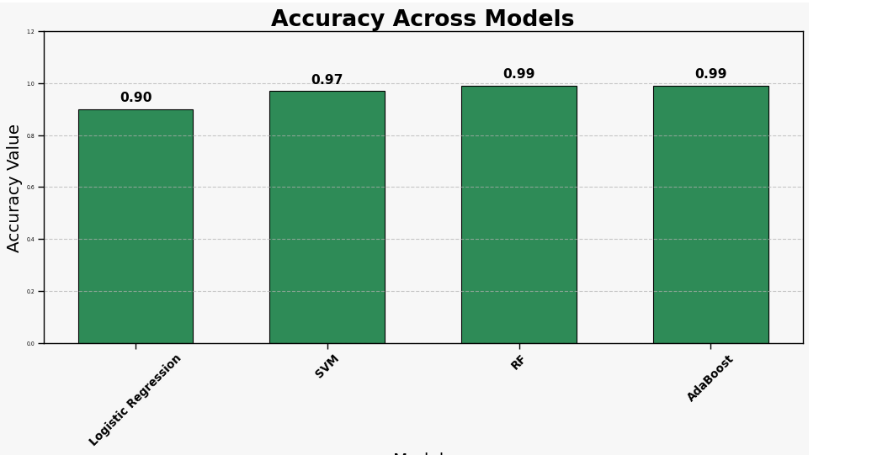
Accuracy
AdaBoost has an accuracy of 0.99, which means it’s performing well overall across the whole dataset

Slide 24
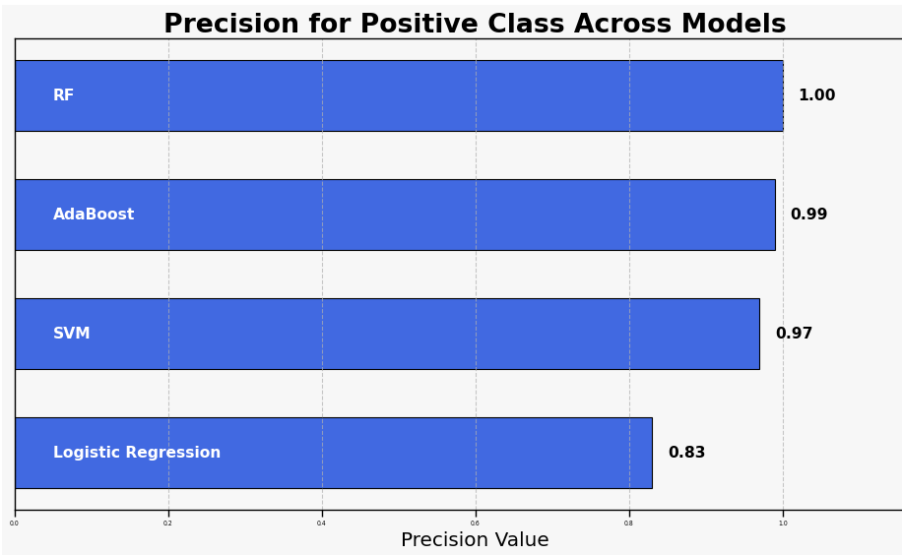
Precision
AdaBoost has a solid precision of 0.99 for both classes (0 and 1), meaning it's really good at avoiding false positives.

Slide 25
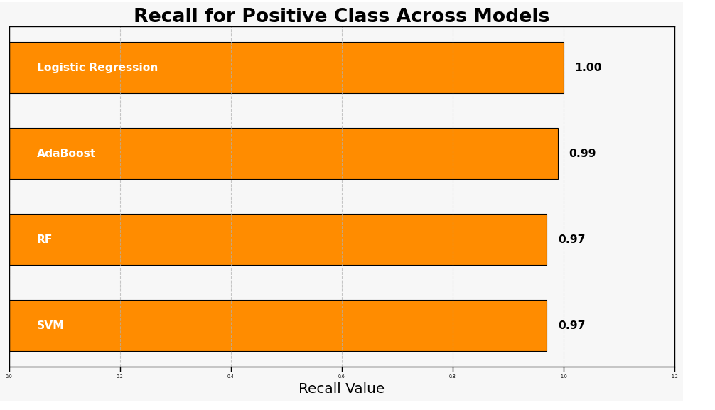
Recall
The recall for class 1 (fraudulent transactions) is 0.99, which is awesome because it catches almost all the fraud cases. This is super important for fraud detection.

Slide 26

Model Comparison and My Conclusion
Best Model: AdaBoost
Precision: 0.99 for both classes, demonstrating strong ability to avoid false positives.
Recall: 0.99 for class 1 (fraudulent transactions), effectively capturing almost all fraud cases—crucial for fraud detection.
F1-Score: 0.99, balancing precision and recall well.
Accuracy: 0.99, indicating excellent overall performance.
Comparison with Logistic Regression:
Logistic Regression has perfect recall (1.00) for class 1 but AdaBoost outperforms in precision and achieves a high F1-score, providing better balance.
Final Take:
AdaBoost is the most reliable model for this task, balancing fraud detection and minimizing mistakes effectively.

Slide 27
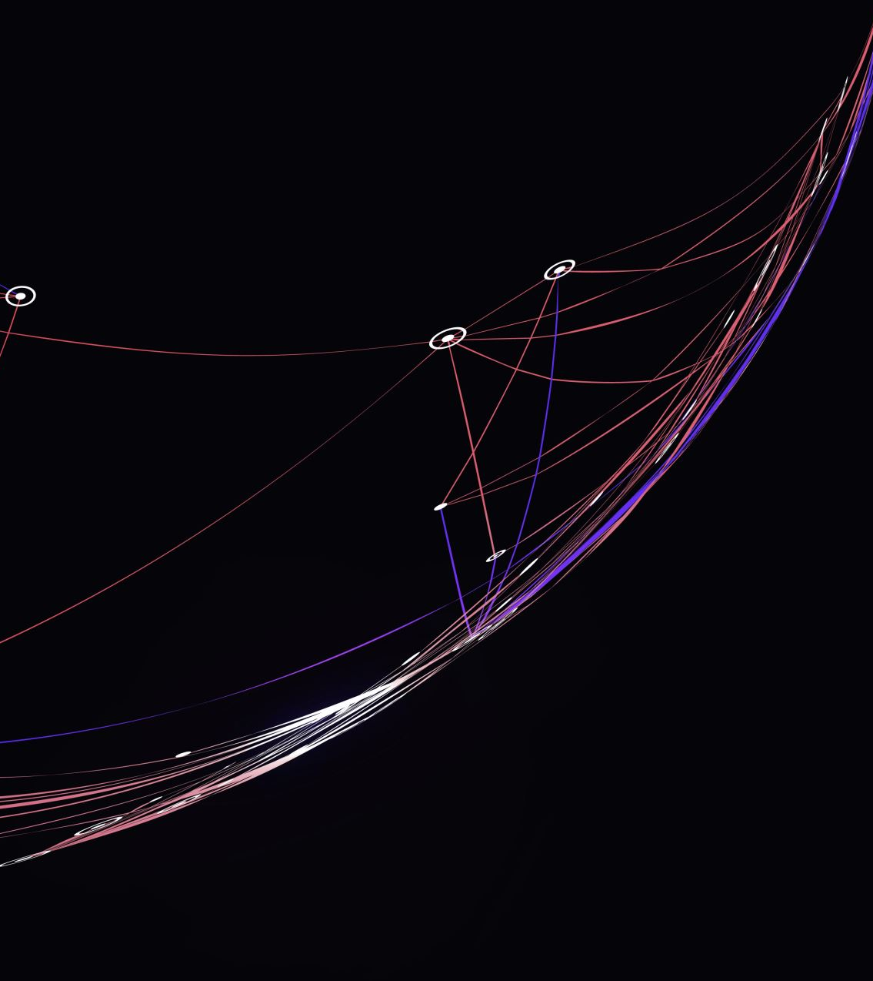
Overfitting Check
Learning Curves: Display the learning curves for the chosen model to check for overfitting.Plot training and validation error curves.
Interpretation:
If the training error is low, but validation error is high, the model might be overfitting.
If both errors converge, the model generalizes well.

Slide 28
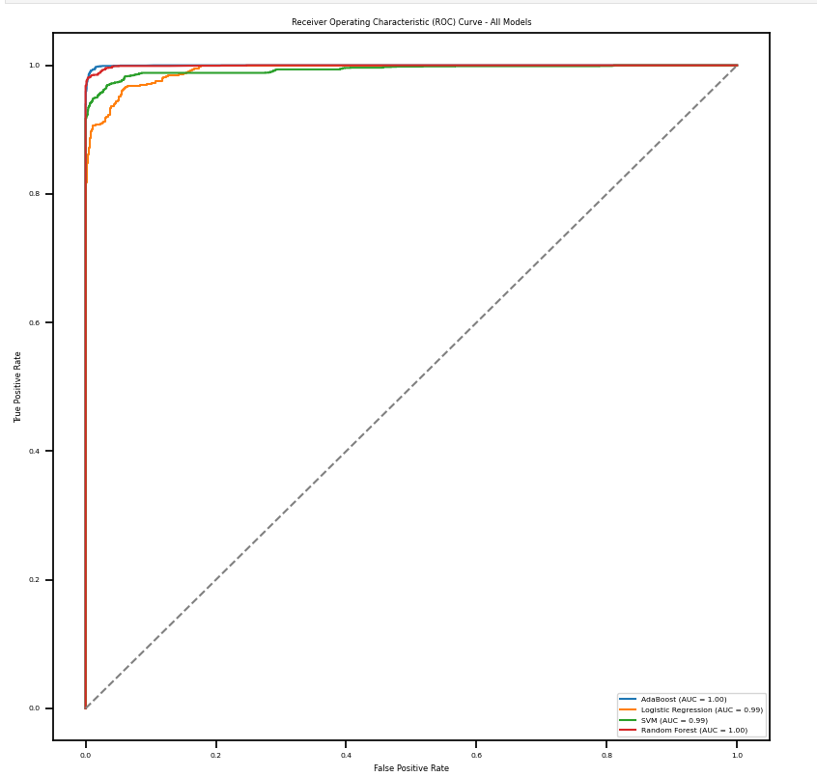
ROC Curve
Objective:
Evaluate the performance of different models (AdaBoost, Logistic Regression, SVM, and Random Forest) using:
Receiver Operating Characteristic (ROC) Curve
Area Under the Curve (AUC) Score
Key Points:
ROC Curve: Plots the True Positive Rate (TPR) against the False Positive Rate (FPR) for each model, visualizing how well the model distinguishes between classes.
AUC Score: Measures the overall ability of the model to discriminate between classes.
AUC closer to 1 = better model performance.
AUC of 0.5 = random guessing.
Results:
ROC Curves: Displayed for each model with AUC scores in the legend.
Diagonal Line: Represents the baseline (AUC = 0.5).
AUC Score Insights:
AdaBoost: High AUC score, good at identifying fraudulent transactions.
Logistic Regression, SVM, Random Forest: AUC scores displayed for easy comparison.

Slide 29

Fraud Detection Streamlit App
A simple Streamlit application designed to predict fraudulent financial transactions.
Uses a pre-trained AdaBoost model for fraud detection based on key features.
User-friendly interface with sliders for input and instant prediction feedback.

Slide 30
Key Features for Fraud Prediction
Important Features The model focuses on the following top 5 features for fraud detection:
step: Transaction time period
type_PAYMENT: Whether the transaction is a payment (binary: 0 for no, 1 for yes)
amount: Transaction amount
oldbalanceDest: Previous balance of destination account
newbalanceDest: Updated balance of destination account

Slide 31
Challenges Faced
Class Imbalance: The dataset had an imbalanced distribution of fraudulent vs. non-fraudulent transactions.
Solution: Used oversampling (SMOTE) and undersampling techniques to balance the dataset.
Feature Engineering: Deciding which features were most important for detecting fraud.
Solution: Tried multiple combinations of features and evaluated their performance.

Slide 32

Conclusion
Summary:
The project successfully demonstrated how machine learning models can be used to predict fraudulent transactions.
AdaBoost performed the best and achieved high accuracy, precision, recall, and F1-score.
Key Findings:
Data preprocessing and feature engineering play a significant role in model performance.
Machine learning provides an effective solution for real-time fraud detection.

Slide 33

Future Work
Improvements:
Use more complex models (e.g., neural networks) for potentially better accuracy.
Incorporate real-time transaction data for deployment in a production environment.
Potential Applications:
Extend the model to other types of fraud detection, such as credit card fraud or identity theft.

Slide 34

Questions ?

Slide 35
Thank You!

