Slide 1
TRANSORG AGENTIQ DATATHON · TRACK 4 – EDUCATION & EDTECH
EduPulse
Student Retention & Welfare Efficacy Tracker
From Messy Education Data to Actionable Insights
Data Dynamos
Ridhi Raheja — 12414456 · Shiven Pratap Singh — 12412435

Slide 2
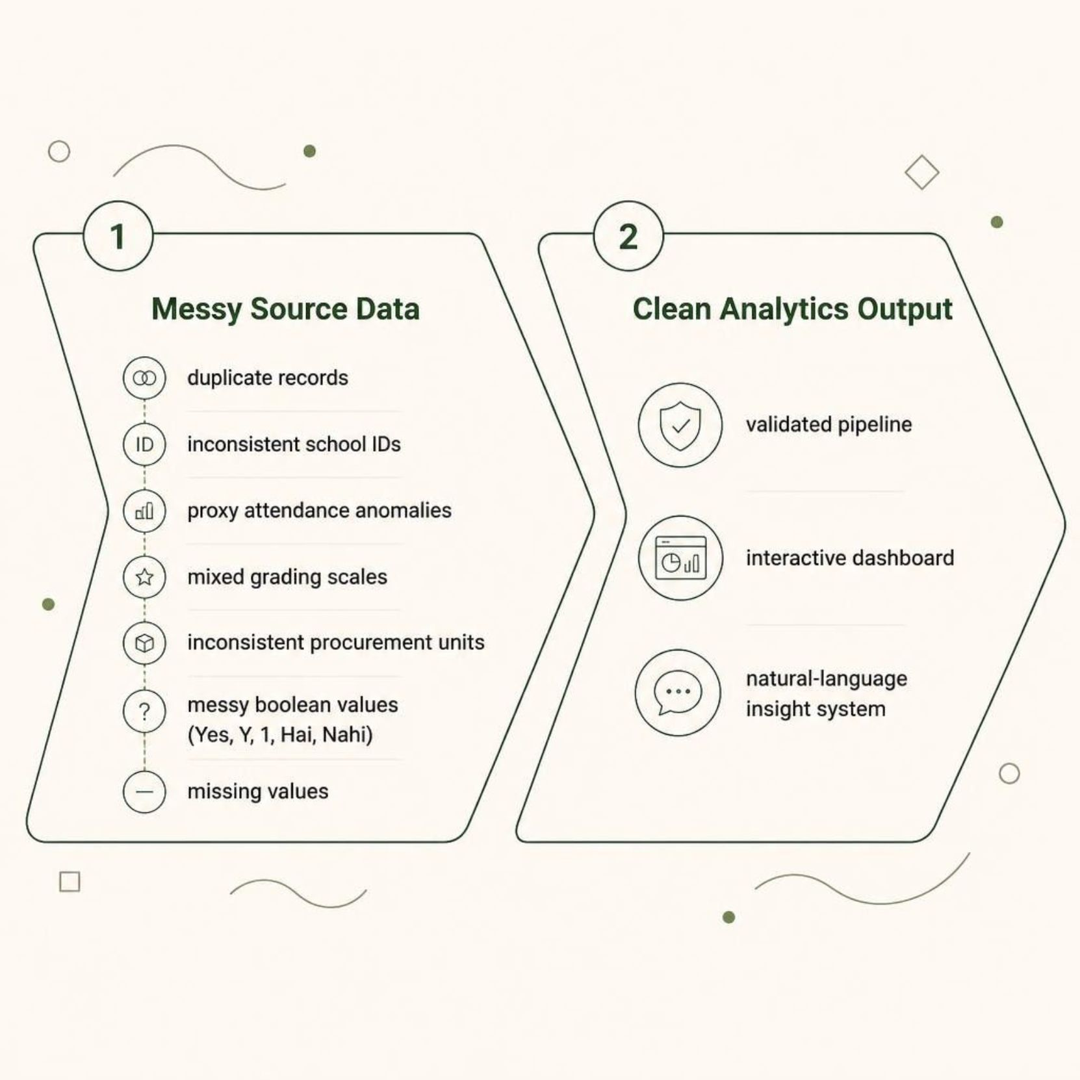
The Problem: Fragmented Education Data
The State Education Department lacks a unified view of student welfare and retention-related risk across schools.
Student Attendance
Academic Performance
Mid-Day Meal Procurement
School Infrastructure
Source data contained duplicates, inconsistent IDs, proxy anomalies, mixed grading scales, and messy boolean values. EduPulse transforms these fragmented records into a validated analytics pipeline, interactive dashboard, and natural-language insight system.

Slide 3


Data Rescue: Turning Messy Data into Reliable Data
Raw Data
Data Profiling
Cleaning
Validation
Integration
Each dataset was profiled, cleaned, and validated before integration into the school-level analytics layer.
Dataset | Raw Rows | Cleaned Rows | Rows Removed
School Master | 618 | 600 | 18
Student Attendance | 20,800 | 20,000 | 800
Test Scores | 8,000 | 8,000 | 0
MDM Procurement | 12,360 | 12,000 | 360
Infrastructure | 3,150 | 3,000 | 150
600 schools successfully integrated into the school-level analytics layer. Exact duplicates were removed. Missing values were not blindly imputed — legitimate missingness was retained and flagged.

Slide 4
Cleaning, Standardization & Validation
Attendance
Test Scores
Standardized school IDs and dates
Rate = present ÷ total × 100
806 invalid records flagged
1,068 Sunday proxy records flagged
Percentage, Raw Marks, CGPA → common percentage scale
6,017 records with percentage values
Letter grades were not converted using an invented mapping.
Records retained for audit.
MDM Procurement
Infrastructure
Grain names standardized
KG, grams, 50 KG bags → KG
Missing fields flagged, not imputed
Yes / Y / 1 / Hai / Haan → True
No / N / 0 / Nahi / Broken → False
All school IDs validated against School Master.
Before → After: "sch-0140" → "SCH0140" · "40.7 KGS" → "40.7 KG" · "Hai" → TRUE · "43.2 / 50" → 86.4%

Slide 5
Analytics Layer: From Records to School-Level KPIs
600
148K
Schools Analyzed
Total Enrolled
148,083 students
81.66%
67.26%
Avg Attendance
Avg Test Score
3.12/5
23.46
Avg Facility Count
Avg Risk Indicator
Attendance Anomalies
Infrastructure Coverage
1,068 Sunday 100% proxy-attendance records
806 invalid attendance records
598 schools have infrastructure records
2 schools do not have infrastructure records
Mid-Day Meal
291,046.90 KG total grain quantity
₹27.92M total procurement cost
49.92% average paid percentage

Slide 6

Retention Risk Indicator: Explainable Analytical Framework
The dataset does not contain an actual dropout label. EduPulse does not predict dropout probability. The Retention Risk Indicator is an analytical measure to identify schools that may require attention.
Infrastructure Risk
Attendance Risk
100 − average attendance %
(5 − avg facilities/5) × 100
Composite Retention Risk Indicator
Academic Risk
Proxy Attendance Risk
100 − average test score %
proxy attendance rate %
Each component is calculated independently and combined as the mean of available risk components.
Highest Observed
Average
Lowest Observed
39.53
23.46
11.54

Slide 7

EduPulse Interactive Dashboard
Dashboard Modules
Executive Command Center
Academic & Attendance
Infrastructure & Welfare
School 360°
Executive Memo
Data Rescue & Audit
Policy Impact Simulator
Ask EduPulse AI
Attendance
Infrastructure
Average attendance across schools = 81.66%
Electricity available in 405 of 541 schools with known status. Playground present in 260 of 526 schools.
Academic Association
Electricity Comparison
Attendance vs. test score Pearson correlation = −0.002, indicating essentially no linear association.
With electricity: 67.45% avg test score. Without: 67.29%. Difference: 0.16 percentage points — an observed comparison, not a causal effect.

Slide 8




Ask EduPulse AI: Natural Language to Visual Insight
Intent Detection
Chart Selection
User Question
Dataset & Column
Users ask business questions in natural language; the system maps each question to an analytical operation and visualization.
"Show me the attendance trend over time."
"Compare average test scores by district."
"Show the top 10 schools by retention risk."
→ Line Chart
→ Bar Chart
→ Ranked Bar Chart
"Show the relationship between attendance and test scores."
"Show schools with proxy attendance above 5%."
→ Scatter Plot
→ Anomaly Table / Chart
Graph-First Approach: Trend → Line · Comparison → Bar · Relationship → Scatter · Ranking → Ranked · Anomaly → Table. Uses a deterministic intent engine — reproducible and auditable. Architecture supports future LLM integration.

Slide 9

EduPulse System Architecture
Raw Data
Data Cleaning
Data Integration
CSV/Excel ingestion
Normalize, standardize & flag missing values
Merge school-level sources
Data Profiling
Data Validation
Assess quality & distributions
Rule-based checks
Technology Stack
Architecture Principles
Python · Pandas · NumPy
Streamlit · Plotly
CSV / Excel data processing
Natural-language intent detection
Dynamic chart generation
Reproducible
Auditable
Modular
School-level integrated analytics
Explainable business metrics

Slide 10
From Messy Data to Actionable Education Insights
Messy Data Rescue
Unified School Analytics
Interactive Dashboard
Explainable Risk Indicator
Graph-First AI Queries
Policy Simulator
What EduPulse Enables
Future Scope
Identify schools requiring attention
Monitor attendance anomalies
Compare academic performance
Identify infrastructure gaps
Monitor Mid-Day Meal procurement
Explore school-level retention risk indicators
Ask questions using natural language
Integrate historical dropout/retention labels
Build validated ML-based risk models
Add external LLM for broader queries
Add automated alerts and intervention tracking
Expand agent to additional education datasets
EduPulse transforms fragmented education data into a single, explainable view for monitoring student welfare and supporting data-driven decisions.
TRANSORG AGENTIQ DATATHON · TRACK 4 – EDUCATION & EDTECH

