Slide 1
MEPG Integrated Planning Process Revision (4th Version)
Medco E&P Grissik | 6th Jun 2026
Executive Update for SM / SVP Endorsement • Rev 3 → Rev 4
Notes:
Title. This is an executive update to secure SM/SVP endorsement of Rev 4 of the MEPG Integrated Planning & Scheduling Guideline. 10-15 minutes; detail is in the appendix.

Slide 2
Executive Summary
Rev 4 realigns Corridor planning to corporate IBP (GN-3005) and the operational framework (GN-3007), both issued after Rev 3.
Dimension | Current State (Rev 3) | Rev 4 Improvement | Business Rationale & Expected Impact
Concept & Strategy | Stand-alone guideline; predates GN-3005 & GN-3007; objectives a simple list. | Aligned & cross-referenced to GN-3005/3007, GL-001/002; scope expanded FDP→7D; new 11-objective table. | One corporately-aligned planning language; consistent decisions across horizons.
Work Process & System | Heritage RACI; vague governance; ownership unclear. | Common work process; governance forums + fixed cadence; clarified approval authorities; OPAA defined; tools/systems. | Clear ownership and cadence; faster, accountable decision-making.
Management of Plans | Thin; limited control of what enters execution. | Gate reviews (G1/G2/G3); constraints, risk, conflict & prioritization; opportunity ID (new); change control / break-in. | Protects execution from unprepared work and uncontrolled change.
Performance Assessment | Legacy / loosely-defined KPIs. | Redefined KPIs — Schedule Attainment (SF), SPI, Break-in, Deletion — plus secondary metrics. | Objective, comparable visibility of planning performance.
Continuous Improvement | Informal; not systematic. | AAR, peer review, benchmarking and feedback loops across all horizons. | Institutional learning; sustained improvement; less NPT.
Notes:
Executive summary in one matrix. The core message: Rev 3 (Nov 2024) predates the two corporate documents it now must align to - GN-3005 (Jan 2025) and GN-3007 (Jan 2026). Rev 4 is alignment, not correction of neglect. Walk the five rows left to right: current state, Rev 4 improvement, business rationale/impact.

Slide 3
Key Changes – Concept & Strategy
From a stand-alone Rev 3 guideline to one corporately-aligned planning framework built on an 11-objective foundation.
BEFORE – Rev 3 (22 Nov 2024)
AFTER – Rev 4 (2026)
Stand-alone guideline — issued before the documents it must now align to existed.
No reference to GN-3005 (corporate IBP, Jan 2025) or GN-3007 (operational, Jan 2026).
Objectives stated as a simple list — no “how” or business value attached.
Scope limited; short-term horizons under-specified.
Aligned & explicitly cross-referenced: GN-3005 (LTP/IBP), GN-3007 (operational horizons), GL-001 FDP, GL-002 ADP, MPEP, AACE RP 37R-06.
Scope expanded to the full chain — FDP, ADP, LTP (outer-years + 24M), 12M, 90D, 30D, 7D.
New Table 1: 11 integrated-planning objectives, each with Expected Behaviour (how) + Organizational Value (why).
BUSINESS VALUE
One common planning language across all horizons — objectives now drive HSE, value creation, cost & resource efficiency, execution readiness and minimized NPT, with roles and behaviours made explicit.
Notes:
Concept & Strategy. Before: a stand-alone guideline with a plain objectives list. After: cross-referenced to GN-3005/3007, GL-001/002, MPEP, AACE 37R-06; scope expanded to the full FDP-to-7D chain; new 11-objective table pairing Expected Behaviour (how) with Organizational Value (why). Value: one common language.

Slide 4
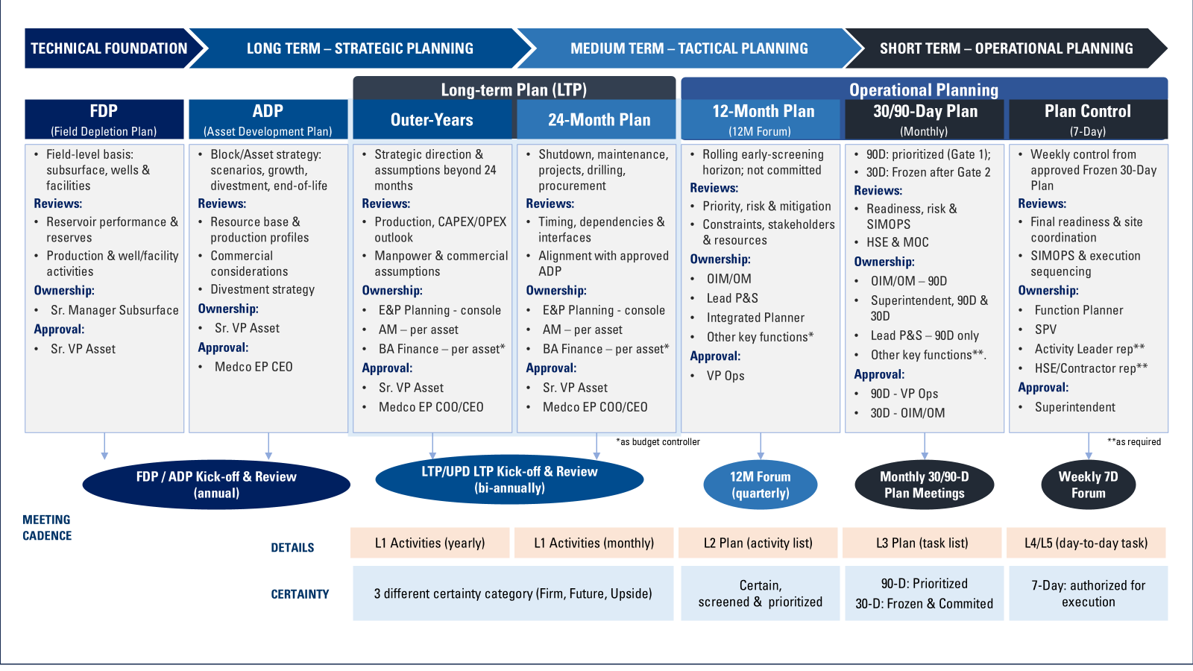
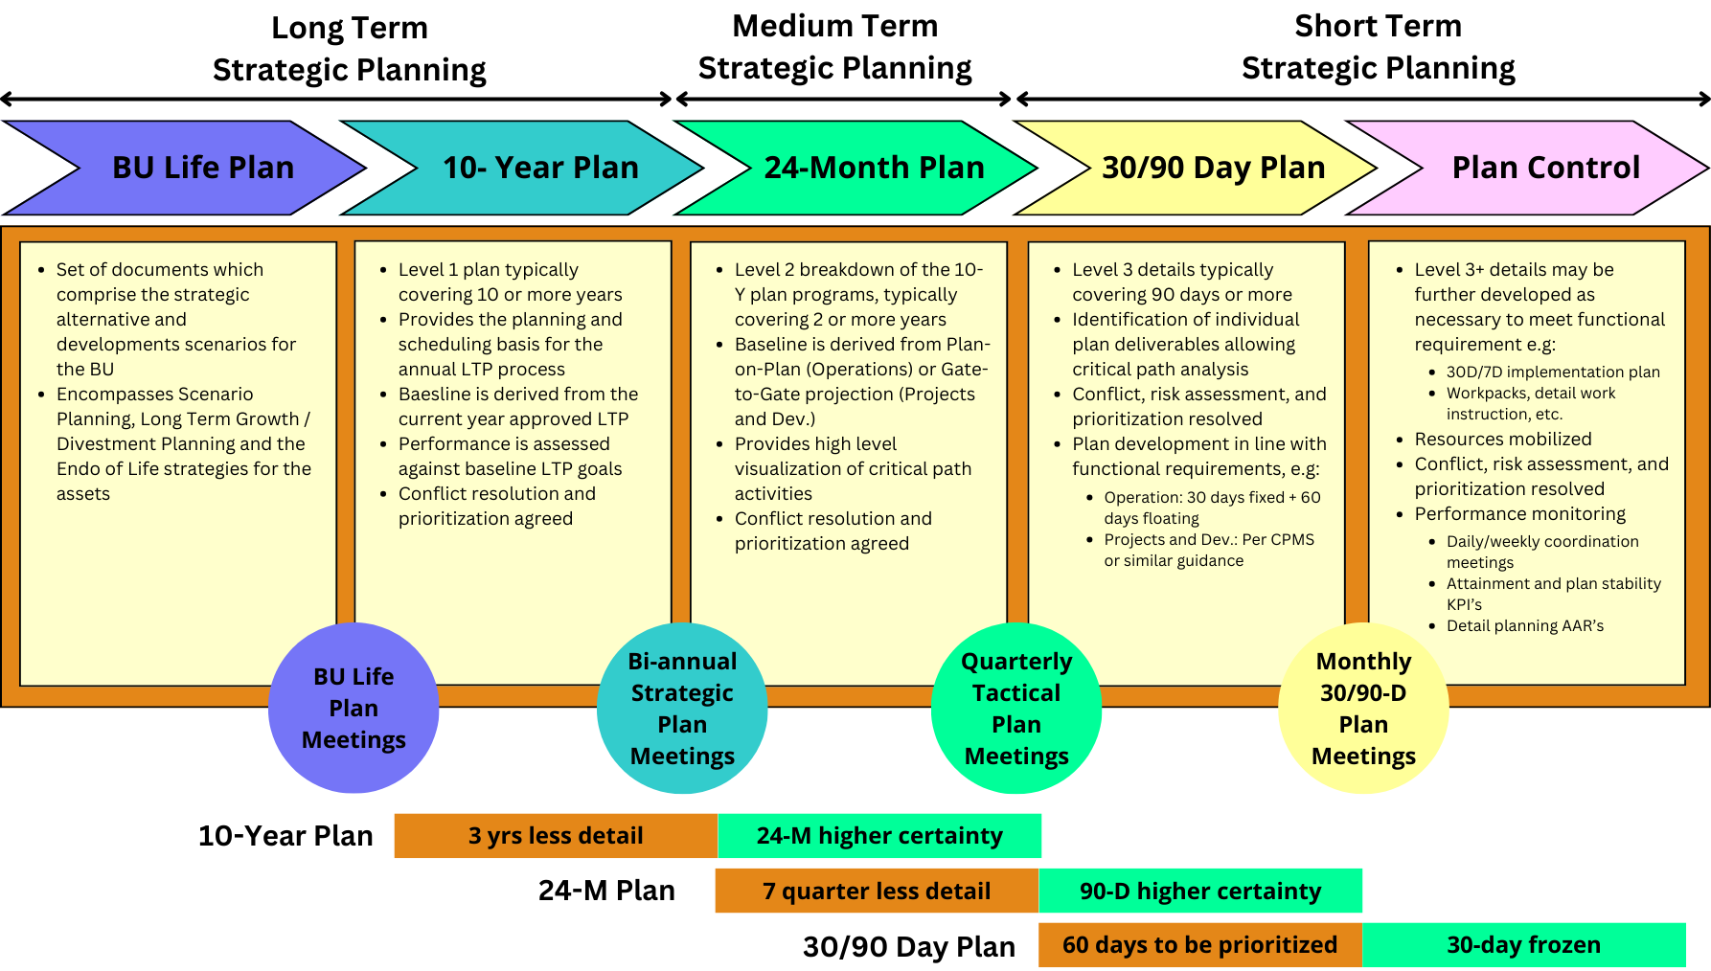
Key Changes – Planning Horizon Evolution
Rev 4 adds the missing 12-Month and 7-Day horizons and three execution gates; detail and certainty build toward execution.
BEFORE — Rev 3: 5 horizons, no 12-Month, no 7-Day, no gates
BU Life / ADP
10-Year / LTP
24-Month / Tactical
30 / 90-Day
Detailed Operational
AFTER — Rev 4: 7 horizons + 3 execution gates
1
2
3
FDP
Field depletion
ADP
Asset develop.
LTP
Outer-yrs + 24M
12M
Rolling screen ★
90D
Prioritized
30D
Frozen
7D
Weekly control
Gate 1
Gate 2 – Freeze
Gate 3
Detail, readiness & planning certainty increase toward execution →
Net-new in Rev 4: 12-Month rolling early-screening horizon • 7-Day weekly execution control • stage-gates G1 (90D, candidates), G2 (30D, plan frozen), G3 (7D, field execution authorized).
Reflects actual practice: planners confirmed they already run this LTP→12M→90D→30D→7D flow — approved Gate 1/2/3 plans are in use today (GGSDR, Suban). See Appendix F.
Full multi-horizon framework (ownership, review forums, approval, cadence): see Appendix – Figure 2.
Notes:
Strongest slide. Rev 3 had 5 horizons and no gates. Rev 4 adds the 12-Month rolling screen and the 7-Day weekly control, and installs three gates: G1 at 90D (candidates), G2 at 30D (freeze), G3 at 7D (execute). Detail and certainty increase toward execution. Full framework detail is Figure 2 in the appendix.

Slide 5
Key Changes – Work Process & Governance
One common work process, a fixed governance cadence and clarified approval authorities replace heritage RACI.
CURRENT (Rev 3)
Governance cadence & approval authority by horizon
Heritage RACI and stakeholder map.
Governance forums and cadence not defined.
Approval authorities ambiguous (legacy “Field Manager”).
Horizon | Cadence | Review Forum | Approval Authority
FDP | Annual | FDP/ADP kick-off & review | Sr. VP Asset
ADP | Annual | FDP/ADP kick-off & review | CEO / COO
LTP | Bi-annual | LTP kick-off & review | CEO/COO + Sr. VP Asset
12M | Quarterly | 12M Forum | VP Operations
90D | Monthly | 90D Forum – Gate 1 | VP Operations (Gate 1)
30D | Monthly | 30D Forum – Gate 2 | OIM / OM (Gate 2, Frozen)
7D | Weekly | 7D Forum – Gate 3 | Superintendent (Gate 3)
REV 4
Common work process: develop → review → approve → monitor plans, iterating across every horizon (Figure 2).
Governance forums with fixed cadence (Table 2).
Approval authorities clarified per horizon (Table 1).
OPAA = Operations Planning & Activities Assurance coordinates 12M / 90D / 30D (not “P&S Team”).
Tools & systems named: IBP module in Medco BPM, SAP (cost), GPT for STPF, BPM Work Orders, MCRS.
Notes:
Work process & governance. Heritage RACI replaced by a common develop-review-approve-monitor process, a fixed cadence (Table 2), and clarified per-horizon approval authorities (Table 1). OPAA - Operations Planning & Activities Assurance - coordinates 12M/90D/30D; it is not the old 'P&S Team'. Named tools: IBP in Medco BPM, SAP, GPT for STPF, BPM Work Orders, MCRS.

Slide 6
Key Changes – Management of Plans
A new ‘Managing the Plans’ spine controls constraints, risk, conflicts, change and opportunities to protect the frozen plan.
Gate Review Criteria
Managing Constraints
Risk Assessment
Conflict Resolution & Prioritization
Defined entry tests for G1 (90D candidates), G2 (30D freeze), G3 (7D execution).
PMI six constraints — Scope, Schedule, Budget, Quality, Resources, Risk; QRA/CBR contingency.
Integrated at 30D/90D — HAZID, HAZOP, SIMOPS, SIL, PJHA; MEPG risk matrix.
Ranked by HSE, asset integrity, production loss, human factors, opportunity cost.
Opportunity Identification (NEW)
Change Control / Break-in
Plan Administration
WHY IT MATTERS
Formal step to capture and mature value-adding opportunities into the plan.
Controlled additions & changes to the Frozen 30D plan — nothing enters uncontrolled.
Documentation, data management, version control — a single source of truth.
Protects execution from unprepared work and uncontrolled change.
Flow of control: screen & prioritize → Gate 1 (90D) → Gate 2 freeze (30D) → changes only via controlled Break-in → Gate 3 execute (7D).
Notes:
Management of Plans - the new control spine. Gate criteria; PMI six constraints plus QRA/CBR; risk integrated at 30/90D; conflict resolution & prioritization; NEW opportunity identification; change control / break-in on the frozen 30D plan; plan administration as single source of truth. Why it matters: protects execution from unprepared work and uncontrolled change.

Slide 7
Key Changes – Performance & Continuous Improvement
Redefined KPIs and structured learning loops make planning performance measurable and improvable.
Redefined KPIs (Rev 4)
Primary KPI | What it measures
Schedule Attainment (with SF) | Plan delivered, adjusted by Schedule Shift Factor.
SPI | Schedule Performance Indicator vs baseline.
Plan Break-in | Unplanned work forced into the frozen plan.
Plan Deletion | Committed scope removed before execution.
Continuous Improvement
After-Action Reviews (AAR) capture execution learning.
Planning Compliance & Peer Review across horizons.
Business Performance Review & Benchmarking.
Feedback loops return results into the relevant planning cycle (MCRS).
Secondary metrics: plan utilization, plan stability, work efficiency, disturbance / delay.
EXPECTED IMPACT
Objective, comparable visibility of planning performance; institutional learning that compounds over cycles and reduces non-productive time (NPT).
Notes:
Performance & continuous improvement. KPIs redefined - Schedule Attainment with Schedule Shift Factor, SPI, Plan Break-in, Plan Deletion - plus secondary metrics. Learning loops: AAR, peer review, benchmarking, business performance review, feedback into the planning cycle via MCRS. Impact: measurable performance and compounding improvement, less NPT.

Slide 8
Summary & Recommendation
Endorse the Rev 4 direction and authorize resolution of the remaining open items to issue.
What Rev 4 delivers
Open items requiring confirmation (not resolved here)
Aligned to corporate IBP (GN-3005) & operational framework (GN-3007).
Complete horizon set FDP→7D with the new 12M and 7D horizons.
Three execution stage-gates (G1/G2/G3) and a Frozen 30D plan.
‘Managing the Plans’ spine: constraints, risk, conflict, change, opportunity.
Redefined KPIs and continuous-improvement loops.
ADP approval authority — GL-002 scope text (President Director) vs summary table (CEO); Rev 4 uses CEO/COO. → Mas Fikri / Mas Robert
FDP approval authority — GL-001 scope text (Sr Manager Subsurface) vs table (Sr VP Asset); Rev 4 uses Sr. VP Asset. → Mas Fikri / Mas Robert
Legacy “Field Manager” language remains in change-control text — conflicts with GN-3007 OIM/OM authority. → Kang Oi / Mas Fikri
GN-3007 vs GN-3008 source defect — cover (4-horizon, incl. 12M) vs header (3-horizon). Source defect, not ours. → Kang Oi
THE ASK
1. Endorse the Rev 4 direction and its alignment to GN-3005 / GN-3007.
2. Authorize resolution of the four open items with the named owners above.
3. Approve the path to issue Rev 4 once those confirmations are closed.
Notes:
Summary & recommendation. Recap the deliverables, then be explicit about the four open items - present them as conflicts, do NOT resolve them live. The ask: (1) endorse the Rev 4 direction, (2) authorize resolution of the open items with named owners, (3) approve the path to issue.

Slide 9
Appendix
Supporting detail — framework figure, matrices, gate criteria, open items, source register
Notes:
Appendix divider.

Slide 10
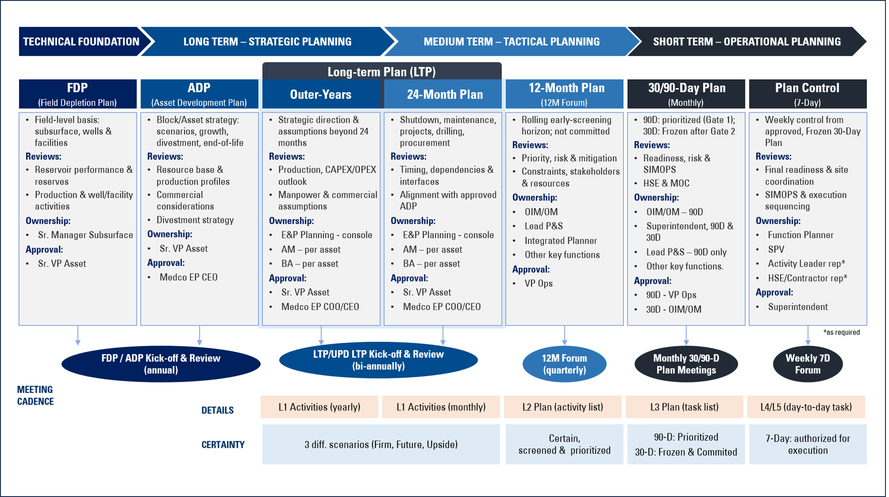
Appendix A – Multi-Horizon Planning Framework (Figure 2)
The complete Rev 4 framework: planning focus, review forum, ownership, approval authority and cadence by horizon.
Source: MEPG Integrated Planning & Scheduling Guideline Rev 4, Figure 2 – Multi-Horizon Planning Work Process.

Slide 11
Appendix B – Why Now: Chronology
Rev 3 was issued before the corporate documents it must now align to existed — Rev 4 closes a structural gap, not neglect.
Date | Document | Significance
22 Nov 2024 | Corridor P&S Guideline Rev 3 (v12) | Current issued baseline. Does not reference GN-3005 or GN-3007 — they did not yet exist.
14 Jan 2025 | Corporate IBP Guideline GN-3005 Rev 1 | Signed incl. SVP Corridor Asset. Rev 3 predates it by ~2 months.
Jan 2026 | Corridor Ops Procedure GN-3007 Rev 0 (IFU) | 12M / 90D / 30D / 7D operational framework. ~14 months after Rev 3.
Jul 2026 | Rev 4 rebuild in progress | Realigns Corridor planning to both corporate documents.

Slide 12
Appendix C – Table 1: Plan Approval & Administration
Approval authority, ownership, focal point and planning administration across all eight horizon rows.
Horizon | Coverage | Plan Ownership | Approval Authority | Focal Point | Planning Admin
FDP | Field technical planning | SM Subsurface | Sr. VP Asset | per FDP guideline | per FDP guideline
ADP | Block/Asset development | Sr. VP Asset | CEO / COO | per ADP guideline | per ADP guideline
LTP (Outer Yrs) | 10-yr+ outlook | Asset Management | CEO/COO + Sr. VP Asset | Asset Management | E&P Planning
LTP (24-Month) | Major asset activities | Asset Management | CEO/COO + Sr. VP Asset | Asset Management | E&P Planning
12M | Operationally impacting | OIM/OM + owners | VP Operations | P&S Team (OPAA) | Integrated Planner
90D | Prioritized candidates | OIM/OM + Superintendent | VP Operations (Gate 1) | P&S Team (OPAA) | Functional/Asset Planner
30D | Execution commitment | OIM/OM + Superintendent | OIM/OM (Gate 2) | P&S Team (OPAA) | Functional/Asset Planner
7D / Plan Control | Weekly field execution | Superintendent/SPV | Superintendent (Gate 3) | Functional Planner | Activity/Functional Planner
Note: FDP/ADP approval authorities and legacy “Field Manager” references carry open items — see Appendix G.

Slide 13
Appendix D – Governance Forums & Cadence (Table 2)
Fixed review cadence and gate designation by horizon — the operating rhythm of the planning system.
Horizon | Cadence | Review Forum | Gate / Purpose
FDP / ADP | Annual | FDP/ADP kick-off & review | Strategic technical & development plans
LTP | Bi-annual | LTP / UPD LTP kick-off & review | Outer-years + 24-month outlook (3 scenarios)
12M | Quarterly | 12M Forum | Rolling early screening; not committed
90D | Monthly | 90D Forum | Gate 1 – prioritized planning candidates
30D | Monthly | 30D Forum | Gate 2 – execution commitment; plan Frozen
7D | Weekly | 7D Forum | Gate 3 – authorizes weekly field execution
— | Continuous | MCRS / feedback loops | Results returned to relevant planning cycle

Slide 14
Appendix E – Stage-Gate Review Criteria
Three gates convert a screened outlook into an authorized, frozen and executed weekly plan.
Gate 1
Gate 2
Gate 3
90-Day Forum
30-Day Forum
7-Day Forum
Purpose: select and prioritize planning candidates.
Not an execution commitment.
Tests: priority, risk & mitigation, constraints, stakeholders & resources.
Approval: VP Operations.
Purpose: commit to execution — plan declared FROZEN.
Tests: readiness, risk & SIMOPS, HSE & MOC, materials on/near site.
Change only via controlled Break-in thereafter.
Approval: OIM / OM.
Purpose: authorize weekly field execution within the frozen window.
Tests: final readiness, site coordination, SIMOPS & execution sequencing.
Approval: Superintendent.

Slide 15
Appendix F – Gates in Practice: Field Evidence
Rev 4 documents what Corridor already runs — approved Gate 1/2/3 plans and a signed Frozen-30D DoA form are in use today (GGSDR, Suban).
Gate 1 / 90D
Gate 2 / 30D
Gate 3 / 7D
“90D Gate Approval June 2026” Approved Plan
“30-Day Operations Plan” — Frozen (Approved)
“7-Day Operations Plan” + weekly forum deck
Corridor Asset, period Jul–Sep 2026, Rev 0.
Executive Decision Summary + 90-day objective.
~100 activities screened, prioritized & readiness/risk-constraint reviewed.
Per facility: Suban 30D, GGSDR 30D Highlight.
Document status checkbox marked Frozen (Approved).
Signed DoA approval form (GGSDR June): Activity Planner, Offsite Planner, Superintendent commit to execute.
Per facility: Suban W1-W2, Integrated 7D W2-W3 (Signed), D1–D7.
Weekly forum deck (GGSD, 28 Jun 2026): break-in requests, PPM compliance, craft-utilization KPI, deferrals.
Performance executive summary & cumulative progress.
Meeting evidence (email thread 15–21 Jul 2026, planners ⇄ E&P Planning, cc OPAA): planners confirmed the LTP→12M→90D→30D→7D flow and that routine & non-routine activities follow it. Rev 4 codifies established practice rather than introducing new process.

Slide 16
Appendix G – Open Items for Stakeholder Confirmation
Presented as conflicts with both readings — to be confirmed by owners, not resolved in this deck.
# | Item | Conflict (both readings) | Confirm with
1 | ADP approval authority | GL-002 scope text: “must be approved by Medco EP President Director” vs summary table: “CEO”. Rev 4 Table 1 uses CEO/COO. | Mas Fikri / Mas Robert
2 | FDP approval authority | GL-001 scope text: “approved by Senior Manager Subsurface” vs summary table: “Sr VP Asset”. Rev 4 uses Sr. VP Asset. | Mas Fikri / Mas Robert
3 | Legacy “Field Manager” language | Change-control body text still references “Field Manager (FM)” — conflicts with GN-3007 OIM/OM authority adopted in Rev 4. | Kang Oi / Mas Fikri
4 | GN-3007 vs GN-3008 defect | Source cover reads GN-00-3007 (4-horizon, incl. 12M); running header reads GN-00-3008 (3-horizon, drops 12M). Defect in the source. | Kang Oi
5 | Appendix C activity inclusion | May lack a 12M column although 12M is a formal Rev 4 horizon. | Mas Fikri

Slide 17
Appendix H – Source Register
Every change in this deck is traceable to the documents below.
Reference | Role in Rev 4
P&S Guideline Rev 3 (v12), 22 Nov 2024 | Current issued baseline being revised (ID-G-BU-GG0-PRO-GN-00-0053).
P&S Guideline Rev 4 draft (v14, accepted) | The revision presented here — tracked changes accepted.
IBP Guideline GN-3005 Rev 1 (Jan 2025) | Corporate Integrated Business Planning – LTP / IBP alignment.
Corridor Ops Procedure GN-3007 Rev 0 (Jan 2026) | 12M / 90D / 30D / 7D operational planning framework.
FDP Guideline GL-001 | Field Depletion Plan — ownership & approval reference.
ADP Guideline GL-002 | Asset Development Plan — ownership & approval reference.
AACE RP 37R-06 / PMI PMBOK | Schedule levels (L1–L5); six project constraints.
Field gate artifacts + planner email thread (Jul 2026) | Approved 90D/30D/7D plans, signed Frozen-30D DoA form, weekly forum deck — evidence of current practice (Appendix F).
Brand note: colours use the deck's existing blues (004C8F / 0070C0); exact MedcoEnergi brand hex codes are unconfirmed and should be swapped in before external use.

