Slide 1
Weekly Activity Planning
GGSDR | 21 June 26

Slide 3
Achievement Highlight Activity (21-27 June)
NO | HIGHLIGHT ACTIVITY | AREA | FUNCT. | PLAN START | PLAN FINISH | Remark
1 | Sambar Surface Facility Construction (Hauling, Stringing, Welding, NDT, FJC, Lowering & Backfill) | Dayung | IDPRJ | 1-Jun | 30-Jun | Continue
2 | Sambar HDD at KPD 19+800 -19+300 | Dayung | IDPRJ | 1-Jun | 30-Jun | Continue
3 | Sambar Install cable FO and Cathodic Protection | Dayung | IDPRJ | 1-Jun | 30-Jun | Continue
4 | GTC Reactivation (Mobilization tools, Site preparation : Cleaning GTC TR3) | Dayung | IDPRJ | 1-Jun | 30-Jun | Continue
5 | Foundation Work for Inlet Cooler & Scrubber (Excavation, install rebar& Formwork, pouring Concrete) at Dayung plant (Project Sambar) | Dayung | IDPRJ | 1-Jun | 30-Jun | Continue
6 | Install new container for Company Base Camp, Facilties Building, modification site office | Dayung | IDPRJ | 1-Jun | 30-Jun | Continue
7 | Rebonjaro Preconstruction (Earthwork for Rebonjaro Pipeline ROW) | Sumpal | IDPRJ | 1-Jun | 30-Jun | Continue
8 | Rebonjaro Temporary Facility Work | Sumpal | IDPRJ | 1-Jun | 30-Jun | Continue
9 | Relocation Equipment Sakakemang (Land preparation at Grissik – cutting and filling) | Grissik | OCS | 1-Jun | 30-Jun | Continue
10 | Ramba Jetty Strengthening (Molding Fabrication). | Rawa | OCS | 1-Jun | 30-Jun | Continue
11 | ASM Phase-2 -Dismantle Metering from Suban & Mobilize to Rawa - Ground preparation, utility building/Panel Room, etc - Installation Metering condensate and flowline and tie in to KM 122 pertagas - Ground preparation for unloading facilities and mobilization Tank from Supat to Rawa Station. | Rawa | OCS | 1-Jun | 30-Jun | Continue
12 | TCMS Phase 1 Continue installation, commissioning and start up GEG and Continue closing Punchlist | Rawa | OCS | 1-Jun | 30-Jun | Continue
13 | TCMS Phase-2 (Installation flowline 10” from Tengah 5 to TCMS) | Rawa | OCS | 1-Jun | 30-Jun | Continue
14 | Rawa 52/1A - Phase 2 (Preparation Relocate flowline Rawa 1A) | Rawa | OCS | 1-Jun | 30-Jun | Continue
15 | Supat-2 Recompletion & Testing (Rig-5) | Supat | WII | 1-Jun | 30-Jun | Continue
16 | Supat-5 Recompletion & Testing (Rig-5) | Supat | WII | 1-Jun | 30-Jun | Continue
17

Slide 4
Achievement Highlight Activity (5-20 June)
NO | HIGHLIGHT ACTIVITY | AREA | FUNCT. | PLAN START | PLAN FINISH | Remark
18 | Replace UPS Parts and Battery Charger | Dayung, Sumpal, | M&R | 7-Jun | 21-Jun | Delay
19 | Rejuvenation phase-2 GC C6+ Grissik | Grissik | M&R | 8-Jun | 29-Jun | Completed
20 | Continue commissioning auto synch GEG-PLN VV | Rawa | M&R | 7-Jun | 30-Jun | Completed
21 | Internal cleaning cooler Dayung (Project Sambar) | Dayung | MECH | 1-Jun | 30-Jun | Continue
22 | Overhaul Genset water well#6 Dayung | Dayung | MECH | 14-Jun | 30-Jun | Continue
23 | Follow up Seepage on Degassing KO Drum Inlet Produce Water Tank-1 | Sumpal | MECH | 1-Jun | 30-Jun | Completed
24 | Overhaul Genset Mangsang unit A | Grissik | MECH | 9-Jun | 14-Jun
25 | WHB 301 repair | Grissik | MECH | 1-Jun | 30-Jun | Continue
26 | WHB 101 recertification | Grissik | MECH | 14-Jun | 20-Jun | Continue
27 | Well test Tengah-1 | Tengah | IDINS IDOPS_RW | 14 Jun 21 Jun | 20 Jun 30 Jun | Delay
28
29
30
31
32
33
34
35
36

Slide 5
Focus next week Highlight Activity (21-26 June)

Slide 6
Focus next week Highlight Activity (21-26 June)

Slide 7
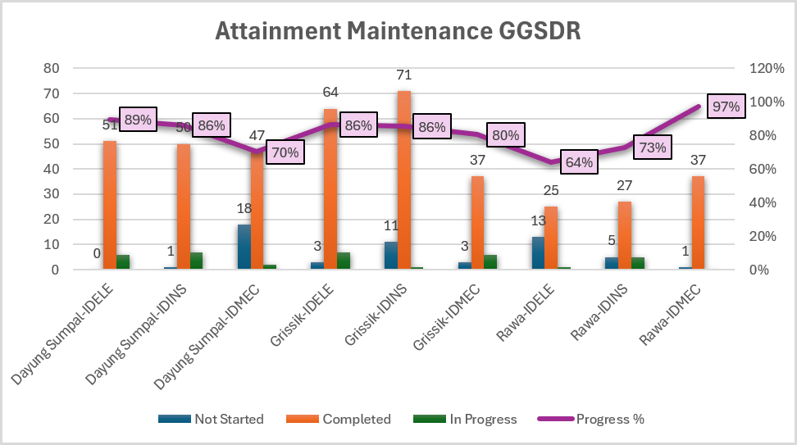
Attainment 30D June 2026, GGSDR (up to 27 June)
Notes:
Lower forecast purchase exhaust silencer GTC-201. $45K
Lower activity Install Shelter for PTW room due to contract transition. ($25K)
Maintenance Higher $45K due to:
Campaign EEHA Manpower. $45K
Operations Lower ($25K) due to:
Low activity from FBMS due to transition period. ($25K)

Slide 8
Break in
Row Labels | ELETECH | MECHTECH | PIPEINSP | Grand Total
Gelam | 3 |  |  | 3
RDG: Battery Diesel Fire pump No Cover | 1 |  |  | 1
RDG: MOTOR LIME DOSING A NOISE | 1 |  |  | 1
RDG: UPS 88G401 OVERLOAD ALARM | 1 |  |  | 1
Grissik |  | 1 | 1 | 2
Scanning Underground SACP Pipeline-AI 4 INCH |  |  | 1 | 1
Support Lighting and Power WHB#1 |  | 1 |  | 1
Tengah |  | 4 |  | 4
DR 1 Engine under speed and compressor o |  | 4 |  | 4
Grand Total | 3 | 5 | 1 | 9
Request Activity
Field | Order Requestor | PMO SAP | Order Description/Level 1 (90 Days Activity) | Main Work Center
Concern:

Slide 9
PPM Compliance in June 2026, GGSDR

Slide 10
Craft Utilization KPI Maintenance in KPI May-Jun 2026
Notes:
Lower forecast purchase exhaust silencer GTC-201. $45K
Lower activity Install Shelter for PTW room due to contract transition. ($25K)
Maintenance Higher $45K due to:
Campaign EEHA Manpower. $45K
Operations Lower ($25K) due to:
Low activity from FBMS due to transition period. ($25K)

Slide 11
List GGSDR PMO Deferral and Potential Deferral
Order | Order Description | Area | Work Center | Type | Due Date | Stage | Dept. | 1st Def Due | Remaining | Remark
1100272723 | 1M-SALES GAS METERING GSPL PM | Grissik | IDMET | Non SCE | 25-May-26 | Grace Period | Production & Safety | 9-Jun-26 | -4 | No Notif Def
1100267354 | 2Y-THERMOGRAPHY AT SUMPAL PM | Sumpal | IDELES | Non SCE | 12-May-26 | Grace Period | Production & Safety | 11-Jun-26 | -2 | PID 10651842, Approved OIM
1100266704 | 3M-PCN BACKUP INS PM | Gelam | IDINS | Non SCE | 3-Jun-26 | Grace Period | Maintenance | 18-Jun-26 | 5
1100274172 | 1M-H2S ANALYZER PM | Grissik | IDINS | Non SCE | 4-Jun-26 | Grace Period | Maintenance | 19-Jun-26 | 6
1100280643 | 3M-PIG TRAP ROW PM | Rawa | IDPL_ROW | Non SCE | 4-Jun-26 | Grace Period | Offsite Support | 19-Jun-26 | 6
1100280626 | 3M-HVAC "A" PCR-3 ELE PM | Sumpal | IDELE | Non SCE | 4-Jun-26 | Grace Period | Maintenance | 19-Jun-26 | 6
1100248996 | SS10 1Y-WELLHEAD STROKE&LEAK TEST WI PM | Sumpal | IDWI | SCE | 21-May-26 | Grace Period | Production & Safety | 20-Jun-26 | 7
1100274455 | 1M-GC ANALYZER 42AT2052 PM | Grissik | IDINS | Non SCE | 6-Jun-26 | Grace Period | Maintenance | 21-Jun-26 | 8
1100274461 | 1M-ESCAPE AND PERSONAL SAFETY HSE PM | Ramba | IDHSE_SY | Non SCE | 6-Jun-26 | Grace Period | Production & Safety | 21-Jun-26 | 8
1100280882 | 1M-83A201C MEC PM | Rawa | IDRENT | Non SCE | 6-Jun-26 | Grace Period | Production & Safety | 21-Jun-26 | 8
1100274540 | 1M-FAN MOTOR VIBRATION MONITORING CMO PM | Grissik | IDCMO | Non SCE | 7-Jun-26 | Grace Period | Production & Safety | 22-Jun-26 | 9
1100274541 | 1M-GLYCOL&MOTOR CIRC.PUMP VIBR. MONITOR | Grissik | IDCMO | Non SCE | 7-Jun-26 | Grace Period | Production & Safety | 22-Jun-26 | 9
1100274543 | 1M-CONDENSATE & FLARE VIB.MONITORING CMO | Grissik | IDCMO | Non SCE | 7-Jun-26 | Grace Period | Production & Safety | 22-Jun-26 | 9
1100274544 | 1M-VIBRATION MONITORING CMO PM | Grissik | IDCMO | Non SCE | 7-Jun-26 | Grace Period | Production & Safety | 22-Jun-26 | 9
1100274546 | 1M-FAN MOTOR VIBRATION MONITORING CMO PM | Grissik | IDCMO | Non SCE | 7-Jun-26 | Grace Period | Production & Safety | 22-Jun-26 | 9
1100274547 | 1M-REGEN GAS VIBR.MONITORING CMO PM | Grissik | IDCMO | Non SCE | 7-Jun-26 | Grace Period | Production & Safety | 22-Jun-26 | 9
Notes:
Lower forecast purchase exhaust silencer GTC-201. $45K
Lower activity Install Shelter for PTW room due to contract transition. ($25K)
Maintenance Higher $45K due to:
Campaign EEHA Manpower. $45K
Operations Lower ($25K) due to:
Low activity from FBMS due to transition period. ($25K)

Slide 12
Need Offsite Support
Requestor | Area | PMO SAP | Order Description/Level 1 (90 Days Activity) | Main Work Center
I/E | Rawa
Next week visitation
Field | Visitation | Date | Participant
GGSDR | pemeriksaan fisik HBM di Grissik untuk keperluan penghapusan asset | 22-26 Jun
Grissik | Socialization SLA & Logbook Contract Issue (Maintenance & Field Operations Contract) | 24-Jun
Grissik | NC Forum | 24-26 Jun

Slide 13

Operation Maintenance Est Budget Monitoring (20 Jun)
Notes:
Lower forecast purchase exhaust silencer GTC-201. $45K
Lower activity Install Shelter for PTW room due to contract transition. ($25K)
Maintenance Higher $45K due to:
Campaign EEHA Manpower. $45K
Operations Lower ($25K) due to:
Low activity from FBMS due to transition period. ($25K)

Slide 14
Operation Maintenance Est Budget Monitoring (20 Jun)
Notes:
Lower forecast purchase exhaust silencer GTC-201. $45K
Lower activity Install Shelter for PTW room due to contract transition. ($25K)
Maintenance Higher $45K due to:
Campaign EEHA Manpower. $45K
Operations Lower ($25K) due to:
Low activity from FBMS due to transition period. ($25K)

Slide 15
Operation Maintenance Est Budget Monitoring (20 Jun)
Notes:
Lower forecast purchase exhaust silencer GTC-201. $45K
Lower activity Install Shelter for PTW room due to contract transition. ($25K)
Maintenance Higher $45K due to:
Campaign EEHA Manpower. $45K
Operations Lower ($25K) due to:
Low activity from FBMS due to transition period. ($25K)

Slide 16
List GGSDR PMO Deferral and Potential Deferral
PM Deferral
Order | Description | Area | Main WC | Type | Risk Assess. | Planned Date | Deferral PID | Approval Date | Current Stage | Deferral Compliance | Dept. | 1st Deferral Due | 2nd Deferral Due | 3rd Deferral Due | Beyond 3rd Deferral/Deferral Aging Due | Remarks
1100238552 | SS10 1Y-WELLHEAD STROKE&LEAK TEST WI PM | Dayung | IDWI | SCE | M1 | 14-Feb-26 | 10688534 |  | DEF1 | No | Production & Safety | 16-Mar-26 | 14-Jun-26 | 14-Jul-26 | 13-Aug-26 | Waiting SCEARA Review
Potential Deferral
Notes:
Lower forecast purchase exhaust silencer GTC-201. $45K
Lower activity Install Shelter for PTW room due to contract transition. ($25K)
Maintenance Higher $45K due to:
Campaign EEHA Manpower. $45K
Operations Lower ($25K) due to:
Low activity from FBMS due to transition period. ($25K)

