Slide 1
MEPG Integrated Planning Process Revision (4th Version)
Medco E&P Grissik | 6th Jun 2026

Slide 2
Executive Summary
Headline #1: Talk about what changed
Before Situation/Table Col: L1: Dimension to Cover
L2: Factors per Dimension
L3: Before (current)
L4: Added Changes (v4 version) L5: Rationale
Row:
Concept/Strategy
Work Process/System
Management of Plans
Performance Assessment
Continuous Achievement

Slide 3
Key Changes – Concept/Strategy of Integrated Planning
Headline #1: Talk about what changed
Before vs After 1) Objective of Integrated Planning as a list
After: 1) Simplify wording -> added how to (expected to do) & values to business philosophy
(show table)

Slide 4
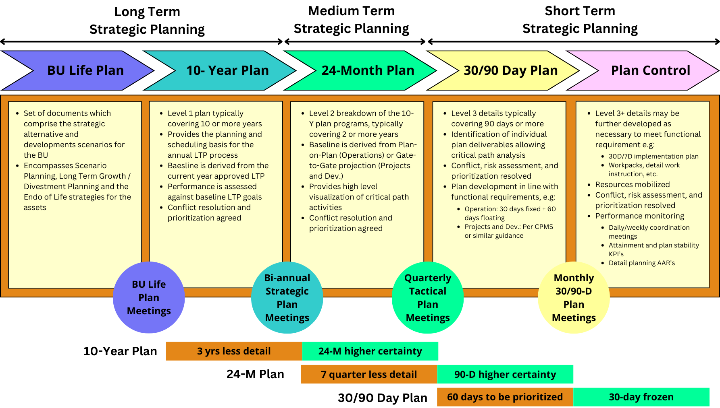
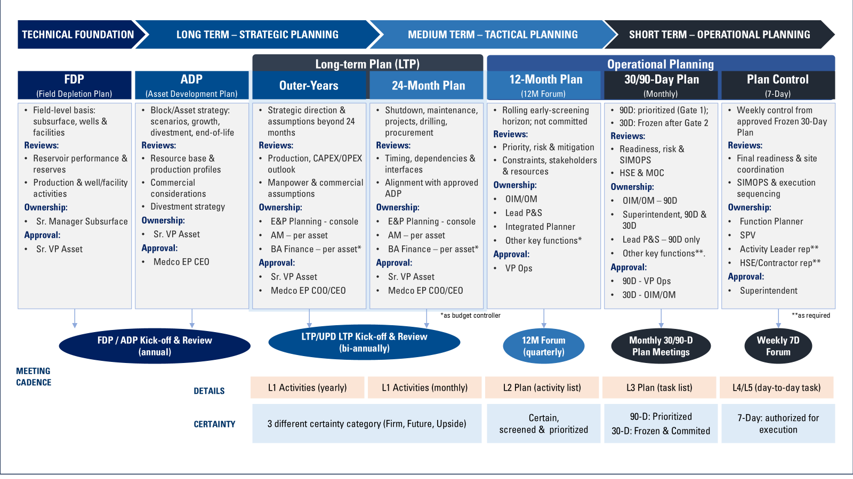
Key Changes – Horizon Change to Reflect MEPG’s Current Practice
Headline #1: Talk about what changed
1
Before – Horizon still refers to heritage
2
After – Updated to reflect MEPG’s current practice
Added details
Structure out the after to have: a) Simple Explanation, b) What is reviewed, c) Ownership, d) Approval by Who, e) Cadence Meeting (when); f) Level of Details; g) Timeframe
Key Highlights:
Recurring OPEX is concentrated in 6 main cost buckets.
Largest cost drivers are maintenance, consumables, & external support
If not properly addressed, these cost may keep increasing over the years.
Hence, review in utilization, criticality, and operating mode need to be review.
Key Highlights:
Recurring OPEX is concentrated in 6 main cost buckets.
Largest cost drivers are maintenance, consumables, & external support
If not properly addressed, these cost may keep increasing over the years.
Hence, review in utilization, criticality, and operating mode need to be review.

Slide 5
Key Changes – Work Processes / Systems
Headline #1: Talk about what changed
Before: 1) Stakeholders/RACI Follows old heritage process
2) Vague Govern
After: 1) Abcd
2) EFGH

Slide 6
Key Changes – Management Of Plans
Headline #1: Talk about what changed
Before vs After Summary

Slide 7
Key Changes – Performance Assessment
Headline #1: Talk about what changed
Before vs After Summary

Slide 8
Key Changes – Performance Assessment
Headline #1: Talk about what changed
Before vs After Summary

