Slide 1
Data Breach Avoidance System

Slide 2
Abstract
The Data Breach Avoidance System leverages the Honeypot Strategy to provide a proactive cybersecurity framework specifically designed for the MyBankCardsManager app. By deploying a sacrificial database alongside the original one, the system distracts would-be attackers, effectively monitoring and mitigating cyber threats. The architecture is built on MS Azure SQL Server and employs machine learning algorithms, Intrusion Detection Systems (IDS), and User and Entity Behavior Analytics (UEBA) to offer a robust security solution.

Slide 3
PROJECT OVERVIEW
In today's digital landscape, the significance of data cannot be overstated. A data breach occurs when crucial information is accessed by unauthorized entities. Organizations typically store their essential data, such as business details, codes, and other critical information, on their servers or cloud systems. To safeguard this data, two primary layers of security are employed:
Web Security: This layer ensures that only individuals connected to the organization's VPN or DNS can access its resources. However, challenges arise when sophisticated attackers exploit vulnerabilities, such as compromised VPN protocols, to infiltrate the organization's network.
Information Security (InfoSec): As a subsequent defense layer, InfoSec plays a pivotal role in ensuring data integrity even if an attacker bypasses web security.

Slide 4
System Functionality
Attackers employ a myriad of tactics to breach defenses, from brute force attacks on passwords to logging in at unconventional times or using suspicious IP addresses. Our system, fortified by the Adaptive Honeypot Behavior Algorithm and the Signature-based Intrusion Detection System (IDS), is designed to identify such anomalies and flag the user as suspicious.
In the event of suspicious activity, instead of denying access, our system adopts a deceptive approach. It grants access to the intruder, even with an incorrect password (after a certain threshold), but redirects them to a decoy server rather than the real database. Simultaneously, specified users are alerted about the potential breach via email.

Slide 5
Understanding Intruder Intent with UEBA
Intruders have varied motives when breaching data. While some aim to extract or download data, others introduce malicious content, and some might even attempt to erase data to disrupt organizational operations. The User and Entity Behavior Analytics (UEBA) module within our system discerns these intentions. By accurately pinpointing the intruder's objective, organizations can bolster specific areas targeted by the attacker, enhancing overall security.

Slide 6
Algorithms
Adaptive Honeypot Behavior Algorithm: Utilizes machine learning techniques to adapt and improve the honeypot’s effectiveness over time.
Intrusion Detection System (IDS): Employs either signature-based or anomaly-based detection methods to identify unauthorized activities.
User and Entity Behavior Analytics (UEBA): Identifies unusual patterns in user behavior, which could be indicative of a security breach.

Slide 7
Existing System
Centralized Database: The MyBankCardsManager app relies on a centralized database for storing sensitive information.
Basic Security Measures: Likely uses traditional firewalls and encryption but lacks proactive threat detection.
Manual Monitoring: Mostly reliant on manual monitoring and auditing of the system for security breaches.
Static Defenses: Utilizes static security measures that don’t adapt to emerging threats.

Slide 8
Proposed System
Sacrificial Database (Honeypot): Deploys a honeypot database alongside the original database to distract potential attackers.
Adaptive Algorithms: Implements machine learning algorithms to improve honeypot functionality and adapt to new types of attacks.
Advanced Threat Detection: Integrates Intrusion Detection Systems (IDS) and User and Entity Behavior Analytics (UEBA) for a multi-layered security approach.
Cloud-based Architecture: Utilizes MS Azure SQL Server for a scalable and secure database solution.
User-Friendly Interface: Incorporates a web application front end to enhance user experience without compromising on security.
Collaborative Development: Utilizes Git for version control and to facilitate effective team collaboration.

Slide 9
Tech Stack
Backend Development: Python
Database: MS Azure SQL Server
Machine Learning: TensorFlow or PyTorch
Web Application & API: Flask
Frontend Development: React or Angular
Version Control: Git

Slide 10
Features
User Authentication: A multi-stage user authentication system to ensure that only authorized users access the system.
Database Management: Seamless interaction with a secure database system to manage bank card details.
Email Alerts: Automated alerts for potential intrusion attempts.
Honeypot System: Redirects unauthorized users to a decoy database, safeguarding genuine data.

Slide 11
Application Structure
The project is structured to ensure modularity and ease of maintenance:
DatabaseManager: A class responsible for interacting with the database system, fetching records, and managing data.
MailSender: A class responsible for sending email alerts.
BankCardManager: The primary application class, responsible for setting up routes, handling requests, and integrating with the DatabaseManager and MailSender.

Slide 12
Security
User Authentication: The application employs a multi-level user authentication system, ensuring that unauthorized access is minimized.
Honeypot Strategy: Unauthorized access attempts are diverted to a decoy database, ensuring that genuine data remains uncompromised.
Email Alerts: Administrators are notified of potential intrusion attempts, ensuring prompt action.
Sensitive Data Handling: Sensitive information, such as passwords and card details, are handled securely, ensuring data privacy.

Slide 13
Lit Review
Paper 1: "Detection and Avoidance of Attackers Using Honey Words in a Purchase Portal"
Authors: P. Baby Shamini et al.
Focus: Securing purchase portals from cyber attackers.
Approach: Use "honey words" as decoys to detect and divert attackers.
Significance: Innovative security approach for e-commerce platforms.
Paper 2: "Avoiding Data Leakage and Providing Privacy to Data in Networking"
Authors: Madhavi Suryawanshi, Sarita Patil
Focus: Preventing data leakage and enhancing data privacy in networking.
Approach: Encryption, access controls, and secure protocols.
Significance: Addresses data security in interconnected networks.

Slide 14
Lit Review (Contd.)
Paper 3: "Intrusion Detection and Prevention using Honeypot Network for Cloud Security"
Authors: Poorvika Singh Negi et al.
Focus: Detecting and preventing intrusions in cloud environments.
Approach: Deploying honeypots to identify and divert attackers.
Significance: Adds proactive defense to cloud security.
Paper 4: "User Behavior Analysis with Machine Learning Techniques in Cloud Computing Architectures"
Authors: Matias Callara, Patrice Wira
Focus: Analyzing user behavior in cloud computing with machine learning.
Approach: Machine learning algorithms for identifying patterns and threats.
Significance: Enhances cloud security through adaptable user behavior analysis.

Slide 15

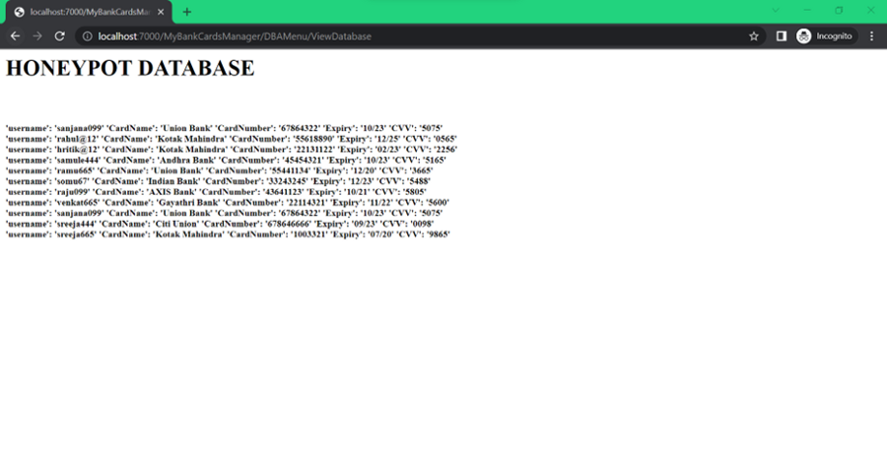
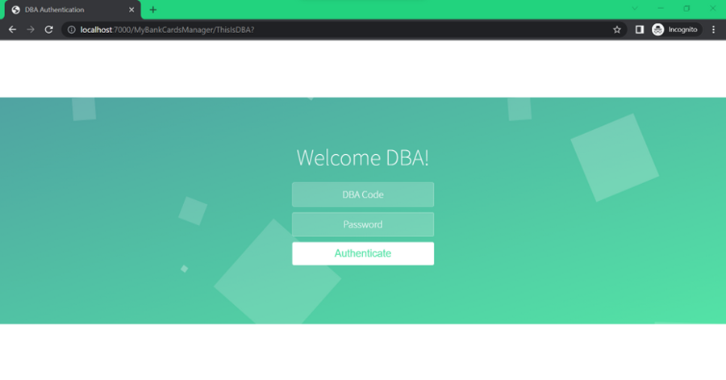
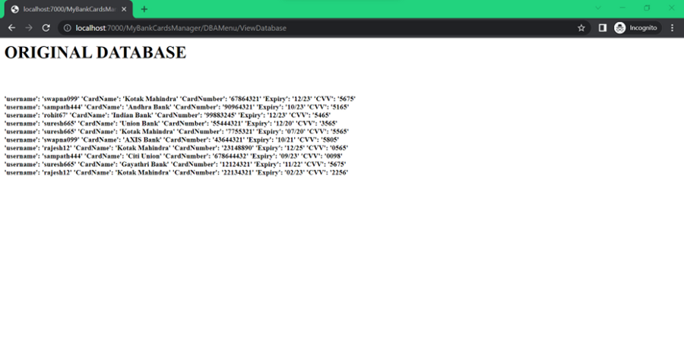
Output

Slide 16
Conclusion
With cyber threats evolving continuously, it's imperative for organizations to not just detect but also understand and adapt to intruder behaviors. Our Data Breach Avoidance System provides a comprehensive solution that is both proactive and adaptive, ensuring optimal data security in a dynamic digital environment.

