Slide 1

Jenkins
https://github.com/ridingintraffic/jenkins_lunch_learn
https://github.com/ridingintraffic/jenkinsfile-demo

Slide 2

what is jenkins
automation server
self contained
open source
CI (continuous integration)
with the ability to be CD (continuous delivery)
via pipelines

Slide 3
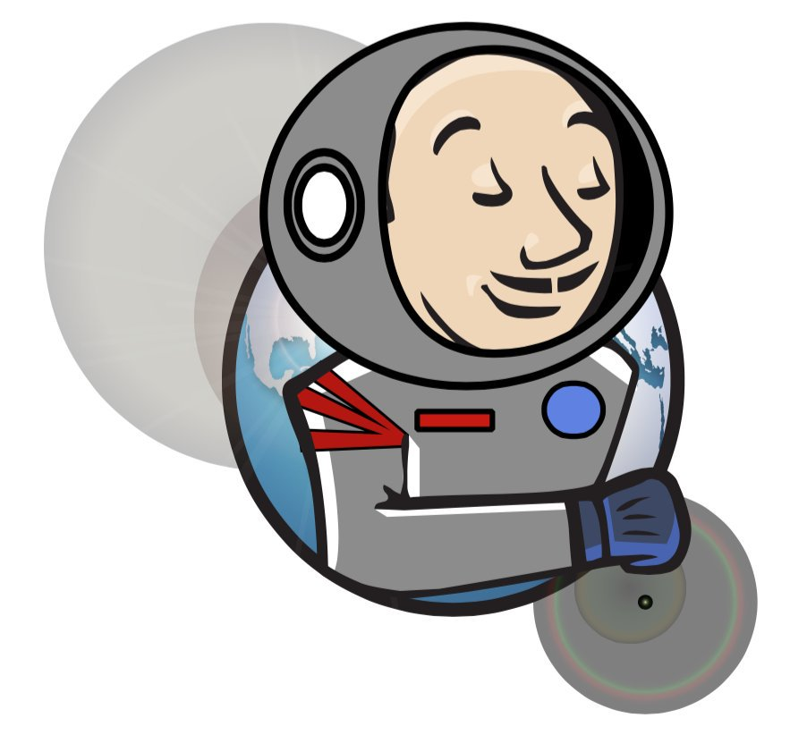
why?
because automation is cool?
repeatability
hands off

Slide 4

Jenkins architecture
master/slave
many many slaves
- complicated
for here – single node where master is a standalone
- less complicated

Slide 5

pipelines
first step towards CD
beginnings of immutability
12 factor app (again)

Slide 6

imute-a-what?
A mutable object can be changed after it's created,
an immutable object can’t.
the build is the object
guarantee the the code
persist the state

Slide 7

many tools
many many aspects
I only care about
jenkinsfiles
docker
git scm
github webhook

Slide 8

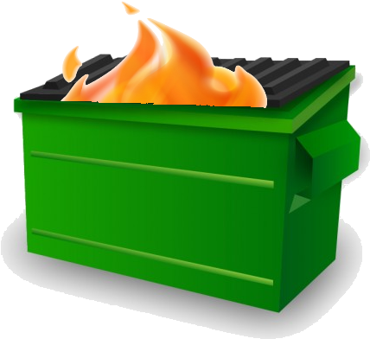
Jenkins is terrible
least terrible
complex software is complex
learn how to unit test
write pass/fail tests to fail jenkins
debugging is a pain
logs aren’t great
dsl/groovy syntax

Slide 9

Jenkins is dangerous
should never be exposed to the internet
build chain attacks are real
massive loot:
logins keys service accounts
LOGS and poor hygiene
privilege escalation galore
pivot pivot
bad plugins

Slide 10

what are we gonna do then?
least amount of configuring as we need to
Jenkins in docker no configuration
Jenkins in docker preconfigured
Jenkins in docker to build docker
because docker brings along dependancies

Slide 11
DEMO - time

Slide 12
links
https://www.infoworld.com/article/3239666/what-is-jenkins-the-ci-server-explained.html
https://medium.com/@mightywomble/jenkins-pipeline-beginners-guide-f3868f715ed9
https://jenkins.io/doc/
https://technologyconversations.com/2017/06/16/automating-jenkins-docker-setup/
https://medium.com/@manav503/how-to-build-docker-images-inside-a-jenkins-container-d59944102f30

