Slide 1

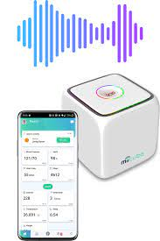


Call for Participants Gait Analysis by detection of footsteps using MiiCube
Aim of the Project:
People living with Dementia in Care Homes are at risk of falling and getting fractures. Setting up devices like MiiCube is an
attempt to recognise the footsteps, detect the risks beforehand and prevent such injuries.
Figure 1: MiiCUBE
Find more about the Adaptive project: https://www.miicare.co.uk/adaptive
Participants requirement:
Recording of footstep sounds using
MiiCube Device and specialised acoustic and wearable equipment.
The participants will be asked to spend a maximum of 1-hour. They will be asked to walk at different pace and with different posture (no physical pain or stress) while acoustic sensing equipment will capture the sounds of their footsteps.
The study will be conducted indoors, following Covid-related regulations for social distancing and safety.
Benefits:
This research project will provide you the opportunity to help the people living with Dementia.
We understand your time investment and we very much appreciate the efforts.
A £20 Amazon voucher will be provided to each of our participants to thank them for their time.
Contact Information:
Please get in touch at
R.Ali-602@kent.ac.uk / c.efstratiou@kent.ac.uk
Researchers involved:
Christos Efstratiou, School of Engineering and Digital Arts
Palaniappan Ramaswamy, Head of Data Science Research Group
Ridita Ali, Research Associate in Machine Learning
Kelvin Summoogum, (CEO of MiiCare) Doctoral Researcher in
Machine Learning applied to Geriatrics
--- University of Kent

