Slide 1
CSE 4128
Lab 4
Frequency Domain Filtering
Dr. Sk. Md. Masudul Ahsan
Professor,
Dept. of Computer Science and Engineering,
KUET
Dipannita Biswas
Lecturer,
Dept. of Computer Science and Engineering,
KUET
Kaniz Fatema Isha
Lecturer,
Dept. of Computer Science and Engineering,
KUET

Slide 2
2D Discrete Fourier Transform
Represents an image in a frequency domain where the original image is represented in spatial domain.
2D DFT converts image into a complex array that consists of :
Power Spectrum
Phase Angle

Slide 3
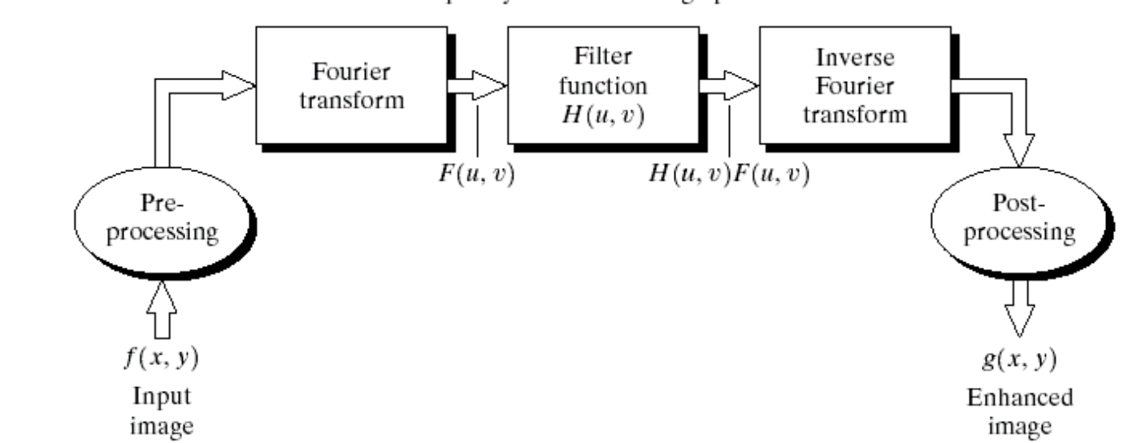
Basics of Filtering in the Frequency Domain
To filter an image in the frequency domain:
Compute F(u,v) the DFT of the image
Multiply F(u,v) by a filter function H(u,v)
Compute the inverse DFT of the result

Slide 4
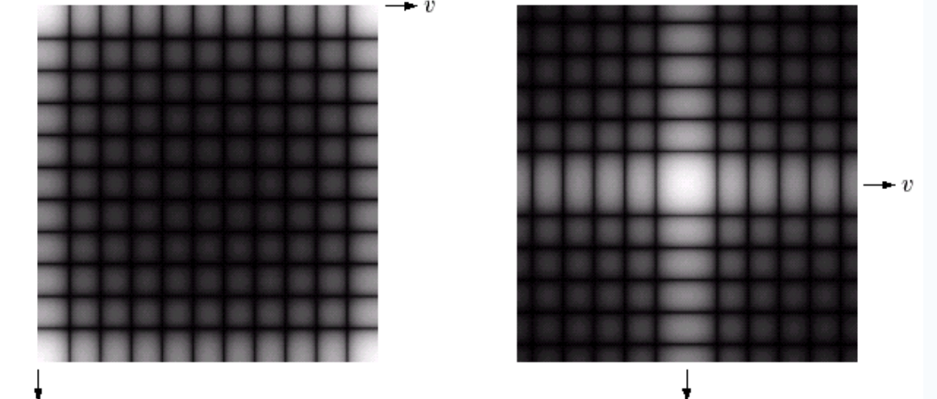
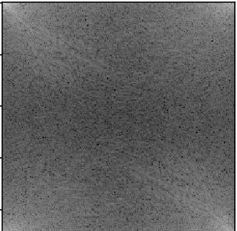
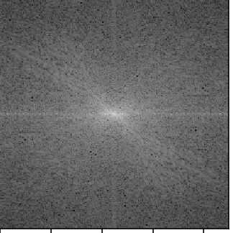
Basics of Filtering in the Frequency Domain
Spectrum moved into the centre

Slide 5
Notch Filter
A notch filter rejects (or passes) frequencies in a predefined neighborhood about the center of the frequency rectangle.
A notch with center at (u0, v0) must have a corresponding notch at location (-u0, -v0)

Slide 6
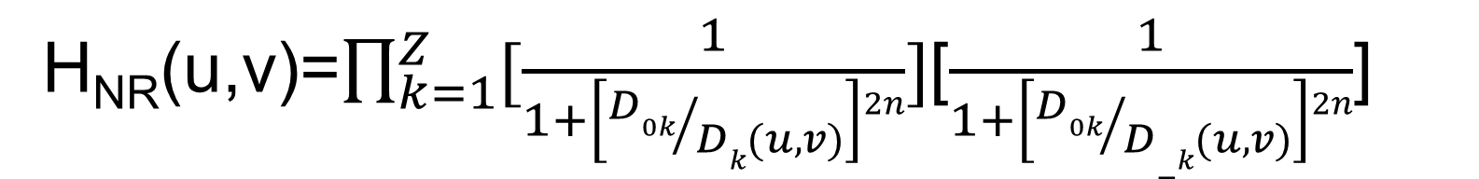
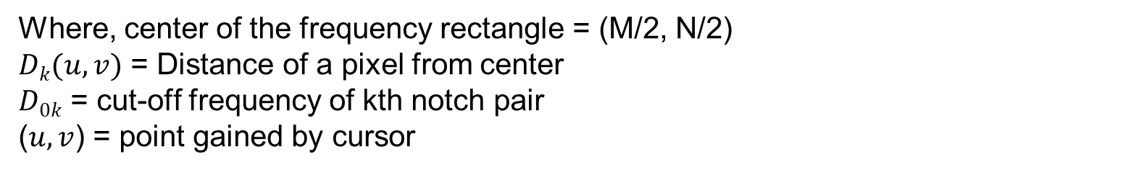
Butterworth notch reject filter of order n
For Butterworth notch reject filter, the Filter Function is given by the expression:
H_{NR}(u,v)=$\prod_{k=1}^{Z}{[\frac{1}{1+\left[{D0k}/{Dk(u,v)}\right]2n}]}$[$\frac{1}{1+\left[{D0k}/{D−k(u,v)}\right]2n}$]
$Dk(u,v)$ = $\left[\left(u−\frac{M}{2}−uk\right)2+\left(v−\frac{N}{2} −vk\right)2\right]1/2$
$D−k(u,v)$ = $\left[\left(u−\frac{M}{2}−uk\right)2+\left(v−\frac{N}{2}+vk\right)2\right]1/2$
Where, center of the frequency rectangle = (M/2, N/2)
$Dk(u,v)$ = Distance of a pixel from center
$D0k$ = cut-off frequency of kth notch pair
($u,v$) = point gained by cursor

Slide 7
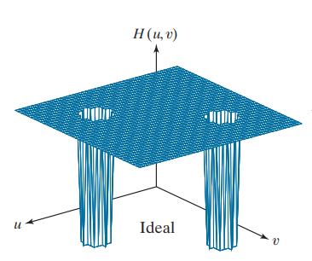
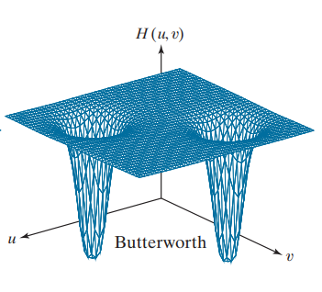
Ideal and Butterworth notch reject filter

Slide 8
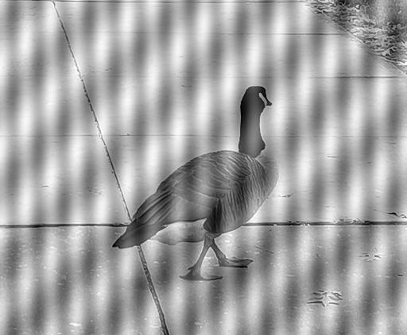
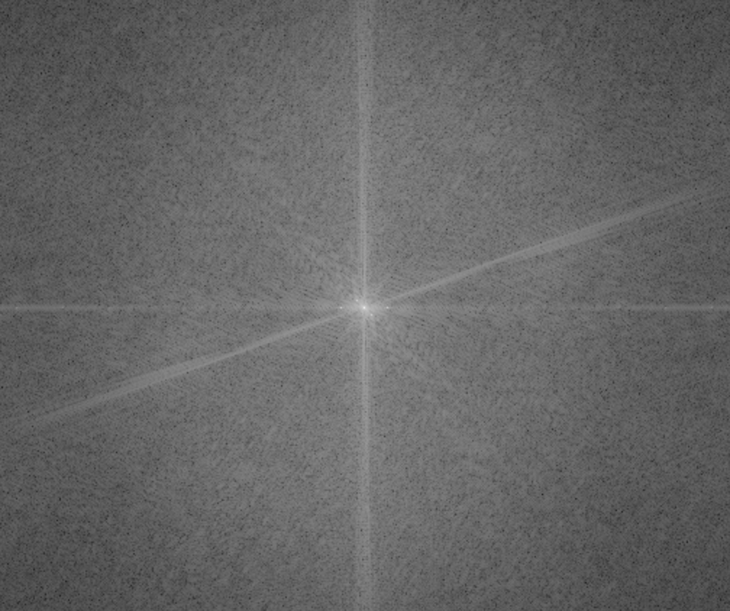
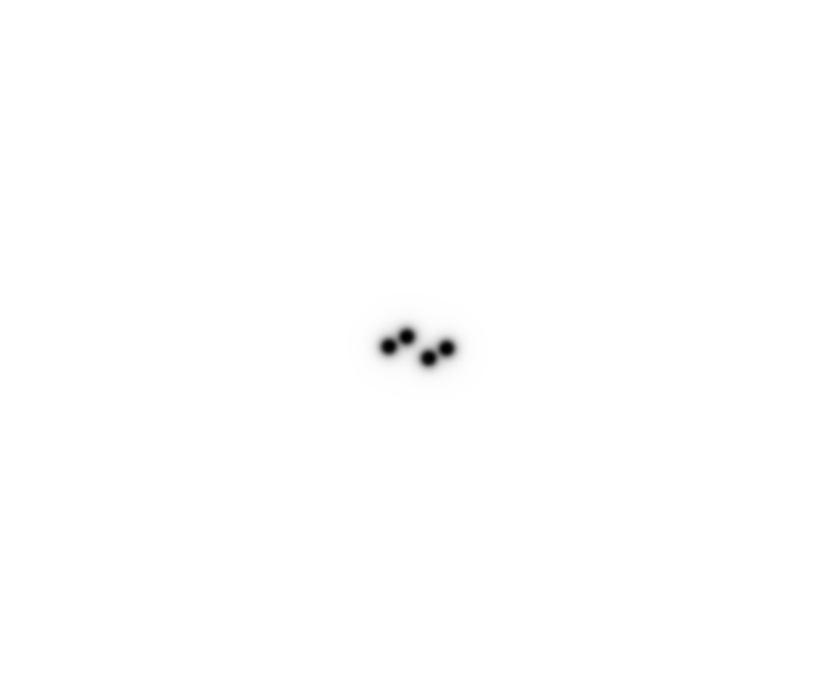
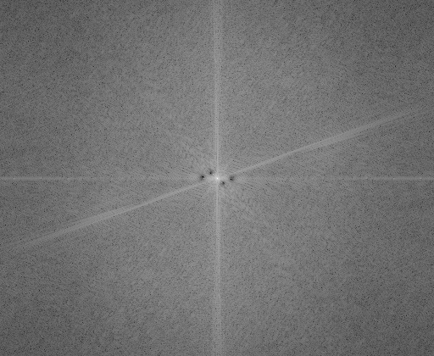
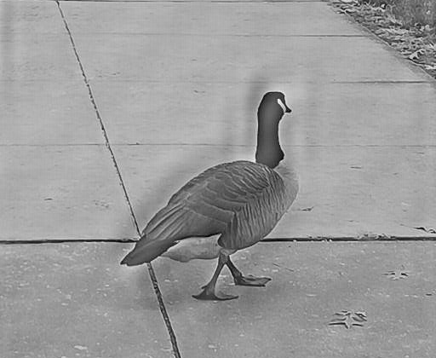
Classwork
Input image
Power Spectrum of input image
Butterworth Filter
Power Spectrum of output image
Output image

Slide 9
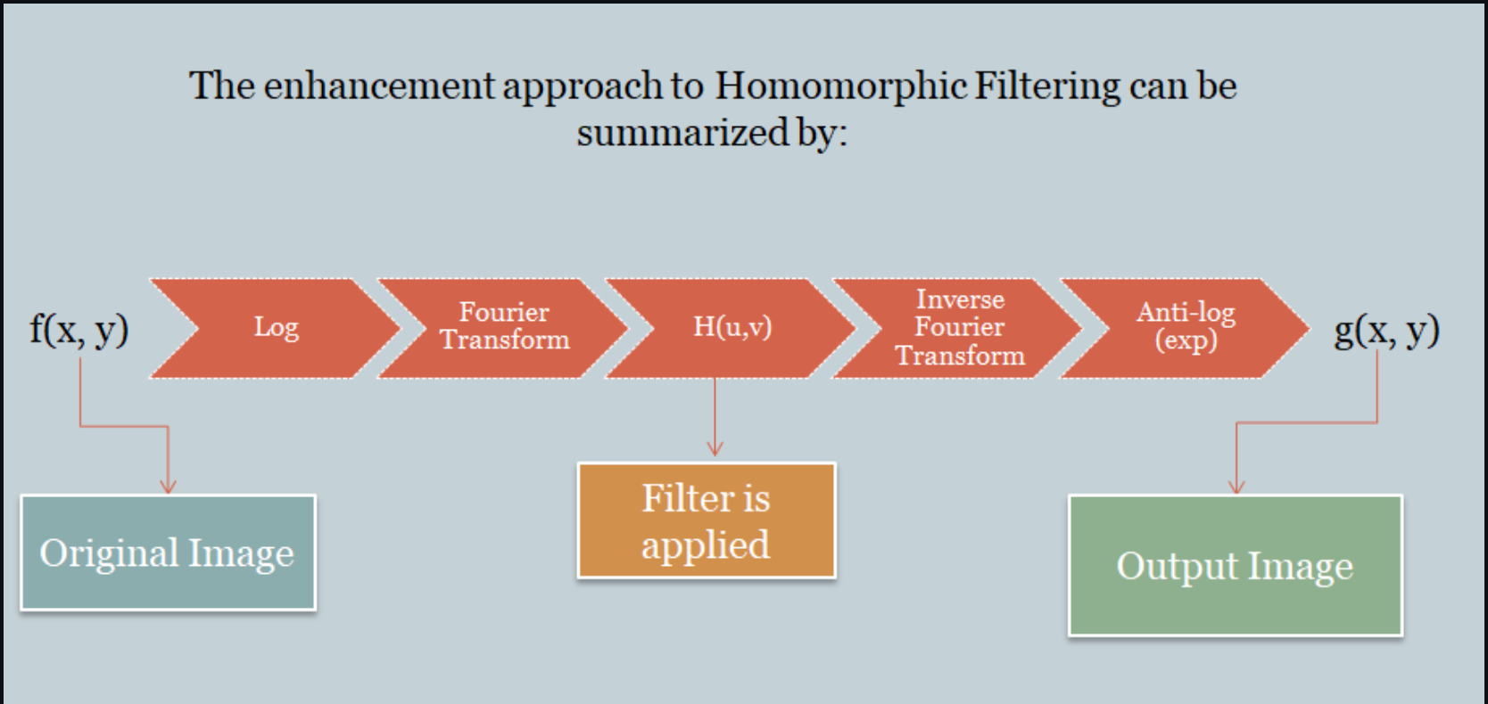
Assignment
Homographic Filtering - a technique for improving the appearance of an image by simultaneous gray-level range compression and contrast enhancement

Slide 10


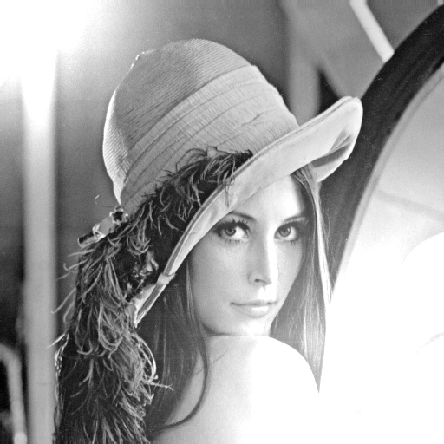
Real image
Illumination pattern
Corrupted image

