Slide 1
CSE 4128
Lab 5
Morphological Image Processing
HOLE FILLING
Dr. Sk. Md. Masudul Ahsan
Professor,
Dept. of Computer Science and Engineering,
KUET
Dipannita Biswas
Lecturer,
Dept. of Computer Science and Engineering,
KUET
Kaniz Fatema Isha
Lecturer,
Dept. of Computer Science and Engineering,
KUET

Slide 2
Basic Operations
erosion = cv2.erode(img, kernel, iterations = 1)
dilation = cv2.dilate(img, kernel, iterations = 1)
opening = cv2.morphologyEx(img, cv2.MORPH_OPEN, kernel)
closing = cv2.morphologyEx(img, cv2.MORPH_CLOSE, kernel)
Bitwise Operations:
bitwiseAnd = cv2.bitwise_and(img1,img2)
bitwiseOr = cv2.bitwise_or(img1,img2)
bitwiseNot = cv2.bitwise_not(img1)

Slide 3
Structuring Element
1. cv2.getStructuringElement(cv2.MORPH_CROSS,(5,5))
2.array([
[0, 0, 1, 0, 0],
[0, 0, 1, 0, 0],
[1, 1, 1, 1, 1],
[0, 0, 1, 0, 0],
[0, 0, 1, 0, 0]], dtype=uint8)

Slide 4
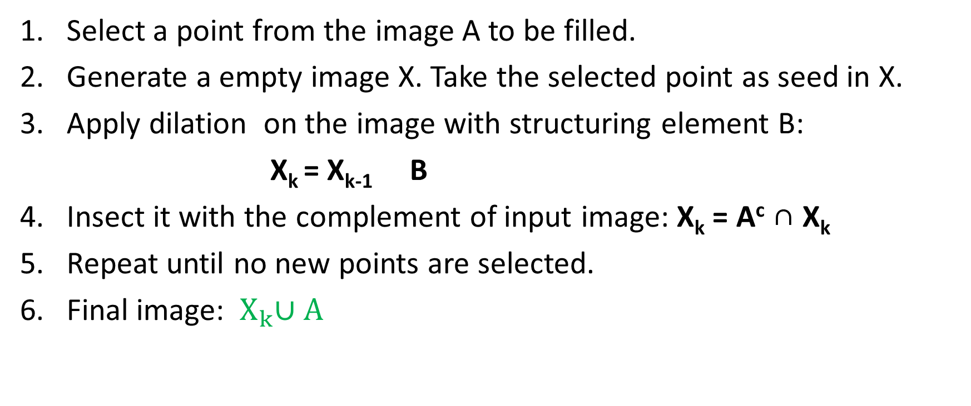
Hole Filling
Select a point from the image A to be filled.
Generate a empty image X. Take the selected point as seed in X.
Apply dilation on the image with structuring element B:
X_{k} = X_{k-1} B
Insect it with the complement of input image: X_{k} = A^{c} ∩ X_{k}
Repeat until no new points are selected.
Final image: ${ X}_{k}∪A$

Slide 5



Hole Filling
A

Slide 6

Hole Filling

Slide 7


Hole Filling

Slide 8
Hole Filling
 | *
Set B
Set A

Slide 9
Hole Filling
 | *
Set B
It’s an iterative process
Let assume X₀ = P
X_{k} = (X_{k-1} B) ∩ A^{c}
Set A
We have a pixel named P

Slide 10
Hole Filling
 |  |  |  | 1
 |  |  | 1 | 1 | 1
 |  |  |  | 1
 | *
Set B
Iteration 1
X₀ = P = 1
X₁ = (X₀ B) ∩ A^{c}
X₀ B

Slide 11
Hole Filling
 | *
 |  |  |  | 1
 |  |  | 1 | 1 | 1
 |  |  |  | 1
X₁ = (X₀ B) ∩ A^{c} =?
Set A^{c}
X₀ B

Slide 12
Hole Filling
 |  |  |  | 1
 |  |  | 1 | 1
 |  |  |  | 1
 | *
Set B
Iteration 2
X₂ = (X₁ B) ∩ A^{c}
X₁ = (X₀ B) ∩ A^{c}

Slide 13

Hole Filling
 |  |  | 6 | 5
 |  | 6 | 5 | 4
 |  |  | 4 | 3
 |  |  | 3 | 2
 |  |  | 2 | 1
 |  |  | 1 | 1
 |  | 3 | 2 | 1 | 2
 | *
Set B
Process terminate
X₇ = X₆
X_{k} = X_{k-1}
X₇ = (X₆ B) ∩ A^{c}
Final Set = ${ X}_{k}∪A$

Slide 14
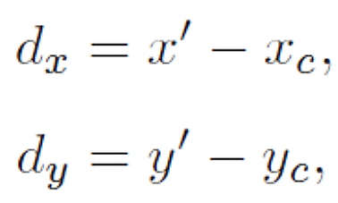
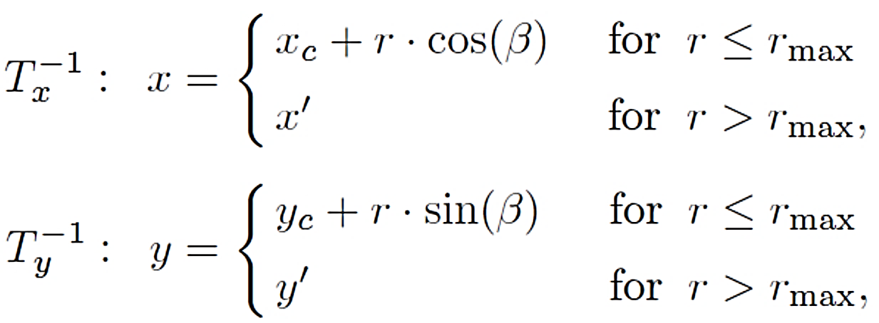
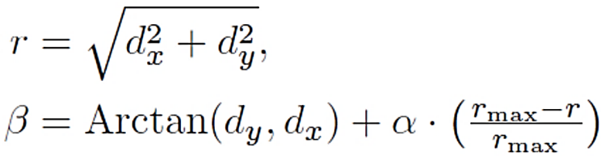
Assignment 1.Twirl:
Rotate image by angle α at center or anchor point (x_{c},y_{c})
Increasingly rotate image as radial distance r from center increases (up to r_{max})
Image unchanged outside radial distance r_{max}

Slide 15



Twirl operation
Output
Rotation Angle = +90° .
Output
Rotation Angle = -90° .
input

Slide 16

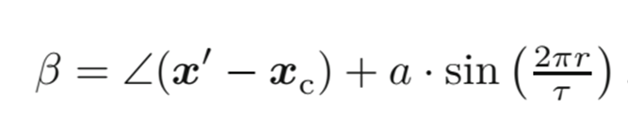
2. Angular wave transformation
This is another variant of the twirl transformation
Its inverse transformation :

Slide 17

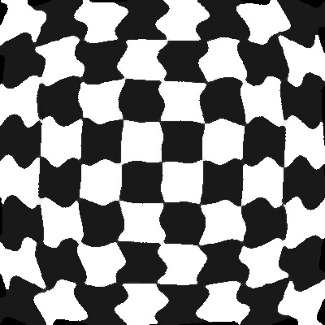
Output
a :0.1
𝜏 :50
Output
a :0.05
𝜏 :50
input

